Slide 1
Selective Export of MicroRNAs via Extracellular Vesicles

Slide 2
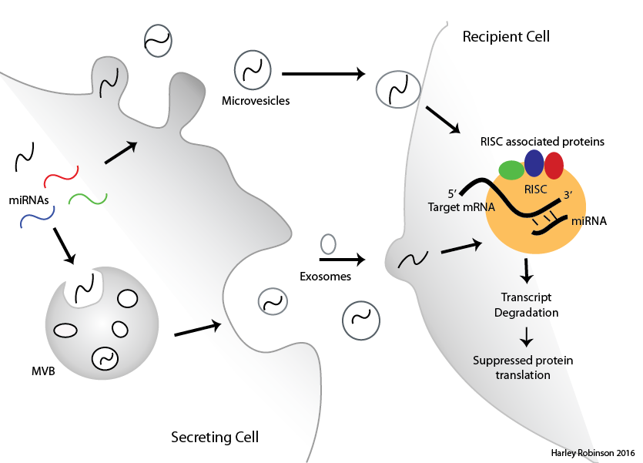
MicroRNAs in Extracellular Vesicles
EVs transfer cellular material between cells
MicroRNAs regulate RNA degradation
Sorting of microRNAs to EVs likely but mechanism not known

Slide 3
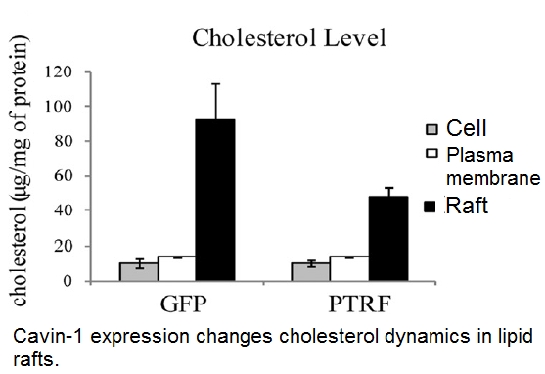
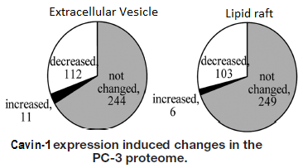
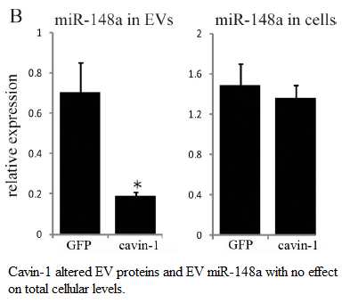
PC3 cell line.
Caveolin-1 expression: No Cavin-1 expression.
Addition of cavin-1 to these cells attenuates:
Oncogenic behaviour
Cholesterol distribution
MicroRNA EV content.

Slide 4
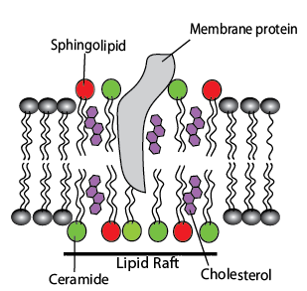
Lipid rafts and EVs
Lipid rafts consisting of cholesterol, sphingolipid and ceramide enriched in EVs.
Depletion of these lipids modifies EV protein content.
RNA-binding proteins associate with lipid rafts frequently.

Slide 5
Aims and Hypotheses:
Identify the selectively exported miRNAs.
Identify candidate miRNA escort proteins.
Verify candidate miRNA escort proteins ability to bind to miRNAs and transport to extracellular vesicles.

Slide 6
Selective Exported miRs.
RNA-seq for small RNAs by Illumina in triplicate for GFP and cavin-1 cell lines.
R package: DEseq2
Filter, normalise, compare between cell lines then between cellular localisation.
FCcell - FCev

Slide 7
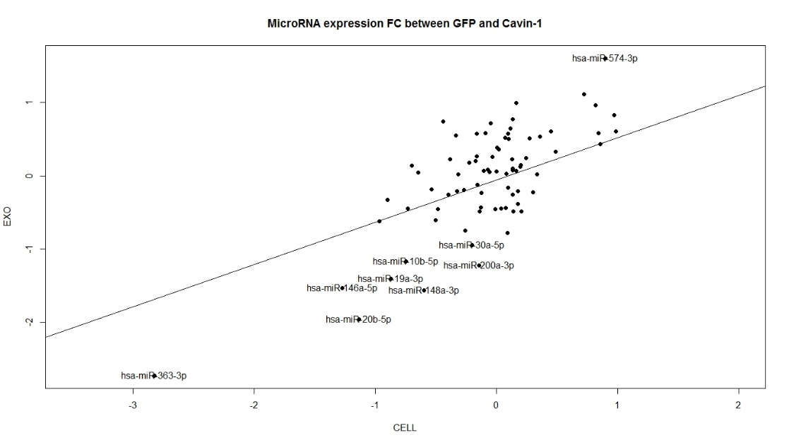
Selectively Exported MiRs.

Slide 8
Selectively Exported MiRs.

Slide 9
Aims:
Identify the selectively exported miRNAs
Identify RNA-binding proteins correlated to the miRNA export
Verify candidate miRNA escort proteins ability to bind to miRNAs and transport to extracellular vesicles.

Slide 10
RNA-binding proteins and Motifs.
TAMO software suite: combines several different algorithms to identify motifs, evaluate enrichment and map motifs to sequences.

Slide 11
Shared motifs found Differentially exported Mir
Sequence logos and networks.
Info about proteins that appear to correlate to these proteins.

Slide 12
Proteins correlate to differential export.

Slide 13
Aims:
Identify the selectively exported miRNAs
Identify RNA-binding proteins correlated to the miRNA export
Verify candidate miRNA escort proteins ability to bind to miRNAs and transport to extracellular vesicles.

Slide 14
Westerns and Immunofluorescence:

Slide 15
To Do:
Confirm miRNA-Protein interaction via pull down/Western/MS
Determine importance of Sumoylation on the proteins.
In vitro colocalization between protein and miRNA (using Cy5-oglio)
Figure out how cavin-1 is enduing its effects?

