Slide 1
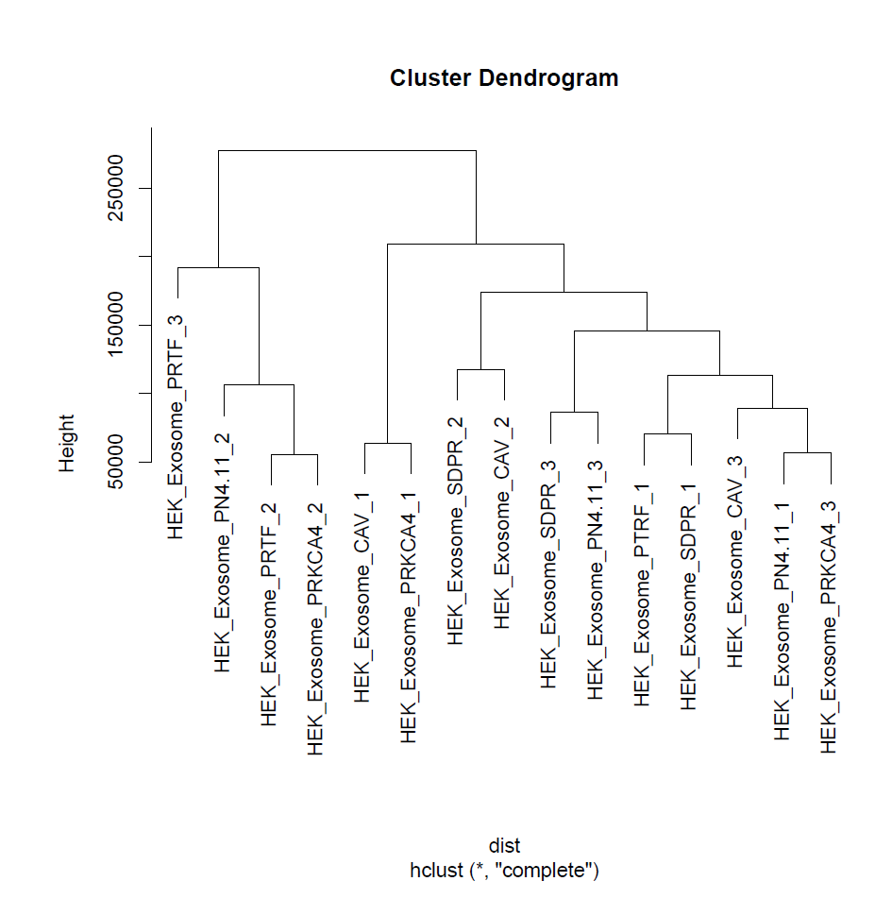
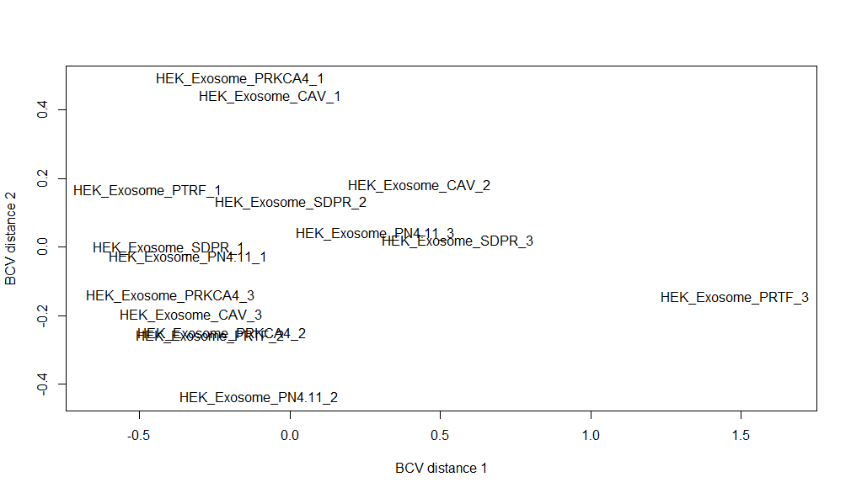
Notes:
HEK exo QC:
HEK exo dendrogram(left), HEK exo MDS (right)

Slide 2
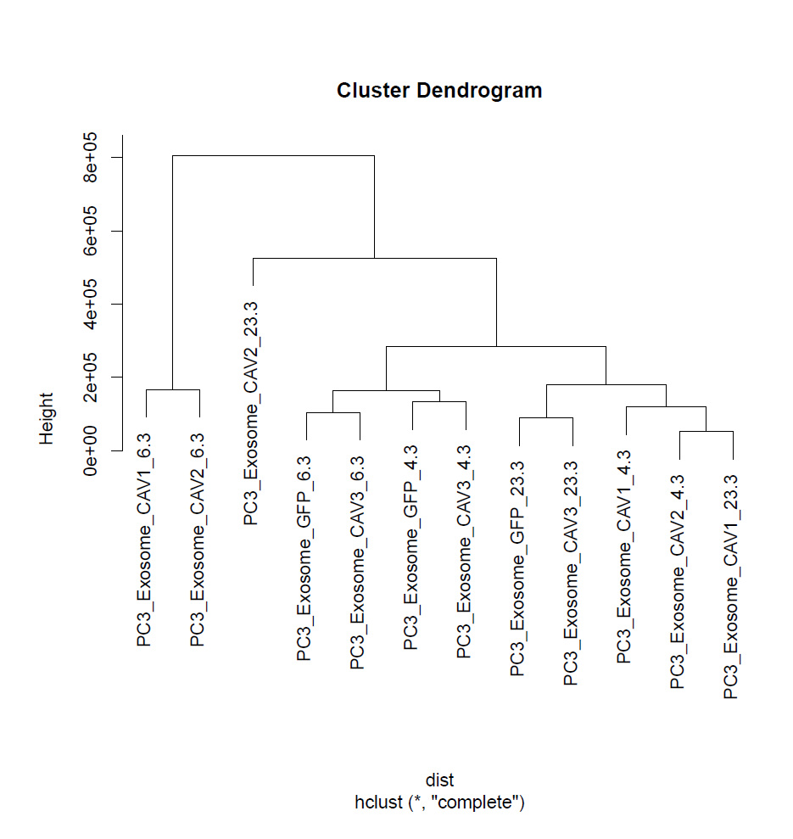
Notes:
PC3 QC
PC3 dendrogram (left), MDS(right)

Slide 3
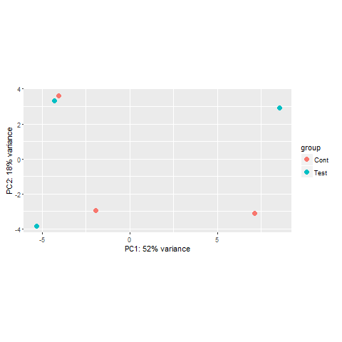
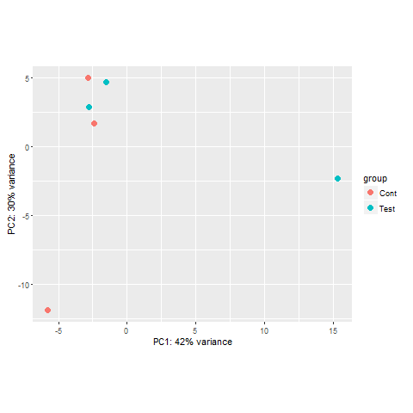
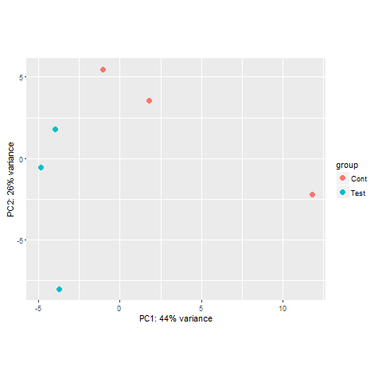
Notes:
DESeq Analysis of PC3 cells. Top: PCA plots, cavin 1, 2 and 3 respectively. No including MA plots because they are too messy.

Slide 4
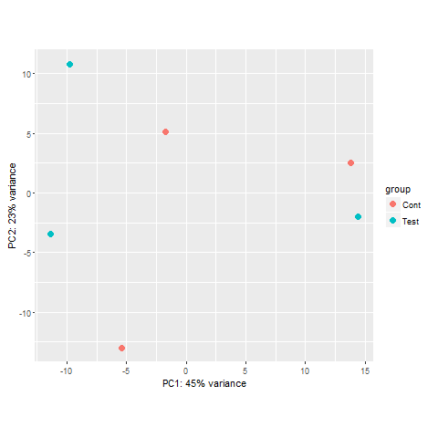
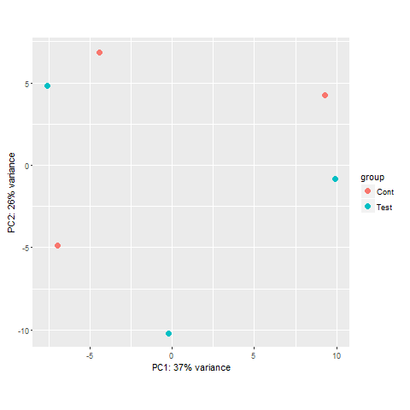
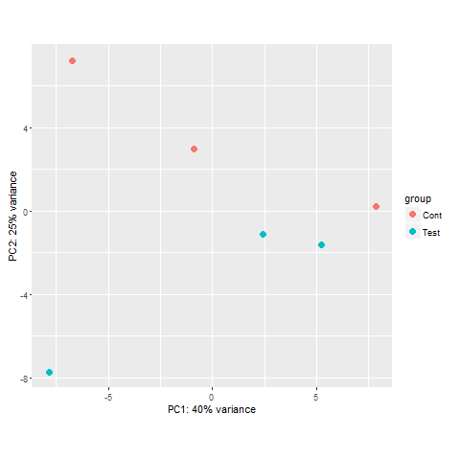
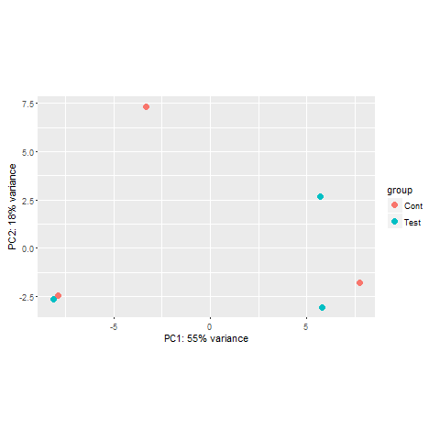
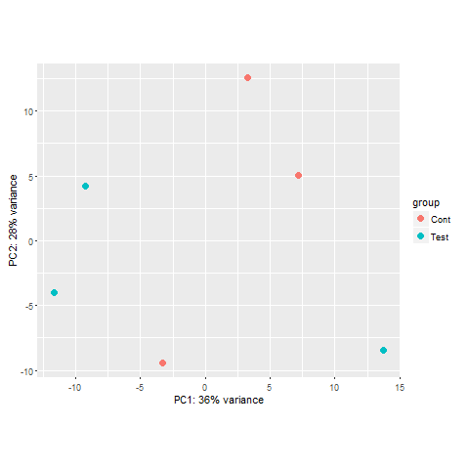
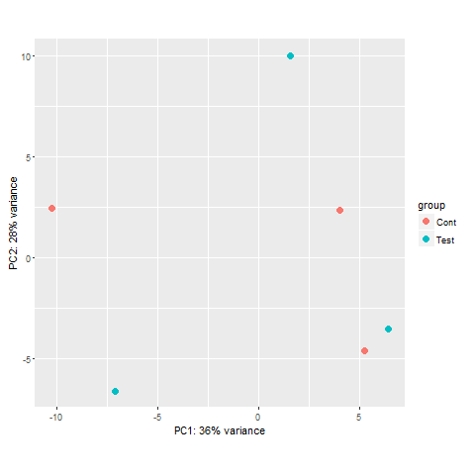
Notes:
HEK data for DESeq. MA plots. CAV1, cav2, cav3, caveolincav1, cav2 cav3.

