Slide 1
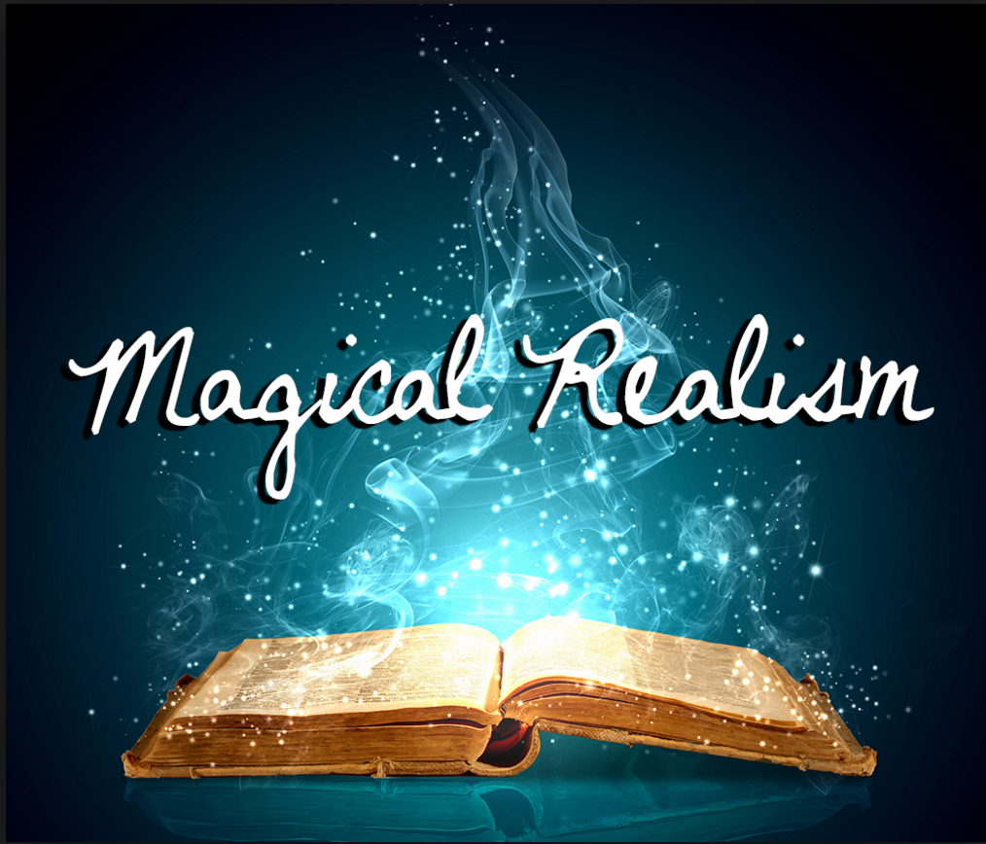
CMN260 Novel Ideas
Week 7 Tutorial

Slide 2
‘If you can explain it, then it’s not magical realism.’ (Luis Leal)
Lo real maravilloso
‘...the blending of reality and magic until the edges are blurred.’
‘…convinces us of what we’re always hoped – that magic exists…that
Beyond science exists a reality that defies rational explanation.’
‘Fabulous and fantastical events are included in a narrative that otherwise maintains the ‘reliable’ tone of objective realistic report.’
Real-world setting + fantastical elements
= Magical Realism

Slide 3
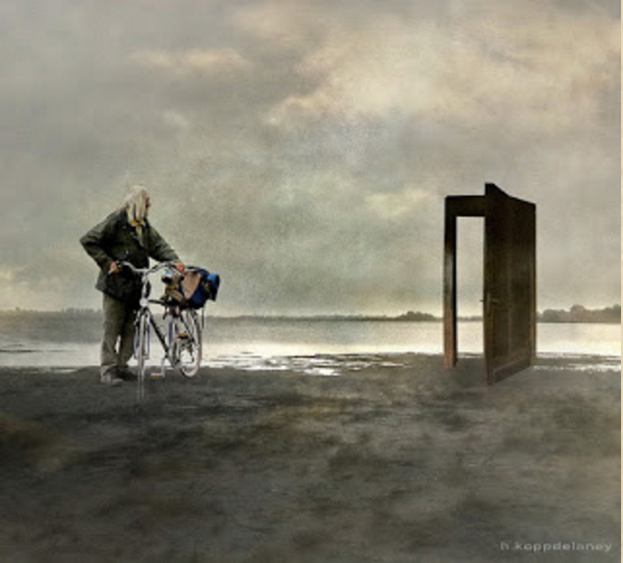
Why magical realism?
In groups of 3-4 make a list of reasons of why you might use magical realism as device in
your work?
discussion
As a means to create a mood and atmosphere in a unique way
To create a sense of wonder, the bizarre or sense of strangeness
Can be used to present ideas/concepts in a story in a unique way
To take metaphor and symbolism a step further (eg. ‘The Thing in the Forest’)
To enhance or bring about the climax of the story (catalyst event)
To convey theme (related to symbolism and metaphor)
To colour or shape the piece or conversely emphasise or distil a single moment
(usually forthe main character)

Slide 4
Do’s & Don’ts for writing
magical realism
Avoid explaining why the magic happens
Time can be fluid (doesn’t have to linear or flow in
one direction)
Present marvellous events as normal, everyday
things happening to ordinary people (the ordinary
as miraculous and the miraculous as ordinary)
Don’t forget the ‘reality’ – the magical elements should lead to the creation of an
abnormal reality. You need reality for the ‘realism’ part (otherwise you’re writing fantasy
The plot doesn’t have to be or revolve around the magic
‘Blending’ is the key element that makes something magical realism as opposed to fantasy or horror.
In ‘catalyst’ Magic Realism characters can react, that is, their actions or choices are motivated or influenced by their interaction/experience with the magical element
Alter the world we exist in, making it new or fresh in some way
Create an air of possibility and/or use foreshadowing so the magical elements don’t ‘come
out of nowhere’. That is, create an atmosphere of expectation (wonder, awe, mystery, strangeness)
discussion

Slide 5
How is Magic Realism different from Fantasy? Choose one of the week 7 set texts and discuss what elements in this story locates it as a magical REAList text.
critical
Suggested prompts/questions:
Magical realism is literary in scope, tone and style with lyrical quality to the writing.
With that in mind, consider the following question.
In establishing the ‘real world’ before introducing the ‘magical’ elements in ‘The Stone Woman’, Byatt also goes to some length to create the conditions (including mood and atmosphere) from which the magical elements then arise. Why is this important? And how (by what sort of language and poetic/language devices) does she achieve this?

Slide 6
How is Magic Realism different from Fantasy? Choose one of the week 7 set texts and discuss what elements in this story locates it as a magical REAList text.
critical
Suggested prompts/questions:
In catalyst magical realism characters are influenced or changed in some way by the
magical elements in the story.
2. Considering the above statement what is the magical element that Marquez introduces in ‘The Handsomest Drowned Man in the World’ that changes the villagers and the place they live. How is the element introduced and how does it transform the characters in the story?

Slide 7
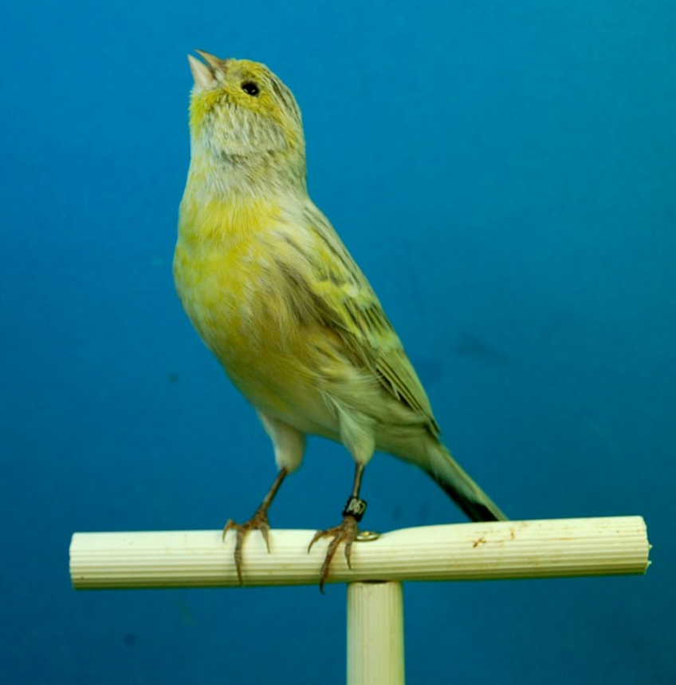
Write a Magic Realist piece:
creative
Establish the familiar, then lift the veil.
Make your real world REAL.
Push yourself over the edge.
Suspend disbelief, and believe what you write.
Don’t be afraid to leave the door open.
Make sure that you are writing Magic Realism and NOT fantasy
A man who has a canary for a heart...
‘Nesting’ by Katerina Gibson

Slide 8
Write a Magic Realist piece:
Suggested prompt:
take an ordinary person in this world and pick one aspect of their life that is fantastic.
For example...
A girl who cries blue (red, purple?) ink instead of water
A child who levitates if not tethered to something
A person who does not have a shadow
A family who all have tails like cats and/or dogs
A girl or boy whose emotions can change the weather
creative

