Slide 1
Control of extracellular vesicle microRNA export in prostate cancer.
Harley Robinson.
Supervisor: Assoc.Prof Michelle Hill
Co-supervisor: Dr. Alexandre Cristino

Slide 2
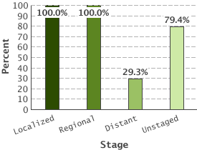
Prostate Cancer
5 Year Relative Survival:
Prostate cancer by stage
2nd highest diagnosed cancer in men worldwide
(SEER 2016)
Bone metastasis leads to poor outcome.
(Body et al 2015)
Metastasis reduced 5 year survival to 29.3%
(SEER 2016)
(SEER 2016)
Notes:
Linker.. This highlights the need to identify biomarkers or biological phenomena that are involved with the metastatic phenotype.

Slide 3
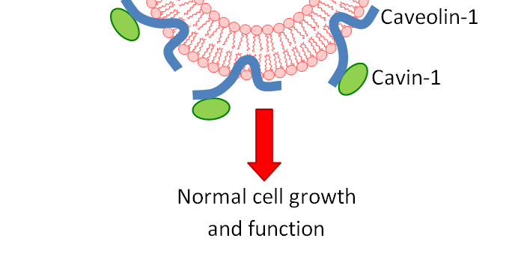
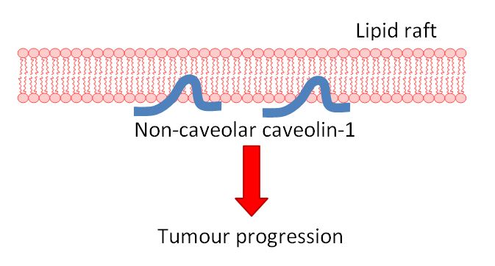
Caveolin-1 and Cavin-1 in Cancer;
Healthy Tissue
Caveolin-1 biomarker for cancer progression.
(Freeman 2012)
Co-expression with cavin-1 in healthy cells.
(Inder 2012, Moon 2014)
Cav1 overexpression linked to metastasis.
(Bennett 2009)
Knock down or addition of cavin-1 reduces metastasis. (Sugie 2015, Inder 2014)
Tumour
?
Notes:
An important biomarker in cancer progression is caveolin-1… Linker: kd or addition of cavin-1 was found to reduce this phenotype in prostate cancer cells.

Slide 4
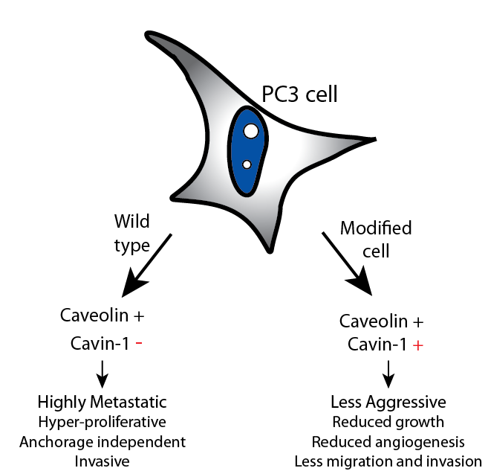
PC3: advanced prostate cancer
Caveolin +ve
Caveolin +ve
Cavin-1 -ve
Cavin-1 +ve
Moon 2012, Tai 2011
Notes:
.. Specifically, cavin-1 added to PC3 cell lines. PC3 cell lines are pro-metastatic prostate cells, derived from a patient with bone metastasis, therefore are suitable cell lines for cancer progression. …. Linker: This establishes

Slide 5
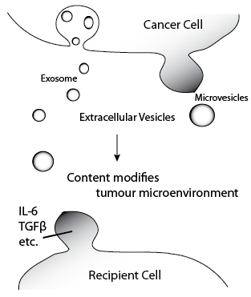
Extracellular Vesicles in Cancer
Intercellular communication by transfer of cytoplasmic material (Zaborowski 2015)
Cancer derived EVs have roles in tumour microenvironment modifications. (Webber 2015)
Protein content of EVs commonly researched
Cavin-1 modulated EV protein content.
(Inder 2014)
Notes:
We’ve used this system to assess the role of extracellular vesicles in Prostate cancer. … While we predominately investigated proteomic content, another interesting finding that indicated microRNAs may also be used in this role.

Slide 6
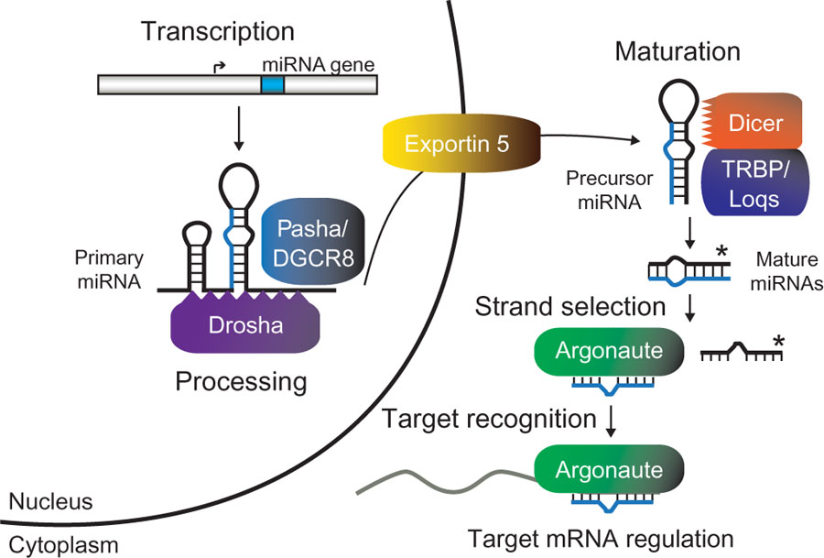
MicroRNAs: biogenesis and function
Kai et al 2010
Notes:
These small non-coding RNAs get processed into a hairpin, then shuttled out of the nucleus where after further maturation allows complimentary binding to protein transcripts. This results in their degradation….. As Micrornas can bind to hundreds of transcripts, thus mediating many pathways, tight temporal and spatial regulation is required to prevent dysregulation. However many of the details surrounding its regulation, such as compartmentalization in the cell, is mostly unknown. Originally, microRNAs were believed to only be contained with their host cell which was facilitated by RNAses in the intracellular space. Yet fairly recent studies found that these miRs are able to be shuttled intercellularly via EVs

Slide 7
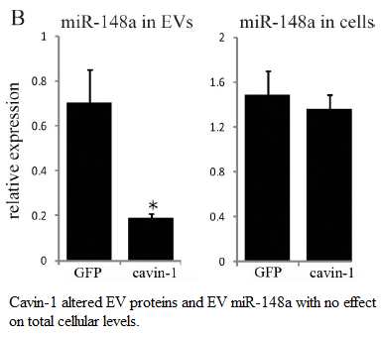
MicroRNAs in EVs
EVs have been proposed as vehicles for microRNAs. (Cheng 2014)
Alike protein, EV contained miRs facilitate modifications to the tumour microenvironment and pre-metastatic niche formation.
(Neviani et al 2015)
Cavin-1 reduced export of miR-148a with little change to cellular expression
Indicates some form of export mechanism
rather than sampling.
(Inder 2014)

Slide 8
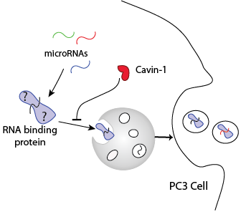
Hypothesis:
Cavin-1 expression in PC3 cell limits the extracellular vesicle export of a subset of microRNAs by modulating the export of their RNA-binding proteins
Aims:
Identify miRs exported in this system
Identify candidate export protein
Investigate the interaction between export protein and miR
Caveolin+

Slide 9
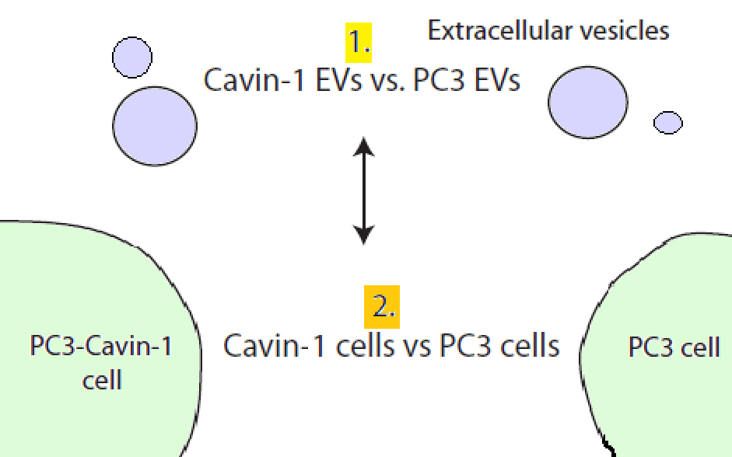
Aim 1. Identify miRNAs exported in this system
miRNAome of EVs
miRNAome of cells
3 replicates prepared by Jayde Ruelcke
RNA-seq by Nicole Cloonan
DESeq2 analysis for R.
Analyses differences in export
Analyses differences in expression

Slide 10
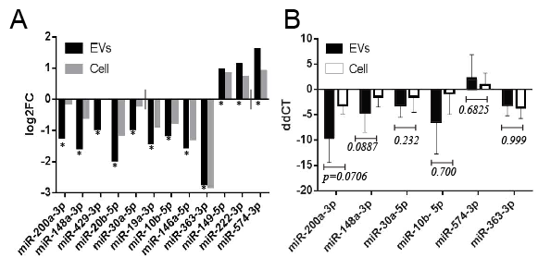
MicroRNAs are selectively exported
95 miRs detected in EVs.
12 miRs significantly modified in EVs by cavin-1 expression.
Presence in EVs due to sampling or selective export: predict by comparing to cell
5 miRs with reduced export by cavin-1, 6 miRs sampled and 1 miR induced export by cavin-1.

Slide 11
RT-qPCR validation
EV and cell collection
RNA extraction
cDNA and poly-A tailing
RT-qPCR
Delta delta CT analysis

Slide 12
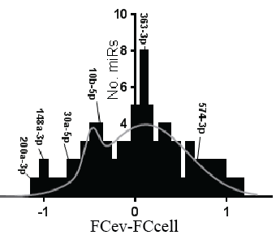
Distribution of miR export
How prevalent is each form of export (sampling vs selective)?
19 miRs selectively exported
Notes:
… We now know which micrornas are being selectively exported from this system, some of which are validated, that can be used to understand mechanism overall. Next we wanted to understand whether these microRNAs possess similarities to explain their export.

Slide 13
Aim 2. Identify candidate export protein
Hypothesis:
Cavin-1 expression in PC3 cell limits the extracellular vesicle export of a subset of microRNAs by modulating the export of their RNA-binding proteins
Export proteins should:
Possess differential export due to cavin-1
Possess RNA binding ability
Predicted to bind the exported miRs.
Caveolin+

Slide 14
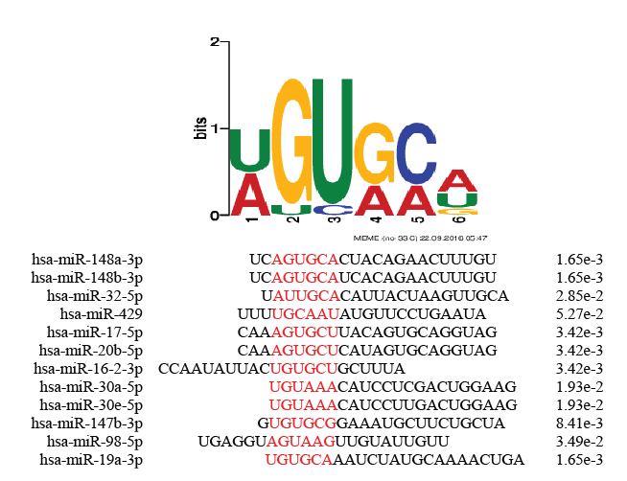
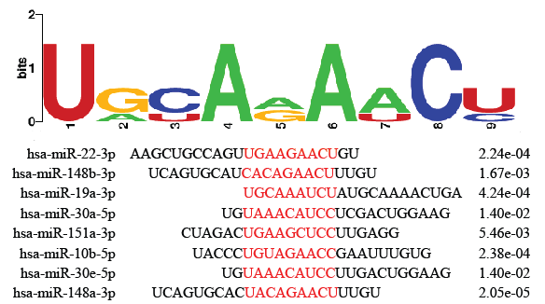
Motifs enriched in exported microRNAs
Exported microRNAs share sub-sequences that RNA-binding export proteins bind to.
8/19
12/19
Together, match 14/19 exported miRs
Notes:
Used the 19 micrornas that were selectively exported, from last analysis.
MEME: 4-10 nucleotides in length.
x/19 is how many of the miRs contained that motif.

Slide 15
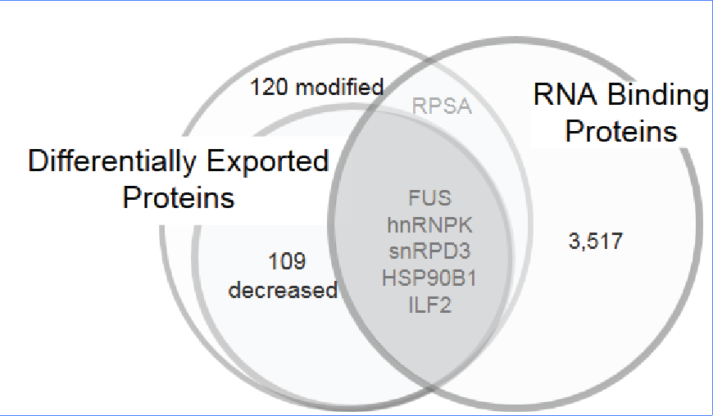
Quantitative proteomics of EVs
Export proteins should:
Possess differential export due to cavin-1
Possess RNA binding ability
Predicted to bind the exported miRs.
MS/MS compared proteomic content of EVs from PC3 and PC3-cavin-1 cells. (Inder 2012)
Gene Ontology analysis for RNA binding.
Notes:
Next we looked at potential proteins that could be interacting with those selectively exported micrornas… Based on this criteria… From this analysis we found 5 proteins that could be potential export proteins. We then assessed these further by looking into the literature to determine if any of these proteins are more suited for the position.

Slide 16
hnRNPK: viable export protein
hnRNPA2B1 mediates export of miRs in T-lymphocytes
(Villarroya-Beltri 2013)
hnRNPK commonly exported in cancer derived EVs
(Zhang 2015, Ji 2013, Welton 2010, Remteke 2015)
hnRNPK binds to miR-122 at AGUGUG region. (Fan 2015)
FIMO prediction matches motif to this region (p=0.0435)
hnRNPK fulfils all criteria for the candidate export protein
Notes:
Memebers of the hnRNP family appear to be involved with the export of mirs in other cell lines, which indicates that FUS or hnrnpk may be better suited for this role… Linker: together, this indicates that hnRNPK fulfills the criteria for export protein.

Slide 17
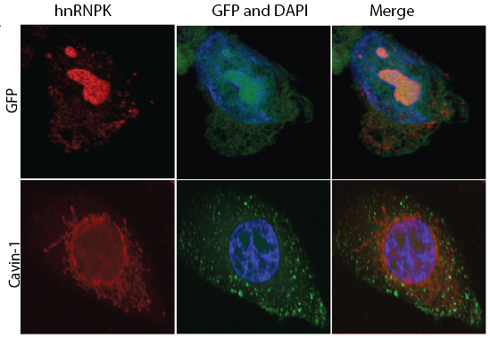
Subcellular localization of hnRNPK modified
Compare PC3 to PC3-cavin-1 cell line to assess difference in activity.
Notes:
So, here we wanted to identify or understand the activity of hnRNPK in these cell lines which may explain how and why it is able to mediate mir export.. Used immunofluorescence on GFP transfected PC3 and GFP tagged cavin01 cell lines… Explain the method and results.. hnRNPK seems to change subcellular localization between cell lines, which may be the driving factor for the export of mirs.

Slide 18
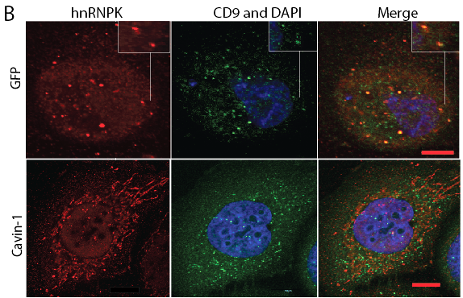
hnRNPK changes between MVB and ER
PC3
CD9 is a MVB and
exosome marker
PC3-Cavin-1
Notes:
Next, we wanted to know what those punctate structures were… CD9 is a common marker used to determine…. Here we found that hnRNPK is found somewhat in forming exosomes, the smaller of the EVs suppopulations, that is not occurring in the cavin-1 cell lines, consistent with what the mass spectrometry data indicated.

Slide 19
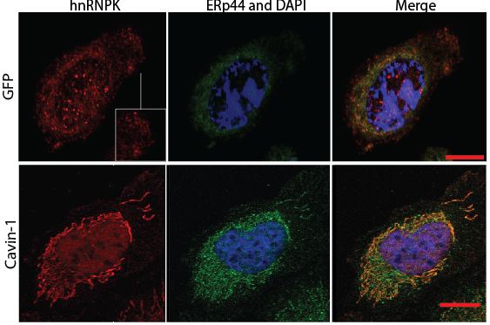
hnRNPK in ER in cavin-1 cells
PC3
ERp44 is a resident
ER protein
PC3-Cavin-1
Notes:
In fact, through further Immunofluorescence, it seems that the hnRNPK in cavin-1 positive cells prefers to localize to the endoplasmic reticulum. This change may be what is changing the differential export of hnRNPK, and therefore selective export of mirs.

Slide 20
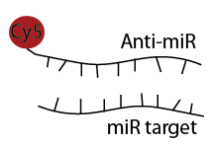
Aim 3. Investigate the interaction between export protein and microRNA. microRNA in situ hybridization
Similar concept to FISH
Fluorophore tagged complimentary RNA hybridizes to target
In addition with IF for hnRNPK localization
Notes:
Next, we wanted to know and confirm that hnRNPK actually interacts with its predicated targets. We attempted to do this in two separate ways: by looking at in situ colocalization, and binding interaction. So first we used a methology similar in concept to FISH, but slightly modified.

Slide 21
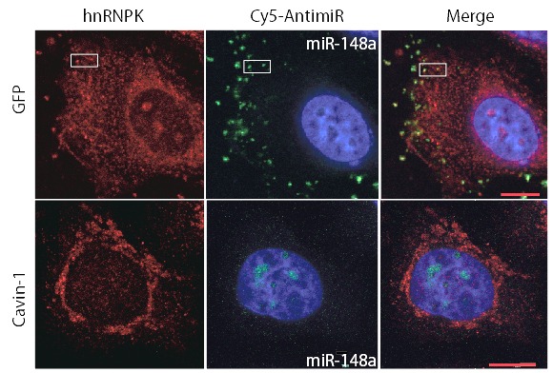
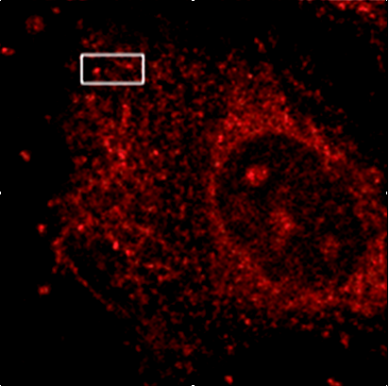
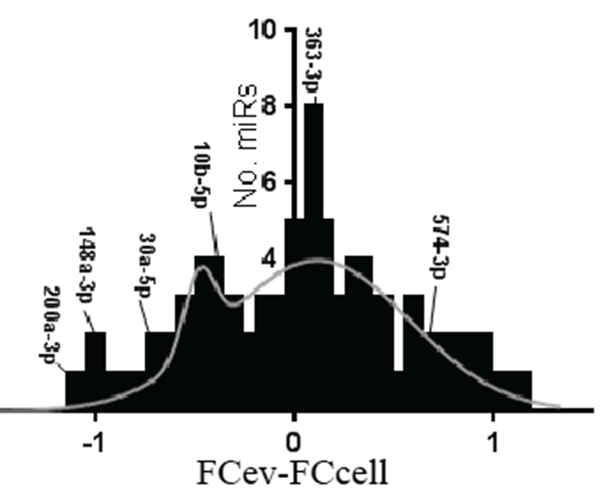
hnRNPK co-localizes with miR-148a
miR-148a
PC3
PC3-Cavin-1

Slide 22
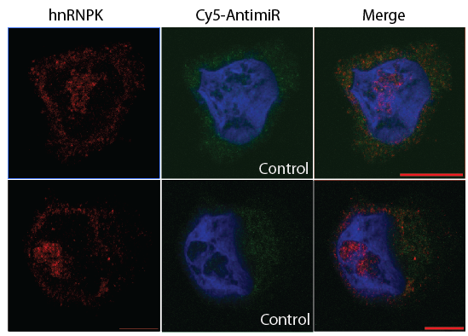
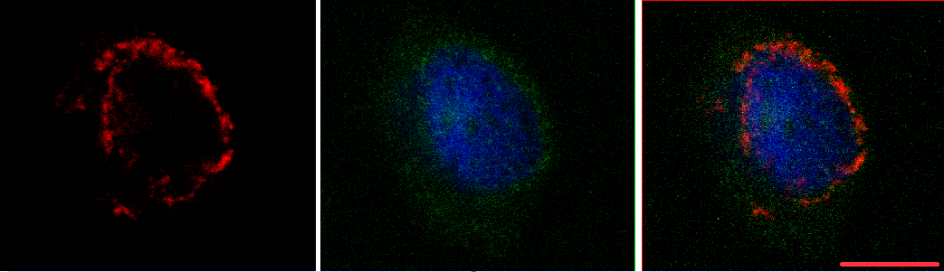
Scrambled 148a as control. Won’t bind hnRNPK or localize to nucleolus
PC3
GFP
Cavin-1
PC3-Cavin-1

Slide 23
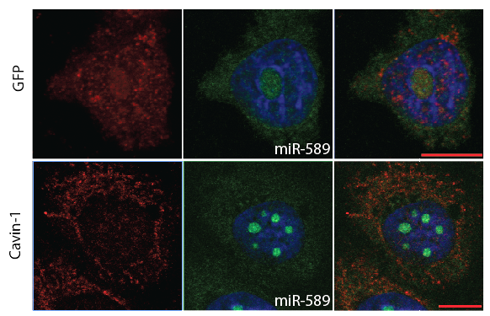
miR-589 is believed to be exported due to sampling
PC3
PC3-Cavin-1

Slide 24
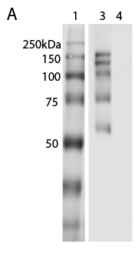
hnRNPK co-localizes with miR-148a, but does it bind?
 | RNA eluted (ng/µL)
replicate | hnRNPK IP | IgG Control
1 | 11.78 | 1.40
2 | 4.20 | 0.20
3 | 14.7 | 0.80
Crosslinked immunoprecipitation: pull down hnRNPK and its binders, including RNA.
hnRNPK
immunoblot
hnRNPK IP
rabbit IgG

Slide 25
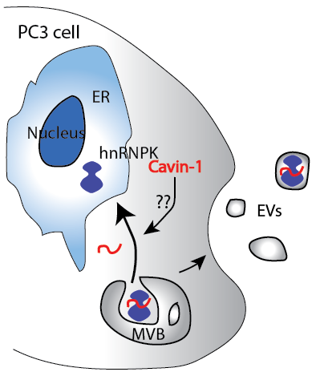
Conclusion and Future Directions:
Mechanism:
- hnRNPK translocate to MVB/EVs
- hnRNPK brings miR targets with it
- addition of cavin-1 prevents hnRNPK in EVs
potentially by sequestering to ER
- Therefore reduces miR export
Confirm hnRNPK- miRNA interaction by hnRNPK knockout and miRNA mutagenesis
Figure out the link between cavin-1 and hnRNPK subcellular localization?

