Slide 1
Control of extracellular vesicle microRNA export in prostate cancer.
Harley Robinson. Alex Cristino
Hill and Cristino Group.

Slide 2
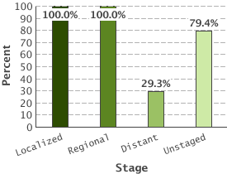
Prostate Cancer
5 Year Relative Survival:
Prostate cancer by stage
Highest diagnosed cancer in men worldwide
(SEER 2016)
Bone metastasis leads to poor outcome.
(Body et al 2015)
Metastasis reduced 5 year survival to 29.3%
(SEER 2016)
(SEER 2016)

Slide 3
Caveolin-1 and Cavin-1 in PCa;
Caveolin-1 biomarker for cancer progression.
Co-expression with cavin-1 in healthy cells.
Overexpression linked to PCa metastasis.
Knock down or addition of cavin-1 reduces metastasis.

Slide 4
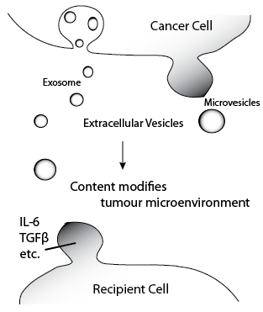
Extracellular Vesicles
Secreted vesicles containing cytoplasmic or sorted material.
Transfer to other cells induces modifications
Cancer derived EVs have roles in tumour microenvironment modification and metastasis.
Protein content of EVs commonly researched

Slide 5
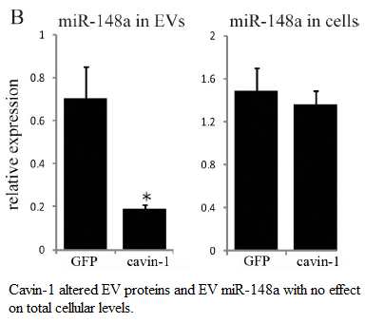
MicroRNAs in EVs
EVs have been proposed as vehicles for microRNAs.
MiR-148a exported from PC3 cell line.
No change to cellular expression
Indicates some form of export mechanism
rather than sampling.

Slide 6
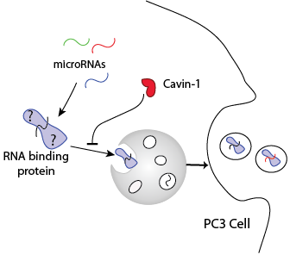
Hypothesis and Aims:
Aims:
Identify all exported miRs
Identify candidate export protein
Investigate the interaction between
candidate and microRNAs

Slide 7
RNA-seq and Differential Expression analysis

Slide 8
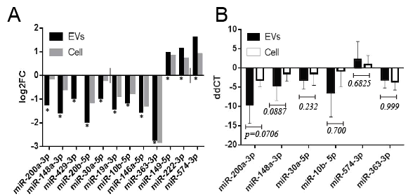
MicroRNAs are selectively exported

Slide 9
RT-qPCR validation
EV and cell collection
RNA extraction
cDNA and poly-A tailing
RT-qPCR
Delta delta CT analysis

Slide 10
Investigating similarities of miRs
EXAPLAINATION OF MOTIF ANALYSIS AND EXPANSION OF MIR SET

Slide 11
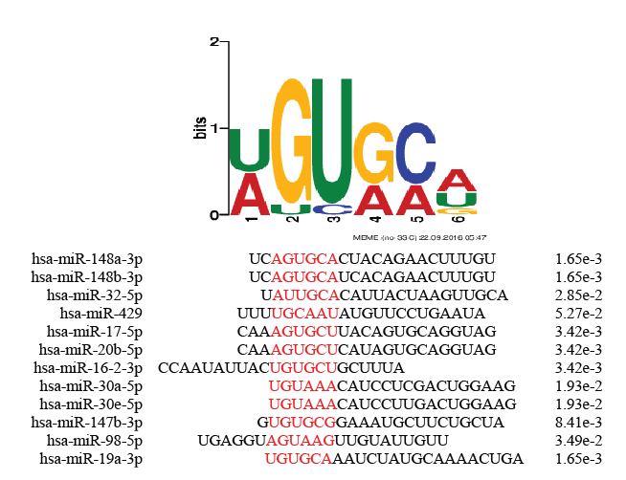
Motifs detected

Slide 12
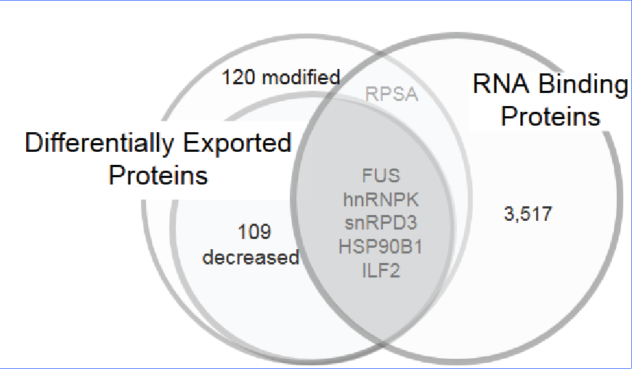
RNA-binding proteins exported
Candidate checklist:
Needs to be differentially exported
Must bind RNA
Predicted to bind the exported miRs.

Slide 13
hnRNPK: viable export protein
hnRNPK commonly exported in cancer derived EVs
hnRNPA2B1 mediates export of miRs in T-lymphocytes
hnRNPK binds to miR-122 at AGUGUG region.
FIMO prediction matches motif to this region (p=0.0435)

Slide 14
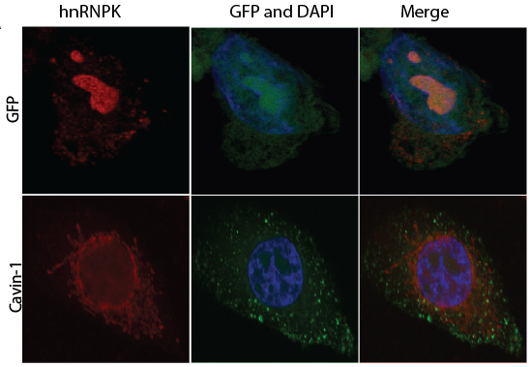
hnRNPK changes subcellular localization
Compare PC3 to PC3-cavin-1 cell line to assess difference in activity.

Slide 15
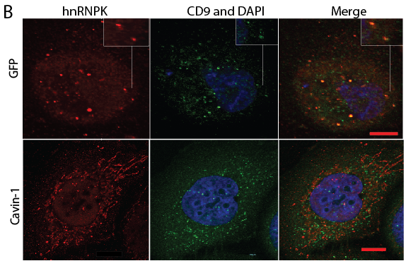
hnRNPK changes between MVB and ER

Slide 16
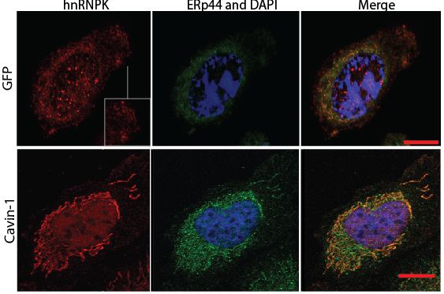
hnRNPK in ER in cavin-1 cells

Slide 17
miR-ISH
Similar method to FISH
Fluorophore tagged complimentary RNA hybridizes to target

Slide 18
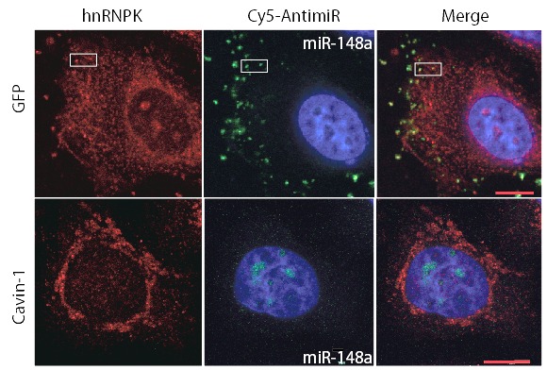
hnRNPK co-localizes with miR-148a

Slide 19
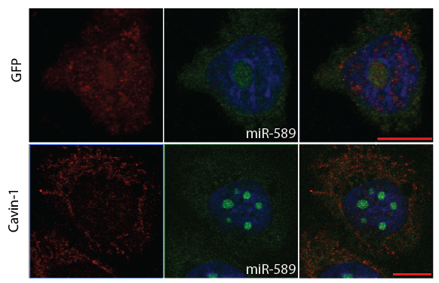
miR-589 is believed to be exported due to sampling

Slide 20
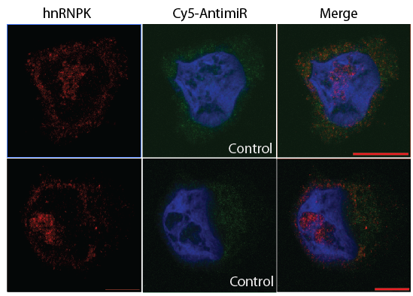
Scrambled 148a as control. Won’t bind hnRNPK or localize to nucleolus

Slide 21
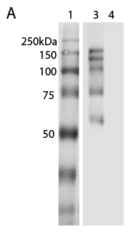
hnRNPK binds RNA
hnRNPK co-localizes with miR-148a, but does it bind?
RNA immunoprecipitation: pull down hnRNPK and its binders, including RNA.
1- ladder
3 – hnRNPK IP
4 – Control; rabbit IgG

Slide 22
hnRNPK binds RNA
Purified RNA bound to hnRNPK
 | RNA eluted (ng/µL)
Replicate | hnRNPK IP | IgG Control
1 | 11.78 | 1.40
2 | 4.20 | 0.20
3 | 14.7 | 0.80

Slide 23
Future:
Look into RNAs binding to see if micrornas are binding

