Slide 1
Control of extracellular vesicle microRna export in prostate cancer.

Slide 2
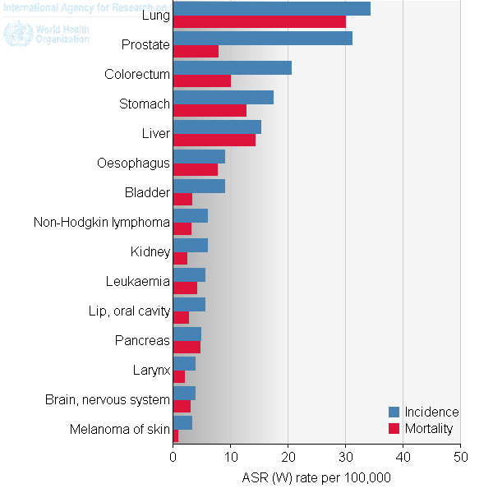
Prostate cancer
Highest diagnosed cancer in men worldwide
Metastasis reduced 5 year survival to 29.3%
Bone metastasis leads to poor outcome.
Ferlay J et al. (2012).

Slide 3
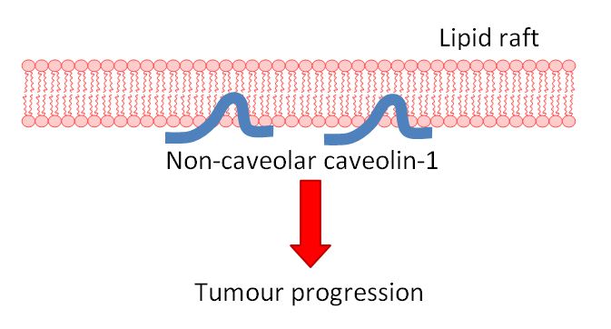
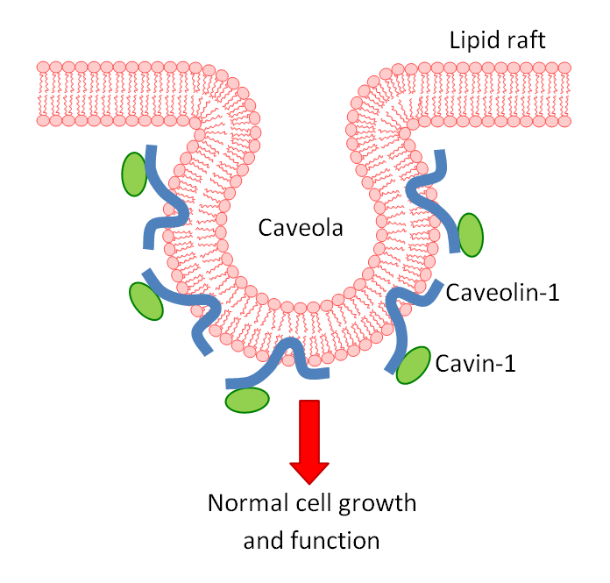
Caveolin-1: Biomarker of progression
Caveolin-1 overexpressed in prostate cancer
Knockout caveolin-1 in prostate cancer reduces metastatic phenotype.
Cavin-1 expression also truncates metastasis.
Use model to assess the role of caveolin in cancer.

Slide 4
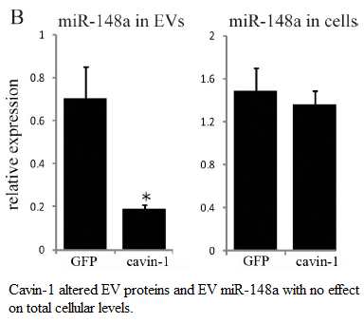
Evs and microRNAs
Cavin-1 expressed in PC3 cell line modifies EV content.
EVs transfer biological material intercellularly.
reduced EV export of oncomiR: miR-148a
But how?

Slide 5
Hypothesis and aims:
Cavin-1 expression attenuates EV export of microRNAs by manipulating RNA-binding protein export.
Aims:
Identify additional miRs that are modified by cavin-1
Identify RNA-binding proteins modified by cavin-1in EVs
Investigate the interaction between escort protein and microrna.

Slide 6
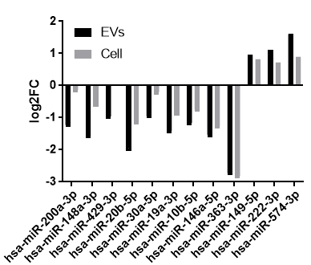
Micrornas selectively exported
RNA-seq data revealed that not all miRs differentially export were proportionately changed in the EVs.
Down-reg miRs share roles in cancer progression.

Slide 7
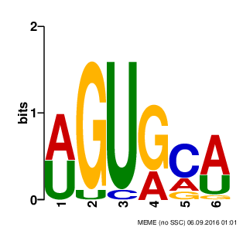
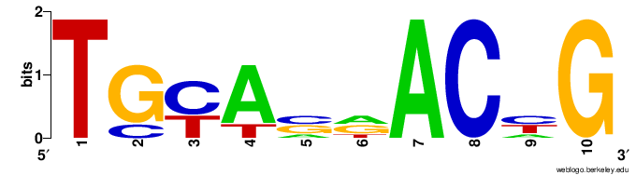
Exported micrornas share motif
miR-148a-3p: AGUGCA
miR-148b-3p: AGUGCA
miR-429: UGCAAU
miR-32-5p: AUUGCA
miR-17-5p: AGUGCU
miR-20b-5p: AGUGCU
miR-19a-3p: UGUGCA
miR-30e-5p: UGUAAA
No10a-3p, 186-5p, 3615, 98, 200a,
miR-30a-3p: UGUAAA
miR-16-2-3p: UGUGCU
miR-125a-3p: AGUGGA
miR-147b: UGUGCG
miR-10b-5p: UGUAGA
Matches 13/20 Diff. miRs
miR-22-3p: UGAAGAACU
miR-148b-3p: CACAGAACU
miR-148a-3p: UACAGAACU
miR-19a-3p: UGCAAAUCU
miR-30a-5p: UAAACAUCC
miR-30e-5p: UAAACAUCC
miR-151a-3p: UGAAGCUCC
Matches 7/20 Diff. miRs
Together, motifs match to 15/20 differentially exported miRs.

Slide 8
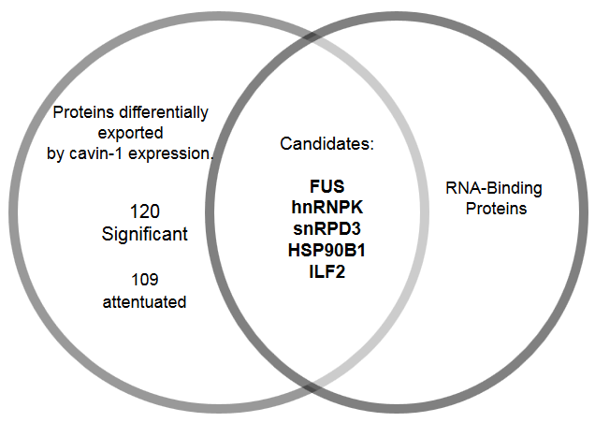
Differentially exported hnRNPK binds similar motif
hnRNPK:
Protein family previously implicated in related function
Known to bind to miRs
Binds AGUGUG region on miR-122-5p (found by mut. assay)
Region matches to AGUGCA motif (p= 0.0593, using FIMO)

Slide 9
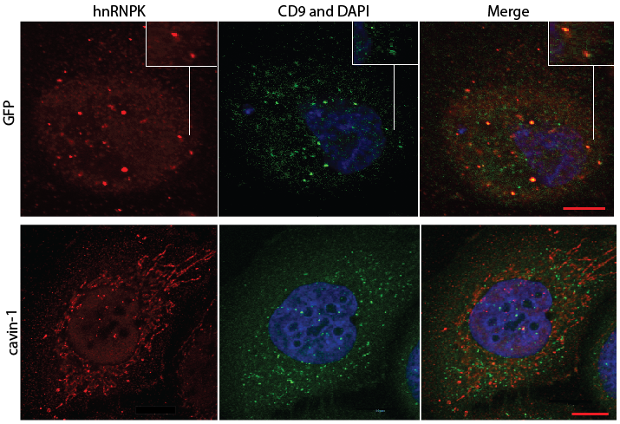
hnRNPK and its subcellular localization
CD9 overlap and ER overlap.

Slide 10
Hnrnpk colocalize with mir-148a

Slide 11
HnrNpk pull down
1; cont (1.4ng/ul), K: 11.78ng/ul
2. cont (0.2ng/ul), K: 4.2ng/ul
3. control (0.8ng/ul), K: 14.7ng/ul

