Slide 1
Control of extracellular vesicle microRna export in prostate cancer.

Slide 2
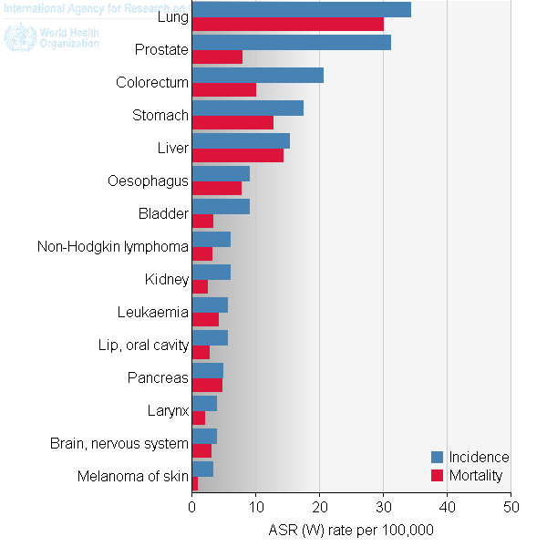
Prostate cancer
Highest diagnosed cancer in men worldwide
Metastasis reduced 5 year survival to 29.3%
Bone metastasis leads to poor outcome.
Ferlay J et al. (2012).

Slide 3
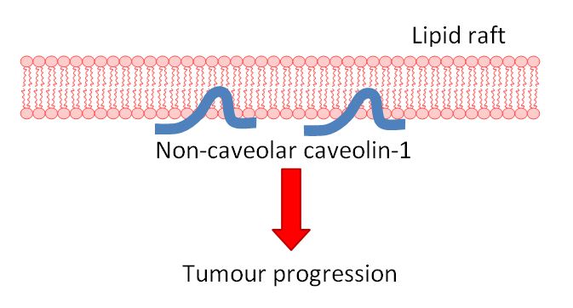
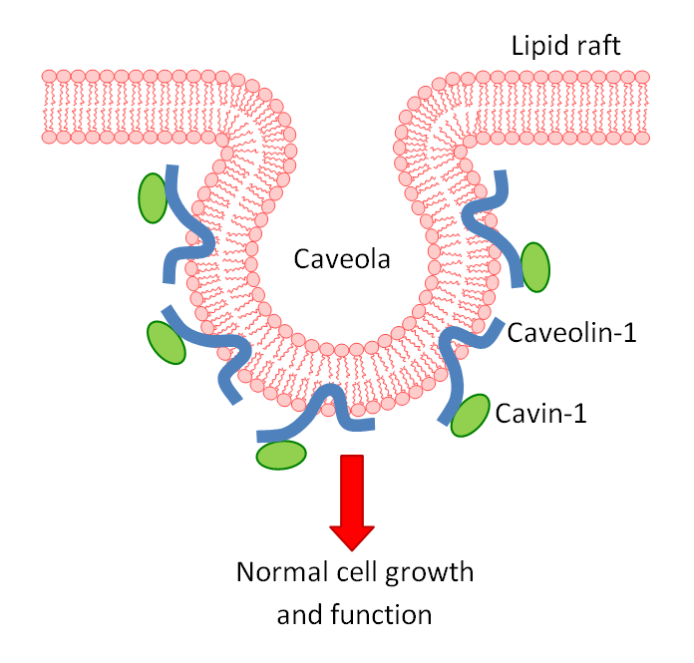
Caveolin-1: Biomarker of progression
Caveolin-1 overexpressed in prostate cancer
Knockout caveolin-1 in prostate cancer reduces metastatic phenotype.
Cavin-1 expression also truncates metastasis.
Use model to assess the role of caveolin in cancer.

Slide 4
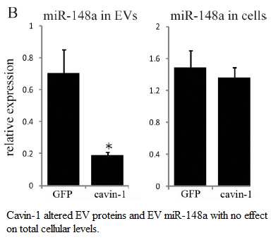
Evs and microRNAs
EVs transfer biological material intercellularly.
Cavin-1 expressed in PC3 cell line modifies EV content.
reduced EV export of oncogmiR: miR-148a
But how?

Slide 5
Hypothesis and aims:
Cavin-1 expression attenuates EV export of microRNAs by manipulating RNA-binding protein export.
Aims:
Identify additional miRs that are modified by cavin-1
Identify RNA-binding proteins modified by cavin-1
Investigate the interaction between escort protein and microrna.

Slide 6
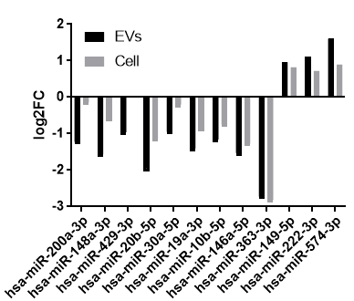
Micrornas selectively exported
RNA-seq data revealed exported miR-148a, 200a, 30a, 19a, and 10b to be truncated by expression of cavin-1.
These share roles in cancer progression.

Slide 7
Exported micrornas share motif
Motif with mirs that it associates to.

Slide 8
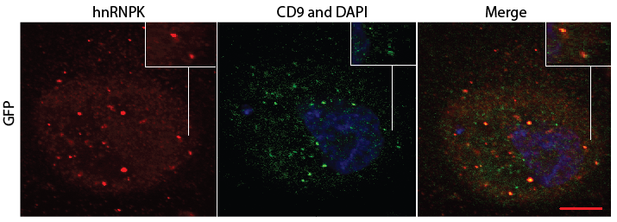
hnRNPK and its subcellular localization
CD9 overlap and ER overlap.

Slide 9
Hnrnpk colocalize with mir-148a

Slide 10
HnrNpk pull down

