Slide 1
Control of extracellular vesicle microRNA export in prostate cancer.

Slide 2
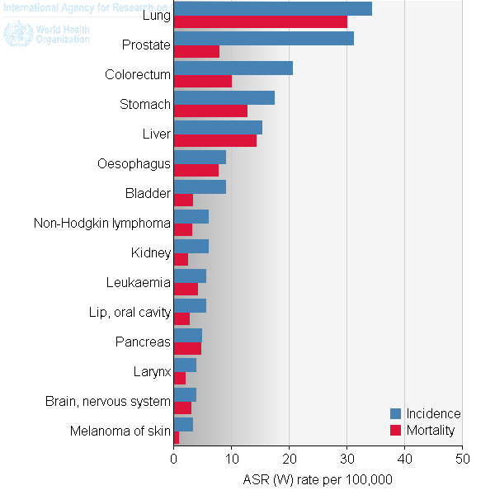
Prostate Cancer
Highest diagnosed cancer in men worldwide
Bone metastasis leads to poor outcome.
Metastasis reduced 5 year survival to 29.3%
Ferlay J et al. (2012).

Slide 3
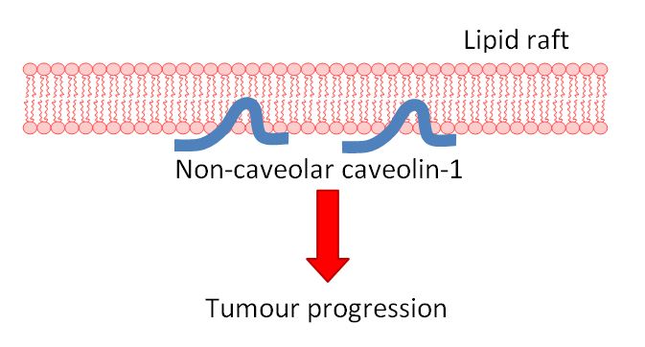
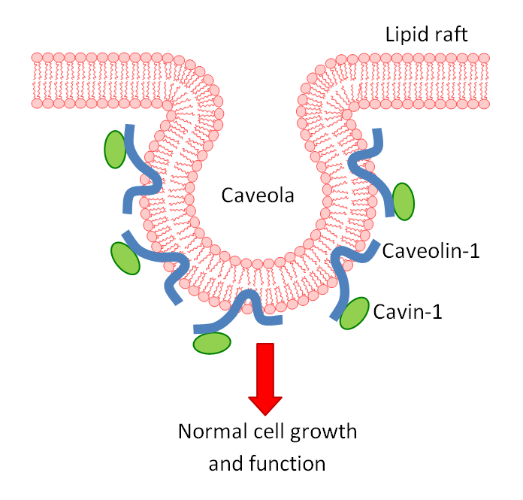
Caveolin-1: Biomarker of Progression
Caveolin-1 overexpressed in prostate cancer
Knockout caveolin-1 in prostate cancer reduces metastatic phenotype.
Cavin-1 expression also truncates metastasis.
Use model to assess the role of caveolin in cancer.

Slide 4
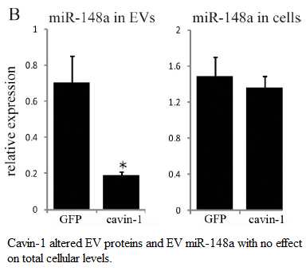
EVs and microRNAs in PCa.
EVs transfer biological material intercellularly.
Cavin-1 expressed in PC3 cell line modifies EV content.
reduced EV export of oncomiR: miR-148a
But how?

Slide 5
Hypothesis and Aims:
Cavin-1 expression attenuates EV export of microRNAs by manipulating RNA-binding protein export.
Aims:
Identify additional miRs that are modified by cavin-1
Identify RNA-binding proteins modified by cavin-1in EVs
Investigate the interaction between escort protein and microRNA.

Slide 6
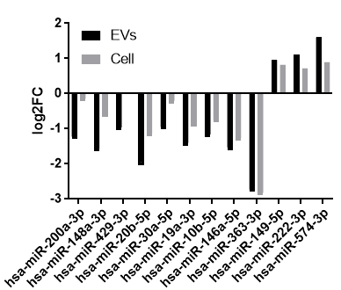
MicroRNAs differentially exported
Are other miRs modified?
5miRs significantly attenuated by cavin-1
Down-reg miRs share roles in cancer progression.

Slide 7
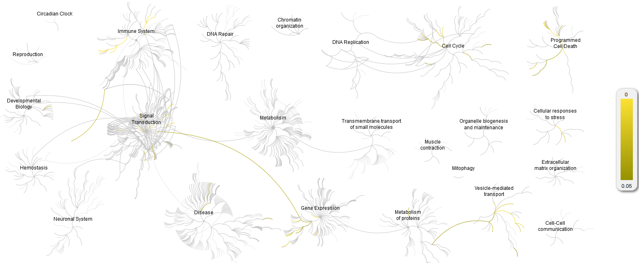
miR targeted pathways
Pathway name | Entities FDR
Endosomal/Vacuolar pathway | 9.99E-10
Antigen Presentation: Folding, assembly and peptide loading of class I MHC | 2.31E-09
Interferon alpha/beta signaling | 1.50E-07
ER-Phagosome pathway | 2.63E-06
Antigen processing-Cross presentation | 6.95E-06
Interferon gamma signaling | 3.89E-05
Class I MHC mediated antigen processing & presentation | 3.57E-04
Intrinsic Pathway for Apoptosis | 0.003287
Apoptosis | 0.012709
Activation of BH3-only proteins | 0.022553
Programmed Cell Death | 0.023677
Regulation of TP53 Expression | 0.078783
Interferon Signaling | 0.093491
Notes:
miRTarBase> reactome.

Slide 8
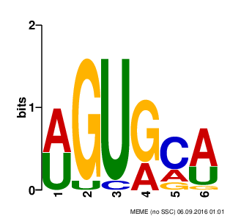
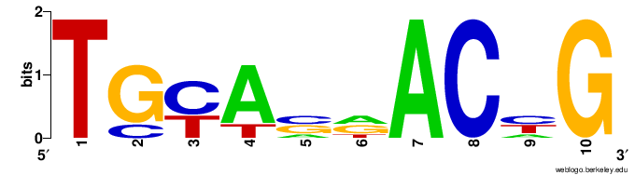
Exported microRNAs share motif
miR-148a-3p: AGUGCA
miR-148b-3p: AGUGCA
miR-429: UGCAAU
miR-32-5p: AUUGCA
miR-17-5p: AGUGCU
miR-20b-5p: AGUGCU
miR-30e-5p: UGUAAA
miR-30a-3p: UGUAAA
miR-16-2-3p: UGUGCU
miR-125a-3p: AGUGGA
miR-147b: UGUGCG
miR-10b-5p: UGUAGA
Matches 12/19 Diff. miRs
miR-22-3p: UGAAGAACU
miR-148b-3p: CACAGAACU
miR-148a-3p: UACAGAACU
miR-30a-5p: UAAACAUCC
miR-30e-5p: UAAACAUCC
miR-151a-3p: UGAAGCUCC
Matches 6/19 Diff. miRs
Together, motifs match to 14/19 differentially exported miRs.

Slide 9
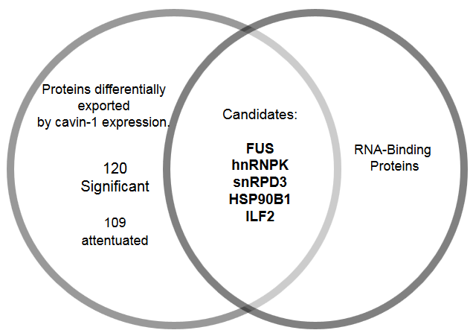
Differentially exported hnRNPK binds similar motif
hnRNPK:
Protein family previously implicated in related function
Known to bind to miRs
Binds AGUGUG region on miR-122-5p (found by mut. assay)
Region matches to AGUGCA motif (p= 0.0593, using FIMO)
Notes:
FIMO: find individual motif occurrences.

Slide 10
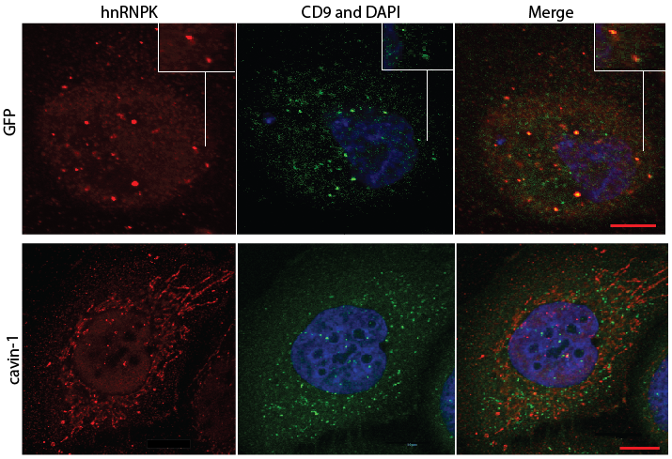
HnRNPK and its subcellular localization

Slide 11
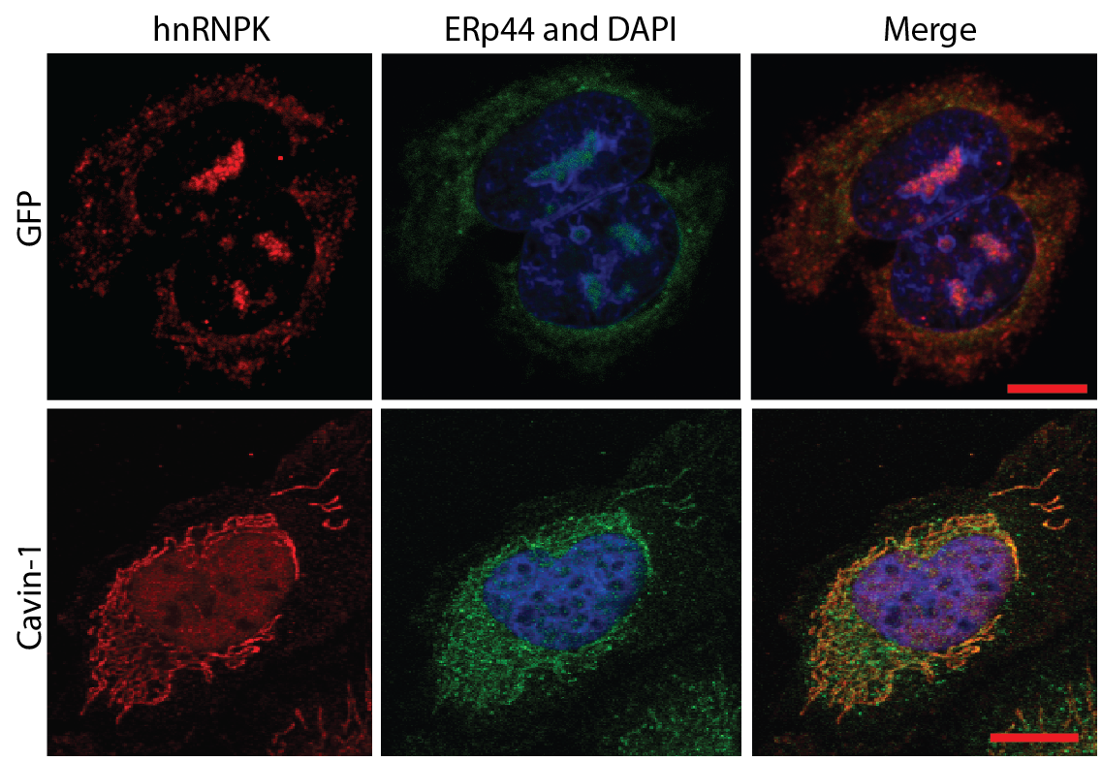

Slide 12
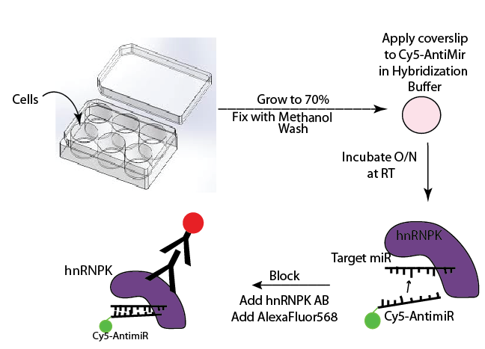
miR-ISH

Slide 13
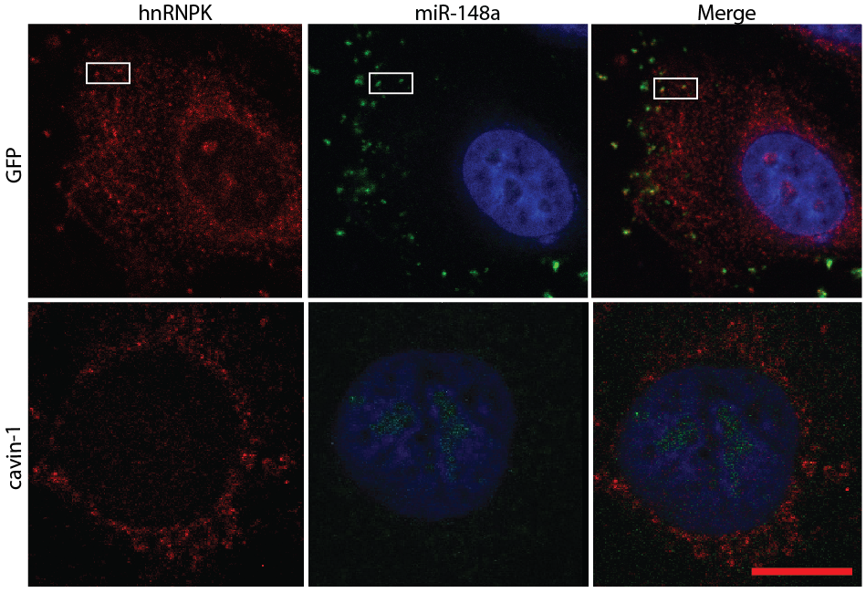
HnRNPk co-localize with miR-148a

Slide 14
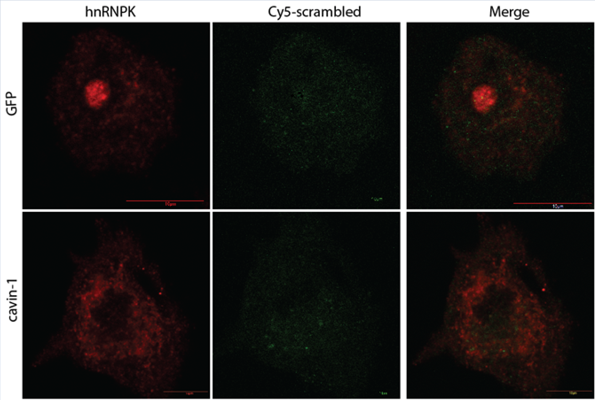
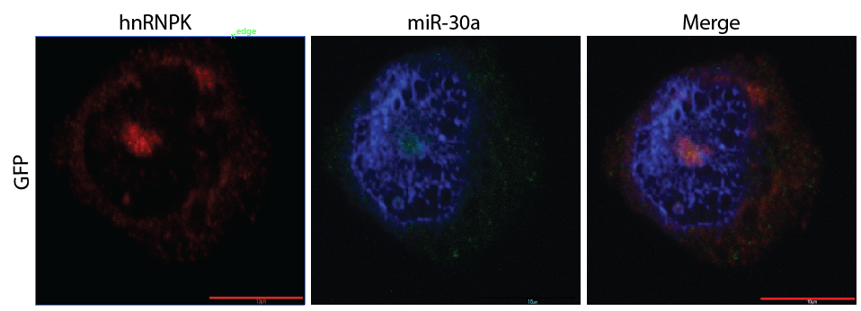

Slide 15
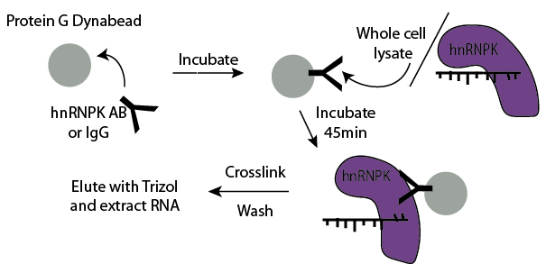
RNA Immunoprecipitation

Slide 16
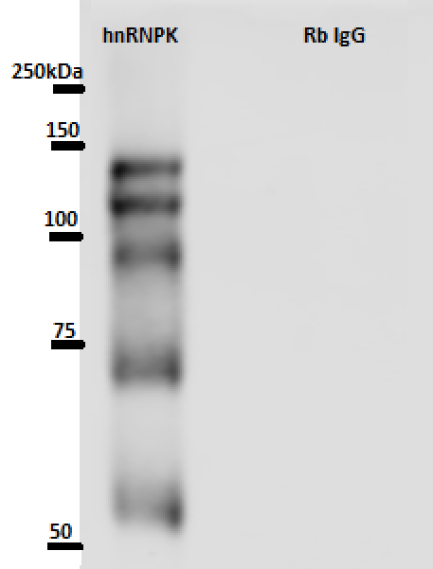
HnRNPK IP
Western of IP result
3 replicates of hnRNPK IP for RNA binding
 | RNA eluted (ng/uL)
Replicate | hnRNPK | Rb IgG
1 | 11.78 | 1.40
2 | 4.20 | 0.20
3 | 14.7 | 0.80

Slide 17
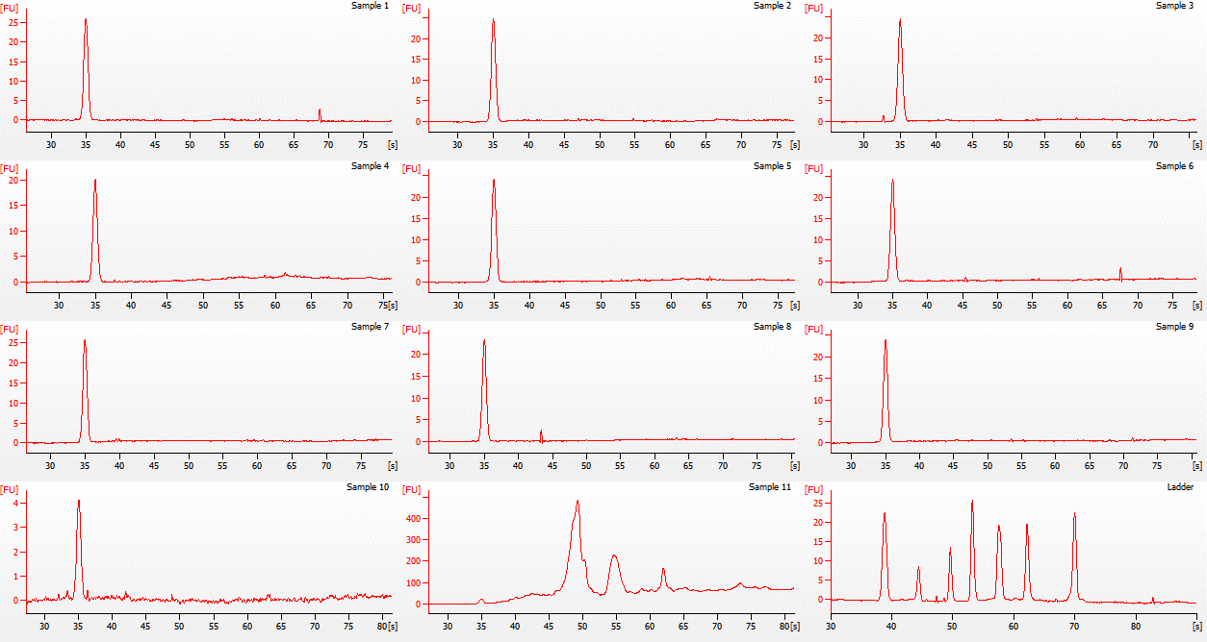
Control (IgG)
hnRNPK
Total Cell RNA

