Slide 1
Control of extracellular vesicle microRNA export in prostate cancer.
Harley Robinson. Alex Cristino. Michelle Hill
Hill And Cristino Group.

Slide 2
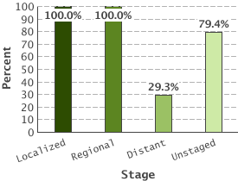
Prostate Cancer
5 Year Relative Survival:
Prostate cancer by stage
Highest diagnosed cancer in men worldwide
(SEER 2016)
Bone metastasis leads to poor outcome.
(Body et al 2015)
Metastasis reduced 5 year survival to 29.3%
(SEER 2016)
(SEER 2016)

Slide 3
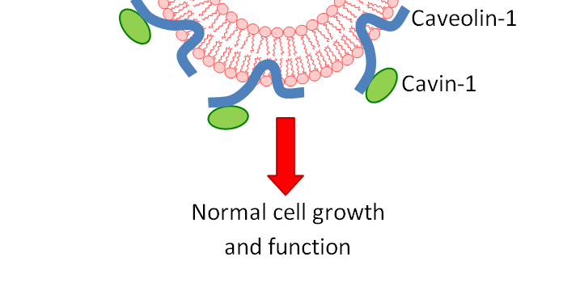
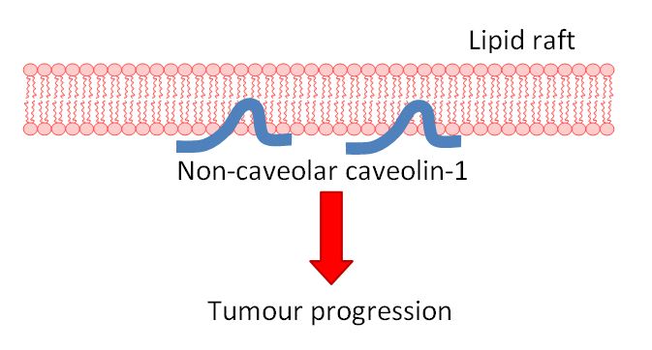
Caveolin-1 and Cavin-1 in Cancer;
Healthy Tissue
Caveolin-1 biomarker for cancer progression.
(Freeman 2012)
Co-expression with cavin-1 in healthy cells.
(Inder 2012, Moon 2014)
Cav1 overexpression linked to metastasis.
(Bennett 2009)
Knock down or addition of cavin-1 reduces metastasis. (Sugie 2015, Inder 2014)
Tumour
?

Slide 4
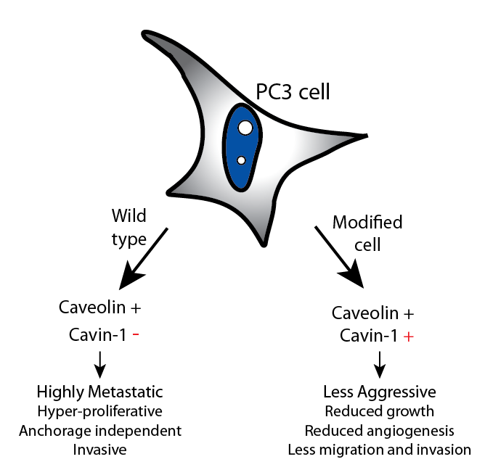
PC3: advanced prostate cancer

Slide 5
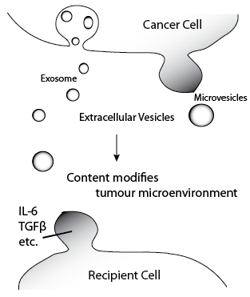
Extracellular Vesicles
Secreted vesicles containing cytoplasmic or sorted material. (Zaborowski 2015)
Transfer to other cells induces modifications
Cancer derived EVs have roles in tumour microenvironment modifications. (Webber 2015)
Protein content of EVs commonly researched

Slide 6
MicroRNAs

Slide 7
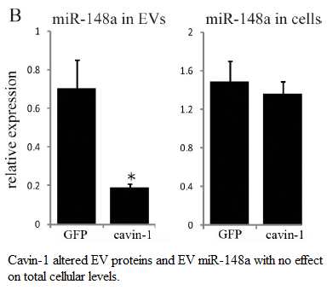
MicroRNAs in EVs
EVs have been proposed as vehicles for microRNAs. (Cheng 2014)
MiR-148a exported from PC3 cell line.
No change to cellular expression
Indicates some form of export mechanism
rather than sampling.
(Inder 2014)

Slide 8
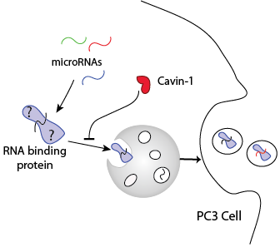
Hypothesis:
RNA binding protein mediates export of microRNAs in PC3 cells where expression of cavin-1 limits protein export and therefore, microRNA export.
Aims:
Identify miRs involved in export
Identify candidate export protein
Investigate the interaction between candidate and miRs
Caveolin+

Slide 9
RNA-seq and Differential Expression analysis
3 total RNA EV and cognate cell samples for PC3-GFP and PC3-GFP tagged Cavin-1 (PC3-cavin-1) cell lines.
RNA-seq for small RNAs, via Illumina sequencing. I received the resulting raw counts for miR species.
DESeq2 analysis for R.

Slide 10
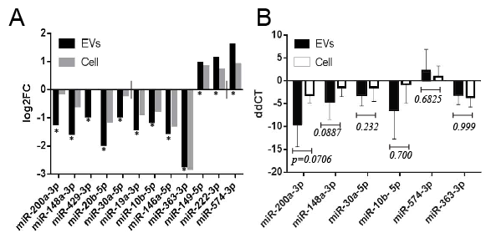
MicroRNAs are selectively exported
12 miRs significantly modified by cavin-1 in EVs.
Presence in EVs due to sampling or selective export: predict by comparing to cell

Slide 11
RT-qPCR validation
EV and cell collection
RNA extraction
cDNA and poly-A tailing
RT-qPCR
Delta delta CT analysis

Slide 12
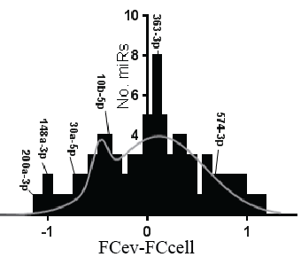
Investigating similarities of miRs
EXAPLAINATION OF MOTIF ANALYSIS AND EXPANSION OF MIR SET

Slide 13
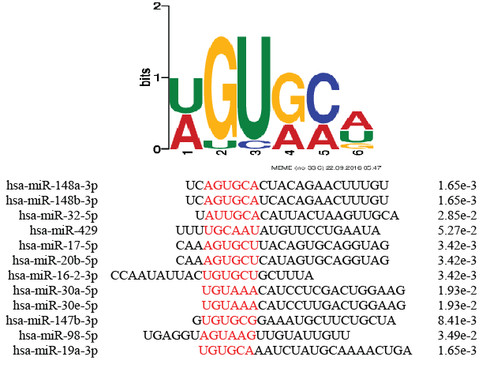
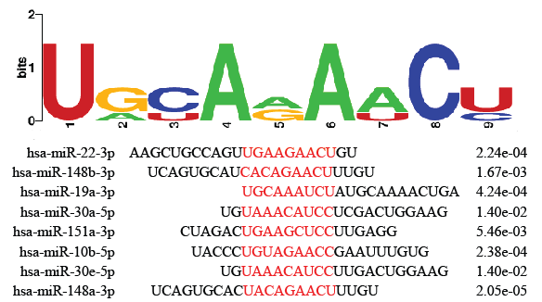
Motifs detected
12/19
8/19
Together, match 14/19 exported miRs

Slide 14
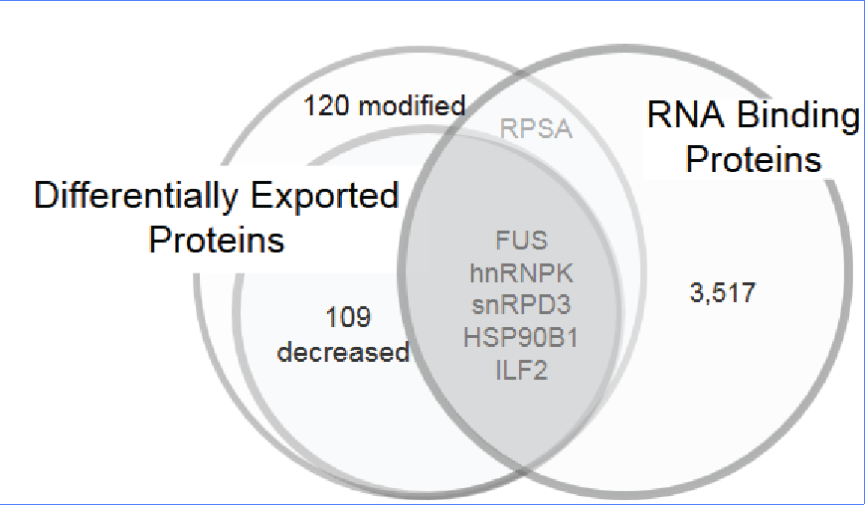
RNA-binding proteins exported
Candidate checklist:
Needs to be differentially exported
Must bind RNA
Predicted to bind the exported miRs.
MS/MS compared proteomic content of EVs from PC3 and PC3-cavin-1 cells. (Inder 2012)
Gene Ontology analysis for RNA binding.

Slide 15
hnRNPK: viable export protein
hnRNPK commonly exported in cancer derived EVs
(Zhang 2015, Ji 2013, Welton 2010, Remteke 2015)
hnRNPA2B1 mediates export of miRs in T-lymphocytes
(Villarroya-Beltri 2013)
hnRNPK binds to miR-122 at AGUGUG region. (Fan 2015)
FIMO prediction matches motif to this region (p=0.0435)
hnRNPK fulfils all criteria for the candidate export protein

Slide 16
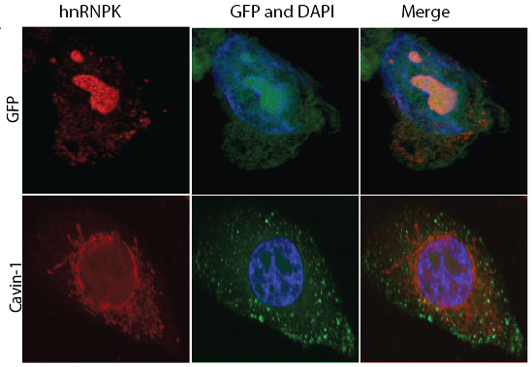
hnRNPK changes subcellular localization
Compare PC3 to PC3-cavin-1 cell line to assess difference in activity.

Slide 17
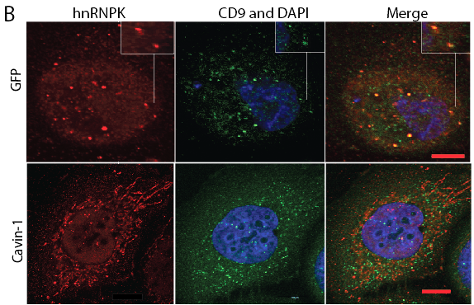
hnRNPK changes between MVB and ER
CD9 is a MVB and
exosome marker

Slide 18
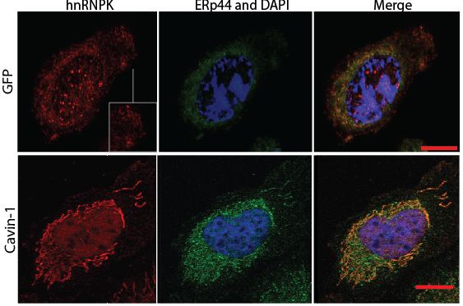
hnRNPK in ER in cavin-1 cells
ERp44 is a resident
ER protein

Slide 19
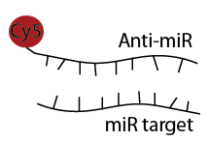
microRNA in situ hybridization
Similar concept to FISH
Fluorophore tagged complimentary RNA hybridizes to target
In addition with IF for hnRNPK localization

Slide 20
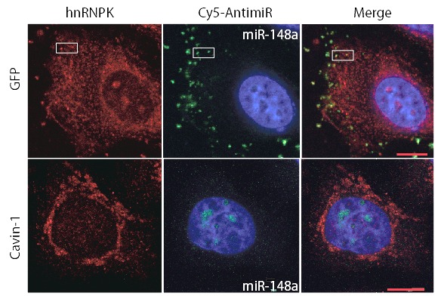
hnRNPK co-localizes with miR-148a

Slide 21
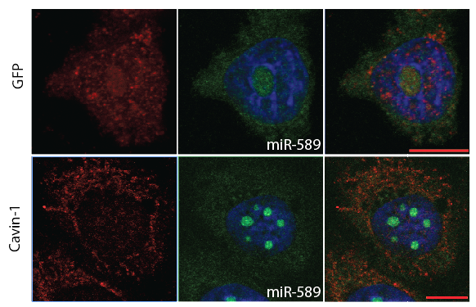
miR-589 is believed to be exported due to sampling

Slide 22
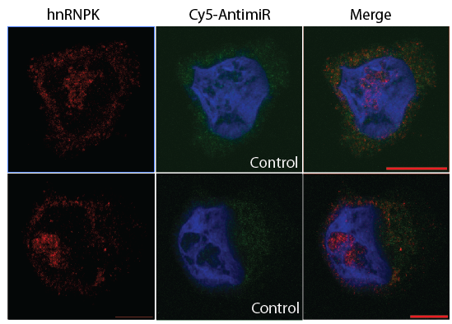
Scrambled 148a as control. Won’t bind hnRNPK or localize to nucleolus

Slide 23
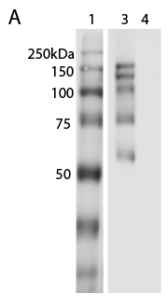
hnRNPK binds RNA
hnRNPK co-localizes with miR-148a, but does it bind?
RNA immunoprecipitation: pull down hnRNPK and its binders, including RNA.
1- ladder
3 – hnRNPK IP
4 – Control; rabbit IgG

Slide 24
hnRNPK binds RNA
 | RNA eluted (ng/µL)
Replicate | hnRNPK IP | IgG Control
1 | 11.78 | 1.40
2 | 4.20 | 0.20
3 | 14.7 | 0.80
Purified RNA bound to hnRNPK
Confirms hnRNPK-RNA interaction,
but not microRNA

