Slide 1
DVA 231 Web Development Project Presentation Project-Group 3

Slide 2
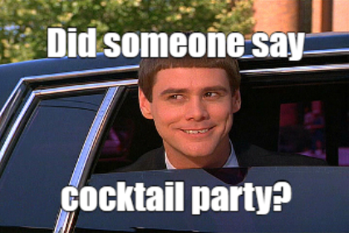
Projektanalyse – Folie 2
Project Description
Web Application for searching Cocktail-Recipes
Cocktails with specific ingredients
Random Cocktails
User registration with following features:
Creating Cocktails for other visitors
Reviewing and rating existing Cocktails
Bookmark favorite Cocktails
Moderator with following features:
Ban Users
Remove Reviews
Blacklist Cocktails
For Data we use: https://www.thecocktaildb.com/about.php
Source: https://mememaker.net/meme/cocktail-party-2645

Slide 3
Story
How it Started (The idea)
How we Separated the Work
Initial Problems
What we Learned

Slide 4
Projektanalyse – Folie 2
Technologies
Back-end:
Cocktail REST API
Django Open-source web framework (Python)
Django Open-source REST framework (Python)
SQLite3
Front-end:
Jquery a JavaScript library
Bootstrap CSS3 framework
Rater JS Widjet
Tags Input Plugin
Font Awesome

Slide 5
Future Improvements
Add an 18+ years old confirmation when the user enters in the website
Show firstly the cocktail that matches more ingredients
Public the website online
Add an SSL certificate in order to use the HTTPS protocol, instead of the HTTP one
Encrypt the login and registration data before sending them to the back-end
Add constraints for the password length and strength
Remove banned users Reviews
Adding a Salt for safe encryption of the user password
Search for non-alcoholic or alcoholic Cocktails
Create privacy/cookie policy for the website
Add email, birth date to the user registration
Add profile picture and friend-list feature
Make Public Profile Pages
Use OAuth 2 for login
Edit some API to lower the possibility of XSS
Use a CDN and save images on the cloud in order to lower the space needed by the website
Add the Admin user with the ability to give and remove moderator rights to users

Slide 6
Projektanalyse – Folie 2
Live-Demo
Cocktail Search Home Page

Slide 7
Questions?

Slide 8


