Slide 1

DVA 231 Web Development Group 3
Ernest Pokropek - Lukas Schnittcher - Francesco Moschella

Slide 2
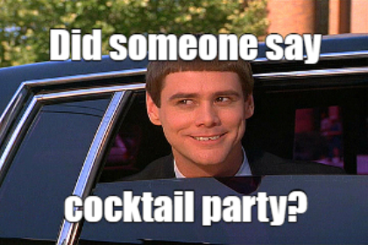

Projektanalyse – Folie 2
Project Description
Web Application for searching Cocktail-Recipes
Cocktails with specific ingredients
Random Cocktails
User registration with following features:
Creating Cocktails for other visitors
Reviewing and rating existing Cocktails
Bookmark favorite Cocktails
Moderator with following features:
Ban Users
Remove Reviews
Blacklist Cocktails
For Data we use: https://www.thecocktaildb.com/about.php
Source: https://mememaker.net/meme/cocktail-party-2645

Slide 3
Story
How it Started (The idea)
How we Separated the Work
Initial Problems
What we Learned

Slide 4
Projektanalyse – Folie 2
Technologies
Back-end:
Cocktail REST API
Django Open-source web framework (Python)
Django Open-source REST framework (Python)
SQLite3
Front-end:
jQuery a JavaScript library
Bootstrap CSS3 framework
Rater JS Widget
Tags Input Plugin
Font Awesome

Slide 5
Future Improvements
Show firstly the cocktail that matches more ingredients
Public the website online
Remove banned users Reviews
Adding a Salt for safe encryption of the user password
Search for non-alcoholic or alcoholic Cocktails
Create privacy/cookie policy for the website
Add profile picture and friend-list feature
Make Public Profile Pages
Use OAuth 2 for login
Allowing the user to edit a cocktail from the User Interface

Slide 6
Projektanalyse – Folie 2
Live-Demo
Cocktail Search Home Page

Slide 7
Questions?

Slide 8


