Slide 1
EcoLoop
Circular material systems and zero-cost digital architecture.
Swami Sant Dass Public School, Jalandhar

Slide 2
The Packaging Trap: Multi-Layer Plastics
Why standard municipal recyclers throw clean packaging straight into landfills.
The Material Reality
■ Bonded Metal & Plastic:
Chips and snack packets laminate aluminum foil between plastic film. Separating those layers is chemically difficult and commercially unprofitable.
■ 100% Landfill Destination:
Because municipal plants cannot process multi-layer packaging, almost all snack wrappers are burned or dumped into local landfills.
■ Clean Waste in Schools:
Canteens and classrooms generate sacks of clean snack wrappers daily with zero realistic collection logistics.
The EcoLoop Approach
■ Skip Separation, Heat-Compress:
Instead of separating the foil, we partner to heat-press whole wrappers into dense boards that replace plywood.
■ Unified Circular Model:
Unifying scattered school green crafts and outsourced heavy materials into one clean system.
■ Digital Transparency:
Building an online catalog so buyers can see exact specifications and request real samples.

Slide 3
The Physical Loop
Six circular products systematically diverted from school waste streams.
STUDENT-MADE
Seed Paper
Handmade plantable paper embedded with native seeds, crafted directly inside school.
STUDENT-MADE
Bioenzymes
Citrus fruit peels fermented into natural multi-purpose cleaning liquids for campus sanitation.
STUDENT-MADE
Uniform Bags
Durable everyday tote bags stitched from discarded school uniform fabrics.
STUDENT-MADE
Eco-Bricks
PET bottles tightly packed with clean plastic wrappers for modular garden walls and simple structures.
STUDENT-MADE
Bottle Planters
Upcycled beverage containers for school corridor nursery and vertical greenery installations.
BULK EXCHANGE
MLP Sheets
Heavy-duty structural boards heat-pressed by an external NGO from bulk wrapper batches.

Slide 4
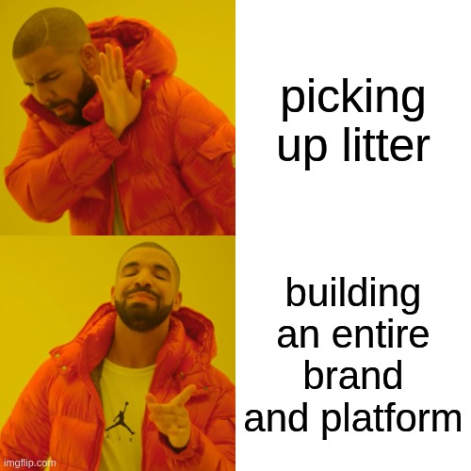
how it started vs how it's going
Student crafts and the wrapper exchange were already happening. I built the circular reinvestment loop and the digital storefront.

Slide 5
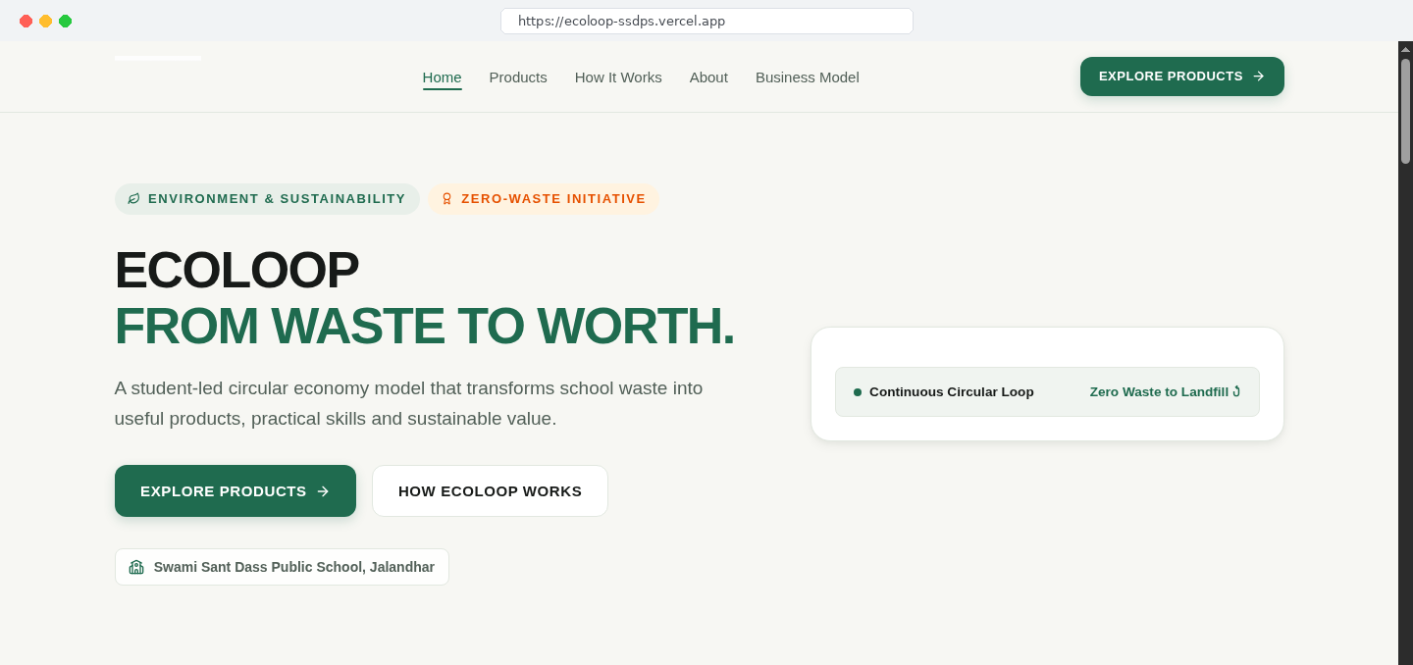
Why Build a Digital Platform?
Transforming scattered school crafts into a unified, public circular initiative.
Platform Objectives
■ Unified Public Presence:
Showcasing all circular materials and workflows in one public place so it operates as a serious initiative, not scattered classroom crafts.
■ Direct Inquiry Routing:
Giving outside people and institutions a friction-free way to contact us and request physical samples.
■ Connecting School to Outside World:
Taking activities happening inside classrooms and presenting them professionally to external organizations.

Slide 6
The Zero-Cost Backend: Built on Google Sheets
Handling live incoming inquiries without paid servers or corporate credit cards.
STEP 01
React Form
User fills in their name, product choice, and notes. The browser validates all inputs locally.
STEP 02
Apps Script Webhook
A free Google Apps Script webhook receives the data payload securely in the cloud.
STEP 03
Sheets Database
Appends the inquiry row into a live Google Sheet and immediately triggers an email alert.
Monthly Infrastructure Bill: $0.00 / month
No credit cards, zero server maintenance, and reliable for real order leads.

Slide 7
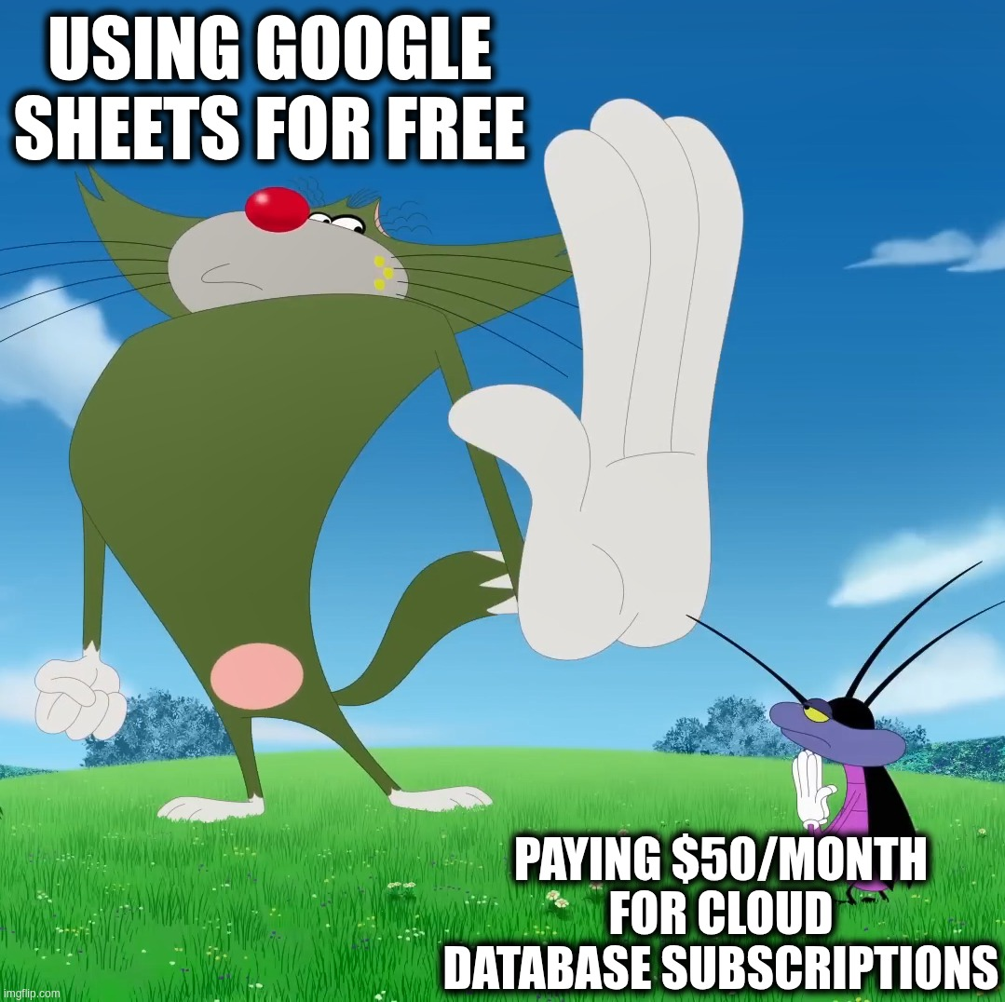
why our database bill is literally $0
Why spend monthly money on complex database servers when a free Google Sheet captures all your incoming inquiries?

Slide 8
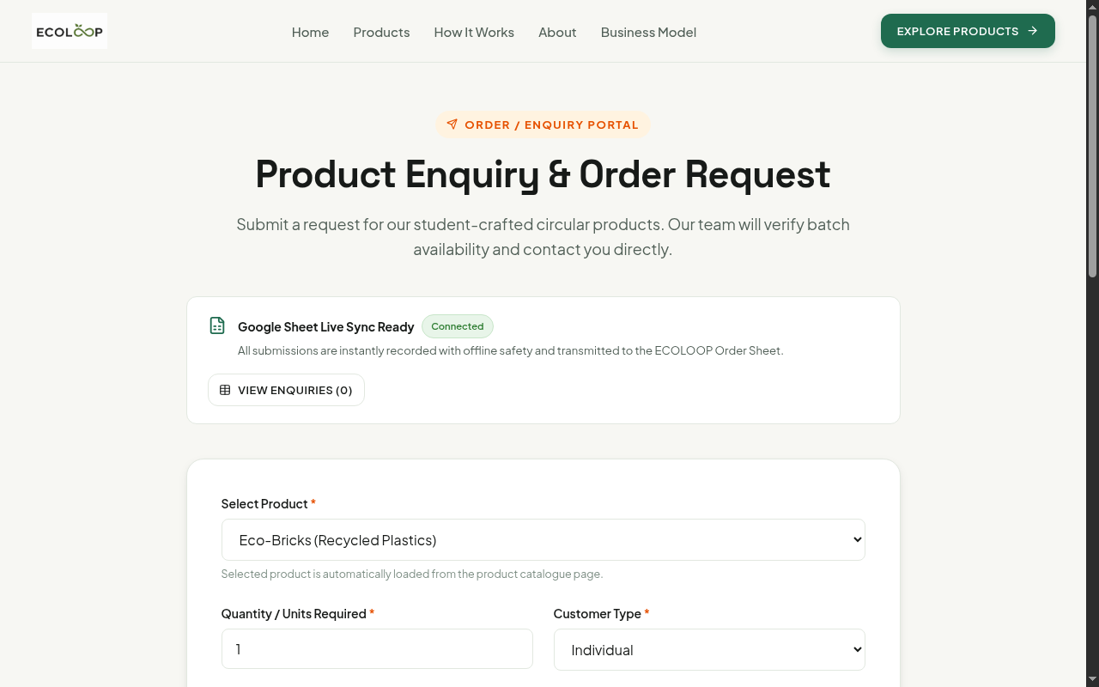
The Inquiry Engine: An Honest Review
Built in a single night sprint: functional, basic, and with plenty of room to improve.
The Reality of Our MVP
■ Built in One Night:
Put together in a single late-night sprint to give the CBSE exhibition judges a working demo to test.
■ Basic but Working:
Automatically pre-populates product details and logs records straight into our backend without paying for services.
■ Room for Improvement:
Needs automated inventory deduction, better error states, and order tracking. It's an MVP, not final software.

Slide 9
How I Built It Without Knowing React
Moving from typing boilerplate code to designing systems with AI agents.
The Traditional Hurdle
■ Syntax Friction:
Getting stuck on missing brackets, package version mismatches, and unfamiliar framework setup.
■ Hours on Forums:
Spending entire evenings digging through Stack Overflow threads instead of building real features.
■ Idea Blocked:
Giving up on software ideas simply because you haven't spent 6 months memorizing syntax.
Developer as Architect
■ Define the System Rules:
You specify the data models, visual style, and constraints in plain language.
■ Agents Write the Code:
An autonomous agent creates components, connects routes, and modifies multiple files.
■ Focus on Testing:
Your primary job becomes quality control, testing user flows, and refining the architecture.

Slide 10
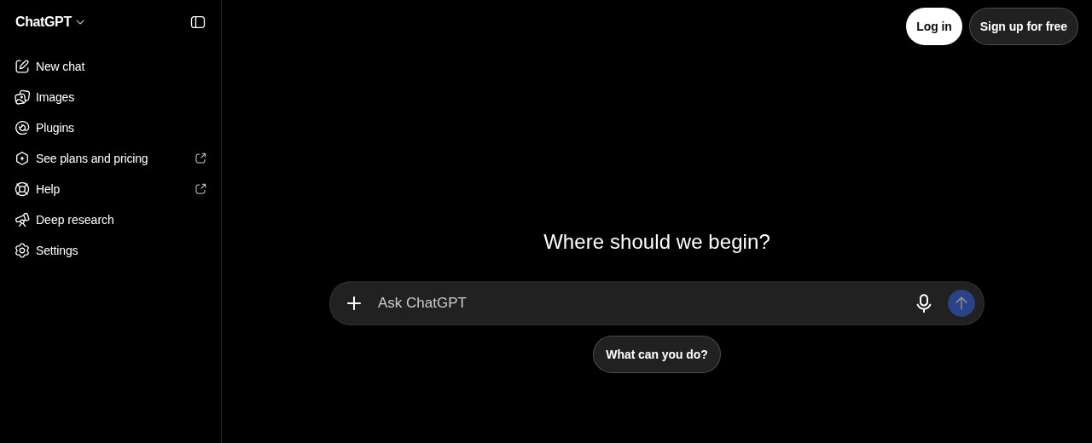
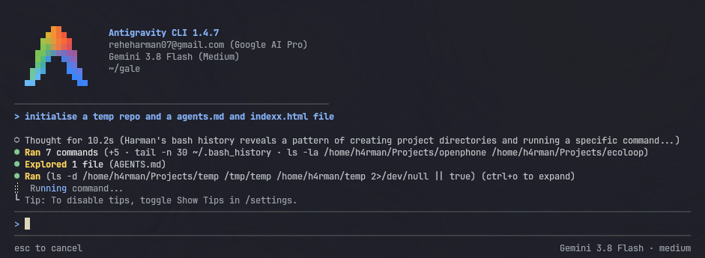
Chatbot vs Agent Workspace
The difference between copy-pasting snippets and letting an agent build inside your files.
ChatGPT: Web Chatbot (Isolated)
Antigravity: Agent Workspace (Autonomous)
■ Copy-Paste Loop:
Generates isolated snippets you must manually copy into your editor.
■ Zero File Access:
Cannot see project folders, config files, or installed dependencies.
■ Blind Execution:
Cannot run commands, view terminal errors, or test builds.
■ Direct Repository Edits:
Inspects folder context and writes multi-file modifications directly.
■ Autonomous Terminal:
Runs shell commands, dev servers, and build tests in the workspace.
■ Self-Repair Loop:
Catches compiler and runtime errors and fixes them automatically.

Slide 11
How Working with an Agent Actually Looks
A practical 4-step loop of specifying, editing, testing, and self-repairing.
STAGE 01
Write the Spec
Describe what you want in plain language: colors, component layout, and behavior rules.
STAGE 02
Agent Edits Files
The agent inspects your repository, writes components, and updates project files directly.
STAGE 03
You Test Locally
You run the app in your browser, click the buttons, and see what works or what broke.
STAGE 04
Agent Fixes Bugs
You paste the error or unexpected behavior back to the agent; it reads the log and repairs it.

Slide 12
Replicating This Workflow: OpenCode
An open-source terminal agent that gives you the same autonomous capabilities.
Why OpenCode for Students?
■ 100% Free & Open Source:
Created by Anomaly (GitHub: anomalyco/opencode). Zero subscriptions or vendor lock-in.
■ Lives in Your Terminal:
Reads your project files, edits code, and runs local commands just like specialized agent harnesses.
■ Dual Execution Modes:
Plan Mode reviews architecture safely; Build Mode executes real code changes.
// Quick Installation in 60 Seconds
$ npm install -g @opencode/cli
$ cd ./my-project
$ opencode
// Runs on macOS, Linux, and Windows WSL

Slide 13
Free AI Models: Zero Cost for Students
Practical options you can use tonight without paying for subscriptions.
Free Cloud APIs
■ Google Gemini API:
Sign in to aistudio.google.com for a free key. Generous free limits for fast coding models.
■ Groq Cloud:
Ultra-fast free inference on open models like Llama 3.3 via console.groq.com.
■ GitHub Models:
Free student access to preview models inside VS Code and GitHub Codespaces.
100% Offline with Ollama
■ Private & Local:
Download ollama.com. Runs entirely on your laptop hardware without needing internet.
■ Recommended Model:
qwen2.5-coder:7b delivers strong coding reasoning on standard student laptops.
■ Zero Latency:
Fast responses directly on your machine with complete data privacy.

Slide 14
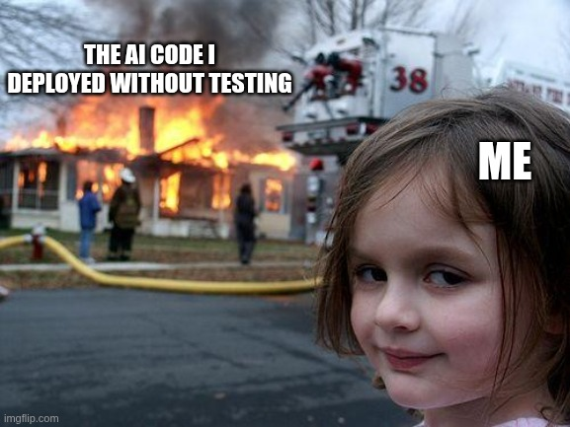
deployed without testing
Prompting is only 20% of the work. Clicking every button to see what actually broke is the other 80%.

Slide 15
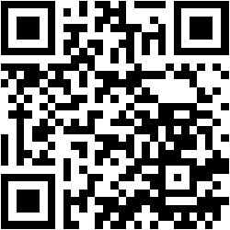
Thank You.
Scan the code to access the complete open-source repository, live demo, and student setup guide.
github.com/Harman209/ecoloop
Swami Sant Dass Public School, Jalandhar

