Slide 1
Project Presentation of CO-OP Project at Industry (Module-2) (22CS421)
On
An Implemented Blockchain-Based Framework for Healthcare Data Sharing
Rohan Kumar (2210990739) Harmanjeet Singh (2210990371)
Supervised By
Mrs. Swati Goel
Department of Computer Science and Engineering,
Chitkara University, Punjab

Slide 2

Introduction
• Healthcare generates massive sensitive patient data.
• Centralized systems face security and interoperability issues.
• Patients have limited control over Personal Health Records.
• Blockchain provides decentralization and transparency.
• Smart contracts enable secure automated access control.
• Off-chain encrypted storage improves scalability.
• Proposed framework focuses on patient-centric security.

Slide 3
Literature Review
• MedRec introduced blockchain-based EHR access control.
• MeDShare enabled decentralized medical cloud sharing.
• Privacy-preserving healthcare systems used encryption techniques.
• OmniPHR proposed decentralized patient-controlled records.
• Existing systems still face scalability and privacy challenges.

Slide 4
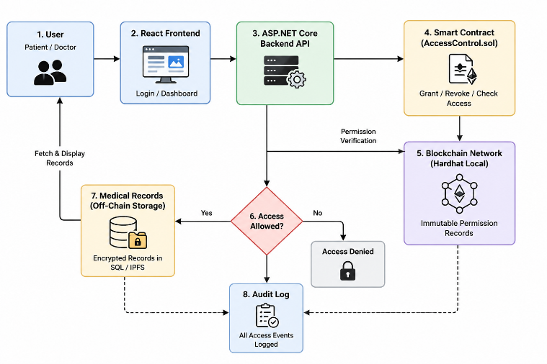
Methodology
• Design Science Research methodology adopted.
• Literature review conducted for 2017–2024 studies.
• Comparative analysis of blockchain healthcare models.
• Requirement-driven framework architecture designed.
• Solidity smart contracts developed and simulated.
• Security evaluated using STRIDE threat modeling.
Fig 1: Workflow

Slide 5
Proposed Framework
• Three-layer blockchain healthcare architecture proposed.
• Storage Layer uses AES-256 encrypted IPFS storage.
• Access Control Layer uses Ethereum smart contracts.
• Application Layer provides patient-facing apps.
• Patients can grant and revoke permissions.
• Emergency access supported using Shamir Secret Sharing.

Slide 6
Smart Contract Design
• Solidity smart contracts manage healthcare permissions.
• grantAccess() and revokeAccess() control access rights.
• Immutable audit logs stored on blockchain.
• Event-driven secure key delivery implemented.
• Mapping structures optimize gas and lookup efficiency.

Slide 7
Security Analysis
• AES-256 encryption ensures confidentiality.
• Blockchain hashes maintain data integrity.
• Digital signatures ensure authentication.
• Immutable audit logs provide non-repudiation.
• Consortium blockchain reduces 51% attack risks.
• IPFS improves distributed availability.

Slide 8
Performance Evaluation
• Proposed framework achieved 80–120 TPS.
• Access latency reduced to 1–2 seconds.
• Full patient control and auditability achieved.
• Higher privacy compared to centralized systems.
• Framework suitable for healthcare deployment.

Slide 9
Conclusion
Blockchain improves healthcare data security and transparency.
Patient-centric framework enhances privacy and control.
Smart contracts automate secure access management.
Off-chain storage improves scalability and efficiency.
Consortium blockchain ensures better performance and trust.
Emergency access protocol solves critical healthcare issues.
Framework provides strong auditability and interoperability.
Future work includes deployment and Layer-2 scaling.

Slide 10
References
Azaria et al. – MedRec
Xia et al. – MeDShare
Gordon & Catalini – Blockchain Healthcare
Roehrs et al. – OmniPHR
Nakamoto – Bitcoin
Buterin – Ethereum
IEEE / ACM / PubMed Research Papers

Slide 11
Thank You

