Slide 1
Brain tumor segmentation
Using U-Net
Submitted by - Harmandeep Kaur (UE203046) CSE 2nd year

Slide 2
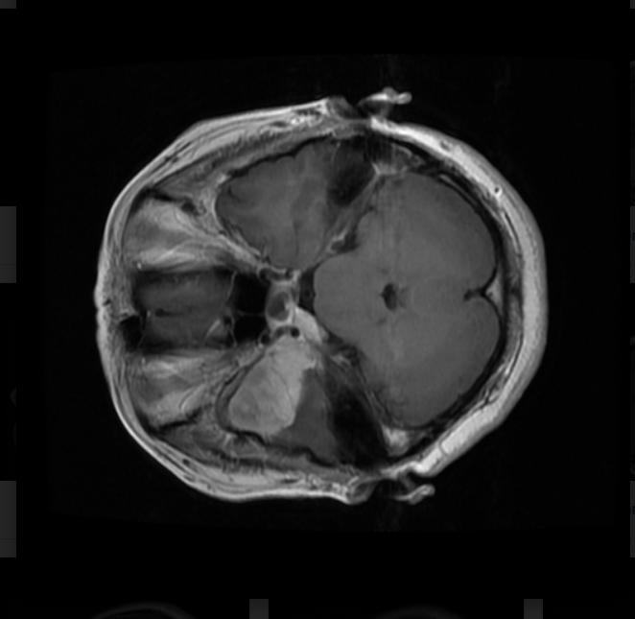
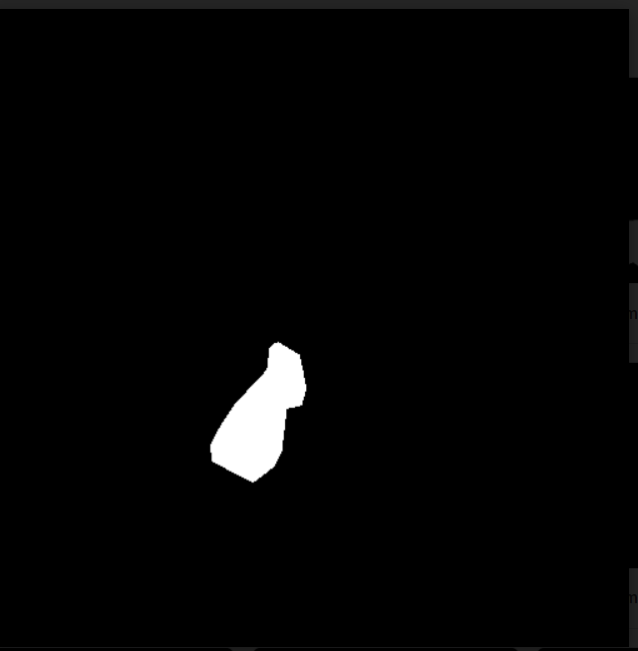
DATASET
Dataset used contains images of brain and masks of each image representing the tumor region.
Image
Mask

Slide 3
Libraries used
Numpy
Pandas
Os
Matplotlib
Keras
Scikit-learn
tqdm

Slide 4
METHODOLOGY : U-Net
Input image
Contracting path
Expansive path
Output

Slide 5
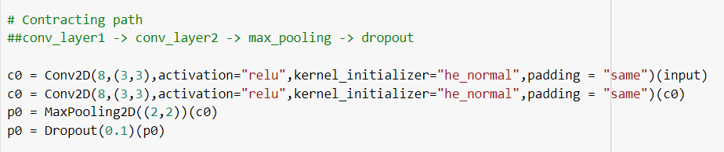
CONTRACTING PATH
2 convolutional layers (Downsampling )
Activation function -> ReLU
Kernel_initializer -> he_normal
Padding -> same
Max pooling layer
Dropout layer

Slide 6
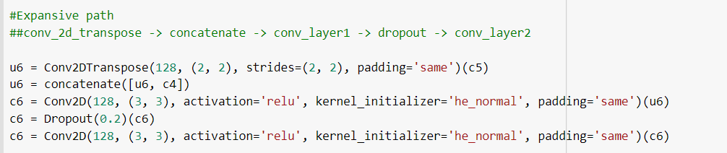
EXPANSIVE PATH
Transpose convolutional layer (Upsampling)
Stride -> (2,2)
Padding -> same
Concatenation layer
2 convolutional layers
Activation function-> Relu
Padding -> same
Dropout layer

Slide 7

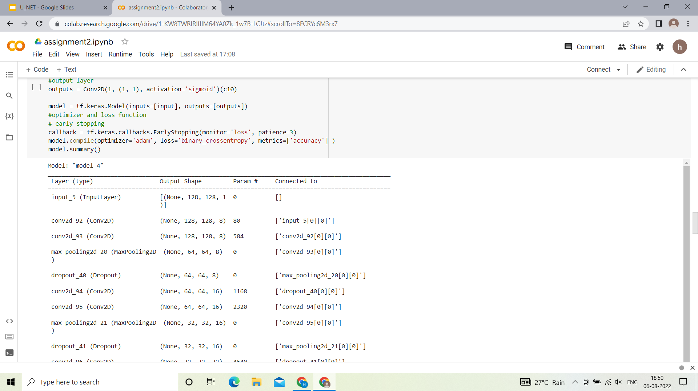
Other concepts used:
Early stopping
-> Early stopping is a method that allows you to specify an arbitrary large number of training epochs and stop training once the model performance stops improving on a hold out validation dataset.

Slide 8
Optimizer (ADAM)
Adam optimization is a stochastic gradient descent method that is based on adaptive estimation of first-order and second-order moments.
Loss (Binary_crossentropy)
Binary Cross Entropy is the negative average of the log of corrected predicted probabilities.
Binary cross entropy compares each of the predicted probabilities to actual class output then calculates the score that penalizes the probabilities based on the distance from the expected value.
Metrics (Accuracy)
This metric creates two local variables, total and count that are used to compute the frequency with which y_pred matches y_true

Slide 9
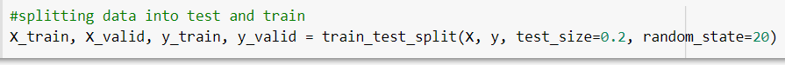
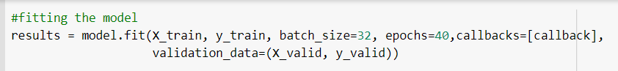
Splitting data (train and test)
Fitting of model
Batch size = 32
Epochs used = 50
Callbacks for Early stopping
Validating data

Slide 10
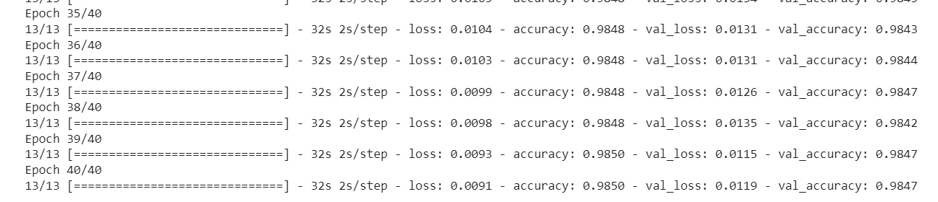
OUTPUT :
Accuracy : 0.9850
Loss : 0.0091
Val_accuracy : 0.9847
Val_loss: 0.0119
FINAL
RESULTS :

Slide 11
Results (with different split ratios and epochs)
Split ratio | Batch size | Epochs | Accuracy
80,20 | 32 | 20 30 | 98.37 98.51
70 ,30 | 32 | 20 30 | 98.18 98.29

Slide 12
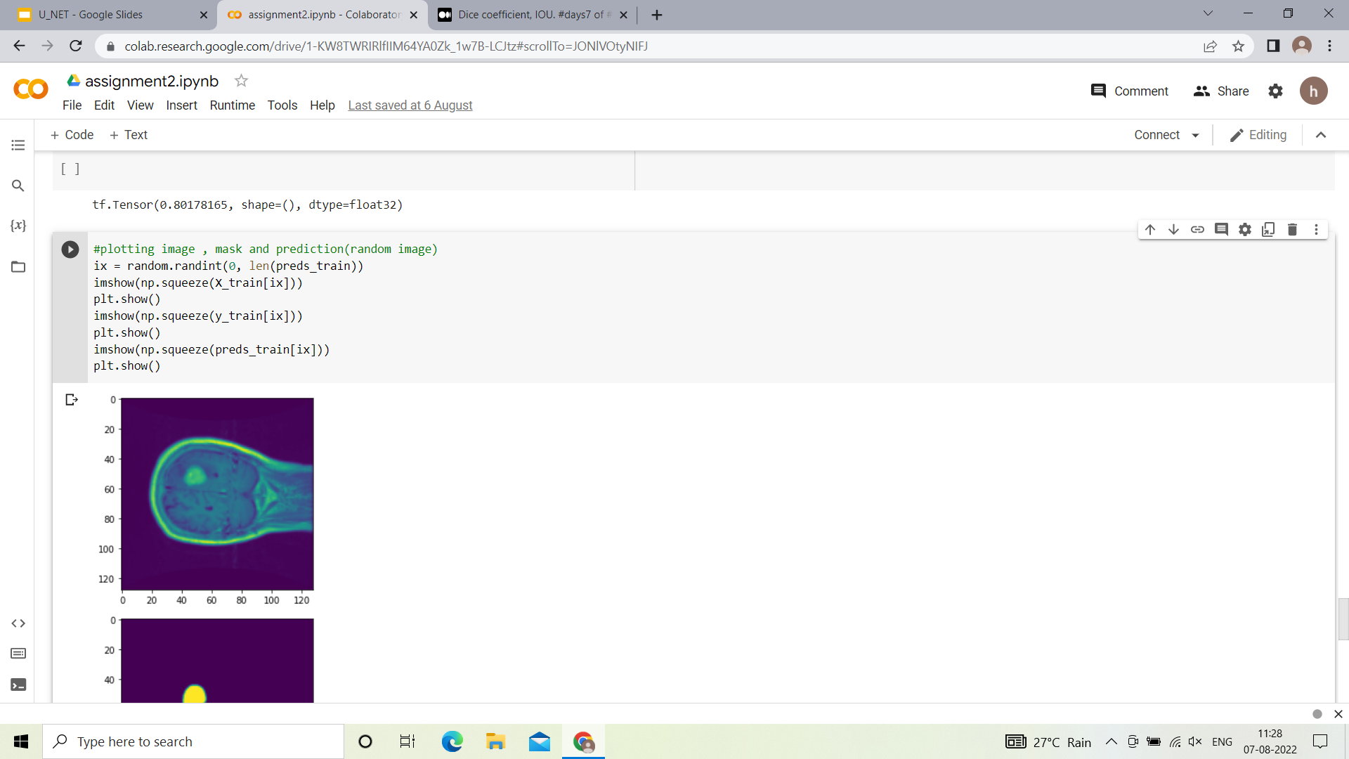
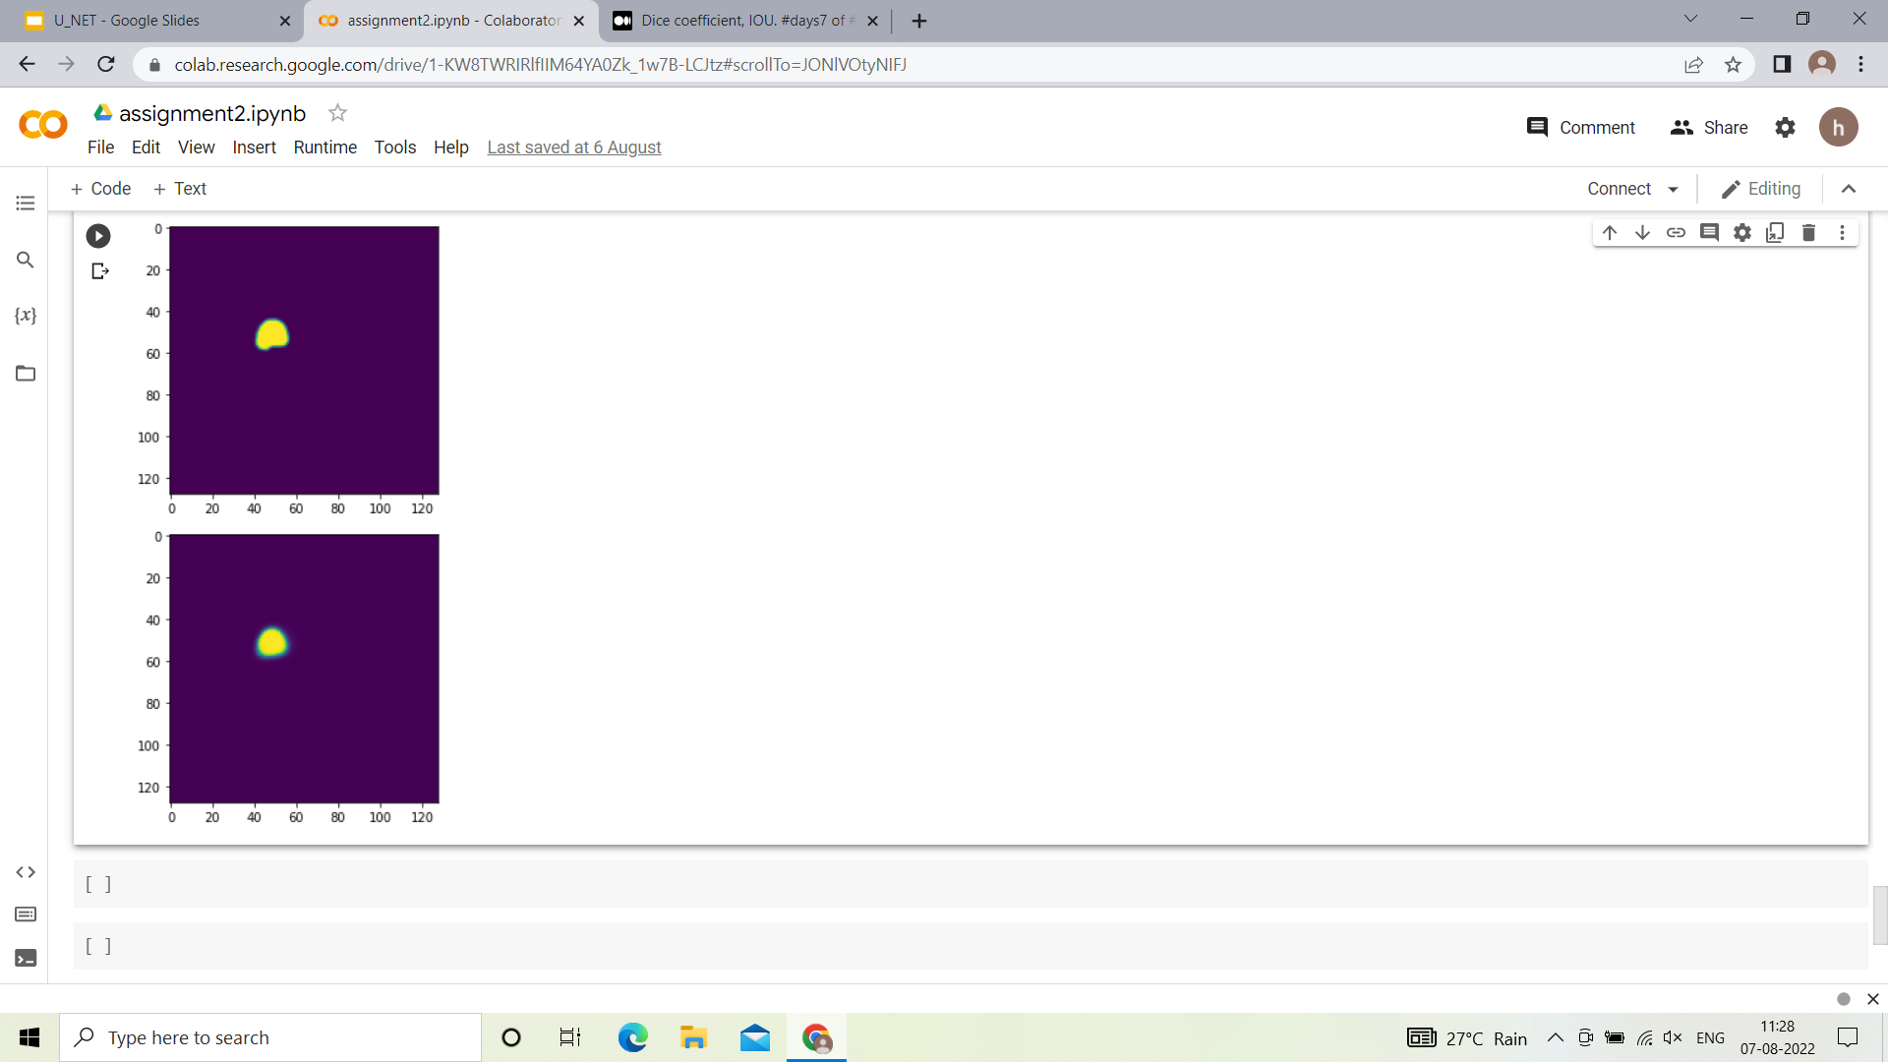
Plotting image, mask and prediction of model
Code :
Image
Mask
Prediction

Slide 13

THANK
YOU

