Slide 1

Rabbit: Your New Favorite E-Commerce Destination
Welcome to Rabbit, the e-commerce platform that's revolutionizing online clothing shopping. We address the challenges of finding the perfect fit and style with a personalized, easy-to-use experience. Discover how Rabbit can transform the way you shop.

Slide 2

Core Features: Shop by Size, Color, & Quantity
Find your perfect fit, every time. Rabbit offers extensive filtering options to narrow down your search. Benefit from real-time inventory updates, so you always know what's in stock.
Size Filtering
Color Selection
Quantity Control
Shop by your exact size for guaranteed fit.
Find items in your favorite colors easily.
Order exactly what you need, no more, no less.

Slide 3
Gender-Specific Sections: Tailored Shopping Experiences
Rabbit provides dedicated sections for men's and women's clothing. Enjoy curated collections and personalized recommendations. Discover an enhanced browsing experience designed just for you.
For Men
For Women
Explore the latest trends and classic styles.
Discover unique pieces and essential wardrobe staples.
Shirts
Dresses
Pants
Tops
Accessories
Shoes

Slide 4




Robust Backend APIs & Routing
Rabbit utilizes a scalable architecture for handling high traffic. Our RESTful APIs ensure seamless data flow. Experience efficient routing for optimal performance, powered by Node.js and Express.
Scalable APIs
Handles increased traffic seamlessly.
Efficient Routing
Ensures fast page loads.
Data Flow
Optimized for quick retrieval.

Slide 5
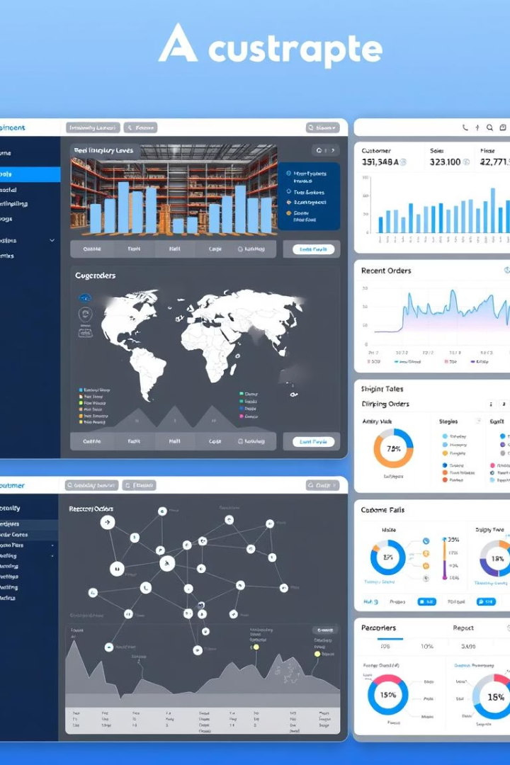



Admin Panel: Streamlined Management
Easily manage inventory, orders, and customers with Rabbit's admin panel. Generate insightful reports and analytics. Take control of marketing campaigns and promotions.
Inventory Management
Order Management
Track and update product stock levels.
Process and fulfill customer orders efficiently.
Customer Management
View and manage customer profiles and data.

Slide 6






Secure Payment Gateway Integration
Rabbit partners with leading payment providers. Enjoy secure transactions using advanced encryption. We support multiple payment methods, including credit cards and PayPal.
Credit Cards
Accepts all major cards.
Encryption
Protects sensitive data.
PayPal
Offers secure checkout.

Slide 7



MySQL Database: Reliable & Scalable Data Storage
Rabbit utilizes a MySQL database for organized data management. Benefit from efficient querying and retrieval. The database is scalable to accommodate a growing product catalog and user base.
Organized Data
Structured for easy access.
Efficient Retrieval
Quickly find what you need.
Scalable
Grows with your business.

Slide 8
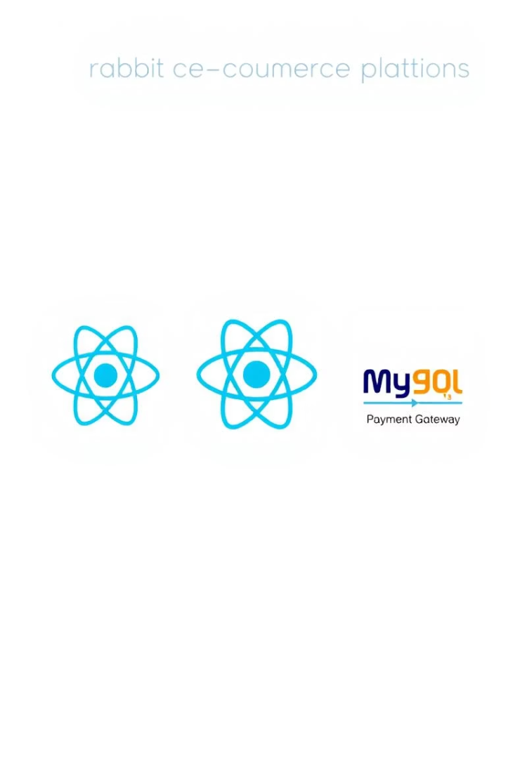




Technology Stack Overview
Rabbit is built on a robust technology stack for optimal performance.
Frontend: React.js
Backend: Node.js
Database: MySQL
Payment: Stripe/PayPal

Slide 9






Future Enhancements & Growth
Rabbit is committed to continuous improvement and growth.
AI Recommendations
Mobile Apps
New Categories
Anticipate AI-powered personalized recommendations for a smarter shopping experience. We will also develop mobile apps for both iOS and Android. Finally, we will expand into new product categories to offer more variety.

