Slide 1

CLASSIFICATION MODEL
By: Harman Kaur

Slide 2
INTRODUCTION
“What is likelihood of an individual involved in crime will be arrested based on certain factors such as the type of crime, location, time of the day, and demographic information?”
Significance: By predicting the likelihood of arrests for individuals in reported crimes, law enforcement agencies can focus their resources more efficiently, focusing on the cases with a higher probability of leading to arrests.
It can also help in predicting individuals who are at higher risk of being arrested.

Slide 3
Classification Model Overview
A supervised learning algorithm used to categorize data into predefined classes or labels.
In my use case, I received the output of the binary classification model evaluation with their probabilities i.e., True or False.
For example: For Narcotic crime type the prediction is { "class": "True", "logs": “null“ probability": { "False": 0.0004416557, "True": 0.9995583443 }
The class indicates the predicted class which corresponds to prediction of an arrest.

Slide 4
Classification Model Continued
Probability: It is the probability assigned my model to each class. In binary there two class.
The model assigned a probability of approximately 0.0004 to the class ‘false’ (not arrested) and a probability of 0.9996 to the class True (arrested).
So, we can infer that an individual will get arrested for the engaging in narcotic crimes.

Slide 5
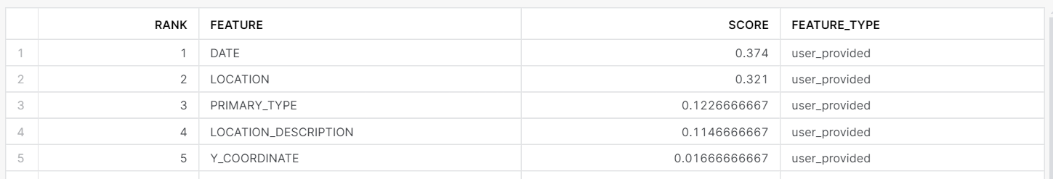
Feature Importance
A feature ranking table was generated from a feature importance analysis.
Date has the highest score indicating it significantly affects the likelihood of a person getting arrested.
Location comes on second position meaning certain areas have higher rates of crime.
The type of crime in also important in predicting the occurrence of arrest.
Location description also contributes to the arrest.

Slide 6
Findings
I searched the location for the some of the crimes where likelihood of getting arrested was higher and most of them had the same zip code 60651.
This area has been graded as F for overall crime grade which means crime rate is higher.
Therefore, it goes with the model’s prediction that location is important in predicting arrests.

Slide 7
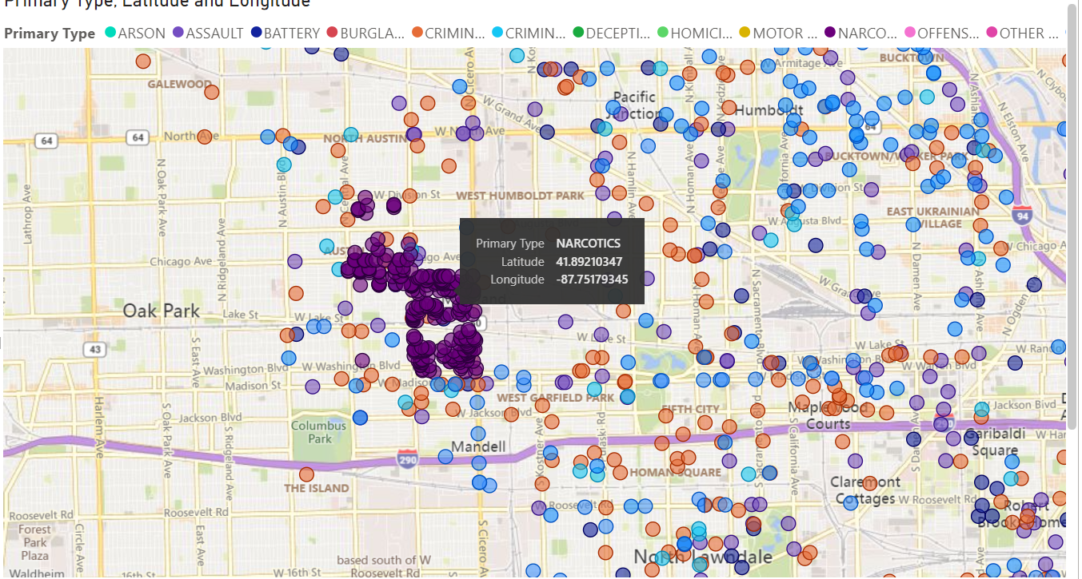
Spatial Analysis

Slide 8
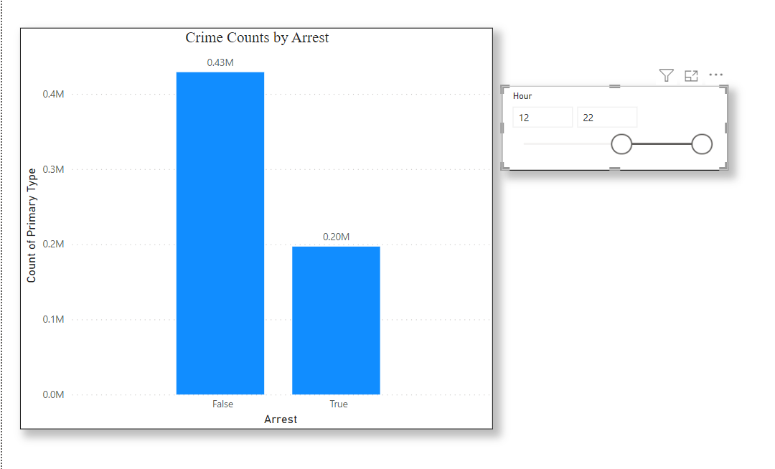
Findings Continued
This is power BI analysis which calculates the total arrets based on time.
The most arrests were made during the 12 pm to 10 pm.
So, this further goes with our prediction that arrests depends upon date/time.
Because count of arrests made prior to this time window were comparatively lower.

Slide 9
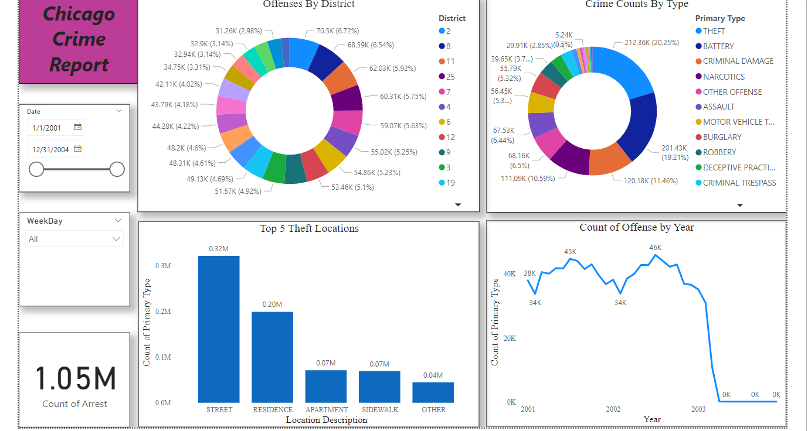
Data Visualizations

