Slide 1
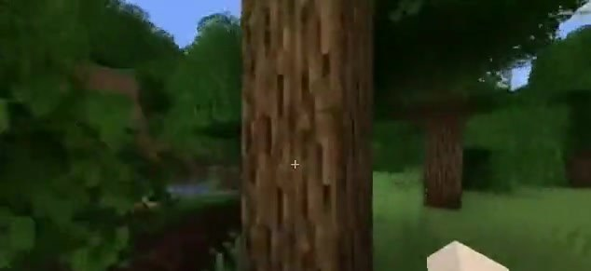
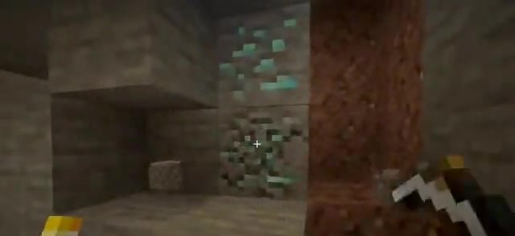
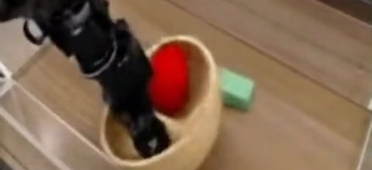
PAPER DEEP DIVE · ARXIV 2509.24527
Dreamer 4
Training Agents Inside of
Scalable World Models
Danijar Hafner*, Wilson Yan*, Timothy Lillicrap — Google DeepMind
29 September 2025 · danijar.com/project/dreamer4
Presenter ____________ Date ____________ ~45–60 min incl. discussion
Right: frames generated by the Dreamer 4 world model — an imagined rollout, a human playing inside the model, and the robot-arm model.
Notes:
Welcome. This is a deep dive into Dreamer 4, the September 2025 DeepMind paper by Danijar Hafner, Wilson Yan and Tim Lillicrap. Headline: an agent that learns to obtain diamonds in Minecraft purely from offline video, by training inside a learned world model that runs in real time on a single GPU. The three frames on the right are all generated by the world model: an imagined training rollout, a human play-testing session, and the robot-arm model.

Slide 2
Agenda
01
Background
why world models, what made scaling them hard, the offline diamond challenge
HOW TO READ THIS DECK
Equations are kept to the minimum needed for intuition; the appendix has the exact settings.
Every number is from the paper's tables (Table 1, 2, 7, 8) or the authors' talks — sources are on each slide.
Figures © the authors (arXiv 2509.24527 / danijar.com), reproduced for discussion.
Suggested pacing: Parts 1–2 ≈ 25 min, Part 3 ≈ 15 min, Part 4 ≈ 10 min + Q&A.
02
Method
tokenizer, dynamics transformer, shortcut forcing, agent tokens, imagination training (PMPO)
03
Experiments
real-time human play-testing, diamond challenge, ablations, learning from unlabeled video, robotics
04
Discussion
limitations, critical reading, future work, takeaways
05
Appendix
hyper-parameters, full tables, glossary
Dreamer 4 · Hafner, Yan, Lillicrap (Google DeepMind) · arXiv 2509.24527
2
Notes:
Four parts plus an appendix. For a mixed audience I'll spend most time on the method intuition and on what the experiments do and do not show.

Slide 3
Dreamer 4 in one slide
What the paper claims, and the evidence behind each claim
Claim | Evidence in the paper
First agent to obtain diamonds in Minecraft from offline data only | 0.7 % of 1,000 × 60-min episodes reach a diamond; 29 % reach an iron pickaxe (vs 11 % for a Gemma-3 VLA, 0.6 % for BC) — Table 7
A world model that simulates Minecraft object interactions and menus accurately, in real time on 1 GPU | Human play-testers solve 14/16 interaction tasks inside it at 21 FPS with a 9.6 s context (Oasis: 5/16, Lucid-v1: 0/16) — Table 1
Shortcut forcing + an efficient transformer make this fast | 4 sampling steps instead of 16–64; FVD 306 → 57 across the design cascade while going from 0.8 to 21 FPS — Table 2, Fig. 8
Action conditioning can be learned from few labels | 100 h of labeled actions ≈ 85 % PSNR / 100 % SSIM of using all 2,541 h; actions transfer to Nether/End seen only unlabeled — Fig. 7
~100× less data than VPT, no environment interaction | 2,541 h contractor video vs VPT's 270 K h web video + online RL — Table 3
Dreamer 4 · Hafner, Yan, Lillicrap (Google DeepMind) · arXiv 2509.24527
3
Notes:
If you remember one slide, it's this one. Five claims, each tied to a table or figure. Note the honesty in the numbers: diamonds are rare (0.7 %), but every earlier milestone is reached far more reliably and faster than by the baselines, all without a single environment step.

Slide 4
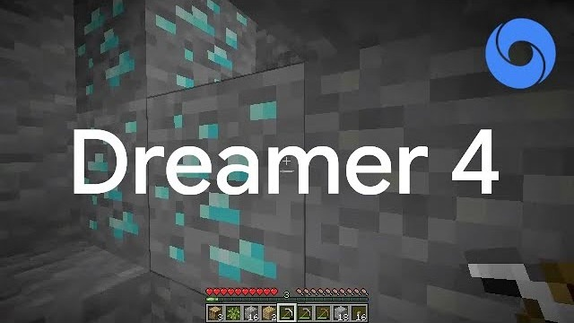

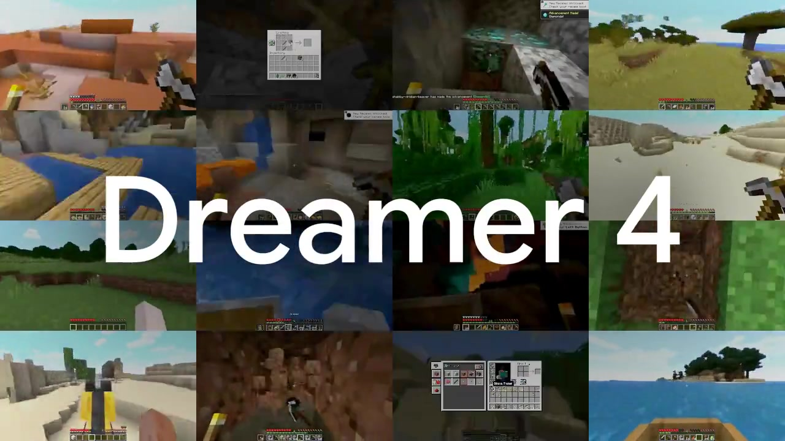
The paper in three minutes: the official video
'Dreamer 4 | Diamonds from Offline Experience' — Danijar Hafner's channel, 1 Oct 2025, 2:55. In effect Figure 1 in motion
Scan to watch on your own device
2:55 · uploaded 1 Oct 2025
YouTube channel @danijar (Danijar Hafner)
Description: 'the first agent to mine diamonds learning entirely offline'
WHAT TO WATCH FOR
The imagined training rollouts of Figure 1 in motion — chopping, crafting menus, mining, cave lighting, diamond ore — decoded from latents for viewing
The headline it builds up to: diamonds from 2,541 h of offline video, no environment interaction
NO INTERNET? EMBEDDED 10-S TEASER — CLICK TO PLAY
▶ Click the picture to open the video on YouTube (internet required): youtube.com/watch?v=oDlBtTcX0g0
Project page: 60 more clips (imagination rollouts, 17 interaction tasks × 3 models, robot arm) — danijar.com/project/dreamer4
Dreamer 4 · Hafner, Yan, Lillicrap (Google DeepMind) · arXiv 2509.24527
4
Notes:
Play the official video here (2:55) — or, if the room has no internet, the embedded ten-second teaser on the right. The video is essentially Figure 1 in motion: imagined rollouts decoded for visualisation, building up to the headline claim. Say it explicitly: what you see there is generated by the world model, not recorded gameplay. The four uncut 60-minute evaluation episodes on the same channel show the trained agent in the real game (linked on the results slide). YouTube does not allow downloading, so the deck only links to the video; the teaser and the 60 project-page clips are archived in dreamer4_resources/media/. If you prefer to show the video later, the natural spot is the Figure 1 slide in Part 3.

Slide 5
01
PART 1
Background & motivation
World models, learning in imagination, and why Minecraft from offline data is a hard test
5

Slide 6
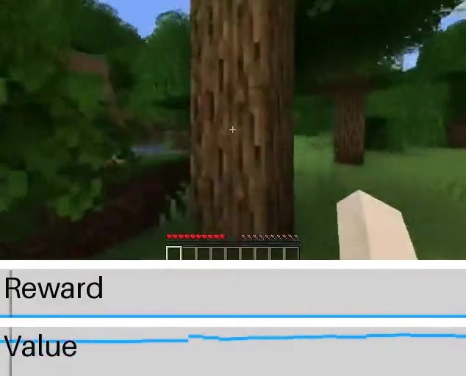
Why world models? Learning in imagination
The Dreamer lineage: same idea, increasingly capable simulators
World model: a learned simulator that predicts what happens next given the current situation and an action
Imagination training: the policy is optimised on rollouts generated by the model, not by the real environment — cheap, parallel, safe
Why it matters now: robots and other real-world systems cannot afford millions of trial-and-error interactions; video on the internet is abundant
Dreamer 4's bet: if the simulator is accurate enough about object interactions, RL inside it can go beyond what pure imitation learns
Imagined rollout decoded for visualisation, with the agent's reward and value estimates (project page, 'Gather wood').
Dreamer (2019)
latent imagination on DM Control
DreamerV2 (2020)
discrete latents, Atari
DreamerV3 (2023/Nature 2025)
one config for 150+ tasks; diamonds with online RL
Dreamer 4 (2025)
transformer diffusion WM; diamonds offline; real-time on 1 GPU
Dreamer 4 · Hafner, Yan, Lillicrap (Google DeepMind) · arXiv 2509.24527
PART 1 · BACKGROUND & MOTIVATION
6
Notes:
The core idea has been constant since the first Dreamer in 2019: learn a model of the environment, then train the policy on imagined trajectories. What changed in Dreamer 4 is the simulator: a 2-billion-parameter block-causal transformer trained with a diffusion-style objective, accurate enough that a human can play inside it. The frame on the right is an imagined rollout, not the real game.

Slide 7
What made scalable world models hard before
Three requirements pulled in different directions
01
02
03
Fidelity of interactions
Speed
Memory & drift
Video generators look good but get game mechanics wrong: inventories, crafting menus, breaking blocks, placing a boat and riding it.
Prior Minecraft world models (Oasis, Lucid-v1, MineWorld) fail most such tasks.
Imagination RL needs millions of generated frames — and a human tester needs ≥ 20 FPS.
Diffusion transformers spend tens of denoising steps per frame: 0.8 FPS for the baseline in this paper.
Autoregressive video drifts: small errors feed back into the context.
Short contexts (1–2 s in prior models) forget what is behind the player.
Dreamer 3's RSSM is fast (~1,000× faster than a diffusion transformer) but operates at 64×64 pixels and needed abstract inventory state and crafting actions — not raw mouse & keyboard
Dreamer 4's answer: a diffusion transformer that needs only 4 sampling steps (shortcut forcing), an architecture tuned for long context at low cost, and training tricks that keep long rollouts stable (x-prediction, noised context)
Dreamer 4 · Hafner, Yan, Lillicrap (Google DeepMind) · arXiv 2509.24527
PART 1 · BACKGROUND & MOTIVATION
7
Notes:
Three tensions: fidelity versus speed versus stability over long horizons. Prior Minecraft world models chose speed and looked plausible, but a human trying to craft a pickaxe inside them fails. The recurrent Dreamer 3 model was fast but low-resolution and relied on privileged state. Dreamer 4 tries to get all three at once.

Slide 8
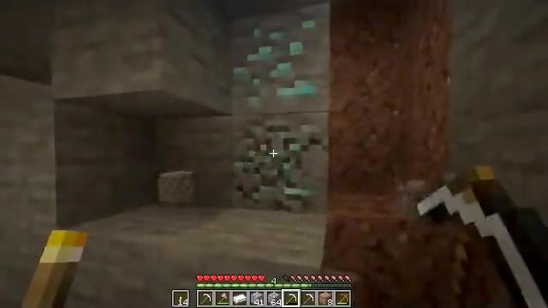
The test bed: the offline diamond challenge
No environment interaction at all — learn everything from 2,541 hours of human gameplay video
Data: OpenAI VPT contractor recordings (subsets 6–10), 2,541 h at 360×640, 20 FPS, with mouse & keyboard labels; 90/10 train/eval split by 5-minute chunk
Actions: 23 binary keys + 121-way mouse class (11×11 foveated bins, VPT convention) — no abstract 'craft' actions
Evaluation: 1,000 fresh random worlds, empty inventory, 60 min each (72,000 actions at 20 FPS); a fixed prompt sequence walks the agent through the 12-item tech tree
Why it is hard: diamonds sit ~24,000 actions deep for a human; rewards are sparse; offline data covers the late tech tree thinly; every skill (chop → craft → mine → smelt) must chain without a single trial in the real game
Baselines, all on the same data: VPT fine-tuned, BC, BC without task input, a VLA built on Gemma 3, and 'WM + BC' (Dreamer 4 without imagination RL)
Diamond ore, as simulated by the world model during a human 'mine diamonds' session (project page).
THE 12 MILESTONES (TABLE 5)
log → planks → crafting table → stick → wooden pickaxe → cobblestone → stone pickaxe → iron ore → furnace → iron ingot → iron pickaxe → diamond
Dreamer 4 · Hafner, Yan, Lillicrap (Google DeepMind) · arXiv 2509.24527
PART 1 · BACKGROUND & MOTIVATION
8
Notes:
Offline means offline: the agent never touches Minecraft during training. The only signal is human gameplay video with logged inputs. Diamonds need a long chain of subgoals, each executed with raw mouse and keyboard at 20 Hz. That is why success rates fall off steeply along the tech tree for every method.

Slide 9
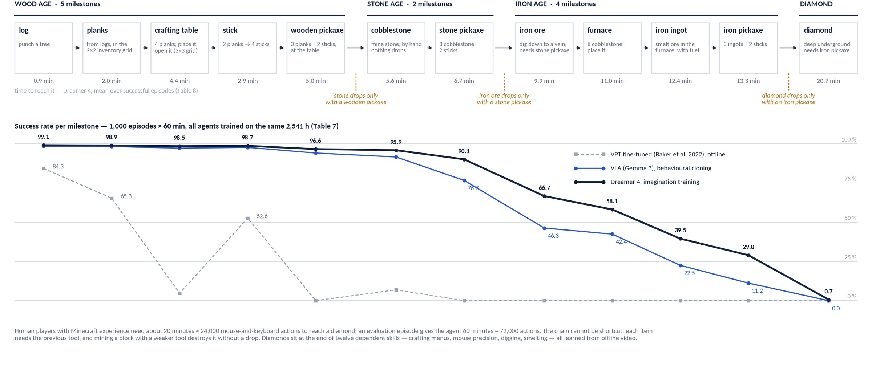
The tech tree: twelve milestones, three tool gates
Why diamonds are a long-horizon problem — and where each agent falls off (Tables 7 and 8)
Dreamer 4 · Hafner, Yan, Lillicrap (Google DeepMind) · arXiv 2509.24527
PART 1 · BACKGROUND & MOTIVATION
9
Notes:
The whole challenge on one picture. Top row: the twelve milestone items in the order the evaluation prompts them, grouped into wood, stone and iron ages and the diamond. The amber gates are game rules, not choices: stone only drops if you hold a wooden pickaxe, iron ore needs a stone pickaxe, diamonds need an iron pickaxe — mining with a weaker tool destroys the block. So there is no shortcut; every item depends on the previous tool, and each step is a different skill: punching, menu navigation with the mouse, placing blocks, digging, smelting. The minutes under the boxes are Dreamer 4's mean time to each item over successful episodes, Table 8: about 13 minutes to the iron pickaxe, 21 to a diamond — humans take about 20. Bottom: success rates from Table 7. Every agent nails the wood age; VPT's offline policy already dies at the wooden pickaxe; the Gemma-3 VLA and Dreamer 4 separate from the stone pickaxe on, and the gap grows with the horizon: 29 versus 11 percent at the iron pickaxe, and only Dreamer 4 ever reaches a diamond. Keep this curve in mind — Part 3 asks where the gap comes from.

Slide 10
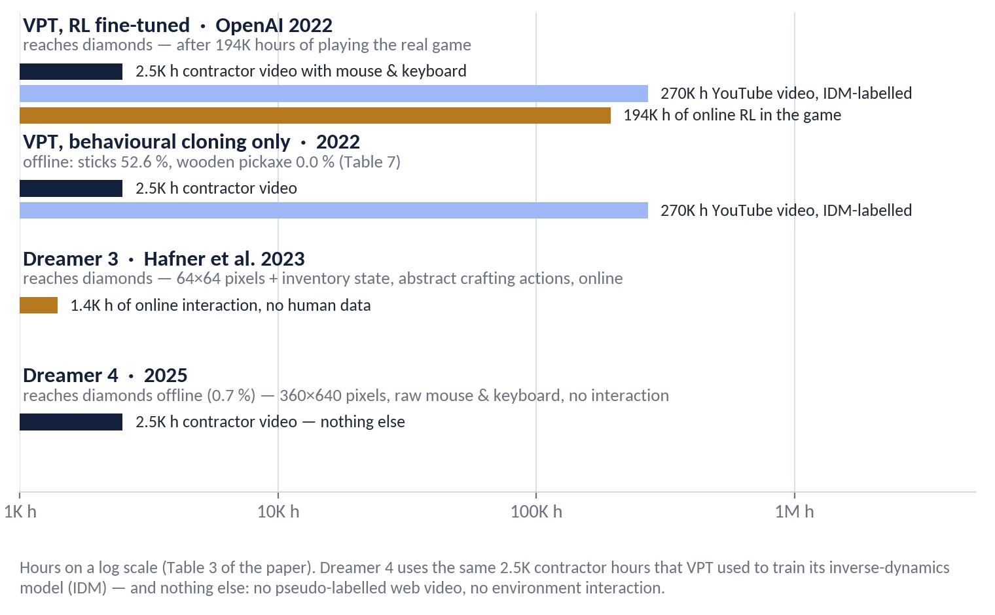
Who reached diamonds before, and what it cost
Table 3: same goal, very different regimes — hours of data and interaction behind each agent
VPT (OPENAI, 2022)
Showed that web video plus an inverse-dynamics model can bootstrap a mouse-and-keyboard policy — but diamonds still took 194K hours of trial and error in the live game, and the pure behavioural-cloning variant never crafts a wooden pickaxe offline.
DREAMER 3 (2023)
Reached diamonds from scratch by online RL inside a small recurrent world model — at 64×64 pixels, with inventory state as input and abstract crafting actions instead of mouse clicks in menus.
DREAMER 4'S BET
Keep the human interface (360×640 pixels, raw mouse & keyboard), drop environment interaction entirely, and get the missing experience from imagination instead of the game — 100× less data than the keyboard-and-mouse agents before it (Table 3 caption).
Dreamer 4 · Hafner, Yan, Lillicrap (Google DeepMind) · arXiv 2509.24527
PART 1 · BACKGROUND & MOTIVATION
10
Notes:
Historical context, with the hours on a log scale because they span three orders of magnitude. VPT is the closest relative: same contractor data, same action space. It got to diamonds, but only after pseudo-labelling 270 thousand hours of YouTube and then playing the real game for 194 thousand hours of RL; its offline-only version is the grey line that collapsed on the previous slide. Dreamer 3 got there with far less experience, but it changed the problem: tiny images, privileged inventory state, and crafting as an abstract action rather than a sequence of mouse movements in a menu. Dreamer 4 keeps the hard interface and removes the interaction. That is the claim in the title of the paper, and it is why the number to remember is not 0.7 percent diamonds but zero hours in the game.

Slide 11
02
PART 2
Method
One transformer, three phases: world-model pretraining → agent fine-tuning → imagination training
11

Slide 12
Overview: three phases, one transformer
Algorithm 1 in the paper
Phase 1
→
Phase 2
→
Phase 3
World-model pretraining
Agent fine-tuning
Imagination training
Train the causal tokenizer (masked autoencoding), then freeze it
Train the interactive dynamics model on tokenized video ± actions with shortcut forcing
Inputs: all 2,541 h, labeled or not
Insert agent tokens with task embedding; add policy & reward heads
Behavioural cloning with multi-token prediction (L = 8) on task-relevant data
Dynamics loss continues on uniform data so the model stays honest
Freeze the transformer; train policy + value heads only
Roll out the policy inside the world model, reward from the learned reward head
PMPO with reverse-KL to the frozen BC policy; γ = 0.997
Key design choice: the same block-causal transformer serves as tokenizer, dynamics model and agent backbone; policy and value are tiny heads on 'agent tokens'
Data mix in phases 2–3: 50 % uniform sequences / 50 % task-relevant; BC loss only on relevant data, dynamics loss only on uniform data ('to avoid optimistic generations')
Dreamer 4 · Hafner, Yan, Lillicrap (Google DeepMind) · arXiv 2509.24527
PART 2 · METHOD
12
Notes:
Three phases. First a world model is trained on all video. Second, agent tokens and heads are added and trained by behavioural cloning while the dynamics loss keeps running. Third, the transformer is frozen and only the policy and value heads are trained by RL on imagined rollouts. Keeping the dynamics loss on uniform data rather than task-relevant data is a small but deliberate choice to avoid a world model that is optimistic about task success.

Slide 13
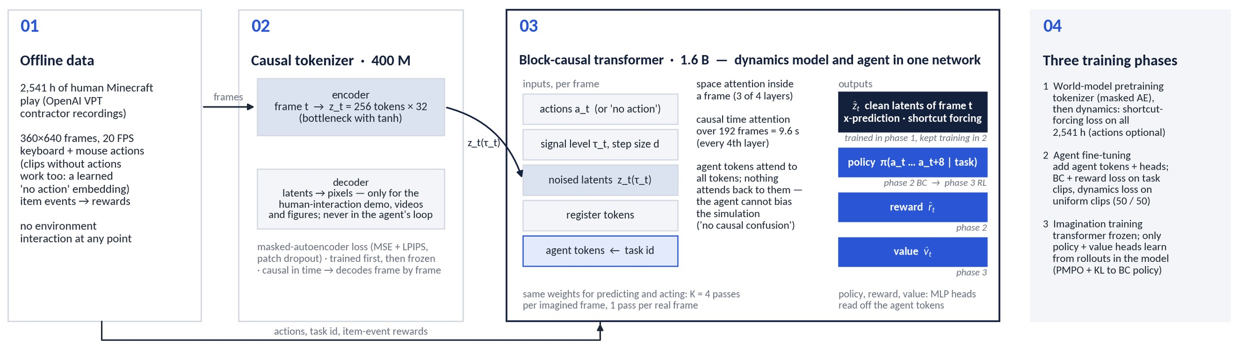
How the pieces fit together (1/2): data → tokenizer → one transformer
What flows between the components, and which phase trains which output
Two block-causal transformers: the tokenizer (400 M) turns each frame into 256 latent tokens; the dynamics/agent transformer (1.6 B) predicts the clean next latents and reads policy, reward and value off its agent tokens (MLP heads, multi-token prediction L = 8)
The decoder is outside the agent's loop: pretraining, fine-tuning and imagination all happen in latent space — pixels are only rendered for humans
One-way attention for agent tokens: they see everything, nothing sees them, so adding the agent cannot change what the simulator predicts
Dreamer 4 · Hafner, Yan, Lillicrap (Google DeepMind) · arXiv 2509.24527
PART 2 · METHOD
13
Notes:
This is the system view before we go component by component. Read it left to right: video frames enter the tokenizer encoder and become 256 latent tokens per frame; those latents, noised to a per-frame signal level, go into the big transformer together with the actions, the register tokens and, from phase 2 on, the agent tokens that carry the task id. The transformer has one output for the world model, the clean latents of the frame, and three outputs for the agent: policy, reward, value. The italic tags say which phase trains which output. Two things to point out: the decoder is only used to make videos and figures, the agent never sees pixels after the encoder; and the agent tokens can read everything but nothing reads them, which is what keeps the agent from biasing its own simulator.

Slide 14
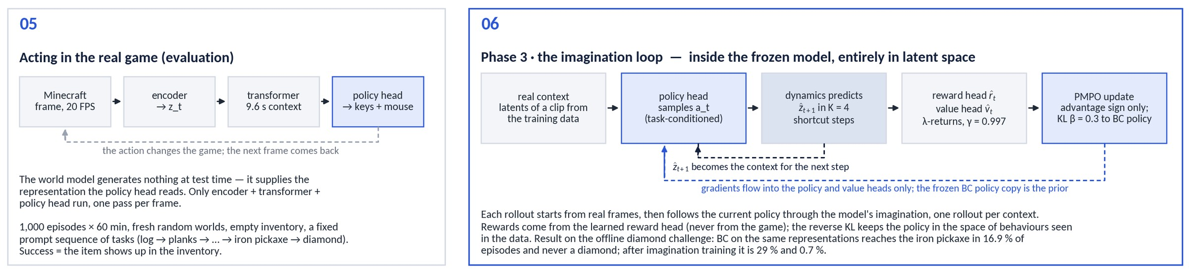
How the pieces fit together (2/2): the two loops
Training inside the model, and acting in the real game
Imagination loop (phase 3): start from real latents → policy head samples an action → dynamics predicts the next latents in K = 4 shortcut steps → reward and value heads score the step → PMPO with reverse KL updates the policy and value heads only; one rollout per context, transformer frozen
Acting (evaluation): encoder → transformer → policy head, once per frame at 20 FPS; the world model generates nothing at test time — it provides the representation
What the loop buys: on the same representations, behavioural cloning reaches the iron pickaxe in 16.9 % of episodes and no diamonds; after imagination training 29 % and 0.7 % (Table 7)
Dreamer 4 · Hafner, Yan, Lillicrap (Google DeepMind) · arXiv 2509.24527
PART 2 · METHOD
14
Notes:
Bottom half of the system view. On the right, the imagination loop: rollouts start from real contexts, the policy proposes actions, the frozen dynamics model predicts what happens in latent space with four forward passes per frame, the learned reward and value heads score the outcome and PMPO nudges the policy toward positive-advantage actions and away from negative ones, with a reverse KL to the frozen behavioural-cloning copy as prior. Gradients only reach the policy and value heads. On the left, evaluation: in the real game the same transformer runs once per frame as a feature extractor for the policy head; nothing is imagined at test time. The numbers at the end are the case for doing RL inside the model at all.

Slide 15
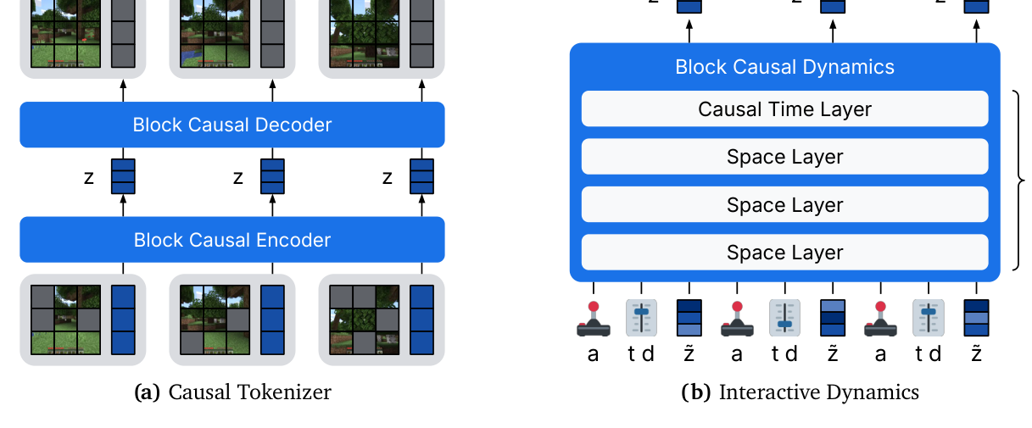
World-model design
Figure 2: causal tokenizer + interactive dynamics model, one shared block-causal transformer
Total 2 B parameters: ≈ 400 M tokenizer + 1.6 B dynamics
Frames: 360×640, zero-padded to 384×640 → 960 patches of 16×16
Latents: N_z = 256 tokens × 32 dims per frame (512×16 bottleneck, tanh)
Context: 192 frames = 9.6 s at 20 FPS
Block-causal: full attention within a frame, causal across frames → usable online, frame by frame
Transformer recipe: pre-RMSNorm, RoPE, SwiGLU, QK-norm, logit soft-capping, register tokens
Left: causal tokenizer (masked patches → latent tokens → reconstruction). Right: interactive dynamics — interleaved action tokens a, latent tokens z, and per-frame signal level τ / step size d; space layers with a causal time layer every 4th block. (Figure 2, arXiv 2509.24527)
Dreamer 4 · Hafner, Yan, Lillicrap (Google DeepMind) · arXiv 2509.24527
PART 2 · METHOD
15
Notes:
Both halves use the same transformer block. Block-causal means every token in frame t can see all tokens of frames up to t, which is exactly what you need for online, frame-by-frame generation with a human or a policy in the loop.

Slide 16
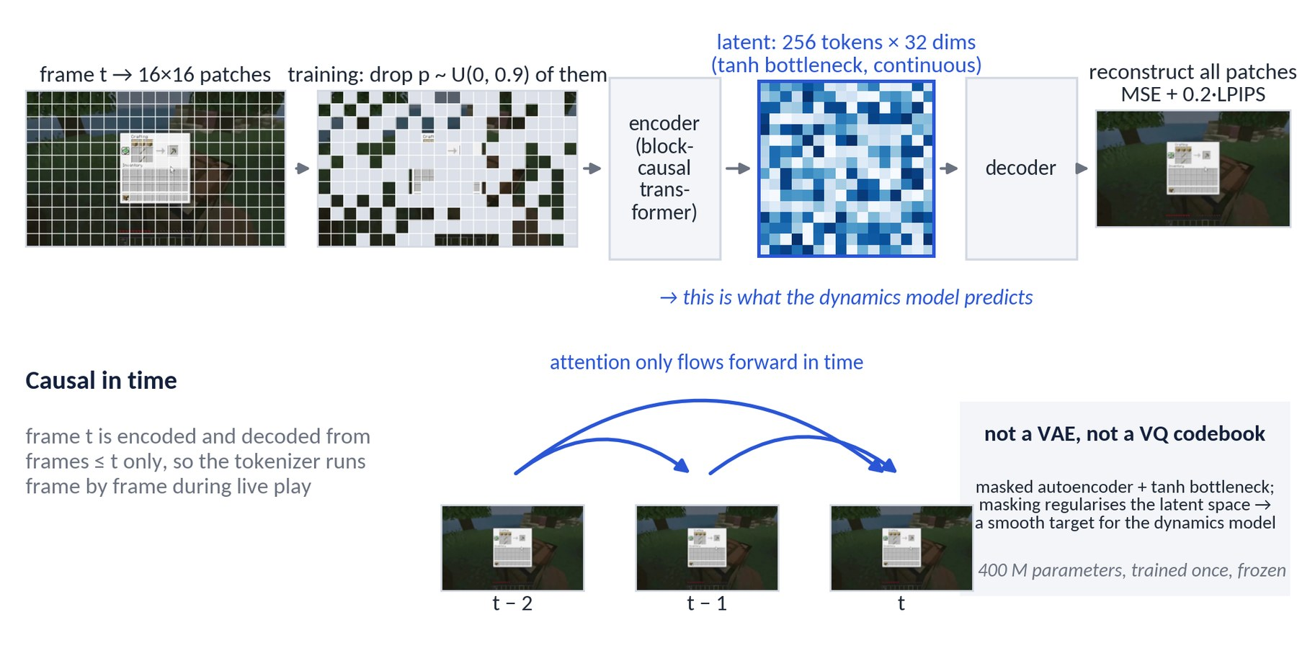
The causal tokenizer
Compress each frame into 256 continuous latent tokens without looking into the future (paper §3.1)
Masked autoencoder, not a VAE/VQ: input patches are dropped with probability p ~ U(0, 0.9) and replaced by a learned embedding, so the encoder must infer them from context — that regularises the latent space; p = 0 at inference
Bottleneck: latent tokens are read out through a linear projection to 512×16 with a tanh, reshaped to 256 tokens × 32 dims per frame — continuous, no codebook
Loss: MSE + 0.2·LPIPS on the reconstructed patches; the perceptual term keeps textures crisp
Causal in time: frame t is encoded and decoded from frames ≤ t only, so the same tokenizer runs frame by frame during live play
Trained once, then frozen (≈ 400 M parameters); Hafner expects end-to-end training to be possible eventually
Schematic built from one archived world-model frame; the latent grid is illustrative (real latents are 256 tokens × 32 dims, not a 16×16 image).
Dreamer 4 · Hafner, Yan, Lillicrap (Google DeepMind) · arXiv 2509.24527
PART 2 · METHOD
16
Notes:
The tokenizer is a masked autoencoder over 16×16 patches with a small continuous bottleneck. Two properties matter downstream: it is causal in time, and its latent space is smooth because of the heavy random masking during training. Everything after this operates on 256 latent tokens per frame instead of 960 patches. The schematic on the left is an illustration built from a real frame, not a visualisation of the trained model.

Slide 17
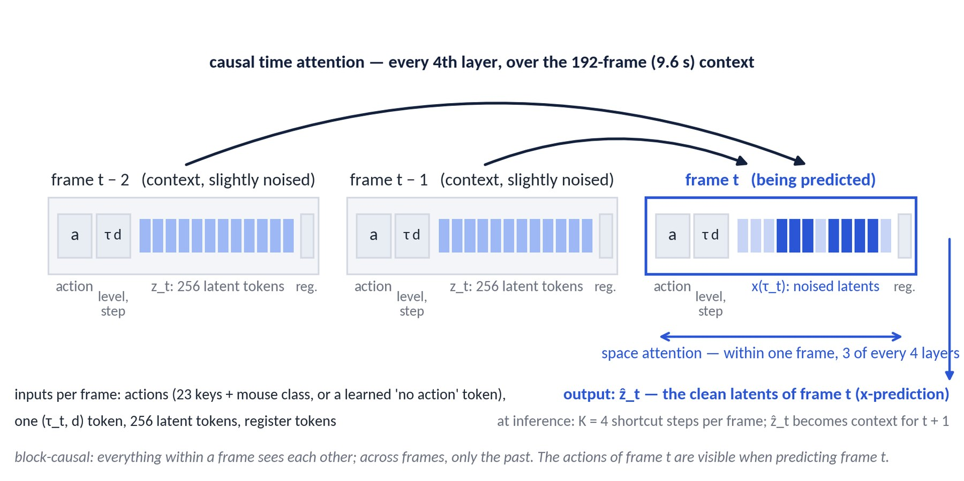
The interactive dynamics model
Predict the clean latents of the next frame from the past, the actions and a noisy guess (paper §3.2)
Sequence per frame: action tokens (23 keys + mouse class, or a learned 'no action' embedding for unlabeled video), one token for signal level τ_t and step size d, the 256 latent tokens, register tokens
Block-causal attention: everything within a frame sees each other; across frames only the past. Space-only layers do most of the work; a causal time layer every 4th layer sees the 192-frame (9.6 s) context
Training target: the clean latents of every frame (x-prediction) from their noised versions, the past and the actions — one loss over the whole sequence
Efficiency: grouped-query attention, alternating 64/256-frame batches, registers — 1.6 B parameters, 21 FPS on one H100 with K = 4
Inference: past frames are kept slightly corrupted (the paper's τ_ctx) so small generation errors do not push the model off-distribution
Sequence layout and attention pattern (schematic). Three of the 192 context frames are shown.
Dreamer 4 · Hafner, Yan, Lillicrap (Google DeepMind) · arXiv 2509.24527
PART 2 · METHOD
17
Notes:
The dynamics model reads the interleaved sequence of actions and latents. Only every fourth layer attends across time; the rest work within one frame. That is what makes a 9.6 s context affordable. Alternating short and long batches is a training-cost trick: it cut a training step from 9.8 s to 1.5 s in the ablation (Table 2). A wording note: the paper says the past inputs are 'slightly corrupted to signal level τ_ctx = 0.1' — read that as a small amount of noise on the context, not 90 % noise.

Slide 18
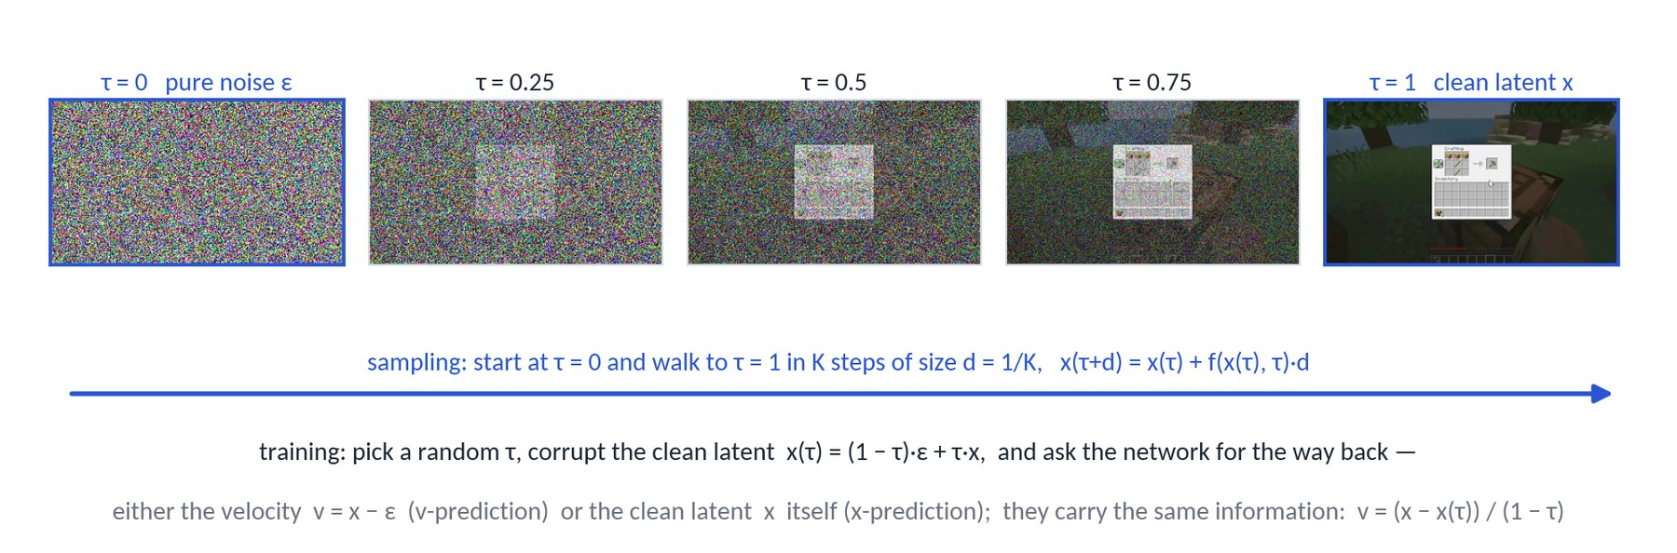
Primer 1 of 3 · Flow matching: one dial from noise to image
The background the dynamics objective is built on (paper §2)
Signal level τ ∈ [0, 1]: x(τ) = (1 − τ)·ε + τ·x — τ = 0 is pure noise, τ = 1 the clean latent; during training τ is drawn at random for every example
The network learns a direction: f(x(τ), τ) ≈ v = x − ε, the velocity pointing from noise to data; sampling starts from noise and walks to τ = 1 in K steps
Two ways to say the same thing: predict the velocity v (standard) or the clean latent x directly (x-prediction); the maths is identical, the error behaviour under autoregressive feedback is not (slide 17)
Why so many steps? The learned direction is only locally right, so ordinary diffusion needs 16–64 small steps per image — far too slow for a 20 FPS simulator
Dreamer 4 · Hafner, Yan, Lillicrap (Google DeepMind) · arXiv 2509.24527
PART 2 · METHOD
18
Notes:
For the non-diffusion people: think of a dial τ from 0 (pure noise) to 1 (clean latent). Training corrupts a clean latent to a random position on the dial and asks the network for the way back, either as a direction (velocity) or as the clean end point. Sampling turns the dial from 0 to 1 in K steps. The strip at the top is a real world-model frame mixed with Gaussian noise at five signal levels. The problem for a real-time simulator is K: standard models need dozens of steps per frame.

Slide 19
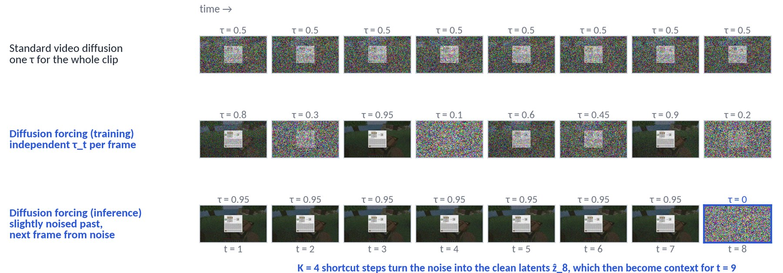
Primer 2 of 3 · Diffusion forcing: a noise level per frame
Chen et al., 2024 — what makes causal, frame-by-frame generation possible
Standard video diffusion corrupts the whole clip with one τ: past and future are always equally noisy, so the model cannot be rolled out one frame at a time
Diffusion forcing draws an independent τ_t for every frame; each frame is at once a denoising target and (noisy) history for the frames after it — a single loss over the whole sequence
What it buys at inference: generate the next frame from pure noise given a clean or lightly noised past — exactly the interactive setting; keeping the past slightly noised makes the model robust to its own small mistakes
What it does not fix: still tens of denoising steps for every frame — the 0.8 FPS starting point of the design cascade (Table 2)
Dreamer 4 · Hafner, Yan, Lillicrap (Google DeepMind) · arXiv 2509.24527
PART 2 · METHOD
19
Notes:
Diffusion forcing is the trick that turns a video diffusion model into a causal simulator: every frame gets its own noise level, so the model learns to predict a noisy future from a cleaner past. That is precisely the situation at inference, where the past is what the model generated a moment ago. What it does not solve is speed; that is what shortcut models are for.

Slide 20
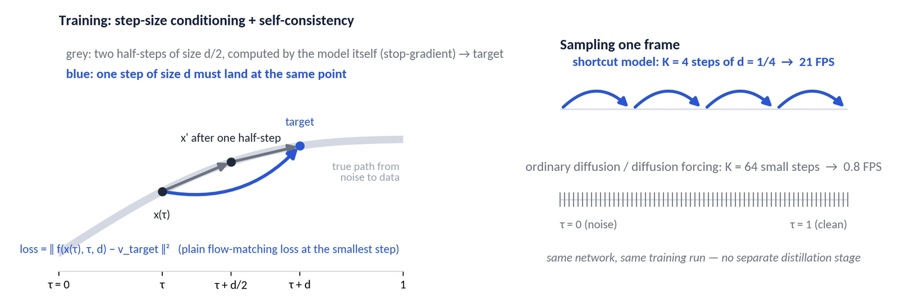
Primer 3 of 3 · Shortcut models: learning to take big steps
Frans, Hafner, Levine, Abbeel, 2024 — why four sampling steps can be enough
Add the step size d as an input: f(x(τ), τ, d) predicts the average direction over a jump of size d, not just the local direction
Smallest step: ordinary flow-matching loss. Larger steps: self-consistency (bootstrap) loss — one step of size d must land where two steps of size d/2 land; the two-step target is produced by the model itself with gradients stopped
Result: 2–4 steps reach the quality of 64 in the original paper, with no separate distillation stage — one model, one training run
Dreamer 4 combines the two: per-frame τ_t from diffusion forcing + step-size conditioning from shortcut models = shortcut forcing, K = 4 steps per frame at 21 FPS (next slide)
Dreamer 4 · Hafner, Yan, Lillicrap (Google DeepMind) · arXiv 2509.24527
PART 2 · METHOD
20
Notes:
Shortcut models teach the network to take big steps consistently. The extra input is the step size; the extra loss says that one big step must agree with two half steps that the model computes itself. Because the target is deterministic it is easier to fit than the noisy flow-matching target, which is one reason the bootstrap term works well. Dreamer 4 combines this with diffusion forcing into shortcut forcing.

Slide 21
Shortcut forcing: the training objective
Diffusion forcing + shortcut models, with three engineering choices that turn out to matter a lot
Per-frame noise: each frame gets an independent signal level τ_t; the model predicts frame t's clean latent from the noisy frame t, past frames, and actions
Step-size conditioning: the network also receives d; for d > d_min the target is the bootstrap target — the result of two half-steps computed by the model itself (no gradient through the target)
Choice 1 — x-prediction: the network outputs the clean latent, not the velocity
Choice 2 — loss in x-space: the bootstrap target is formed in v-space (where two half-steps compose cleanly) but the loss is scaled back to x-space by (1 − τ)²
Choice 3 — ramp weight: loss weight w(τ) = 0.9 τ + 0.1 emphasises high-signal (low-noise) levels, where fine detail is decided
Inference: K = 4 steps per frame; context frames at τ_ctx ≈ 0.1; sampling remains stochastic → diverse imagined futures for RL
EFFECT OF EACH PIECE (TABLE 2, FVD ↓)
Diffusion forcing, K = 64 steps: 306 (0.8 FPS)
Same model, K = 4 steps: 875
+ shortcut objective: 329
+ x-prediction: 326
+ x-space loss: 151
+ ramp weight: 102
Full architecture but v-space prediction/loss: 124 vs 57
WHY THIS IS THE KEY CONTRIBUTION
4 steps ≈ the quality of 16–32 diffusion-forcing steps (Fig. 8) — roughly 16× fewer network evaluations per frame, which is what makes real-time interaction and large-scale imagination RL feasible.
Dreamer 4 · Hafner, Yan, Lillicrap (Google DeepMind) · arXiv 2509.24527
PART 2 · METHOD
21
Notes:
Here is the objective in words. Combining the two prior ideas gets you from 875 back to 329 FVD at 4 steps — but the big wins come from the parameterisation details: predicting x instead of v, computing the loss in x-space, and the ramp weight together take FVD from 329 to 102. These are the kind of choices you only discover with a careful cascade of ablations, which the paper provides.

Slide 22
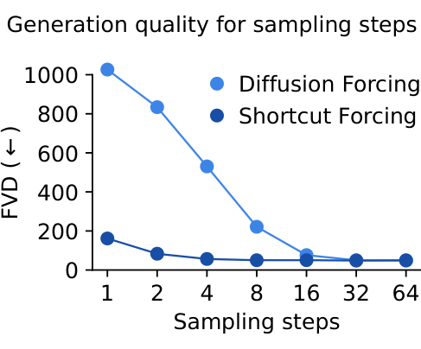
Why x-prediction matters for autoregressive world models
Hafner's explanation (TalkRL, Nov 2025) and the numbers
v-prediction carries the noise: to output v = x − ε the network must reproduce the exact noise pattern of its input through every layer; small mistakes in that noise become errors in the sample
In autoregressive use these errors compound: each generated frame becomes context for the next; velocity errors accumulate as drift, blur or flicker over long rollouts
x-prediction is a denoising target: the network only needs to know what the clean frame should look like — errors are 'pulled back' toward plausible images every step
Combined with noised context (τ_ctx ≈ 0.1): the model is trained and run on slightly corrupted context, so it never sees a distribution it was not trained on
Evidence: full architecture with v-space prediction/loss reaches FVD 124; with x-prediction and x-space loss, 57 (Table 2). Long 384-frame generations were used for FVD precisely to expose compounding error
Figure 8: FVD vs sampling steps. Shortcut forcing at 4 steps ≈ 60; diffusion forcing needs 16–32 steps to match.
Dreamer 4 · Hafner, Yan, Lillicrap (Google DeepMind) · arXiv 2509.24527
PART 2 · METHOD
22
Notes:
This is the most transferable lesson of the paper for anyone building autoregressive generative models: predict the clean signal, not the velocity, when your own outputs become your inputs. Open Dreamer, the open-source reproduction, independently confirmed this — they report the same instability with v-prediction at scale.

Slide 23
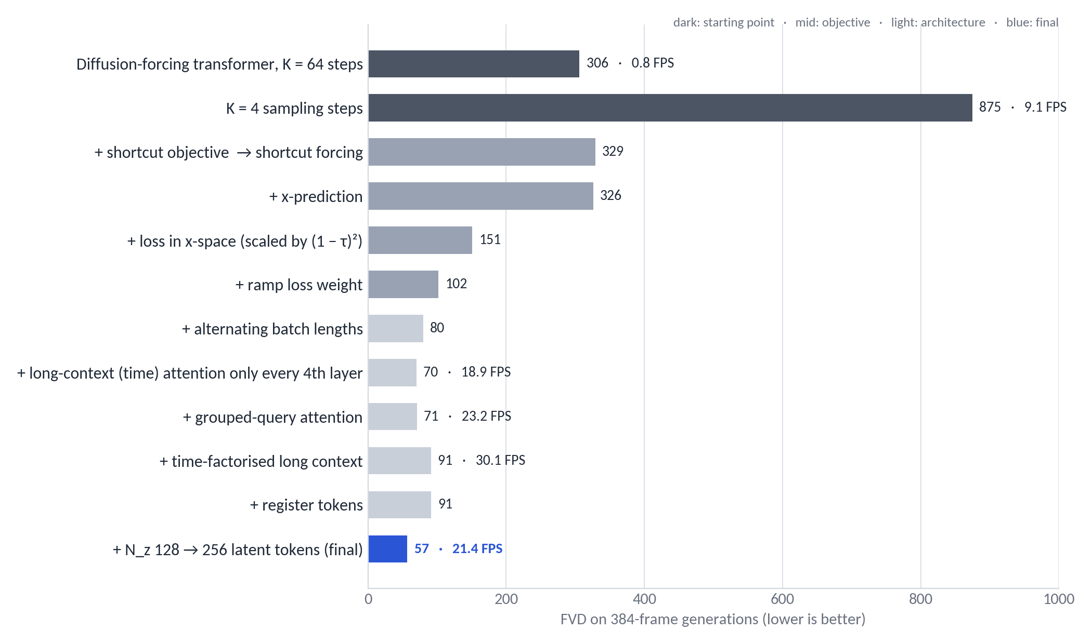
Architecture choices that buy speed without losing quality
Table 2: each row adds one change to the previous row
Alternating batch lengths (64 / 256 frames): FVD 102 → 80 and a training step from 9.8 s → 1.5 s
Time attention only every 4th layer: 18.9 FPS at FVD 70
Grouped-query attention: 23.2 FPS, FVD unchanged
Time-factorised long context trades a little quality (91) for 30 FPS; registers stabilise attention
More latent tokens (128 → 256) brings FVD to 57 at 21.4 FPS — the final configuration
Runs were 48 h each; FVD computed on 1,024 generations of 384 frames
Dreamer 4 · Hafner, Yan, Lillicrap (Google DeepMind) · arXiv 2509.24527
PART 2 · METHOD
23
Notes:
Read the bars top to bottom. The two dark bars at the top are the starting point: a diffusion-forcing transformer that is either slow or bad. The grey bars are the objective changes from the previous slides; the blue bar is the final model. The architectural changes on the lower half mostly move FPS, not FVD — exactly what you want.

Slide 24
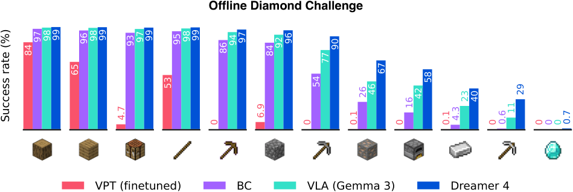
From world model to agent: agent tokens & heads
Phase 2 — policy and reward live inside the same transformer, but cannot disturb the simulation
Agent tokens: extra tokens per frame that carry a task embedding (one-hot over the 20 training tasks) and read out policy and reward
One-way attention: agent tokens attend to actions, latents and past frames — but nothing attends back to them, so the world model never conditions on the policy's intentions or reward estimates
Policy head — behavioural cloning with multi-token prediction: predict the next L = 8 actions; the extra horizon regularises the representation and encodes intent
Reward head: predicts task rewards derived from game events (item obtained); a task-conditioned scalar reward was chosen over a reward vector so that open-vocabulary tasks remain possible
Value head: added in Phase 3, trained by TD learning on imagined rollouts
Result already at this stage: 'WM + BC' beats BC on every hard milestone (iron pickaxe 16.9 % vs 0.6 %) — the video-prediction representation is a strong prior for control
Figure 3: success rates of agents trained on the same offline data (BC, VLA, WM+BC, Dreamer 4).
WHY NOT A SEPARATE POLICY NETWORK?
Sharing the backbone gives the policy the world model's representation for free, and keeps everything one model. The one-way attention mask is what makes this safe.
Dreamer 4 · Hafner, Yan, Lillicrap (Google DeepMind) · arXiv 2509.24527
PART 2 · METHOD
24
Notes:
Agent tokens are the interface between simulation and decision making. The one-directional mask is subtle but important: if latents could attend to agent tokens, the model could 'cheat' by predicting frames consistent with what the policy intends rather than with the physics of the game. Notice how much of the gain over BC comes from this phase alone — the representation matters.

Slide 25
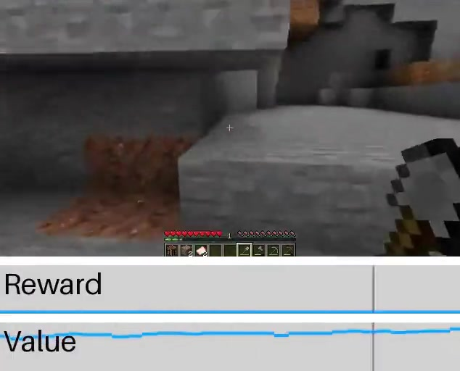
Imagination training with PMPO
Phase 3 — RL on imagined rollouts, with the transformer frozen
Rollouts: start from real context frames, let the policy act, and let the world model generate what happens next; rewards come from the learned reward head; γ = 0.997
Frozen transformer: only policy and value heads are trained → the simulator cannot drift toward the policy
PMPO (Preference-style MPO): instead of scaling the policy gradient by the advantage, use only its sign — positive-advantage actions are pushed up, negative ones down, with balanced weight α = 0.5 on each set
Reverse-KL to the frozen BC policy with β = 0.3 keeps the policy on the data manifold — analogous to KL-regularised RLHF; also the main guard against exploiting world-model gaps
Why not Dreamer 3's recipe? Return normalisation + entropy bonus were replaced by the sign-based update: robust to reward scale and to the extremely sparse late-game rewards
Effect: iron pickaxe 16.9 % → 29.0 %, iron ingot 27.8 % → 39.5 %, diamond 0 → 0.7 %; agents also become faster (Table 8)
Imagined 'mine stone' rollout with reward and value traces (project page).
FAILURE MODE THE KL TERM ADDRESSES
Hafner's example: the policy discovers it can 'craft' a pickaxe from invalid materials because the model renders it anyway. The KL to the BC prior limits such exploitation.
Dreamer 4 · Hafner, Yan, Lillicrap (Google DeepMind) · arXiv 2509.24527
PART 2 · METHOD
25
Notes:
PMPO is deliberately simple. Using only the sign of the advantage makes the update invariant to reward scale, which matters when rewards are rare item events. The KL term to the BC policy is doing two jobs: stabilising RL and preventing the policy from wandering into regions the world model gets wrong. Hafner mentioned in a talk that a few rounds of corrective online data would allow a much weaker KL — but that is not in the paper.

Slide 26
03
PART 3
Experiments
Real-time play-testing, the offline diamond challenge, ablations, label efficiency, robotics
26

Slide 27
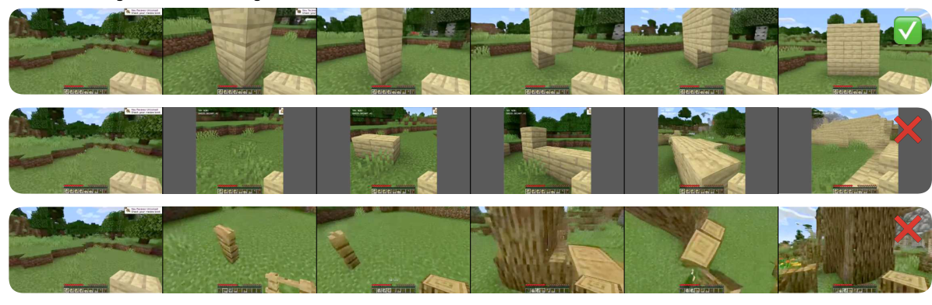
Is the world model accurate? Let humans play inside it
Table 1: real-time interaction on one H100; 16 tasks attempted by human testers from the same starting frame
Model | Params | Resolution | Context | FPS | Tasks solved
MineWorld | 1.2 B | 384×224 | 0.8 s | 2 | not evaluable (needs actions in advance)
Lucid-v1 | 1.1 B | 640×360 | 1.0 s | 44 | 0 / 16
Oasis (small) | 500 M | 640×360 | 1.6 s | 20 | 0 / 16
Oasis (large) | — | 360×360 | 1.6 s | ~5 | 5 / 16
Dreamer 4 | 2 B | 640×360 | 9.6 s | 21 | 14 / 16
Figure 5: same task, same start frame — Dreamer 4 (top) builds the wall; Lucid-v1 and Oasis do not.
The 16 tasks: eat apple · place 3 torches · chop tree · dig 3×3 pit · craft wooden pickaxe · use furnace · place & open workbench · kill zombies · mine diamonds · complete window · place & ride boat · enter portal · place door · bed & sleep · plant reed & pour water · turn 360° & enter house
The two failures were memory-related: the world changes when you look away for longer than the 9.6 s context, and inventory contents become unclear over time
Genie 3 is not compared: it has no fine-grained mouse/keyboard control
WHY THIS EVALUATION
FVD and PSNR measure how video looks; only interaction tests whether the model got the mechanics right. The paper complements it with FVD on 384-frame rollouts, but no long-horizon quantitative interaction metric exists yet — a fair critique.
Dreamer 4 · Hafner, Yan, Lillicrap (Google DeepMind) · arXiv 2509.24527
PART 3 · EXPERIMENTS
27
Notes:
This is the paper's most convincing evidence about the world model. Real people sit down with a mouse and keyboard and try to do things. Dreamer 4 is the only model in which crafting, riding a boat or entering a portal work. The caveat is on the right: this is a small, human-judged protocol; I'd like to see automated long-horizon metrics in follow-ups.

Slide 28
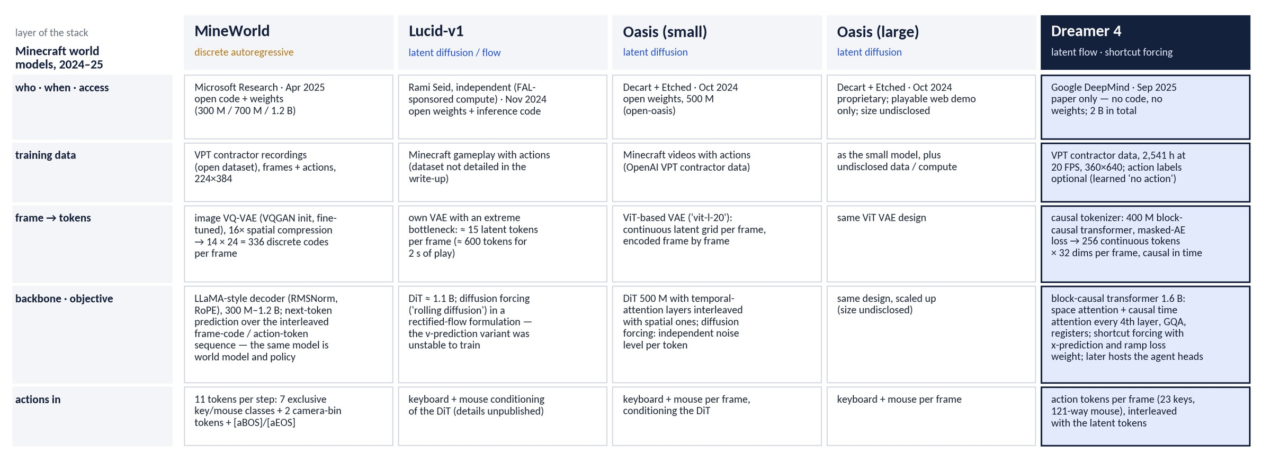
Minecraft world models, stack by stack (1/2): how they are built
The Table 1 models compared layer by layer — provenance, data, tokenizer, backbone and objective, action interface
Two families: MineWorld predicts discrete codes with a LLaMA-style decoder that doubles as the policy; Lucid-v1, Oasis and Dreamer 4 denoise continuous latents with a transformer — Dreamer 4 with shortcut forcing so that four passes per frame suffice, and with the agent heads living in the same network
Dreamer 4 · Hafner, Yan, Lillicrap (Google DeepMind) · arXiv 2509.24527
PART 3 · EXPERIMENTS
28
Notes:
Before the play-test numbers, a look at what the competitors actually are, layer by layer. The two extremes are MineWorld — a language-model recipe over discrete image codes, elegant because model and policy are one network, but slow — and the diffusion family, which Dreamer 4 belongs to. Within that family the differences that matter are the tokenizer capacity (Lucid squeezes a frame into about 15 tokens, Dreamer 4 keeps 256) and the training objective: rolling diffusion or plain diffusion forcing versus shortcut forcing with x-prediction. The action interface is similar across all four — that is what makes them comparable at all, and what excludes Genie 3.

Slide 29
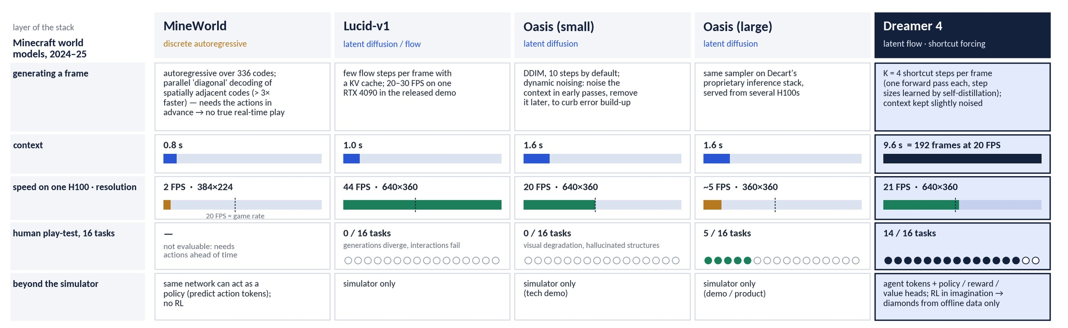
Minecraft world models, stack by stack (2/2): how they run
Sampling, context, speed on one H100, the 16-task human play-test, and what each model is used for
Speed alone is not the story: Lucid-v1 is the fastest model in the table and solves none of the tasks; MineWorld cannot be played at all because its parallel decoding needs the actions in advance
Context is: 9.6 s versus 0.8–1.6 s is what lets the player look away and back — and the two tasks Dreamer 4 still fails are exactly the ones that exceed that window
Only Dreamer 4 is used as a training ground: the others are simulators or demos; here the same network also hosts the policy that is trained inside it
Dreamer 4 · Hafner, Yan, Lillicrap (Google DeepMind) · arXiv 2509.24527
PART 3 · EXPERIMENTS
29
Notes:
Second half: how they behave at run time. Two things to point at. First, frame rate is necessary but not sufficient — Lucid is twice as fast as Dreamer 4 and fails every task, and Oasis large is the one that autocompletes buildings you never built. Second, context length is the quiet hero: six times more than the others, and the failures that remain are memory failures. The last row is the conceptual difference: for the other projects the simulator is the product; for Dreamer 4 it is the means, and the policy trained inside it is the result.

Slide 30


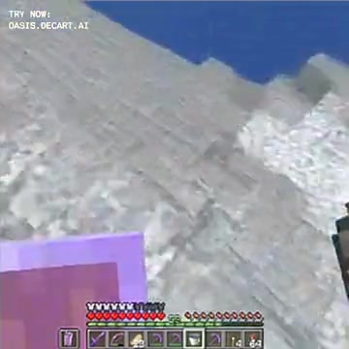
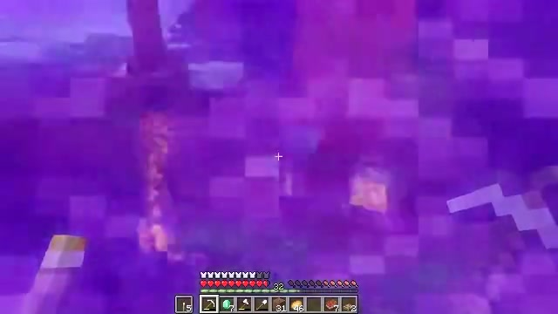
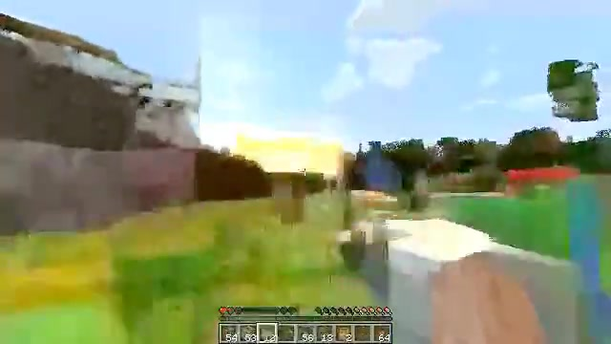
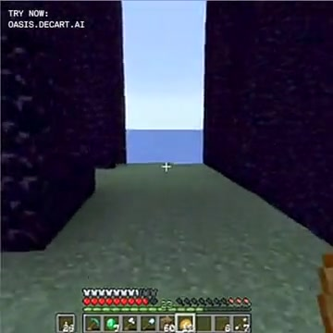
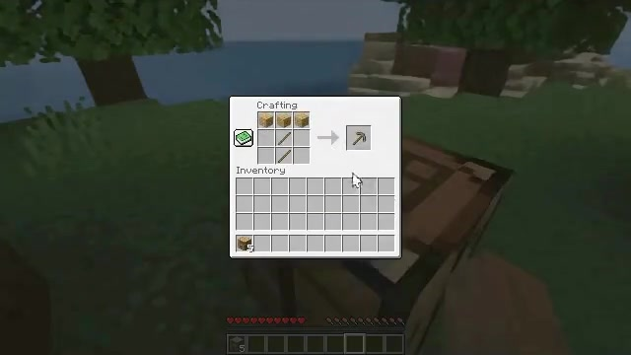
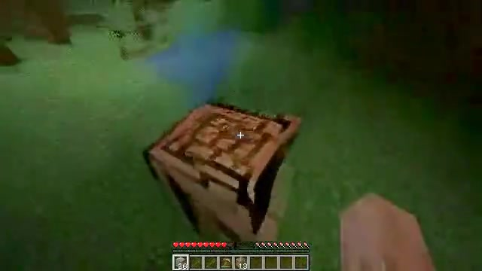
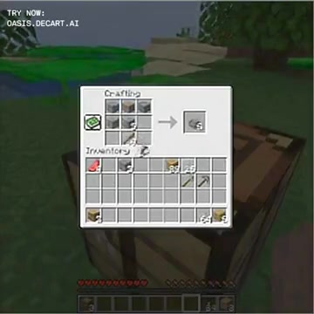
What 'accurate object interactions' looks like
Frames from the project page's side-by-side human sessions (same start frame, same human inputs)
Dreamer 4
Lucid-v1
Oasis
Place and ride boat
Enter portal
Craft wooden pickaxe
Single frames sampled from the project-page clips. Dreamer 4 renders the boat ride, the Nether-portal swirl and a working crafting-table menu; the baselines lose the scene or the menu. ▶ All 51 clips (17 tasks × 3 models): danijar.com/project/dreamer4
Dreamer 4 · Hafner, Yan, Lillicrap (Google DeepMind) · arXiv 2509.24527
PART 3 · EXPERIMENTS
30
Notes:
Three of the sixteen tasks. In the boat task Lucid shows only blue; in the portal task the baselines never enter; in the crafting task Dreamer 4 opens a functional crafting menu. The clips themselves are in the resource archive if you want to play them during the talk.

Slide 31
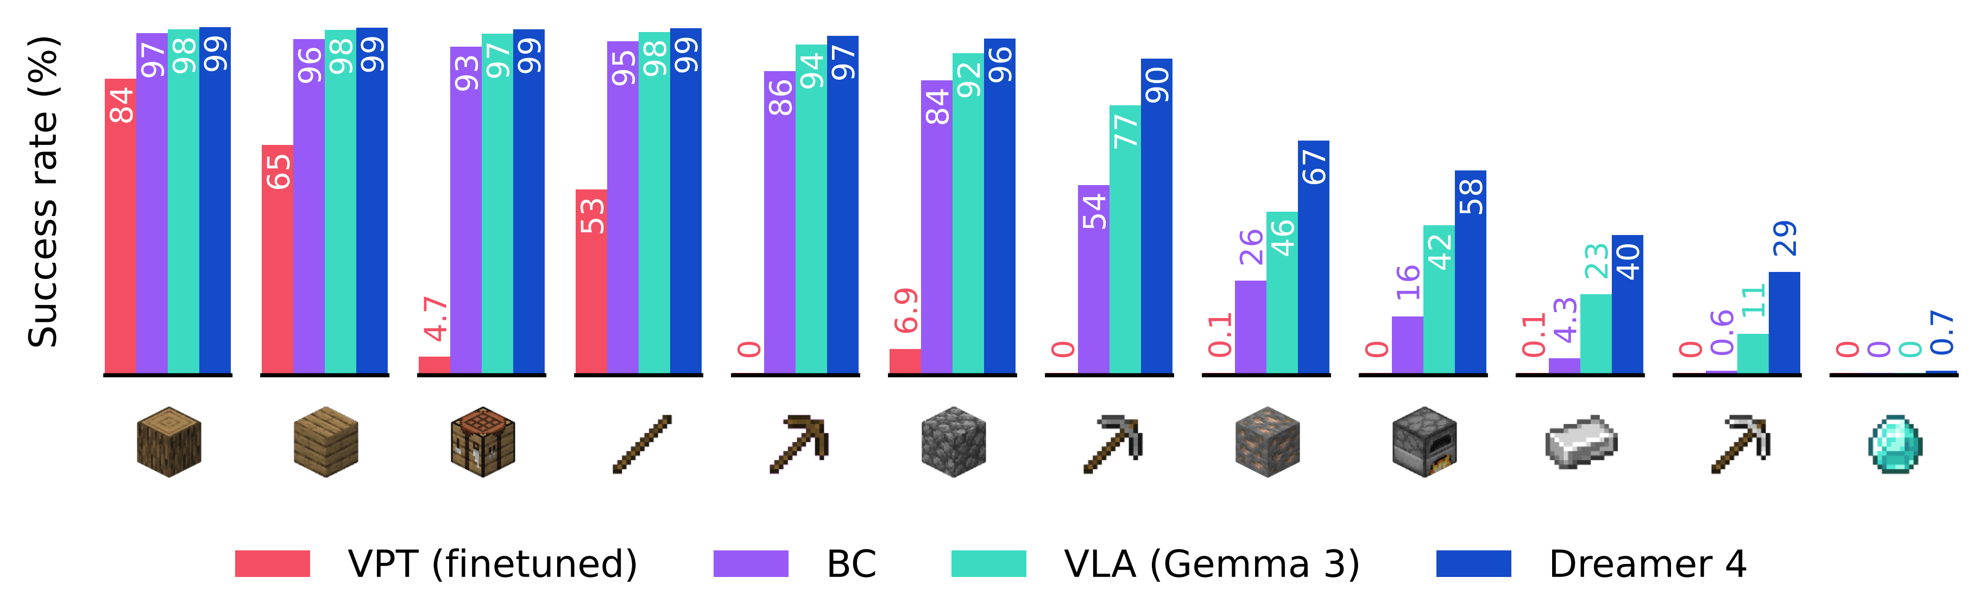
Offline diamond challenge: results
Success rate per milestone; 1,000 episodes × 60 min; same 2,541 h of data for all methods (Table 7 / Fig. 3)
Official figure from danijar.com/project/dreamer4 (benchmark.png). ▶ Watch the trained agent in the real game — four uncut 60-minute evaluation episodes on YouTube: Uncut #1 · #2 · #3 · #4
Dreamer 4: stone pickaxe 90.1 % · iron ore 66.7 % · furnace 58.1 % · iron ingot 39.5 % · iron pickaxe 29.0 % · diamond 0.7 % (≈ 7 of 1,000 episodes)
VLA on Gemma 3 (same data): iron pickaxe 11.2 %, no diamonds · BC: 0.6 % · VPT fine-tuned (pretrained on 270 K h of web video): only reliably reaches sticks
Gap widens along the tech tree: imitation is enough for early items, imagination RL matters where data is thin and horizons are long
Dreamer 4 · Hafner, Yan, Lillicrap (Google DeepMind) · arXiv 2509.24527
PART 3 · EXPERIMENTS
31
Notes:
The official results figure. Every method nails the first items; the interesting region is the right half. Dreamer 4 roughly doubles or triples the VLA on iron-age items and is the only one reaching diamonds — rarely, but from zero interaction. Remember this is a 60-minute budget per episode; humans need about 20 minutes on average.

Slide 32
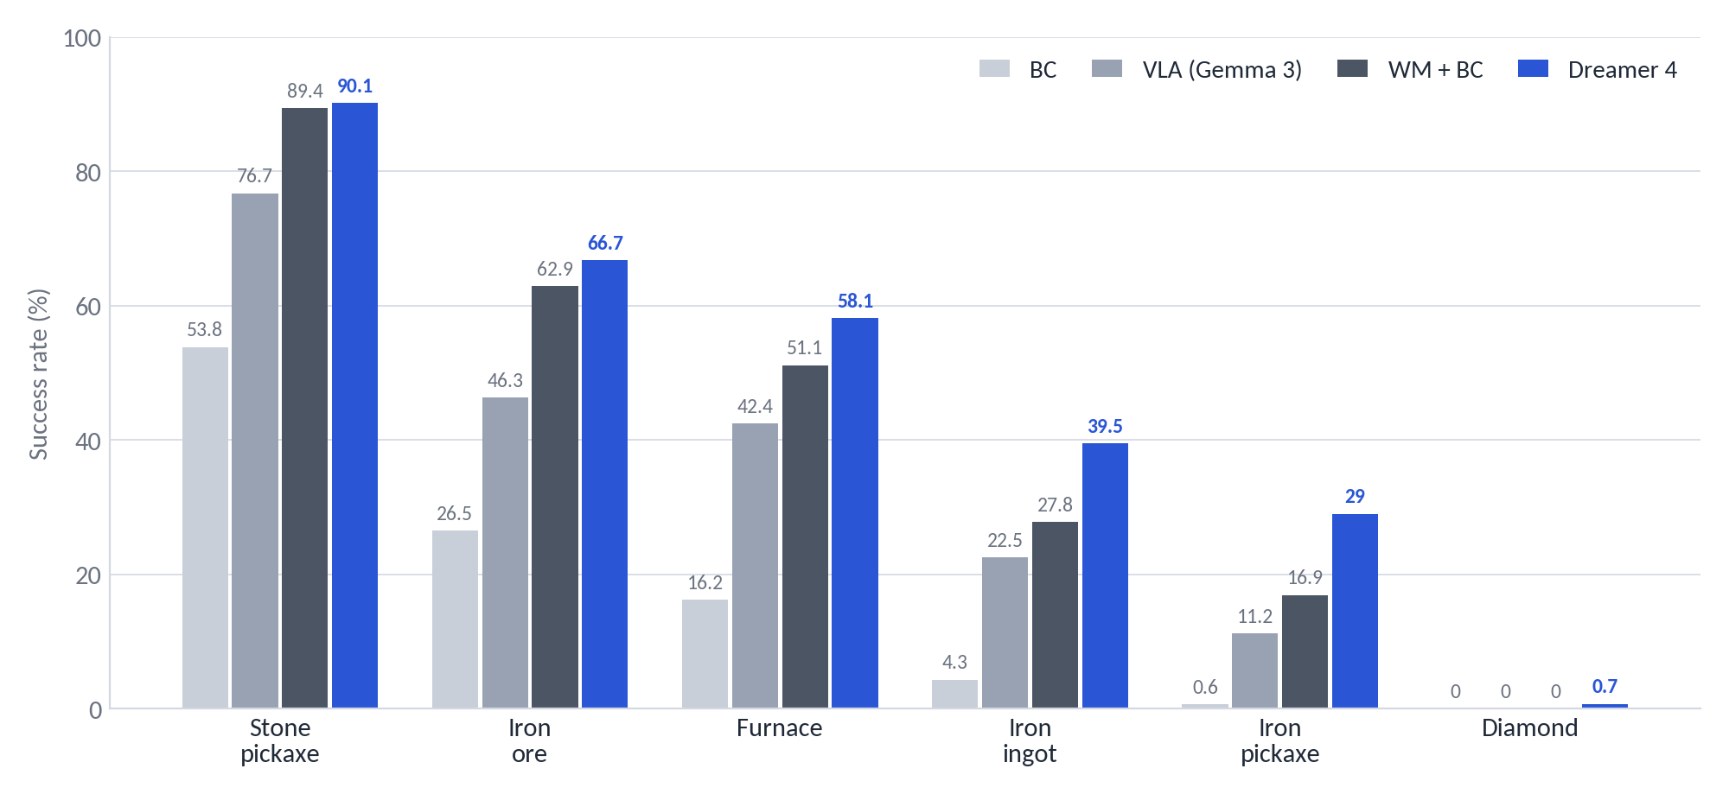
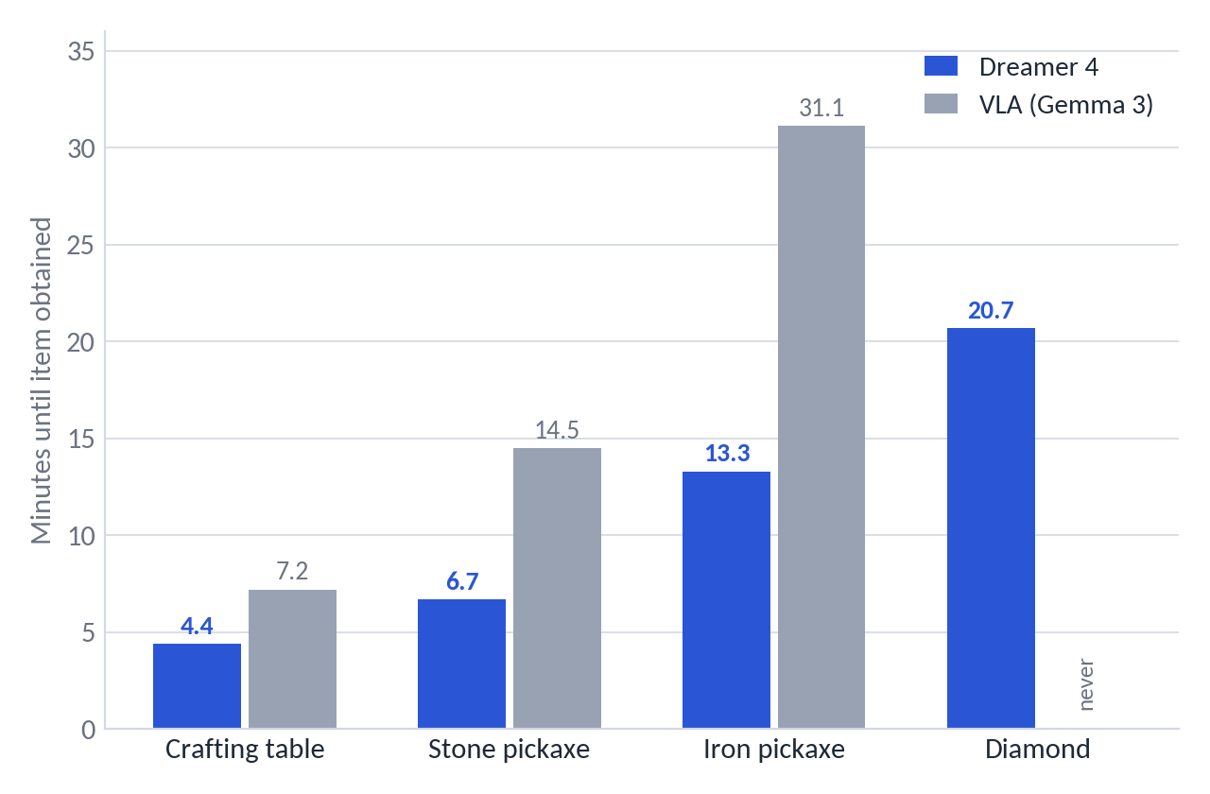
Where do the gains come from? Agent ablations and speed
Figure 4 / Table 8: representation (WM+BC vs BC) and imagination RL (Dreamer 4 vs WM+BC) both contribute
Representation: BC on the world model's features (WM+BC) vs plain BC — iron pickaxe 16.9 % vs 0.6 %; authors: 'video prediction implicitly learns an understanding of the world that is useful for decision making'
Imagination RL: adds +12 pts on iron pickaxe and +12 pts on iron ingot over WM+BC, and unlocks diamonds
Speed: Dreamer 4 is fastest at every milestone — iron pickaxe in 13.3 min vs 31.1 min for the VLA; diamonds in 20.7 min on average when achieved (human average ≈ 20 min)
Task input matters: BC without the task embedding collapses to 8.8 % stone pickaxe (Table 7)
Dreamer 4 · Hafner, Yan, Lillicrap (Google DeepMind) · arXiv 2509.24527
PART 3 · EXPERIMENTS
32
Notes:
Two separable effects. First, using the world model as the representation for imitation already gives a large jump — that's a statement about video pretraining. Second, RL inside the model adds a further, smaller but consistent gain on the hardest items and makes the agent faster, which is a hallmark of RL over imitation.

Slide 33
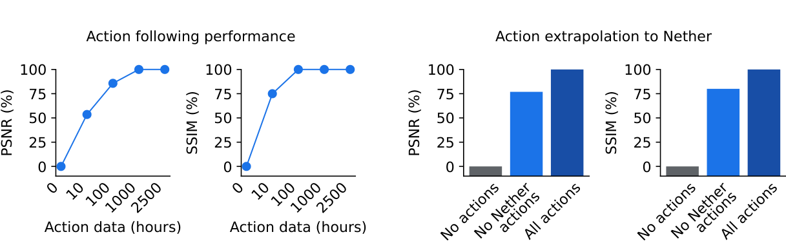
Unlabeled video: how many action labels are needed?
Figure 7 — action conditioning from a small labeled fraction, and transfer to unseen visual domains
MECHANISM
Unlabeled frames receive a learned 'no action' embedding; the dynamics loss is the same. The model therefore learns visual dynamics from everything and the action mapping from the labeled slice.
Setup: train on all 2,541 h of video, but keep actions for only a subset; measure PSNR/SSIM of action-conditioned predictions, normalised between 'no actions' (0 %) and 'all actions' (100 %)
10 h of labels → 53 % PSNR / 75 % SSIM; 100 h → 85 % / 100 %; 1,000 h → 100 % — action understanding saturates with roughly 4 % of the data labeled
Domain transfer: with actions only from the Overworld, predictions in the Nether/End (seen unlabeled) recover 76 % / 80 % — the model separates 'what actions do' from 'what the world looks like'
Why it matters: the road to internet-scale video pretraining, where labels are scarce (VPT needed an inverse-dynamics model for this)
Dreamer 4 · Hafner, Yan, Lillicrap (Google DeepMind) · arXiv 2509.24527
PART 3 · EXPERIMENTS
33
Notes:
This experiment is easy to overlook but strategically important. Only about a hundred hours of labeled actions are needed on top of thousands of unlabeled hours, and the learned action semantics transfer to visual domains that were never labeled. That is the argument for scaling to internet video later.

Slide 34
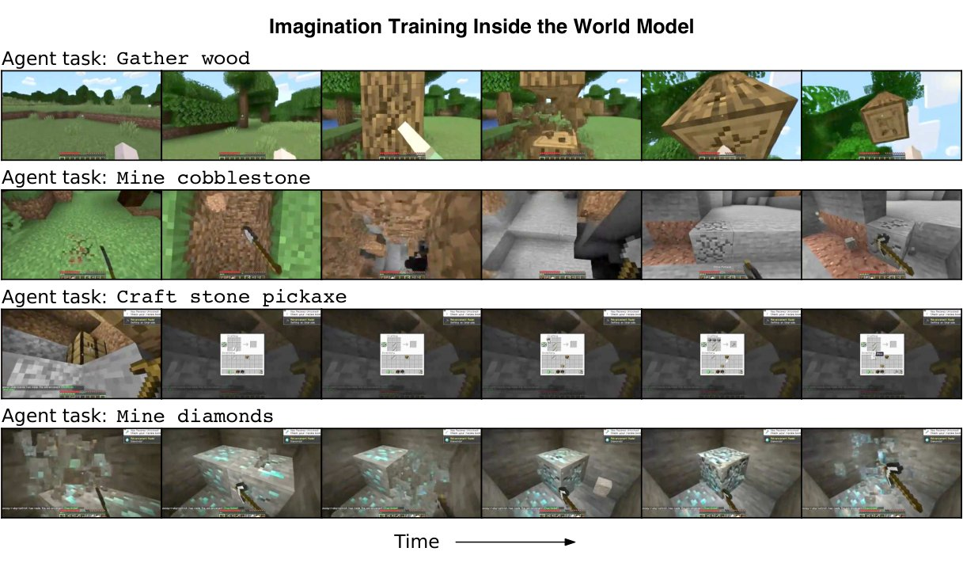
Inside the imagination: decoded training rollouts
Figure 1 — imagined sequences for four agent tasks, decoded only for visualisation
The world model simulates chopping, crafting menus, mining, cave lighting and diamond ore — all generated, not recorded
RL never sees pixels: it operates on latents; decoding is for us
Each rollout starts from real context frames and follows the current policy → training data stays on-policy without touching the game
Stochastic sampling gives diverse futures — useful for exploring rare outcomes such as finding ore
▶ The official video (slide 4, 2:55) shows these rollouts in motion: youtube.com/watch?v=oDlBtTcX0g0
Dreamer 4 · Hafner, Yan, Lillicrap (Google DeepMind) · arXiv 2509.24527
PART 3 · EXPERIMENTS
34
Notes:
Figure 1 from the paper. All of these frames are generated by the model while the policy is being trained. Worth stressing to a mixed audience: the agent learns in latent space; decoding is purely for visualisation.

Slide 35
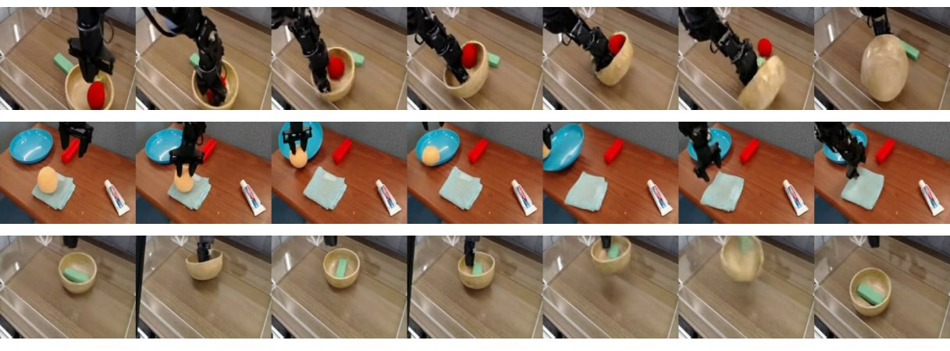
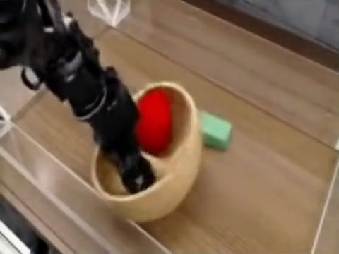
Beyond Minecraft: robotics & egocentric video (qualitative)
Figure 6 and Figure 9 — same recipe, different data; no quantitative benchmark yet
Project page: human counterfactual interaction with the robot world model.
Figure 6: SOAR robot-arm data — counterfactual actions (pick objects, flip bowl, press ball, move towel, throw bowl) rendered by the world model.
SOAR: 180 h of teleoperation + online-RL data, 256×256 at 5 FPS, 7-D relative end-effector actions; N_z = 512, context 96 frames
Epic Kitchens 100: 100 h of egocentric kitchen video, no actions — generations from held-out context (Fig. 9) show the recipe works on real, unstructured video
Caveat: no policy was trained and no metrics are reported for these domains — they demonstrate generality of the world model, not of the agent
Dreamer 4 · Hafner, Yan, Lillicrap (Google DeepMind) · arXiv 2509.24527
PART 3 · EXPERIMENTS
35
Notes:
The paper positions Dreamer 4 as a step toward robotics. The evidence here is qualitative: plausible counterfactual generations on real robot and kitchen video. Hafner left DeepMind shortly after the paper to work on humanoid robotics, which tells you where the authors think this goes.

Slide 36
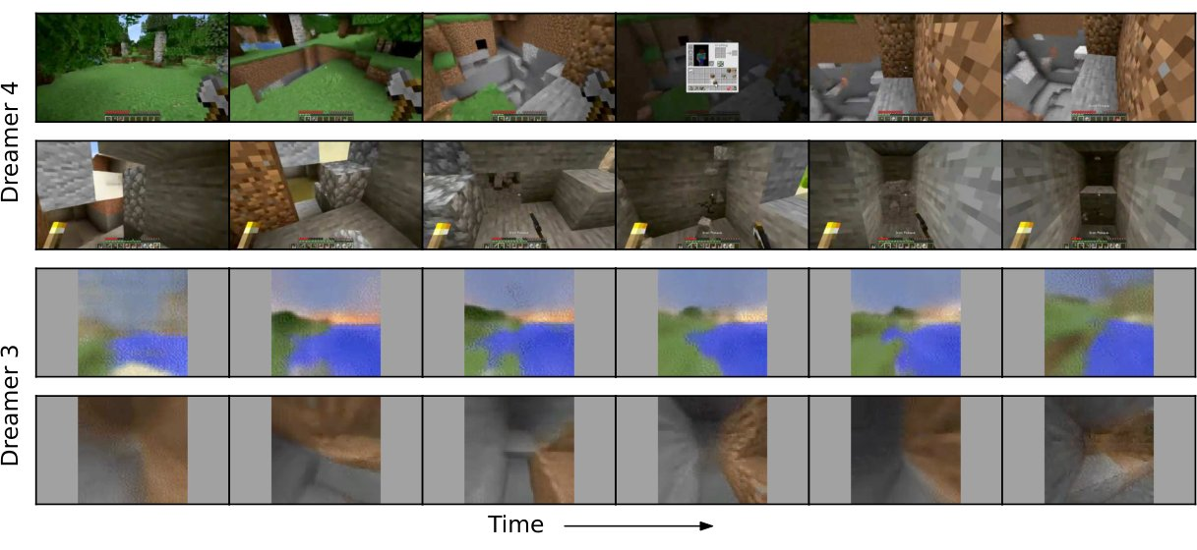
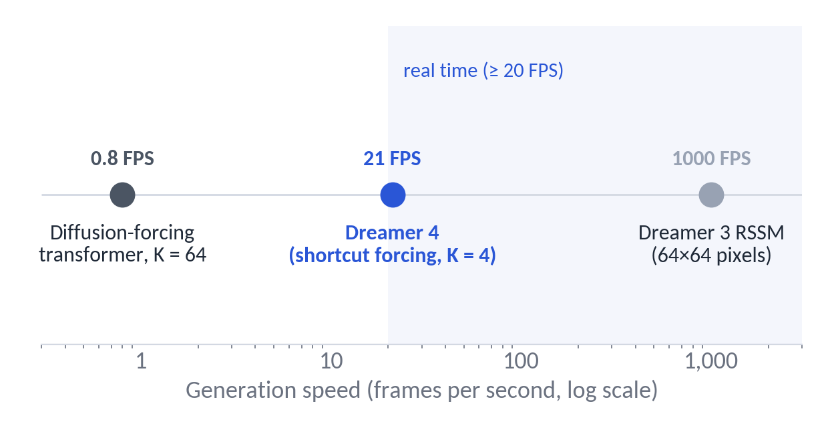
Dreamer 3 vs Dreamer 4
Appendix F: what changed, and what the higher-fidelity model costs
 | Dreamer 3 (Nature 2025) | Dreamer 4
World model | RSSM (recurrent + variational latent) | Block-causal diffusion/flow transformer, shortcut forcing
Minecraft input | 64×64 pixels + inventory state; abstract crafting actions | 360×640 pixels only; raw mouse & keyboard
Data | 1.4 K h of online interaction, no human data | 2.5 K h of offline human data, no interaction
RL | Return normalisation + entropy bonus | PMPO (advantage sign) + KL to BC prior
Speed | ~1,000× faster than a diffusion transformer | ~30× faster than diffusion forcing; ~40× slower than the RSSM
Figure 11: multi-step generations, Dreamer 4 (top) vs Dreamer 3 (bottom).
Generation speed on a log scale (paper, TalkRL): ~30× faster than diffusion forcing, ~40× slower than the RSSM.
Dreamer 4 · Hafner, Yan, Lillicrap (Google DeepMind) · arXiv 2509.24527
PART 3 · EXPERIMENTS
36
Notes:
Same family, different regime. Dreamer 3 solved diamonds with online interaction and privileged state at 64×64; Dreamer 4 does it offline from raw pixels and inputs. The price is speed: the transformer is still about forty times slower than the recurrent model, according to Hafner.

Slide 37
Data, compute and scale
Appendix A and Table 3
Dataset | Size | Resolution / FPS | Actions | Dynamics config
Minecraft (VPT contractor 6–10) | 2,541 h | 360×640 → 384×640 padded, 20 FPS | 23 keys + 121-way mouse; item events → rewards | N_z 256 · C 192 · T 64/256
Overworld vs Nether/End split | subset | same | labels only for Overworld | action-generalisation study
SOAR robotics | 180 h | 256×256, 5 FPS | 7-D relative end-effector | N_z 512 · C 96 · T 32/128
Epic Kitchens 100 | 100 h | 256×256, 10 FPS | none | same as SOAR
Agent (Table 3) | Human data | Web video | Online interaction
VPT (RL fine-tuned) | 2.5 K h | 270 K h | 194 K h
VPT (BC) | 2.5 K h | 270 K h | —
Dreamer 3 | — | — | 1.4 K h
Dreamer 4 | 2.5 K h | — | —
Compute: 256–1,024 TPU v5p chips per run (exact chip-hours not disclosed)
Ablations: 48 h runs per configuration
Model: ≈ 2 B parameters total; inference 21 FPS on one H100
Not released: code, weights or data recipe (Hafner: 'probably not') — reproductions exist (Open Dreamer, Dreamer-MC, Hansen's PyTorch port)
Dreamer 4 · Hafner, Yan, Lillicrap (Google DeepMind) · arXiv 2509.24527
PART 3 · EXPERIMENTS
37
Notes:
Scale context. The Minecraft data is the public VPT contractor set, which makes the comparison with VPT clean: Dreamer 4 uses about a hundred times less data and no interaction. Compute is disclosed only as a TPU range. Nothing was open-sourced, which shaped the follow-up ecosystem.

Slide 38
04
PART 4
Discussion
Limitations, critical reading, future work, takeaways
38

Slide 39
Limitations the paper itself states
From the discussion section and the authors' talks
01
Diamonds are rare: 0.7 % success; the authors call the pipeline a 'reliable and performant starting point', not a solved task
02
Memory: 9.6 s of context; walk into a house for 30 s and the outside is regenerated — long-term memory is the number-one item on the roadmap
03
Inventory drift: small UI elements and item counts blur over long horizons; small objects and long-range semantic correlations are what video models learn last
04
Frozen, exploitable simulator: no epistemic-uncertainty estimate; the policy can exploit model errors (invalid crafting) — currently mitigated only by the KL constraint
05
Two-stage training: tokenizer is trained separately and frozen; the authors expect end-to-end training eventually
06
Single domain for the agent: RL results exist only for Minecraft; robotics and kitchen video are qualitative world-model demos
07
Compute: hundreds of TPU v5p chips per run; not a recipe individuals can reproduce at full scale
Dreamer 4 · Hafner, Yan, Lillicrap (Google DeepMind) · arXiv 2509.24527
PART 4 · DISCUSSION
39
Notes:
The authors are quite candid. The two that matter most for the agenda of the paper are memory and exploitability: both limit how far imagination training can be pushed before the policy learns things that are only true inside the model.

Slide 40
A critical reading: established vs. open
What a reviewer would push on (and what independent groups later found)
Well supported
Open or thinly supported
Shortcut forcing + x-prediction gives a large speed/quality win — a clean 12-step ablation cascade, and reproduced by Open Dreamer at 1.6 B scale (JAX, 2026).
The world model handles object interactions far better than Oasis / Lucid-v1 — consistent human play-tests plus long-rollout FVD.
World-model features are a strong prior for imitation (WM+BC ≫ BC on the same data).
Action conditioning from ~4 % labeled data works and transfers across visual domains.
Diamond result: 0.7 % without confidence intervals or per-seed variance; success criterion is a game event, protocol details are in the appendix only.
No direct quantitative long-horizon accuracy metric — interaction accuracy is human-judged on 16 tasks (Pith/EmergentMind critique).
RL gains over WM+BC are modest on most items; small-scale reproductions report high seed variance in the RL phase and reward-hacking of the frozen reward head.
No peer review as of Sept 2026 (arXiv v1 only); no code or weights; nobody outside DeepMind has reproduced offline diamonds.
Generality of the agent beyond Minecraft is untested.
Dreamer 4 · Hafner, Yan, Lillicrap (Google DeepMind) · arXiv 2509.24527
PART 4 · DISCUSSION
40
Notes:
Balance sheet. The methodological contribution — how to make a fast, accurate autoregressive video world model — is robust and has been independently reproduced. The headline agent result is real but statistically thin and has not been reproduced outside DeepMind. For a reading group, this split is where the discussion usually starts.

Slide 41
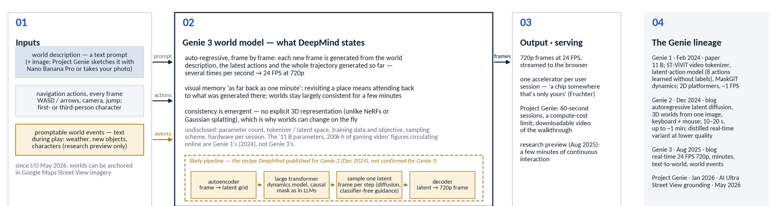
Context: Genie 3 (1/2) — what is actually public
Google DeepMind, Aug 2025 — blog post and model page only. Plain boxes = stated; amber = inferred from the Genie 2 recipe; grey = undisclosed
A different problem: any text-prompted world, 24 FPS at 720p, about a minute of visual memory, navigation-level actions — versus one game, full mouse & keyboard, 9.6 s of context at 21 FPS and 360p
Why the paper cannot compare (§4.2): Genie 3 exposes only camera actions and one generic 'interact' button, so the 16 Minecraft tasks are not expressible; nothing about its size, data or objective is published — the '11 B / 200k hours' figures that circulate are Genie 1's
Dreamer 4 · Hafner, Yan, Lillicrap (Google DeepMind) · arXiv 2509.24527
PART 4 · DISCUSSION
41
Notes:
People will ask about Genie 3, so here is what is actually known. Everything in the plain boxes is stated by DeepMind: auto-regressive frame-by-frame generation conditioned on the prompt, the latest actions and the whole trajectory so far, with an emergent — not explicit — 3D consistency. The amber pipeline is the recipe DeepMind published for Genie 2, which is a reasonable guess for Genie 3 but not confirmed. Parameter count, tokenizer, data and objective are undisclosed; there is no paper. The Dreamer 4 authors say why they do not compare: Genie 3's action space is navigation plus one interact button, and the Minecraft tasks need menus and precise mouse input.

Slide 42
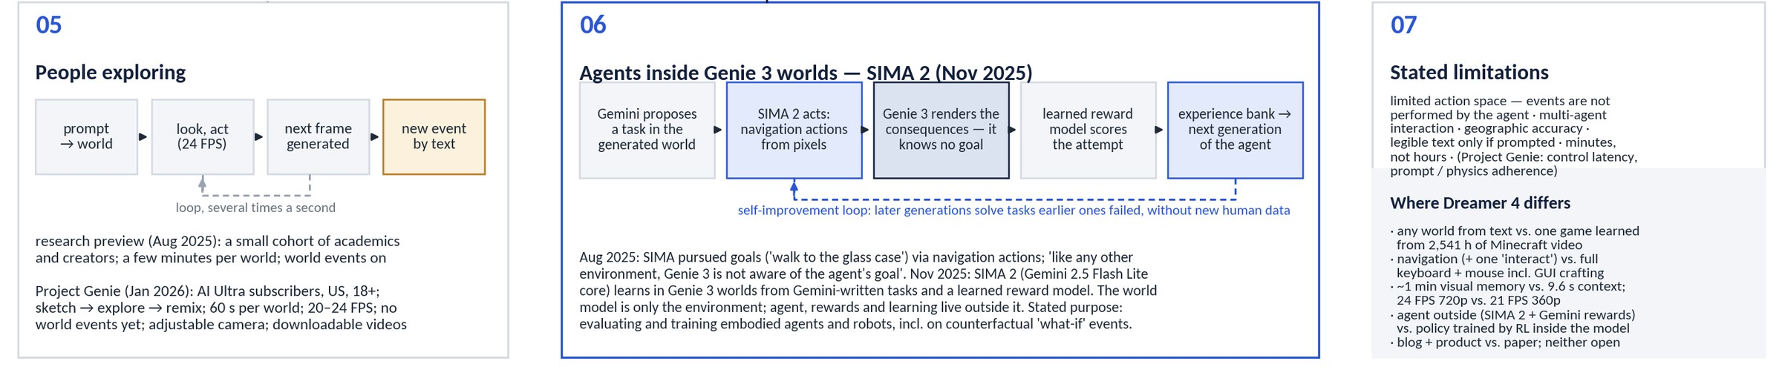
Context: Genie 3 (2/2) — in use, and where Dreamer 4 differs
Human play in the research preview and Project Genie, the SIMA 2 agent loop, stated limitations
Agent outside vs. agent inside: SIMA 2 acts in Genie 3 worlds with Gemini-written tasks and a learned reward model, and Genie 3 only renders the consequences; Dreamer 4's policy is a head on the same transformer, trained by RL on imagined latents with the reward head it learned from the data
Same limits, different scale: both are closed. Genie 3 stays consistent for minutes but with a limited action space; Dreamer 4 forgets beyond 9.6 s but simulates crafting menus, furnaces, boats and portals from raw mouse and keyboard
Convergent direction: both bet on world models as training grounds — Genie 3 via generated worlds for embodied agents and robots, Dreamer 4 via imagination training on offline video; neither has yet shown a policy that transfers to a physical robot
Dreamer 4 · Hafner, Yan, Lillicrap (Google DeepMind) · arXiv 2509.24527
PART 4 · DISCUSSION
42
Notes:
Bottom half of the Genie 3 picture. The interesting contrast is architectural: in DeepMind's own SIMA 2 work the agent, its rewards and its learning all live outside the world model, which is just an environment. In Dreamer 4 the policy is part of the world-model transformer and is trained on the model's latents, never on pixels. Both approaches are closed and both point the same way — world models as the place where agents get their experience — but they trade off breadth against precision: Genie 3 generalises across worlds with a coarse action space, Dreamer 4 masters one world with the full human interface.

Slide 43
Where the authors want to take it
Future work listed in the paper and expanded in the TalkRL interview (Nov 2025)
01
02
03
Internet-video pretraining
Long-term memory
Language conditioning
Learn dynamics from unlabeled web video; label only a small slice with actions (Fig. 7 is the proof of concept).
Beyond 9.6 s: retrieval or compressed memory so the world stays consistent when you look away.
Replace one-hot task IDs with text embeddings; scalar task-conditioned reward already anticipates open-vocabulary tasks.
04
05
06
A little online data
Automatic goal discovery
End-to-end training
Small rounds of corrective interaction to fix the errors the policy exploits — then the KL constraint can be relaxed.
Empowerment / exploration objectives (APD, Plan2Explore, Director) so agents propose their own tasks inside the model.
Fold the tokenizer into the dynamics model; scale parameters and context together.
Dreamer 4 · Hafner, Yan, Lillicrap (Google DeepMind) · arXiv 2509.24527
PART 4 · DISCUSSION
43
Notes:
Six directions, three of which — memory, corrective data, and language — directly address the limitations we just discussed. Note that the authors' next steps are toward physical robots, not more Minecraft.

Slide 44
Key takeaways
01
02
03
Imagination training works offline, from pixels
The enabling contribution is speed at quality
Interaction accuracy, not visual polish, is the bar
Dreamer 4 reaches diamonds in Minecraft with zero environment interaction and about 100× less data than VPT.
Shortcut forcing (4 sampling steps), x-prediction with an x-space loss, and time attention only in every 4th layer: 21 FPS on one GPU with a 9.6 s context.
Validated by humans playing inside the model: 14 of 16 tasks, against 5 of 16 for the best prior Minecraft world model.
04
05
06
Video pretraining is a strong prior for control
Action labels are cheap
Open problems remain
Most of the gain over BC comes from the world-model representation; RL adds the rest on the hardest, longest-horizon items.
About 100 h of labeled actions on top of thousands of unlabeled hours suffice, and action semantics transfer to unseen visual domains.
Short memory, exploitable frozen simulators, thin statistics on the headline result, and no official code or weights.
Dreamer 4 · Hafner, Yan, Lillicrap (Google DeepMind) · arXiv 2509.24527
PART 4 · DISCUSSION
44
Notes:
Six takeaways, ordered from result to method to caveats.

Slide 45
Questions for discussion
01
How much of the diamond result is the world model versus PMPO? Would a stronger offline-RL baseline on world-model features (no imagination) close the gap?
02
Is human play-testing on 16 tasks a sufficient measure of 'accurate simulation'? What automated long-horizon metric would you propose?
03
The transformer is frozen during RL and the reward head is learned: where would you expect exploitation to appear first, and how would you detect it offline?
04
9.6 s of context: which memory mechanism (retrieval, state-space layers, compressed summaries) fits a block-causal diffusion transformer best?
05
The recipe needs ~100 h of action labels per domain. What does the path to internet-scale video look like — inverse dynamics models, or Dreamer 4's 'no-action' embedding at scale?
06
What would convince you that this transfers to real robots — and what evaluation would you run first?
Dreamer 4 · Hafner, Yan, Lillicrap (Google DeepMind) · arXiv 2509.24527
PART 4 · DISCUSSION
45
Notes:
Pick two or three depending on the room.

Slide 46
References & resources
Paper: Hafner*, Yan*, Lillicrap. Training Agents Inside of Scalable World Models. arXiv:2509.24527 (29 Sep 2025). https://arxiv.org/abs/2509.24527
Project page & videos: https://danijar.com/project/dreamer4/ — overview video (youtube.com/watch?v=oDlBtTcX0g0), four uncut 60-min 'Diamond Challenge' evaluation episodes, 51 human-interaction clips
Authors in conversation: TalkRL E73 'Danijar Hafner on Dreamer v4' (10 Nov 2025), transcript available; Hack Club AMA (Dec 2025)
Ingredients: Chen et al., Diffusion Forcing (2407.01392) · Frans, Hafner, Levine, Abbeel, Shortcut Models (2410.12557) · Chen et al., MAETok (2502.03444) · Baker et al., VPT (2206.11795) · Hafner et al., DreamerV3 (2301.04104)
Independent reproductions / follow-ups: next-state/open-dreamer (JAX, 1.6 B Minecraft world model, Jul 2026) · IamCreateAI/Dreamerv4-MC (weights on HF) · nicklashansen/dreamer4 & MMBench2 (Hansen & Wang, 2606.27326) · lucidrains/dreamer4 (PyTorch)
Everything above, archived: https://github.com/HarmannBitte/Dreamer-4 — PDFs, repo snapshots, articles, transcripts, the official clips used in this deck, and a MEDIA_INDEX.md
Dreamer 4 · Hafner, Yan, Lillicrap (Google DeepMind) · arXiv 2509.24527
PART 4 · DISCUSSION
46
Notes:
All sources, plus the GitHub archive that contains local copies of every item used to build this deck.

Slide 47
Appendix A — Configuration & hyper-parameters
Component | Setting
Tokenizer | Masked autoencoder; 16×16 patches; patch dropout ~ U(0, 0.9); loss MSE + 0.2·LPIPS; bottleneck 512×16 with tanh → N_z = 256 tokens × 32 dims; causal in time; ≈ 400 M params; frozen after pretraining
Dynamics model | ≈ 1.6 B params; pre-RMSNorm, RoPE, SwiGLU, QK-norm, logit soft-capping, register tokens; space attention in 3/4 layers, causal time attention every 4th layer; GQA; context C = 192 frames (9.6 s); alternating batch lengths T1/T2 = 64/256
Shortcut forcing | per-frame signal level τ, step size d; x-prediction; bootstrap target formed in v-space, loss scaled to x-space by (1−τ)²; ramp weight w(τ) = 0.9τ + 0.1; K = 4 sampling steps; context noise τ_ctx ≈ 0.1
Actions | 23 binary keys + 121-way mouse (μ-law, 11×11 foveated bins, VPT convention); learned 'no action' embedding for unlabeled video
Agent (phase 2) | agent tokens with one-hot task (20 tasks), one-way attention; BC with multi-token prediction L = 8; task-conditioned scalar reward head; data mix 50 % uniform / 50 % task-relevant
Imagination RL (phase 3) | transformer frozen; policy + TD value heads; PMPO with advantage sign, α = 0.5, reverse-KL β = 0.3 to frozen BC policy; γ = 0.997
Evaluation | 1,000 episodes × 60 min, empty inventory, random worlds, fixed prompt sequence; human interaction: 16 tasks on one H100 at 21 FPS
Compute / data | 256–1,024 TPU v5p; 2,541 h VPT contractor video (subsets 6–10), 90/10 split by 5-min chunk; ablations: 48 h runs, FVD on 1,024 × 384-frame generations
Dreamer 4 · Hafner, Yan, Lillicrap (Google DeepMind) · arXiv 2509.24527
APPENDIX
47
Notes:
Reference slide; not meant to be presented in full.

Slide 48
Appendix B — Full design cascade (Table 2)
Change (cumulative) | FPS | FVD ↓
Diffusion-forcing transformer, K = 64 | 0.8 | 306
K = 4 sampling steps | 9.1 | 875
+ shortcut objective (→ shortcut forcing) |  | 329
+ x-prediction |  | 326
+ x-space loss |  | 151
+ ramp weight |  | 102
+ alternating batch lengths (step 9.8 s → 1.5 s) |  | 80
+ long context only every 4th layer | 18.9 | 70
+ grouped-query attention | 23.2 | 71
+ time-factorised long context | 30.1 | 91
+ register tokens |  | 91
N_z 128 → 256 (final) | 21.4 | 57
(reference) full architecture, v-space prediction & loss |  | 124
48-hour training runs per row
FVD on 1,024 generations of 384 frames (long rollouts to expose compounding error)
FPS measured for generation on one H100 where reported
Fig. 8 adds the steps sweep: shortcut forcing FVD ≈ 160/85/60/50 at 1/2/4/8 steps vs ≈ 1,020/830/530/220 for diffusion forcing
Dreamer 4 · Hafner, Yan, Lillicrap (Google DeepMind) · arXiv 2509.24527
APPENDIX
48
Notes:
Numbers transcribed from Table 2 and read off Figure 8.

Slide 49
Appendix C — Full success-rate table (Table 7, %)
Milestone | VPT (ft) | BC (no task) | BC | VLA (Gemma 3) | WM + BC | Dreamer 4
Log | 84.3 | 71.4 | 97.3 | 98.5 | 99.6 | 99.1
Planks | 65.3 | 68.6 | 95.7 | 98.3 | 99.6 | 98.9
Crafting table | 4.7 | 63.8 | 93.5 | 97.2 | 99.1 | 98.5
Stick | 52.6 | 62.4 | 95.0 | 97.7 | 98.9 | 98.7
Wooden pickaxe | 0.0 | 33.8 | 86.5 | 94.1 | 97.3 | 96.6
Cobblestone | 6.9 | 32.0 | 83.9 | 91.6 | 97.2 | 95.9
Stone pickaxe | 0.0 | 8.8 | 53.8 | 76.7 | 89.4 | 90.1
Iron ore | 0.1 | 3.6 | 26.5 | 46.3 | 62.9 | 66.7
Furnace | 0.0 | 4.0 | 16.2 | 42.4 | 51.1 | 58.1
Iron ingot | 0.1 | 0.2 | 4.3 | 22.5 | 27.8 | 39.5
Iron pickaxe | 0.0 | 0.0 | 0.6 | 11.2 | 16.9 | 29.0
Diamond | 0.0 | 0.0 | 0.0 | 0.0 | 0.0 | 0.7
1,000 evaluation episodes of 60 minutes each; all agents trained on the same 2,541 h of contractor data (VPT additionally pretrained on 270 K h of web video).
Dreamer 4 · Hafner, Yan, Lillicrap (Google DeepMind) · arXiv 2509.24527
APPENDIX
49
Notes:
Full table for reference.

Slide 50
Appendix D — Glossary
Term | Meaning in this paper
World model | Learned model that predicts future observations (here: latent frames) given past observations and actions
Imagination training | Training the policy on rollouts generated by the world model instead of the real environment
Tokenizer / latents | Encoder–decoder mapping each frame to 256 continuous tokens the dynamics model operates on
Block-causal attention | Full attention within a frame, causal across frames — enables frame-by-frame online generation
Diffusion forcing | Diffusion training with an independent noise level per frame in a sequence
Shortcut model | Diffusion/flow model conditioned on step size, trained to be self-consistent across step sizes → few-step sampling
x- vs v-prediction | Network predicts the clean latent (x) vs the velocity x − ε (v); Dreamer 4 uses x-prediction
FVD / PSNR / SSIM | Fréchet Video Distance (distribution-level video quality, lower is better) / per-frame reconstruction fidelity metrics
GQA, RoPE, registers | Grouped-query attention (fewer KV heads), rotary position embeddings, extra learnable tokens that absorb attention mass
BC, VLA, PMPO | Behavioural cloning; vision-language-action model (here built on Gemma 3); the sign-based, KL-regularised policy-gradient update used for RL
Dreamer 4 · Hafner, Yan, Lillicrap (Google DeepMind) · arXiv 2509.24527
APPENDIX
50
Notes:
Glossary for the mixed audience.

