Slide 1
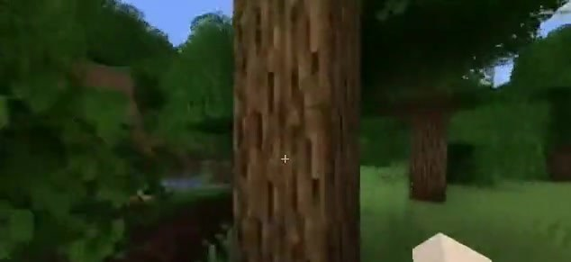
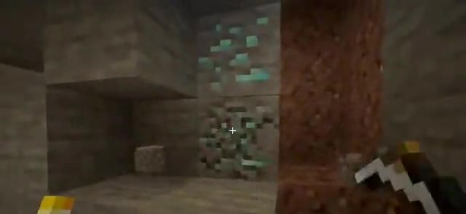
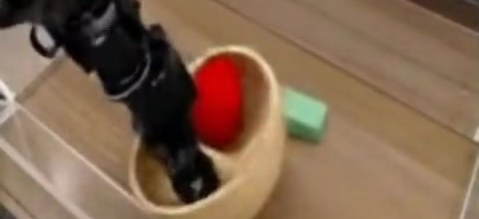
WORLD MODELS · ARXIV 2509.24527
Dreamer 4
A world model good enough
to train an agent in
Training Agents Inside of Scalable World Models
Hafner*, Yan*, Lillicrap — Google DeepMind, September 2025
Presenter ____________ Date ____________ ~30 min + discussion
Right: frames generated by the Dreamer 4 world model — an imagined rollout, a human playing inside the model, and the robot-arm model.
Notes:
This talk is about world models, and about one paper that changed what we can expect from them: Dreamer 4, by Danijar Hafner, Wilson Yan and Tim Lillicrap at Google DeepMind, September 2025. The one-line version: world models have become impressive to look at; Dreamer 4 is the first that is accurate and fast enough to train an agent in, and it proves it by learning to find diamonds in Minecraft from offline video alone. The three frames on the right are all generated by the model, not recorded from the game.

Slide 2
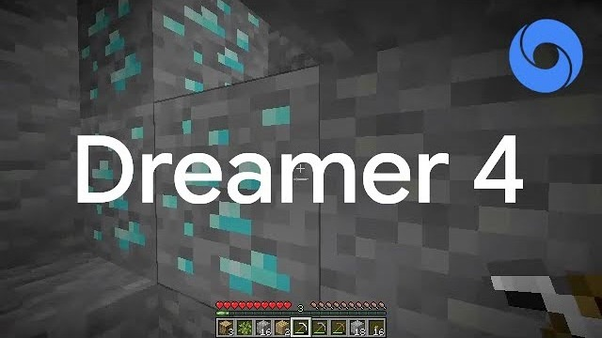

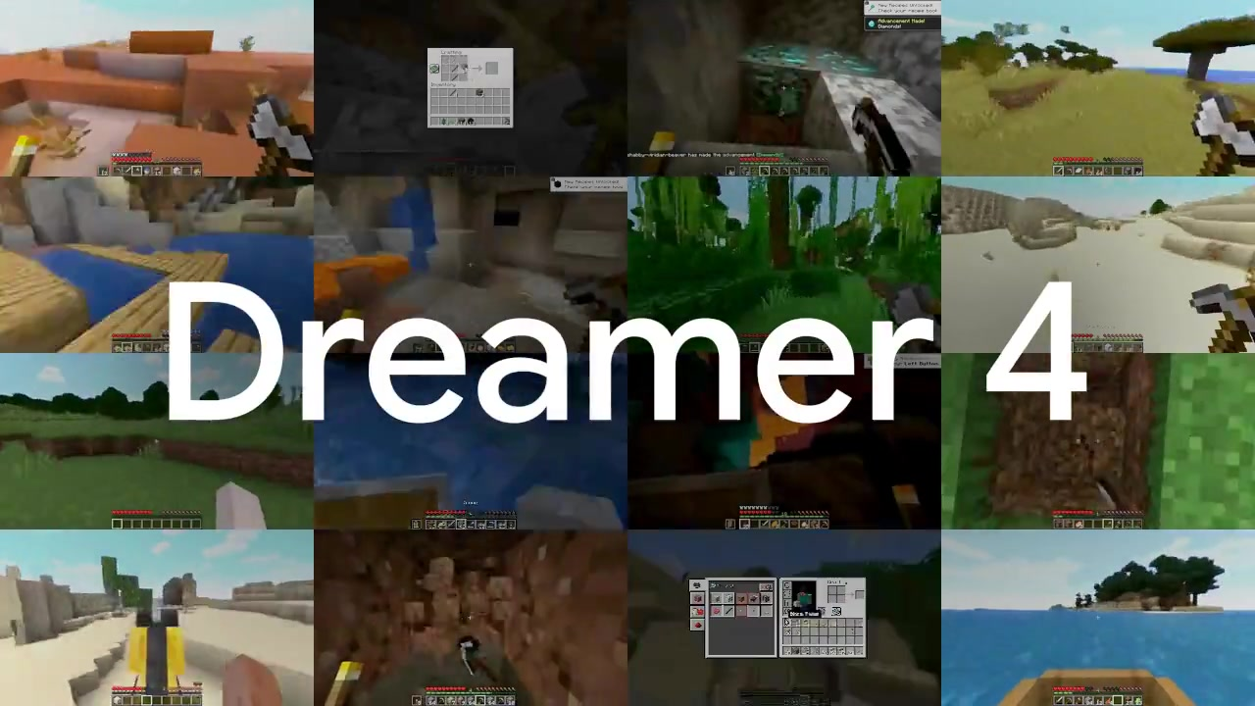
The paper in three minutes: the official video
'Dreamer 4 | Diamonds from Offline Experience' — Danijar Hafner's channel, 1 Oct 2025, 2:55. In effect Figure 1 in motion
Scan to watch on your own device
2:55 · uploaded 1 Oct 2025
YouTube channel @danijar (Danijar Hafner)
Description: 'the first agent to mine diamonds learning entirely offline'
WHAT TO WATCH FOR
The imagined training rollouts of Figure 1 in motion — chopping, crafting menus, mining, cave lighting, diamond ore — decoded from latents for viewing
The headline it builds up to: diamonds from 2,541 h of offline video, no environment interaction
NO INTERNET? EMBEDDED 10-S TEASER — CLICK TO PLAY
▶ Click the picture to open the video on YouTube (internet required): youtube.com/watch?v=oDlBtTcX0g0
Project page: 60 more clips (imagination rollouts, 17 interaction tasks × 3 models, robot arm) — danijar.com/project/dreamer4
Dreamer 4 · Hafner, Yan, Lillicrap (Google DeepMind) · arXiv 2509.24527
2
Notes:
Play the official video here (2:55) — or, if the room has no internet, the embedded ten-second teaser on the right. The video is essentially Figure 1 of the paper in motion: imagined rollouts decoded for visualisation, building up to the headline claim. Say it explicitly: what you see there is generated by the world model, not recorded gameplay. The four uncut 60-minute evaluation episodes on the same channel show the trained agent in the real game (linked on the results slide). YouTube does not allow downloading, so the deck only links to the video; the teaser and the 60 project-page clips are archived in dreamer4_resources/media/.

Slide 3
The thesis in one slide
Why this paper matters for anyone who cares about world models — three statements and three numbers
01
World models became media. In 2024–25, Genie, Oasis, Lucid-v1 and GameNGen showed real-time, playable video worlds — judged by how they look and feel, not by whether an agent can learn in them.
THREE NUMBERS TO REMEMBER
14 / 16 — interaction tasks human testers solve inside the model, live, at 21 FPS (Table 1; best prior Minecraft model: 5 / 16)
21 FPS on one H100 — with a 9.6 s context and four sampling steps per frame; the same design at 64 steps ran at 0.8 FPS (Table 2)
29 % · 0.7 % — iron pickaxe and diamond success from offline video only; a Gemma-3 VLA on the same data: 11 % · 0 %, plain BC: 0.6 % · 0 % (Table 7)
02
An agent needs more than looks. To train in a model, the mechanics must be right (menus, crafting, tools), it must run fast enough for millions of rollouts, and it must stay stable over long horizons. The playable models failed the first test; the agent-side models (Dreamer 1–3) passed it only at 64×64 pixels with privileged state.
03
Dreamer 4 is the first to do both. Humans solve 14 of 16 interaction tasks inside it in real time — and an agent trained only inside it, from 2,541 h of offline video, reaches diamonds. No environment interaction at any point.
Route: Part 1 what a world model is and where the field stood → Part 2 six things Dreamer 4 does differently → Part 3 the evidence → Part 4 where it stands, and what to take away.
Dreamer 4 · Hafner, Yan, Lillicrap (Google DeepMind) · arXiv 2509.24527
3
Notes:
Three statements carry the whole talk. One: world models became a media category, judged visually. Two: an agent needs mechanics, speed and long-horizon stability, and no single model had all three. Three: Dreamer 4 has them, and the proof is not a video metric but two experiments: humans playing inside the model, and an agent that learned inside the model succeeding in the real game. The three numbers on the right are the ones to remember if nothing else sticks.

Slide 4
01
PART 1
World models
What they are, what the 2024–25 wave delivered, and what an agent needs from one
4

Slide 5
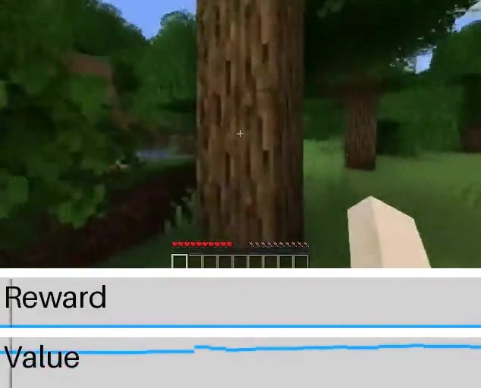
What a world model is — and what 'learning in imagination' means
The Dreamer lineage: same idea, increasingly capable simulators
World model: a learned simulator that predicts what happens next given the current situation and an action
Imagination training: the policy is optimised on rollouts generated by the model, not by the real environment — cheap, parallel, safe
Why it matters now: robots and other real-world systems cannot afford millions of trial-and-error interactions; video on the internet is abundant
Dreamer 4's bet: if the simulator is accurate enough about object interactions, RL inside it can go beyond what pure imitation learns
Imagined rollout decoded for visualisation, with the agent's reward and value estimates (project page, 'Gather wood').
Dreamer (2019)
latent imagination on DM Control
DreamerV2 (2020)
discrete latents, Atari
DreamerV3 (2023/Nature 2025)
one config for 150+ tasks; diamonds with online RL
Dreamer 4 (2025)
transformer diffusion WM; diamonds offline; real-time on 1 GPU
Dreamer 4 · Hafner, Yan, Lillicrap (Google DeepMind) · arXiv 2509.24527
PART 1 · WORLD MODELS
5
Notes:
The core idea has been constant since the first Dreamer in 2019: learn a model of the environment, then train the policy on imagined trajectories. What changed in Dreamer 4 is the simulator: a 2-billion-parameter block-causal transformer trained with a diffusion-style objective, accurate enough that a human can play inside it. The frame on the right is an imagined rollout, not the real game.

Slide 6
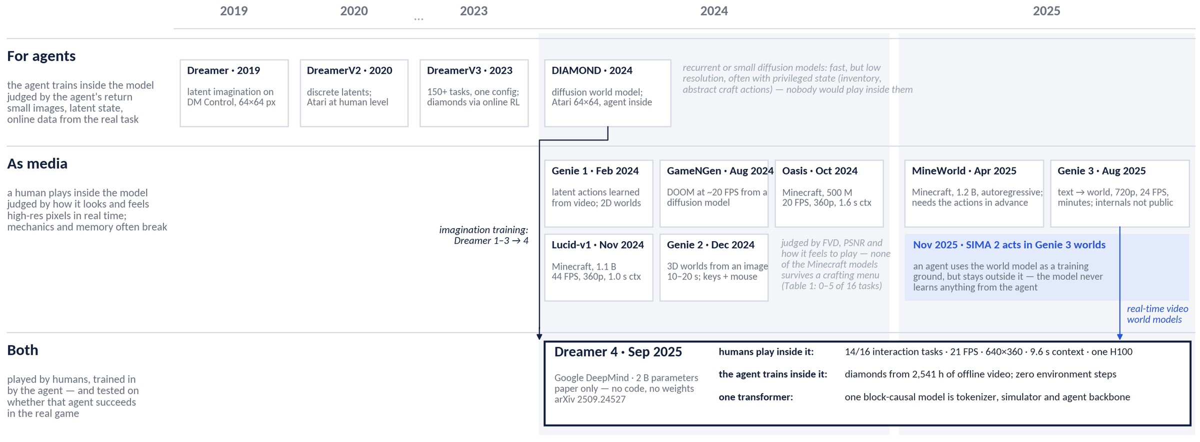
Two families of world models — and where Dreamer 4 sits
2019–2025: models an agent trains inside vs. models a human plays inside (numbers from Table 1 and the vendors' announcements)
Two yardsticks: agent-side models are judged by the agent's return, media-side models by how the video looks — Dreamer 4 is held to both, plus a third: does an agent trained only inside it succeed in the real game?
Direct baselines are the playable Minecraft models (Table 1); Genie 3 is the closest in ambition but exposes no comparable action space, so the paper cannot compare against it (§4.2)
Dreamer 4 · Hafner, Yan, Lillicrap (Google DeepMind) · arXiv 2509.24527
PART 1 · WORLD MODELS
6
Notes:
A map of the field. Top row: world models built for agents, from the first Dreamer in 2019 to DreamerV3 and DIAMOND — fast, but small images and often privileged state; nobody would want to play inside them. Middle row: the 2024–25 wave of world models as media — Genie, GameNGen, Oasis, Lucid-v1, Genie 2, MineWorld, Genie 3 — high-resolution, real-time, made for people to play, judged by how they look. The Minecraft ones are the direct baselines in the paper, and none of them survives a crafting menu. The blue note is the other way to combine the two: SIMA 2 trains inside Genie 3's worlds, but the agent stays outside the model. Dreamer 4, bottom, is the first model that sits in both rows: humans play it, the agent trains in it, and the agent is then tested in the real game.

Slide 7
What an agent needs from a world model — and why that was hard
Three requirements that pulled in different directions
01
02
03
Fidelity of interactions
Speed
Memory & drift
Video generators look good but get game mechanics wrong: inventories, crafting menus, breaking blocks, placing a boat and riding it.
Prior Minecraft world models (Oasis, Lucid-v1, MineWorld) fail most such tasks.
Imagination RL needs millions of generated frames — and a human tester needs ≥ 20 FPS.
Diffusion transformers spend tens of denoising steps per frame: 0.8 FPS for the baseline in this paper.
Autoregressive video drifts: small errors feed back into the context.
Short contexts (1–2 s in prior models) forget what is behind the player.
Dreamer 3's RSSM is fast (~1,000× faster than a diffusion transformer) but operates at 64×64 pixels and needed abstract inventory state and crafting actions — not raw mouse & keyboard
Dreamer 4's answer: a diffusion transformer that needs only 4 sampling steps (shortcut forcing), an architecture tuned for long context at low cost, and training tricks that keep long rollouts stable (x-prediction, noised context)
Dreamer 4 · Hafner, Yan, Lillicrap (Google DeepMind) · arXiv 2509.24527
PART 1 · WORLD MODELS
7
Notes:
Three tensions: fidelity versus speed versus stability over long horizons. Prior Minecraft world models chose speed and looked plausible, but a human trying to craft a pickaxe inside them fails. The recurrent Dreamer 3 model was fast but low-resolution and relied on privileged state. Dreamer 4 tries to get all three at once.

Slide 8
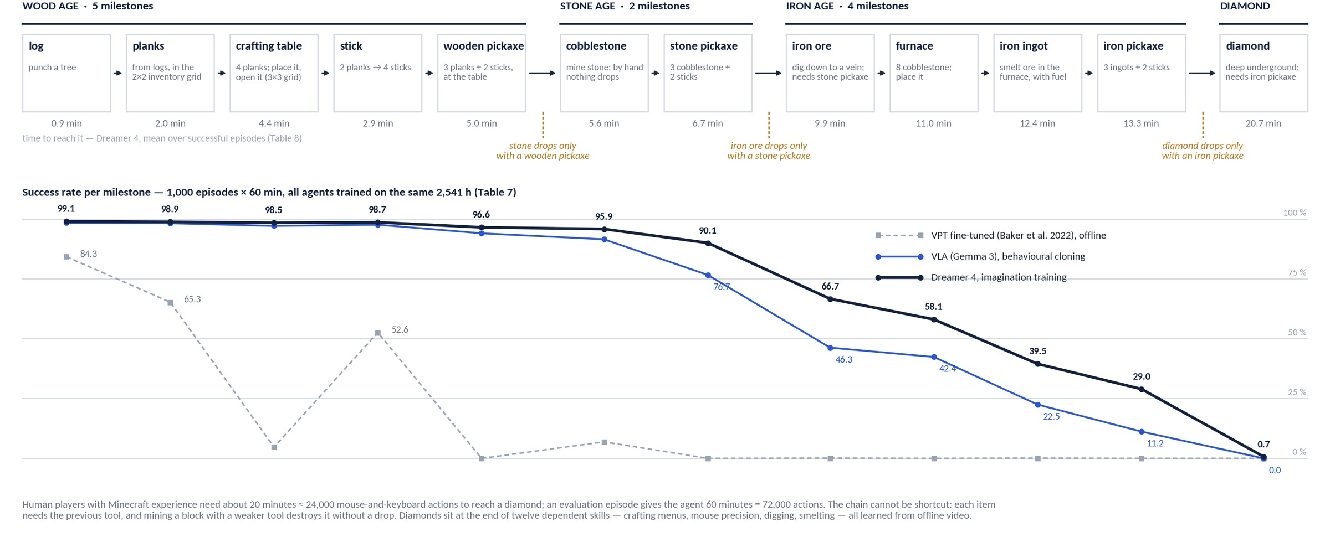
The test: twelve milestones, three tool gates, ~24,000 actions
2,541 h of human gameplay video, no environment interaction — and where each agent falls off (Tables 7 and 8)
Dreamer 4 · Hafner, Yan, Lillicrap (Google DeepMind) · arXiv 2509.24527
PART 1 · WORLD MODELS
8
Notes:
The whole challenge on one picture. Top row: the twelve milestone items in the order the evaluation prompts them, grouped into wood, stone and iron ages and the diamond. The amber gates are game rules, not choices: stone only drops if you hold a wooden pickaxe, iron ore needs a stone pickaxe, diamonds need an iron pickaxe — mining with a weaker tool destroys the block. So there is no shortcut; every item depends on the previous tool, and each step is a different skill: punching, menu navigation with the mouse, placing blocks, digging, smelting. The minutes under the boxes are Dreamer 4's mean time to each item over successful episodes, Table 8: about 13 minutes to the iron pickaxe, 21 to a diamond — humans take about 20. Bottom: success rates from Table 7. Every agent nails the wood age; VPT's offline policy already dies at the wooden pickaxe; the Gemma-3 VLA and Dreamer 4 separate from the stone pickaxe on, and the gap grows with the horizon: 29 versus 11 percent at the iron pickaxe, and only Dreamer 4 ever reaches a diamond. Keep this curve in mind — Part 3 asks where the gap comes from.

Slide 9
02
PART 2
What makes Dreamer 4 special
Six design decisions: latents, shortcut forcing, a fast architecture, the agent inside, offline RL, cheap labels
9

Slide 10
What makes Dreamer 4 special: six design decisions
Each maps to a slide in this part; the phase of the recipe it belongs to is in brackets
01
Latents, not pixels. A causal tokenizer compresses each frame to 256 continuous tokens; simulation and RL happen in latent space, pixels are only decoded for people [phase 1]
THE RECIPE (ALGORITHM 1)
Phase 1 · World-model pretraining — tokenizer (masked autoencoding), then the dynamics model with shortcut forcing on all 2,541 h, labeled or not
Phase 2 · Agent fine-tuning — add agent tokens, policy and reward heads; behavioural cloning with multi-token prediction while the dynamics loss keeps running
Phase 3 · Imagination training — freeze the transformer; train policy and value heads by RL on rollouts inside the model
One block-causal transformer throughout; the agent is a few heads on top of the simulator.
02
Shortcut forcing: diffusion quality in four steps. Diffusion forcing + shortcut models, with x-prediction and an x-space loss, so long rollouts stay sharp and fast [phase 1]
03
An architecture tuned for 21 FPS on one GPU. Space attention in most layers, causal time attention every 4th, grouped-query attention, registers — 9.6 s of context in real time [phase 1]
04
The agent lives inside the world model. Agent tokens with one-way attention read the simulator's state; policy, reward and value are small heads on the same transformer [phase 2]
05
Imagination training, offline, with PMPO. The transformer is frozen; policy and value heads learn from imagined rollouts scored by the learned reward head, anchored to the BC prior [phase 3]
06
Action semantics from few labels. Unlabeled video gets a learned 'no action' embedding; ~100 h of labels suffice and the actions transfer to worlds seen only unlabeled [phase 1]
Dreamer 4 · Hafner, Yan, Lillicrap (Google DeepMind) · arXiv 2509.24527
PART 2 · WHAT MAKES DREAMER 4 SPECIAL
10
Notes:
The recipe on the right is three phases: pretrain the world model, fine-tune it into an agent by imitation, then train the policy by RL inside the model. The six items on the left are what the paper does differently at each step, and they are the structure of this part: one slide per item, with the shortcut-forcing item getting the three primers it needs.

Slide 11
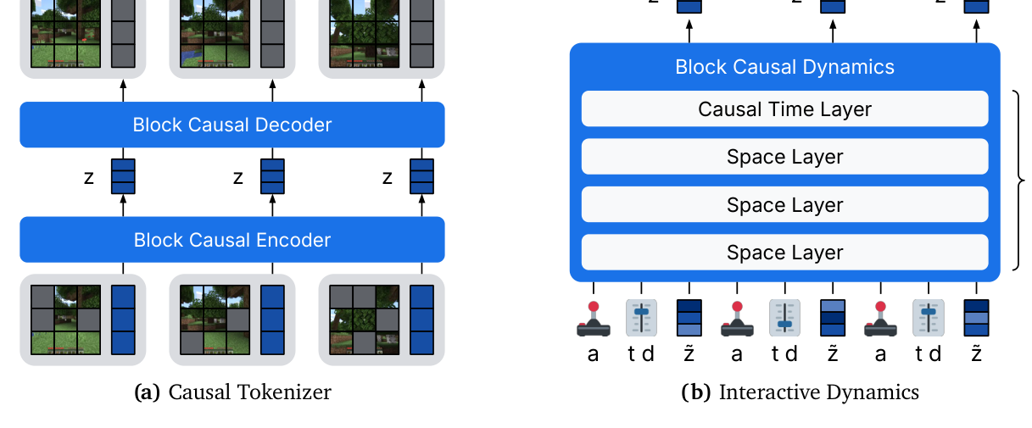
1 · One transformer, two roles: causal tokenizer + dynamics model
Figure 2: causal tokenizer + interactive dynamics model, one shared block-causal transformer
Total 2 B parameters: ≈ 400 M tokenizer + 1.6 B dynamics
Frames: 360×640, zero-padded to 384×640 → 960 patches of 16×16
Latents: N_z = 256 tokens × 32 dims per frame (512×16 bottleneck, tanh)
Context: 192 frames = 9.6 s at 20 FPS
Block-causal: full attention within a frame, causal across frames → usable online, frame by frame
Transformer recipe: pre-RMSNorm, RoPE, SwiGLU, QK-norm, logit soft-capping, register tokens
Left: causal tokenizer (masked patches → latent tokens → reconstruction). Right: interactive dynamics — interleaved action tokens a, latent tokens z, and per-frame signal level τ / step size d; space layers with a causal time layer every 4th block. (Figure 2, arXiv 2509.24527)
Dreamer 4 · Hafner, Yan, Lillicrap (Google DeepMind) · arXiv 2509.24527
PART 2 · WHAT MAKES DREAMER 4 SPECIAL
11
Notes:
Both halves use the same transformer block. Block-causal means every token in frame t can see all tokens of frames up to t, which is exactly what you need for online, frame-by-frame generation with a human or a policy in the loop.

Slide 12
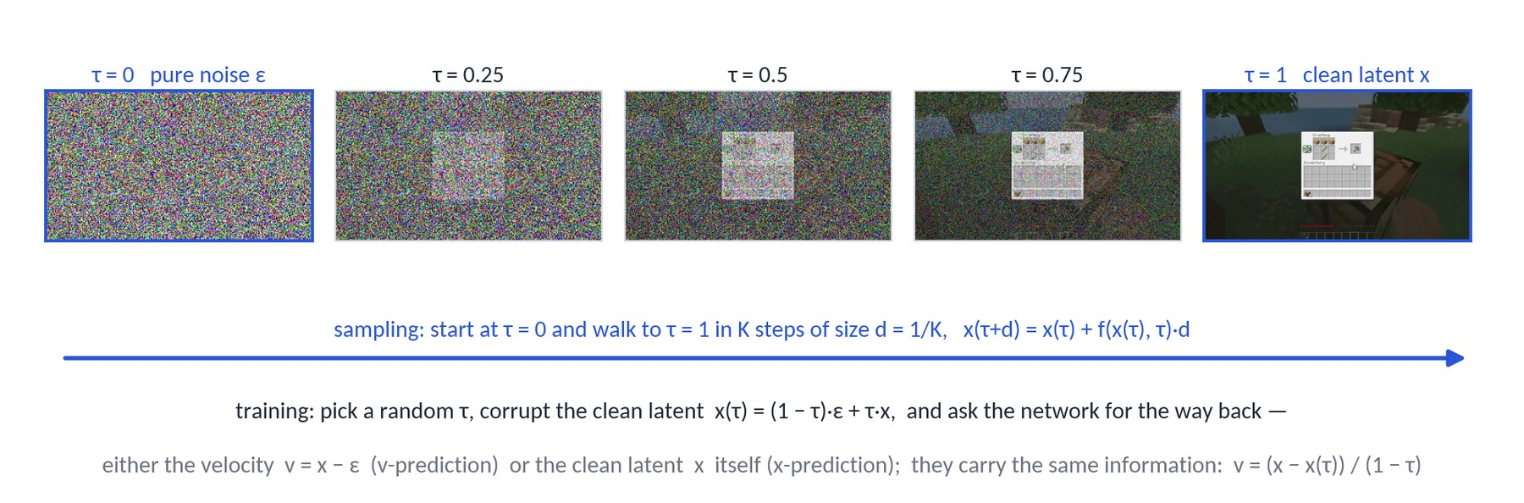
2 · Primer 1 of 3 · Flow matching: one dial from noise to image
The background the dynamics objective is built on (paper §2)
Signal level τ ∈ [0, 1]: x(τ) = (1 − τ)·ε + τ·x — τ = 0 is pure noise, τ = 1 the clean latent; during training τ is drawn at random for every example
The network learns a direction: f(x(τ), τ) ≈ v = x − ε, the velocity pointing from noise to data; sampling starts from noise and walks to τ = 1 in K steps
Two ways to say the same thing: predict the velocity v (standard) or the clean latent x directly (x-prediction); the maths is identical, the error behaviour under autoregressive feedback is not (slide 17)
Why so many steps? The learned direction is only locally right, so ordinary diffusion needs 16–64 small steps per image — far too slow for a 20 FPS simulator
Dreamer 4 · Hafner, Yan, Lillicrap (Google DeepMind) · arXiv 2509.24527
PART 2 · WHAT MAKES DREAMER 4 SPECIAL
12
Notes:
For the non-diffusion people: think of a dial τ from 0 (pure noise) to 1 (clean latent). Training corrupts a clean latent to a random position on the dial and asks the network for the way back, either as a direction (velocity) or as the clean end point. Sampling turns the dial from 0 to 1 in K steps. The strip at the top is a real world-model frame mixed with Gaussian noise at five signal levels. The problem for a real-time simulator is K: standard models need dozens of steps per frame.

Slide 13
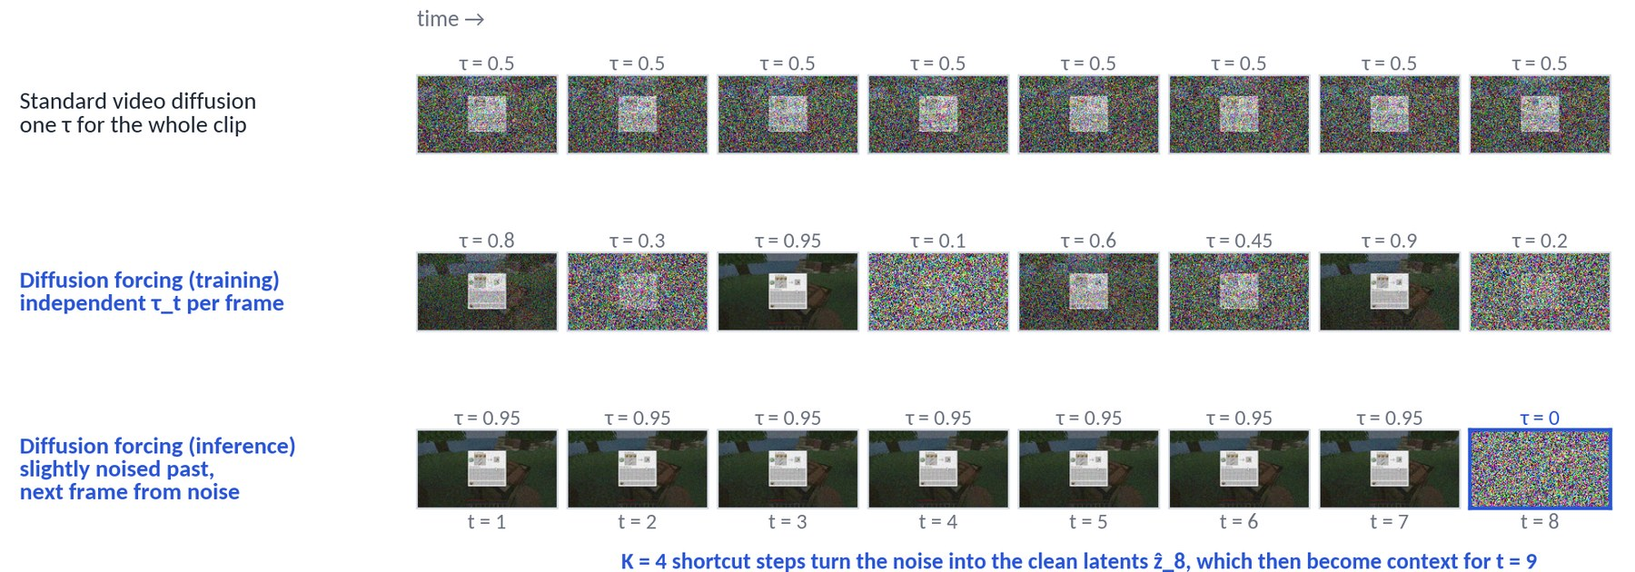
2 · Primer 2 of 3 · Diffusion forcing: a noise level per frame
Chen et al., 2024 — what makes causal, frame-by-frame generation possible
Standard video diffusion corrupts the whole clip with one τ: past and future are always equally noisy, so the model cannot be rolled out one frame at a time
Diffusion forcing draws an independent τ_t for every frame; each frame is at once a denoising target and (noisy) history for the frames after it — a single loss over the whole sequence
What it buys at inference: generate the next frame from pure noise given a clean or lightly noised past — exactly the interactive setting; keeping the past slightly noised makes the model robust to its own small mistakes
What it does not fix: still tens of denoising steps for every frame — the 0.8 FPS starting point of the design cascade (Table 2)
Dreamer 4 · Hafner, Yan, Lillicrap (Google DeepMind) · arXiv 2509.24527
PART 2 · WHAT MAKES DREAMER 4 SPECIAL
13
Notes:
Diffusion forcing is the trick that turns a video diffusion model into a causal simulator: every frame gets its own noise level, so the model learns to predict a noisy future from a cleaner past. That is precisely the situation at inference, where the past is what the model generated a moment ago. What it does not solve is speed; that is what shortcut models are for.

Slide 14
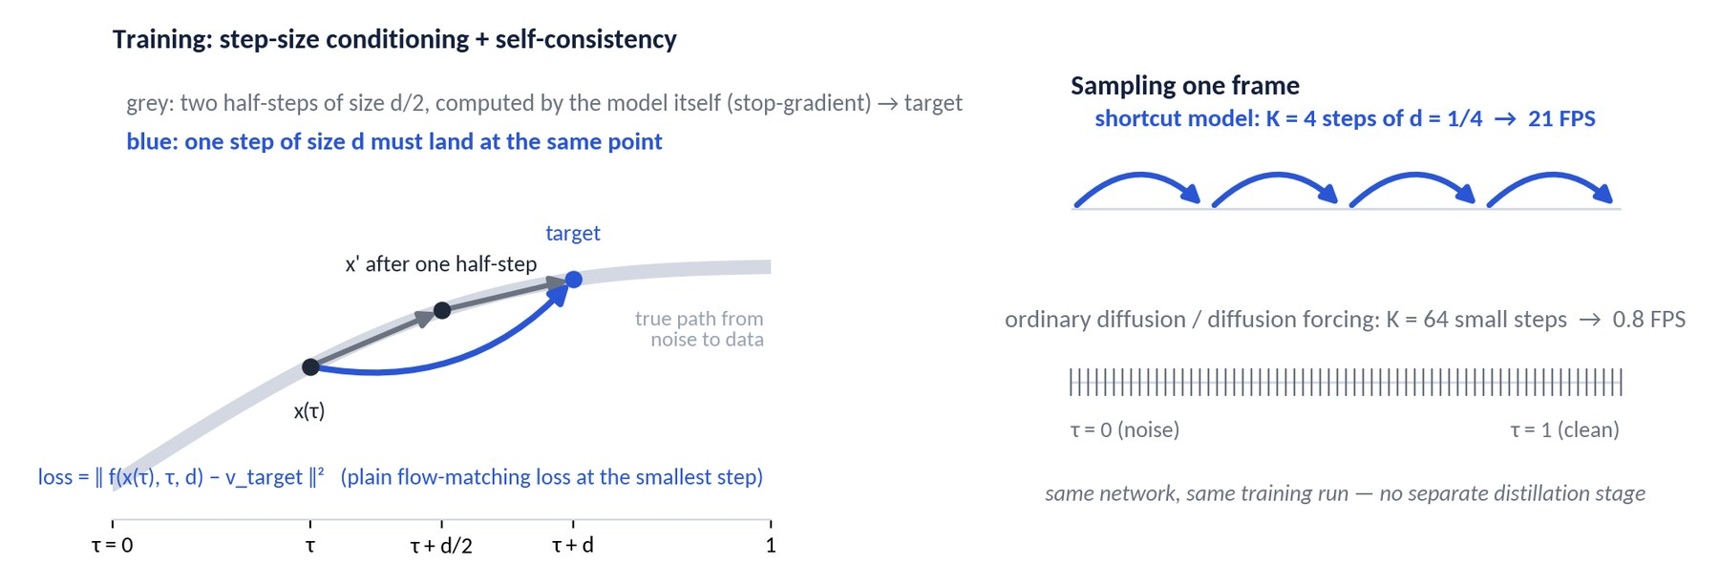
2 · Primer 3 of 3 · Shortcut models: learning to take big steps
Frans, Hafner, Levine, Abbeel, 2024 — why four sampling steps can be enough
Add the step size d as an input: f(x(τ), τ, d) predicts the average direction over a jump of size d, not just the local direction
Smallest step: ordinary flow-matching loss. Larger steps: self-consistency (bootstrap) loss — one step of size d must land where two steps of size d/2 land; the two-step target is produced by the model itself with gradients stopped
Result: 2–4 steps reach the quality of 64 in the original paper, with no separate distillation stage — one model, one training run
Dreamer 4 combines the two: per-frame τ_t from diffusion forcing + step-size conditioning from shortcut models = shortcut forcing, K = 4 steps per frame at 21 FPS (next slide)
Dreamer 4 · Hafner, Yan, Lillicrap (Google DeepMind) · arXiv 2509.24527
PART 2 · WHAT MAKES DREAMER 4 SPECIAL
14
Notes:
Shortcut models teach the network to take big steps consistently. The extra input is the step size; the extra loss says that one big step must agree with two half steps that the model computes itself. Because the target is deterministic it is easier to fit than the noisy flow-matching target, which is one reason the bootstrap term works well. Dreamer 4 combines this with diffusion forcing into shortcut forcing.

Slide 15
2 · Shortcut forcing: the training objective
Diffusion forcing + shortcut models, with three engineering choices that turn out to matter a lot
Per-frame noise: each frame gets an independent signal level τ_t; the model predicts frame t's clean latent from the noisy frame t, past frames, and actions
Step-size conditioning: the network also receives d; for d > d_min the target is the bootstrap target — the result of two half-steps computed by the model itself (no gradient through the target)
Choice 1 — x-prediction: the network outputs the clean latent, not the velocity
Choice 2 — loss in x-space: the bootstrap target is formed in v-space (where two half-steps compose cleanly) but the loss is scaled back to x-space by (1 − τ)²
Choice 3 — ramp weight: loss weight w(τ) = 0.9 τ + 0.1 emphasises high-signal (low-noise) levels, where fine detail is decided
Inference: K = 4 steps per frame; context frames at τ_ctx ≈ 0.1; sampling remains stochastic → diverse imagined futures for RL
EFFECT OF EACH PIECE (TABLE 2, FVD ↓)
Diffusion forcing, K = 64 steps: 306 (0.8 FPS)
Same model, K = 4 steps: 875
+ shortcut objective: 329
+ x-prediction: 326
+ x-space loss: 151
+ ramp weight: 102
Full architecture but v-space prediction/loss: 124 vs 57
WHY THIS IS THE KEY CONTRIBUTION
4 steps ≈ the quality of 16–32 diffusion-forcing steps (Fig. 8) — roughly 16× fewer network evaluations per frame, which is what makes real-time interaction and large-scale imagination RL feasible.
Dreamer 4 · Hafner, Yan, Lillicrap (Google DeepMind) · arXiv 2509.24527
PART 2 · WHAT MAKES DREAMER 4 SPECIAL
15
Notes:
Here is the objective in words. Combining the two prior ideas gets you from 875 back to 329 FVD at 4 steps — but the big wins come from the parameterisation details: predicting x instead of v, computing the loss in x-space, and the ramp weight together take FVD from 329 to 102. These are the kind of choices you only discover with a careful cascade of ablations, which the paper provides.

Slide 16
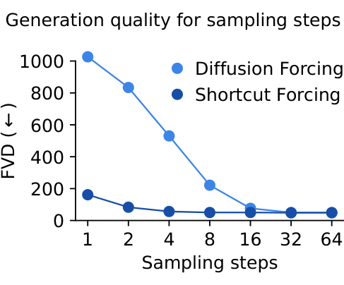
2 · Why x-prediction matters for autoregressive world models
Hafner's explanation (TalkRL, Nov 2025) and the numbers
v-prediction carries the noise: to output v = x − ε the network must reproduce the exact noise pattern of its input through every layer; small mistakes in that noise become errors in the sample
In autoregressive use these errors compound: each generated frame becomes context for the next; velocity errors accumulate as drift, blur or flicker over long rollouts
x-prediction is a denoising target: the network only needs to know what the clean frame should look like — errors are 'pulled back' toward plausible images every step
Combined with noised context (τ_ctx ≈ 0.1): the model is trained and run on slightly corrupted context, so it never sees a distribution it was not trained on
Evidence: full architecture with v-space prediction/loss reaches FVD 124; with x-prediction and x-space loss, 57 (Table 2). Long 384-frame generations were used for FVD precisely to expose compounding error
Figure 8: FVD vs sampling steps. Shortcut forcing at 4 steps ≈ 60; diffusion forcing needs 16–32 steps to match.
Dreamer 4 · Hafner, Yan, Lillicrap (Google DeepMind) · arXiv 2509.24527
PART 2 · WHAT MAKES DREAMER 4 SPECIAL
16
Notes:
This is the most transferable lesson of the paper for anyone building autoregressive generative models: predict the clean signal, not the velocity, when your own outputs become your inputs. Open Dreamer, the open-source reproduction, independently confirmed this — they report the same instability with v-prediction at scale.

Slide 17
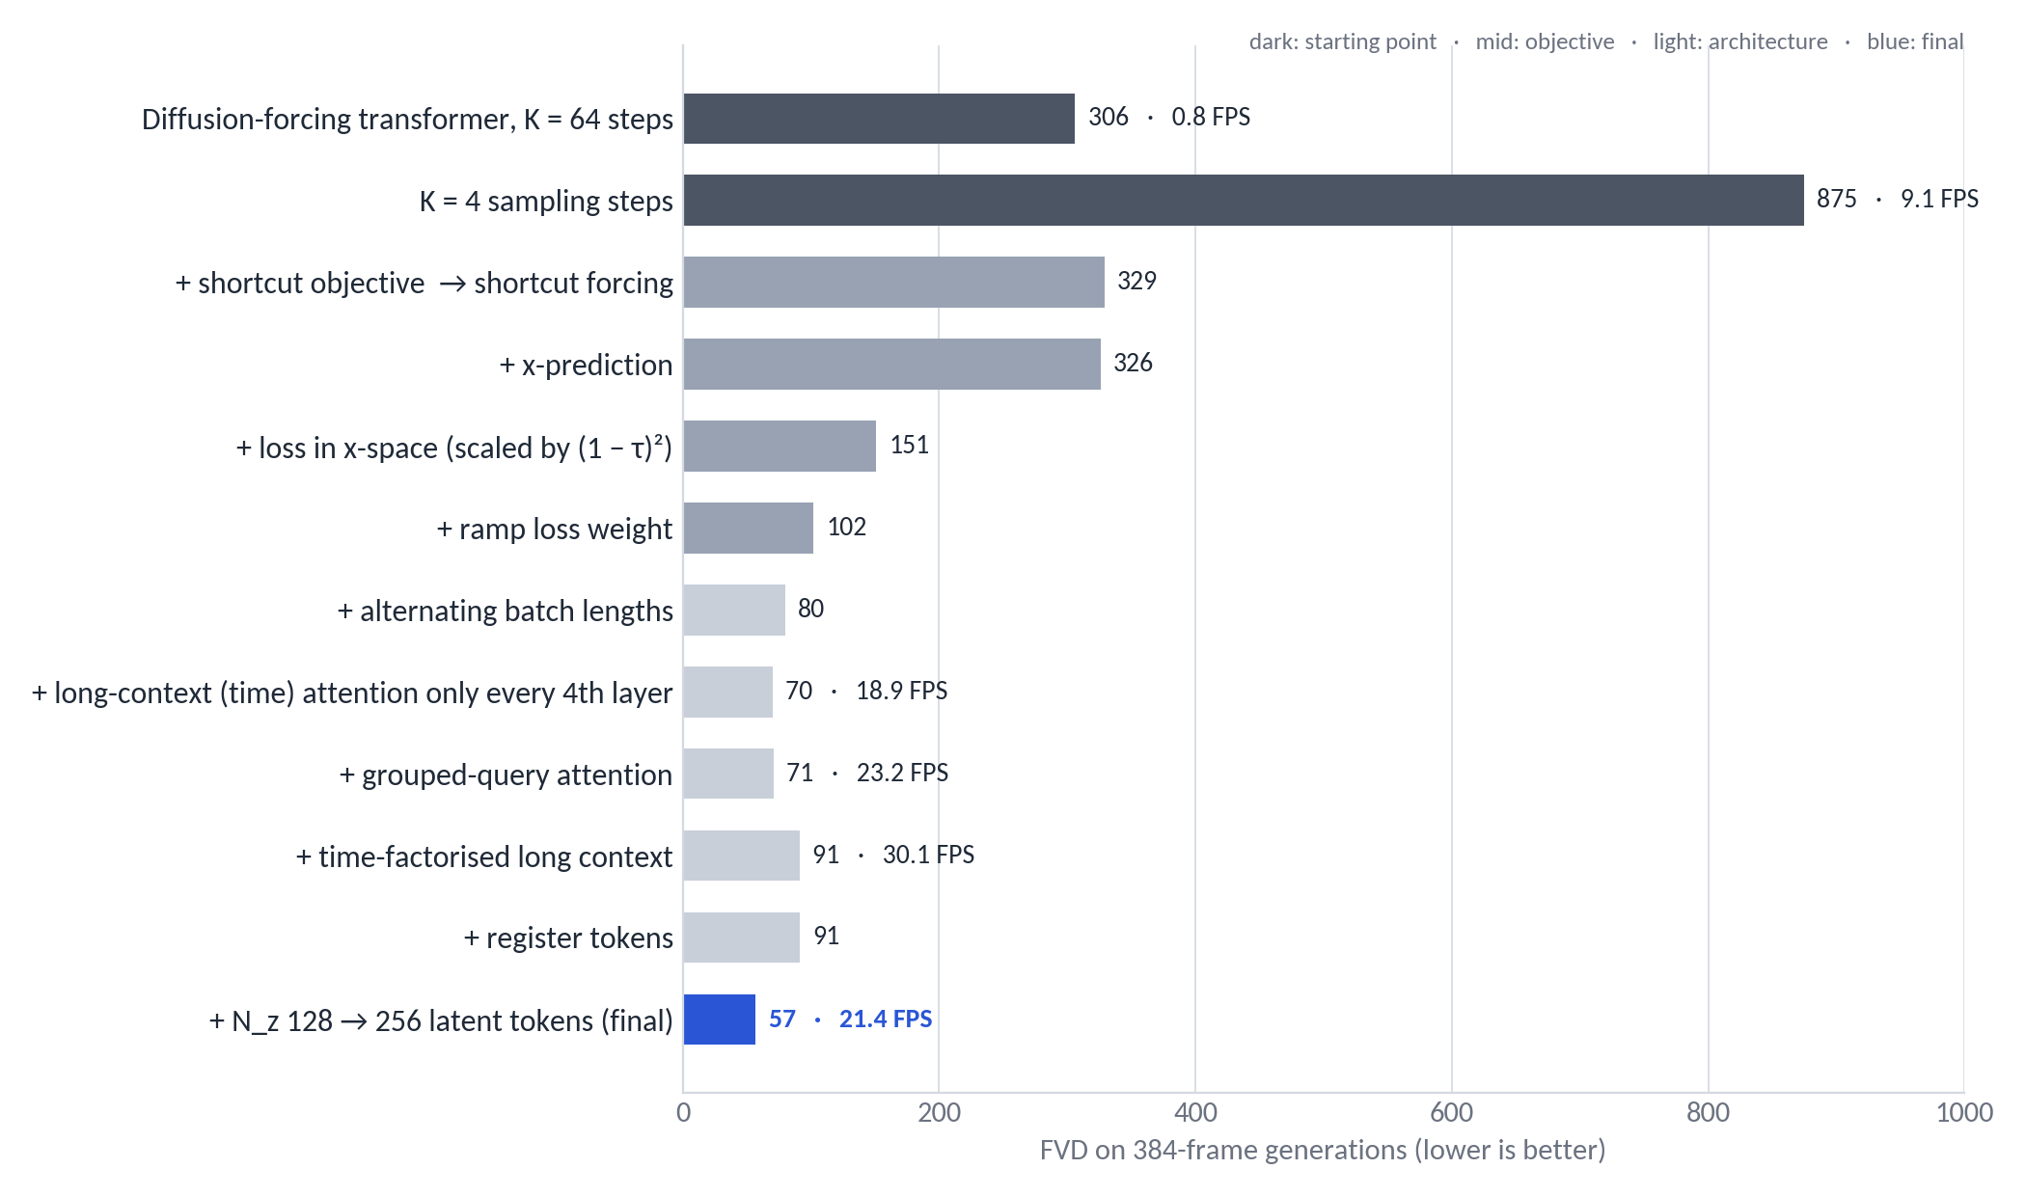
3 · Architecture choices that buy speed without losing quality
Table 2: each row adds one change to the previous row
Alternating batch lengths (64 / 256 frames): FVD 102 → 80 and a training step from 9.8 s → 1.5 s
Time attention only every 4th layer: 18.9 FPS at FVD 70
Grouped-query attention: 23.2 FPS, FVD unchanged
Time-factorised long context trades a little quality (91) for 30 FPS; registers stabilise attention
More latent tokens (128 → 256) brings FVD to 57 at 21.4 FPS — the final configuration
Runs were 48 h each; FVD computed on 1,024 generations of 384 frames
Dreamer 4 · Hafner, Yan, Lillicrap (Google DeepMind) · arXiv 2509.24527
PART 2 · WHAT MAKES DREAMER 4 SPECIAL
17
Notes:
Read the bars top to bottom. The two dark bars at the top are the starting point: a diffusion-forcing transformer that is either slow or bad. The grey bars are the objective changes from the previous slides; the blue bar is the final model. The architectural changes on the lower half mostly move FPS, not FVD — exactly what you want.

Slide 18
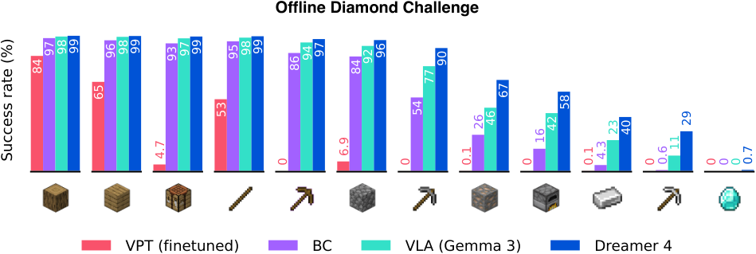
4 · From world model to agent: agent tokens & heads
Phase 2 — policy and reward live inside the same transformer, but cannot disturb the simulation
Agent tokens: extra tokens per frame that carry a task embedding (one-hot over the 20 training tasks) and read out policy and reward
One-way attention: agent tokens attend to actions, latents and past frames — but nothing attends back to them, so the world model never conditions on the policy's intentions or reward estimates
Policy head — behavioural cloning with multi-token prediction: predict the next L = 8 actions; the extra horizon regularises the representation and encodes intent
Reward head: predicts task rewards derived from game events (item obtained); a task-conditioned scalar reward was chosen over a reward vector so that open-vocabulary tasks remain possible
Value head: added in Phase 3, trained by TD learning on imagined rollouts
Result already at this stage: 'WM + BC' beats BC on every hard milestone (iron pickaxe 16.9 % vs 0.6 %) — the video-prediction representation is a strong prior for control
Figure 3: success rates of agents trained on the same offline data (BC, VLA, WM+BC, Dreamer 4).
WHY NOT A SEPARATE POLICY NETWORK?
Sharing the backbone gives the policy the world model's representation for free, and keeps everything one model. The one-way attention mask is what makes this safe.
Dreamer 4 · Hafner, Yan, Lillicrap (Google DeepMind) · arXiv 2509.24527
PART 2 · WHAT MAKES DREAMER 4 SPECIAL
18
Notes:
Agent tokens are the interface between simulation and decision making. The one-directional mask is subtle but important: if latents could attend to agent tokens, the model could 'cheat' by predicting frames consistent with what the policy intends rather than with the physics of the game. Notice how much of the gain over BC comes from this phase alone — the representation matters.

Slide 19
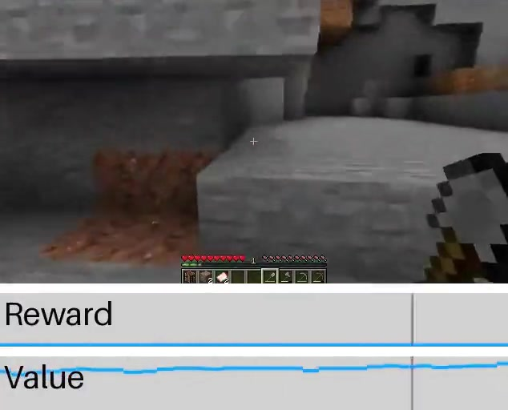
5 · Imagination training with PMPO
Phase 3 — RL on imagined rollouts, with the transformer frozen
Rollouts: start from real context frames, let the policy act, and let the world model generate what happens next; rewards come from the learned reward head; γ = 0.997
Frozen transformer: only policy and value heads are trained → the simulator cannot drift toward the policy
PMPO (Preference-style MPO): instead of scaling the policy gradient by the advantage, use only its sign — positive-advantage actions are pushed up, negative ones down, with balanced weight α = 0.5 on each set
Reverse-KL to the frozen BC policy with β = 0.3 keeps the policy on the data manifold — analogous to KL-regularised RLHF; also the main guard against exploiting world-model gaps
Why not Dreamer 3's recipe? Return normalisation + entropy bonus were replaced by the sign-based update: robust to reward scale and to the extremely sparse late-game rewards
Effect: iron pickaxe 16.9 % → 29.0 %, iron ingot 27.8 % → 39.5 %, diamond 0 → 0.7 %; agents also become faster (Table 8)
Imagined 'mine stone' rollout with reward and value traces (project page).
FAILURE MODE THE KL TERM ADDRESSES
Hafner's example: the policy discovers it can 'craft' a pickaxe from invalid materials because the model renders it anyway. The KL to the BC prior limits such exploitation.
Dreamer 4 · Hafner, Yan, Lillicrap (Google DeepMind) · arXiv 2509.24527
PART 2 · WHAT MAKES DREAMER 4 SPECIAL
19
Notes:
PMPO is deliberately simple. Using only the sign of the advantage makes the update invariant to reward scale, which matters when rewards are rare item events. The KL term to the BC policy is doing two jobs: stabilising RL and preventing the policy from wandering into regions the world model gets wrong. Hafner mentioned in a talk that a few rounds of corrective online data would allow a much weaker KL — but that is not in the paper.

Slide 20
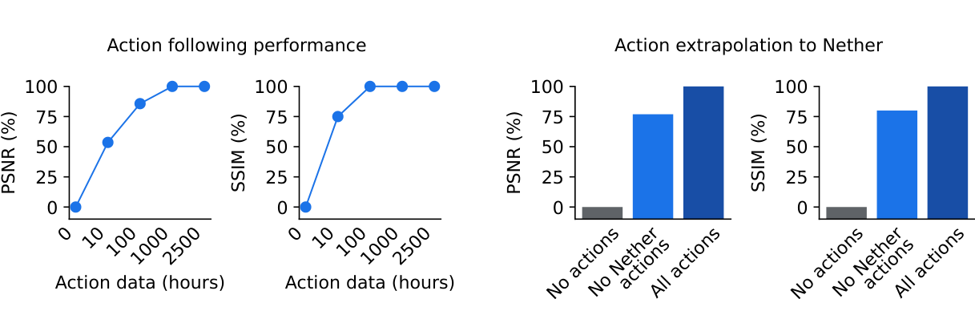
6 · Unlabeled video: how many action labels are needed?
Figure 7 — action conditioning from a small labeled fraction, and transfer to unseen visual domains
MECHANISM
Unlabeled frames receive a learned 'no action' embedding; the dynamics loss is the same. The model therefore learns visual dynamics from everything and the action mapping from the labeled slice.
Setup: train on all 2,541 h of video, but keep actions for only a subset; measure PSNR/SSIM of action-conditioned predictions, normalised between 'no actions' (0 %) and 'all actions' (100 %)
10 h of labels → 53 % PSNR / 75 % SSIM; 100 h → 85 % / 100 %; 1,000 h → 100 % — action understanding saturates with roughly 4 % of the data labeled
Domain transfer: with actions only from the Overworld, predictions in the Nether/End (seen unlabeled) recover 76 % / 80 % — the model separates 'what actions do' from 'what the world looks like'
Why it matters: the road to internet-scale video pretraining, where labels are scarce (VPT needed an inverse-dynamics model for this)
Dreamer 4 · Hafner, Yan, Lillicrap (Google DeepMind) · arXiv 2509.24527
PART 2 · WHAT MAKES DREAMER 4 SPECIAL
20
Notes:
This experiment is easy to overlook but strategically important. Only about a hundred hours of labeled actions are needed on top of thousands of unlabeled hours, and the learned action semantics transfer to visual domains that were never labeled. That is the argument for scaling to internet video later.

Slide 21
03
PART 3
Does it hold up?
Humans inside the model, diamonds from offline data, and where the gains come from
21

Slide 22
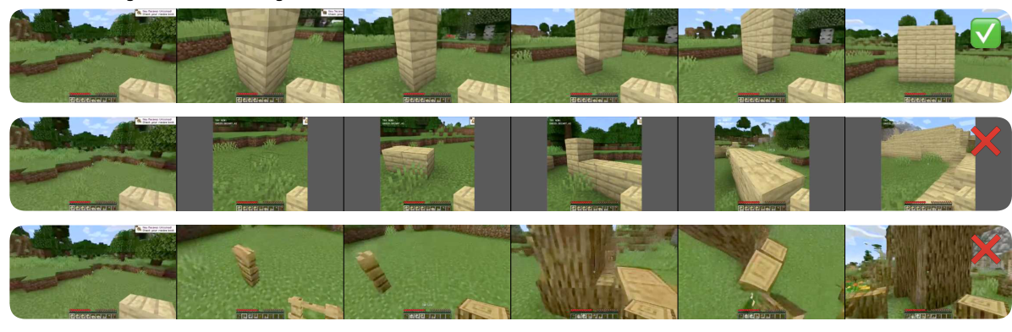
Is the world model accurate? Let humans play inside it
Table 1: real-time interaction on one H100; 16 tasks attempted by human testers from the same starting frame
Model | Params | Resolution | Context | FPS | Tasks solved
MineWorld | 1.2 B | 384×224 | 0.8 s | 2 | not evaluable (needs actions in advance)
Lucid-v1 | 1.1 B | 640×360 | 1.0 s | 44 | 0 / 16
Oasis (small) | 500 M | 640×360 | 1.6 s | 20 | 0 / 16
Oasis (large) | — | 360×360 | 1.6 s | ~5 | 5 / 16
Dreamer 4 | 2 B | 640×360 | 9.6 s | 21 | 14 / 16
Figure 5: same task, same start frame — Dreamer 4 (top) builds the wall; Lucid-v1 and Oasis do not.
The 16 tasks: eat apple · place 3 torches · chop tree · dig 3×3 pit · craft wooden pickaxe · use furnace · place & open workbench · kill zombies · mine diamonds · complete window · place & ride boat · enter portal · place door · bed & sleep · plant reed & pour water · turn 360° & enter house
The two failures were memory-related: the world changes when you look away for longer than the 9.6 s context, and inventory contents become unclear over time
Genie 3 is not compared: it has no fine-grained mouse/keyboard control
WHY THIS EVALUATION
FVD and PSNR measure how video looks; only interaction tests whether the model got the mechanics right. The paper complements it with FVD on 384-frame rollouts, but no long-horizon quantitative interaction metric exists yet — a fair critique.
Dreamer 4 · Hafner, Yan, Lillicrap (Google DeepMind) · arXiv 2509.24527
PART 3 · DOES IT HOLD UP?
22
Notes:
This is the paper's most convincing evidence about the world model. Real people sit down with a mouse and keyboard and try to do things. Dreamer 4 is the only model in which crafting, riding a boat or entering a portal work. The caveat is on the right: this is a small, human-judged protocol; I'd like to see automated long-horizon metrics in follow-ups.

Slide 23
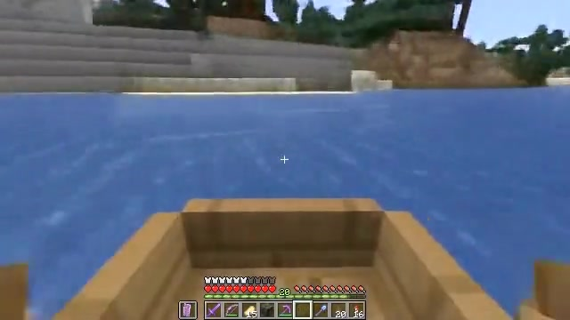

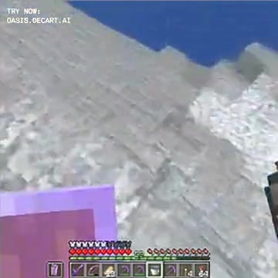
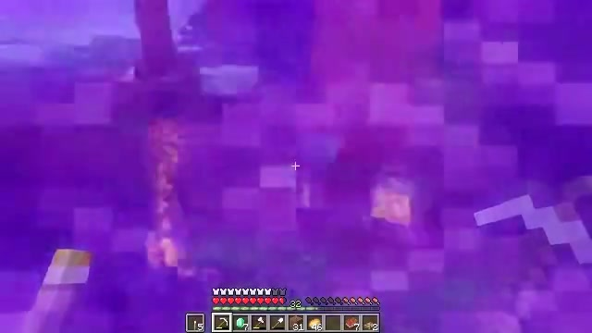
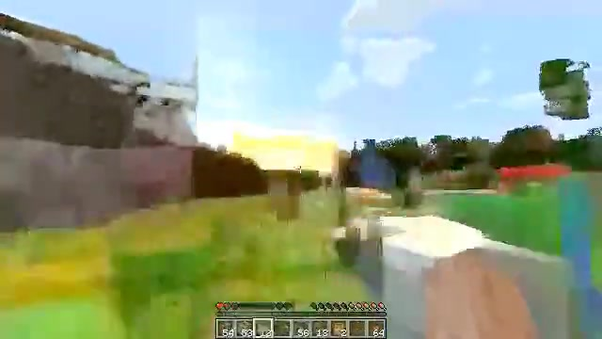
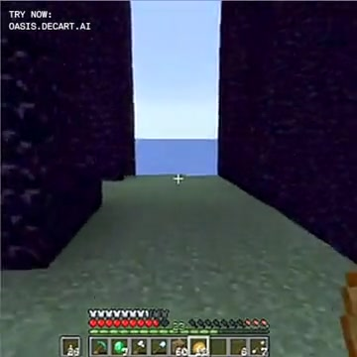
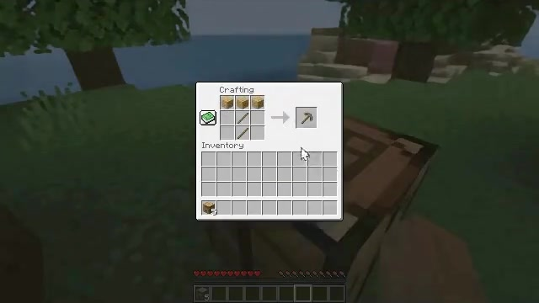
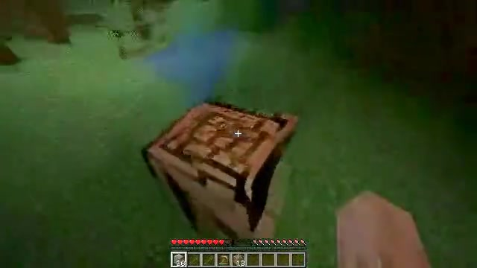
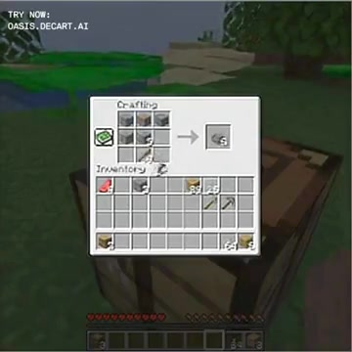
What 'accurate object interactions' looks like
Frames from the project page's side-by-side human sessions (same start frame, same human inputs)
Dreamer 4
Lucid-v1
Oasis
Place and ride boat
Enter portal
Craft wooden pickaxe
Single frames sampled from the project-page clips. Dreamer 4 renders the boat ride, the Nether-portal swirl and a working crafting-table menu; the baselines lose the scene or the menu. ▶ All 51 clips (17 tasks × 3 models): danijar.com/project/dreamer4
Dreamer 4 · Hafner, Yan, Lillicrap (Google DeepMind) · arXiv 2509.24527
PART 3 · DOES IT HOLD UP?
23
Notes:
Three of the sixteen tasks. In the boat task Lucid shows only blue; in the portal task the baselines never enter; in the crafting task Dreamer 4 opens a functional crafting menu. The clips themselves are in the resource archive if you want to play them during the talk.

Slide 24
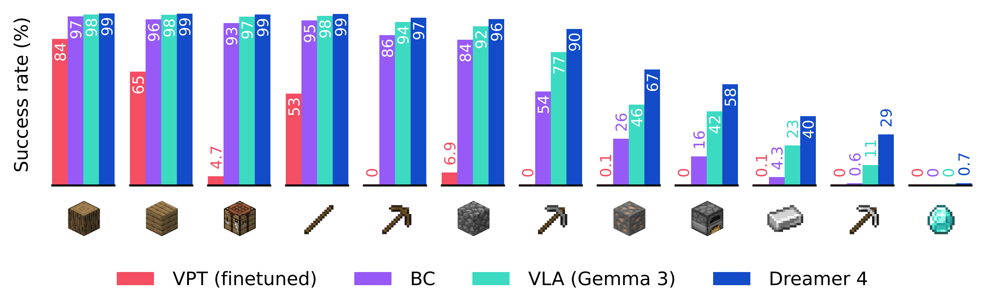
Diamonds from offline experience: the results
Success rate per milestone; 1,000 episodes × 60 min; same 2,541 h of data for all methods (Table 7 / Fig. 3)
Official figure from danijar.com/project/dreamer4 (benchmark.png). ▶ Watch the trained agent in the real game — four uncut 60-minute evaluation episodes on YouTube: Uncut #1 · #2 · #3 · #4
Dreamer 4: stone pickaxe 90.1 % · iron ore 66.7 % · furnace 58.1 % · iron ingot 39.5 % · iron pickaxe 29.0 % · diamond 0.7 % (≈ 7 of 1,000 episodes)
VLA on Gemma 3 (same data): iron pickaxe 11.2 %, no diamonds · BC: 0.6 % · VPT fine-tuned (pretrained on 270 K h of web video): only reliably reaches sticks
Gap widens along the tech tree: imitation is enough for early items, imagination RL matters where data is thin and horizons are long
Dreamer 4 · Hafner, Yan, Lillicrap (Google DeepMind) · arXiv 2509.24527
PART 3 · DOES IT HOLD UP?
24
Notes:
The official results figure. Every method nails the first items; the interesting region is the right half. Dreamer 4 roughly doubles or triples the VLA on iron-age items and is the only one reaching diamonds — rarely, but from zero interaction. Remember this is a 60-minute budget per episode; humans need about 20 minutes on average.

Slide 25
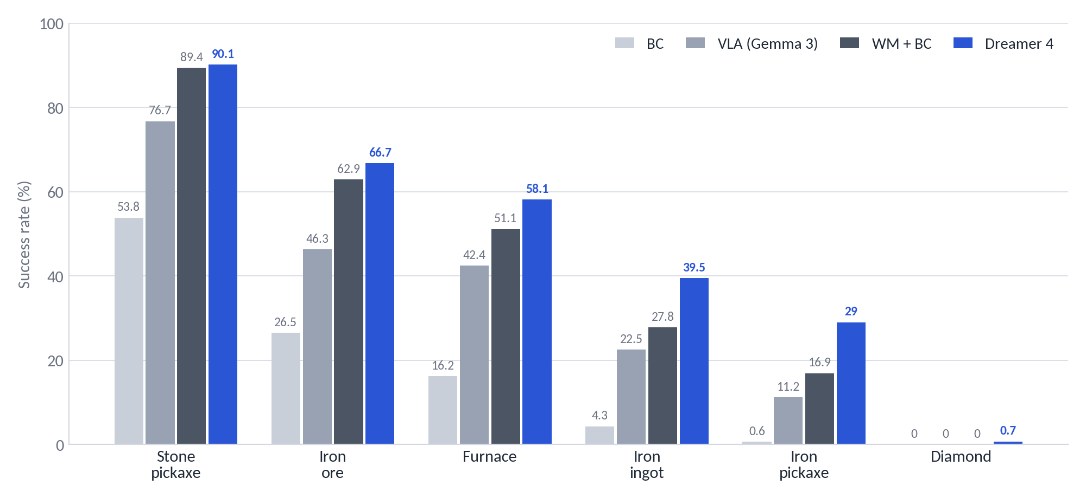
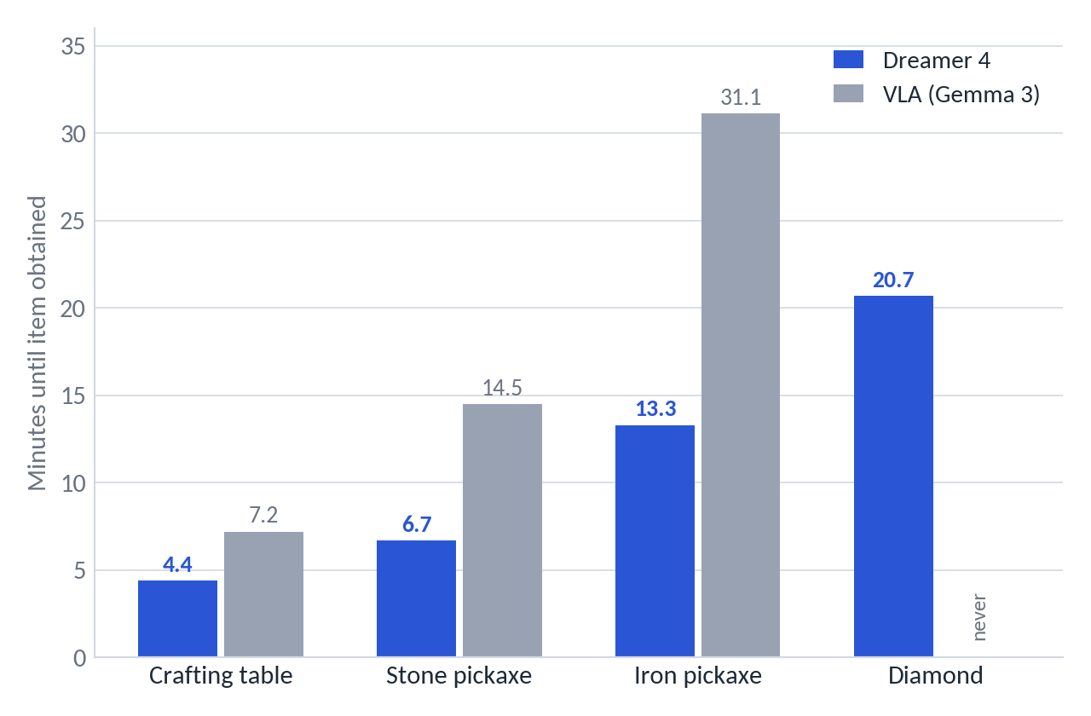
Where do the gains come from? Agent ablations and speed
Figure 4 / Table 8: representation (WM+BC vs BC) and imagination RL (Dreamer 4 vs WM+BC) both contribute
Representation: BC on the world model's features (WM+BC) vs plain BC — iron pickaxe 16.9 % vs 0.6 %; authors: 'video prediction implicitly learns an understanding of the world that is useful for decision making'
Imagination RL: adds +12 pts on iron pickaxe and +12 pts on iron ingot over WM+BC, and unlocks diamonds
Speed: Dreamer 4 is fastest at every milestone — iron pickaxe in 13.3 min vs 31.1 min for the VLA; diamonds in 20.7 min on average when achieved (human average ≈ 20 min)
Task input matters: BC without the task embedding collapses to 8.8 % stone pickaxe (Table 7)
Dreamer 4 · Hafner, Yan, Lillicrap (Google DeepMind) · arXiv 2509.24527
PART 3 · DOES IT HOLD UP?
25
Notes:
Two separable effects. First, using the world model as the representation for imitation already gives a large jump — that's a statement about video pretraining. Second, RL inside the model adds a further, smaller but consistent gain on the hardest items and makes the agent faster, which is a hallmark of RL over imitation.

Slide 26
04
PART 4
Where it stands
Genie 3, the caveats, and what to take away
26

Slide 27
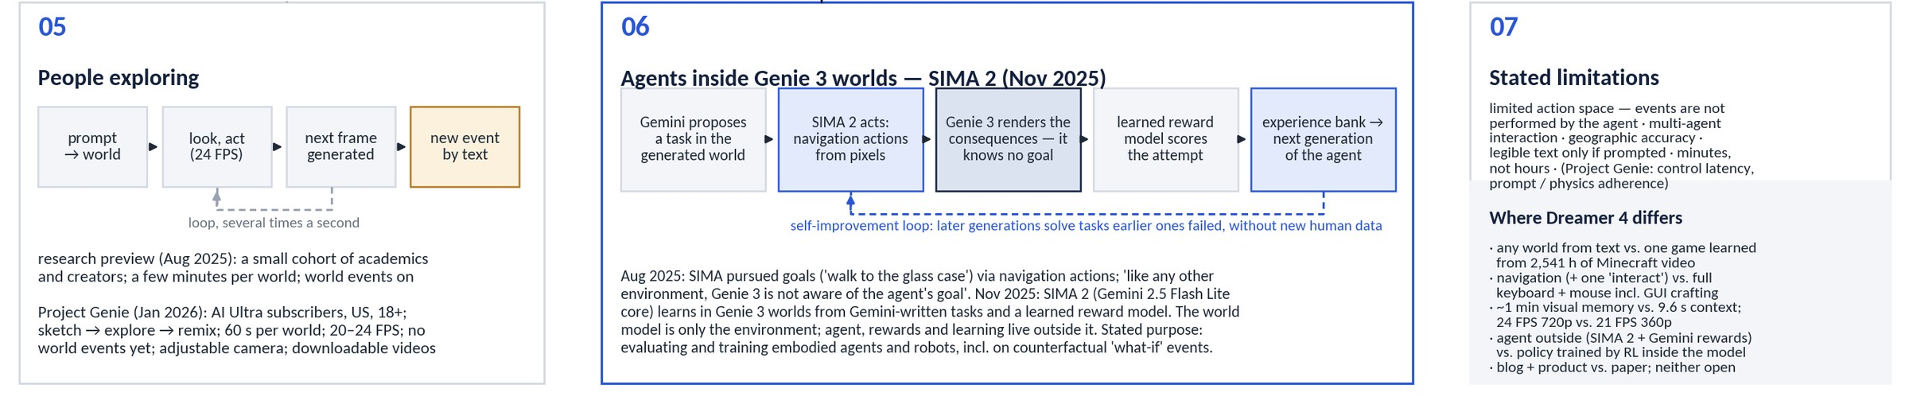
Genie 3 and Dreamer 4: agent outside vs. agent inside the model
Human play in the research preview and Project Genie, the SIMA 2 agent loop, stated limitations
Agent outside vs. agent inside: SIMA 2 acts in Genie 3 worlds with Gemini-written tasks and a learned reward model, and Genie 3 only renders the consequences; Dreamer 4's policy is a head on the same transformer, trained by RL on imagined latents with the reward head it learned from the data
Same limits, different scale: both are closed. Genie 3 stays consistent for minutes but with a limited action space; Dreamer 4 forgets beyond 9.6 s but simulates crafting menus, furnaces, boats and portals from raw mouse and keyboard
Convergent direction: both bet on world models as training grounds — Genie 3 via generated worlds for embodied agents and robots, Dreamer 4 via imagination training on offline video; neither has yet shown a policy that transfers to a physical robot
Dreamer 4 · Hafner, Yan, Lillicrap (Google DeepMind) · arXiv 2509.24527
PART 4 · WHERE IT STANDS
27
Notes:
Bottom half of the Genie 3 picture. The interesting contrast is architectural: in DeepMind's own SIMA 2 work the agent, its rewards and its learning all live outside the world model, which is just an environment. In Dreamer 4 the policy is part of the world-model transformer and is trained on the model's latents, never on pixels. Both approaches are closed and both point the same way — world models as the place where agents get their experience — but they trade off breadth against precision: Genie 3 generalises across worlds with a coarse action space, Dreamer 4 masters one world with the full human interface.

Slide 28
A critical reading: established vs. open
What a reviewer would push on (and what independent groups later found)
Well supported
Open or thinly supported
Shortcut forcing + x-prediction gives a large speed/quality win — a clean 12-step ablation cascade, and reproduced by Open Dreamer at 1.6 B scale (JAX, 2026).
The world model handles object interactions far better than Oasis / Lucid-v1 — consistent human play-tests plus long-rollout FVD.
World-model features are a strong prior for imitation (WM+BC ≫ BC on the same data).
Action conditioning from ~4 % labeled data works and transfers across visual domains.
Diamond result: 0.7 % without confidence intervals or per-seed variance; success criterion is a game event, protocol details are in the appendix only.
No direct quantitative long-horizon accuracy metric — interaction accuracy is human-judged on 16 tasks (Pith/EmergentMind critique).
RL gains over WM+BC are modest on most items; small-scale reproductions report high seed variance in the RL phase and reward-hacking of the frozen reward head.
No peer review as of Sept 2026 (arXiv v1 only); no code or weights; nobody outside DeepMind has reproduced offline diamonds.
Generality of the agent beyond Minecraft is untested.
Dreamer 4 · Hafner, Yan, Lillicrap (Google DeepMind) · arXiv 2509.24527
PART 4 · WHERE IT STANDS
28
Notes:
Balance sheet. The methodological contribution — how to make a fast, accurate autoregressive video world model — is robust and has been independently reproduced. The headline agent result is real but statistically thin and has not been reproduced outside DeepMind. For a reading group, this split is where the discussion usually starts.

Slide 29
What makes Dreamer 4 special — in one slide
01
02
03
The first world model good enough to train in
Real-time diffusion is the enabling trick
One transformer, three roles
Humans solve 14 of 16 interaction tasks inside it in real time; an agent trained only inside it reaches diamonds from offline video.
Shortcut forcing (4 steps), x-prediction with an x-space loss and time attention every 4th layer: 21 FPS on one GPU with 9.6 s of context.
Tokenizer, simulator and agent share the block-causal design; the agent reads the simulator through one-way attention and cannot bias it.
04
05
06
Imagination adds what imitation cannot
Video is the prior, labels are cheap
What is still open
Most of the gain over BC is the world-model representation; RL inside the model adds the rest where data is thin: iron pickaxe 16.9 → 29 %, diamonds 0 → 0.7 %.
About 100 h of action labels on top of thousands of unlabeled hours suffice; action semantics transfer to worlds seen only as video.
9.6 s of memory, a frozen simulator the policy could exploit, thin statistics on the headline number, and no code or weights.
Dreamer 4 · Hafner, Yan, Lillicrap (Google DeepMind) · arXiv 2509.24527
PART 4 · WHERE IT STANDS
29
Notes:
Six things to take home, in the order of the talk: the claim, the trick that makes it possible, the architecture, what RL adds, what the data story is, and what remains open.

Slide 30
Questions for discussion
01
How much of the diamond result is the world model versus PMPO? Would a stronger offline-RL baseline on world-model features (no imagination) close the gap?
02
Is human play-testing on 16 tasks a sufficient measure of 'accurate simulation'? What automated long-horizon metric would you propose?
03
The transformer is frozen during RL and the reward head is learned: where would you expect exploitation to appear first, and how would you detect it offline?
04
9.6 s of context: which memory mechanism (retrieval, state-space layers, compressed summaries) fits a block-causal diffusion transformer best?
05
The recipe needs ~100 h of action labels per domain. What does the path to internet-scale video look like — inverse dynamics models, or Dreamer 4's 'no-action' embedding at scale?
06
What would convince you that this transfers to real robots — and what evaluation would you run first?
Dreamer 4 · Hafner, Yan, Lillicrap (Google DeepMind) · arXiv 2509.24527
PART 4 · WHERE IT STANDS
30
Notes:
Pick two or three depending on the room.

Slide 31
References & resources
Paper: Hafner*, Yan*, Lillicrap. Training Agents Inside of Scalable World Models. arXiv:2509.24527 (29 Sep 2025). https://arxiv.org/abs/2509.24527
Project page & videos: https://danijar.com/project/dreamer4/ — overview video (youtube.com/watch?v=oDlBtTcX0g0), four uncut 60-min 'Diamond Challenge' evaluation episodes, 51 human-interaction clips
Authors in conversation: TalkRL E73 'Danijar Hafner on Dreamer v4' (10 Nov 2025), transcript available; Hack Club AMA (Dec 2025)
Ingredients: Chen et al., Diffusion Forcing (2407.01392) · Frans, Hafner, Levine, Abbeel, Shortcut Models (2410.12557) · Chen et al., MAETok (2502.03444) · Baker et al., VPT (2206.11795) · Hafner et al., DreamerV3 (2301.04104)
Independent reproductions / follow-ups: next-state/open-dreamer (JAX, 1.6 B Minecraft world model, Jul 2026) · IamCreateAI/Dreamerv4-MC (weights on HF) · nicklashansen/dreamer4 & MMBench2 (Hansen & Wang, 2606.27326) · lucidrains/dreamer4 (PyTorch)
Everything above, archived: https://github.com/HarmannBitte/Dreamer-4 — PDFs, repo snapshots, articles, transcripts, the official clips used in this deck, and a MEDIA_INDEX.md
Dreamer 4 · Hafner, Yan, Lillicrap (Google DeepMind) · arXiv 2509.24527
PART 4 · WHERE IT STANDS
31
Notes:
All sources, plus the GitHub archive that contains local copies of every item used to build this deck.

Slide 32
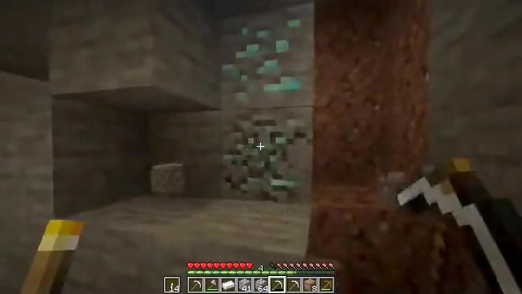
The test bed: the offline diamond challenge
No environment interaction at all — learn everything from 2,541 hours of human gameplay video
Data: OpenAI VPT contractor recordings (subsets 6–10), 2,541 h at 360×640, 20 FPS, with mouse & keyboard labels; 90/10 train/eval split by 5-minute chunk
Actions: 23 binary keys + 121-way mouse class (11×11 foveated bins, VPT convention) — no abstract 'craft' actions
Evaluation: 1,000 fresh random worlds, empty inventory, 60 min each (72,000 actions at 20 FPS); a fixed prompt sequence walks the agent through the 12-item tech tree
Why it is hard: diamonds sit ~24,000 actions deep for a human; rewards are sparse; offline data covers the late tech tree thinly; every skill (chop → craft → mine → smelt) must chain without a single trial in the real game
Baselines, all on the same data: VPT fine-tuned, BC, BC without task input, a VLA built on Gemma 3, and 'WM + BC' (Dreamer 4 without imagination RL)
Diamond ore, as simulated by the world model during a human 'mine diamonds' session (project page).
THE 12 MILESTONES (TABLE 5)
log → planks → crafting table → stick → wooden pickaxe → cobblestone → stone pickaxe → iron ore → furnace → iron ingot → iron pickaxe → diamond
Dreamer 4 · Hafner, Yan, Lillicrap (Google DeepMind) · arXiv 2509.24527
APPENDIX
32
Notes:
Offline means offline: the agent never touches Minecraft during training. The only signal is human gameplay video with logged inputs. Diamonds need a long chain of subgoals, each executed with raw mouse and keyboard at 20 Hz. That is why success rates fall off steeply along the tech tree for every method.

Slide 33
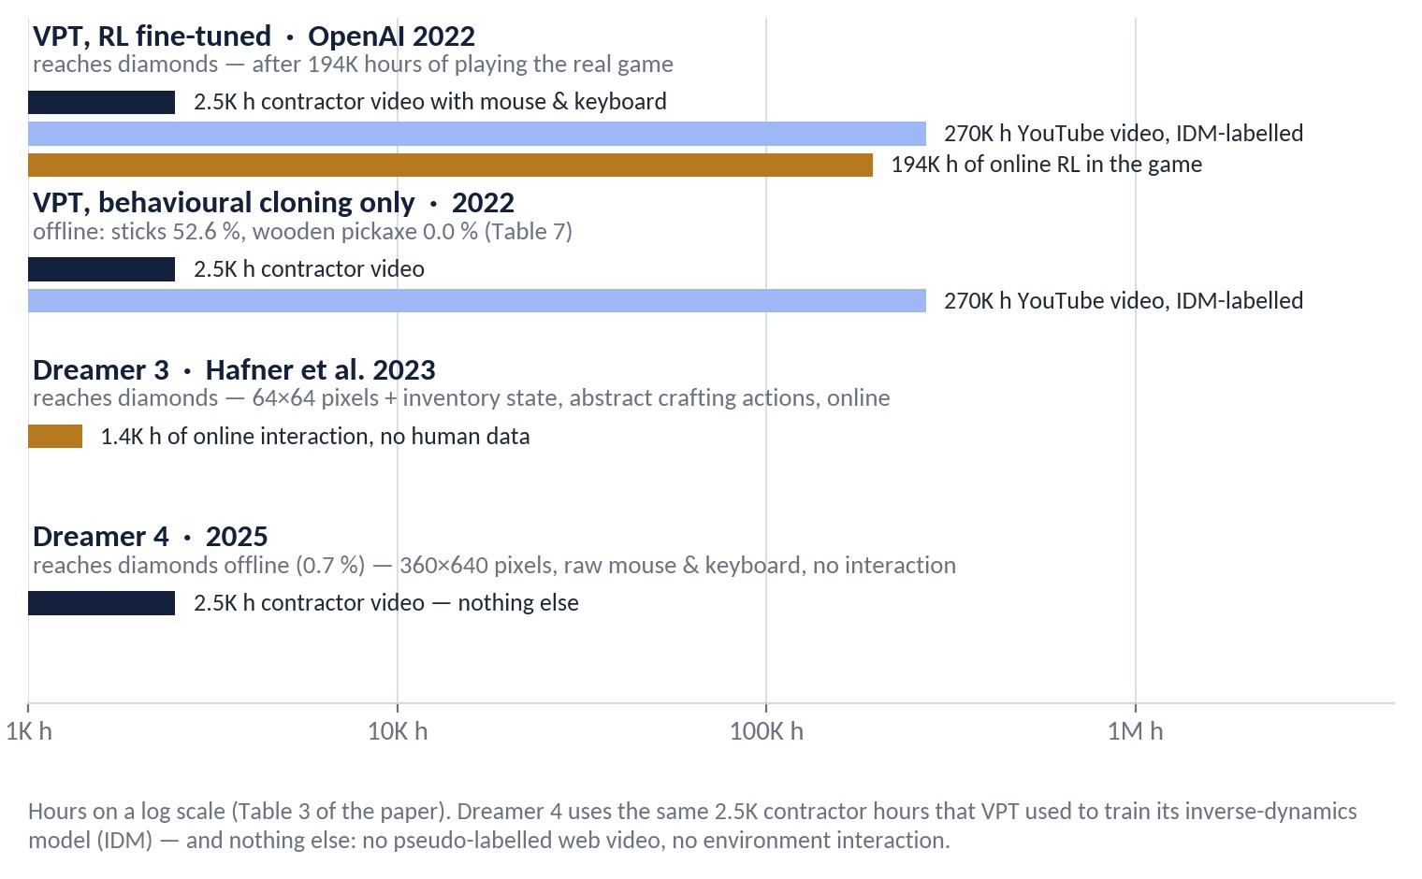
Who reached diamonds before, and what it cost
Table 3: same goal, very different regimes — hours of data and interaction behind each agent
VPT (OPENAI, 2022)
Showed that web video plus an inverse-dynamics model can bootstrap a mouse-and-keyboard policy — but diamonds still took 194K hours of trial and error in the live game, and the pure behavioural-cloning variant never crafts a wooden pickaxe offline.
DREAMER 3 (2023)
Reached diamonds from scratch by online RL inside a small recurrent world model — at 64×64 pixels, with inventory state as input and abstract crafting actions instead of mouse clicks in menus.
DREAMER 4'S BET
Keep the human interface (360×640 pixels, raw mouse & keyboard), drop environment interaction entirely, and get the missing experience from imagination instead of the game — 100× less data than the keyboard-and-mouse agents before it (Table 3 caption).
Dreamer 4 · Hafner, Yan, Lillicrap (Google DeepMind) · arXiv 2509.24527
APPENDIX
33
Notes:
Historical context, with the hours on a log scale because they span three orders of magnitude. VPT is the closest relative: same contractor data, same action space. It got to diamonds, but only after pseudo-labelling 270 thousand hours of YouTube and then playing the real game for 194 thousand hours of RL; its offline-only version is the grey line that collapsed on the previous slide. Dreamer 3 got there with far less experience, but it changed the problem: tiny images, privileged inventory state, and crafting as an abstract action rather than a sequence of mouse movements in a menu. Dreamer 4 keeps the hard interface and removes the interaction. That is the claim in the title of the paper, and it is why the number to remember is not 0.7 percent diamonds but zero hours in the game.

Slide 34
Overview: three phases, one transformer
Algorithm 1 in the paper
Phase 1
→
Phase 2
→
Phase 3
World-model pretraining
Agent fine-tuning
Imagination training
Train the causal tokenizer (masked autoencoding), then freeze it
Train the interactive dynamics model on tokenized video ± actions with shortcut forcing
Inputs: all 2,541 h, labeled or not
Insert agent tokens with task embedding; add policy & reward heads
Behavioural cloning with multi-token prediction (L = 8) on task-relevant data
Dynamics loss continues on uniform data so the model stays honest
Freeze the transformer; train policy + value heads only
Roll out the policy inside the world model, reward from the learned reward head
PMPO with reverse-KL to the frozen BC policy; γ = 0.997
Key design choice: the same block-causal transformer serves as tokenizer, dynamics model and agent backbone; policy and value are tiny heads on 'agent tokens'
Data mix in phases 2–3: 50 % uniform sequences / 50 % task-relevant; BC loss only on relevant data, dynamics loss only on uniform data ('to avoid optimistic generations')
Dreamer 4 · Hafner, Yan, Lillicrap (Google DeepMind) · arXiv 2509.24527
APPENDIX
34
Notes:
Three phases. First a world model is trained on all video. Second, agent tokens and heads are added and trained by behavioural cloning while the dynamics loss keeps running. Third, the transformer is frozen and only the policy and value heads are trained by RL on imagined rollouts. Keeping the dynamics loss on uniform data rather than task-relevant data is a small but deliberate choice to avoid a world model that is optimistic about task success.

Slide 35
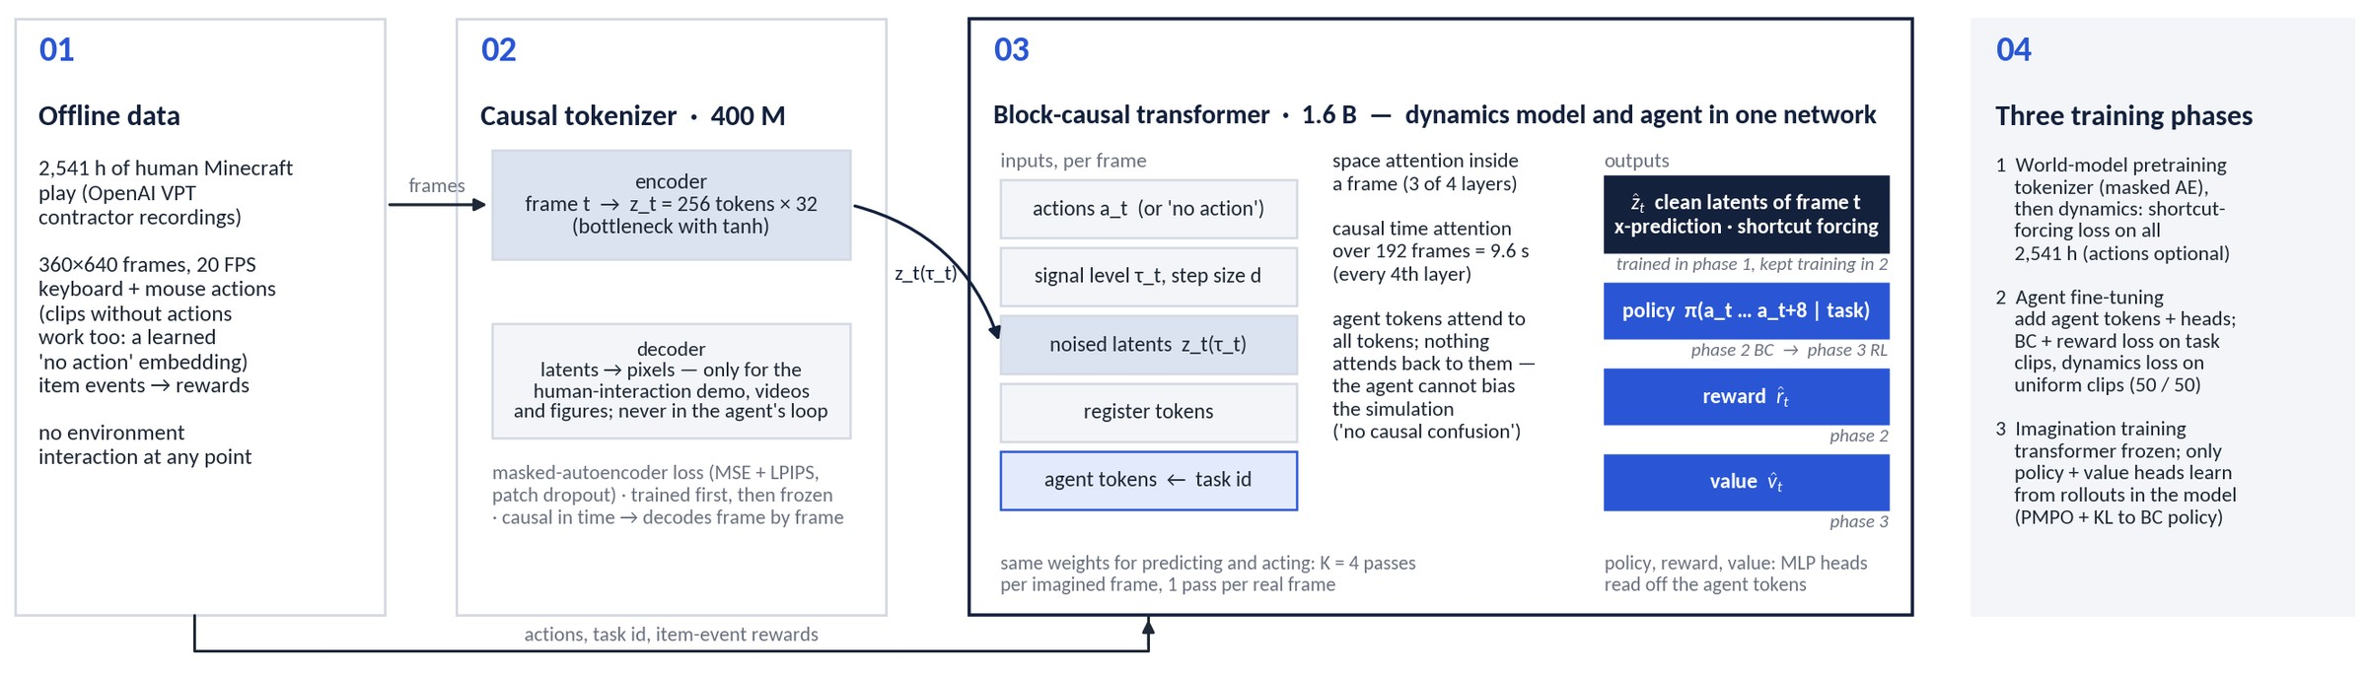
How the pieces fit together (1/2): data → tokenizer → one transformer
What flows between the components, and which phase trains which output
Two block-causal transformers: the tokenizer (400 M) turns each frame into 256 latent tokens; the dynamics/agent transformer (1.6 B) predicts the clean next latents and reads policy, reward and value off its agent tokens (MLP heads, multi-token prediction L = 8)
The decoder is outside the agent's loop: pretraining, fine-tuning and imagination all happen in latent space — pixels are only rendered for humans
One-way attention for agent tokens: they see everything, nothing sees them, so adding the agent cannot change what the simulator predicts
Dreamer 4 · Hafner, Yan, Lillicrap (Google DeepMind) · arXiv 2509.24527
APPENDIX
35
Notes:
This is the system view before we go component by component. Read it left to right: video frames enter the tokenizer encoder and become 256 latent tokens per frame; those latents, noised to a per-frame signal level, go into the big transformer together with the actions, the register tokens and, from phase 2 on, the agent tokens that carry the task id. The transformer has one output for the world model, the clean latents of the frame, and three outputs for the agent: policy, reward, value. The italic tags say which phase trains which output. Two things to point out: the decoder is only used to make videos and figures, the agent never sees pixels after the encoder; and the agent tokens can read everything but nothing reads them, which is what keeps the agent from biasing its own simulator.

Slide 36
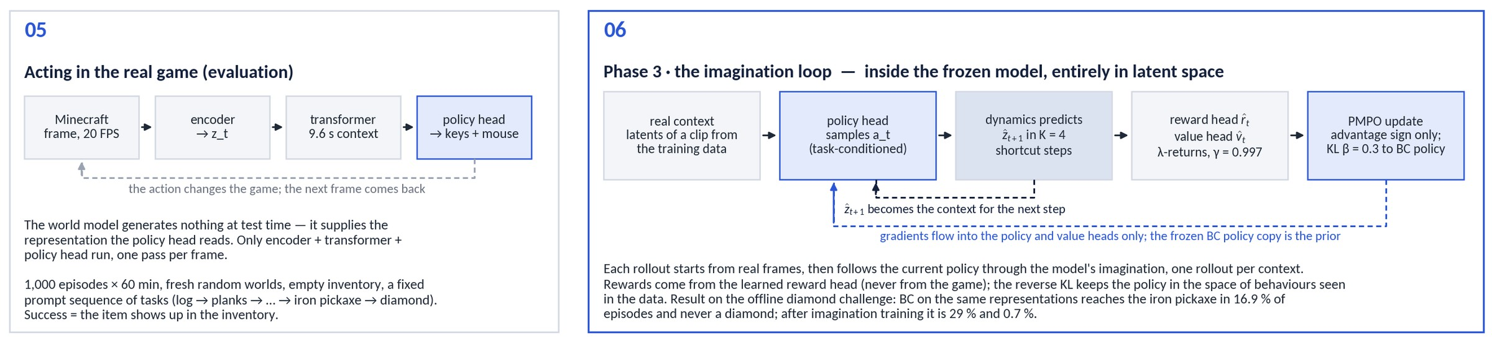
How the pieces fit together (2/2): the two loops
Training inside the model, and acting in the real game
Imagination loop (phase 3): start from real latents → policy head samples an action → dynamics predicts the next latents in K = 4 shortcut steps → reward and value heads score the step → PMPO with reverse KL updates the policy and value heads only; one rollout per context, transformer frozen
Acting (evaluation): encoder → transformer → policy head, once per frame at 20 FPS; the world model generates nothing at test time — it provides the representation
What the loop buys: on the same representations, behavioural cloning reaches the iron pickaxe in 16.9 % of episodes and no diamonds; after imagination training 29 % and 0.7 % (Table 7)
Dreamer 4 · Hafner, Yan, Lillicrap (Google DeepMind) · arXiv 2509.24527
APPENDIX
36
Notes:
Bottom half of the system view. On the right, the imagination loop: rollouts start from real contexts, the policy proposes actions, the frozen dynamics model predicts what happens in latent space with four forward passes per frame, the learned reward and value heads score the outcome and PMPO nudges the policy toward positive-advantage actions and away from negative ones, with a reverse KL to the frozen behavioural-cloning copy as prior. Gradients only reach the policy and value heads. On the left, evaluation: in the real game the same transformer runs once per frame as a feature extractor for the policy head; nothing is imagined at test time. The numbers at the end are the case for doing RL inside the model at all.

Slide 37
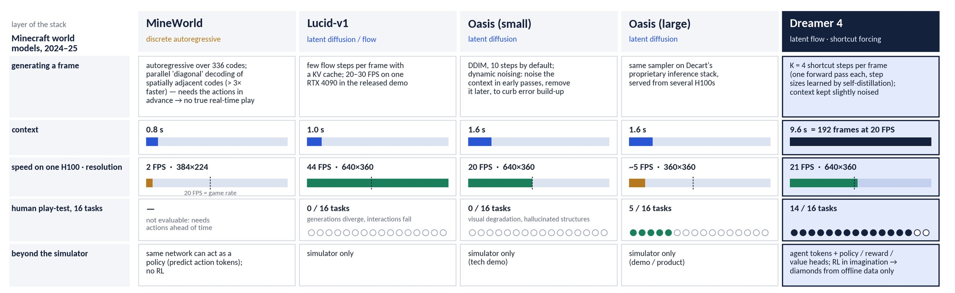
Minecraft world models, stack by stack (2/2): how they run
Sampling, context, speed on one H100, the 16-task human play-test, and what each model is used for
Speed alone is not the story: Lucid-v1 is the fastest model in the table and solves none of the tasks; MineWorld cannot be played at all because its parallel decoding needs the actions in advance
Context is: 9.6 s versus 0.8–1.6 s is what lets the player look away and back — and the two tasks Dreamer 4 still fails are exactly the ones that exceed that window
Only Dreamer 4 is used as a training ground: the others are simulators or demos; here the same network also hosts the policy that is trained inside it
Dreamer 4 · Hafner, Yan, Lillicrap (Google DeepMind) · arXiv 2509.24527
APPENDIX
37
Notes:
Second half: how they behave at run time. Two things to point at. First, frame rate is necessary but not sufficient — Lucid is twice as fast as Dreamer 4 and fails every task, and Oasis large is the one that autocompletes buildings you never built. Second, context length is the quiet hero: six times more than the others, and the failures that remain are memory failures. The last row is the conceptual difference: for the other projects the simulator is the product; for Dreamer 4 it is the means, and the policy trained inside it is the result.

Slide 38
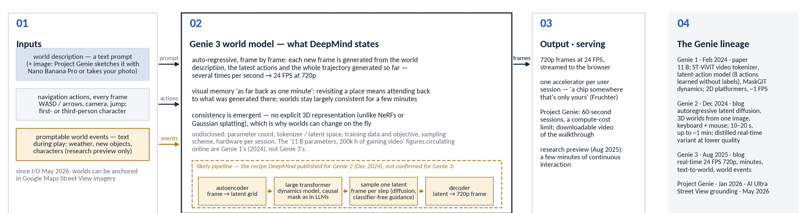
Context: Genie 3 (1/2) — what is actually public
Google DeepMind, Aug 2025 — blog post and model page only. Plain boxes = stated; amber = inferred from the Genie 2 recipe; grey = undisclosed
A different problem: any text-prompted world, 24 FPS at 720p, about a minute of visual memory, navigation-level actions — versus one game, full mouse & keyboard, 9.6 s of context at 21 FPS and 360p
Why the paper cannot compare (§4.2): Genie 3 exposes only camera actions and one generic 'interact' button, so the 16 Minecraft tasks are not expressible; nothing about its size, data or objective is published — the '11 B / 200k hours' figures that circulate are Genie 1's
Dreamer 4 · Hafner, Yan, Lillicrap (Google DeepMind) · arXiv 2509.24527
APPENDIX
38
Notes:
People will ask about Genie 3, so here is what is actually known. Everything in the plain boxes is stated by DeepMind: auto-regressive frame-by-frame generation conditioned on the prompt, the latest actions and the whole trajectory so far, with an emergent — not explicit — 3D consistency. The amber pipeline is the recipe DeepMind published for Genie 2, which is a reasonable guess for Genie 3 but not confirmed. Parameter count, tokenizer, data and objective are undisclosed; there is no paper. The Dreamer 4 authors say why they do not compare: Genie 3's action space is navigation plus one interact button, and the Minecraft tasks need menus and precise mouse input.

Slide 39
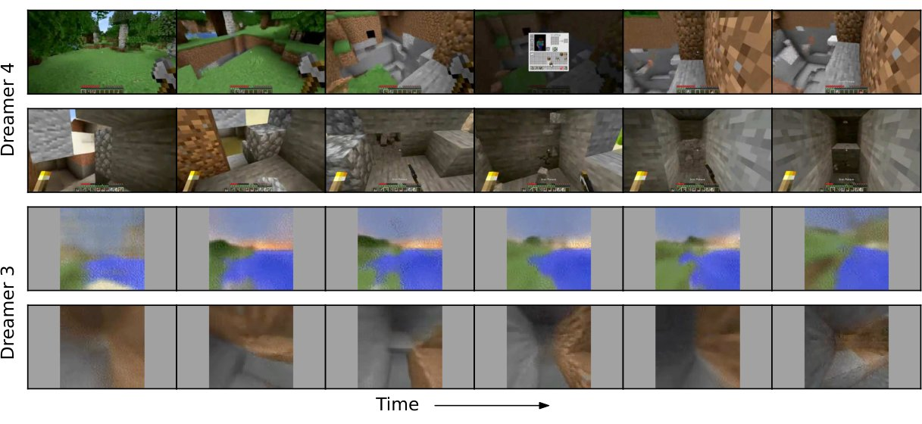
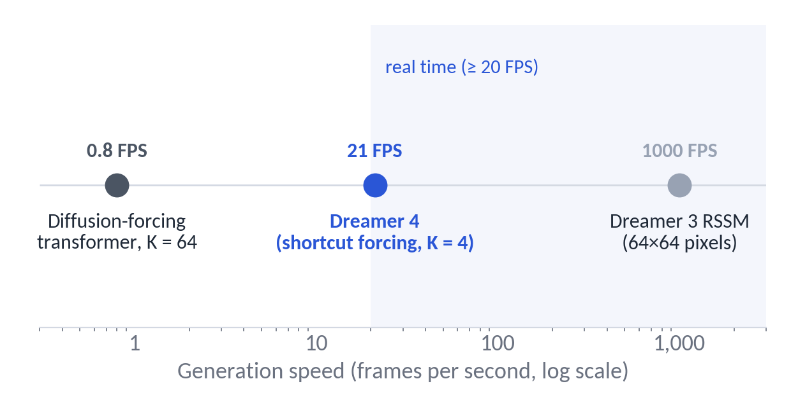
Dreamer 3 vs Dreamer 4
Appendix F: what changed, and what the higher-fidelity model costs
 | Dreamer 3 (Nature 2025) | Dreamer 4
World model | RSSM (recurrent + variational latent) | Block-causal diffusion/flow transformer, shortcut forcing
Minecraft input | 64×64 pixels + inventory state; abstract crafting actions | 360×640 pixels only; raw mouse & keyboard
Data | 1.4 K h of online interaction, no human data | 2.5 K h of offline human data, no interaction
RL | Return normalisation + entropy bonus | PMPO (advantage sign) + KL to BC prior
Speed | ~1,000× faster than a diffusion transformer | ~30× faster than diffusion forcing; ~40× slower than the RSSM
Figure 11: multi-step generations, Dreamer 4 (top) vs Dreamer 3 (bottom).
Generation speed on a log scale (paper, TalkRL): ~30× faster than diffusion forcing, ~40× slower than the RSSM.
Dreamer 4 · Hafner, Yan, Lillicrap (Google DeepMind) · arXiv 2509.24527
APPENDIX
39
Notes:
Same family, different regime. Dreamer 3 solved diamonds with online interaction and privileged state at 64×64; Dreamer 4 does it offline from raw pixels and inputs. The price is speed: the transformer is still about forty times slower than the recurrent model, according to Hafner.

Slide 40
Limitations the paper itself states
From the discussion section and the authors' talks
01
Diamonds are rare: 0.7 % success; the authors call the pipeline a 'reliable and performant starting point', not a solved task
02
Memory: 9.6 s of context; walk into a house for 30 s and the outside is regenerated — long-term memory is the number-one item on the roadmap
03
Inventory drift: small UI elements and item counts blur over long horizons; small objects and long-range semantic correlations are what video models learn last
04
Frozen, exploitable simulator: no epistemic-uncertainty estimate; the policy can exploit model errors (invalid crafting) — currently mitigated only by the KL constraint
05
Two-stage training: tokenizer is trained separately and frozen; the authors expect end-to-end training eventually
06
Single domain for the agent: RL results exist only for Minecraft; robotics and kitchen video are qualitative world-model demos
07
Compute: hundreds of TPU v5p chips per run; not a recipe individuals can reproduce at full scale
Dreamer 4 · Hafner, Yan, Lillicrap (Google DeepMind) · arXiv 2509.24527
APPENDIX
40
Notes:
The authors are quite candid. The two that matter most for the agenda of the paper are memory and exploitability: both limit how far imagination training can be pushed before the policy learns things that are only true inside the model.

Slide 41
Appendix A — Configuration & hyper-parameters
Component | Setting
Tokenizer | Masked autoencoder; 16×16 patches; patch dropout ~ U(0, 0.9); loss MSE + 0.2·LPIPS; bottleneck 512×16 with tanh → N_z = 256 tokens × 32 dims; causal in time; ≈ 400 M params; frozen after pretraining
Dynamics model | ≈ 1.6 B params; pre-RMSNorm, RoPE, SwiGLU, QK-norm, logit soft-capping, register tokens; space attention in 3/4 layers, causal time attention every 4th layer; GQA; context C = 192 frames (9.6 s); alternating batch lengths T1/T2 = 64/256
Shortcut forcing | per-frame signal level τ, step size d; x-prediction; bootstrap target formed in v-space, loss scaled to x-space by (1−τ)²; ramp weight w(τ) = 0.9τ + 0.1; K = 4 sampling steps; context noise τ_ctx ≈ 0.1
Actions | 23 binary keys + 121-way mouse (μ-law, 11×11 foveated bins, VPT convention); learned 'no action' embedding for unlabeled video
Agent (phase 2) | agent tokens with one-hot task (20 tasks), one-way attention; BC with multi-token prediction L = 8; task-conditioned scalar reward head; data mix 50 % uniform / 50 % task-relevant
Imagination RL (phase 3) | transformer frozen; policy + TD value heads; PMPO with advantage sign, α = 0.5, reverse-KL β = 0.3 to frozen BC policy; γ = 0.997
Evaluation | 1,000 episodes × 60 min, empty inventory, random worlds, fixed prompt sequence; human interaction: 16 tasks on one H100 at 21 FPS
Compute / data | 256–1,024 TPU v5p; 2,541 h VPT contractor video (subsets 6–10), 90/10 split by 5-min chunk; ablations: 48 h runs, FVD on 1,024 × 384-frame generations
Dreamer 4 · Hafner, Yan, Lillicrap (Google DeepMind) · arXiv 2509.24527
APPENDIX
41
Notes:
Reference slide; not meant to be presented in full.

Slide 42
Appendix C — Full success-rate table (Table 7, %)
Milestone | VPT (ft) | BC (no task) | BC | VLA (Gemma 3) | WM + BC | Dreamer 4
Log | 84.3 | 71.4 | 97.3 | 98.5 | 99.6 | 99.1
Planks | 65.3 | 68.6 | 95.7 | 98.3 | 99.6 | 98.9
Crafting table | 4.7 | 63.8 | 93.5 | 97.2 | 99.1 | 98.5
Stick | 52.6 | 62.4 | 95.0 | 97.7 | 98.9 | 98.7
Wooden pickaxe | 0.0 | 33.8 | 86.5 | 94.1 | 97.3 | 96.6
Cobblestone | 6.9 | 32.0 | 83.9 | 91.6 | 97.2 | 95.9
Stone pickaxe | 0.0 | 8.8 | 53.8 | 76.7 | 89.4 | 90.1
Iron ore | 0.1 | 3.6 | 26.5 | 46.3 | 62.9 | 66.7
Furnace | 0.0 | 4.0 | 16.2 | 42.4 | 51.1 | 58.1
Iron ingot | 0.1 | 0.2 | 4.3 | 22.5 | 27.8 | 39.5
Iron pickaxe | 0.0 | 0.0 | 0.6 | 11.2 | 16.9 | 29.0
Diamond | 0.0 | 0.0 | 0.0 | 0.0 | 0.0 | 0.7
1,000 evaluation episodes of 60 minutes each; all agents trained on the same 2,541 h of contractor data (VPT additionally pretrained on 270 K h of web video).
Dreamer 4 · Hafner, Yan, Lillicrap (Google DeepMind) · arXiv 2509.24527
APPENDIX
42
Notes:
Full table for reference.

Slide 43
Appendix D — Glossary
Term | Meaning in this paper
World model | Learned model that predicts future observations (here: latent frames) given past observations and actions
Imagination training | Training the policy on rollouts generated by the world model instead of the real environment
Tokenizer / latents | Encoder–decoder mapping each frame to 256 continuous tokens the dynamics model operates on
Block-causal attention | Full attention within a frame, causal across frames — enables frame-by-frame online generation
Diffusion forcing | Diffusion training with an independent noise level per frame in a sequence
Shortcut model | Diffusion/flow model conditioned on step size, trained to be self-consistent across step sizes → few-step sampling
x- vs v-prediction | Network predicts the clean latent (x) vs the velocity x − ε (v); Dreamer 4 uses x-prediction
FVD / PSNR / SSIM | Fréchet Video Distance (distribution-level video quality, lower is better) / per-frame reconstruction fidelity metrics
GQA, RoPE, registers | Grouped-query attention (fewer KV heads), rotary position embeddings, extra learnable tokens that absorb attention mass
BC, VLA, PMPO | Behavioural cloning; vision-language-action model (here built on Gemma 3); the sign-based, KL-regularised policy-gradient update used for RL
Dreamer 4 · Hafner, Yan, Lillicrap (Google DeepMind) · arXiv 2509.24527
APPENDIX
43
Notes:
Glossary for the mixed audience.

