Slide 1

FIFA 2018 Statistics Dataset
Classification Models to Predict MoM

Slide 2
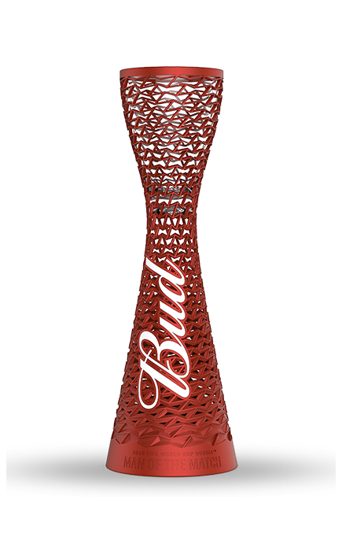
Understanding Data and Problem Statement
2018 Football World Cup data with football statistics and MoM Award details.
The 2018 FIFA World Cup was the 21st FIFA World Cup contested by men's national teams and took place between 14 June and 15 July 2018 in Russia. It involved 32 teams, of which 31 came through qualifying competitions, while as the host nation Russia qualified automatically.
This dataset contains the details/statistics of all matches played in FIFA World Cup 2018 with all stats regarding goals, fouls, On/Off Target and various other features.
Problem Statement :
With available dataset, we will try to analyze the tournament based on the football parameters like goals, passes, shots, ball possession, free kicks etc.
Diving into the data, we will try to predict Man of the Match award based on different football attributes from data.
Post Profiling:

Slide 3
Understanding Data and Problem Statement
Data Preparation/EDA
2018 Football World Cup data with football statistics and MoM Award details.
Enriched Data
Input Raw data
Data Wrangling
EDA
Data Visualizations
Post Profiling:
(Treating missing Values, Data type changes, outliers, data formatting, etc)
Better Understanding of Data for modelling

Slide 4
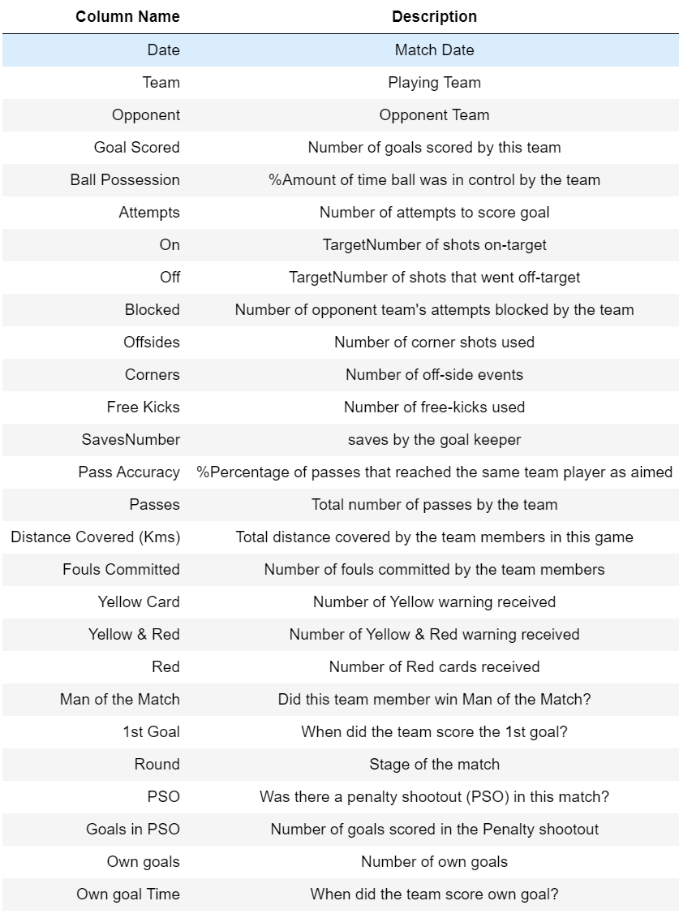

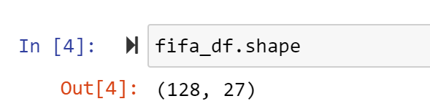
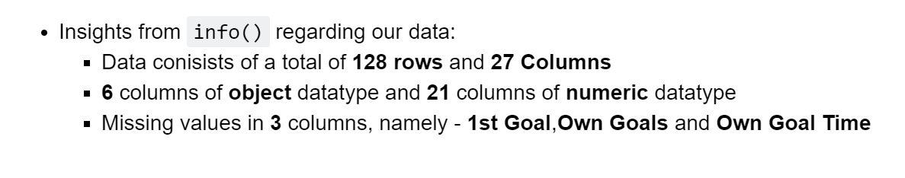
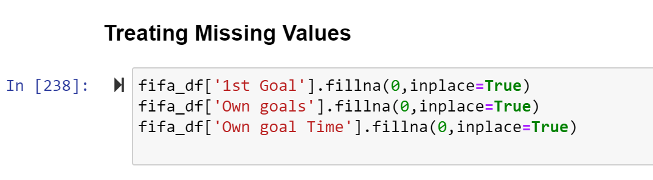
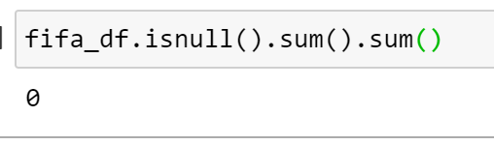

Understanding Data -
Pre-Processing Data -
No more Missing Values!!!

Slide 5

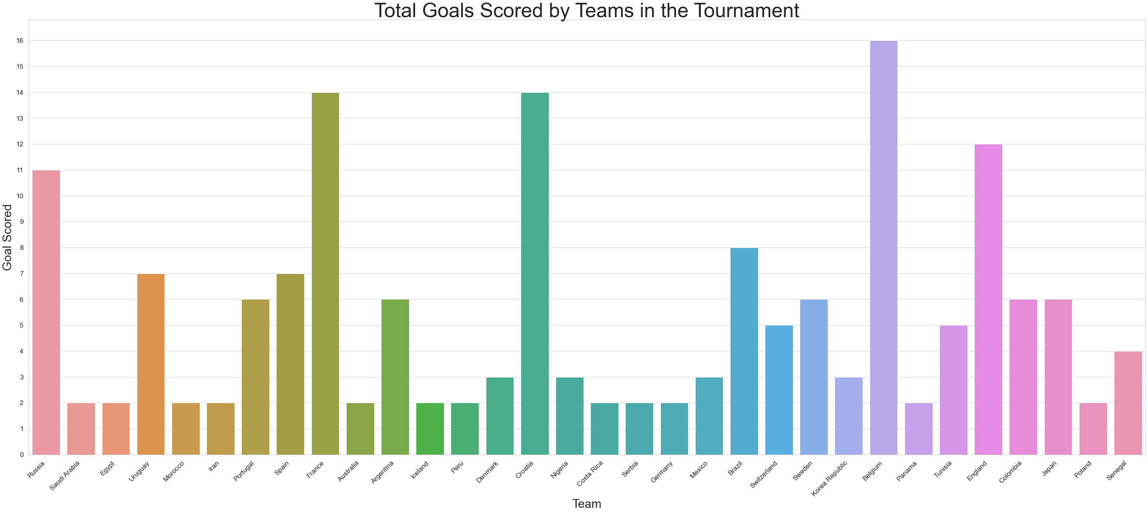
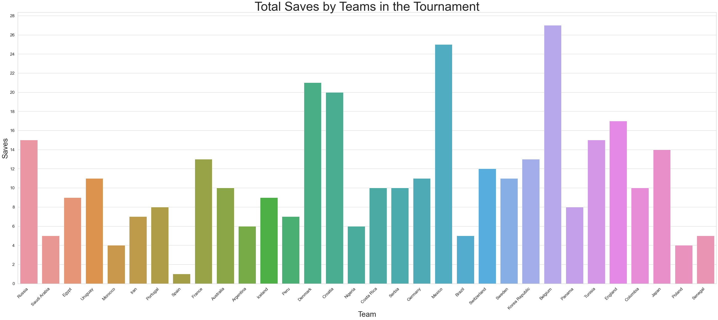
Belgium
France
Croatia
England
Belgium
Mexico
Denmark
Croatia

Slide 6
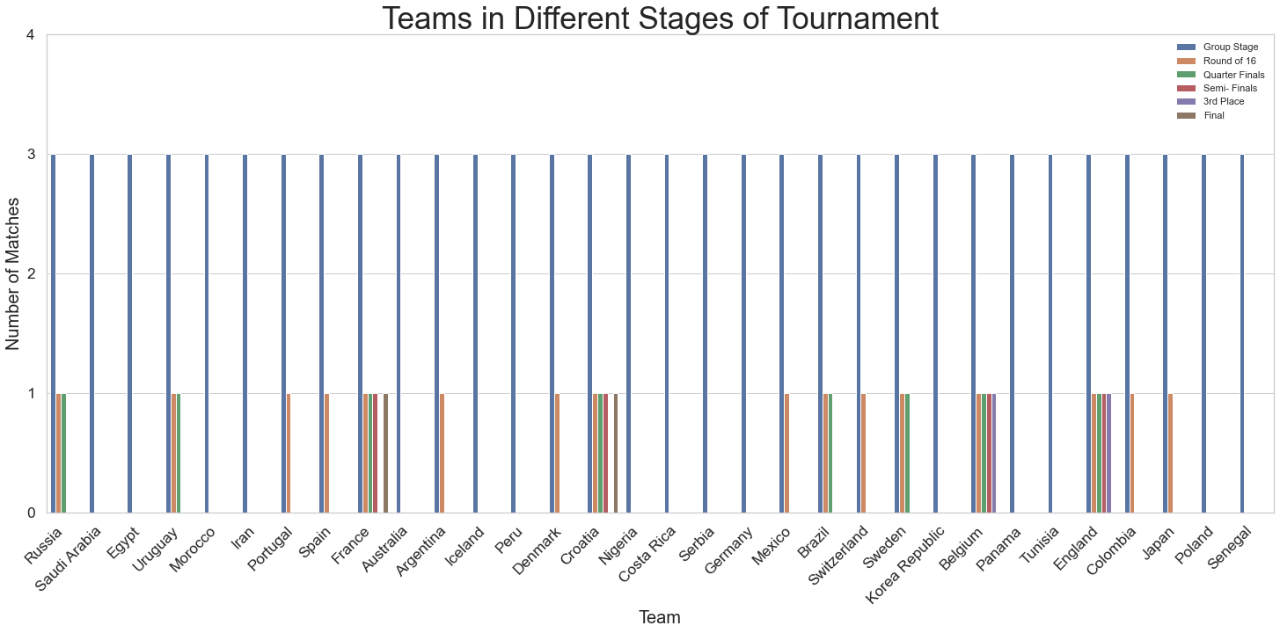
France
Croatia
Belgium
England

Slide 7
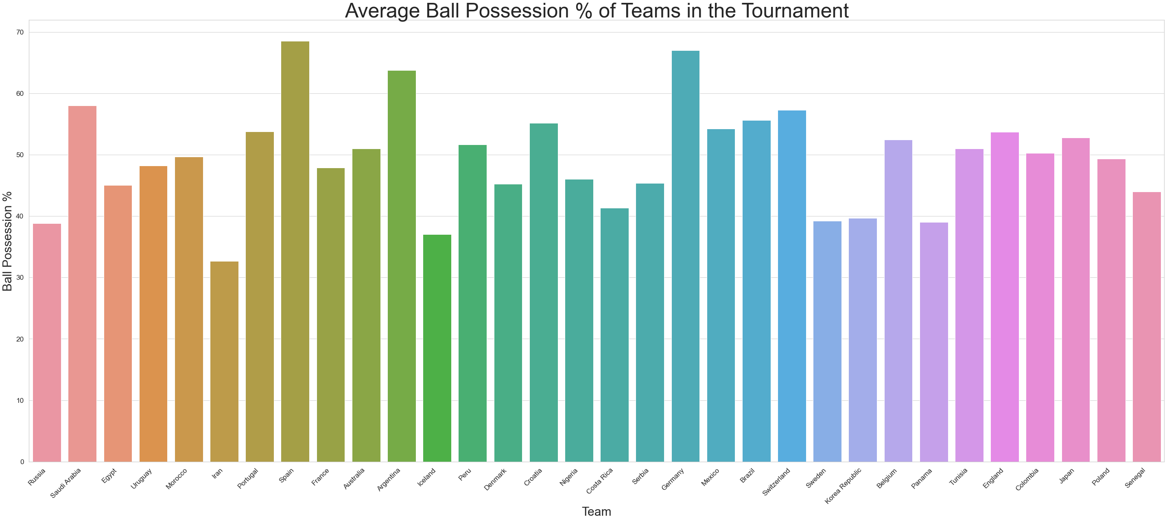
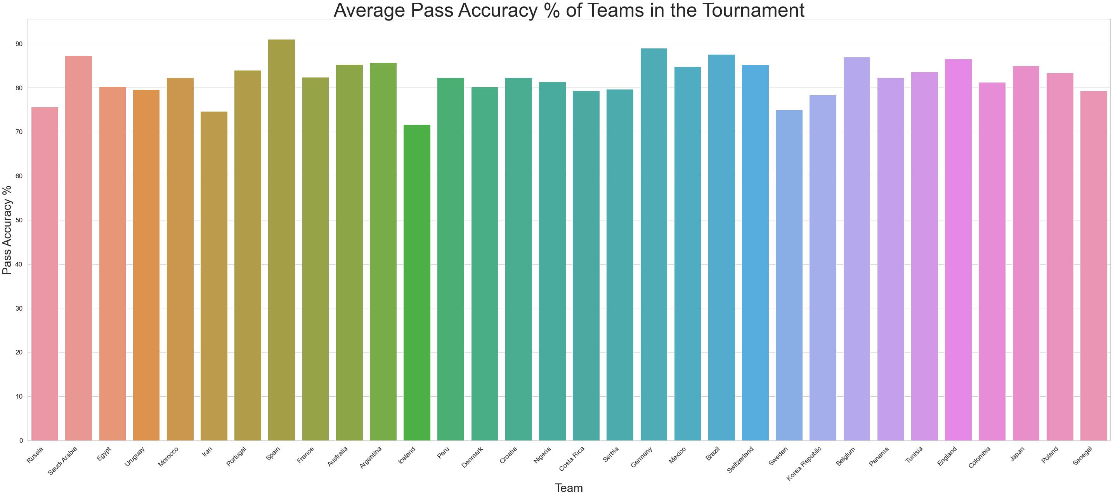
Spain
Germany
Argentina
Saudi Arabia
Spain
Germany
Brazil
Saudi Arabia

Slide 8
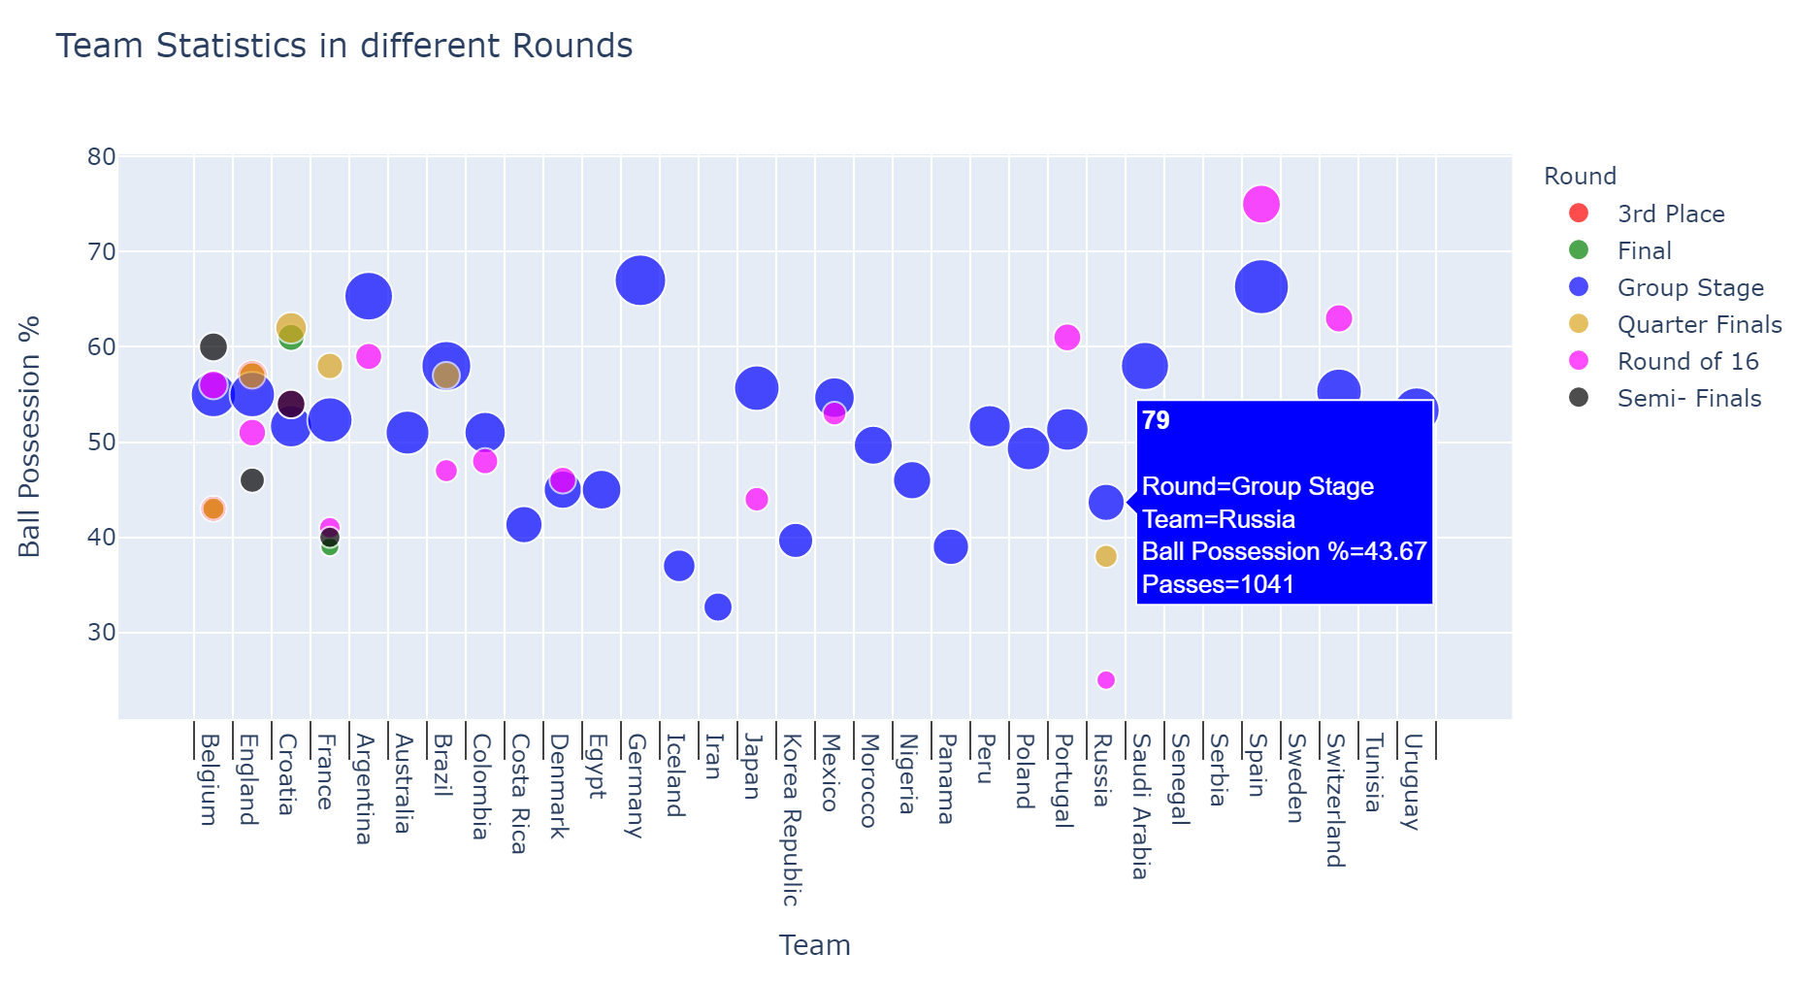
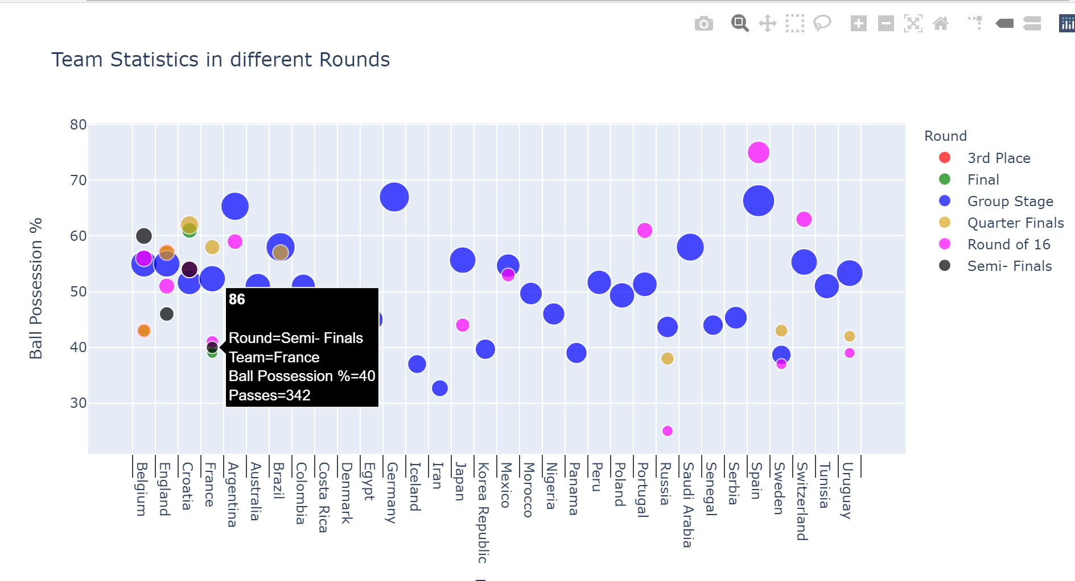
To overcome the shortcoming that last visualization had, I have used plotly interactive graphs to show the similar statistics but a group wise level.
Ball Possession %, Total Passes and Passing Accuracy % of teams as per Group Highlighted.

Slide 9
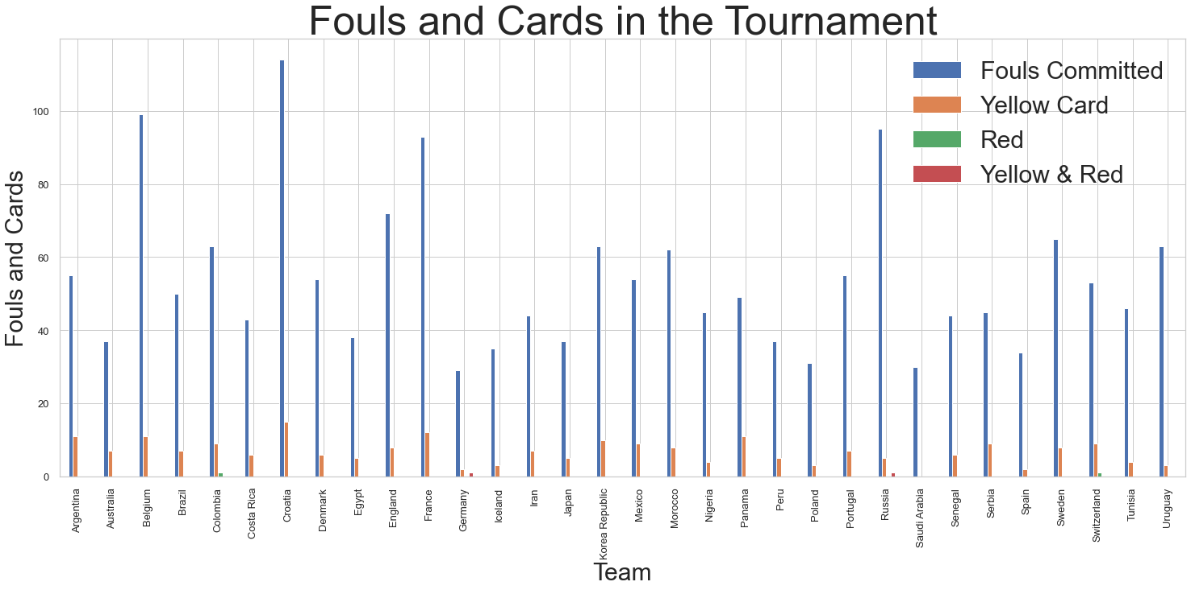
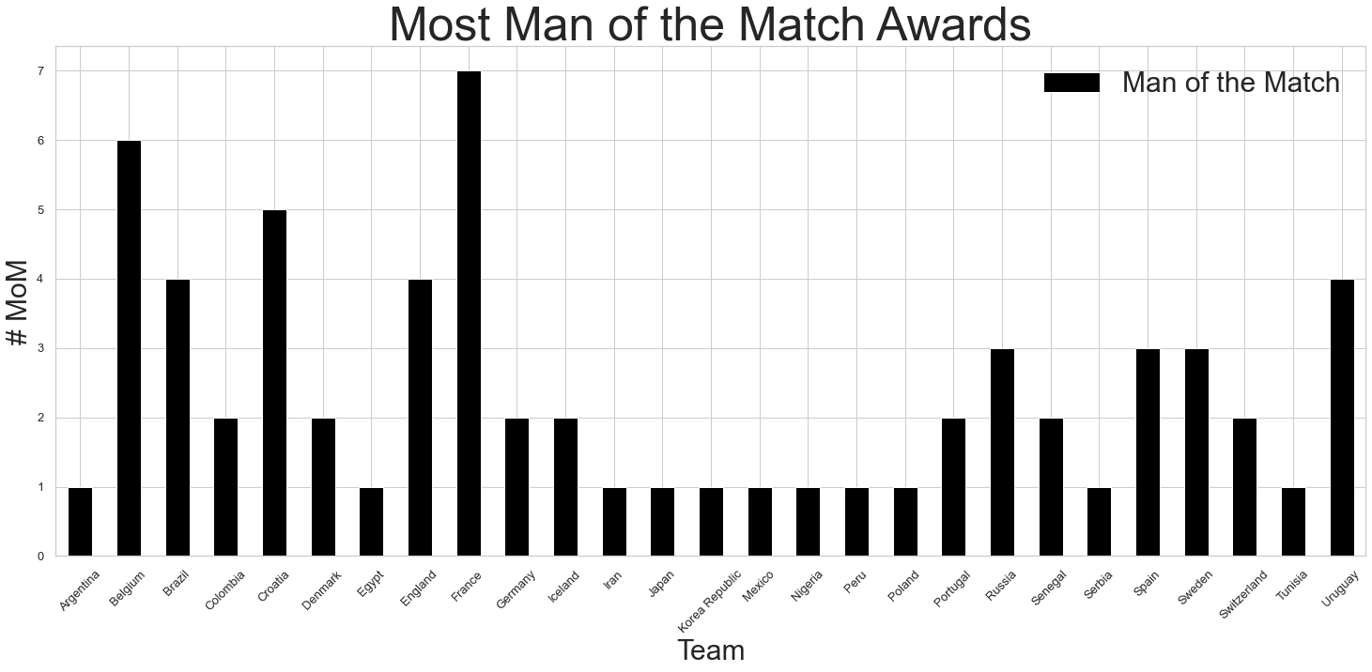
Most Fouls were committed by Croatia.
Only Switzerland and Columbia received straight red cards. While only Russia and Germany players got their yellow card converted to red.
This gives us an insight on a Team’s Discipline and its impact on our TV.
Most Man of the Match Awards
France
Belgium
Croatia
4. Brazil , England

Slide 10
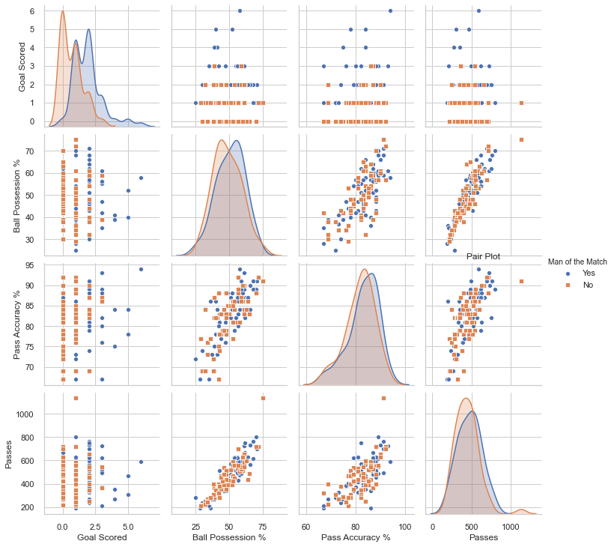
Let’s look at pair plots to analyze distribution of important parameters and relationships between them to identify trends for follow-up analysis.
Important Points -
More Goals Scored do not guarantee more MoM awards.
Ball Possession % and Passes are highly corelated

Slide 11
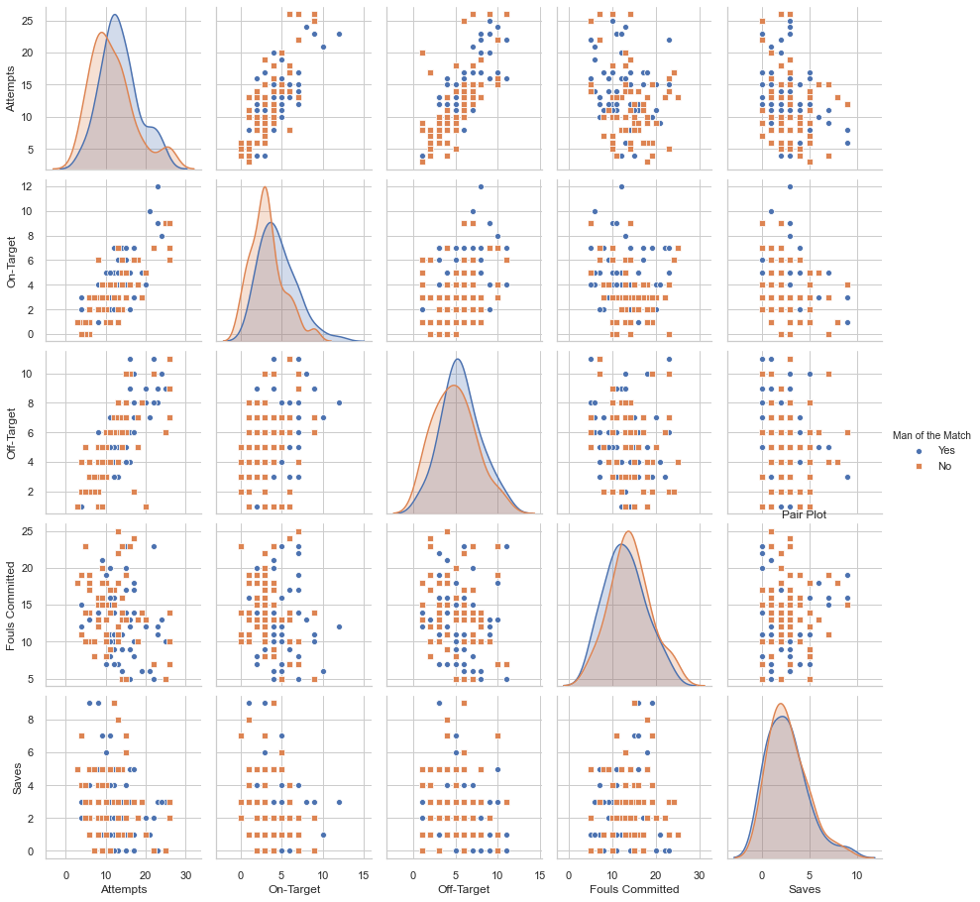
Other Parameters
Not Much Correlation between parameters.
Almost equal distribution of MoM awards in respect to all parameters and thus difficult for accurate prediction.

Slide 12
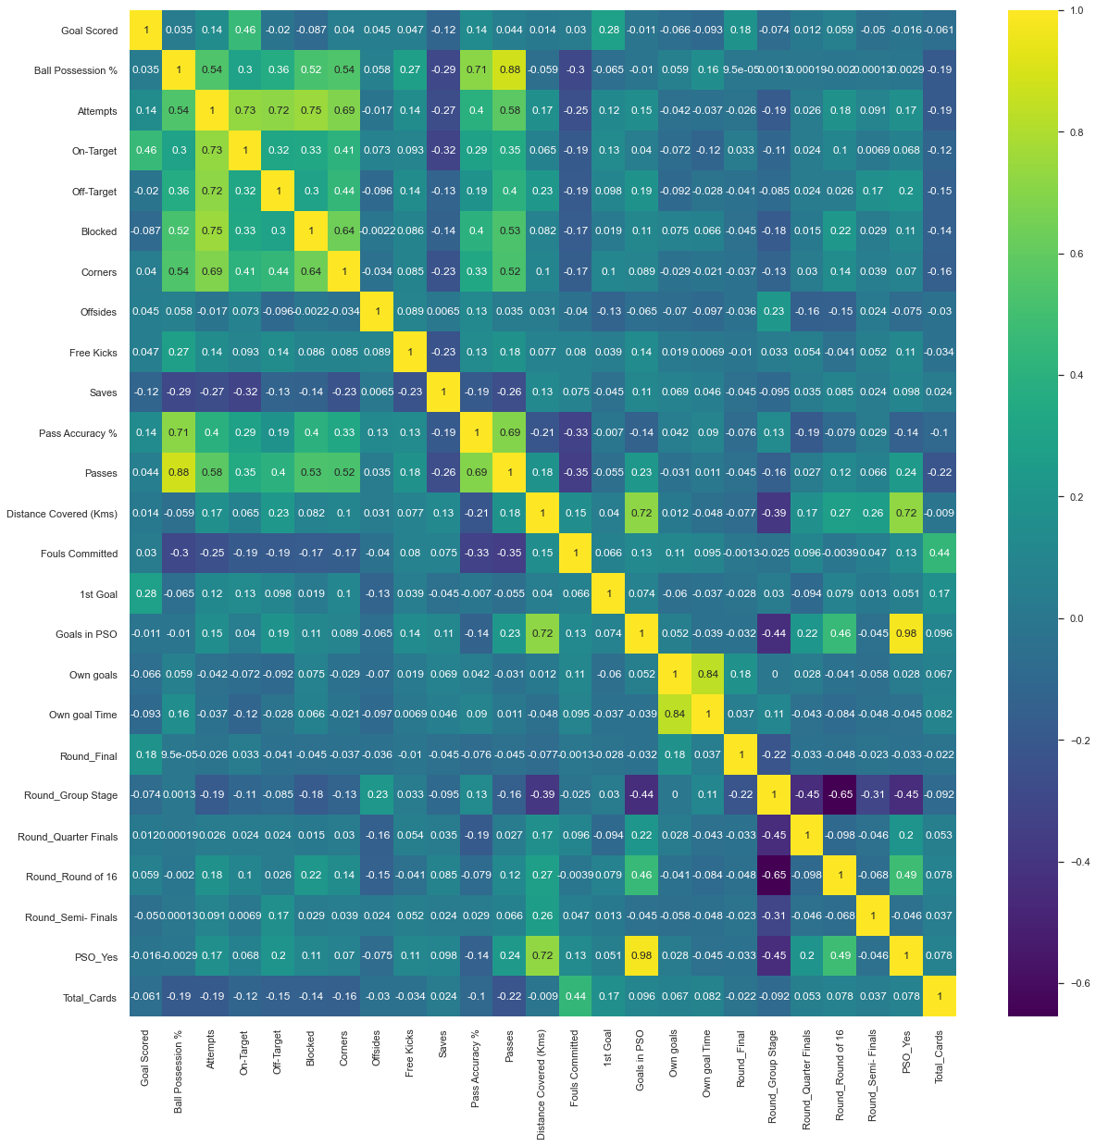
Correlation Matrix
Not many columns have high correlation.

Slide 13
Understanding Data and Problem Statement
Data Preparation/EDA
Modelling
2018 Football World Cup data with football statistics and MoM Award details.
Repeat for all models/ algorithms
Train Data
Build Model
Feature Engineering post EDA knowledge
EV
TV split
Train Test Split
Scaling EV
Train Model
Post Profiling:
Test Data
Test Model

Slide 14
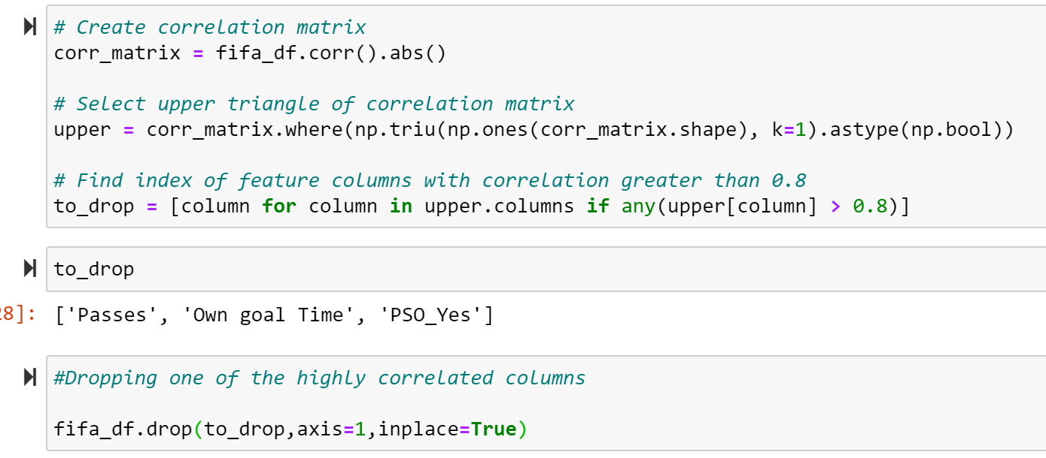
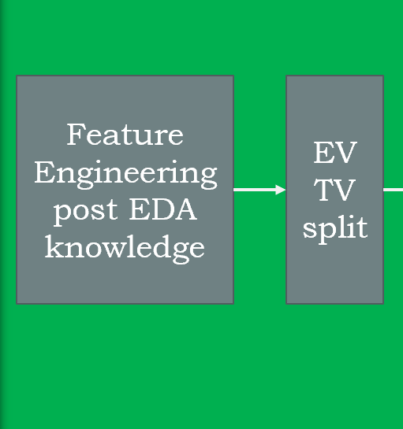
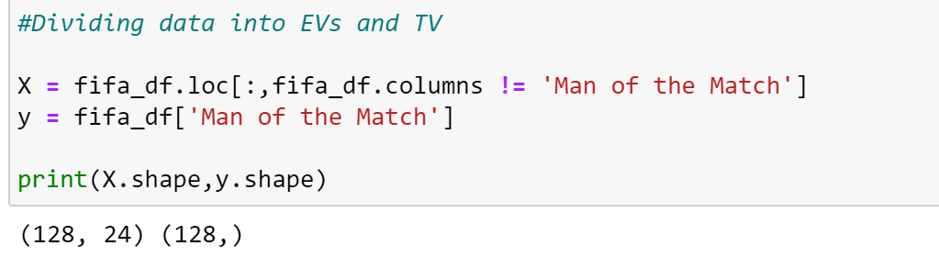
Feature Engineering (Dropping ID and Corelated Columns)
Preparing the data (X and y) for Classification Models

Slide 15
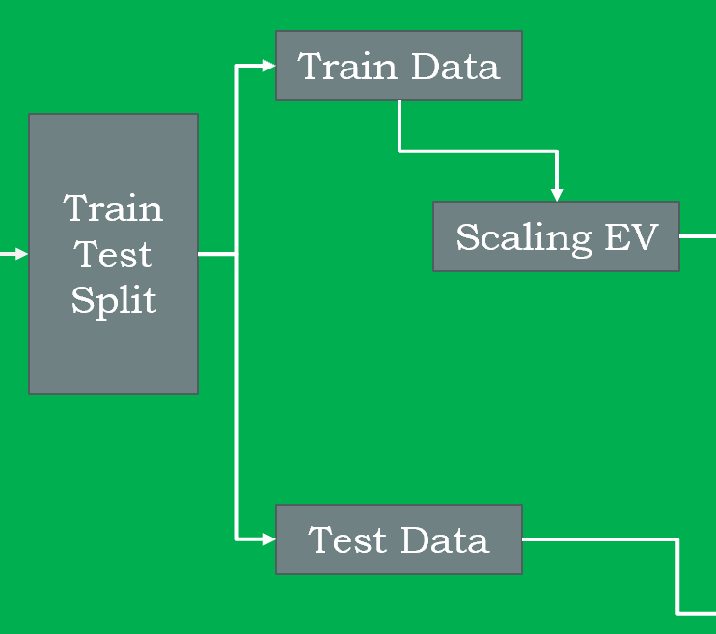
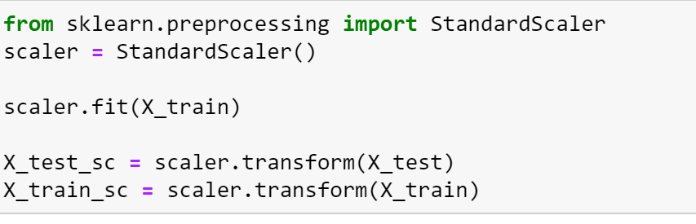
Train-Test Split and Scaling

Slide 16
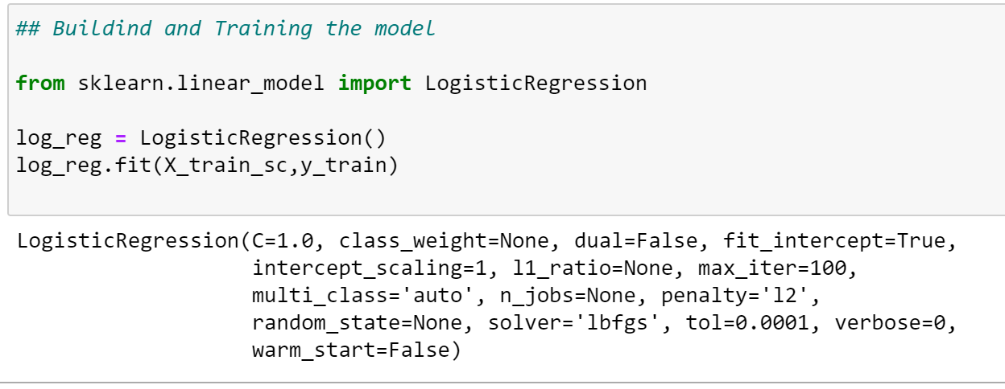
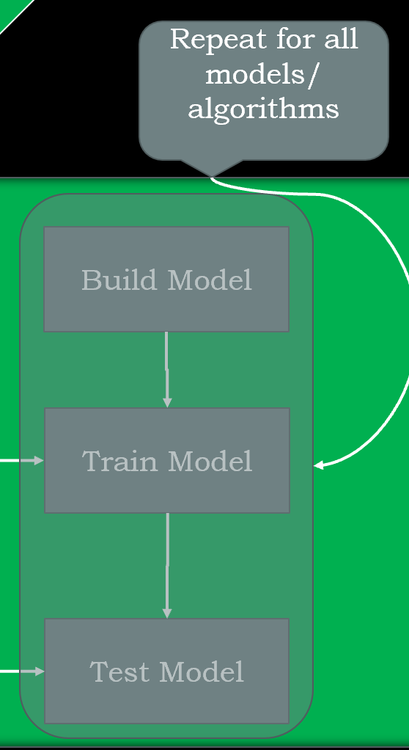
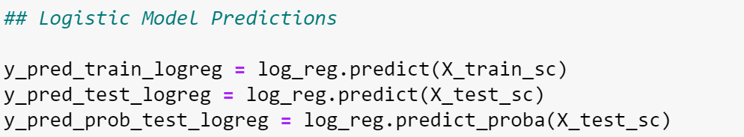
Model Building and Training -
Testing the Model -

Slide 17

Classification Modelling Techniques :
Decision Tree
Without GridSearchCV
With GridSearchCV
Random Forest
Without GridSearchCV
With GridSearchCV
Logistic Regression

Slide 18
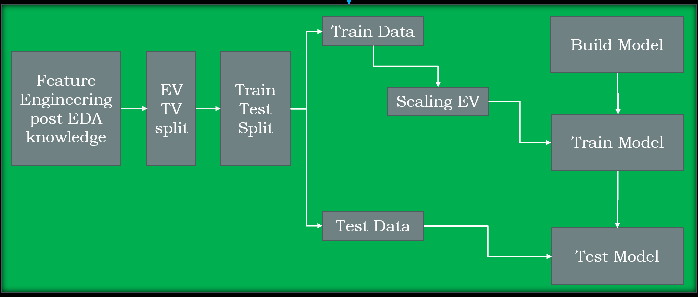
Understanding Data and Problem Statement
Data Preparation/EDA
Evaluation
Modelling
2018 Football World Cup data with football statistics and MoM Award details.
Accuracy Score
Model Evaluation
Confusion Matrix
Recall
Post Profiling:
Precision
F1 Score
Chose the Best Model in respect to Problem Statement
ROC AUC

Slide 19

Model Evaluation
Accuracy Score | Recall | Precision | F1 Score | ROC AUC
0.730769 | 0.769231 | 0.714286 | 0.740741 | 0.781065
0.538462 | 0.307692 | 0.571429 | 0.4 | 0.538462
0.769231 | 1 | 0.684211 | 0.8125 | 0.769231
0.769231 | 0.846154 | 0.733333 | 0.785714 | 0.789941
0.730769 | 0.923077 | 0.666667 | 0.774194 | 0.804734
Logistic Regression
Decision Tree
Decision Tree (with GridSearch)
Random Forest
Random Forest (with GridSearch)

Slide 20
Understanding Evaluation Parameters :
High Recall ~~ Lower False Negatives
In our use case this implies a Team did won MoM Award but our model did not predict it.
High Precision ~~ Lower False Positives
In our use case this implies a Team did not win MoM but our model predicted as they won.
The Use of this data set is by Gaming Professionals who participate in the Virtual Fantasy Leagues. In such Leagues, the MoM awardees get bonus points which can be a deciding factor in the final outcomes. Thus, in our case both False Positives and False Negatives have adverse effect and thus Accuracy is the best parameter to judge the model.

Slide 21


Decision Tree Model (with GridSearchCV) and Random Forest Classification (without GridSearchCV) provide us with the best results with an Accuracy of 76.92% and can be used for the Classification process

Slide 22



Thank You
Please share your queries and feedback -
Ishaan Marwah
ishum17@gmail.com

