Slide 1
Foodshades
Group 41:
Members:
Harmi Shah (201901007)
Nirali Odedara (201901115)
Foram Mehta (201901127)
Pratyaksha Maheshwari (201901282)
Dharti Ikharwala (201901243)
Keyur Champawat (201901458)

Slide 2
Functionalities
Login and Logout option for users.
Edit Profile for users.
Users can Change Passwords.
Customers can also give their feedback on appropriate orders.
Customers can add restaurants in the Favorite list.
Customers can provide cooking and delivery instructions based on their needs.
They can also place an order in advance so that they don’t need to worry about any hassles.
The customers can give ratings and also read and write reviews.
Customers can view the process of tracking the preparation of food and food arrival time.
Customers also have access to the contact details of the delivery person.

Slide 3
Functionalities
The customer details would also be stored by the database which includes information like the customer’s name, order history, contact number, payment details, subscription details, address etc.
The application will provide monthly and yearly subscriptions which are silver, gold and platinum. This offers discount coupons, promo codes and cashback.
Platinum subscription includes free delivery, promo codes upto 40% discount, and cashback on online payments.
Gold subscription includes free delivery and promo codes
Silver subscriptions include free delivery.

Slide 4
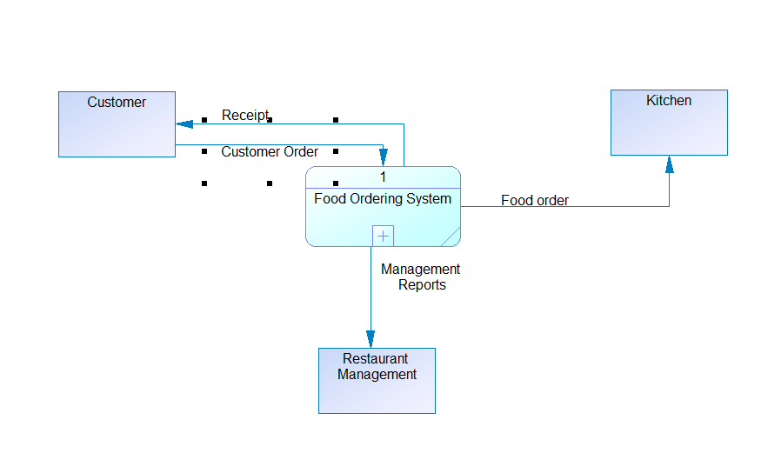
DFD Diagram Level 0:

Slide 5
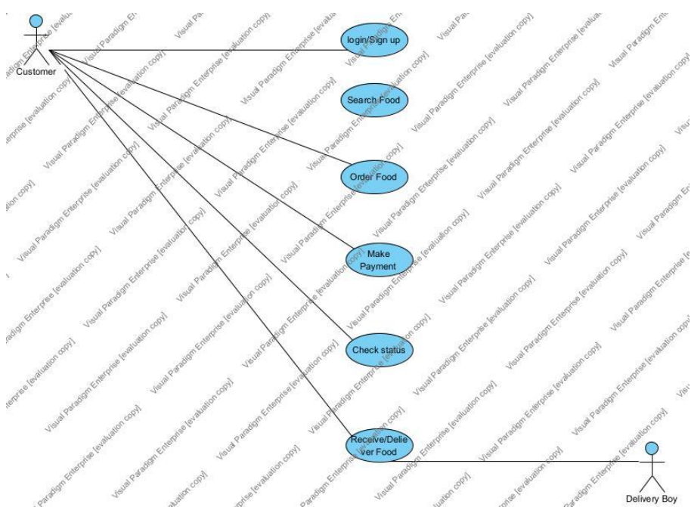
Use Case Diagram

Slide 6
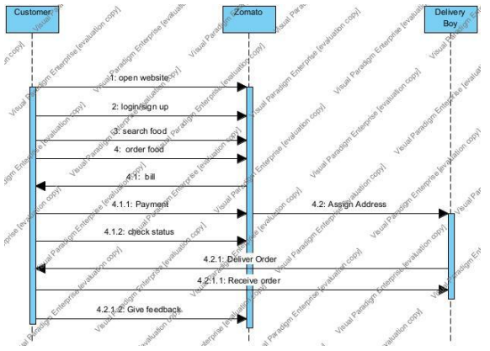
Sequence diagram
Food shades

Slide 7
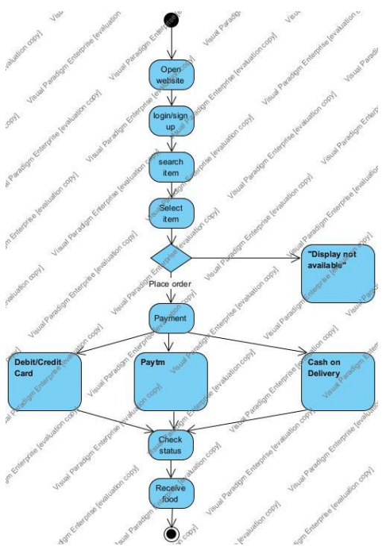
Activity diagram

Slide 8
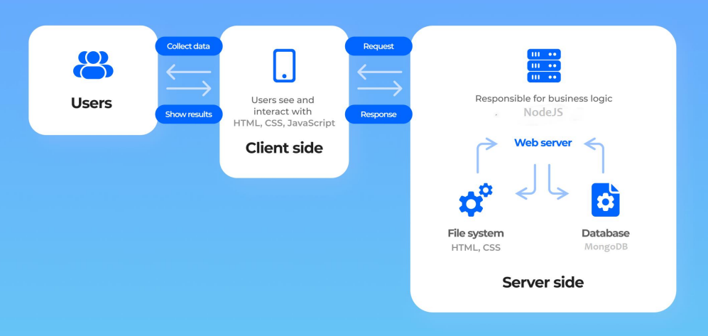
Application architecture
Firebase

Slide 9
Technologies/tools
Technologies:
HTML
CSS
JS
Firebase
Tools:
VS code, Github

Slide 10
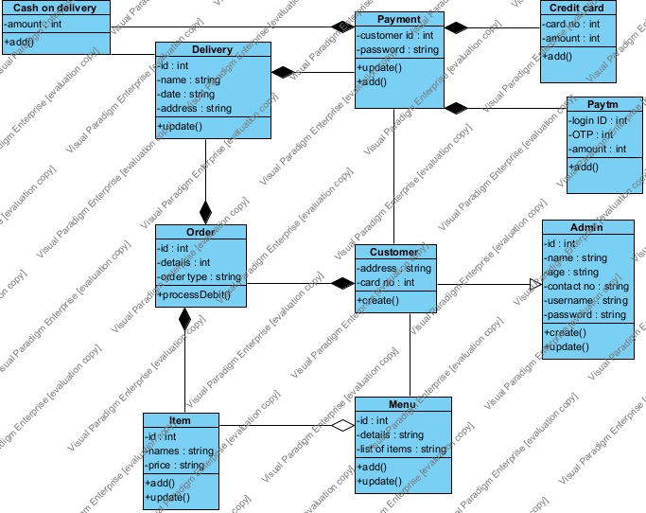
UML Diagram Class Diagram

Slide 11
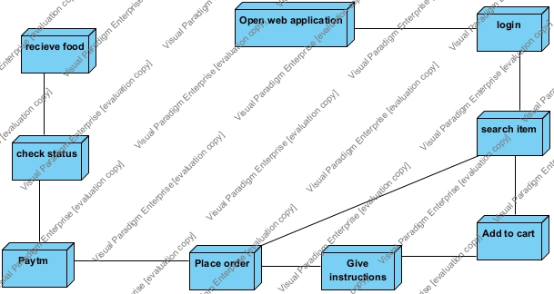
UML Diagram Deployment Diagram

Slide 12
Gantt chart
 | Month 1 |  |  |  |  | Month 2 |  |  |  | Month 3
 | Week 1 | Week 2 | Week 3 | Week 4 | Week 5 | Week 6 | Week 7 | Week 8 | Week 9 | Week 10 | Week 11
Plan
Analyze
Design
Build
Test

Slide 13
Summary of implementation
we made all of the pages using html and css and we connected them using href attribute. In Sign in and login page, we connected both through transition feature in css. After that we built a database using firebase which stores signup details of the user. Then we have menu page which shows all the item details which can be added to cart and total amount is presented at the end.

Slide 14
Summary of test plan
Test
Add new item
Cart value
Register
Use Case Derivation
User-item use case
Cart Value use case
Register use case
Test Result
PASS
PASS
PASS

Slide 15
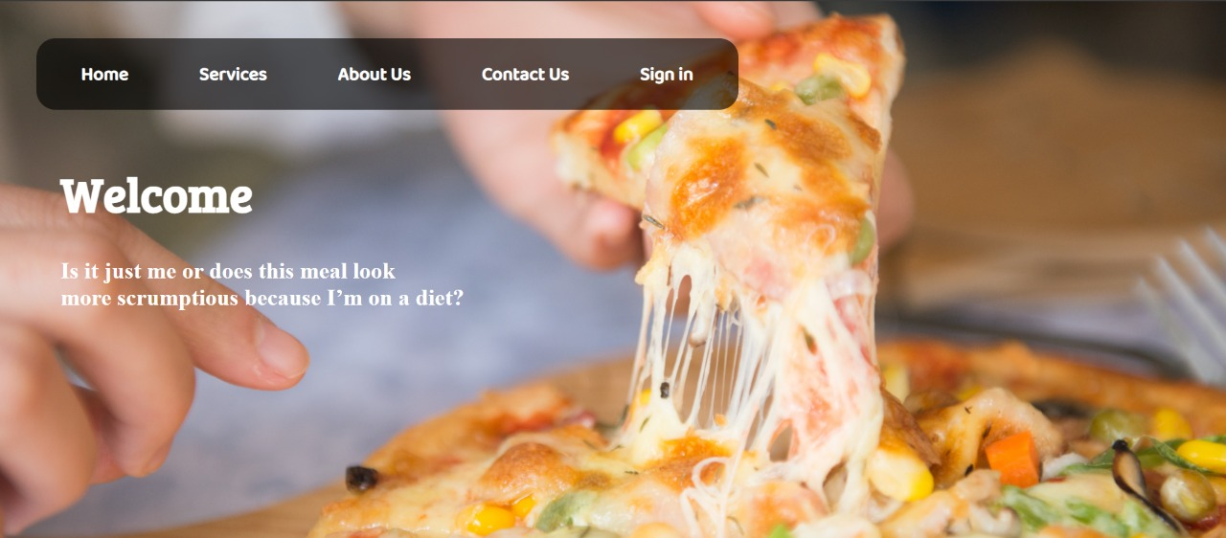
Application navigation using Ui/Ux design Home Page

Slide 16
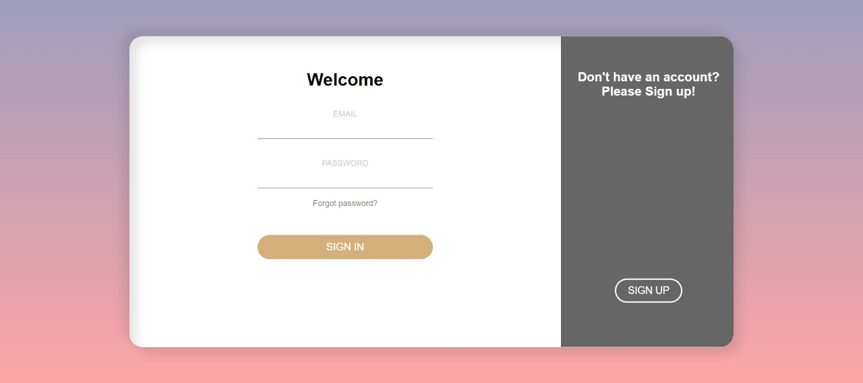
Log in

Slide 17
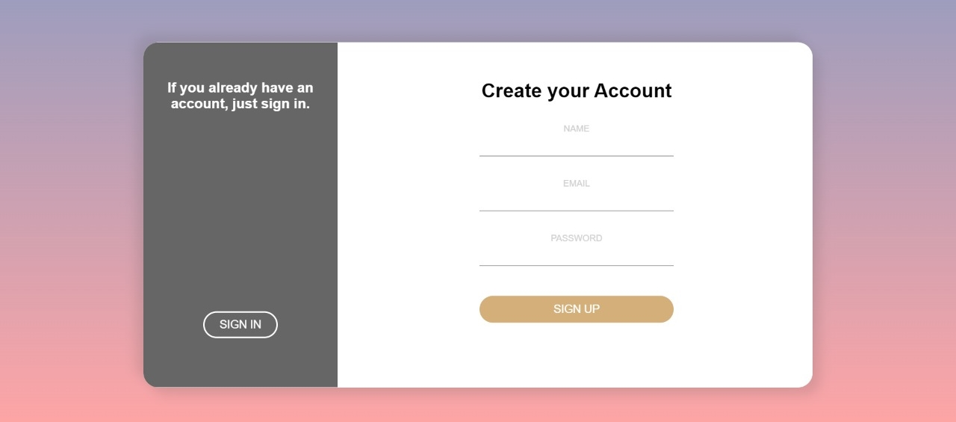
Sign up

Slide 18
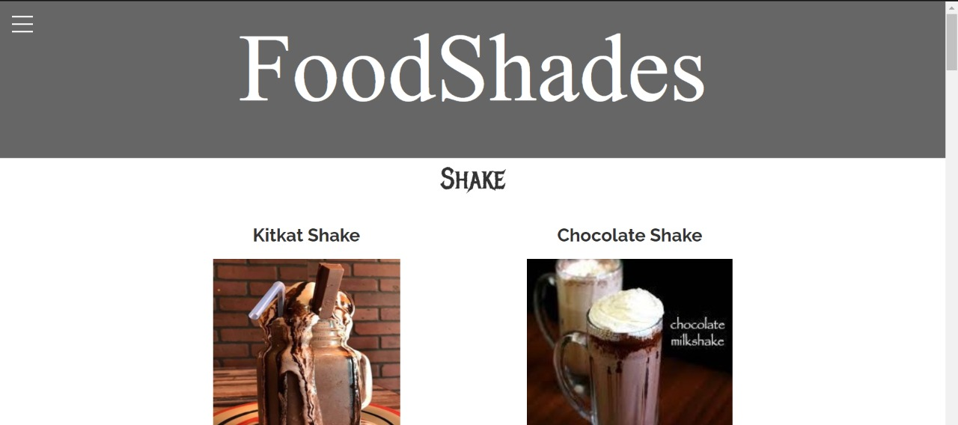
menu

Slide 19
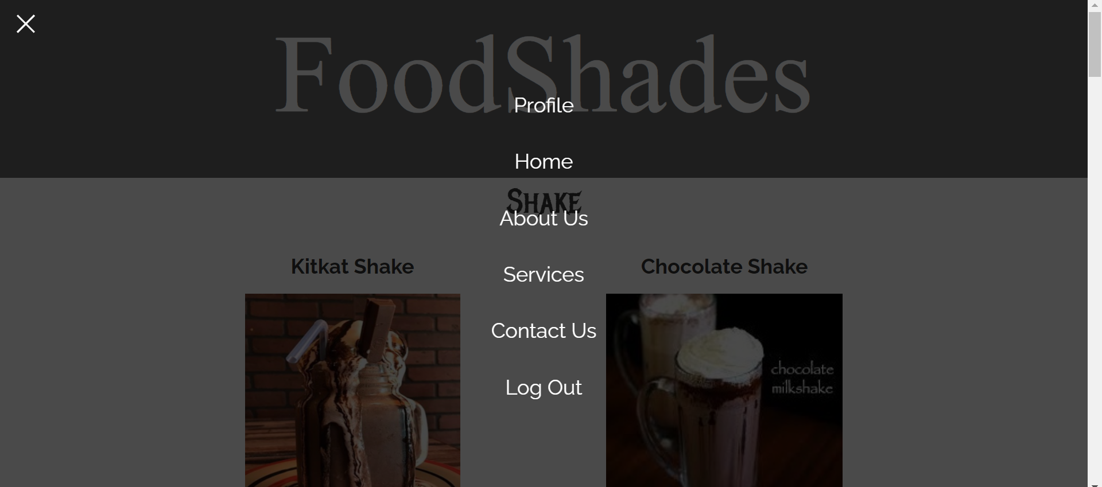
Home 2

Slide 20
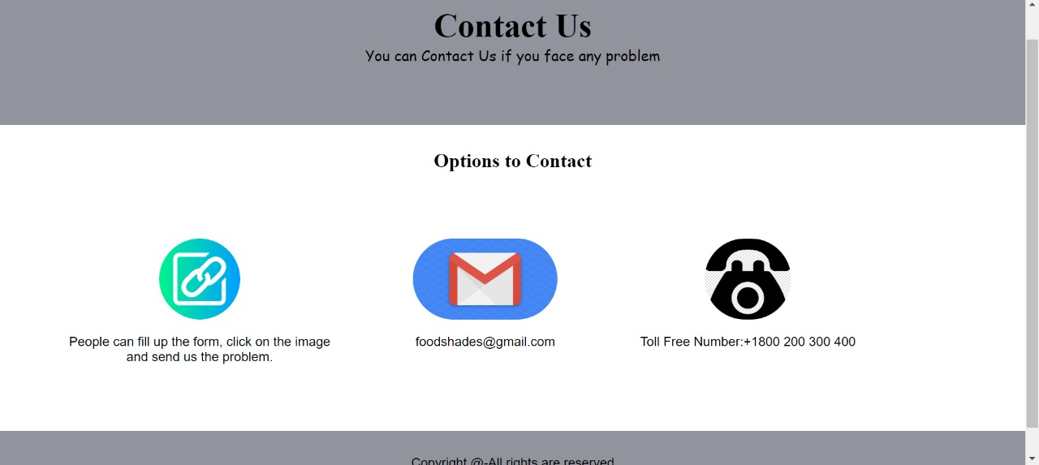
Contact us

Slide 21
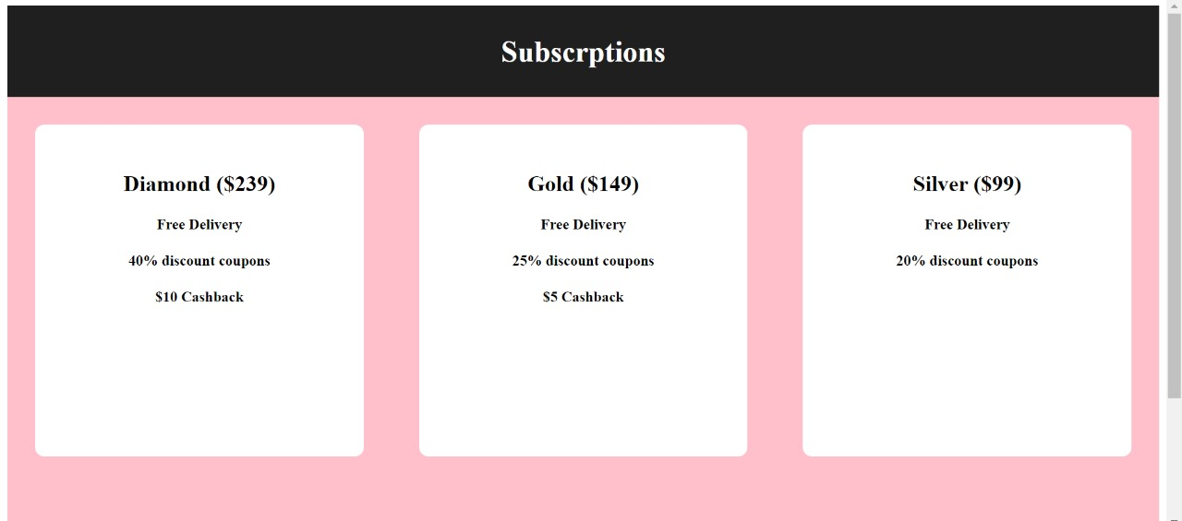
Subscription

Slide 22
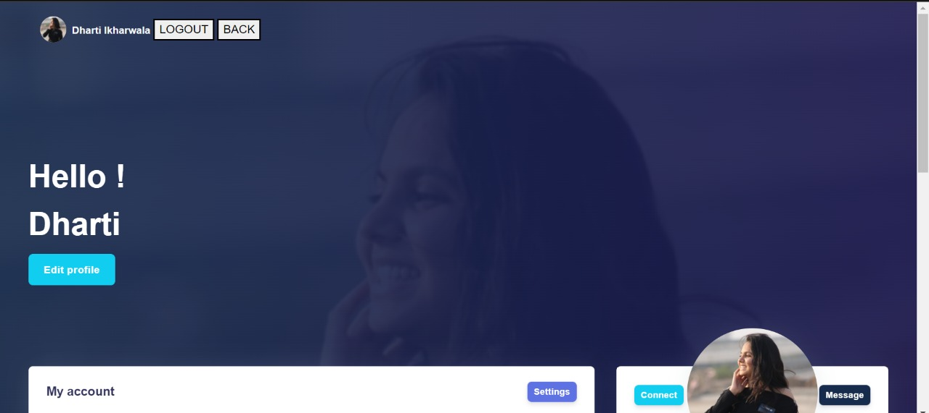
Profile page

Slide 23
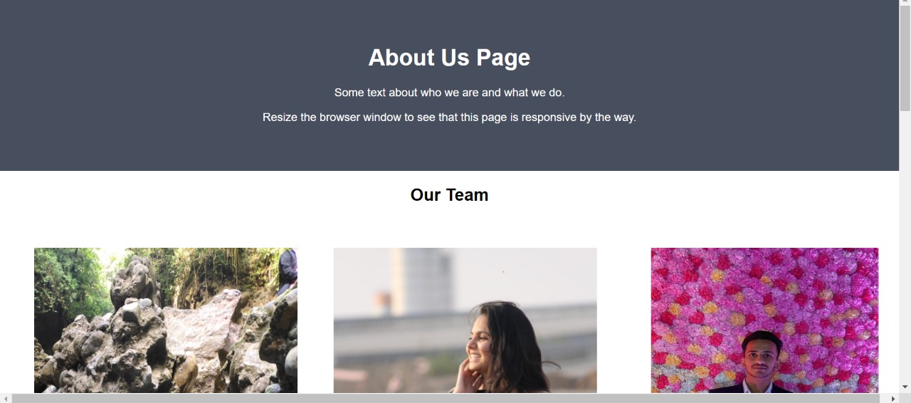
About US

Slide 24
Contribution
Harmi Shah(201901007)
Functionalities, DFD diagram, UML Diagrams, UI/UX diagram
Nirali Odedara(201901115)
Functionalities, Information gathering, DFD diagram, UML diagram , UI/UX diagram
Foram Mehta(20190127)
Requirement gathering, SRS preparation, DFD diagram, UI/UX diagram
Dharti Ikharwala(201901243)
Front end, Database
Pratyaksha Maheshwari(201901282)
Front end, Database
Keyur Champawat(201901458)
Information Gathering, DFD diagram, UI/UX diagram, Functionalities

Slide 25
Thank you

