Slide 1

Lights Out, Data On: Forecasting Formula 1 Podiums and Championship Points

Slide 2
CONTENTS
1
Predictive Tasks and Evaluation
2
Data Pre-processing and Exploratory Analysis
3
Modeling
4
Evaluation
5
Discussion of related work

Slide 3
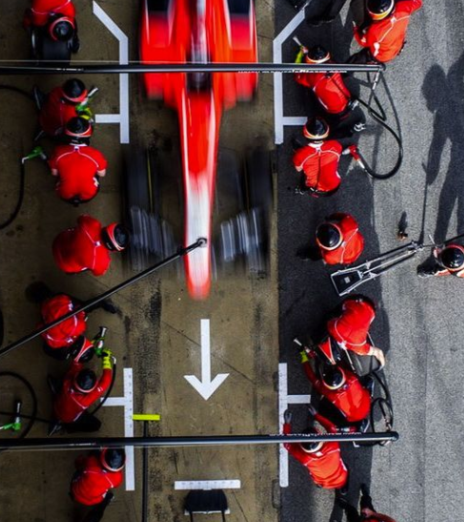


Part 1. Predictive Tasks and Evaluation

Slide 4
Formula 1 Background: What Are We Predicting?
Formula 1 (F1) is the top tier of open-wheel motor racing
Annual World Championship with ~20–23 Grands Prix per season
Each race weekend has qualifying → starting grid → main race
Grid position is determined by qualifying lap times
Race result gives points towards the Drivers’ and Constructors’ Championships
Points system rewards consistent high finishes
Top 10 finishers score points (e.g., P1 = 25, P2 = 18, P3 = 15, … in modern F1)
Podium = Top 3 finishers of each race
Performance depends on multiple factors
Driver skill, car and team (constructor), circuit layout, weather, regulations (era)

Slide 5

Project Overview
Goal: use real Formula 1 data to study two predictive tasks
Task 1: predict which drivers will finish on the podium in a given race
Task 2: predict each driver’s final championship points from mid-season information
Methods: combine simple frequency-based baselines with classic models from this class

Slide 6
Predictive Tasks We Study
Task 1 – Race-level podium prediction
For each race, and each participating driver
Predict the probability that the driver finishes in the Top 3
Task 2 – Season-level points prediction
For each driver–season pair
Predict the final championship points at the end of the season
The two tasks are complementary:
Task 1 focuses on single-race outcomes
Task 2 focuses on long-term season performance

Slide 7
Task 1: Evaluation & Baselines
Metrics
ROC-AUC, F1: podium vs non-podium classification
Recall@3, Top-1 accuracy: ranking quality within each race
Baselines
Simple frequencies: global, driver, driver–circuit, constructor, circuit
Era & weather-aware driver podium rates
Grid-only: rank drivers by starting position
Logistic Regression: grid + pre-race form + short-term form + race weather

Slide 8
Task 2: Evaluation & Baselines
Metrics
MAE, RMSE: point prediction error
R²: variance in final points explained
Spearman: agreement with true season ranking
Baselines
Means: global mean, driver mean
mid_points baseline: use mid-season points directly
Era & constructor means, constructor × weather means
Linear Regression: mid_points + year + constructor + season-average weather

Slide 9
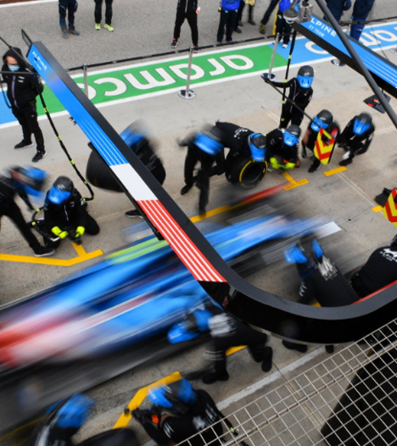
Part 2. Data Pre-processing and Exploratory Analysis

Slide 10
Ensuring Valid Predictions
Temporal split:
Train 2000–2014, Val 2015–2018, Test 2019–2023
Compare models against intuitive baselines:
grid-only (Task 1), mid_points (Task 2)
Use multiple metrics: classification + regression + ranking
Check robustness across eras and weather, and inspect surprising cases

Slide 11
Data Sources and Scope
Two Kaggle datasets:
F1 World Championship (1950–2024)
F1 Weather Info (1950–2024)
We keep only seasons 2000–2023:
Modern F1 era, more stable scoring and calendar
Better coverage and quality of weather data

Slide 12
From Raw CSVs to Task Datasets
Raw racing data (races, results, driver_standings, drivers, constructors)
Weather data (weather_features_v4: temperature, precipitation, windspeed)
Task 1 dataset:
One row per (race, driver), label is_podium
Task 2 dataset:
One row per (year, driver), with mid_points and final_points

Slide 13
Features and Basic Observations
Task 1 features:
grid, year/round, circuit, pre-race points and rank, recent finishes, constructor, race weather
Task 2 features:
mid_points, year, main constructor, season-average weather
Dataset sizes (after filtering to 2000–2023):
Task 1: 5,860 train / 1,660 val / 2,080 test samples
Task 2: 340 train / 86 val / 103 test seasons
mid_points and grid already show very strong signals, which our baselines and models build on

Slide 14

Part 3. Modeling

Slide 18

Part 4. Evaluation

Slide 22
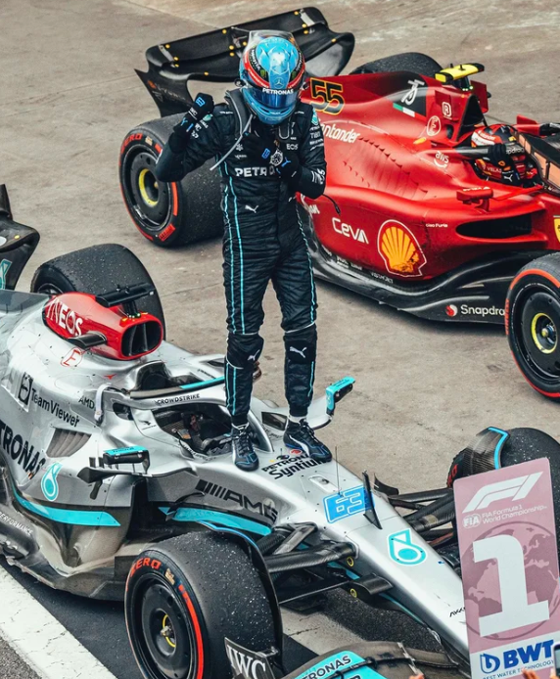
Part 5. Discussion of related work

Slide 26
THANK YOU!

