Slide 1
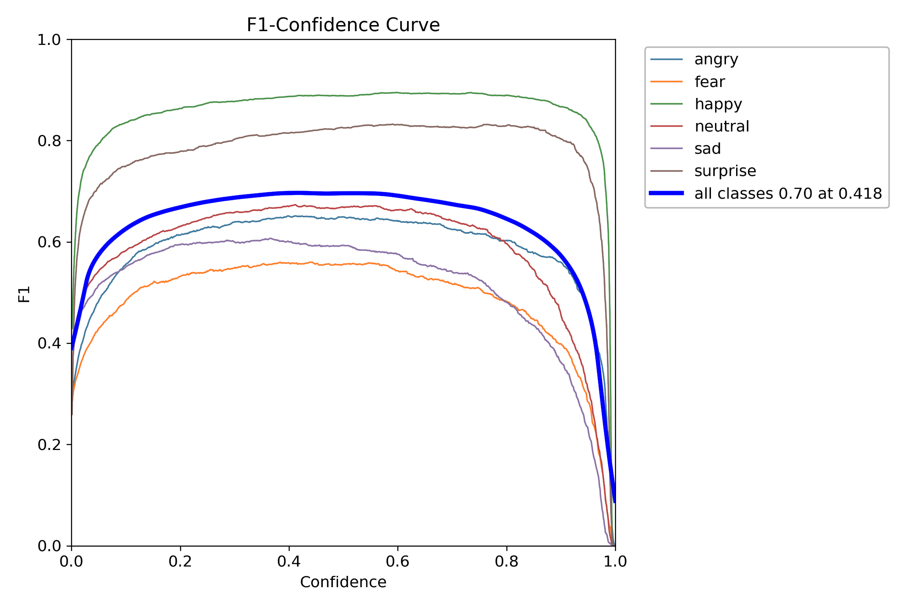
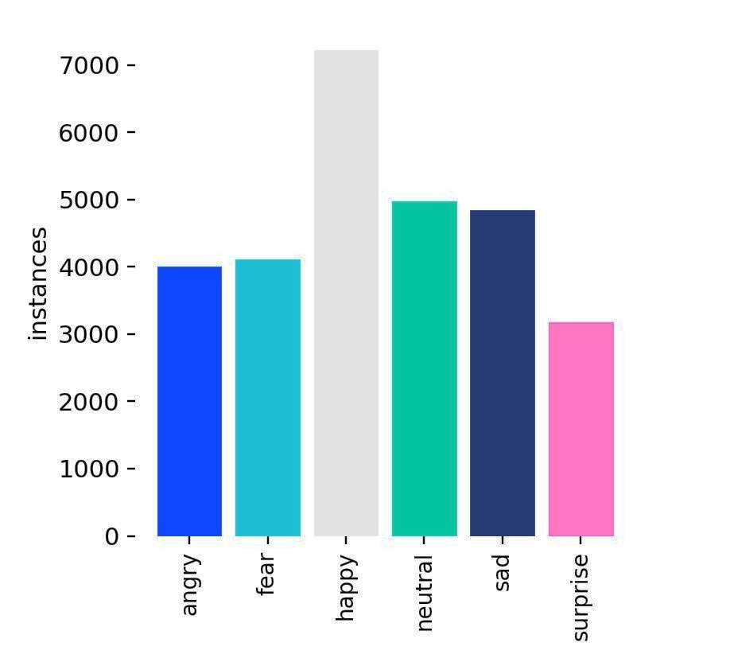
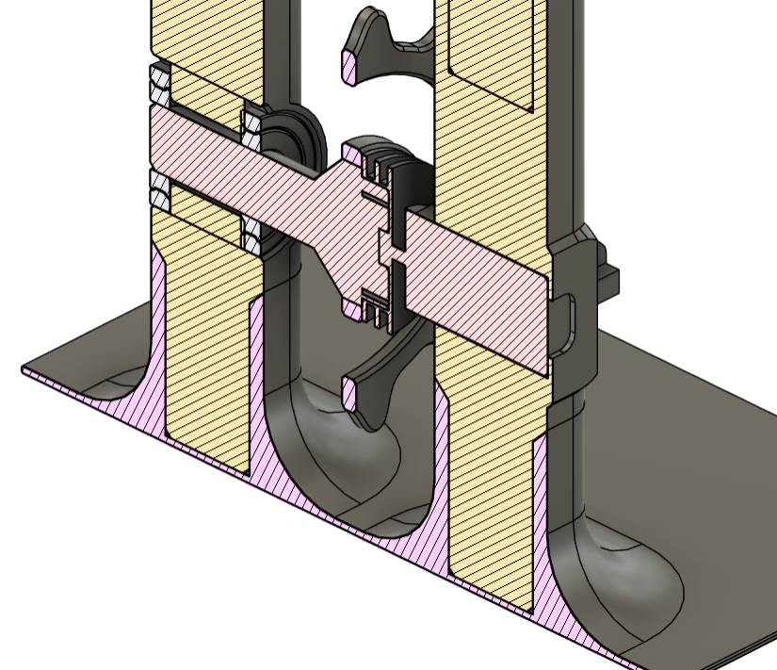
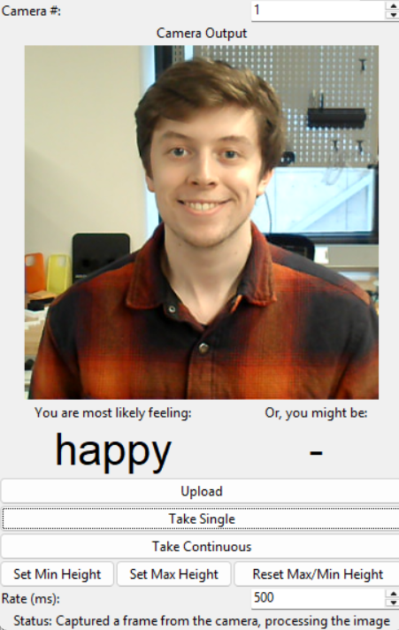
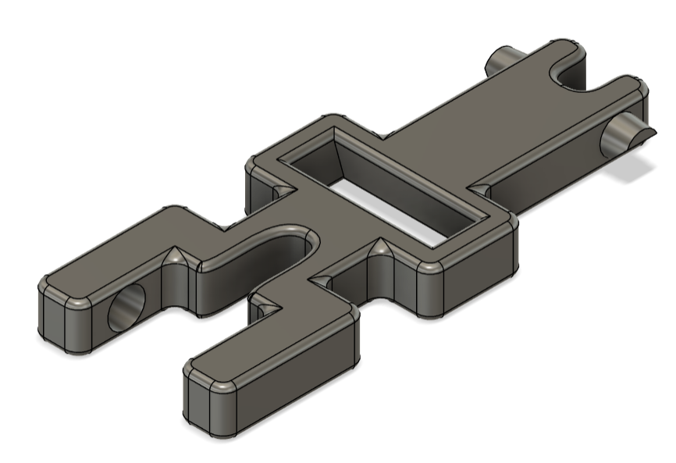
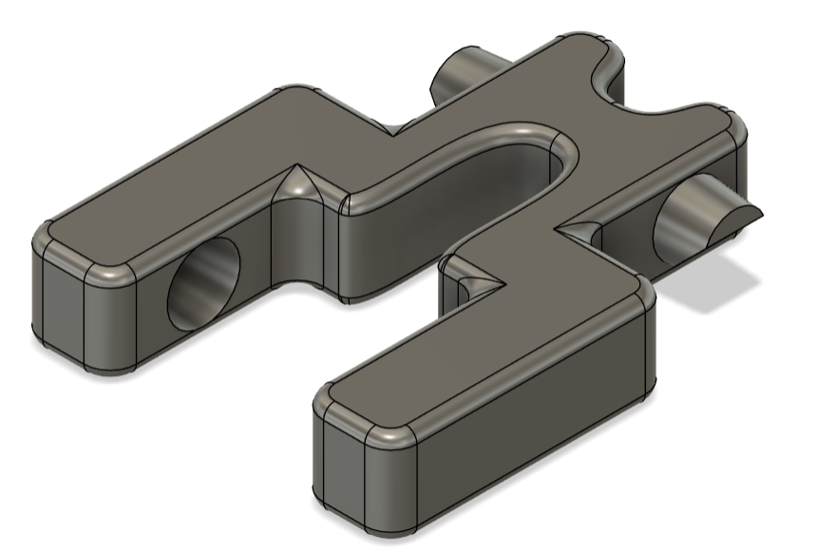
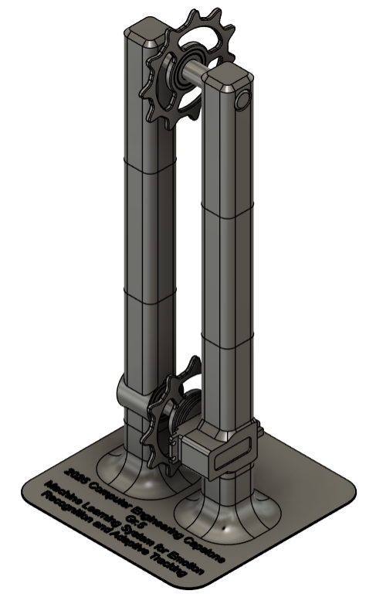
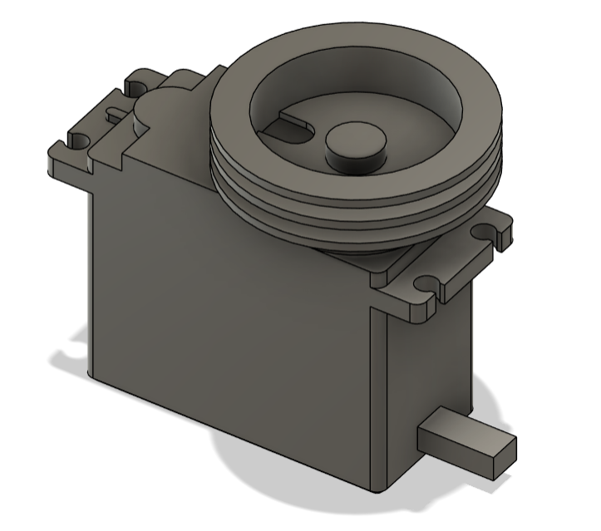

#05
Machine Learning System for Emotion Recognition and Adaptive Tracking
Group Number
Group Members: Justin Hoddenbagh, Liam O’Regan , Jide Obatolu, Harminder Saini
INTRODUCTION
The initial project proposal, before further discussion, was titled “Application of Machine Learning”.
With an open-ended project goal, the team decided to use machine learning to create a face and emotion recognition system.
The system can be applied to therapy sessions to give therapists data about how a patient was feeling throughout an appointment.
Model
YOLOv11-S Model:
Used for real-time face and emotion recognition.
Balanced speed and accuracy with lightweight architecture.
Handled complex and overlapping emotions effectively.
Software
All software was written in Python 3.10.
The user interface (UI) was designed with Tkinter, a library included with Python as an interface to the Tcl/Tk tooklit.
Hardware
Servomotor Control:
Controlled by Micro Maestro servo controller via Python code.
Non-Electrical Parts:
Modeled in Autodesk Fusion 360, fabricated with 3D printing.
Designed for compatibility and modularity.
Rails connect with friction-fitted sockets.
Height can be adjusted by adding/removing rail parts and chain links, then recalibrating camera limits.
ANALYSIS
YOLOv11 released in September 2024, improves speed and accuracy with C3k2 and SPPF (22% fewer parameters than YOLOv8).
C3k2 boosts feature extraction; C2PSA improves facial region detection.
Hitec HS-785HB servomotor supports 2520° range (seven rotations) for 720° project requirement.
TABLES / FIGURES / DIAGRAMS
CONCLUSIONS & RECOMMENDATIONS
If the project were to be repeated, we would make the following improvements:
Exploring additional applications of machine learning:
Sign language recognition
Lip reading
Training the model on a larger dataset to improve accuracy and generalization
Enhancing camera mobility by incorporating additional degrees of motion, such as horizontal movement and rotation
Using a more cost-effective motor with a smaller range of motion, better suited for small-scale applications
REFERENCES
Hitec Radio Control. (n.d.). Home. [Online]. Available at: https://hitecrcd.com/hs-785hb-karbonite-3-5-turn-winch-servo. Accessed March 13, 2025.
Pololu Robotics & Electronics. (n.d.). Pololu - Micro Maestro 6-channel USB servo controller (assembled). [Online]. Available at: https://www.pololu.com/product/1350. Accessed March 13, 2025.
Khanam, R., & Hussain, M. (2024). YOLOv11: An overview of the key architectural enhancements. arXiv. [Online]. Available at: https://arxiv.org/pdf/2410.17725. Accessed March 13, 2025.
Ultralytics. (n.d.). YOLOv11 Documentation. [Online]. Available at: https://docs.ultralytics.com/models/yolo11/. Accessed March 13, 2025.
Kaggle. (n.d.). Emotion Detection FER. [Online]. Available at: https://www.kaggle.com/datasets/ananthu017/emotion-detection-fer. Accessed March 13, 2025.
ACKNOWLEDGEMENTS
Thanks to Dr. Manjikian for guiding and supporting us, and for providing valuable feedback throughout the project.

