Slide 1


AgriRent - Agricultural Equipment Rental & Farm Supplies Selling System
Babu Madhav Institute of Information Technology
5th Semester
Project Presentation
On
Group Number: 24
Group Members:
1. Hamish 202307100110120
2. Yash 202307100110141
3. Darshak 202307100110172
Guide Name : Dr. Preeti Bhatt

Slide 2
Table of Content
Project Definition
Functional Requirements
Non-Functional Requirements
Use Case Diagram
Activity Diagram
Data Dictionary

Slide 3
Project Definition
Purpose
An AgriRent is web based system that lets equipment owners rent out farming machines to farmers.
It also helps manage the sale of farming products. The goal is to make it easy and affordable for farmers to access what they need.
Scope
A web-based platform accessible via desktop and mobile browsers.
A catalog of agricultural equipment available for rent, with features for searching and booking.

Slide 4
Project Definition
Scope (Conti…)
User account management for farmers, equipment owners, and admin.
Reporting and dashboard features for equipment owners, farmers and admin to monitor listings, rentals, and sales.
Notification system for booking and order confirmations, listing equipment and product.

Slide 5
Project Definition
Identification of Need
Many farmers can’t afford to buy expensive equipment and Farm Supplies.
This system helps them rent and buy what they need, saving money and making farming easier.

Slide 6
Functional Requirements
User Management
Requirement ID | Description | Comments | Component
FR-U1 | The system shall allow new users to register by providing essential details. | Validates mobile number and password strength. | Registration Page
FR-U2 | The system shall allow registered users to log in using their Mobile number and password. | Implements session management. | Login Page
FR-U3 | The system shall provide a ‘Forgot Password’ feature to allow users to reset their password securely | OTP send to registered mobile number for verification.” | Forgot Password Page

Slide 7
Functional Requirements
Subscription Management
Requirement ID | Description | Comments | Component
FR-S1 | The system shall allow users to view available subscription plans. | Includes pricing, features, and duration. | Subscription Plans Page
FR-S2 | The system shall allow users to subscribe, renew, or cancel a future subscription. | Cancellation does not trigger an automatic refund. | User Profile / Dashboard
FR-S3 | The system shall integrate with a secure payment gateway to process payments. | e.g., GPay | Payment Processing Module

Slide 8
Functional Requirements
Equipment & Product Management
Requirement ID | Description | Comments | Component
FR-EP1 | Equipment Owner shall be able to add, update, and delete equipment listings. | Includes images. | Equipment Owner Dashboard - Equipment Mgmt.
FR-EP2 | Farmer shall be able to add, update, and delete product listings. | Includes images. | Farmer Dashboard - Product Mgmt.
FR-EP3 | Users shall be able to view available equipment and products. | Includes search, filter, and sort. | Main Catalog / Browse Page

Slide 9
Functional Requirements
Booking & Order Management
Requirement ID | Description | Comments | Component
FR-BO1 | Users shall be able to submit a booking request for equipment. | System checks for availability conflicts. | Equipment Detail Page
FR-BO2 | Users shall be able to submit an order for a product. | May involve quantity selection. | Product Detail Page
FR-BO3 | The system shall require administrative approval for all requests. | Requests enter a "Pending" state. | Admin Dashboard - Approvals
FR-BO4 | The system shall notify the user of the approval or rejection of their request. | Sent notification. | Notification System

Slide 10
Functional Requirements
Communication, Review and Complaint
Requirement ID | Description | Comments | Component
FR-CRC1 | Users shall be able to submit reviews for items they have rented/ordered. | Users can only review completed transactions. | Order History / Review Page
FR-CRC2 | The system shall provide a secure messaging interface for users. | Messages are private between users. | Messaging Inbox
FR-CRC3 | Users shall be able to submit formal complaints tracked with a unique ID. | Statuses: Received, In Review, Resolved. | Support / Contact Page

Slide 11
Functional Requirements
Administrative Functions
Requirement ID | Description | Comments | Component
FR-A1 | Admin must approve all new listings before they appear publicly. | Prevents spam and ensures quality. | Admin Dashboard – Product and Equipment Page
FR-A2 | Admin shall be able to monitor subscriptions and process refunds. | Refunds processed via payment gateway API. | Admin Dashboard - Subscriptions & Finance
FR-A3 | The system shall generate reports (sales, revenue, usage) for administrators. | Reports should be exportable (CSV, PDF). | Admin Dashboard – Reports
FR-A4 | Administrators shall have a dashboard to manage pending requests. | Provides a clear summary of pending actions. | Admin Dashboard – Product and Equipment Page

Slide 12
Non-Functional Requirements
Requirement ID | Description | Comments | Component
NFR-1 | The system should respond to user actions (login, viewing listings, etc.) |  | Performance
NFR-2 | All sensitive user data (passwords, payments) must be encrypted |  | Security
NFR-3 | Only authorized users should access their respective dashboards and functions. |  | Security
NFR-4 | Recovery/reset of passwords requires secure authentication (Phone Number, OTP, etc.). |  | Security
NFR-5 | The application should be easily scalable to support increased listings, more users, and additional features in the future. |  | Scalability

Slide 13
Non-Functional Requirements (conti..)
Requirement ID | Description | Comments | Component
NFR-6 | The system must be available 99.5% of the time. |  | Availability
NFR-7 | Interface should be easy to use for all stakeholders with clear navigation and user instructions for equipment rental, product management, bookings, and reporting. |  | Usability
NFR-8 | Use modular coding standards and proper documentation so future updates, bug-fixing, or upgrades can be performed efficiently. |  | Maintainability
NFR-9 | The platform must work smoothly on major browsers and mobile devices. |  | Compatibility

Slide 14
Non-Functional Requirements (conti..)
Requirement ID | Description | Comments | Component
NFR-10 | All key events (logins, approvals/rejections, complaints) should be stored securely for administrative review and troubleshooting. |  | Audit Logging
NFR-11 | The system must support multiple languages and provide features for users with disabilities. |  | Accessibility
NFR-12 | All equipment rental, product sale, and payment transactions must be recorded accurately, avoiding duplication, loss, or error. |  | Data Integrity

Slide 15
Use Case Diagram

Slide 16
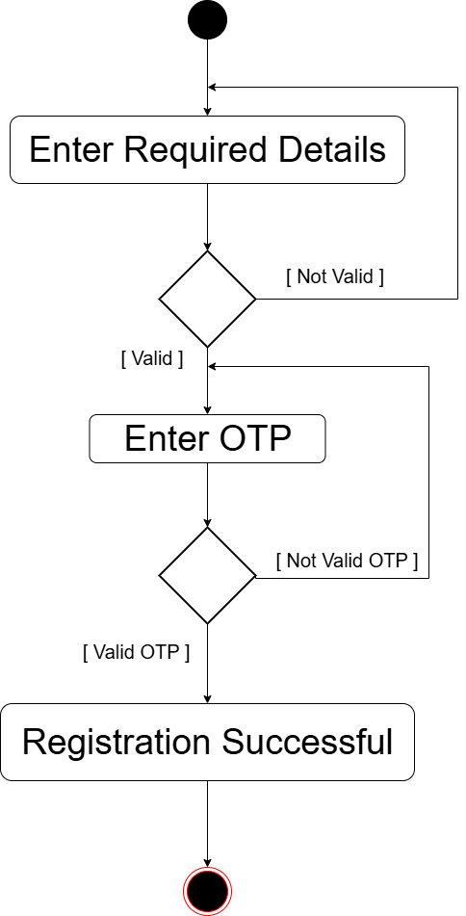
Activity Diagram
Registration

Slide 17
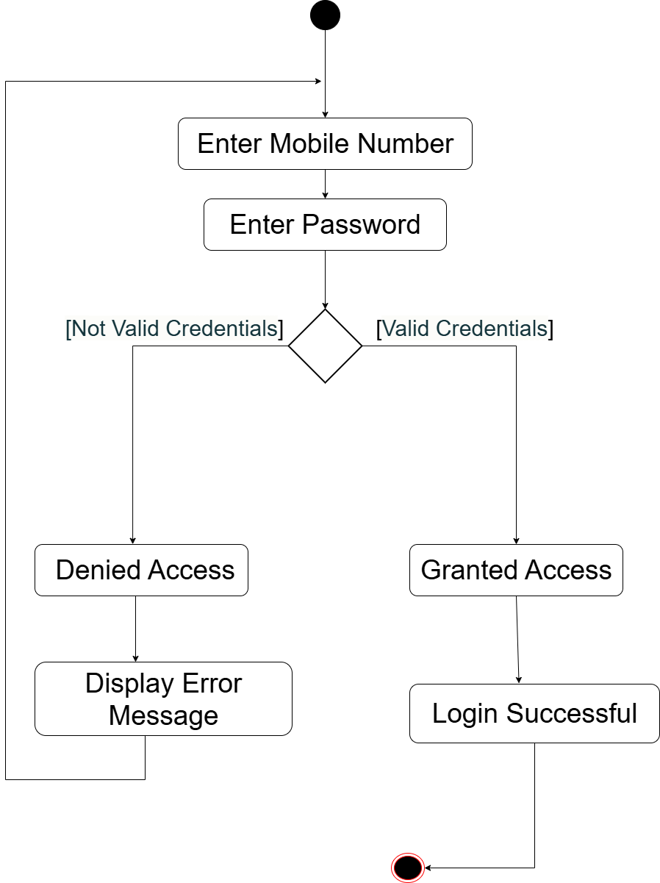
User Login

Slide 18
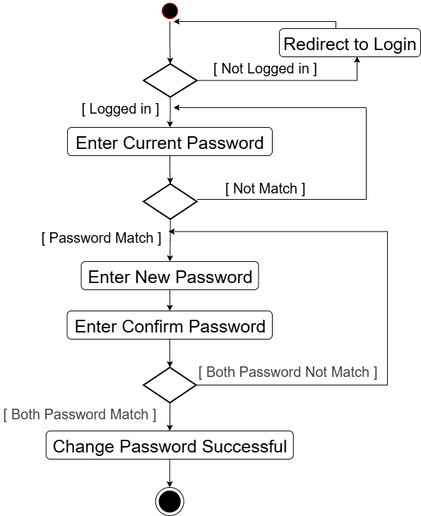
Change Password

Slide 19
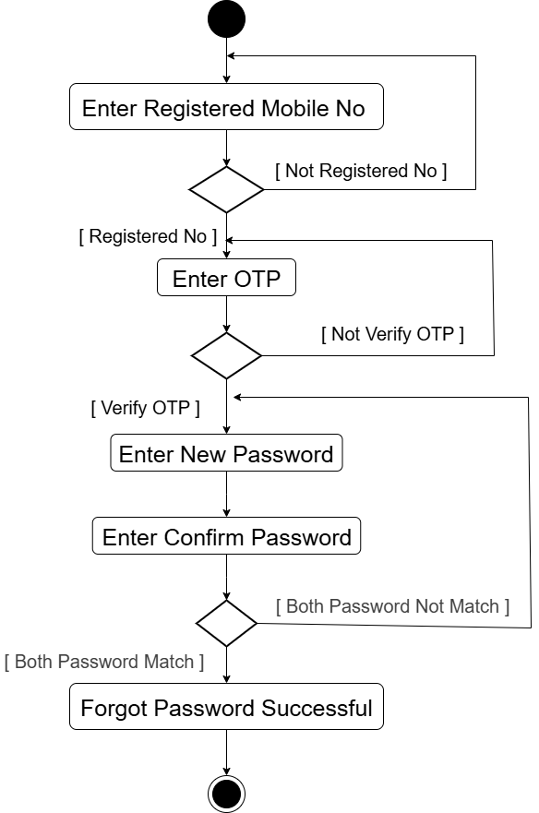
Forgot Password

Slide 20
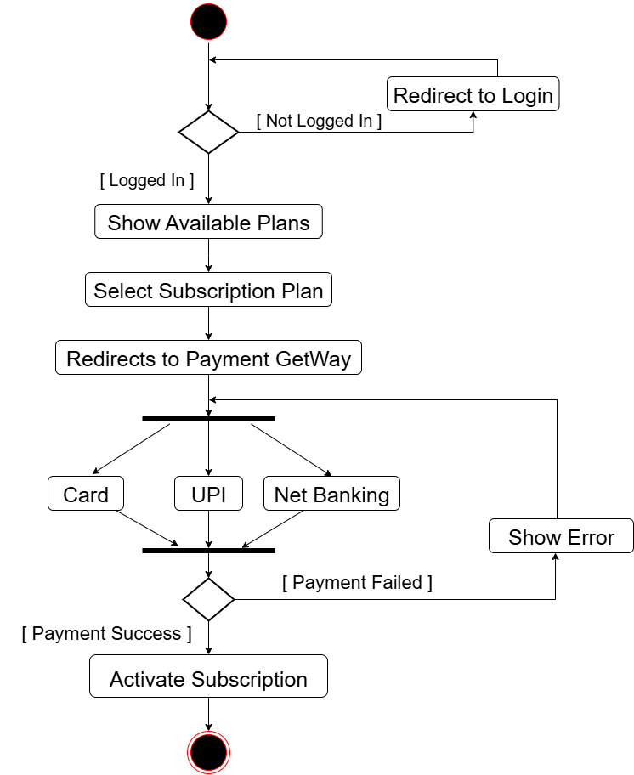
Subscription

Slide 21
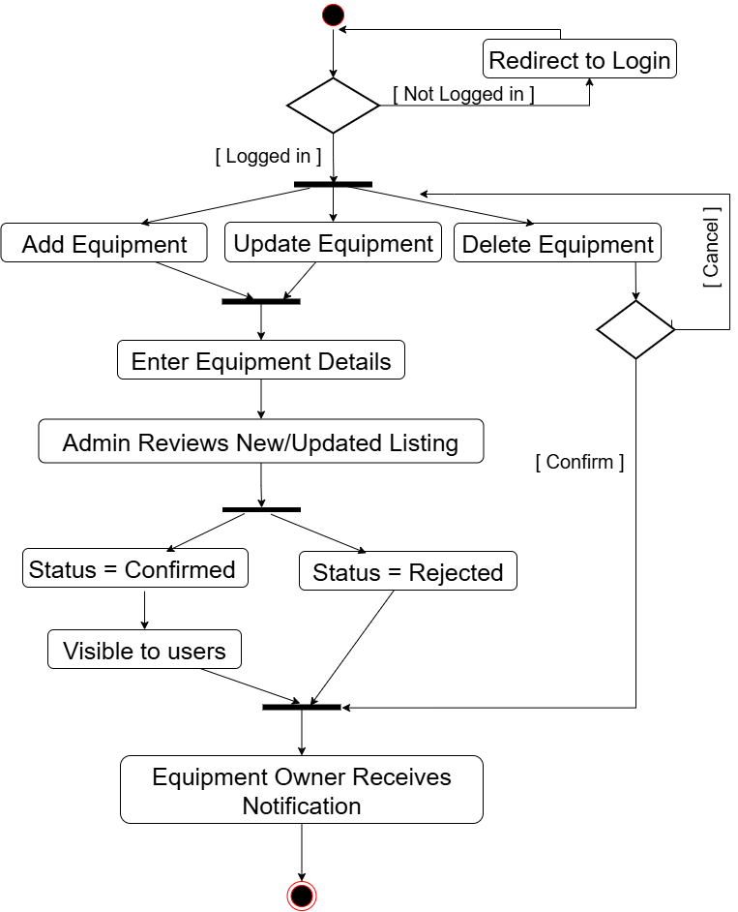
Manage Equipment

Slide 22
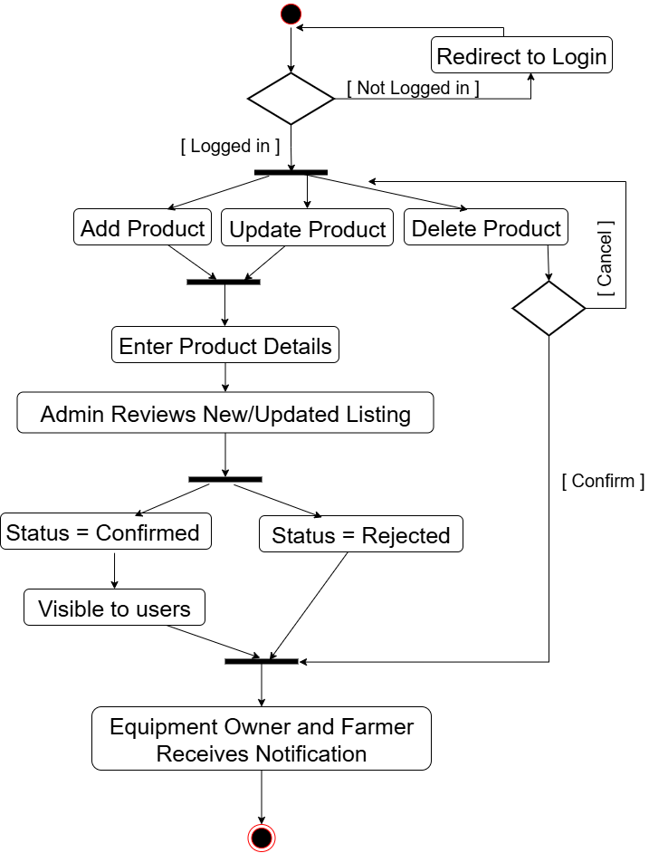
Manage Product

Slide 23
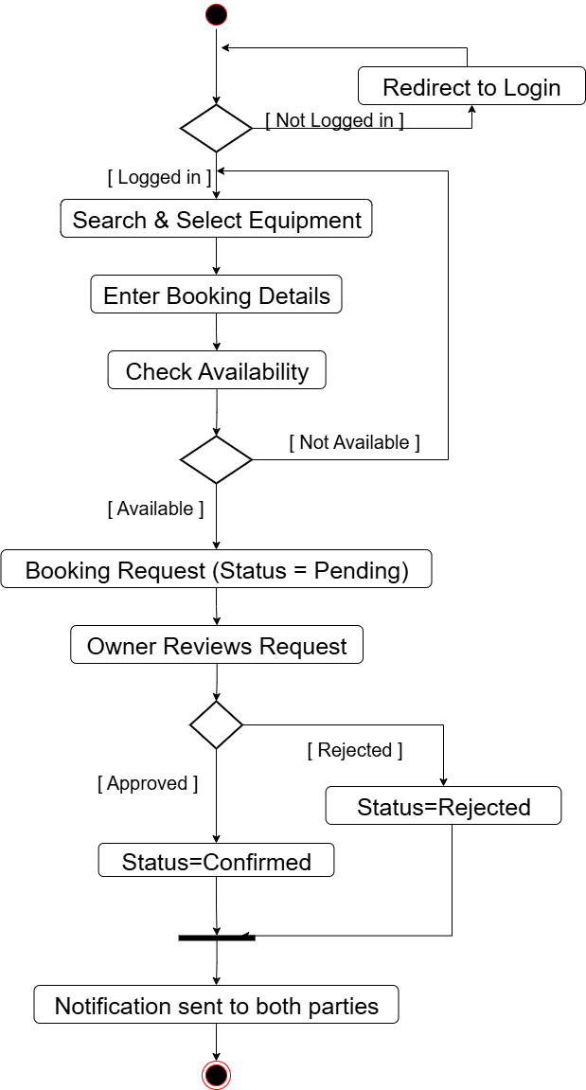
Equipment Booking

Slide 24
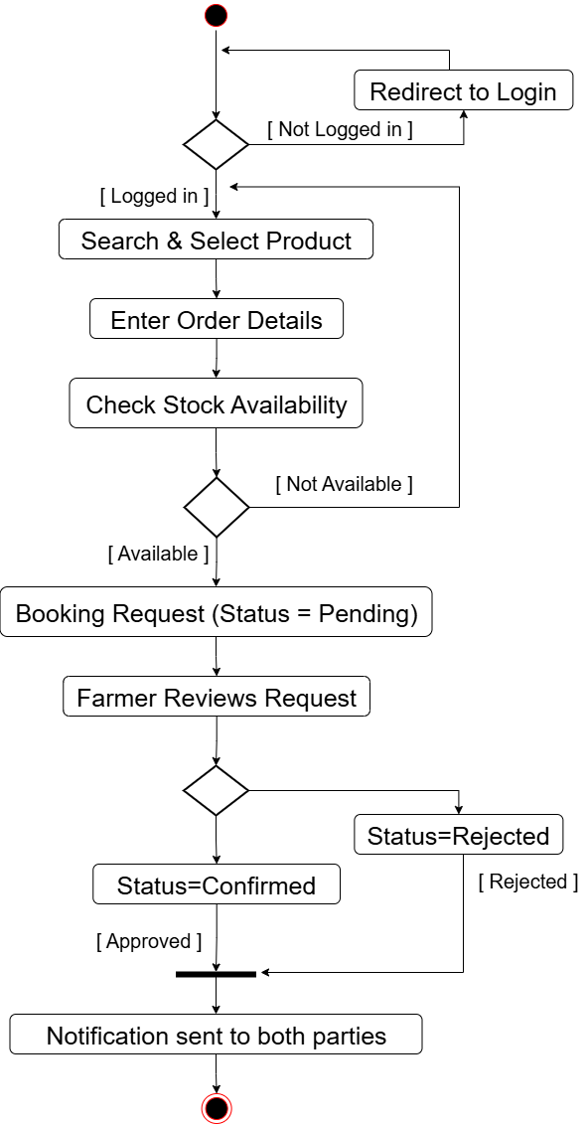
Product Order

Slide 25
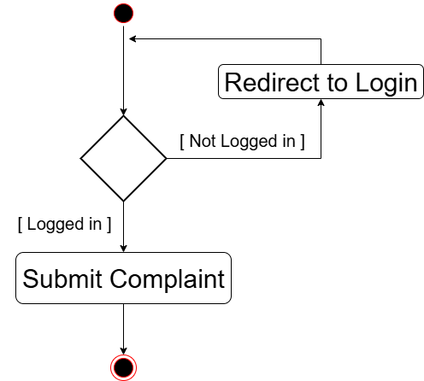
Complaint

Slide 26
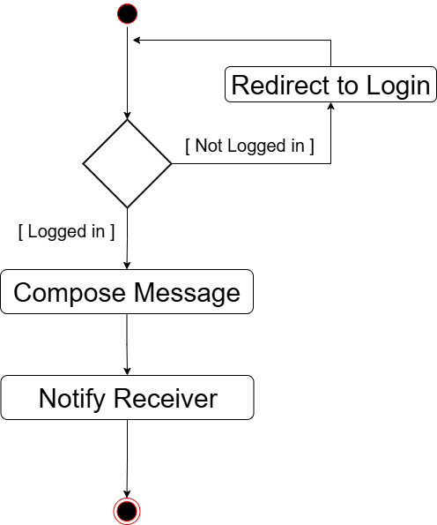
Messaging

Slide 27
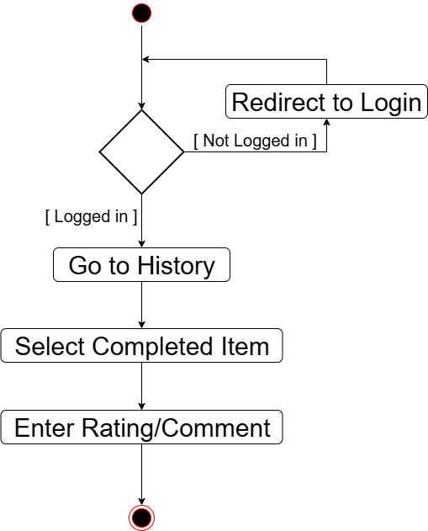
Submit Review

Slide 28
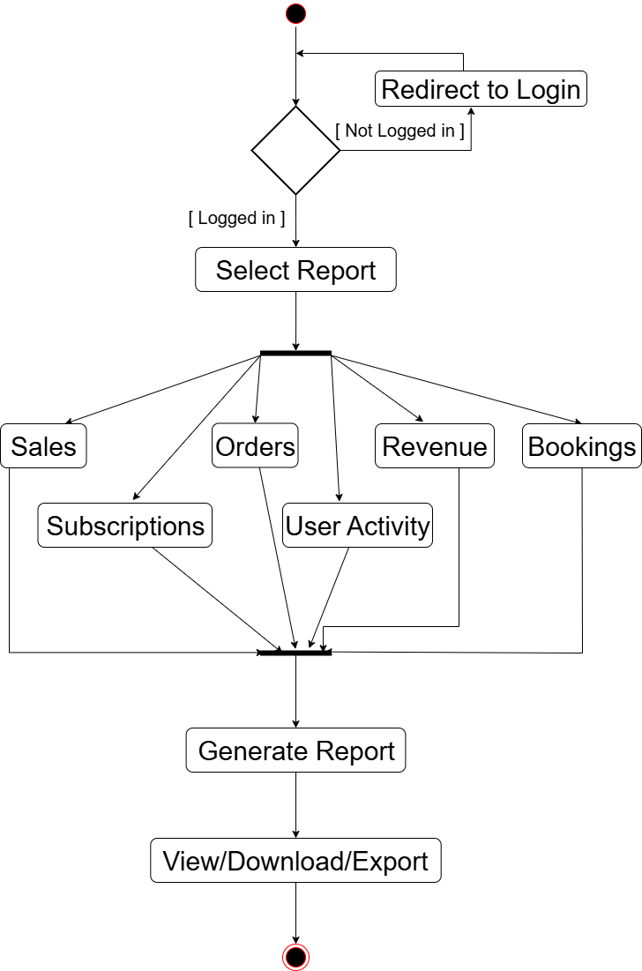
Admin Generate Reports

Slide 29
Data Dictionary
Users Table
Field | Data Type | Size | Constraints | Description
user_id | INT | - | PRIMARY KEY | Unique user identifier
Name | VARCHAR | 50 | NOT NULL | User's full name
Email | VARCHAR | 90 | UNIQUE, NOT NULL | User's email address
Phone | CHAR | 10 | UNIQUE, NOT NULL | User's phone number
password | VARCHAR | 255 | NOT NULL | User password Max size is 20
User_type | CHAR | 1 | NOT NULL | Two type of Users : O = Equipment owner F = Farmer A = Admin

Slide 30
Data Dictionary
2. User Address Table
Field | Data Type | Size | Constraints | Description
address_id | INT | - | PRIMARY KEY | Unique address ID
user_id | INT | - | REFERENCES Users(user_id) | Associated user
address | TEXT | - | NOT NULL | Primary address
city | VARCHAR | 20 | NOT NULL | Select City Name
state | VARCHAR | 25 | NOT NULL | Select State Name
Pin_code | CHAR | 6 | NOT NULL | Postal code

Slide 31
Data Dictionary
3. Subscription Plans Table
Field | Data Type | Size | Constraints | Description
plan_id | INT | - | PRIMARY KEY | Plan identifier
Plan_name | VARCHAR | 50 | NOT NULL | Plan name
Plan_type | CHAR | 1 | NOT NULL | Plan Two type: M = Monthly Y = Yearly
Price | DECIMAL | 10,2 | NOT NULL | Plan price

Slide 32
Data Dictionary
4. User Subscriptions Table
Field | Data Type | Size | Constraints | Description
subscription_id | INT | - | PRIMARY KEY | Unique subscription ID
user_id | INT | - | REFERENCES Users(user_id) | Subscribed user
plan_id | INT | - | REFERENCES Subscription Plans(plan_id) | Chosen plan
start_date | DATE | - | NOT NULL | Subscription start
end_date | DATE | - | NOT NULL | Subscription end
Status | CHAR | 1 | DEFAULT 'E' | Status of plan: A = active E = expired C = cancelled

Slide 33
Data Dictionary
5. Payments Table
Field | Data Type | Size | Constraints | Description
Payment_id | INT | - | PRIMARY KEY | Payment identifier
Subscription_id | INT | - | REFERENCES User_Subscriptions | Associated subscription
Amount | DECIMAL | 10,2 | NOT NULL | Payment amount
transaction_id | VARCHAR | 100 | UNIQUE | Gateway reference
Status | CHAR | 1 | DEFAULT 'pending' | Payment status: P = pending C = completed F = failed R = refunded
payment_date | DATE/TIME | - | DEFAULT CURRENT_DATE/TIME | Payment DATE/TIME

Slide 34
Data Dictionary
6. Equipment_Categories Table
Field | Data Type | Size | Constraints | Description
category_id | INT | - | PRIMARY KEY | Category identifier
Name | VARCHAR | 50 | NOT NULL | Category name
Description | TEXT | - | NULL | Category description

Slide 35
Data Dictionary
7. Equipment_Subcategories Table
Field | Data Type | Size | Constraints | Description
Subcategory_id | INT | - | PRIMARY KEY | Subcategory ID
Category_id | INT | - | REFERENCES Categories | Parent category
Subcategory_name | VARCHAR | 70 | NOT NULL | Subcategory name
Description | TEXT | - | NULL | Subcategory description

Slide 36
8. Equipment Table
Field | Data Type | Size | Constraints | Description
Equipment_id | INT | - | PRIMARY KEY | Equipment ID
Owner_id | INT | - | REFERENCES Users(user_id) | Equipment owner
Subcategories_id | INT | - | REFERENCES Subcategories | Equipment subcategory
Title | VARCHAR | 50 | NOT NULL | Equipment title
Brand | VARCHAR | 50 | NOT NULL | Manufacturer brand
Model | VARCHAR | 50 | NOT NULL | Model number
Year | INTEGER | - | - | Manufacturing year

Slide 37
Equipment Table (Conti..)
Field | Data Type | Size | Constraints | Description
Description | TEXT | - | NOT NULL | Detailed description
Hourly_rate | DECIMAL | 10,2 | - | Hourly rental rate
Daily_rate | DECIMAL | 10,2 | - | Daily rental rate
listed_date | DATE/TIME | - | DEFAULT CURRENT_DATE/TIME | Listing date
Approval_status | CHAR | 3 | DEFAULT “PEN” | Equipment approval Status: PEN = pending CON= confirmed REJ = Rejected

Slide 38
Data Dictionary
9. Equipment_Images Table
Field | Data Type | Size | Constraints | Description
image_id | INT | - | PRIMARY KEY | Image identifier
equipment_id | INT | - | REFERENCES Equipment | Related equipment
image_url | VARCHAR | 255 | NOT NULL | Image storage URL

Slide 39
Data Dictionary
10. Equipment_Bookings Table
Field | Data Type | Size | Constraints | Description
booking_id | INT | - | PRIMARY KEY | Booking ID
equipment_id | INT | - | REFERENCES Equipment | Booked equipment
customer_id | INT | - | REFERENCES Users(user_id) | Renting farmer
start_date | DATE | - | NOT NULL | Rental start
end_date | DATE | - | NOT NULL | Rental end
Hours | NUMBER |  | NOT NULL | How many hours taken time
total_amount | DECIMAL | 10,2 | NOT NULL | Calculated rental cost
status | CHAR | 3 | DEFAULT 'pending' | Booking status: PEN = pending CON= confirmed REJ = Rejected

Slide 40
Data Dictionary
11. product_categories Table
Field | Data Type | Size | Constraints | Description
Category_id | INT | - | PRIMARY KEY, AUTO_INCREMENT | Unique product category ID
Category_name | VARCHAR | 50 | NOT NULL, UNIQUE | Category name (grains, seeds, fertilizers)
description | TEXT | - | NULL | Category description

Slide 41
Data Dictionary
12. Product_Subcategories Table
Field | Data Type | Size | Constraints | Description
Subcategory_id | INT | - | PRIMARY KEY | Subcategory ID
Category_id | INT | - | REFERENCES Categories | Parent category
Subcategory_name | VARCHAR | 70 | NOT NULL | Subcategory name
Description | TEXT | - | NULL | Subcategory description

Slide 42
Data Dictionary
13. Product Table
Field | Data Type | Size | Constraints | Description
product_id | INT | - | PRIMARY KEY | Product ID
seller_id | INT | - | REFERENCES Users(user_id) | Product seller
Subcategory_id | INT | - | REFERENCES Subcategories | Product subcategory
Name | VARCHAR | 50 | NOT NULL | Product name
Description | TEXT | - | - | Product details
Price | DECIMAL | 10,2 | NOT NULL | Selling price

Slide 43
Data Dictionary
Product Table (Conti…)
Field | Data Type | Size | Constraints | Description
Quantity | DECIMAL | 10,2 | NOT NULL | Available quantity
Unit | CHAR | 1 | NOT NULL | Measurement unit K = kg L = liter
listed_date | DATE/TIME | - | DEFAULT CURRENT_DATE/TIME | Listing date
Approval_status | CHAR | 3 | DEFAULT “PEN” | Product approval Status: PEN = pending CON= confirmed REJ = Rejected

Slide 44
Data Dictionary
14. Product_Orders Table
Field | Data Type | Size | Constraints | Description
Order­­_id | INT | - | PRIMARY KEY | Order ID
Product_id | INT | - | REFERENCES Products | Ordered product
buyer_id | INT | - | REFERENCES Users(user_id) | Purchasing user
quantity | DECIMAL | 10,2 | NOT NULL | Ordered amount
total_price | DECIMAL | 10,2 | NOT NULL | Calculated price
delivery_address | INT | - | REFERENCES User_Addresses | Shipping address
Status | CHAR | 3 | DEFAULT 'pending' | Order status PEN = pending CON = Confirmed CAN = cancelled
order_date | DATE/TIME | - | DEFAULT CURRENT_DATE/TIME | Order time

Slide 45
Data Dictionary
15. Messages Table
Field | Data Type | Size | Constraints | Description
message_id | INT | - | PRIMARY KEY | Message ID
sender_id | INT | - | REFERENCES Users(user_id) | Sender user
receiver_id | INT | - | REFERENCES Users(user_id) | Recipient user
Content | TEXT | - | NOT NULL | Message text
is_read | BOOLEAN | - | DEFAULT FALSE | Read status
sent_at | DATE/TIME | - | DEFAULT CURRENT_DATE/TIME | Send time

Slide 46
Data Dictionary
16. Reviews Table
Field | Data Type | Size | Constraints | Description
Review_id | INT | - | PRIMARY KEY, AUTO_INCREMENT | Unique review ID
Reviewer_id | INT | - | FOREIGN KEY, NOT NULL | Reference to Users
Review_type | CHAR | 1 | NOT NULL | Review type: E = Equipment P = Product
ID | INT | - | FOREIGN KEY, NOT NULL | Reference from Product ID or Equipment ID
Rating | INT | - | CHECK (rating BETWEEN 1 AND 5) | NOT NULL
comment | TEXT | - | NULL | Review text
created_date | DATETIME | - | DEFAULT CURRENT_TIMESTAMP | Review creation date

Slide 47
Data Dictionary
17. Complaints Table
Field | Data Type | Size | Constraints | Description
Complaint_id | INT | - | PRIMARY KEY, AUTO_INCREMENT | Unique complaint ID
User_id | INT | - | FOREIGN KEY, NOT NULL | Complainant
Complaint_type | CHAR | 1 | NOT NULL | Complaint type: E = Equipment P = Product
ID | INT | - | FOREIGN KEY, NOT NULL | Reference from Product ID or Equipment ID
Description | TEXT | - | NOT NULL | Complaint details
Status | CHAR | 1 | DEFAULT ‘Open’ | Complaint status: O = Open P = InProgress R = Resolved

