Slide 1


AgriRent - Agricultural Equipment Rental & Farm Supplies Selling System
Babu Madhav Institute of Information Technology
5th Semester
Project Presentation
On
Group Number: 24
Group Members:
1. Hamish 202307100110120
2. Yash 202307100110141
3. Darshak 202307100110172
Guide Name : Dr. Preeti Bhatt

Slide 2
Table of Content
Project Definition
Functional Requirements
Non-Functional Requirements
Use Case Diagram
Activity Diagram
Data Dictionary

Slide 3
Project Definition
Purpose
An AgriRent is web based system that lets equipment owners rent out farming machines to farmers.
It also helps manage the sale of farming products. The goal is to make it easy and affordable for farmers to access what they need.

Slide 4
Scope
A web-based platform accessible via desktop and mobile browsers.
The platform is limited to one district and all features and services will be available only to users within that district.
Make contact between farmers and equipment owners.

Slide 5
Identification of Need
Many farmers can’t afford to buy expensive equipment and Farm Supplies.
This system helps them rent and buy what they need, saving money and making farming easier.

Slide 6
Functional Requirements
User Management
Requirement ID | Description | Comments | Component
FR-01 | The system shall allow new users to register by providing essential details including name, email, phone number, password, and user type | Validates mobile number format and password strength; User types: Equipment Owner (O), Farmer (F), Admin (A) | Registration Page
FR-02 | The system shall allow registered users to log in using their mobile number and password | Implements session management to maintain authentication state | Login Page
FR-03 | The system shall provide a 'Forgot Password' feature to allow users to reset their password securely | OTP sent to registered mobile number for verification | Forgot Password Page
FR-04 | The system shall allow users to manage their profile information and addresses | Users can add/update address, city, state, and pincode | User Profile

Slide 7
Subscription Management
Requirement ID | Description | Comments | Component
FR-01 | The system shall allow users to view available subscription plans with pricing, features, and duration | Plans categorized by user type and plan type (Monthly/Yearly) | Subscription Plans Page
FR-02 | The system shall integrate with UPI payment gateway to process payments | Uses QR code scanner and UPI app links (PhonePe, Google Pay, Paytm, BHIM UPI) | Payment Processing Module
FR-03 | The system shall require users to enter UPI Transaction ID (12-digit) after payment completion | Transaction ID validated and stored for admin verification | Payment Confirmation Page
FR-04 | The system shall track subscription status as Active (A), Expired (E), Cancelled (C), or Pending (P) | Auto-expiry functionality when end_date passes current date | Subscription Tracking System

Slide 8
Equipment & Product Management
Requirement ID | Description | Comments | Component
FR-01 | Equipment Owner shall be able to manage equipment. | Includes add, update, delete, view. | Equipment Owner Dashboard - Equipment Management.
FR-02 | Farmer and Equipment Owner shall be able to manage products. | Includes add, update, delete, view. | Equipment Owner Dashboard ,Farmer Dashboard - Product Management.
FR-03 | Users shall be able to view available equipment and products. | Includes search, filter, and sort. | Main Catalog / Browse Page
FR-04 | The system shall store images for equipment and products | Manage type indicator (E=Equipment, P=Product) with storage URLs | Images Table

Slide 9
Booking & Order Management
Requirement ID | Description | Comments | Component
FR-01 | Users shall be able to submit booking requests for equipment with start date, end date, and hours | System checks for availability conflicts to prevent double bookings | Equipment Detail Page
FR-02 | Users shall be able to submit orders for products with quantity selection | Order calculation: quantity × price per unit | Product Detail Page
FR-03 | The system shall automatically calculate total amounts for bookings and orders | Booking: (hours ×hourly rate) or (days × daily rate); Order: quantity × price | Equipment booking or Product orders page

Slide 10
Communication, Review and Complaint
Requirement ID | Description | Comments | Component
FR-01 | Users shall be able to submit reviews and ratings (1-5 stars) for items they have rented or ordered | Users can only review items they have rented or ordered | Order History / Review Page
FR-02 | The system shall provide WhatsApp integration to facilitate direct communication between users (farmers, equipment owners) and administrators | Clicking WhatsApp button redirects users to WhatsApp | Equipment Detail and Product Detail page
FR-03 | Users shall be able to submit complaints with description and type | Statuses: Pending and Resolved. | Equipment and Product Page
FR-04 | The system shall display reviews with ratings and comments on listing pages | Shows reviewer information and creation date | Listing Pages

Slide 11
Administrative Functions
Requirement ID | Description | Comments | Component
FR-01 | The administrator shall have a centralized dashboard to manage pending approval requests for equipment listings, product listings, and subscription payments. | Provides a summary of all pending actions. Admin can approve or reject equipment, products, and subscriptions. | Admin Dashboard – Product and Equipment Page
FR-02 | Admin shall be able to verify payments by reviewing UPI Transaction IDs submitted by Users | Updates payment status from Pending to Completed after verification NO REFUND PROCESSING | Admin Dashboard - Subscriptions
FR-03 | The system shall generate reports on users, equipment listings, product listings, bookings, orders, and subscriptions for administrative analysis. | Reports exportable in CSV and PDF formats | Admin Dashboard – Reports

Slide 12
Non-Functional Requirements
Performance
Security
ID | Description | Comment
NFR-01 | The system should respond to user actions (login, viewing listings, etc.) | Ensures fast page loading and smooth navigation
ID | Description | Comment
NFR-01 | Only authorized users should access their respective dashboards and functions. | Role-based access control (Equipment Owner, Farmer, Admin)
NFR-02 | Registration and password recovery requires secure authentication using phone number and OTP | Two-factor authentication for enhanced security
NFR-03 | The system shall prevent SQL injection attacks | Implemented using prepared statements with bind_param()
NFR-04 | User passwords must be encrypted using hash algorithms | Uses password_hash() with bcrypt algorithm

Slide 13
Scalability
ID | Description | Comment
NFR-01 | The application should be easily scalable to support increased listings, more users, and additional features in the future | Modular code structure allows easy expansion
NFR-02 | The system should handle at least 1000 concurrent users without performance degradation | Supports district-wide user base growth

Slide 14
Usability
ID | Description | Comment
NFR-01 | The system shall have an attractive and clear user interface | Responsive design with intuitive navigation
NFR-02 | The system should support multiple languages, including English, Gujarati, and Hindi. | Enhances accessibility for diverse user base
NFR-03 | Error messages shall be clear and actionable | Guides users to correct actions without confusion
NFR-04 | The system should be mobile-friendly and responsive | Works seamlessly on tablets and smartphones

Slide 15
Availability
Data Integrity
ID | Description | Comment
NFR-01 | The system should be accessible 24/7 with minimal downtime | Target uptime of 99% availability
ID | Description | Comment
NFR-01 | All equipment rental, product sale, and payment transactions must be recorded accurately, avoiding duplication, loss, or error. | Ensures accurate and complete data recording
NFR-02 | The system shall allow administrators to backup and download the complete database to ensure data security and enable database migration. | Creates SQL backup files; Displays backup list with file details

Slide 16
Use Case Diagram

Slide 17
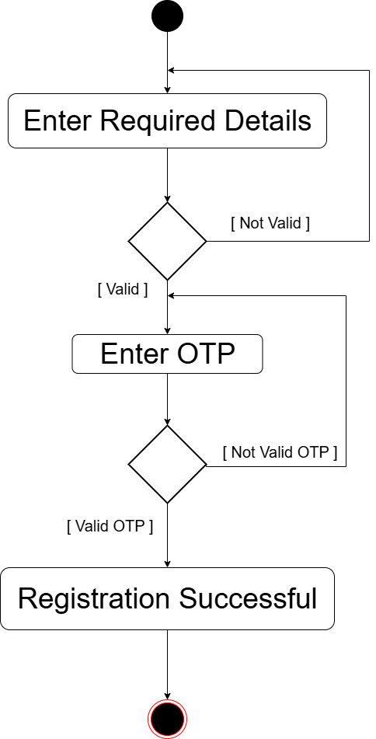
Activity Diagram
Registration

Slide 18
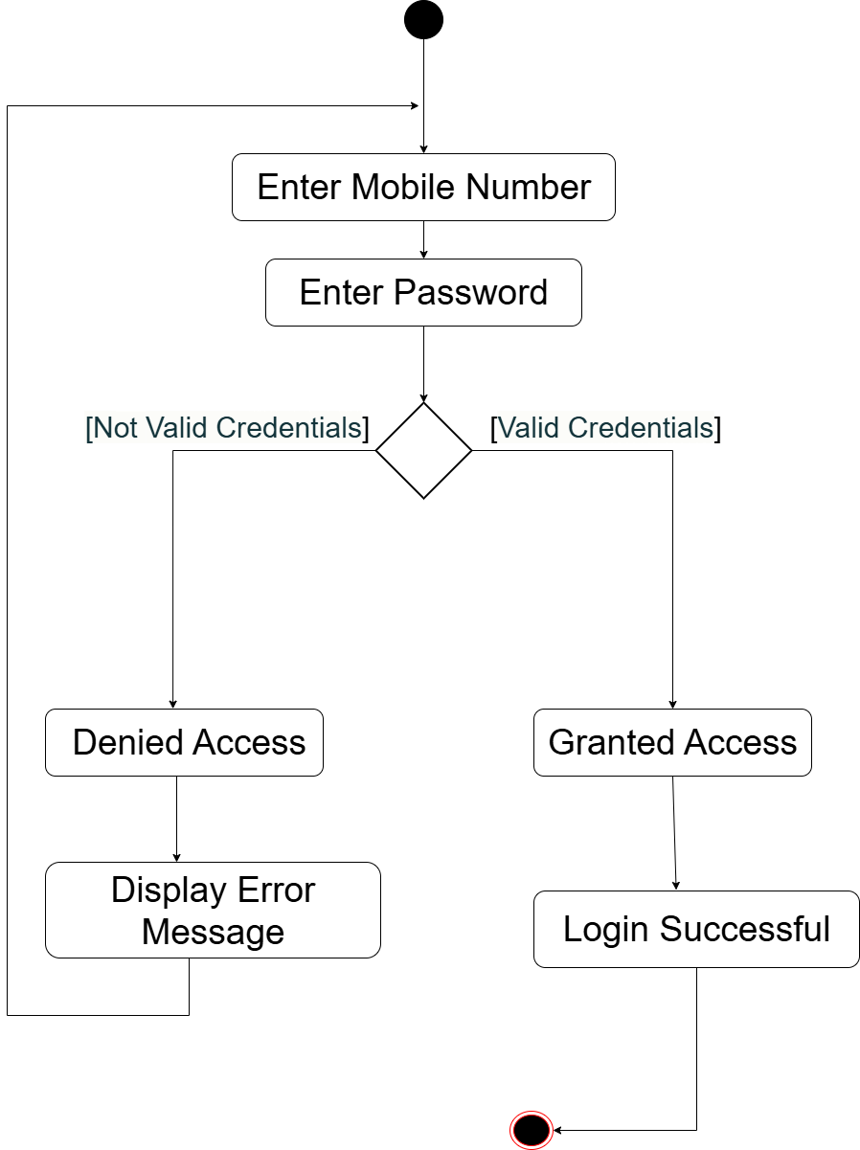
User Login

Slide 19
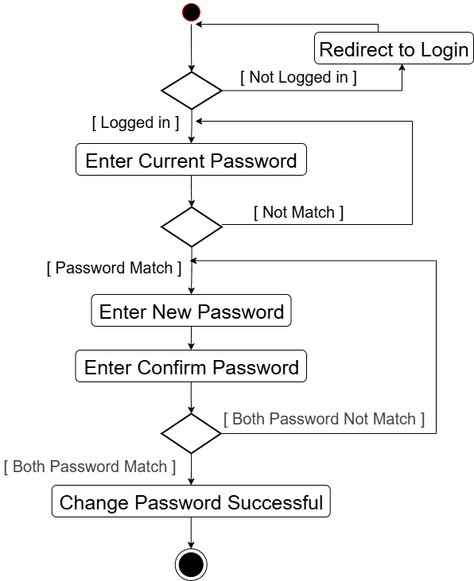
Change Password

Slide 20
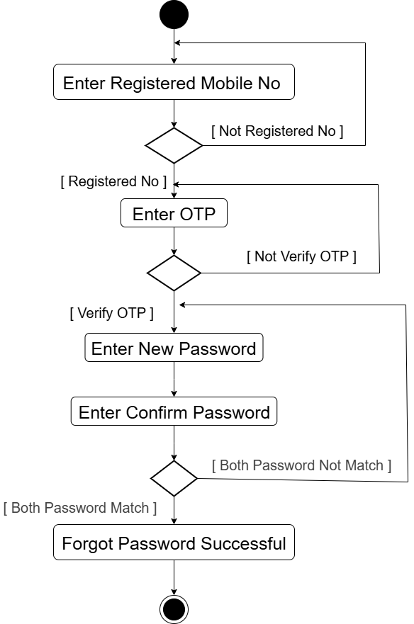
Forgot Password

Slide 21
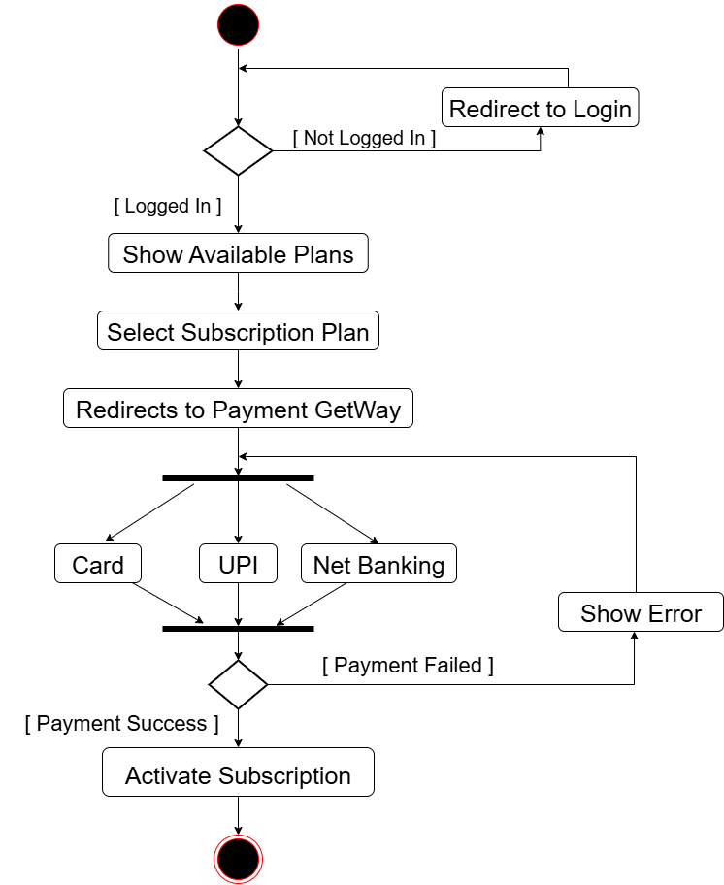
Subscription

Slide 22
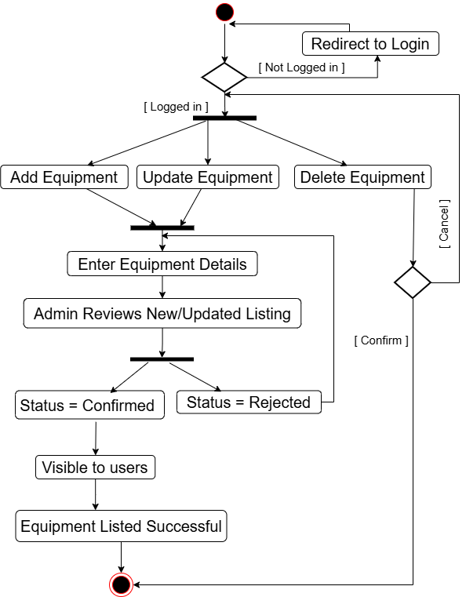
Manage Equipment

Slide 23
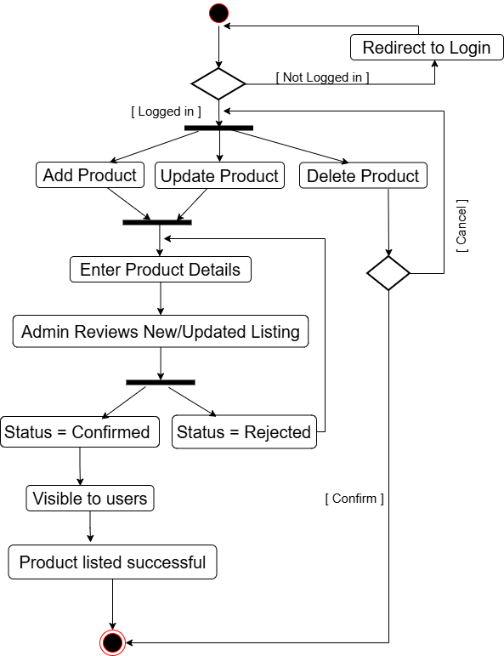
Manage Product

Slide 24
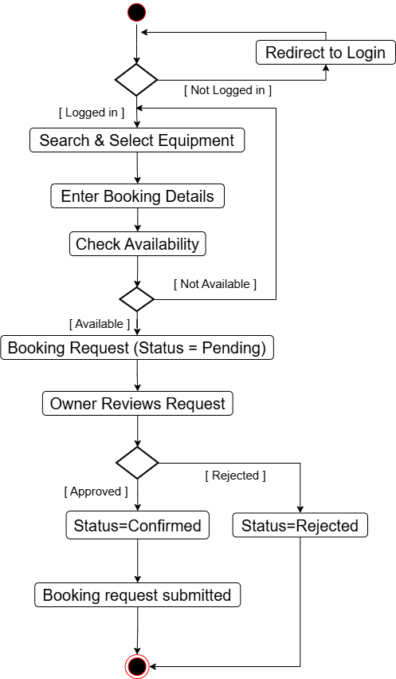
Equipment Booking

Slide 25
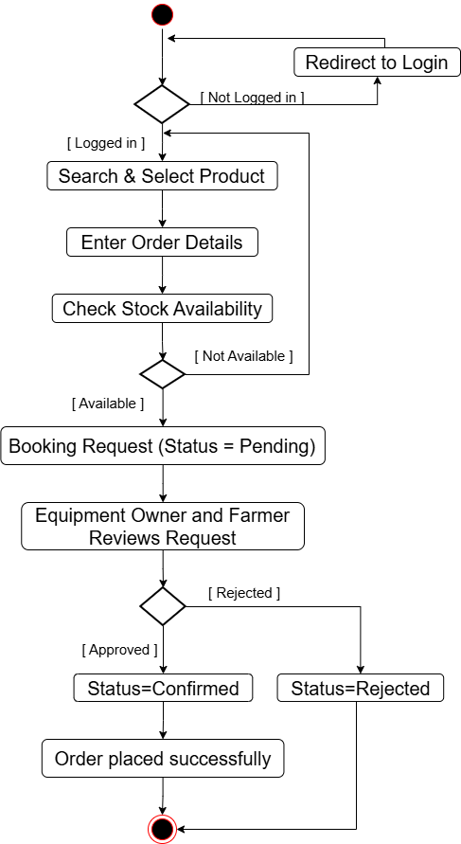
Product Order

Slide 26
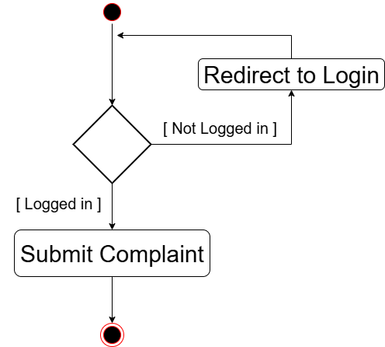
Complaint

Slide 27
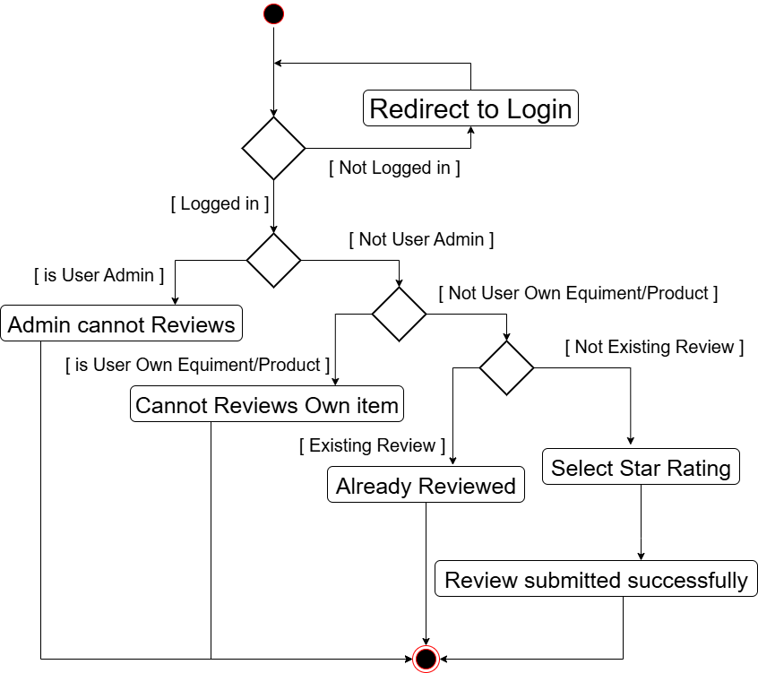
Submit Review

Slide 28
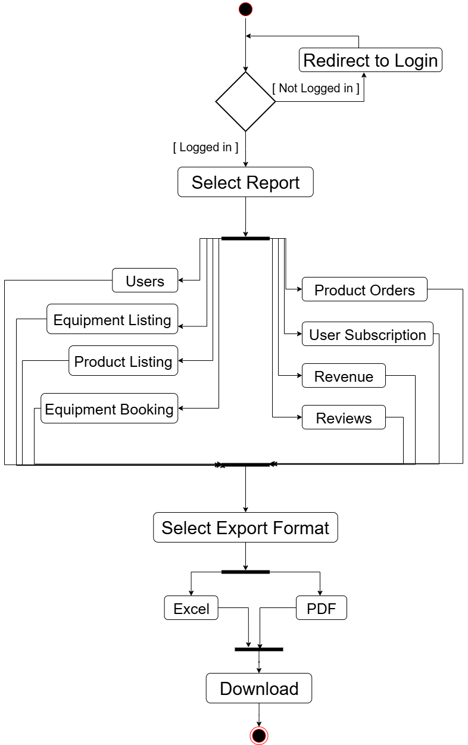
Admin Generate Reports

Slide 29
Data Dictionary
Users Table
Field | Data Type | Size | Constraints | Description
user_id | INT | 11 | PRIMARY KEY, AUTO_INCREMENT | Unique user identifier
Name | VARCHAR | 50 | NOT NULL | User's full name
Email | VARCHAR | 90 | UNIQUE | User's email address
Phone | CHAR | 10 | UNIQUE, NOT NULL | User's phone number
password | VARCHAR | 255 | NOT NULL | User password Max size is 20
User_type | CHAR | 1 | NOT NULL | Two type of Users : O = Equipment owner F = Farmer A = Admin
status | CHAR | 1 | NOT NULL, DEFAULT 'A' | Account status: A = Active I = Inactive

Slide 30
2. User Address Table
Field | Data Type | Size | Constraints | Description
address_id | INT | 11 | PRIMARY KEY, AUTO_INCREMENT | Unique address ID
user_id | INT | 11 | FOREIGN KEY, NOT NULL | References Users(user_id)
address | TEXT | - | NOT NULL | Complete street address
city | VARCHAR | 20 | NOT NULL | City Name
state | VARCHAR | 25 | NOT NULL | State Name
Pin_code | CHAR | 6 | NOT NULL | Postal PIN code

Slide 31
3. Subscription Plans Table
Field | Data Type | Size | Constraints | Description
plan_id | INT | 11 | PRIMARY KEY, AUTO_INCREMENT | Unique plan identifier
Plan_name | VARCHAR | 50 | NOT NULL | Subscription plan name
Plan_type | CHAR | 1 | NOT NULL | Plan duration type: M = Monthly Y = Yearly
user_type | CHAR | 1 | NOT NULL, CHECK | user type: F = Farmer O = Equipment Owner
Price | DECIMAL | 10,2 | NOT NULL | Subscription price

Slide 32
4. User Subscriptions Table
Field | Data Type | Size | Constraints | Description
subscription_id | INT | 11 | PRIMARY KEY, AUTO_INCREMENT | Unique subscription ID
user_id | INT | 11 | FOREIGN KEY, NOT NULL | References Users(user_id)
plan_id | INT | 11 | FOREIGN KEY, NOT NULL | References Subscription_Plans(plan_id)
start_date | DATE | - | NOT NULL | Subscription start date
end_date | DATE | - | NOT NULL | Subscription end date
Status | CHAR | 1 | DEFAULT 'P' | Subscription status: P = Pending A = Active E = Expired C = Cancelled

Slide 33
5. Payments Table
Field | Data Type | Size | Constraints | Description
Payment_id | INT | 11 | PRIMARY KEY, AUTO_INCREMENT | Unique payment identifier
Subscription_id | INT | 11 | FOREIGN KEY, NOT NULL | References User_Subscriptions(subscription_id)
Amount | DECIMAL | 10,2 | NOT NULL | Payment amount
transaction_id | VARCHAR | 100 | UNIQUE | Payment transaction ID
UPI_transaction_id | VARCHAR | 12 | NOT NULL | 12-digit UPI transaction ID
Status | CHAR | 1 | NOT NULL, DEFAULT 'P' | Payment status: P = pending C = completed F = failed
payment_date | DATETIME | - | DEFAULT CURRENT_TIMESTAMP | Payment date and time

Slide 34
6. Equipment_Categories Table
Field | Data Type | Size | Constraints | Description
category_id | INT | 11 | PRIMARY KEY, AUTO_INCREMENT | Unique category identifier
Name | VARCHAR | 50 | NOT NULL | Equipment category name
Description | TEXT | - | NULL | Category description

Slide 35
7. Equipment_Subcategories Table
Field | Data Type | Size | Constraints | Description
Subcategory_id | INT | 11 | PRIMARY KEY, AUTO_INCREMENT | Unique subcategory ID
Category_id | INT | 11 | FOREIGN KEY, NOT NULL | References Equipment_Categories(category_id)
Subcategory_name | VARCHAR | 70 | NOT NULL | Subcategory name
Description | TEXT | - | NULL | Subcategory description

Slide 36
8. Equipment Table
Field | Data Type | Size | Constraints | Description
Equipment_id | INT | 11 | PRIMARY KEY, AUTO_INCREMENT | Unique equipment identifier
Owner_id | INT | 11 | FOREIGN KEY, NOT NULL | References Users(user_id)
Subcategories_id | INT | 11 | FOREIGN KEY, NOT NULL | References Equipment_Subcategories(Subcategory_id)
Title | VARCHAR | 50 | NOT NULL | Equipment title
Brand | VARCHAR | 50 | NOT NULL | Manufacturer brand name
Model | VARCHAR | 50 | NOT NULL | Equipment model number
Year | INT | 11 | NOT NULL | Manufacturing year

Slide 37
Equipment Table (Conti..)
Field | Data Type | Size | Constraints | Description
Description | TEXT | - | NOT NULL | Detailed equipment description
Hourly_rate | DECIMAL | 10,2 | NOT NULL | Hourly rental rate
Daily_rate | DECIMAL | 10,2 | NOT NULL | Daily rental rate
listed_date | DATETIME | - | DEFAULT CURRENT_TIMESTAMP | Equipment listing date
Approval_status | CHAR | 3 | DEFAULT 'PEN' | Equipment approval Status: PEN = pending CON= confirmed REJ = Rejected

Slide 38
9. Equipment and Product Images Table
Field | Data Type | Size | Constraints | Description
image_id | INT | 11 | PRIMARY KEY, AUTO_INCREMENT | Unique image identifier
image_type | CHAR | 1 | NOT NULL | Image type: E = Equipment P = Product
ID | INT | 11 | FOREIGN KEY, NOT NULL | References Product_id or Equipment_id
image_url | VARCHAR | 255 | NOT NULL | Image file storage path
upload_date | DATETIME | - | CURRENT_TIMESTAMP | Image upload date and time

Slide 39
10. Equipment_Bookings Table
Field | Data Type | Size | Constraints | Description
booking_id | INT | 11 | PRIMARY KEY, AUTO_INCREMENT | Unique booking identifier
equipment_id | INT | 11 | FOREIGN KEY, NOT NULL | References Equipment(Equipment_id)
customer_id | INT | 11 | FOREIGN KEY, NOT NULL | References Users(user_id)
start_date | DATE | - | NOT NULL | Rental start date
end_date | DATE | - | NOT NULL | Rental end date

Slide 40
Equipment_Bookings Table (conti…)
Field | Data Type | Size | Constraints | Description
Hours | INT | 11 | NOT NULL | Total rental hours
total_amount | DECIMAL | 10,2 | NOT NULL | Calculated total rental cost
status | CHAR | 3 | DEFAULT 'PEN' | Booking status: PEN = pending CON= confirmed REJ = Rejected
time_slot | VARCHAR | 20 | NOT NULL | Selected time slot (e.g., 8AM - 8PM)

Slide 41
11. Product_categories Table
Field | Data Type | Size | Constraints | Description
Category_id | INT | 11 | PRIMARY KEY, AUTO_INCREMENT | Unique product category ID
Category_name | VARCHAR | 50 | NOT NULL, UNIQUE | Product category name
description | TEXT | - | NULL | Category description

Slide 42
12. Product_Subcategories Table
Field | Data Type | Size | Constraints | Description
Subcategory_id | INT | 11 | PRIMARY KEY, AUTO_INCREMENT | Unique subcategory ID
Category_id | INT | 11 | FOREIGN KEY, NOT NULL | References Product_Categories(Category_id)
Subcategory_name | VARCHAR | 70 | NOT NULL | Product subcategory name
Description | TEXT | - | NULL | Subcategory description

Slide 43
13. Product Table
Field | Data Type | Size | Constraints | Description
product_id | INT | 11 | PRIMARY KEY, AUTO_INCREMENT | Unique product identifier
seller_id | INT | 11 | FOREIGN KEY, NOT NULL | References Users(user_id)
Subcategory_id | INT | 11 | FOREIGN KEY, NOT NULL | References Product_Subcategories(Subcategory_id)
Name | VARCHAR | 50 | NOT NULL | Product name
Description | TEXT | - | NULL | Product detailed description
Price | DECIMAL | 10,2 | NOT NULL | Product price per unit

Slide 44
Product Table (Conti…)
Field | Data Type | Size | Constraints | Description
Quantity | DECIMAL | 10,2 | NOT NULL | Available quantity in stock
Unit | CHAR | 1 | NOT NULL | Measurement unit K = Kilogram L = liter
listed_date | DATE/TIME | - | DEFAULT CURRENT_DATE/TIME | Listing date
address_id | INT | 11 | FOREIGN KEY, NULL | References User_Addresses(address_id)
Approval_status | CHAR | 3 | DEFAULT “PEN” | Product approval Status: PEN = pending CON= confirmed REJ = Rejected

Slide 45
14. Product_Orders Table
Field | Data Type | Size | Constraints | Description
Order­­_id | INT | 11 | PRIMARY KEY, AUTO_INCREMENT | Unique order identifier
Product_id | INT | 11 | FOREIGN KEY, NOT NULL | References Product(product_id)
buyer_id | INT | 11 | FOREIGN KEY, NOT NULL | References Users(user_id)
quantity | DECIMAL | 10,2 | NOT NULL | Ordered quantity
total_price | DECIMAL | 10,2 | NOT NULL | Calculated total price
delivery_address | INT | 11 | FOREIGN KEY, NOT NULL | References User_Addresses(address_id)
Status | CHAR | 3 | DEFAULT 'PEN' | Order status PEN = pending CON = Confirmed CAN = cancelled
order_date | DATE/TIME | - | DEFAULT CURRENT_DATE/TIME | Order time

Slide 46
16. Reviews Table
Field | Data Type | Size | Constraints | Description
Review_id | INT | 11 | PRIMARY KEY, AUTO_INCREMENT | Unique review ID
Reviewer_id | INT | 11 | FOREIGN KEY, NOT NULL | References Users(user_id)
Review_type | CHAR | 1 | NOT NULL | Review type: E = Equipment P = Product
ID | INT | 11 | FOREIGN KEY, NOT NULL | Reference from Product ID or Equipment ID
Rating | INT | 11 | NOT NULL, CHECK (1-5) | Rating value between 1 and 5 stars
comment | TEXT | - | NULL | Review comment text
created_date | DATETIME | - | DEFAULT CURRENT_TIMESTAMP | Review creation date

Slide 47
17. Complaints Table
Field | Data Type | Size | Constraints | Description
Complaint_id | INT | 11 | PRIMARY KEY, AUTO_INCREMENT | Unique complaint identifier
User_id | INT | 11 | FOREIGN KEY, NOT NULL | References Users(user_id) - Complainant
Complaint_type | CHAR | 1 | NOT NULL | Complaint type: E = Equipment P = Product
ID | INT | 11 | FOREIGN KEY, NOT NULL | Reference from Product ID or Equipment ID
Description | TEXT | - | NOT NULL | Complaint details
Status | CHAR | 1 | DEFAULT ‘Open’ | Complaint status: O = Open P = InProgress R = Resolved

Slide 48
AgriRent connects farmers and equipment owners,
supports sales of farm supplies, and provides a secure,
scalable platform that can be easily expanded in the future.
Thank you

