Slide 1

A PROJECT PRESENTATION
ON
Smart City Information And Service Portal
Submitted By
Prajapati Prince Hasmukhbhai (En. No:-23082221080)
Prajapati Pruthvi Prakashbhai (En. No:-23082221081)
B.Sc.(CA&IT) - VI
U16A1PRII : INDUSTRIAL PROJECT – II
Group No:- 42
Internal Guide
Dr. Asha Patel
Submitted To
Department of Computer Science,
Ganpat University, Ganpat Vidyanagar – 384012
Academic Year 2025-2026

Slide 2
1. PROJECT PROFILE
Project Profile : | Smart City Information And Service Portal
Objective: | To develop a Smart City portal that provides city information and online services on a single platform for efficient and smart governance.
Platform of Application: | Web base Application
Front End Tool: | JavaScript ES6+, React.js
Back End Tool: | MongoDB( Atlas Cloud )
Project Duration : | 90 Days
Internal Project Guide : | Dr. Asha Patel
Submitted By : | Prajapati Prince: 23082221080 Prajapati Pruthvi : 23082221081
Submitted To : | Department Of Computer Science

Slide 3
2. EXISTING SYSTEM
City information and services are provided through the Mehsana Municipal Corporation website.
Citizens use the website to get details, submit forms, and request services online.
Complaints can be registered through the site, though some work still continues offline
Communication between citizens and authorities is slow and time-consuming.

Slide 4
3. NEED FOR NEW SYSTEM
To provide a fully digital and user-friendly smart city portal instead of limited website services.
To allow citizens to apply, track, and receive services online without visiting offices.
To improve complaint handling with real-time tracking and faster responses.
To integrate all departments and services into one centralized online system.
Website | Easy Navigation | Complaint | Service Provider List | Secure
www.digitalgujarat.gov.in | ✓ | ✗ | ✗ | ✓
ahmedabadcity.gov.in | ✓ | ✓ | ✗ | ✓
www.Suratmunicipal.gov.in | ✓ | ✓ | ✗ | ✓
mahesanacity.in | ✓ | ✓ | ✗ | ✓
Smart City Information & Service Portal | ✓ | ✓ | ✓ | ✓

Slide 5
4. FUNCTIONAL SPECIFICATION
4.1 USER OF THE SYSTEM
(1) Admin:-
    The admin can login into the system by entering valid credentials.
    The admin can manage all users.
    The admin can manage city information and public services.
    The admin can manage staff accounts .
    The admin can view reports related to Services, and complaints

Slide 6
4. FUNCTIONAL SPECIFICATION
4.1 USER OF THE SYSTEM
(2) Staff:-
    The staff has to register on website by giving some information.
    The staff can login on the website by providing some personal information.
    The staff has to solve complaints and can update the status of Complaints.
    Communicate with users regarding their requests.

Slide 7
4. FUNCTIONAL SPECIFICATION
4.1 USER OF THE SYSTEM
(3) User:-
    The user has to register on website by giving some information.
    The user can login on the website by providing some personal information.
    The user can submit complaints.
    The user can see the tourist places and service provider contact details.
    The user can view and update his/her profile.

Slide 8
4. FUNCTIONAL SPECIFICATION
4.2 MODULE OF THE SYSTEM
Registration :-
The user and staff can register on the website.
Login:-
The admin, staff and user can login on the website.
Manage User:-
  Admin can manage all user but staff and user can only manage their own profile.
Manage Complaint And Services :-
The staff can manage services and solve all complaints.
The user can register complaints and access other services.

Slide 9
4. FUNCTIONAL SPECIFICATION
4.2 MODULE OF THE SYSTEM
Report:-
The admin can see reports of received, solved and pending complaints and other services data

Slide 10
5. SYSTEM REQUIREMENT
5.1 MINIMUM SOFTWARE REQUIREMENT
Server Side Requirement
Operating System | Window 7 or Any Compatible Server OS
Web Server | Node.js (v12.22.12) with Express.js
Front-End Tools | Javascript ES6+, React.js
Back-End Tool | MongoDB (Atlas Cloud)
Client Side Requirement
Operating System | Window 7 or Any Compatible OS
Web Browser | Google Chrome or Any Compatible Browser

Slide 11
5. SYSTEM REQUIREMENT
5.2 MINIMUM HARDWARE REQUIREMENT
Server Side Requirement
Processor | 2.8 GHz or higher
RAM | 4 GB
Hard disk | 4 GB(Free Space)
Client Side Requirement
Processor | 1.88 GHz or Higher
RAM | 4 GB
Hard disk | 4 GB(Free Space)

Slide 12
6. SYSTEM FLOWCHART

Slide 13
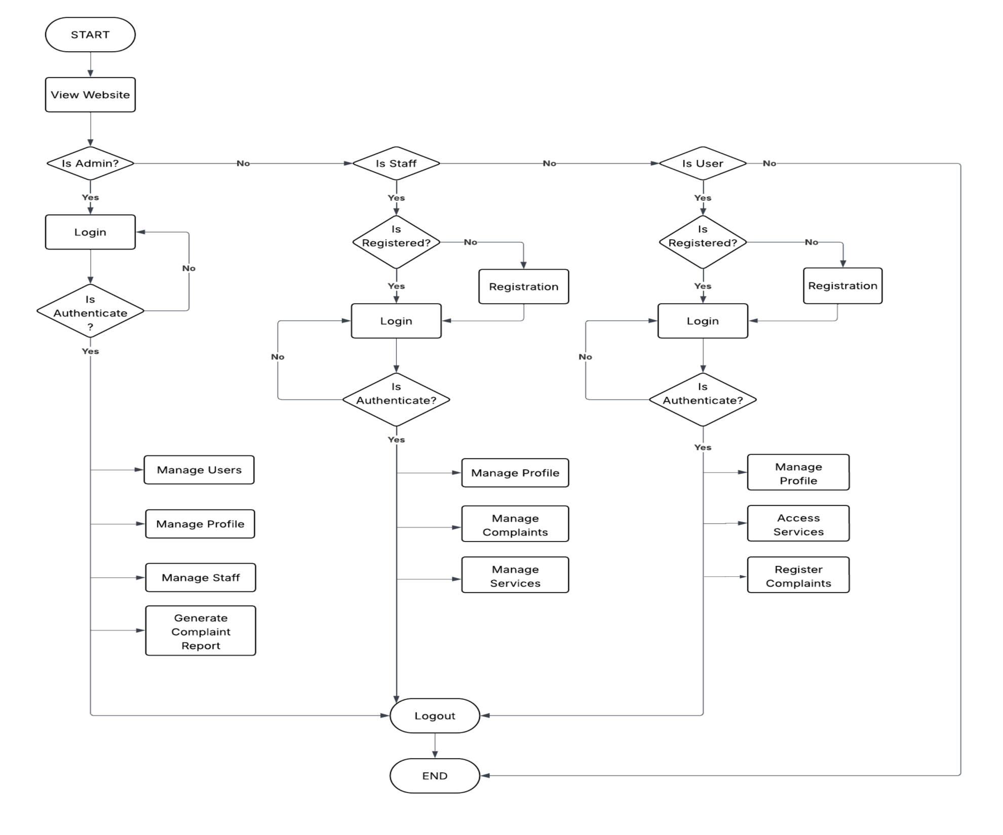
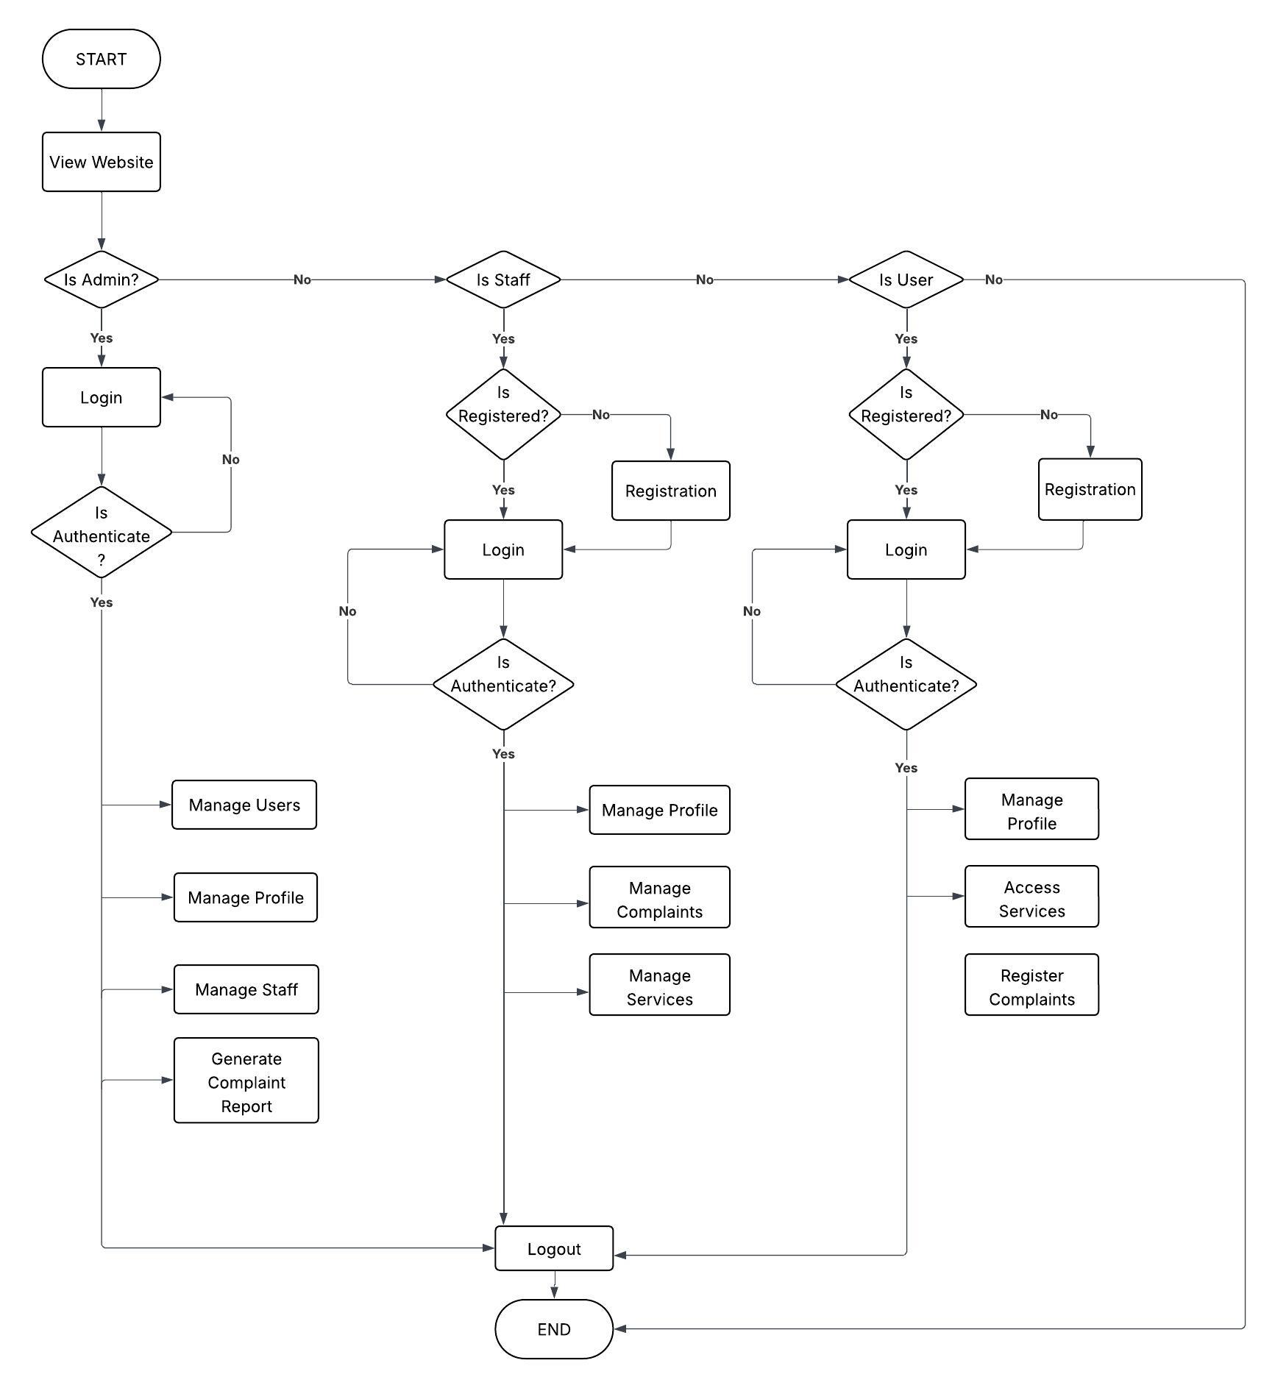

Slide 14
7. ER DIAGRAM

Slide 15
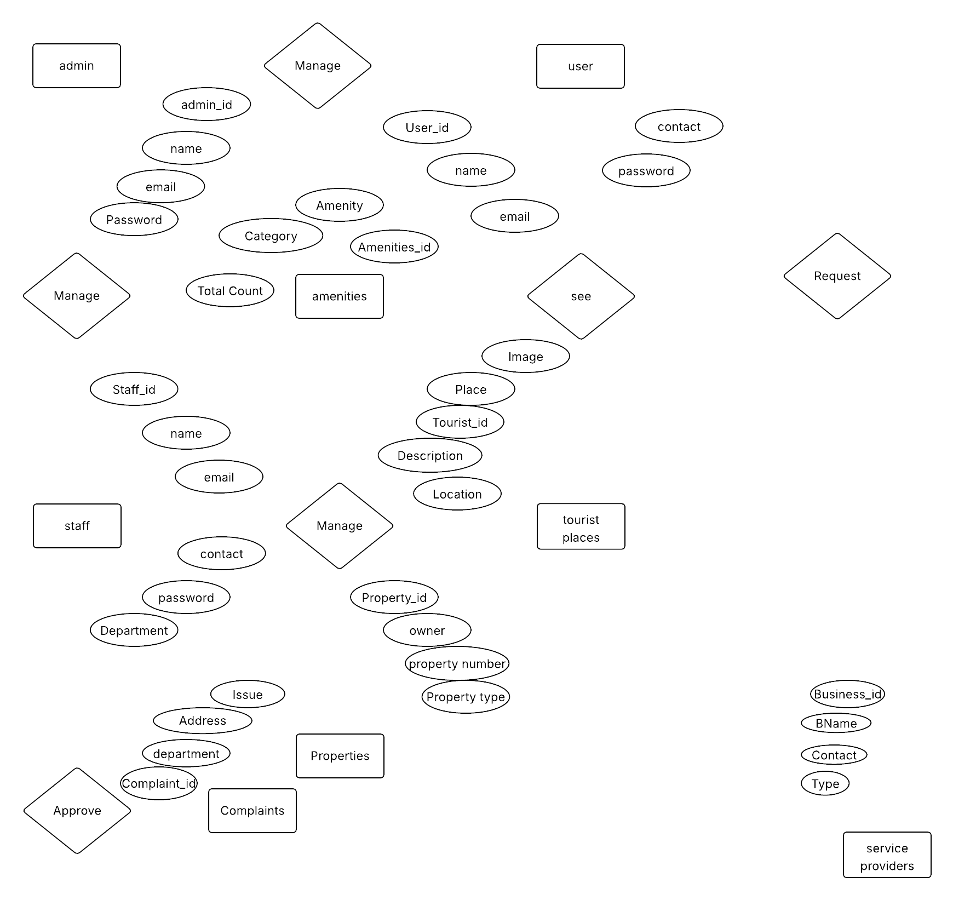

Slide 16
8. DATAFLOW DIAGRAM

Slide 17
8.1 ZERO LEVEL DFD

Slide 18
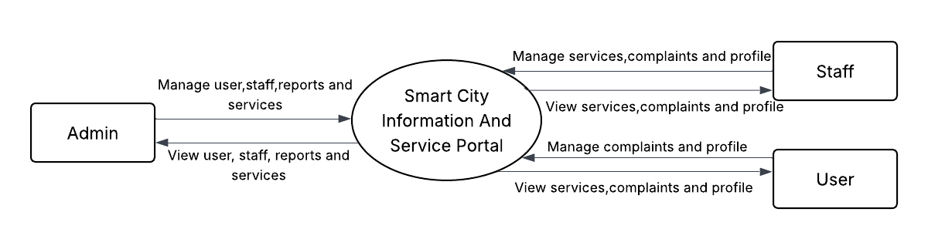

Slide 19
8.2 FIRST LEVEL DFD

Slide 20
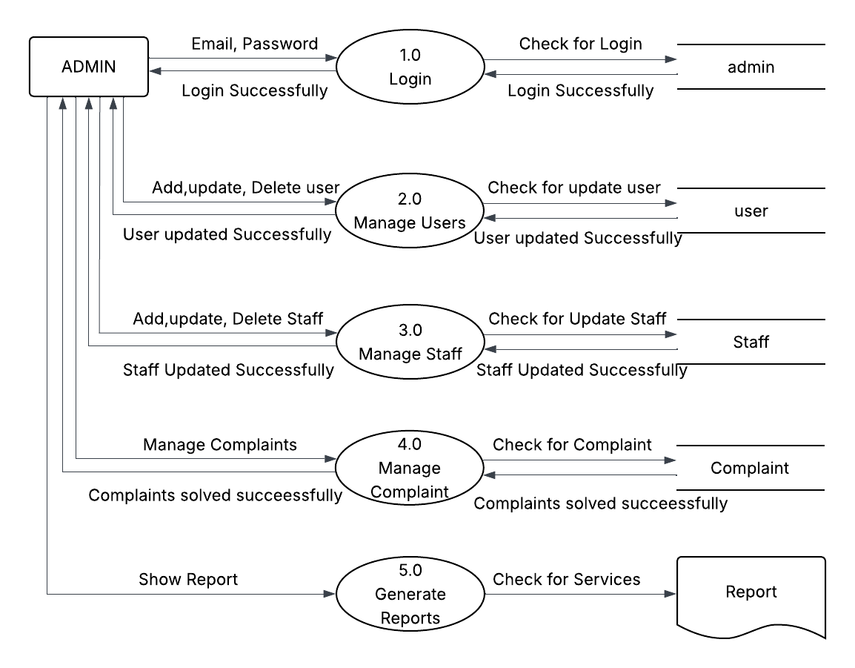
FIRST LEVEL DFD ADMIN SIDE

Slide 21
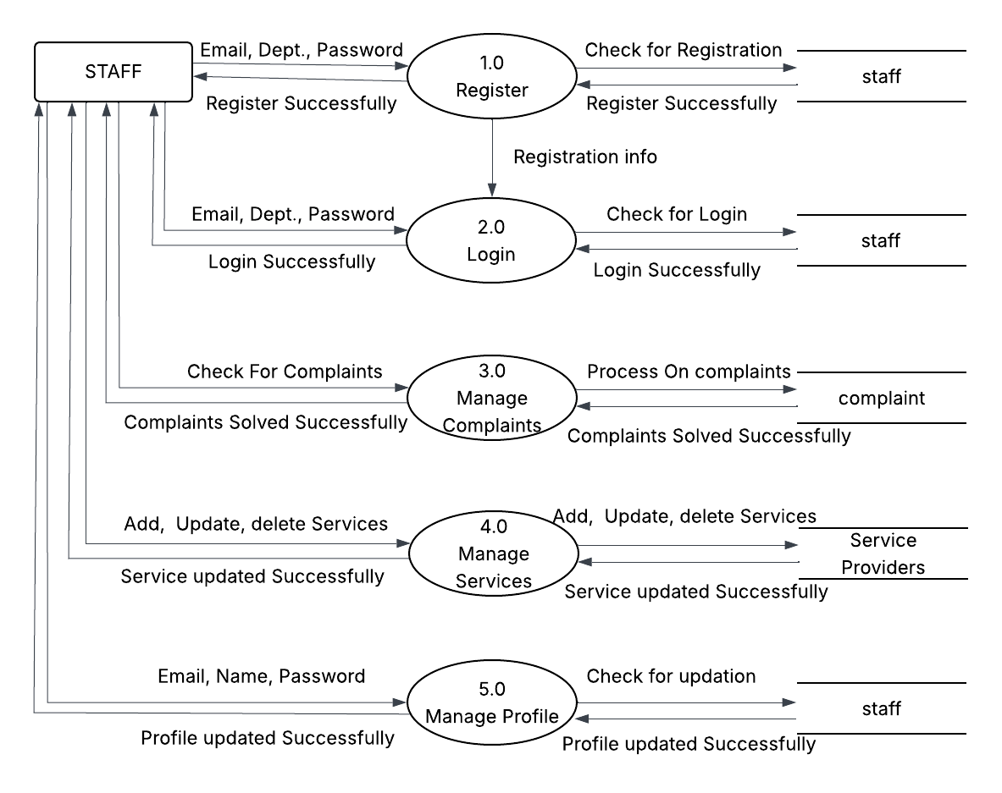
FIRST LEVEL DFD STAFF SIDE

Slide 22

FIRST LEVEL DFD BIDDER SIDE

Slide 23
9. DATA DICTIONARY
TABLE NAME
admin
staff
user
Amenities
tourist Places
service Providers
Properties
complaints

Slide 24
admin
Table Name : - | admin
Primary Key : - | admin_id
Description : - | To store admin information
Sr. No | Field Name | DataType(Size) | Constraint | Description | Sample Data
1 | admin_id | Int (3) | Primary Key | To store admin id & id is Auto Increment. | 101
2 | name | Varchar (50) | Not Null | To store the name. | Admin
3 | email | Varchar (50) | Not Null | To store the Email. | admin@gmail.com
4 | password | Varchar (150) | Not Null | To store the Password. | $2y$10$5v0DlzDlSXfyExABdHr/dOe…

Slide 25
Staff
Table Name : - | staff
Primary Key : - | staff_id
Description : - | To store staff information
Sr. No | Field Name | DataType(Size) | Constraint | Description | Sample Data
1 | staff_id | Int (3) | Primary Key | To store id & id is Auto Increment. | 101
2 | name | Varchar (50) | Not Null | To store the name. | Jay
3 | email | Varchar (50) | Not Null | To store the Email. | Jay@gmail.com
4 | password | Varchar (150) | Not Null | To store the Password. | $2y$10$5v0DlzDlSXfyExABdHr/dOe…
5 | phone | Int(10) | Not Null | To store the Phone number. | 9675465756
6 | department | Varchar(30) | Not Null | To Store the department | Public utilities

Slide 26
Users
Table Name : - | users
Primary Key : - | user_id
Description : - | To store user information
Sr. No | Field Name | DataType(Size) | Constraint | Description | Sample Data
1 | user_id | Int (3) | Primary Key | To store user_id.& id is Auto Increment. | 101
2 | username | Varchar (50) | Not Null | To store the Username. | ajay
3 | user_email | Varchar (50) | Not Null | To store the User’s Email. | ajay@gmail.com
4 | user_password | Varchar (150) | Not Null | To store the User’s Passw--ord. | $2y$10$5v0DlzDlSXfyExABdHr/dOe…
5 | user_phone | Int(10) | Not Null | To store the User’s Phone number. | 9675456756

Slide 27
Amenities
Table Name : - | amenities
Primary Key : - | amenities_id
Description : - | To store amenities information
Sr. No | Field Name | DataType(Size) | Constraint | Description | Sample Data
1 | amenities_id | Int (3) | Primary Key | To store id & id is Auto Increment. | 101
2 | Amenity | Varchar (50) | Not Null | To store the Amenity name. | Bank
3 | Category | Varchar (50) | Not Null | To store the Type of Amenity | Finance
4 | Total_count | Int(5) | Not Null | To store the total number of amenities | 5

Slide 28
Tourist place
Table Name : - | Tourist_place
Primary Key : - | Touristplace_id
Description : - | To store Tourist places information
Sr. No | Field Name | DataType(Size) | Constraint | Description | Sample Data
1 | touristplace_id | Int (3) | Primary Key | To store id & id is Auto Increment. | 101
2 | place_name | Varchar (50) | Not Null | To store the Place name. | Annapurna temple
3 | description | Varchar (150) | Not Null | To store the Description of place | Famous spiritual temple and annual fair (Melo) in Modipur
4 | location | Varchar (150) | Not Null | To store the place location | https://www.google.com/maps/search/Mehsana Sun Temple
5 | image | Varchar(50) | Not Null | To store Image | /uploads/place1.jpg

Slide 29
Service Provider
Table Name : - | Service_Provider
Primary Key : - | Business_id
Description : - | To store business information
Sr. No | Field Name | DataType(Size) | Constraint | Description | Sample Data
1 | Business_id | Int (3) | Primary Key | To store id & id is Auto Increment. | 101
2 | Bname | Varchar (50) | Not Null | To store the Business name. | Brahmani Electrics
3 | Contact | Int(10) | Not Null | To store the conatact | 6549873215
4 | Type | Varchar (150) | Not Null | To store the type of business | Electrician

Slide 30
Properties
Table Name : - | properties
Primary Key : - | property_id
Description : - | To store property information
Sr. No | Field Name | DataType(Size) | Constraint | Description | Sample Data
1 | property_id | Int (3) | Primary Key | To store id & id is Auto Increment. | 101
2 | owner | Varchar (50) | Not Null | To store the owner name. | Raj patel
3 | Propert_type | Varchar (50) | Not Null | To store the Type of property | Land
4 | Property_number | Int(5) | Not Null | To store the property number | 123456
5 | contact | Int(10) | Not Null | To store the owners number | 6589754896

Slide 31
Complaint
Table Name : - | complaints
Primary Key : - | complaint_id
Description : - | To store complaint information
Sr. No | Field Name | DataType(Size) | Constraint | Description | Sample Data
1 | complaint_id | Int (3) | Primary Key | To store id & id is Auto Increment. | 101
2 | Issue | Varchar (50) | Not Null | To store the issue | Water leakage
3 | Department | Varchar (50) | Not Null | To store the Type of complaint | Water
4 | Address | Varchar (50) | Not Null | To store the address of issue | Modhera road , mehsana

