Slide 1
IBC233 - iSeries Business Computing

Slide 2
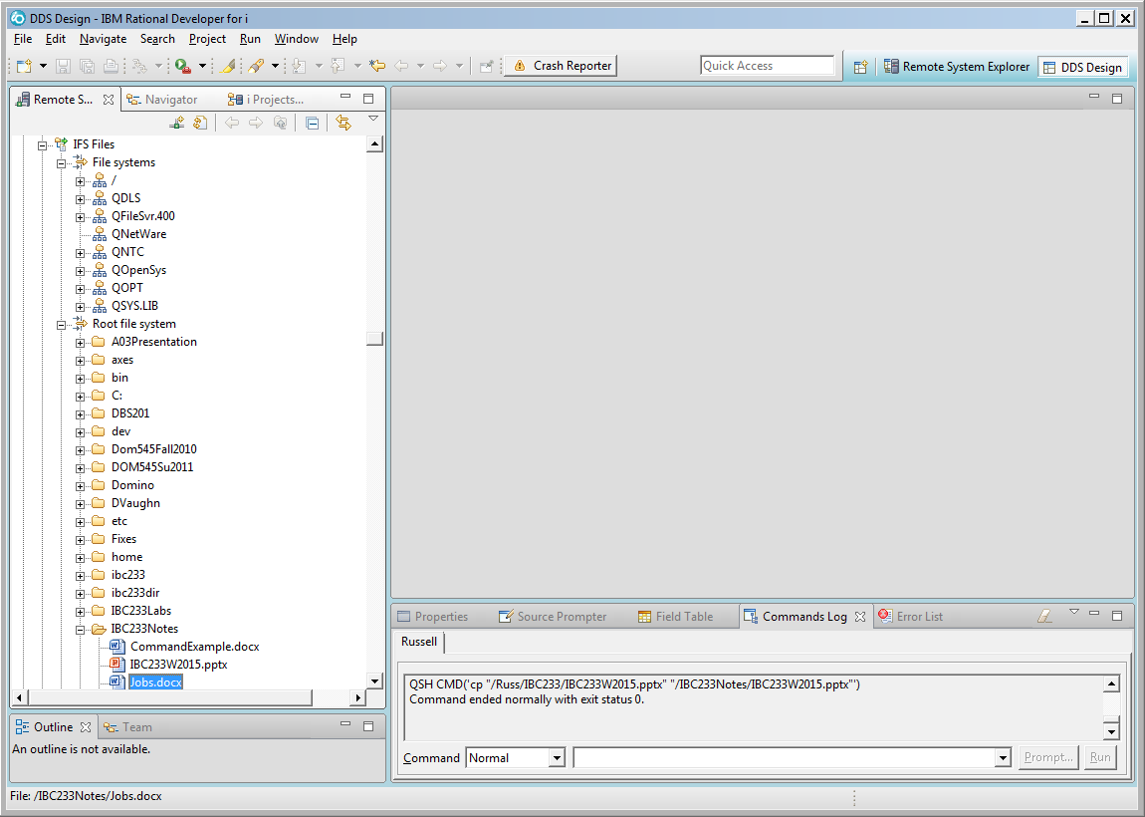
Accessing This Powerpoint Presentation in the IFS Using RDi

Slide 3
IBC233 Formula for Success
Complete the Labs
Show up for Lectures
Take notes
Utilize the IBC233 webpage
Bring required USB flash drive to labs
Ask Lots of Questions

Slide 4
IBC233 Resources
IBC233 Home Page https://scs.senecacollege.ca/~ibc233/
Handouts in IBC233RUSS/Handouts on iSeries
IBM’s i Information Center http://publib.boulder.ibm.com/eserver/ibmi.html
Instructor
  Labs
  Office Hours
  Email

Slide 5
iSeries User Interface
5250 emulation with Client Access or Mocha
GUI with System i Navigator
Program Development with Websphere Devbelopment Studio Client (WDSC) (large install)
IBM Rational Developer for Power Systems (RDp) (smaller footprint)
Rdi Rational Developer for IBMi

Slide 6
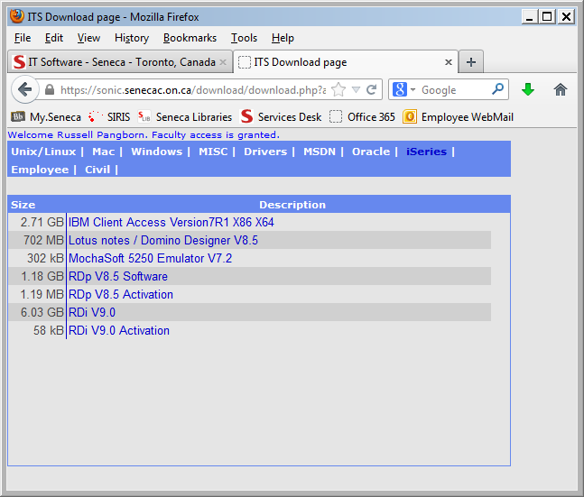
iSeries Downloads
Install Client Access V7R1 X 64 and
IBM Rational Developer for i (RDi Software)
RDi Activation (for use past 90 days)

Slide 7
iSeries Business Application Developer
Specialist Designations discontinued
Still retain the SENECA/TUG award
Take a few System i Subjects in later semesters

Slide 8
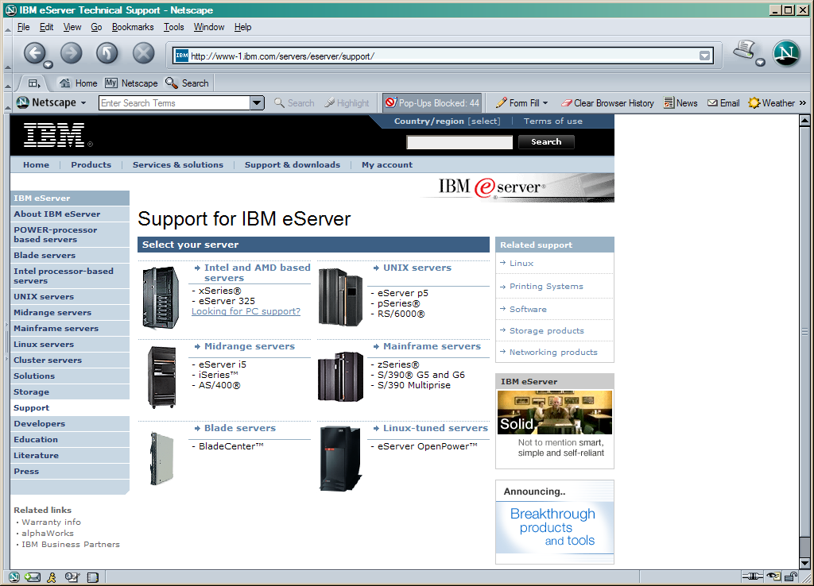
A Midrange System

Slide 9
A Business System
Used by Banks
Used by Retailers
Used by Hockey Hall of Fame
Used by Casinos in Vegas

Slide 10
IBM Systems
zSeries - Mainframe servers – System 390
pSeries - Unix servers – RS6000
xSeries - Intel Based servers – PC’s
iSeries - Midrange servers – AS/400
pSeries and iSeries are united on one hardware platform called Power Systems

Slide 11
A Naming Nightmare
AS/400 using OS/400 operating system
iSeries using OS/400 operating system
System i using i5/OS operating system
Power System using i operating system
Power Systems is the platform
IBM i is the operating system
User Magazine Article on Name Changes

Slide 12
Our Machine
System Value Qmodel – M25
9408-M25 - IBM Power 520 Express
Uses POWER6 microprocessor developed by IBM
520 Express used by small businesses
Power 595 used by multi-environment large data centers

Slide 13
RELIABLE
“Platform Availability: Can You Spare a Minute”
Gartner Group study
Platform | Outages/Server/Year | Availability (24x365 basis)
iSeries | 5.2 hours | 99.94%
S/390 | 8.9 hours | 99.90%
VAX | 18.9 hours | 99.78%
UNIX (all) | 23.64 hours | 99.73%
NT server | 224.5 hours | 97.44%

Slide 14
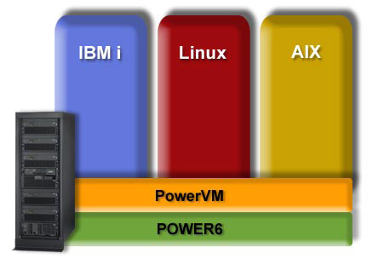
PowerVM Partitioning IBM AIX , IBM i, and Linux on a Single POWER6 System

Slide 15
News Item 2007
IBM Unleashes World's Fastest Chip in Powerful New Computer
This processor doubles speed without adding to energy 'footprint,' enabling customers to reduce electricity consumption by almost half; Enough bandwidth to download entire iTunes catalog in 60 seconds
Power Systems based on Power 6 Processors

Slide 16
POWER7
The Power7 is IBM's first eight-core processor, with each core capable of four-way simultaneous-multithreading operation. Its key architectural features include an advanced memory hierarchy with three levels of on-chip cache; embedded-DRAM devices used in the highest level of the cache; and a new memory interface. This balanced multicore design scales from 1 to 32 sockets in commercial and scientific environments.

Slide 17
Open Power Consortium Aug 2013
The Consortium intends to build advanced server, networking, storage and GPU-acceleration technology aimed at delivering more choice, control and flexibility to developers of next-generation, hyperscale and cloud data centers.
http://www-03.ibm.com/press/us/en/pressrelease/41684.wss

Slide 18
A Database System
Database is built in...not added on
All data accessed through integrated data base
DB2 UDB for iSeries does not have a data base package
iSeries is a data base machine
iSeries designed with a relational database

Slide 19
ComputerWorld DBMS Survey

Slide 20
NT Server Weaknesses
64-Bits. No Buts.
64 Bit Support
DB2/400
AS/400
Today
SQL Server
NT Server
Today
Oracle
on Alpha
Today
Oracle on others Today
Hardware
Yes
Intel No
Alpha Yes
Others No
Alpha Yes
No
Operating System
Addressing
Data path
Instructions
Registers
Functional Units
Yes
Yes
Yes
Yes
Yes
No
No
No
No
No
Yes
Yes
Yes
Yes
Yes
No
No
No
No
No
Middleware
Database
All other
Yes
Yes
No
No
Yes
No
No
No
Applications
Automatic Migration
Yes
Yes
No
No
No
No
No
No

Slide 21
A Popular Platform
Over 800,000 units sold
Capable of running a variety of operating systems and applications
Linux, Java, Domino, HTML, Apache Web server, Windows NT and 200, and Unix
Flexible, Durable, Dependable, Easy to run

Slide 22
User Groups
Toronto User Group for Power Systems
(TUG) http://www.tug.on.ca/
Common http://www.common.org/
European User Groups

Slide 23
i Blogs
You and i
i Can
Modern i zation
DB2 for i

Slide 24
Consultant & Press Comments
"IBM's AS/400 scored exceptionally high satisfaction ratings in nearly every category....it's superior ratings in areas such as service and support, product quality and database management put the AS/400 in a league of it's own." -- Computerworld
"OS/400 is, in our view, the database in the DB2 family which has the most sophistication in its parallel implementation, and the AS/400 Development Plans are sound." -- The Bloor Research Group
"DB2/400's cost-to-use is less than that for Oracle or any other database." -- ETG Consulting
“Sutdy shows Intel servers cost 95 percent more than IBM eserver iSeries over a five-year period” IDC
"There will be more Data Warehousing done on AS/400s than any other platform for the next several years." -- Gartner Group
IBM iSeries named “Best of Show at LinuxWorld Conference and Expo – San Francisco, Aug 30, 2001

Slide 25
Lab 1
Introduction to system environment
Library Lists
System Values
Writing Cl Programs
Printing

Slide 26
Definitions - Object
On the Power System everything is an object
When storage is allocated for an object, the object type determines what programs are allowed to act upon that object
Lab 1 objects used were *USRPRF, *LIB, *CMD, *MSGQ, *OUTQ, *FILE and *PGM

Slide 27
Definitions - Library
Object that is used as a system directory to keep track of other objects
Object Type is *LIB
QSYS is the only library that can contain other libraries
Allowing access to an object additionally requires allowing access to the library that contains the object

Slide 28
Definitions – Source Physical File
Object that is used to store program code
Each separate program is a member of the source physical file
When this member is successfully compiled a new program object (*PGM) is placed in a library (usually your current library)
All members have three fields. Data stored in these fields are: a line number; actual program code; and the date the line was entered or changed.

Slide 29
Definitions – Library List
Used when an object is referred to without including the library name where it is stored
A system administrator decides what libraries are included
System portion of library list is QSYSLIBL and usually is a list of IBM libraries with IBM objects
User Portion of library list is QUSRLIBL and usually contains libraries with commonly shared user objects
Current library is your student library

Slide 30
Definitions – Library List
The library list is searched for a library containing the name of the object referenced
Call INTROLAB ---- What Happens
If INTROLAB is in none of the libraries in the library list?
If INTROLAB is in all of the libraries in the library list?

