Slide 2
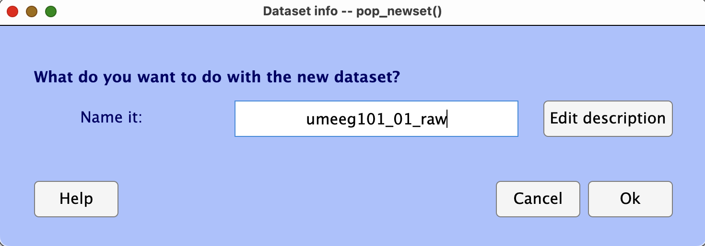
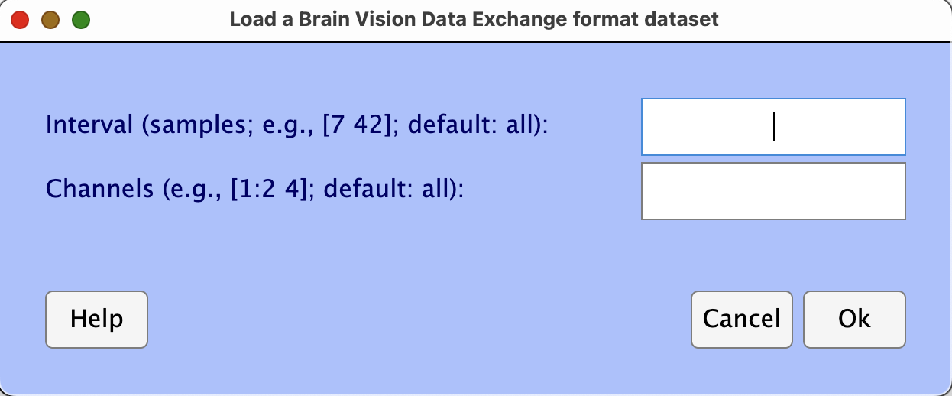
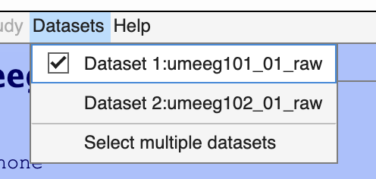
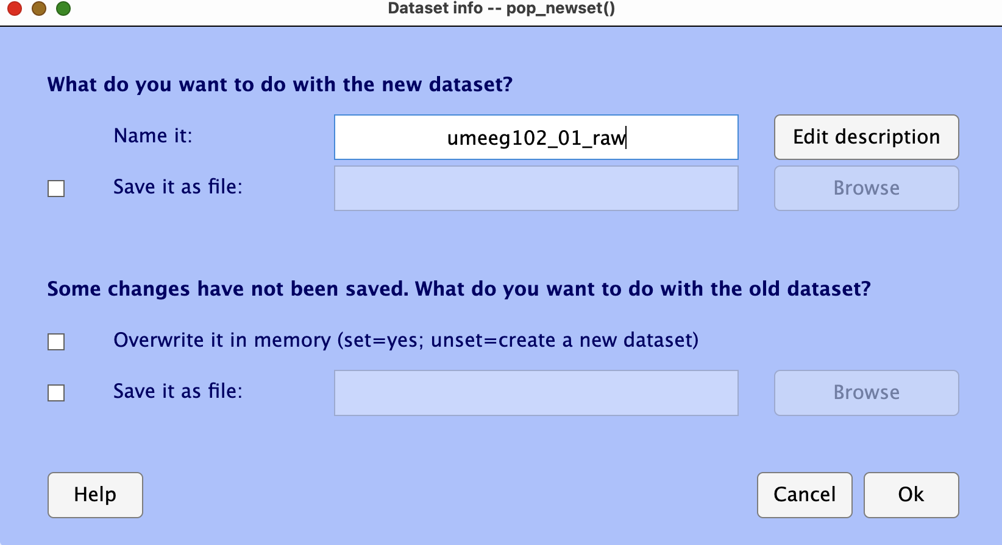
Ch7 导入头文件数据
- Number of experiment & participant
- Step number
- description
Number of data point to be imported
Number of channel to be imported
Leave blank means import all number of …

Slide 3
Ch7 滤波原则
surrounding
Channel 1
surrounding
Channel 4
Broken
Channel
surrounding
Channel 2
surrounding
Channel 3

Slide 4
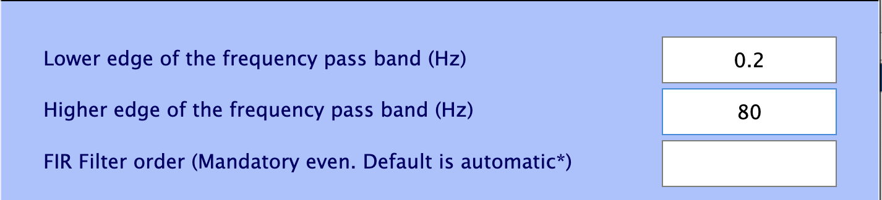
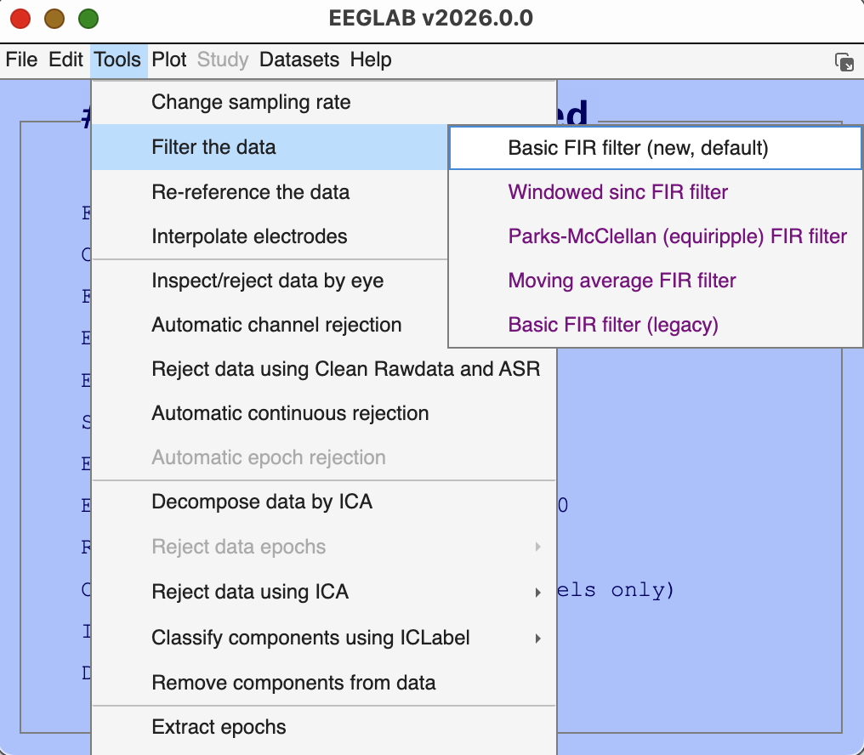
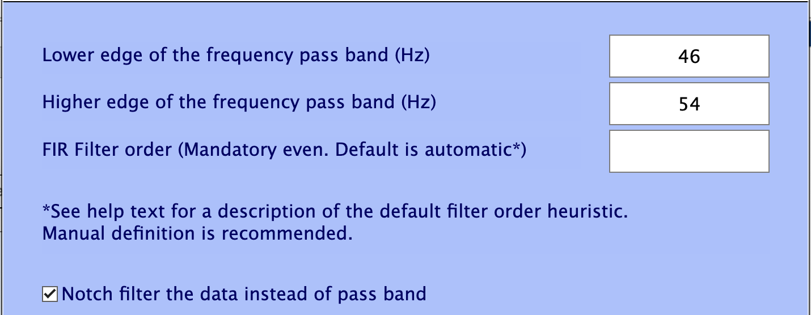
Ch7 滤波操作
The interval of frequency that you want to keep
The interval of frequency that you want to remove

Slide 5
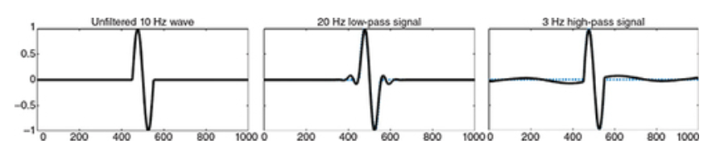
Ch7_filter_distoration

Slide 6
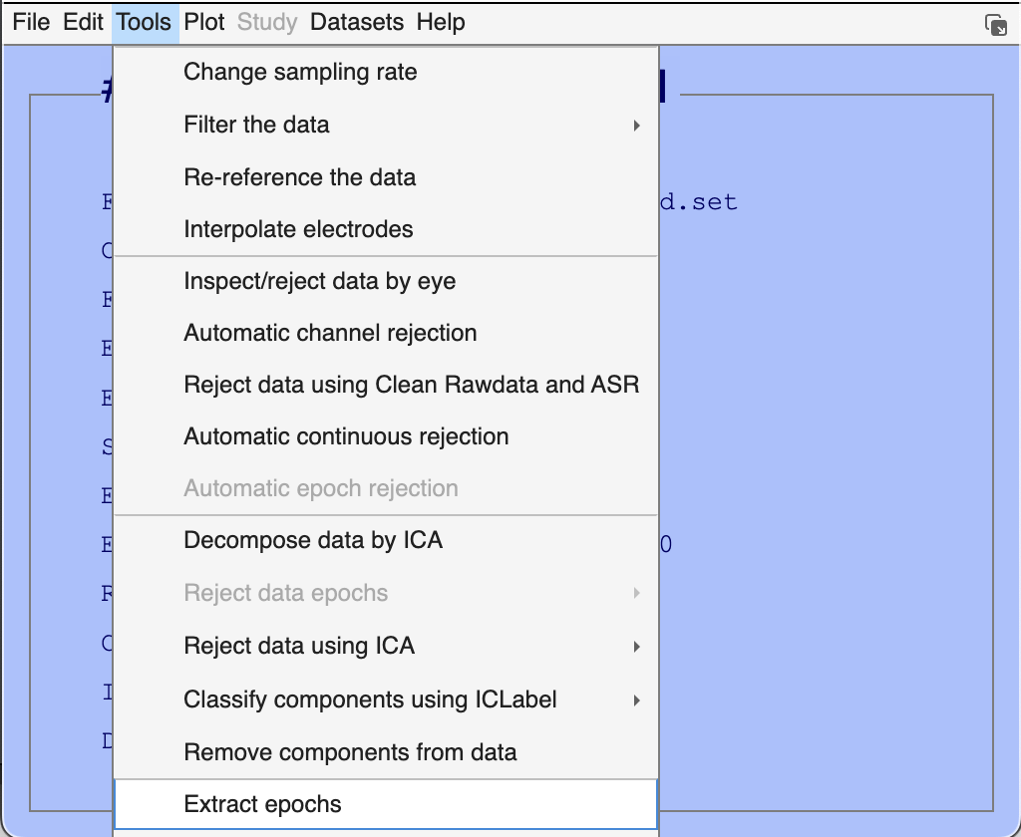
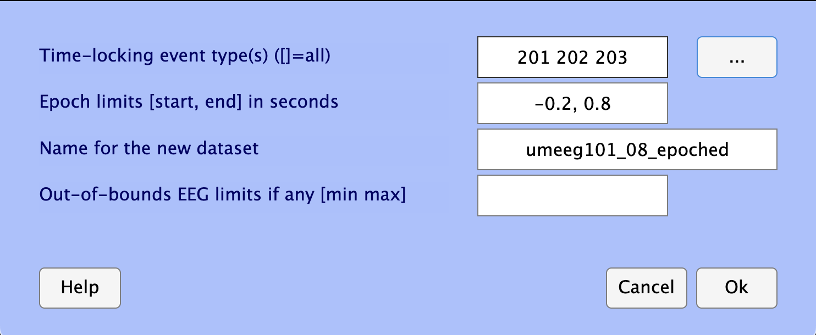
Ch8 Epoch data
Where info, enter the markers
How long, define the duration interval
Don’t forget to name and save it

Slide 7
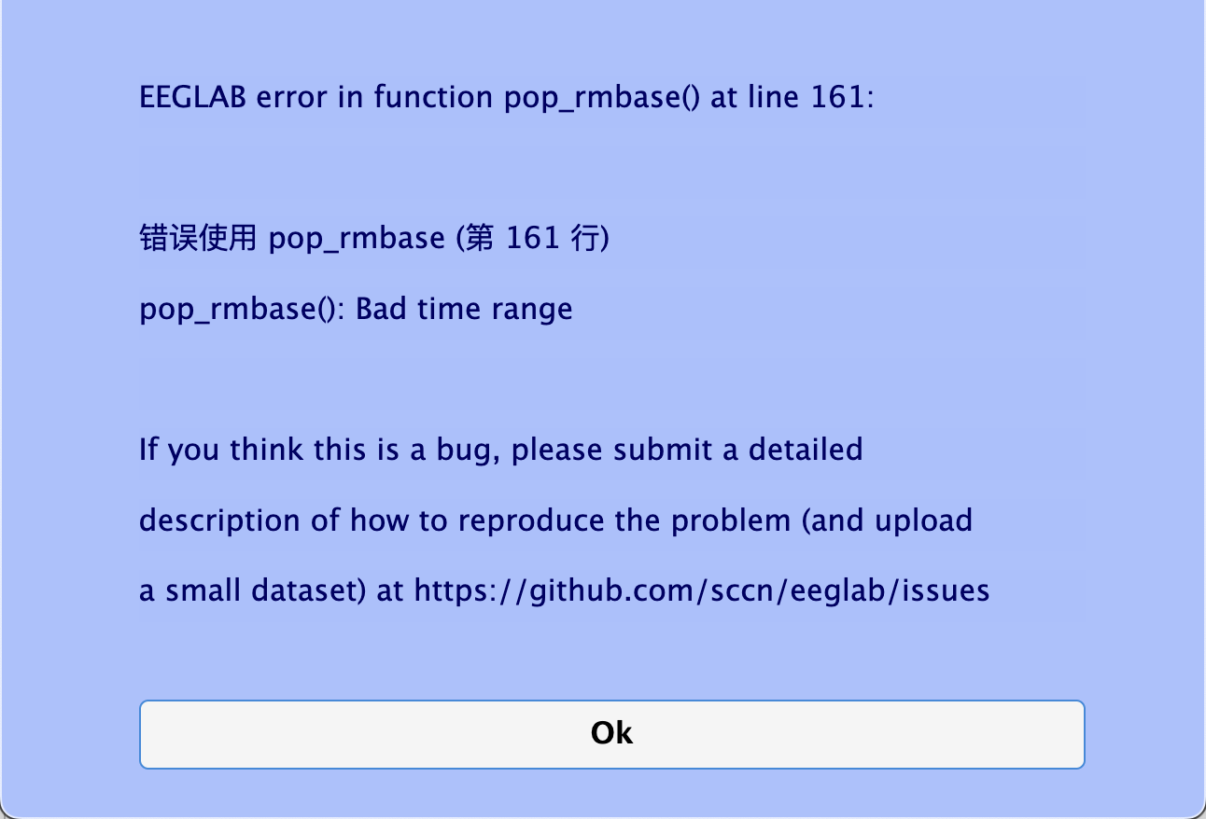
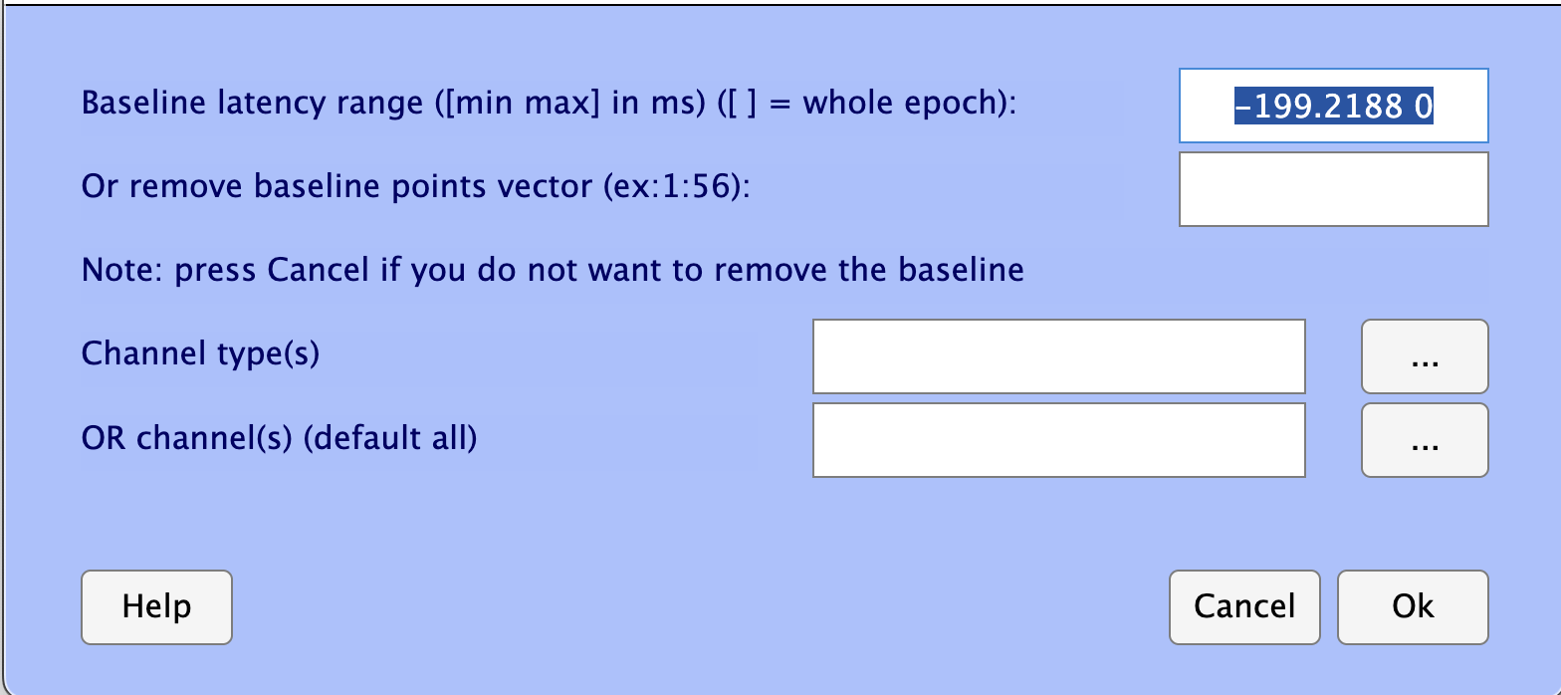
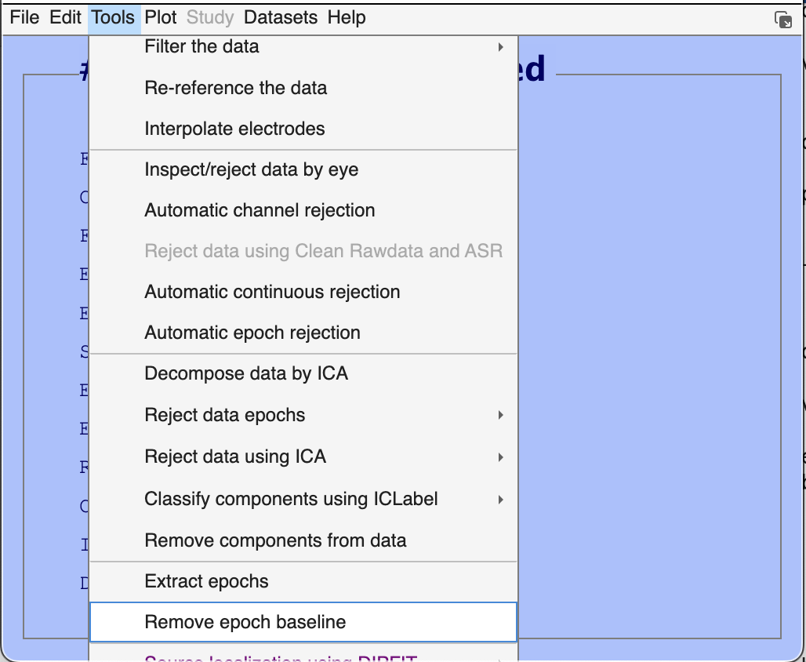
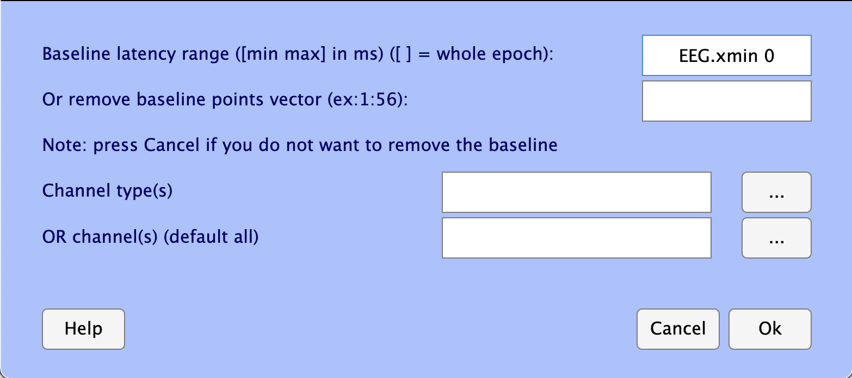
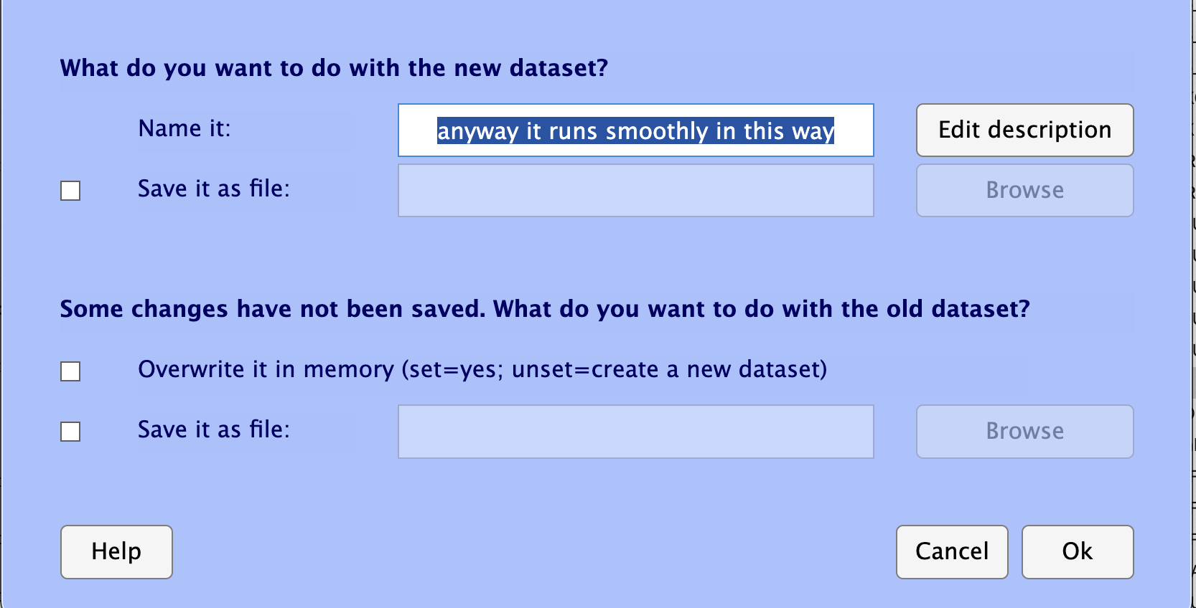
Ch8 set baseline
In sum,
ERROR & BUG
The default given value
My elegant and smart solution

Slide 8
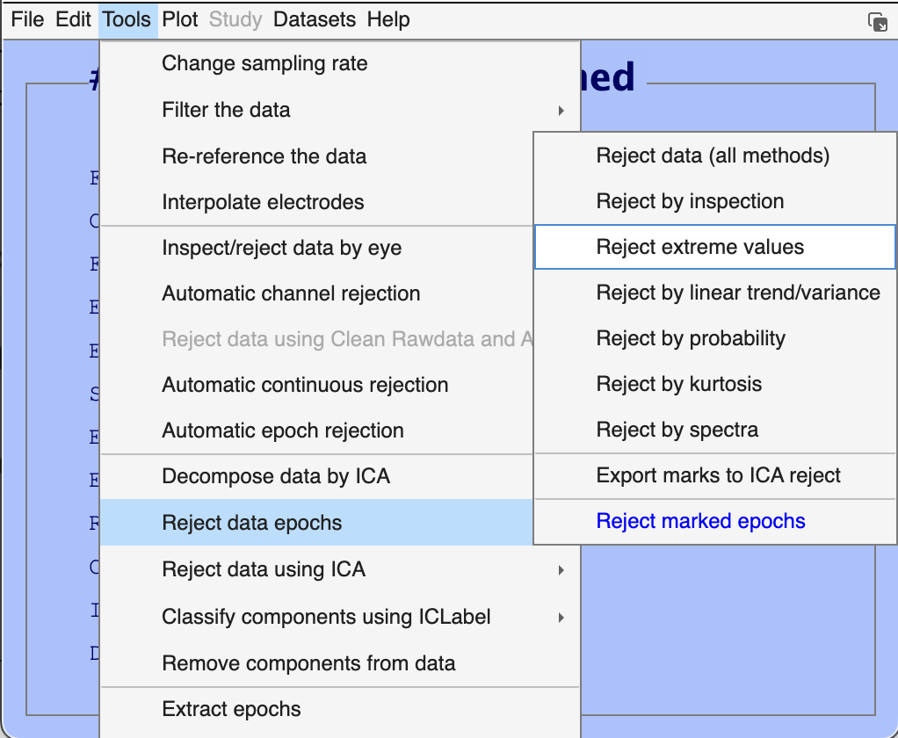
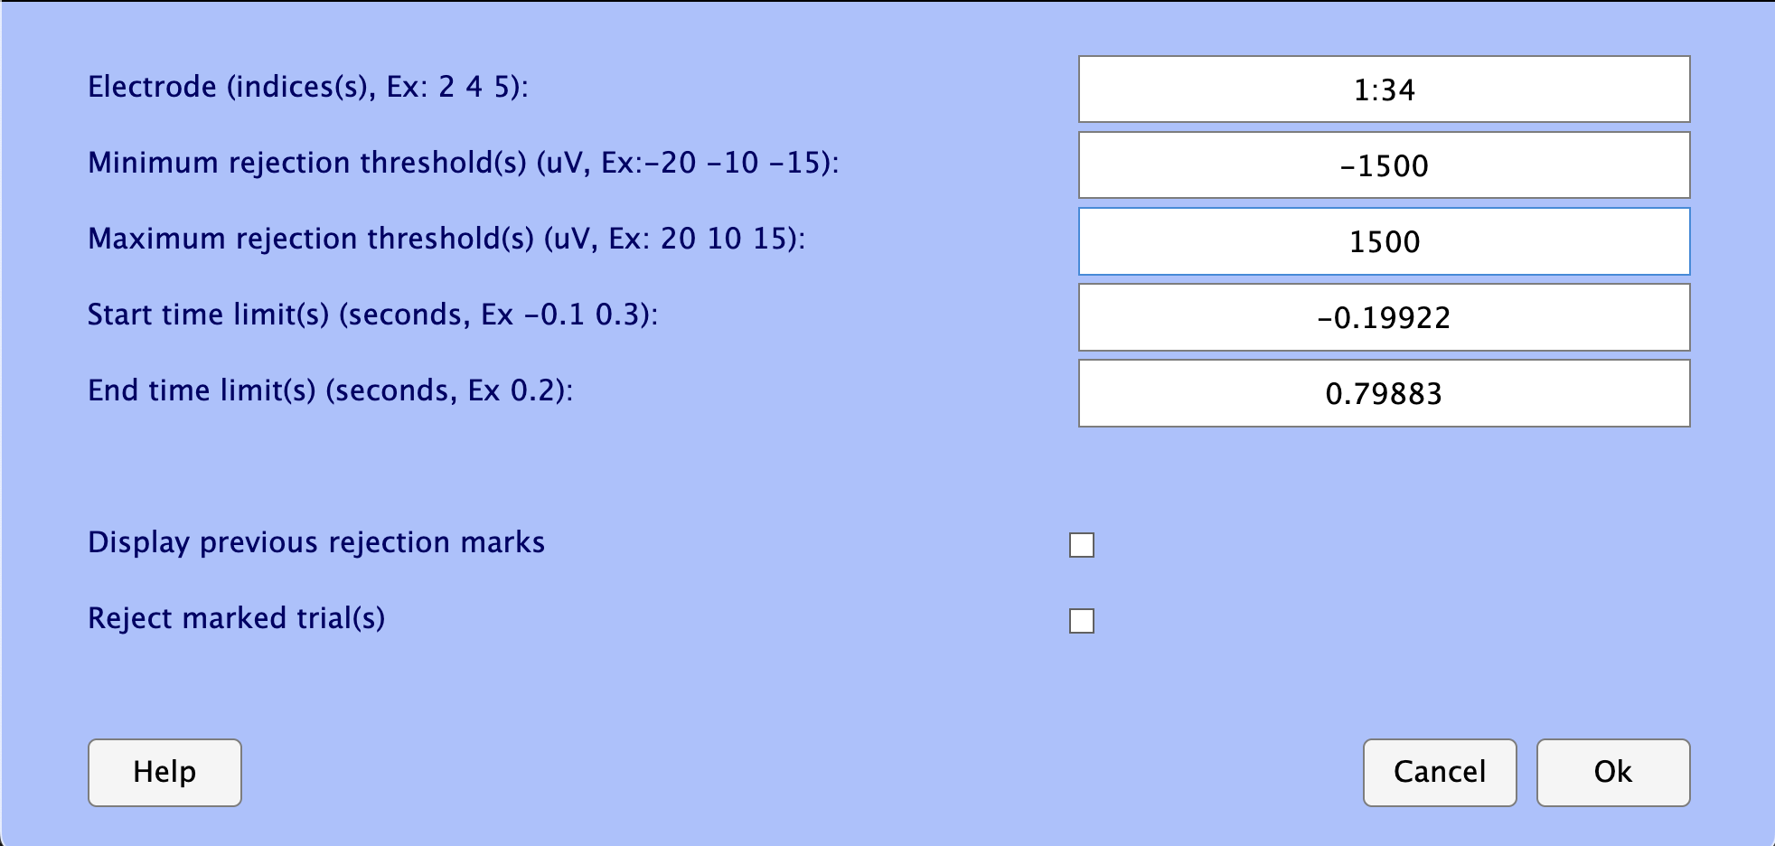
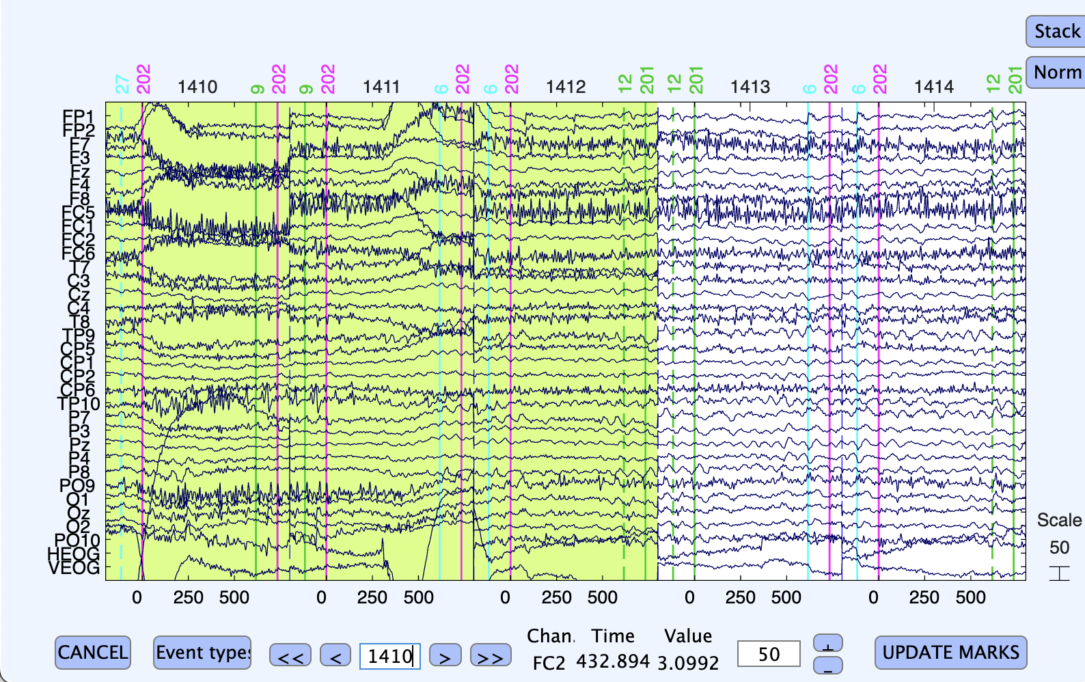
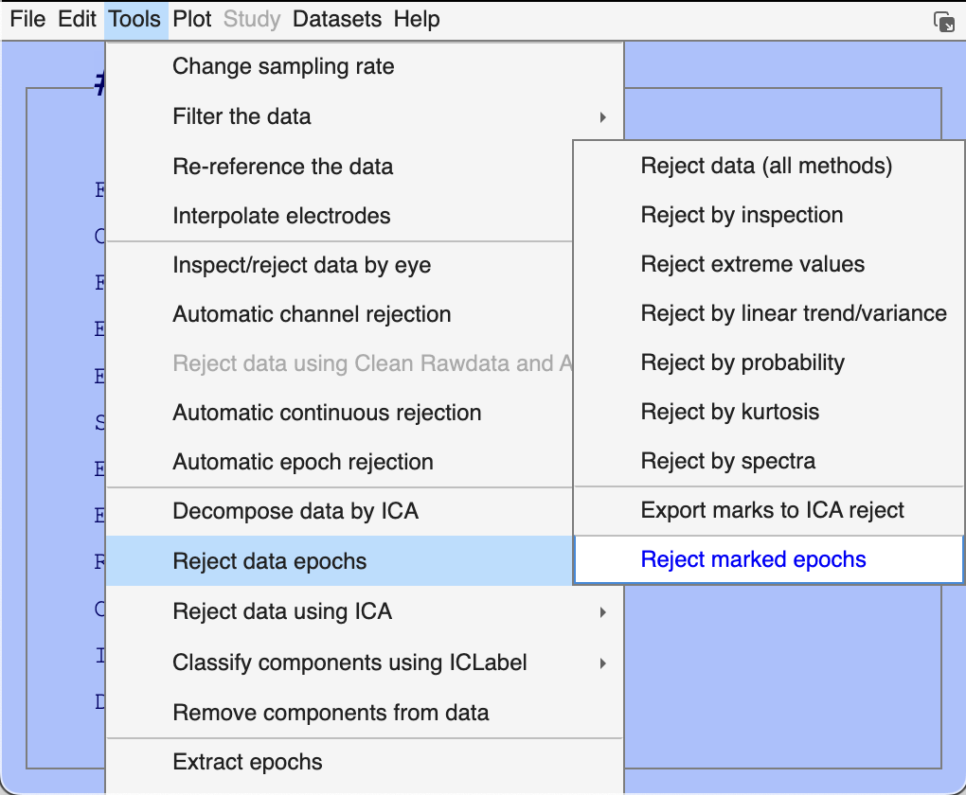
Ch8 Reject bad epochs
Change values of these two and keep the left default
It will mark all suspicious trials to be deleted
Press update

Slide 9
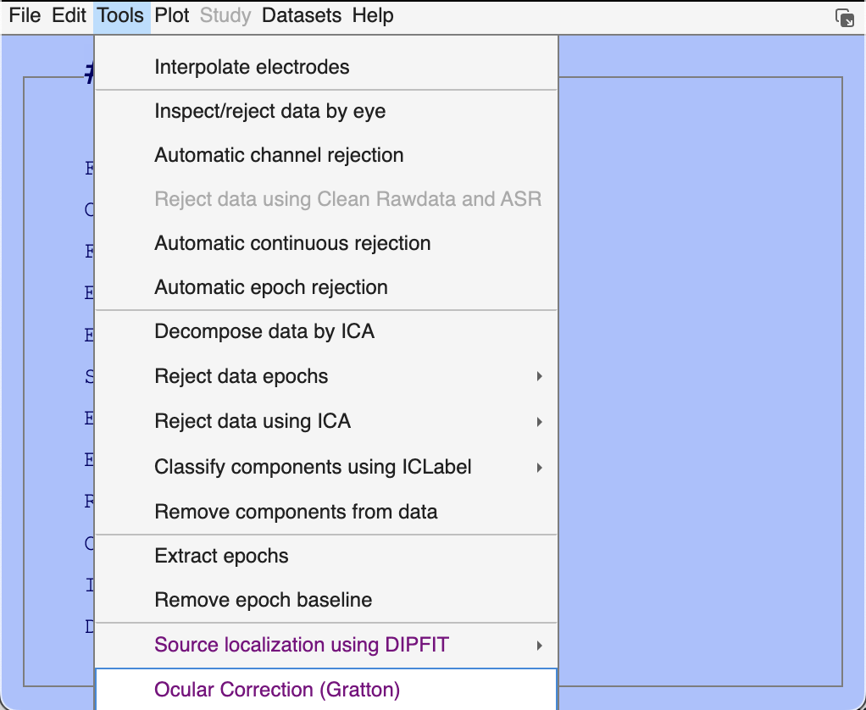
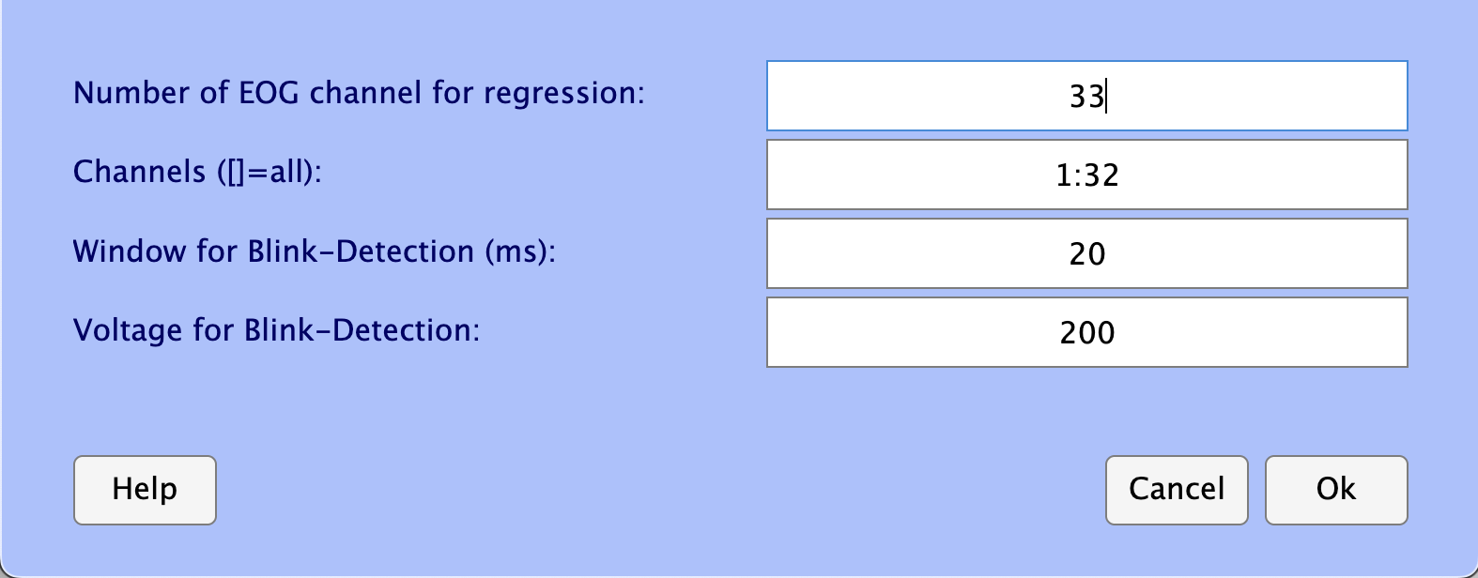
Ch8 artifact correction

Slide 10
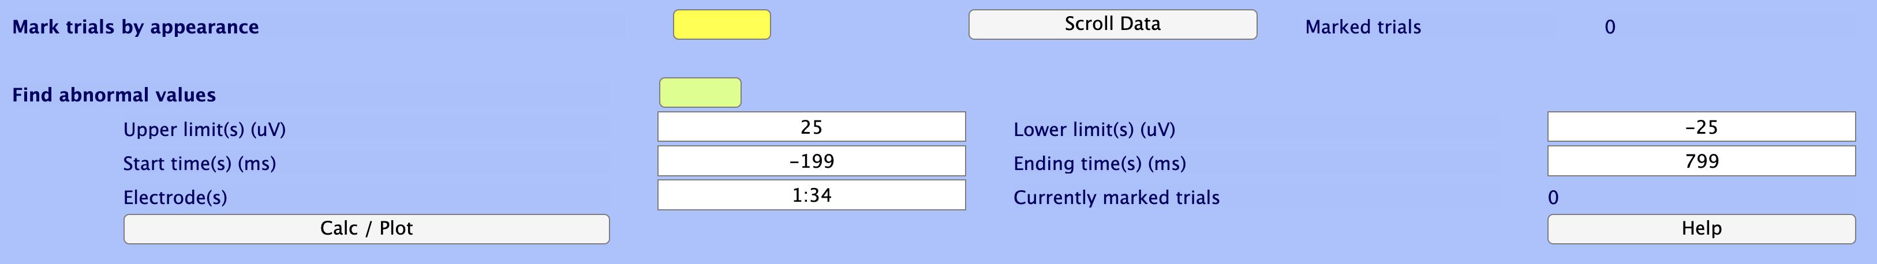
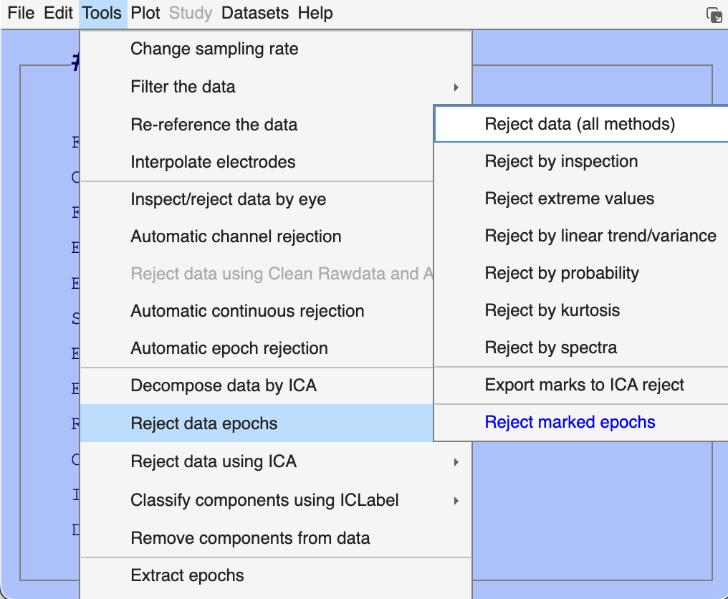
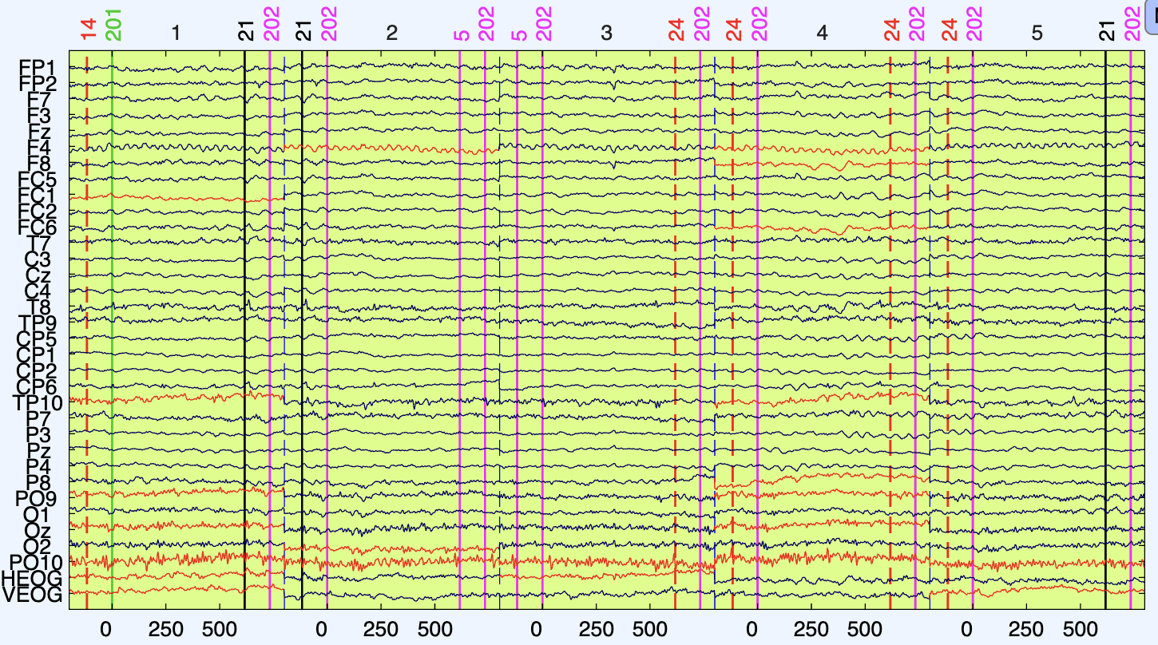
Ch8 Reject data, second roll
All epochs are marked to be removed due to the lines that turns into orange

Slide 11
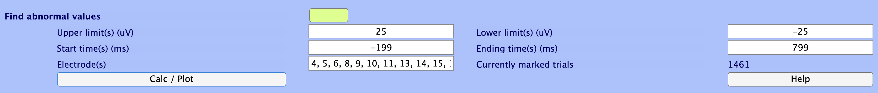
Ch8 fining the artifact rejection
Enter the channel number of target
Still get too many

Slide 12
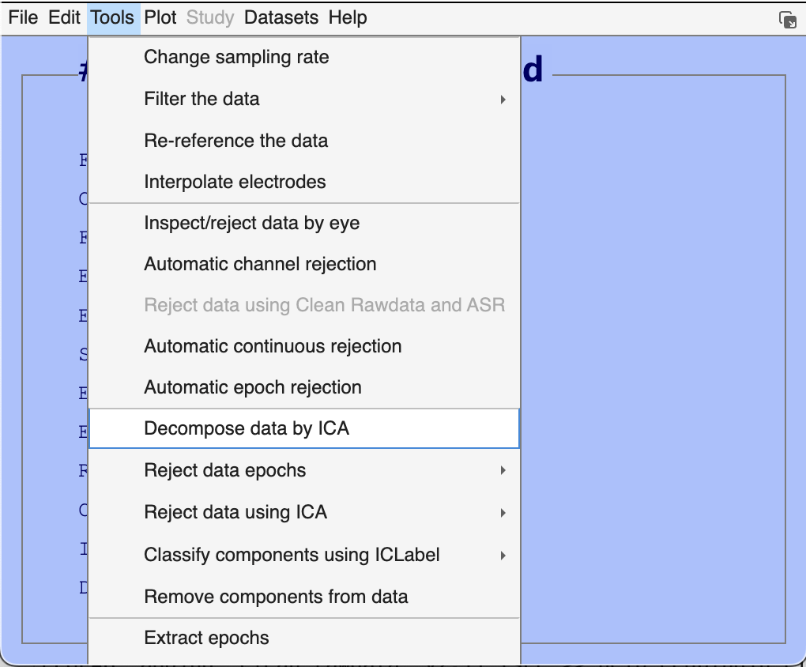
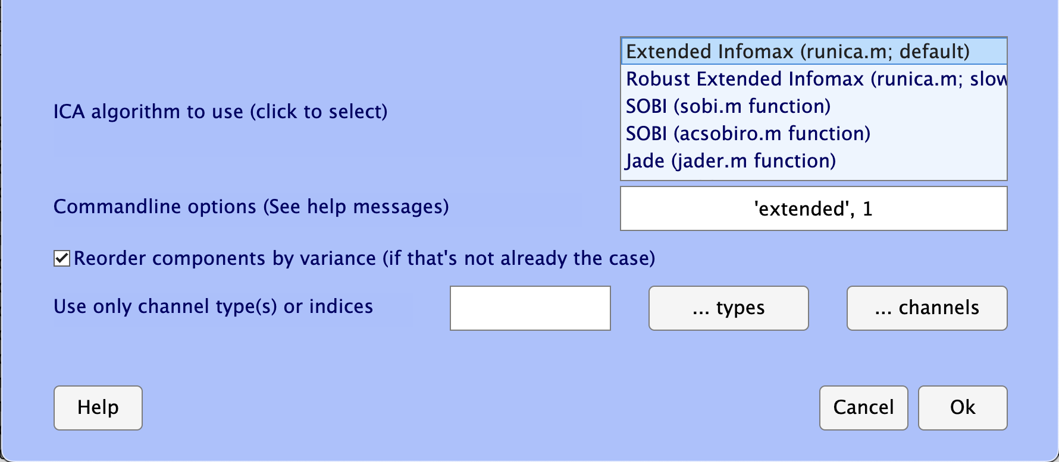
Ch8 run ICA
So many algorithms…

Slide 13
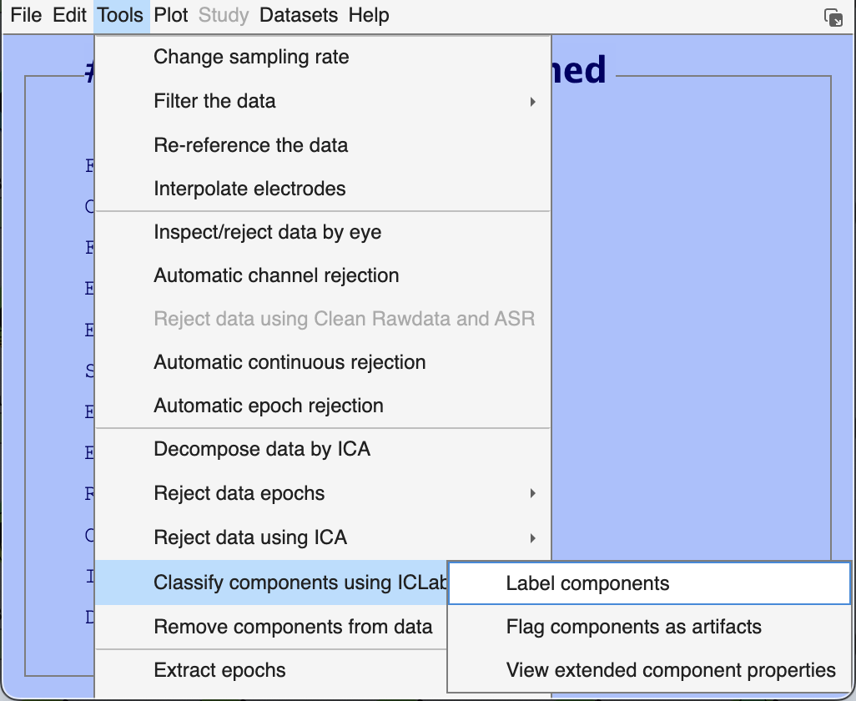
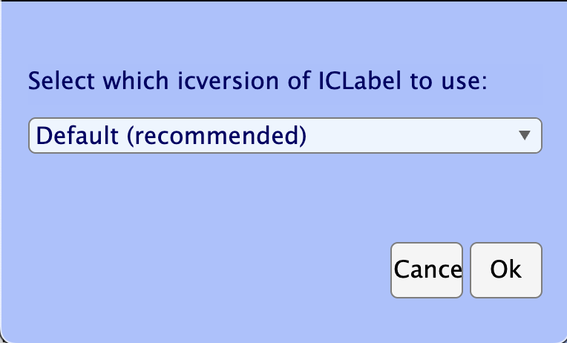
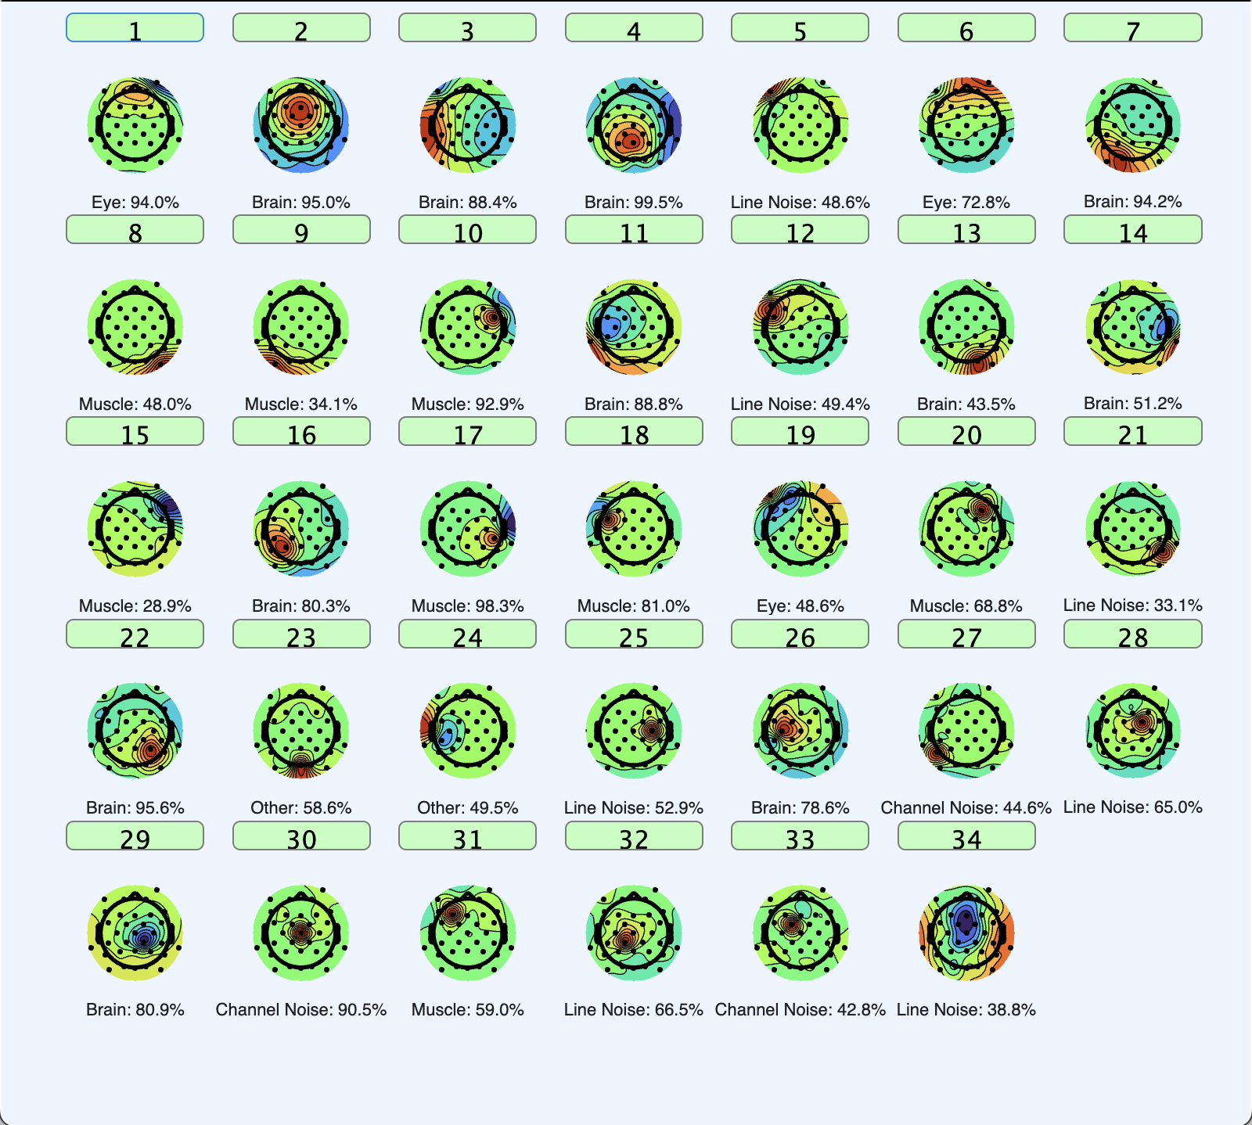
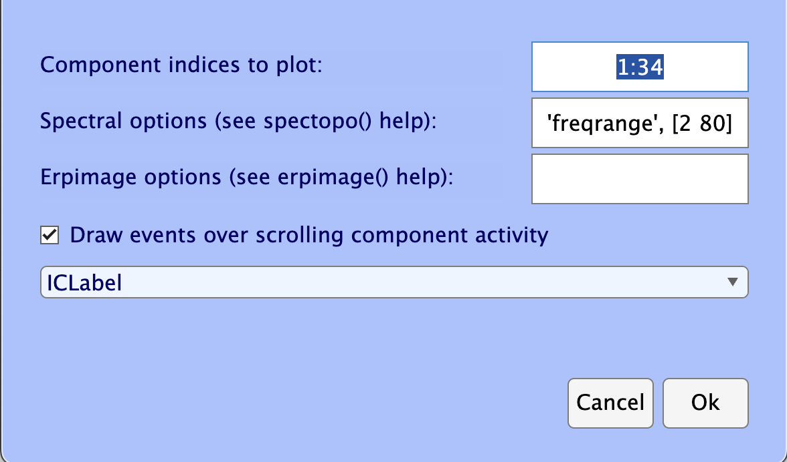
Ch8 Check ICA labels
Click the number to further check
Just use the default parameters

Slide 14
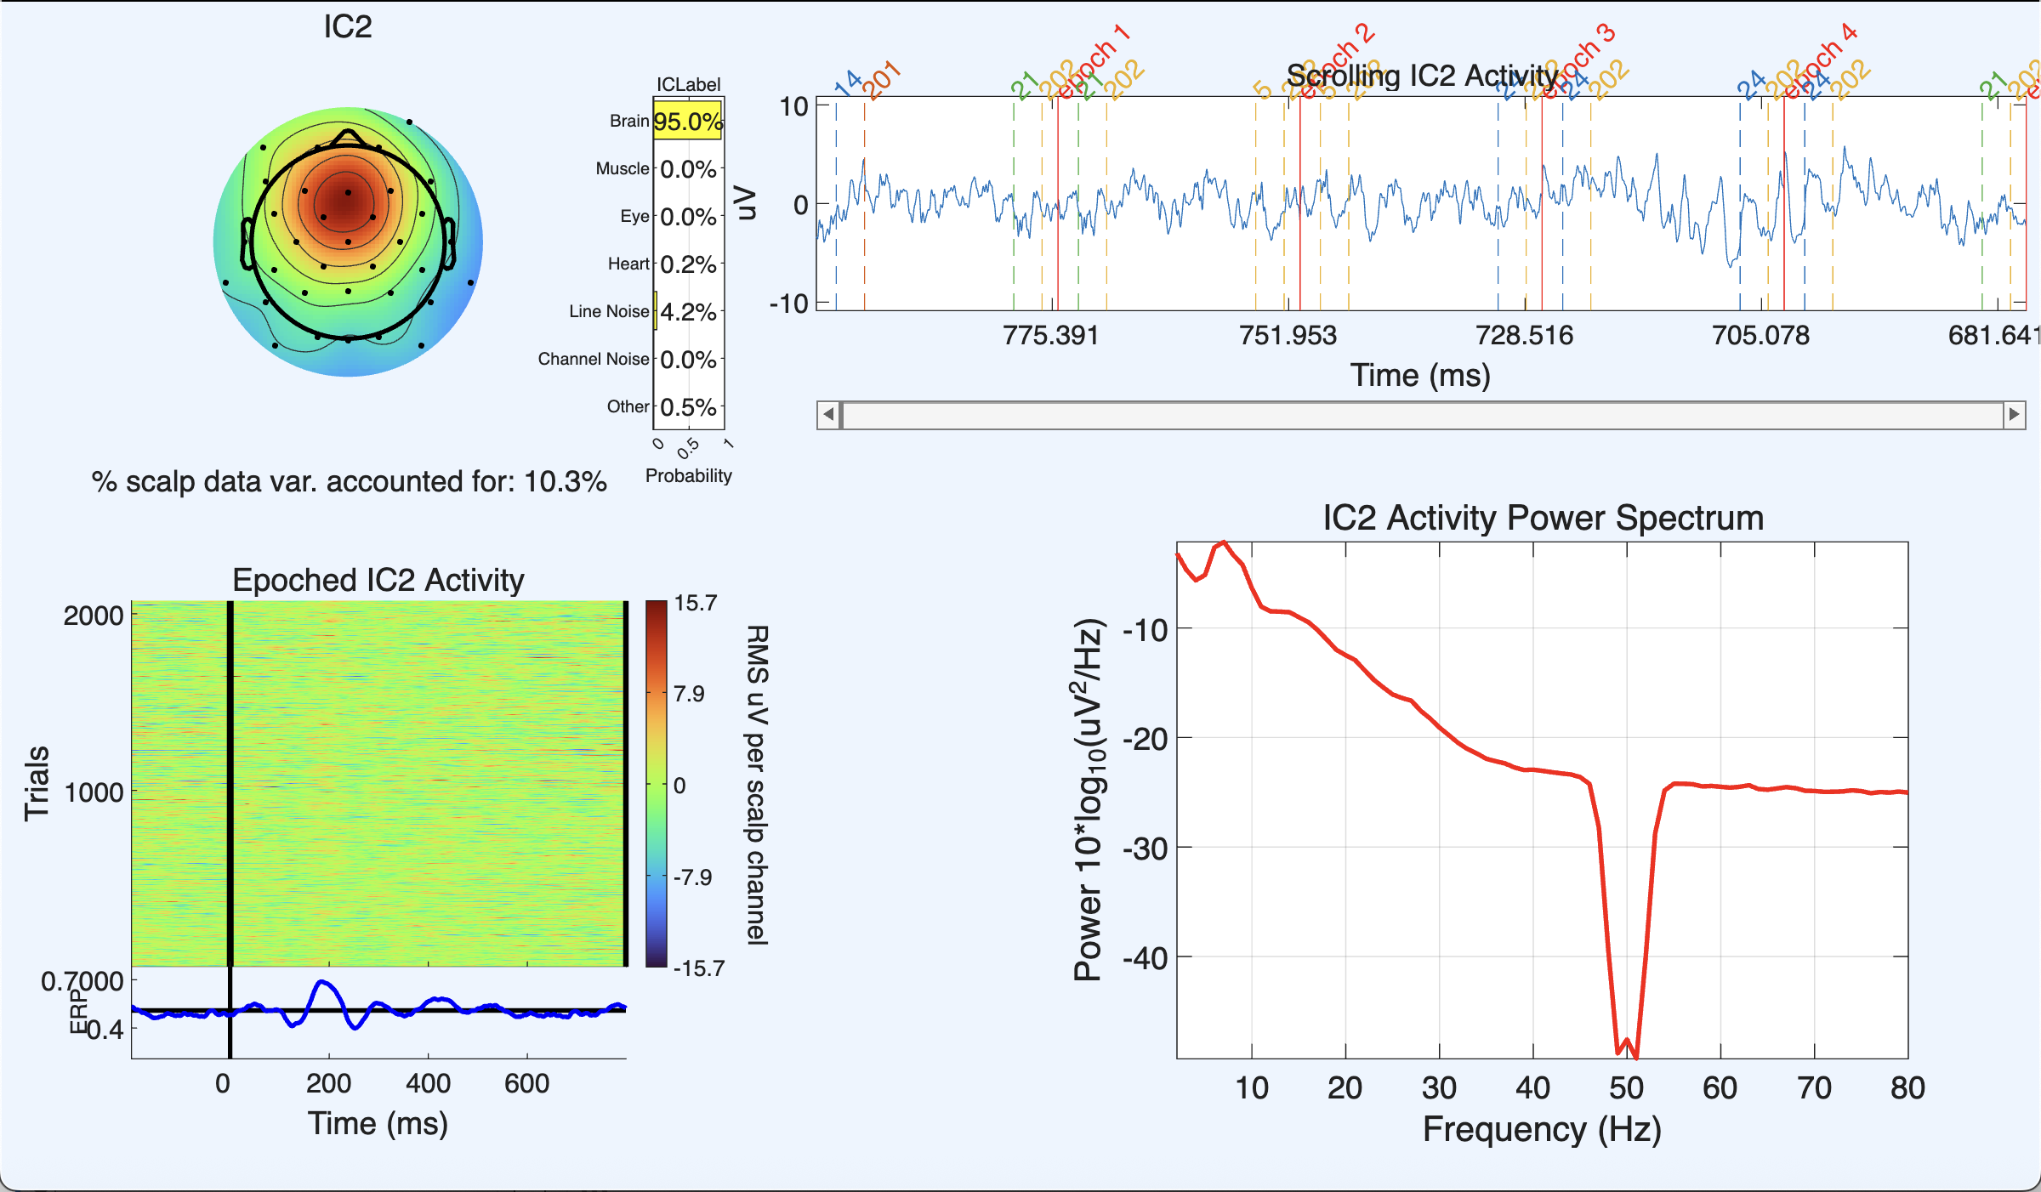
Ch8 ICA check

Slide 15
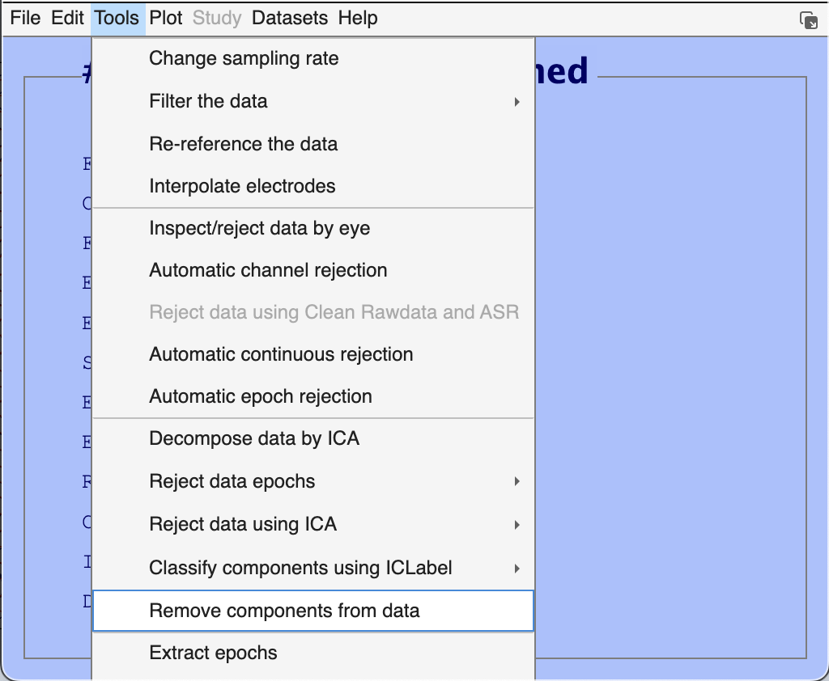
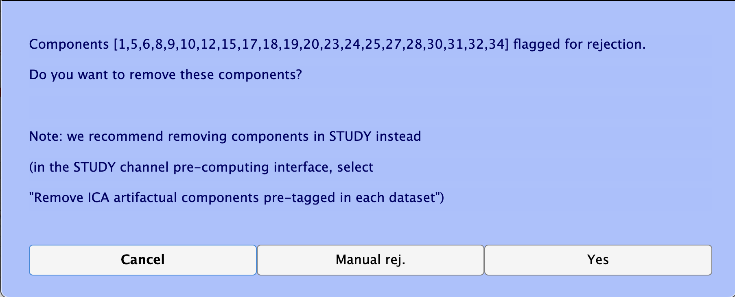
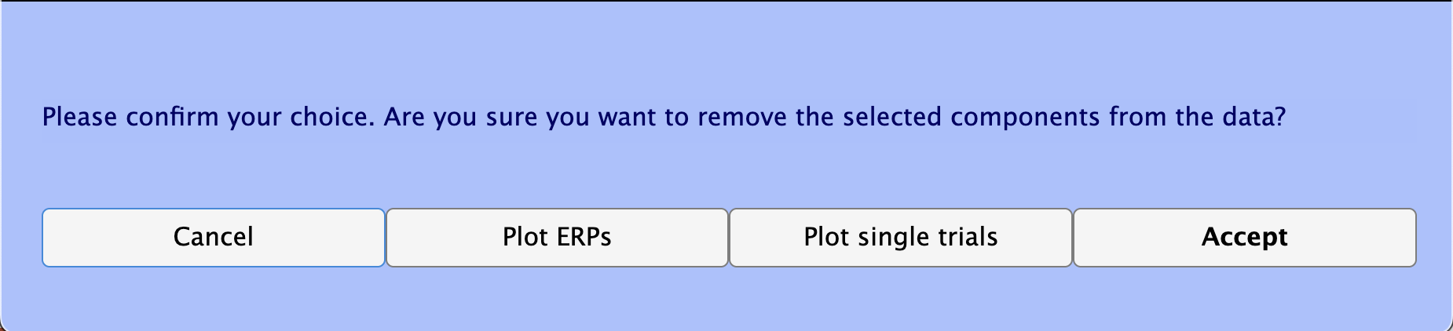
Ch8 reject components

Slide 16
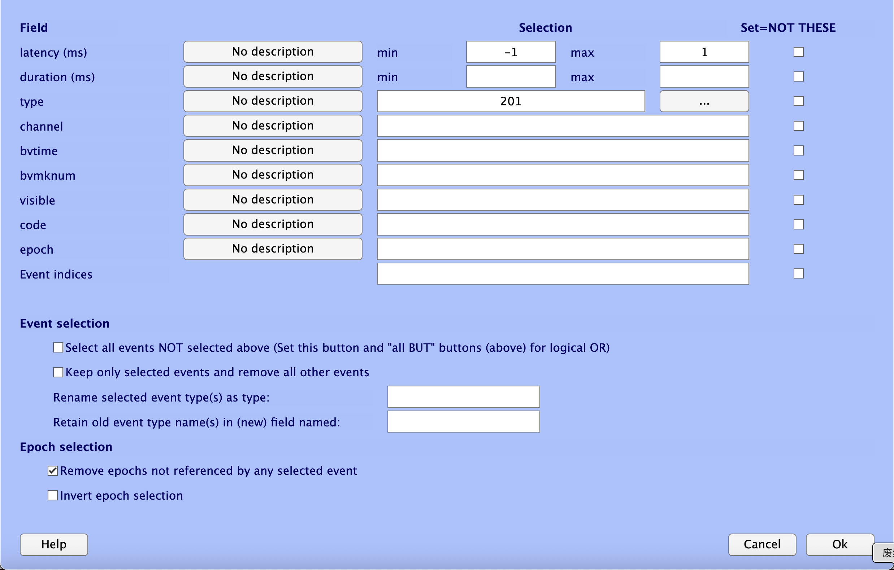
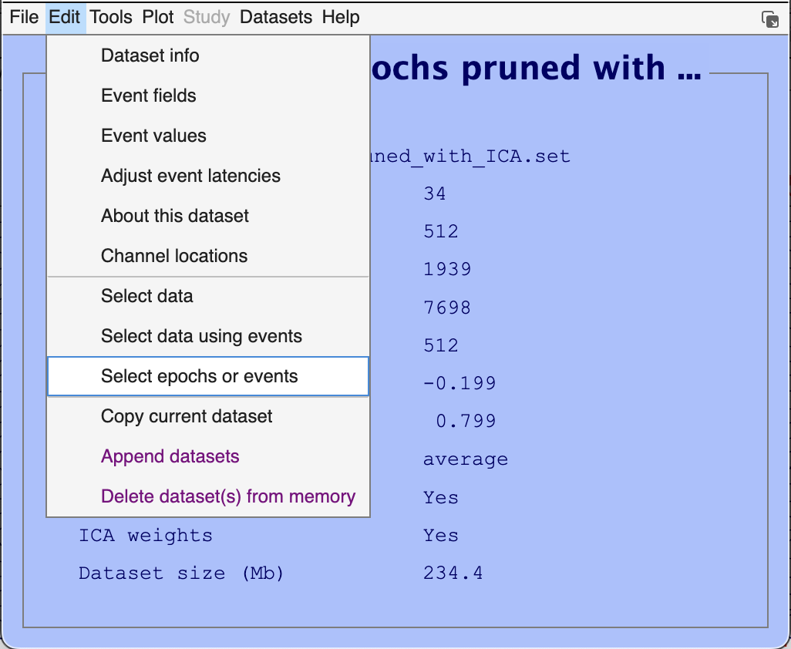
Ch9 select epochs
This is in 1 ms, not 1 s
Enter the marker number

Slide 17
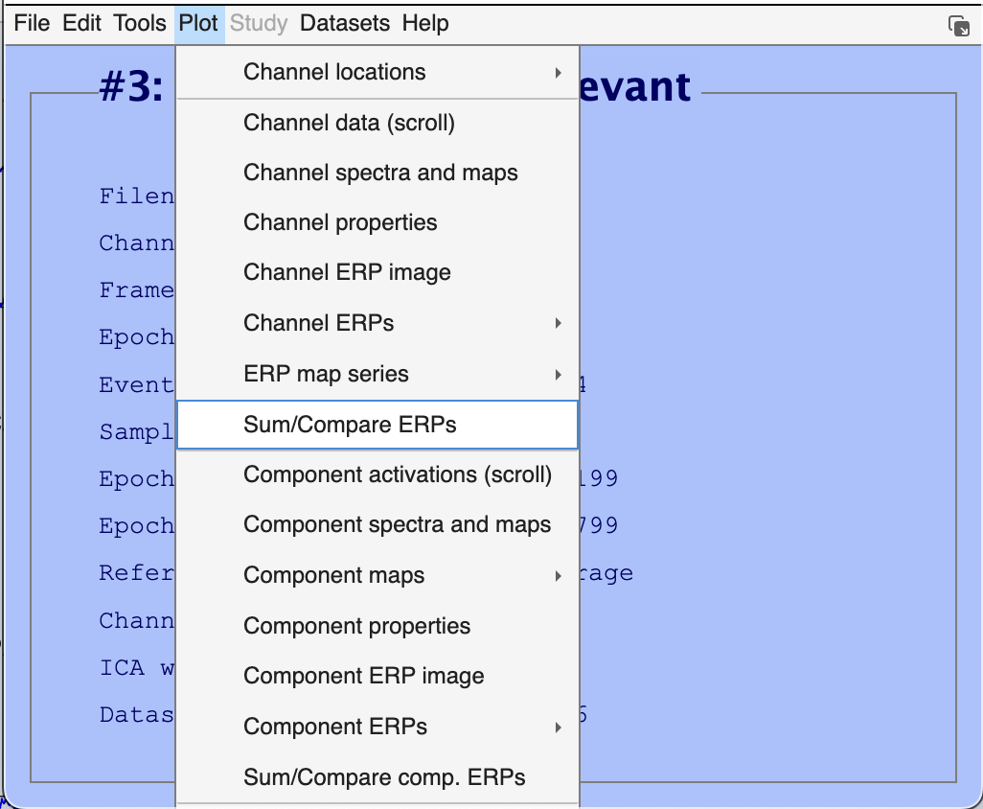
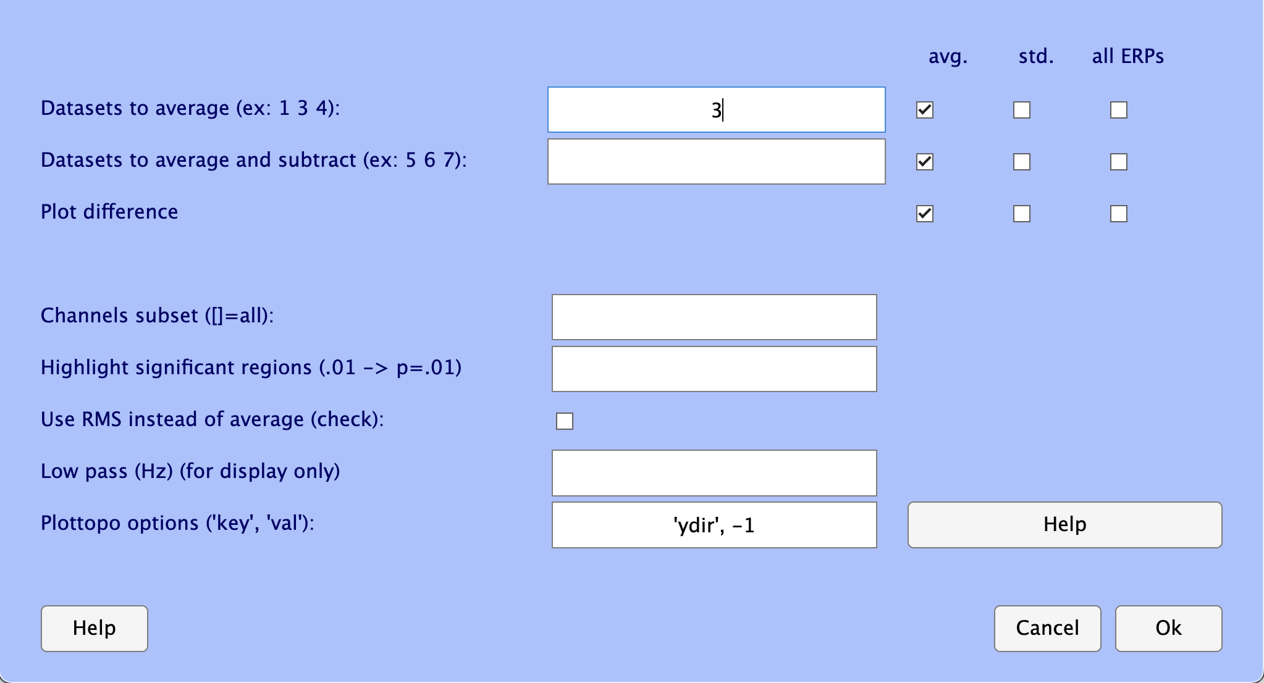
Ch9 plot1
The dataset to be plotted
The another dataset to be plotted for comparing conditions
Enable to plot the difference between dataset (the 3rd line)
-1 = negative up
1 = positive up

Slide 18
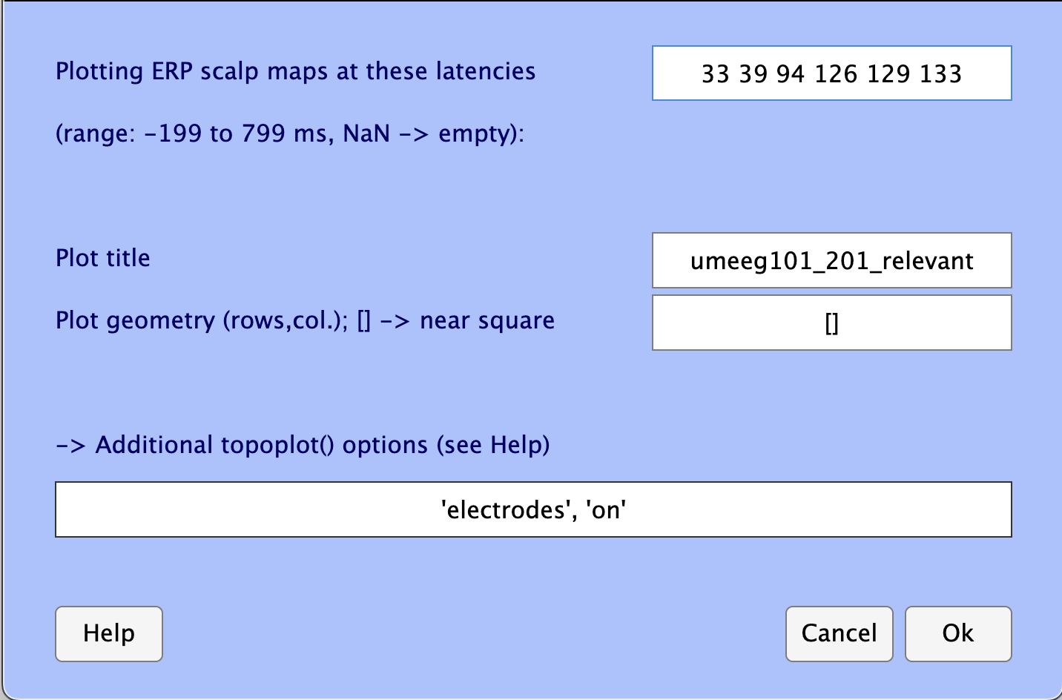
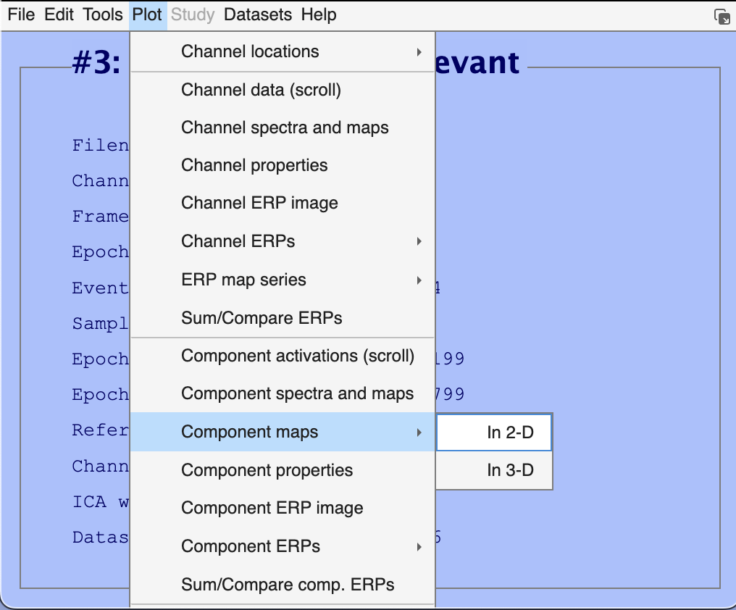
Ch9 topoplot
Enter the latency time of interest in millisecond

Slide 19
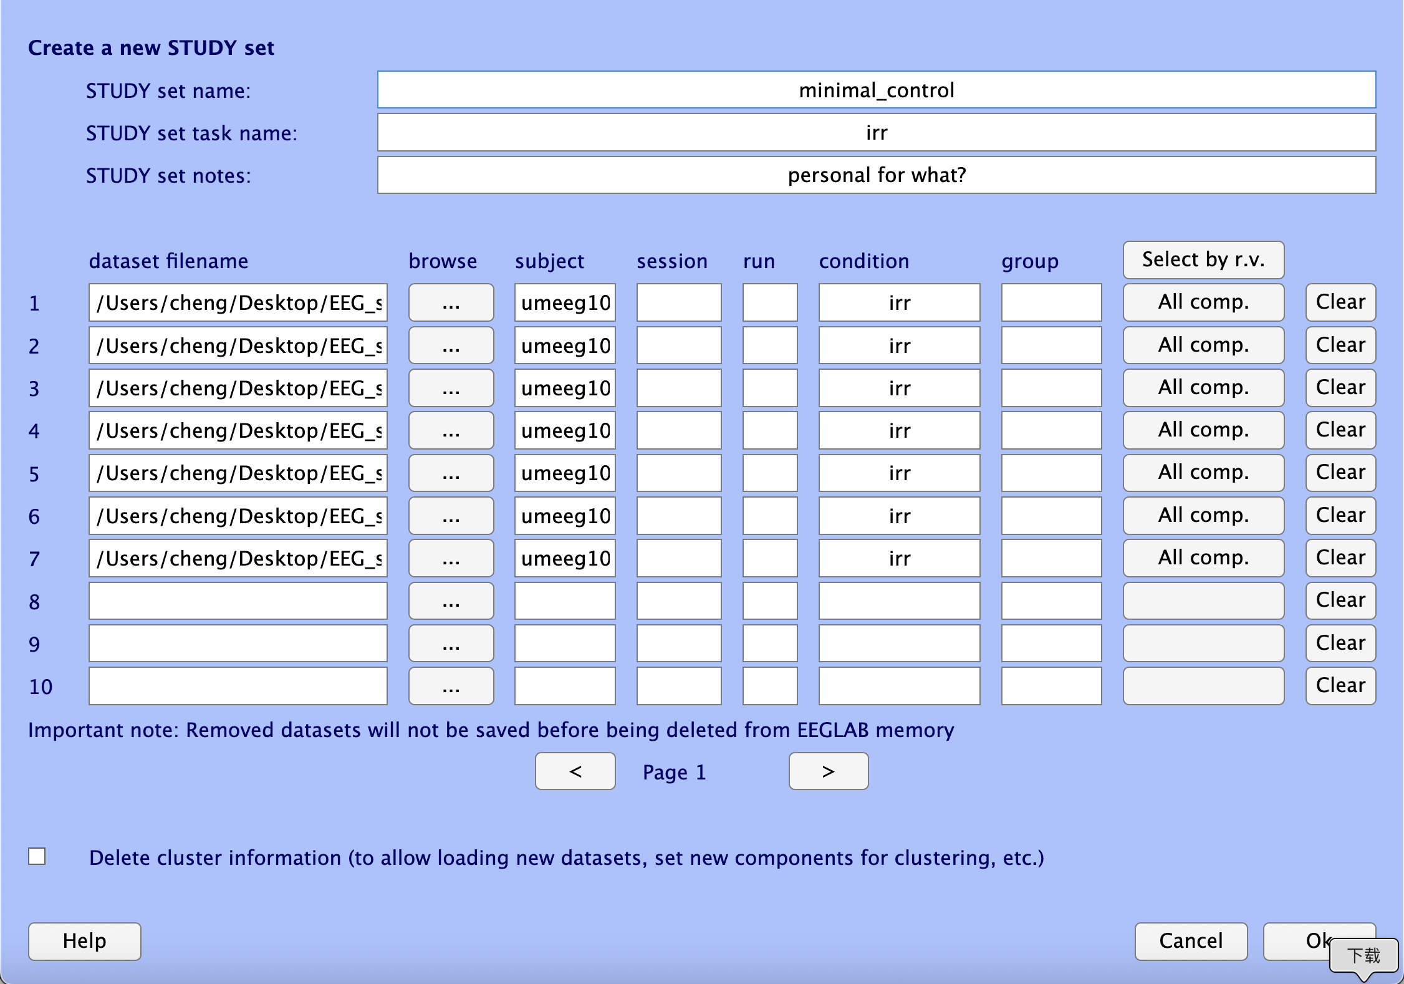
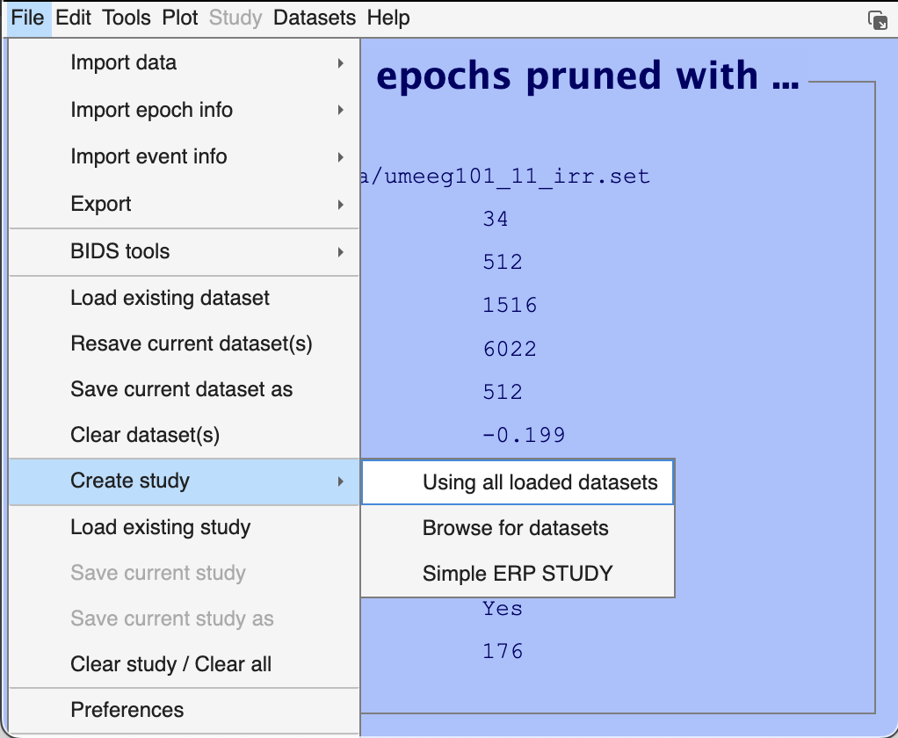
Ch10 create study

Slide 20
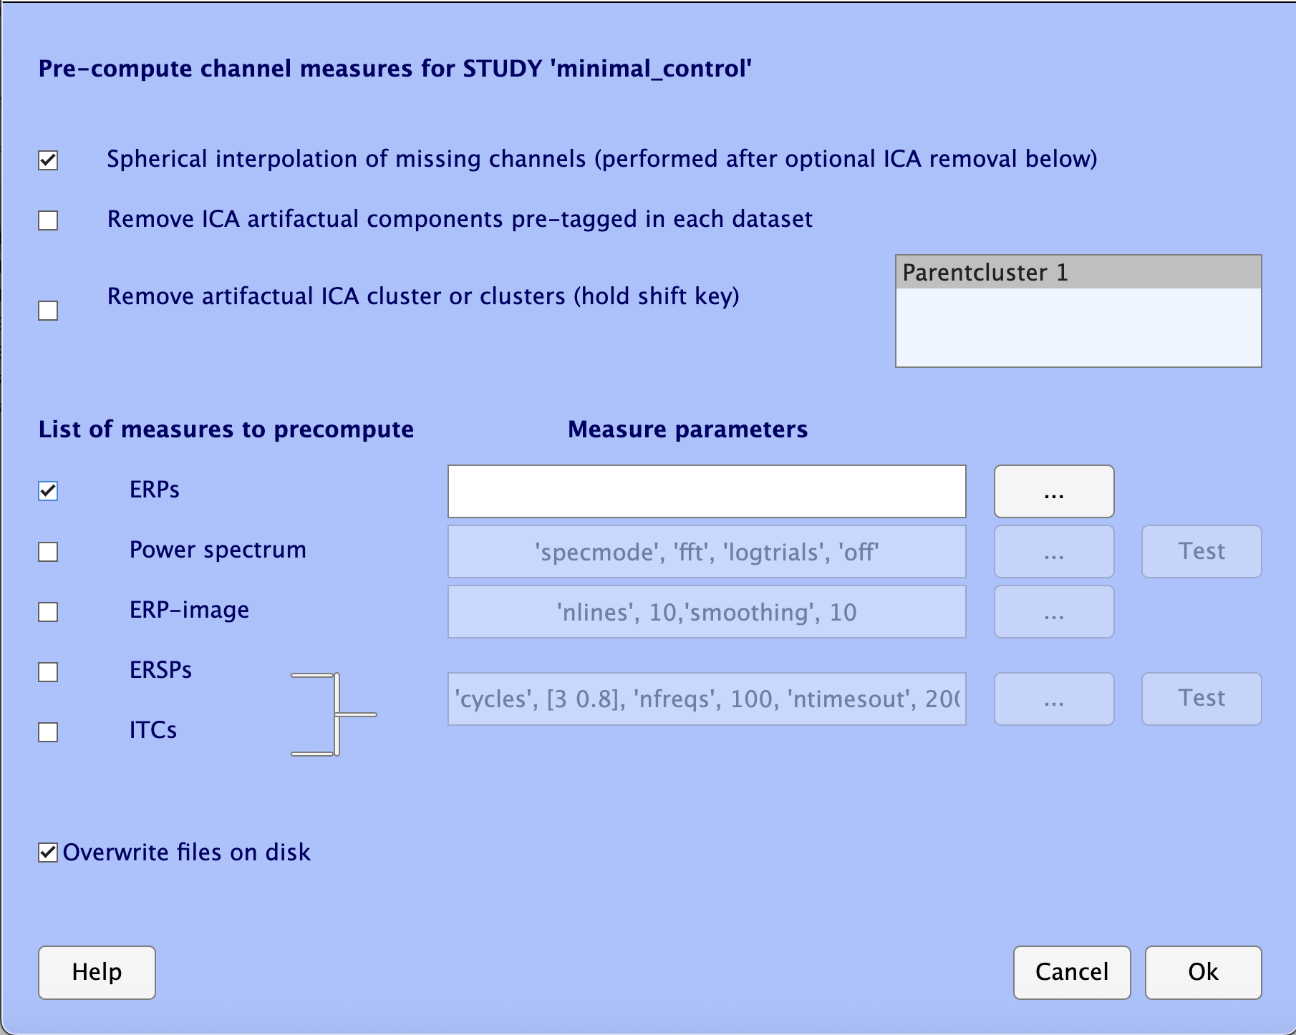
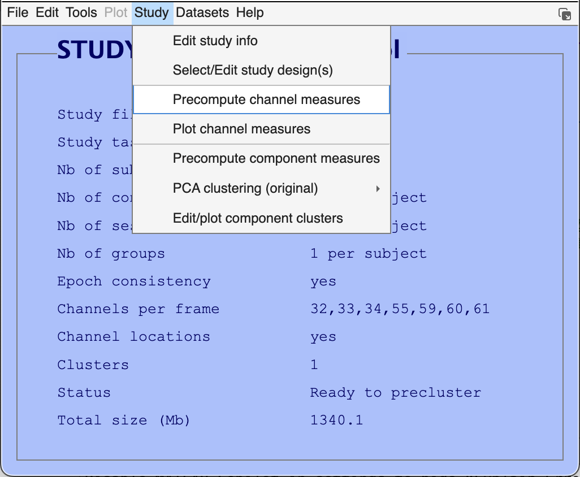
Ch10 interpolate channels
No need to specify
Attention may be required but I don’t know what here means

Slide 21
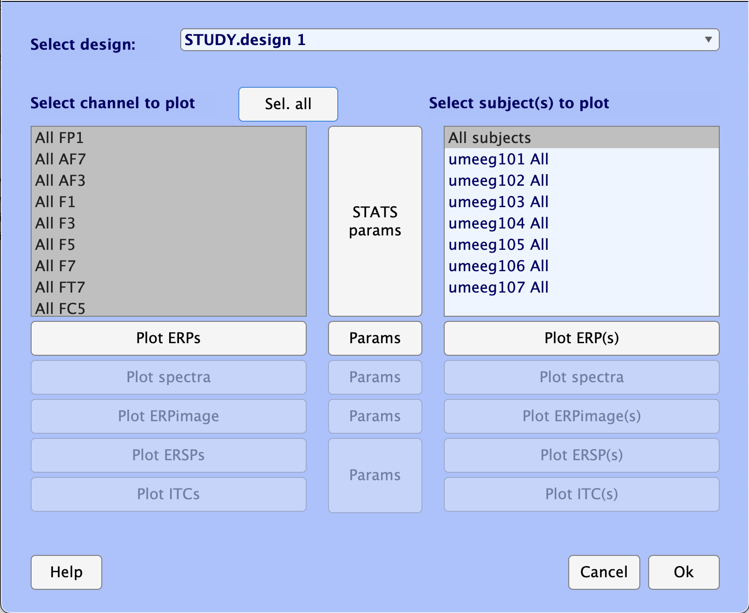

Ch10 Plot grand average
Plot the average
Plot the difference

Slide 22
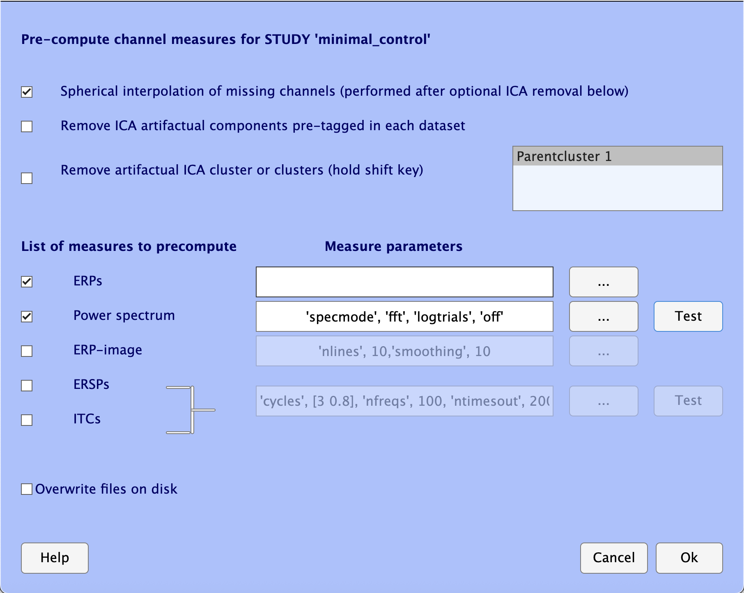
Ch10 Power spectrum
We can just use by default

Slide 23
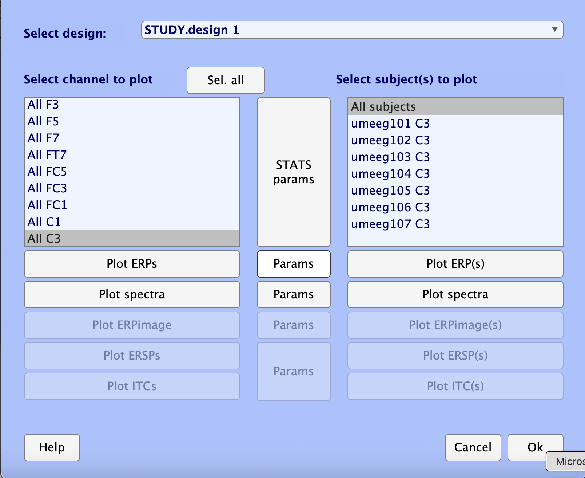
Ch10 Power spectrum
Set frequency range to plot

Slide 24
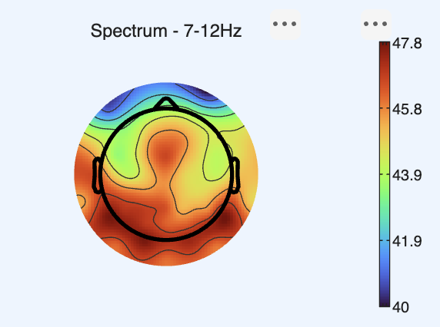
Ch10 topo alpha

Slide 25
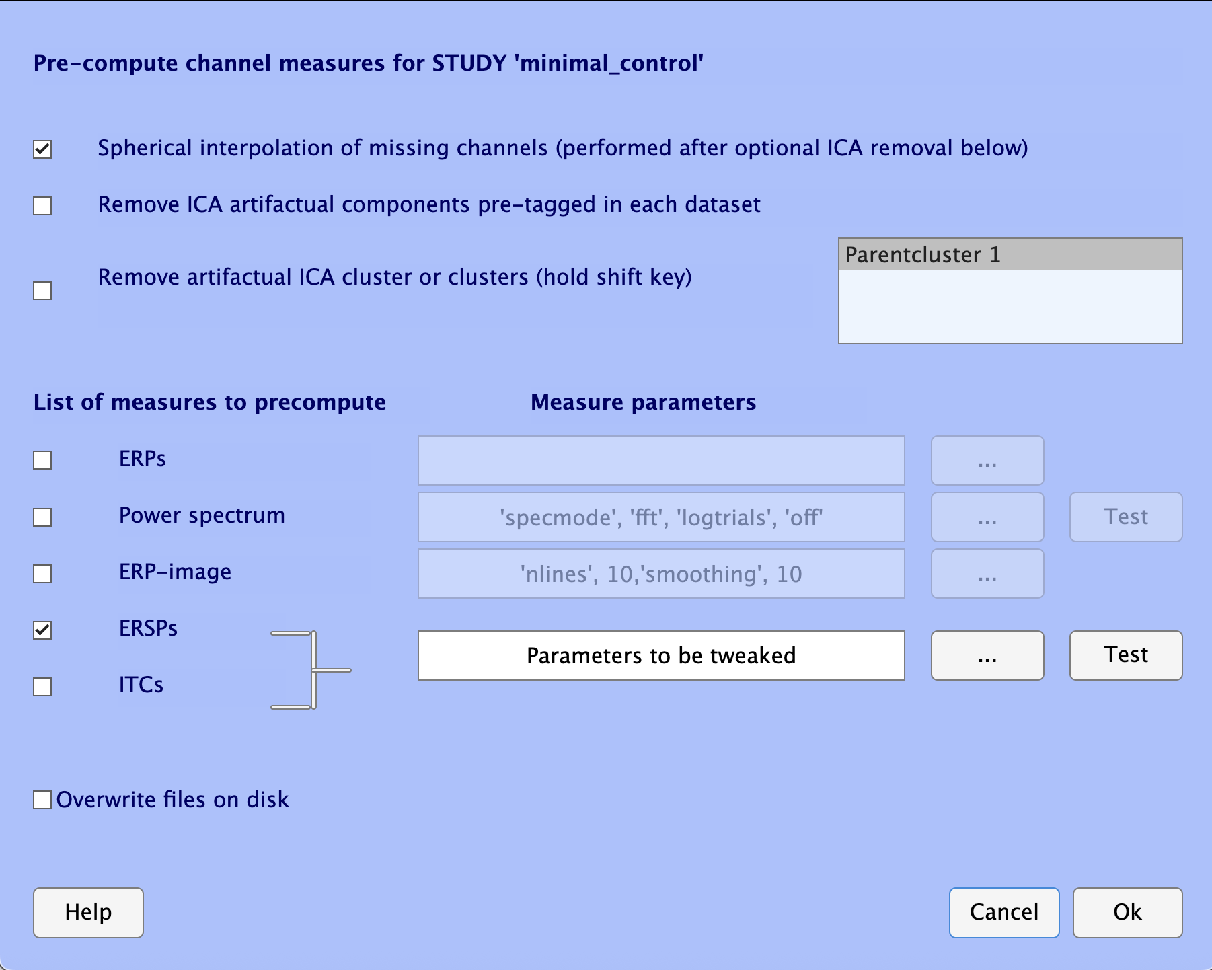
Ch10 wavelet precom

Slide 26


Ch10 condition compara

Slide 27


Slide 28

Ch10 statistics

Slide 29


Ch11 single interpolation
Interpolate dead electrodes
Overwrite pre-existed channels
Add channels from other dataset

Slide 30


Slide 31


Slide 32


