Slide 1


MTeamⓇ
MultiNationalTeam
Vitaly Kokhanau
Tomasz Józwik
Andrii Stefanyshyn

Slide 2

Choose the language
1. Belorussian
2. Ukrainian
3. Polish

Slide 3
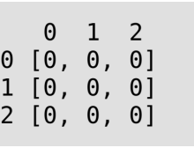
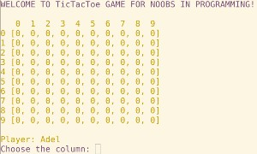
Gra Tic-Tac-Toe
”Kółko I Krzyżyk”
Gra ma celem przyzwyczajenia początkujących programistów odliczania wszystkiego od zera
Zasady gry:
dwóch graczy ‘O’ i ‘X’ == ‘1’ i ‘2’
każdy z graczy wykonuje jeden
ruch na polach oznaczonych ‘0’

Slide 4
Tic Tac Toe specification (backlog) 1st week:
1.Consider game’s functionality, which will be
suitable for the present team’s level.
2.Create a scheme of base functions of game’s
architecture.
3.Add a scalable board’s generator, which allows to create a board with dedicated size.
4.Add users input with validations: “isdigit” for
columns and rows, “out of board range”,
“is the spot empty”.
5.Add a logic to preform changes
on board’s stage.

Slide 5
Tic Tac Toe specification (backlog) 1st week:
6.Add functionality of Definition of Done (win conditions) for 3x3 size board.
6.1. Horizontal.
6.2. Vertical.
6.3. Left diagonal.
6.4. Right diagonal.
6.5. Draw.

Slide 6
Tic Tac Toe specification (backlog) 2nd week:
7.After-winning invitation to continue/quit game
with user (Yes/No) answers validation.
8.Add users a possibility to change the default
Player1/Player2 name before game’s start.
9.Add different colors for spots, occupied by players
for better visibility.
10.Add game effects (sound and visual).
11.To expand all kinds of win conditions
functionality to scalable board.
12. Add single player game mode
with two difficulty levels(random
and artificial intelligence).

Slide 7
Wnioski i czego nauczyliśmy się w ciągu tych dwóch tygodni:
1.Wzorców projektowych (single responsibility).
2.Obsłudze wyjątków (try, except).
3.Sprawdzać poprawności danych użytkownika
(isdigit, out of range).
4.Pracy zespołowej (tolerance and politeness).
5.Podłączania i pracy z modułami Python
(Colorama, Termcolor)
6.Podziału obowiązków i pracy z
systemem kontroli wersji GIT.

Slide 8
Thanks for your attention
Vitaly Kokhanau
Tomasz Józwik
Andrii Stefanyshyn
All questions send to mteam@somewhere.com

