Slide 1
GEONARRATIVE AI
An Intelligent Geospatial Digital Twin and GeoAI Decision-Support Framework for Urban Flood Risk Assessment in Pune
Student: Harnish Savant Programme: M.Sc. Data Science and Spatial Analytics (Geo-Intelligence) Institute: Symbiosis Institute of Geoinformatics (SIG), Pune
Notes:
Good day, members of the evaluation committee and esteemed faculty. Today, I am proud to present my M.Sc. dissertation research titled GeoNarrative AI. This research addresses one of Pune's most pressing urban challenges—flooding—by bridging rigorous spatial analytical modeling with an intelligent, 3D WebGL Digital Twin and an explainable GeoAI decision-support platform.

Slide 2
1. PROBLEM DEFINITION: THE URBAN HYDROLOGICAL CRISIS IN PUNE
Accelerated Urbanization & Monsoon Cloudburst Vulnerability
• Topographical Complexity: The Mula-Mutha river valley experiences intense seasonal monsoon cloudbursts. Extreme urbanization and increased impervious surface sealing lead to rapid runoff accumulation in low-lying basins.
• Limitations of Traditional Static Maps: Standard 2D GIS flood hazard printouts lack real-time dynamic interactivity and fail to provide municipal responders with exploratory scenario simulation.
• Operational Data Silos: Hydrological spatial modeling (AHP/GIS) remains completely decoupled from operational municipal emergency disaster coordination engines.
• Lack of Analytical Explainability: Emergency coordinators lack automated, explainable decision-support interfaces to interpret spatial numerical susceptibility indices instantaneously during critical flood crises.
GEONARRATIVE AI | M.SC. THESIS DEFENSE | SYMBIOSIS INSTITUTE OF GEOINFORMATICS (SIG), PUNE
Notes:
As Pune experiences unprecedented urban expansion, the proliferation of impervious surfaces alongside erratic monsoon precipitation has turned urban flood management into a critical priority. Traditional disaster management relies heavily on static, two-dimensional GIS printouts or decoupled tables. These conventional deliverables fail to provide emergency controllers with interactive multi-scenario exploration or real-time explainability during critical flood events.

Slide 3
2. RESEARCH OBJECTIVES (RQ1 - RQ3) & SCIENTIFIC NOVELTY
RQ1: Multi-Criteria Spatial Hazard Modeling
Formulate and mathematically validate a continuous Flood Susceptibility Index (FSI) across Pune utilizing a robust 5-factor Analytic Hierarchy Process (AHP) weighted linear overlay.
RQ2: Infrastructure Exposure Quantification
Establish a comprehensive, multi-scenario evaluation matrix evaluating vulnerability and physical exposure across municipal structural buildings and transportation networks.
RQ3: Explainable Digital Twin Synthesis
Develop a real-time, interactive 3D WebGL Digital Twin integrated with an LLM-driven GeoAI natural language assistant to automate technical disaster situation reports.
GEONARRATIVE AI | M.SC. THESIS DEFENSE | SYMBIOSIS INSTITUTE OF GEOINFORMATICS (SIG), PUNE
Notes:
To resolve these operational bottlenecks, this thesis establishes three comprehensive research objectives. First, to model flood susceptibility across Pune using a rigorous five-factor Analytic Hierarchy Process. Second, to quantify actual infrastructure exposure across multiple storm severities. And third, to engineer an enterprise-grade 3D Digital Twin that integrates an LLM-driven GeoAI assistant capable of synthesizing automated disaster reports and explaining spatial analytics through natural language dialogue.

Slide 4
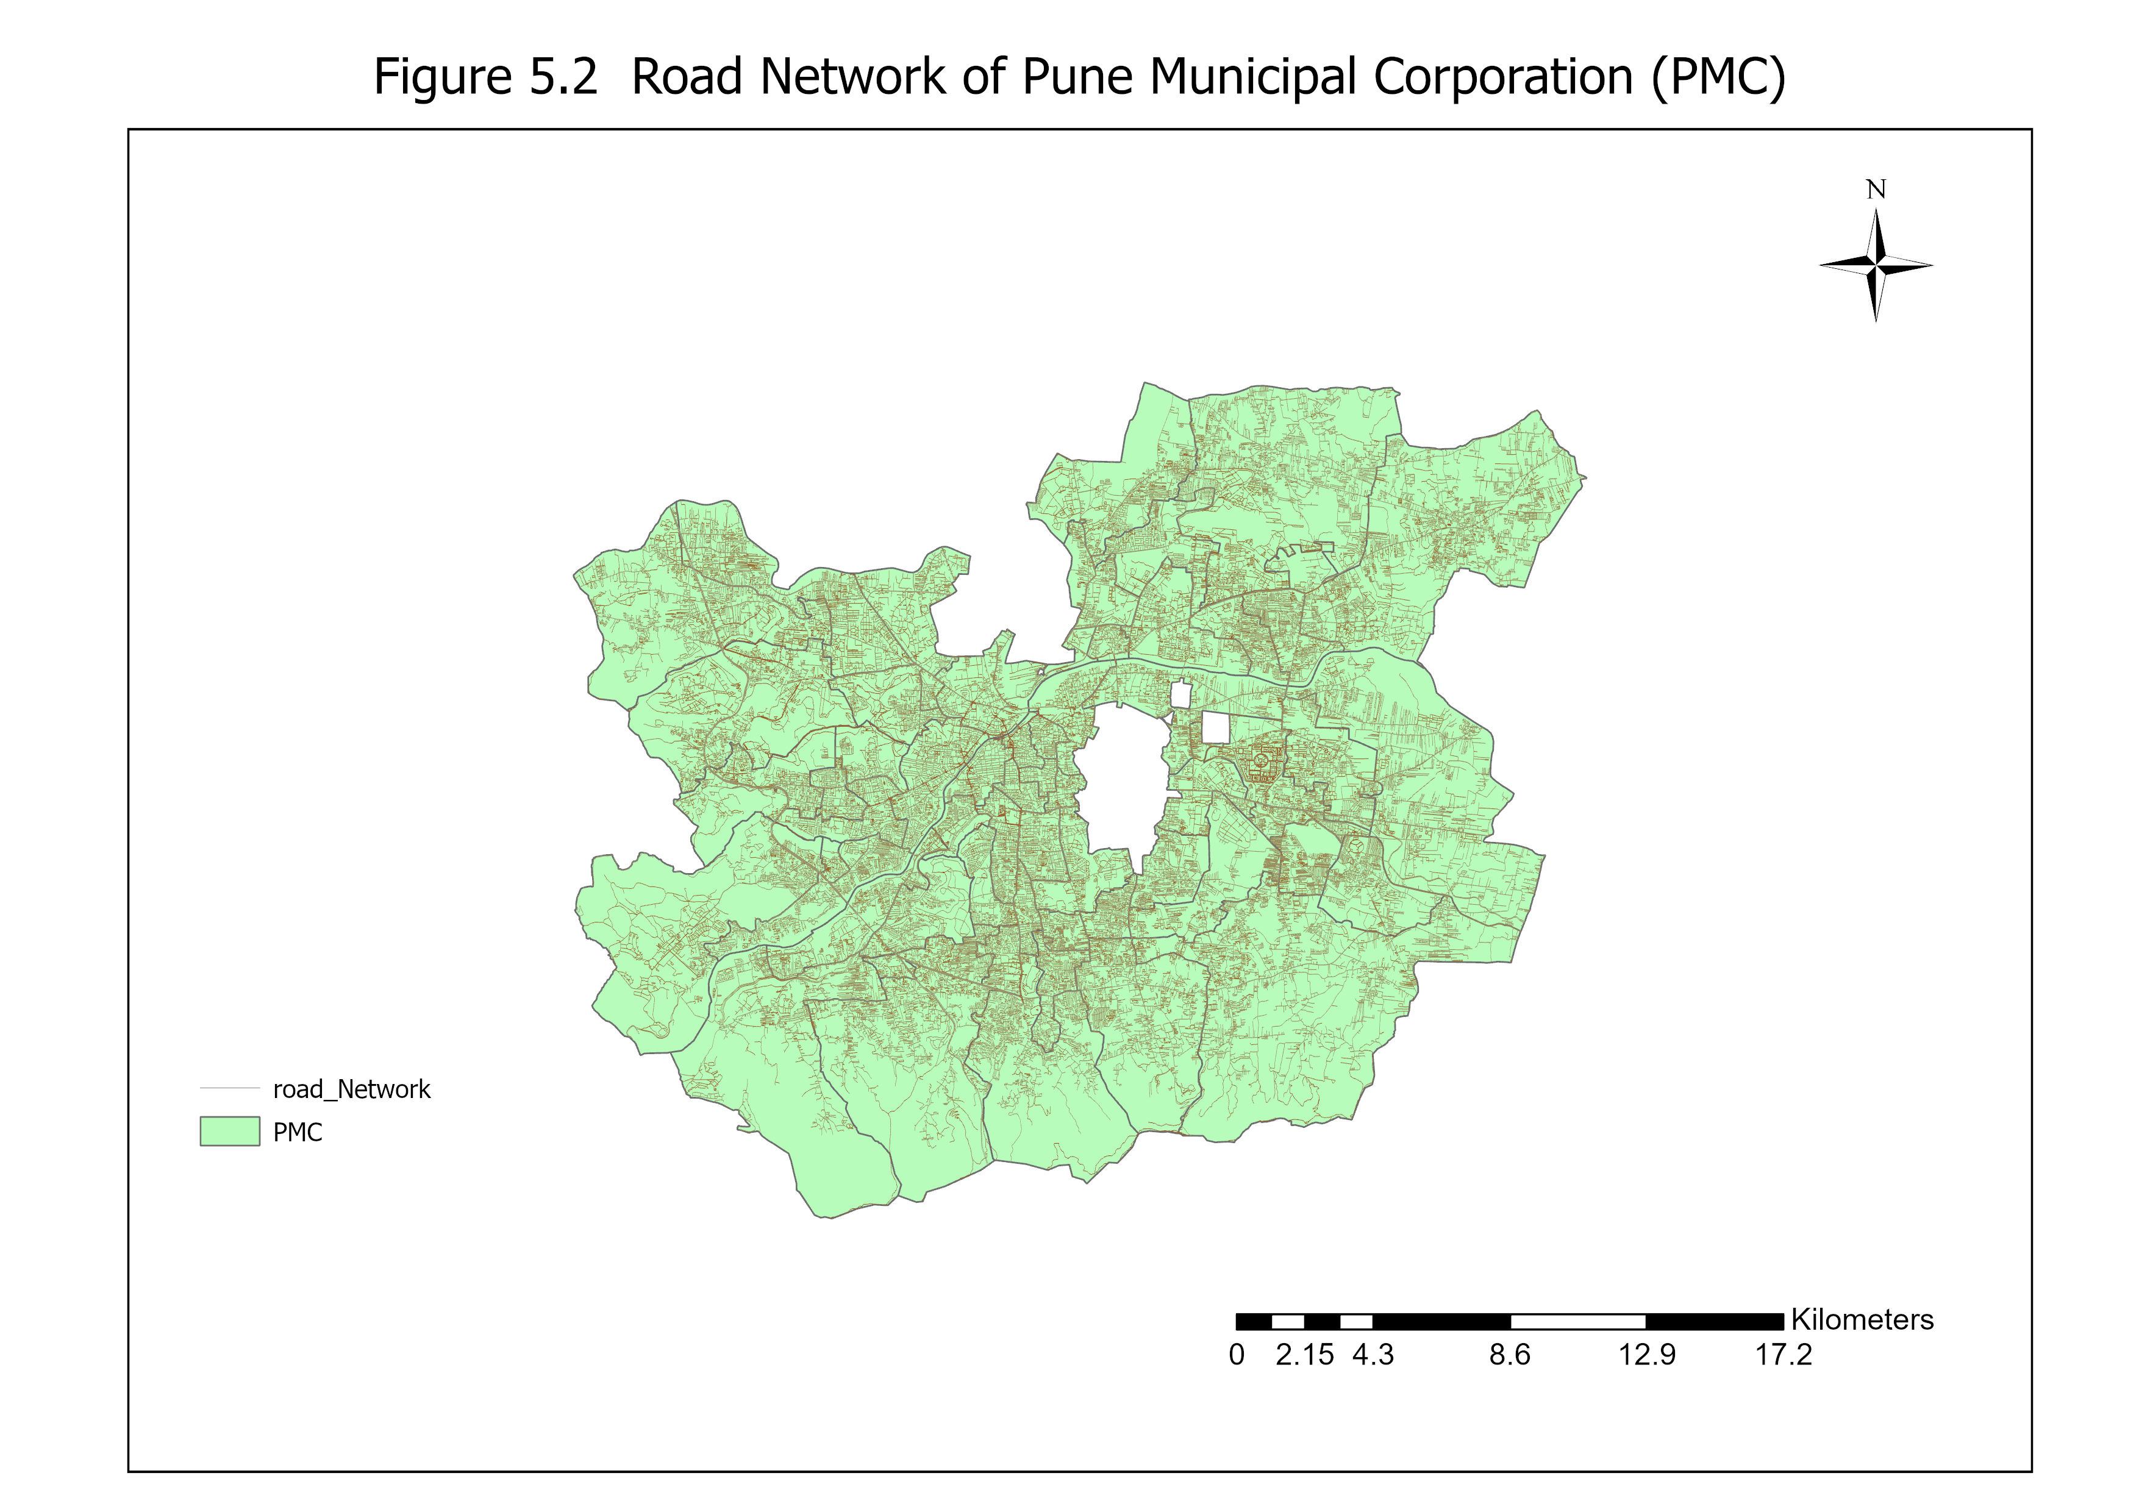
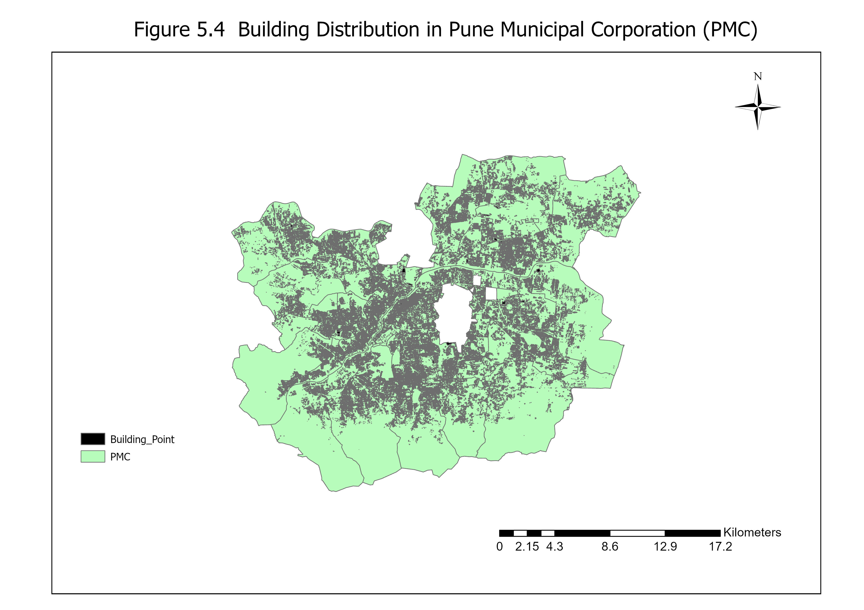
3. STUDY AREA SCOPE: PUNE MUNICIPAL CORPORATION (PMC)
Empirical Infrastructure Scope & Inventory
• Administrative Study Area: 506.91 sq. km
(Entire PMC domain situated on the Deccan Plateau.)
• Structural Building Inventory: 180,307 structures
(Georegistered structural building footprints used for exposure analysis.)
• Municipal Road Network: 7,445.90 km
(Multimodal transport and urban vehicular arterial roads.)
GEONARRATIVE AI | M.SC. THESIS DEFENSE | SYMBIOSIS INSTITUTE OF GEOINFORMATICS (SIG), PUNE
Notes:
Our domain of investigation covers the entire administrative boundary of the Pune Municipal Corporation, spanning exactly 506.91 square kilometers. To perform high-resolution exposure assessment, we integrated and pre-processed a massive municipal inventory comprising over 7,445 kilometers of road networks and exactly 180,307 georegistered building structures, creating a robust baseline for vulnerability evaluation.

Slide 5
4. METHODOLOGICAL FRAMEWORK: UNDRR DISASTER RISK STANDARD
United Nations UNDRR Risk Formulation:
Risk = Hazard × Exposure × Vulnerability
1. Geospatial ETL & Data Harmonization
Ingestion of OpenStreetMap spatial layers, USGS EarthEngine topography (DEM), and hydrological streamlines into PostGIS.
2. Analytical Raster Algebra (GDAL / AHP)
Derivation of Euclidean river distance arrays, topographic slope angles, and 5-factor weighted overlay algebra.
3. Infrastructure Spatial Intersection
Multi-scenario spatial intersection mapping building structural impact and road network severance.
4. Digital Twin WebGL & GeoAI Synthesis
3D CesiumJS visual scene generation and Large Language Model (LLM) natural language analytical explanation.
GEONARRATIVE AI | M.SC. THESIS DEFENSE | SYMBIOSIS INSTITUTE OF GEOINFORMATICS (SIG), PUNE
Notes:
Our methodology is structurally grounded in the United Nations Disaster Risk Reduction framework, where overall disaster risk is defined as the mathematical product of Hazard intensity, Structural Exposure, and localized Vulnerability. By constructing a fully end-to-end analytical pipeline—from PostGIS database ingestion to GDAL spatial raster algebra—our platform guarantees that every visual layer displayed in the 3D frontend is underpinned by defensible statistical equations.

Slide 6
5. HAZARD MODELING: THE 5-FACTOR AHP OVERLAY ENGINE
Mathematical Formulation: FSI = ∑ ( w_j · S_ij ) [where w_j are normalized factor weights]
• Digital Elevation Model (DEM) → Weight: 0.35 (35%) (Primary hydrological baseline governing gravitational flow density and drainage aggregation.)
• Euclidean Distance to River → Weight: 0.25 (25%) (Direct geographical distance to perennial Mula, Mutha, and Pavana overflow alignments.)
• Topographic Slope Angle → Weight: 0.20 (20%) (Surface gradient influencing water velocity and localized ponding accumulation in basin flats.)
• Land Use / Land Cover (LULC) → Weight: 0.10 (10%) (Impervious surface runoff coefficients and natural infiltration inhibition.)
• Structural Building Density → Weight: 0.10 (10%) (Anthropogenic urban structural sealing and artificial surface flow channeling.)
Mathematical Consistency Verification: Consistency Ratio (CR) = 0.038 (Complying strictly with Saaty's academic threshold of CR < 0.10).
GEONARRATIVE AI | M.SC. THESIS DEFENSE | SYMBIOSIS INSTITUTE OF GEOINFORMATICS (SIG), PUNE
Notes:
To compute the continuous Flood Susceptibility Index, we employed an Analytic Hierarchy Process utilizing a five-factor weighted linear combination. Based on geomorphological dominance, Topographic Elevation and Euclidean Distance to permanent rivers received the highest weights of 35% and 25%, respectively, followed by Topographic Slope at 20%, and LULC alongside Building Density at 10% each. Our expert pairwise judgment matrix achieved a rigorous Consistency Ratio of just 0.038, well below the acceptable limit of 0.10, proving mathematical soundness.

Slide 7
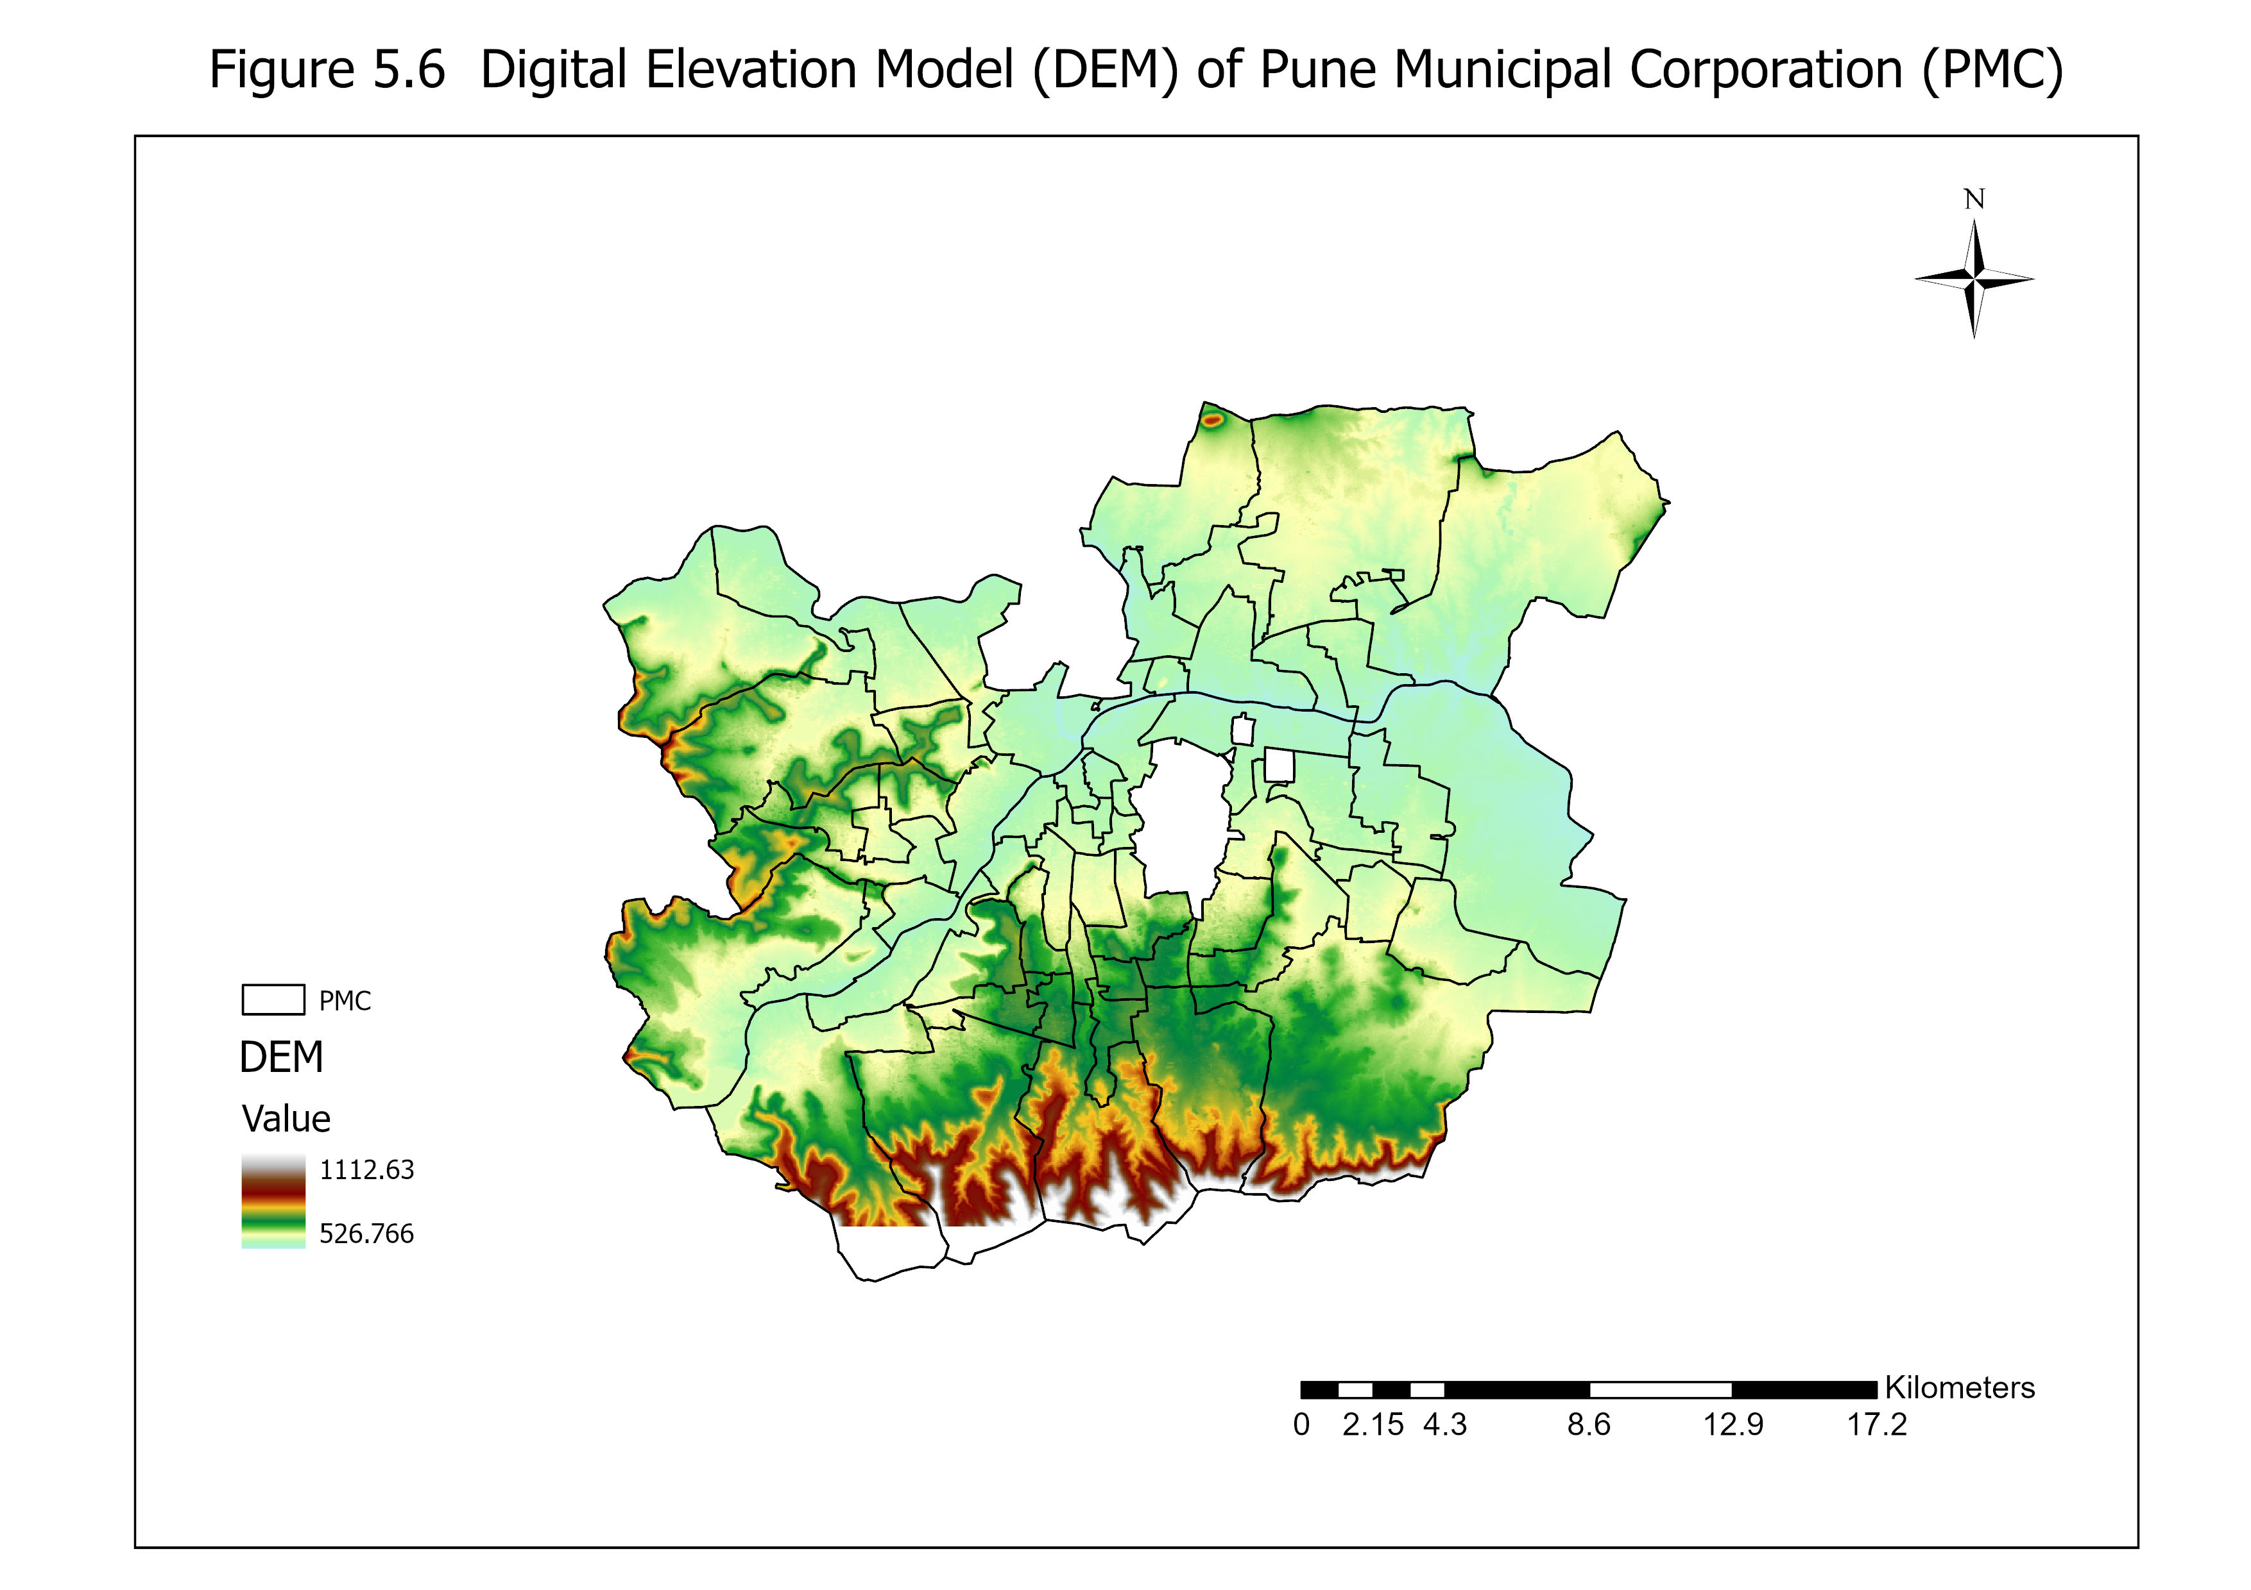
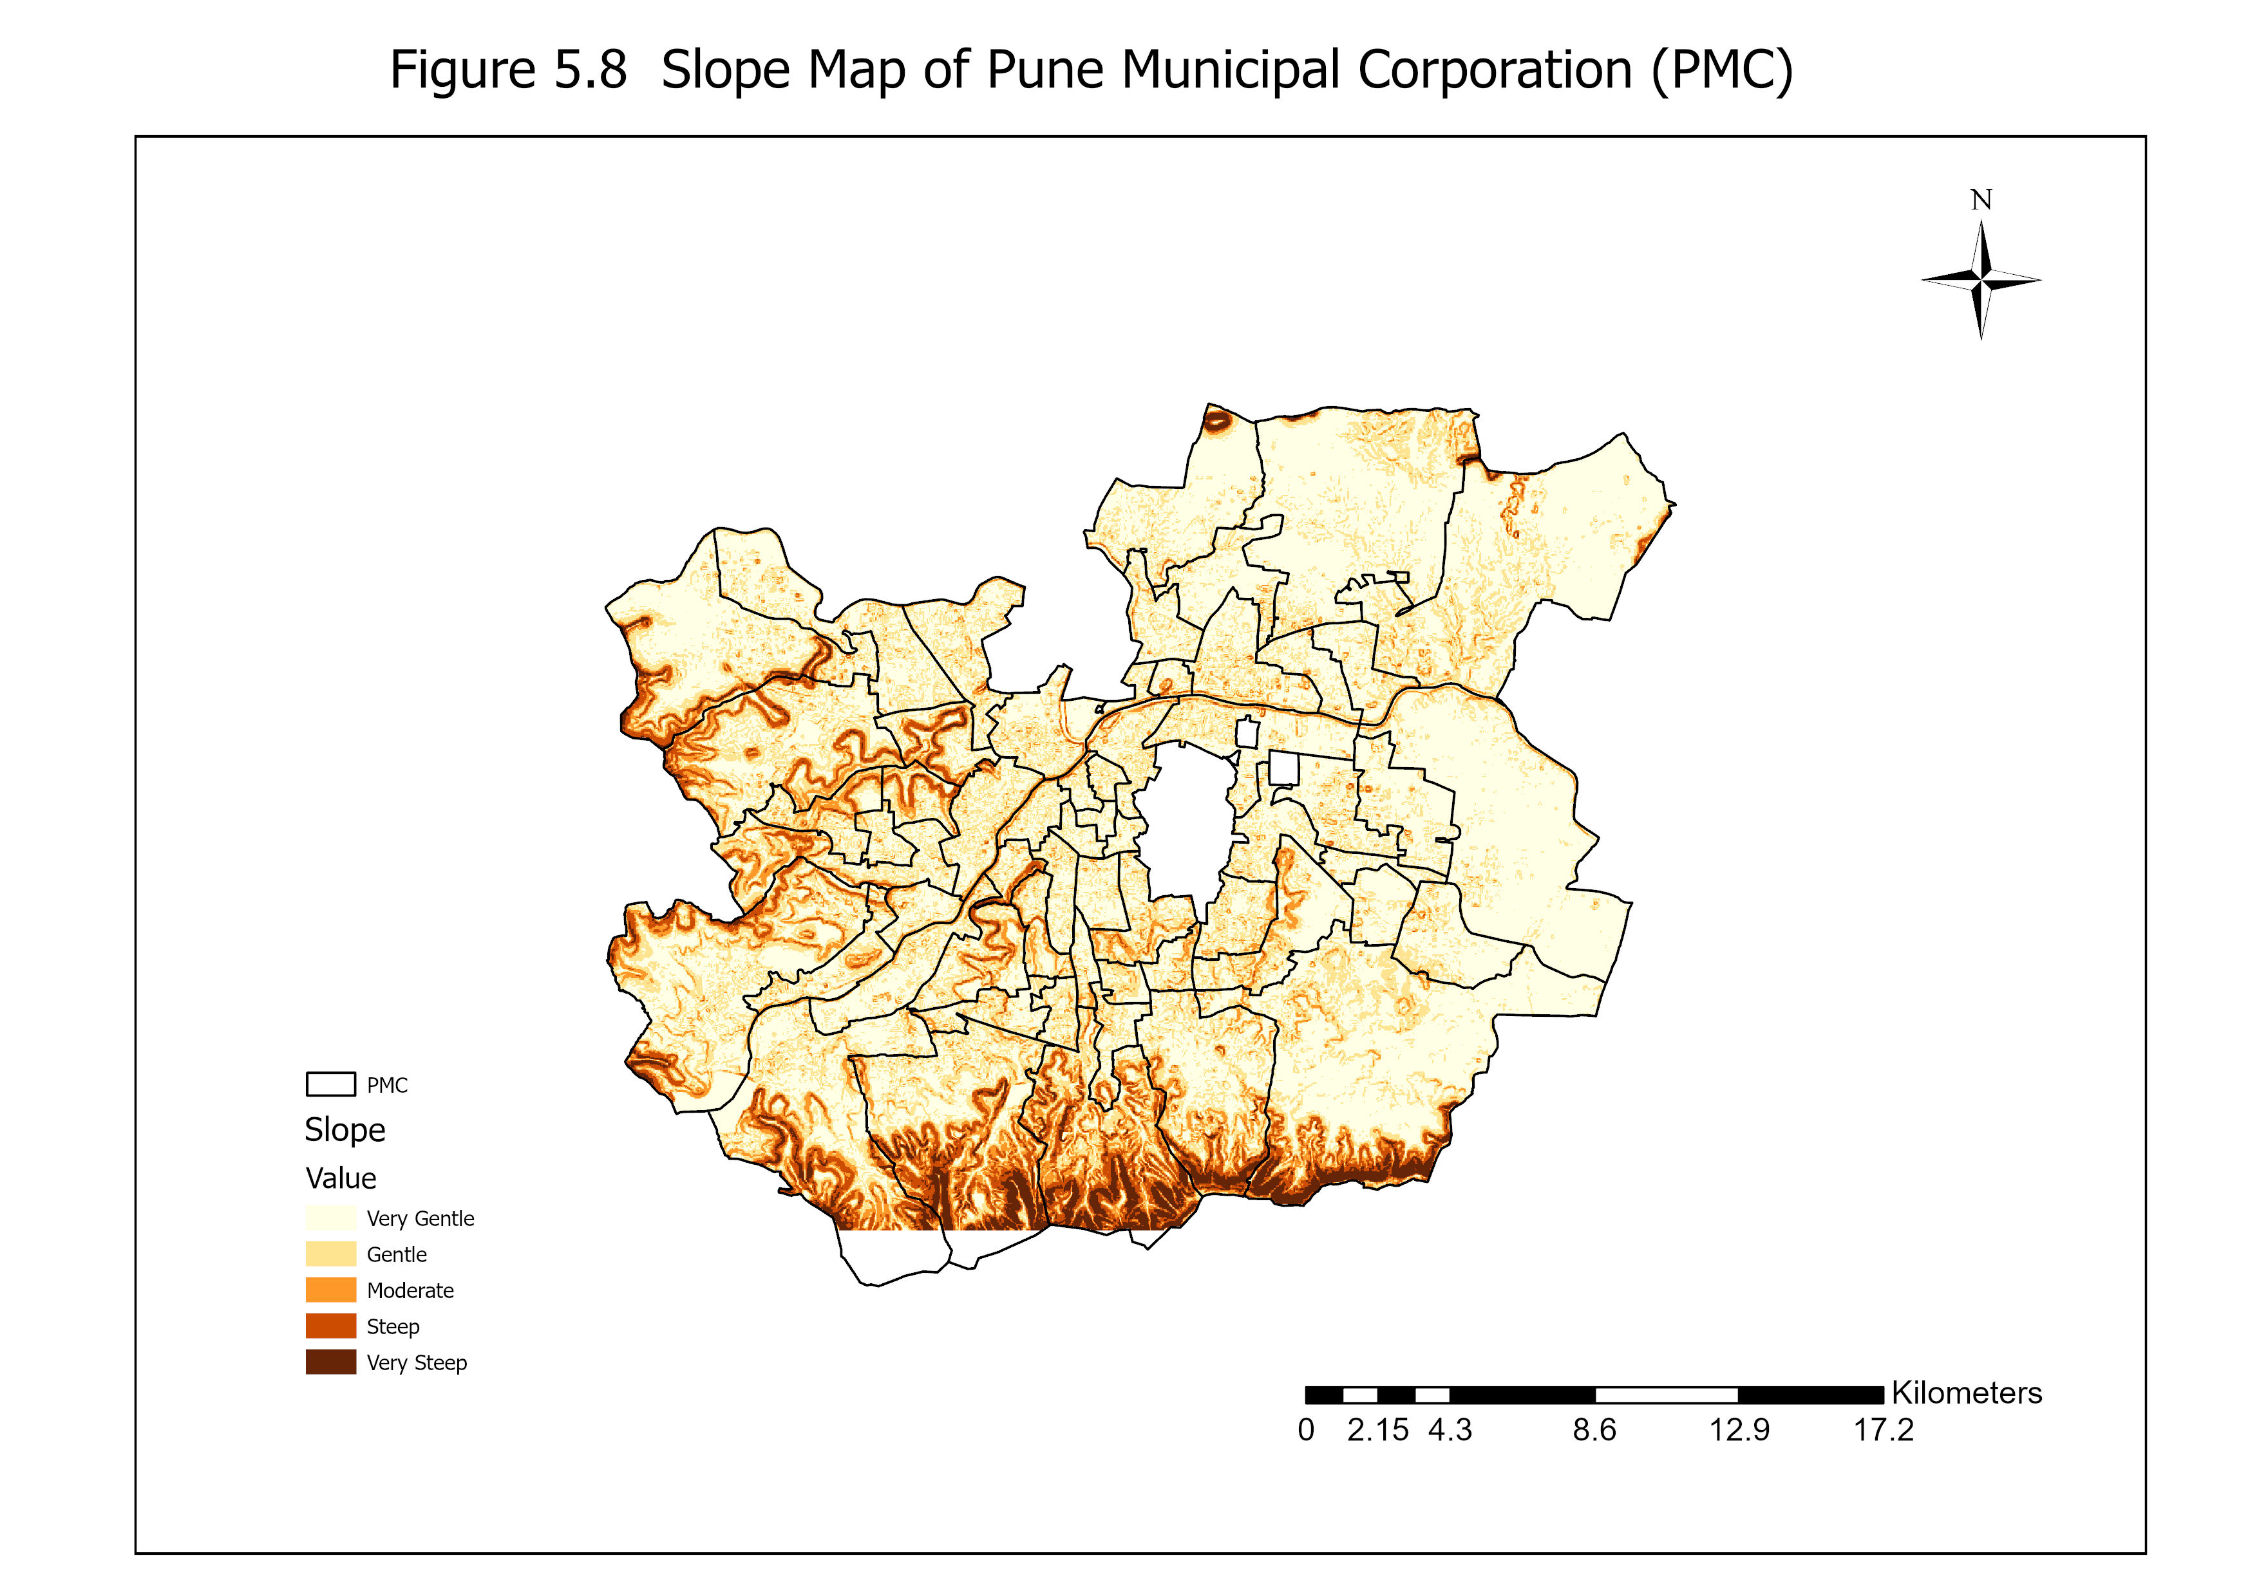
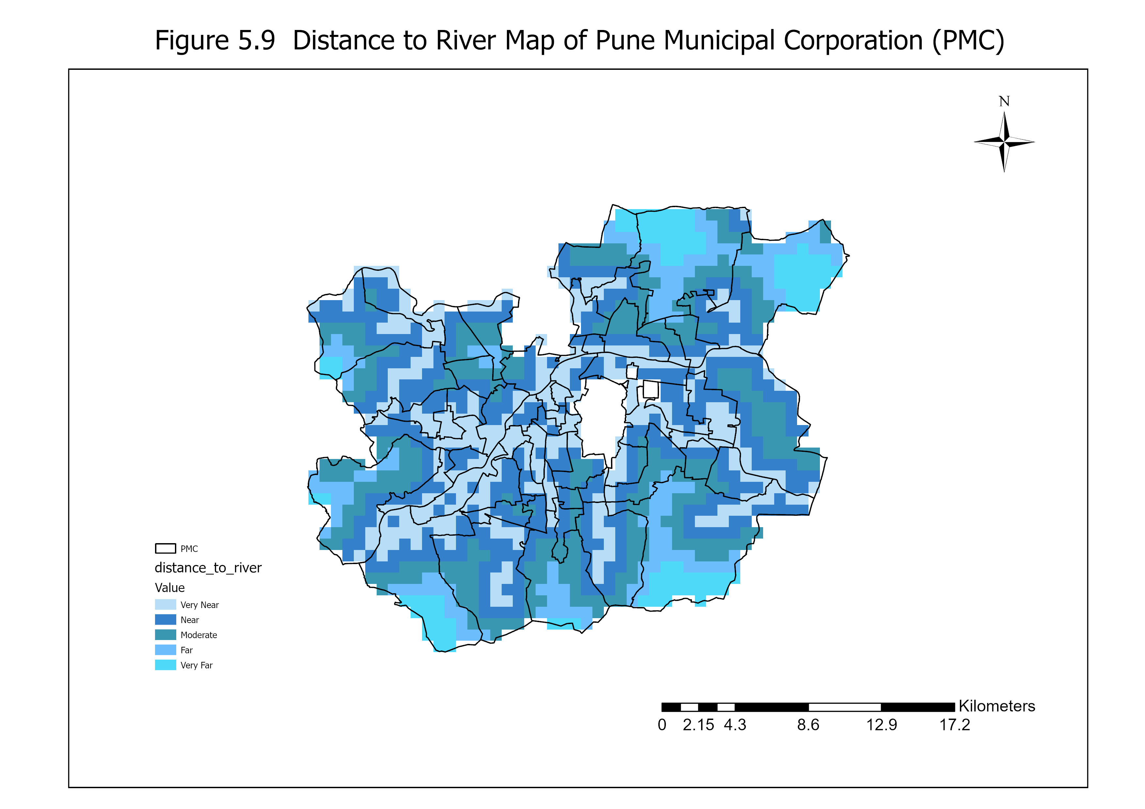
6. GEOSPATIAL FACTOR MAPPING: MORPHOLOGICAL & HYDROLOGY DRIVERS
Spatial Driver Outputs (Elevation, Slope & River Distance Buffering):
• DEM: Elevation ranges from <540m along river beds to >1,100m in western ghat hills. • Slope: Ultra-flat accumulation basins identified in Shivajinagar and Aundh. • Distance to River: Euclidean buffering demonstrates localized structural vulnerability zones along main channels.
GEONARRATIVE AI | M.SC. THESIS DEFENSE | SYMBIOSIS INSTITUTE OF GEOINFORMATICS (SIG), PUNE
Notes:
Here we inspect the core spatial raster outputs generated during our GIS modeling phase. On the left, the Digital Elevation Model illustrates the steep elevation drop from the western hills into the Mula-Mutha valley. In the center, our Topographic Slope map clearly delineates ultra-low gradient floodplains where water ponding inevitably concentrates during prolonged storms. On the right, our continuous Euclidean Distance matrix establishes precise spatial proximity bands from every building to the primary river network.

Slide 8
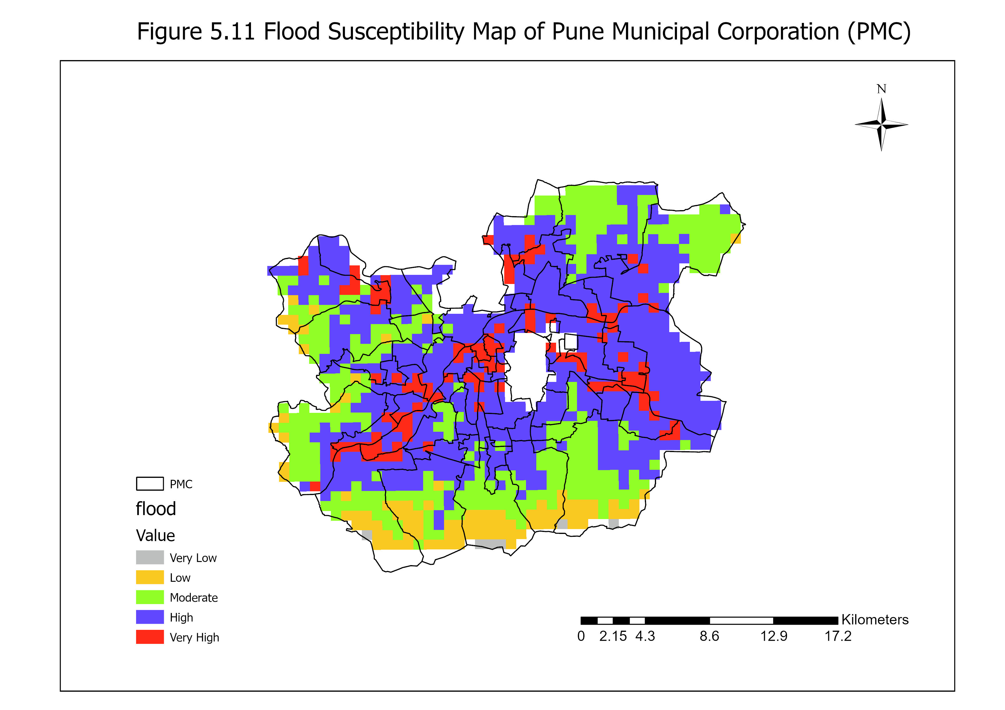
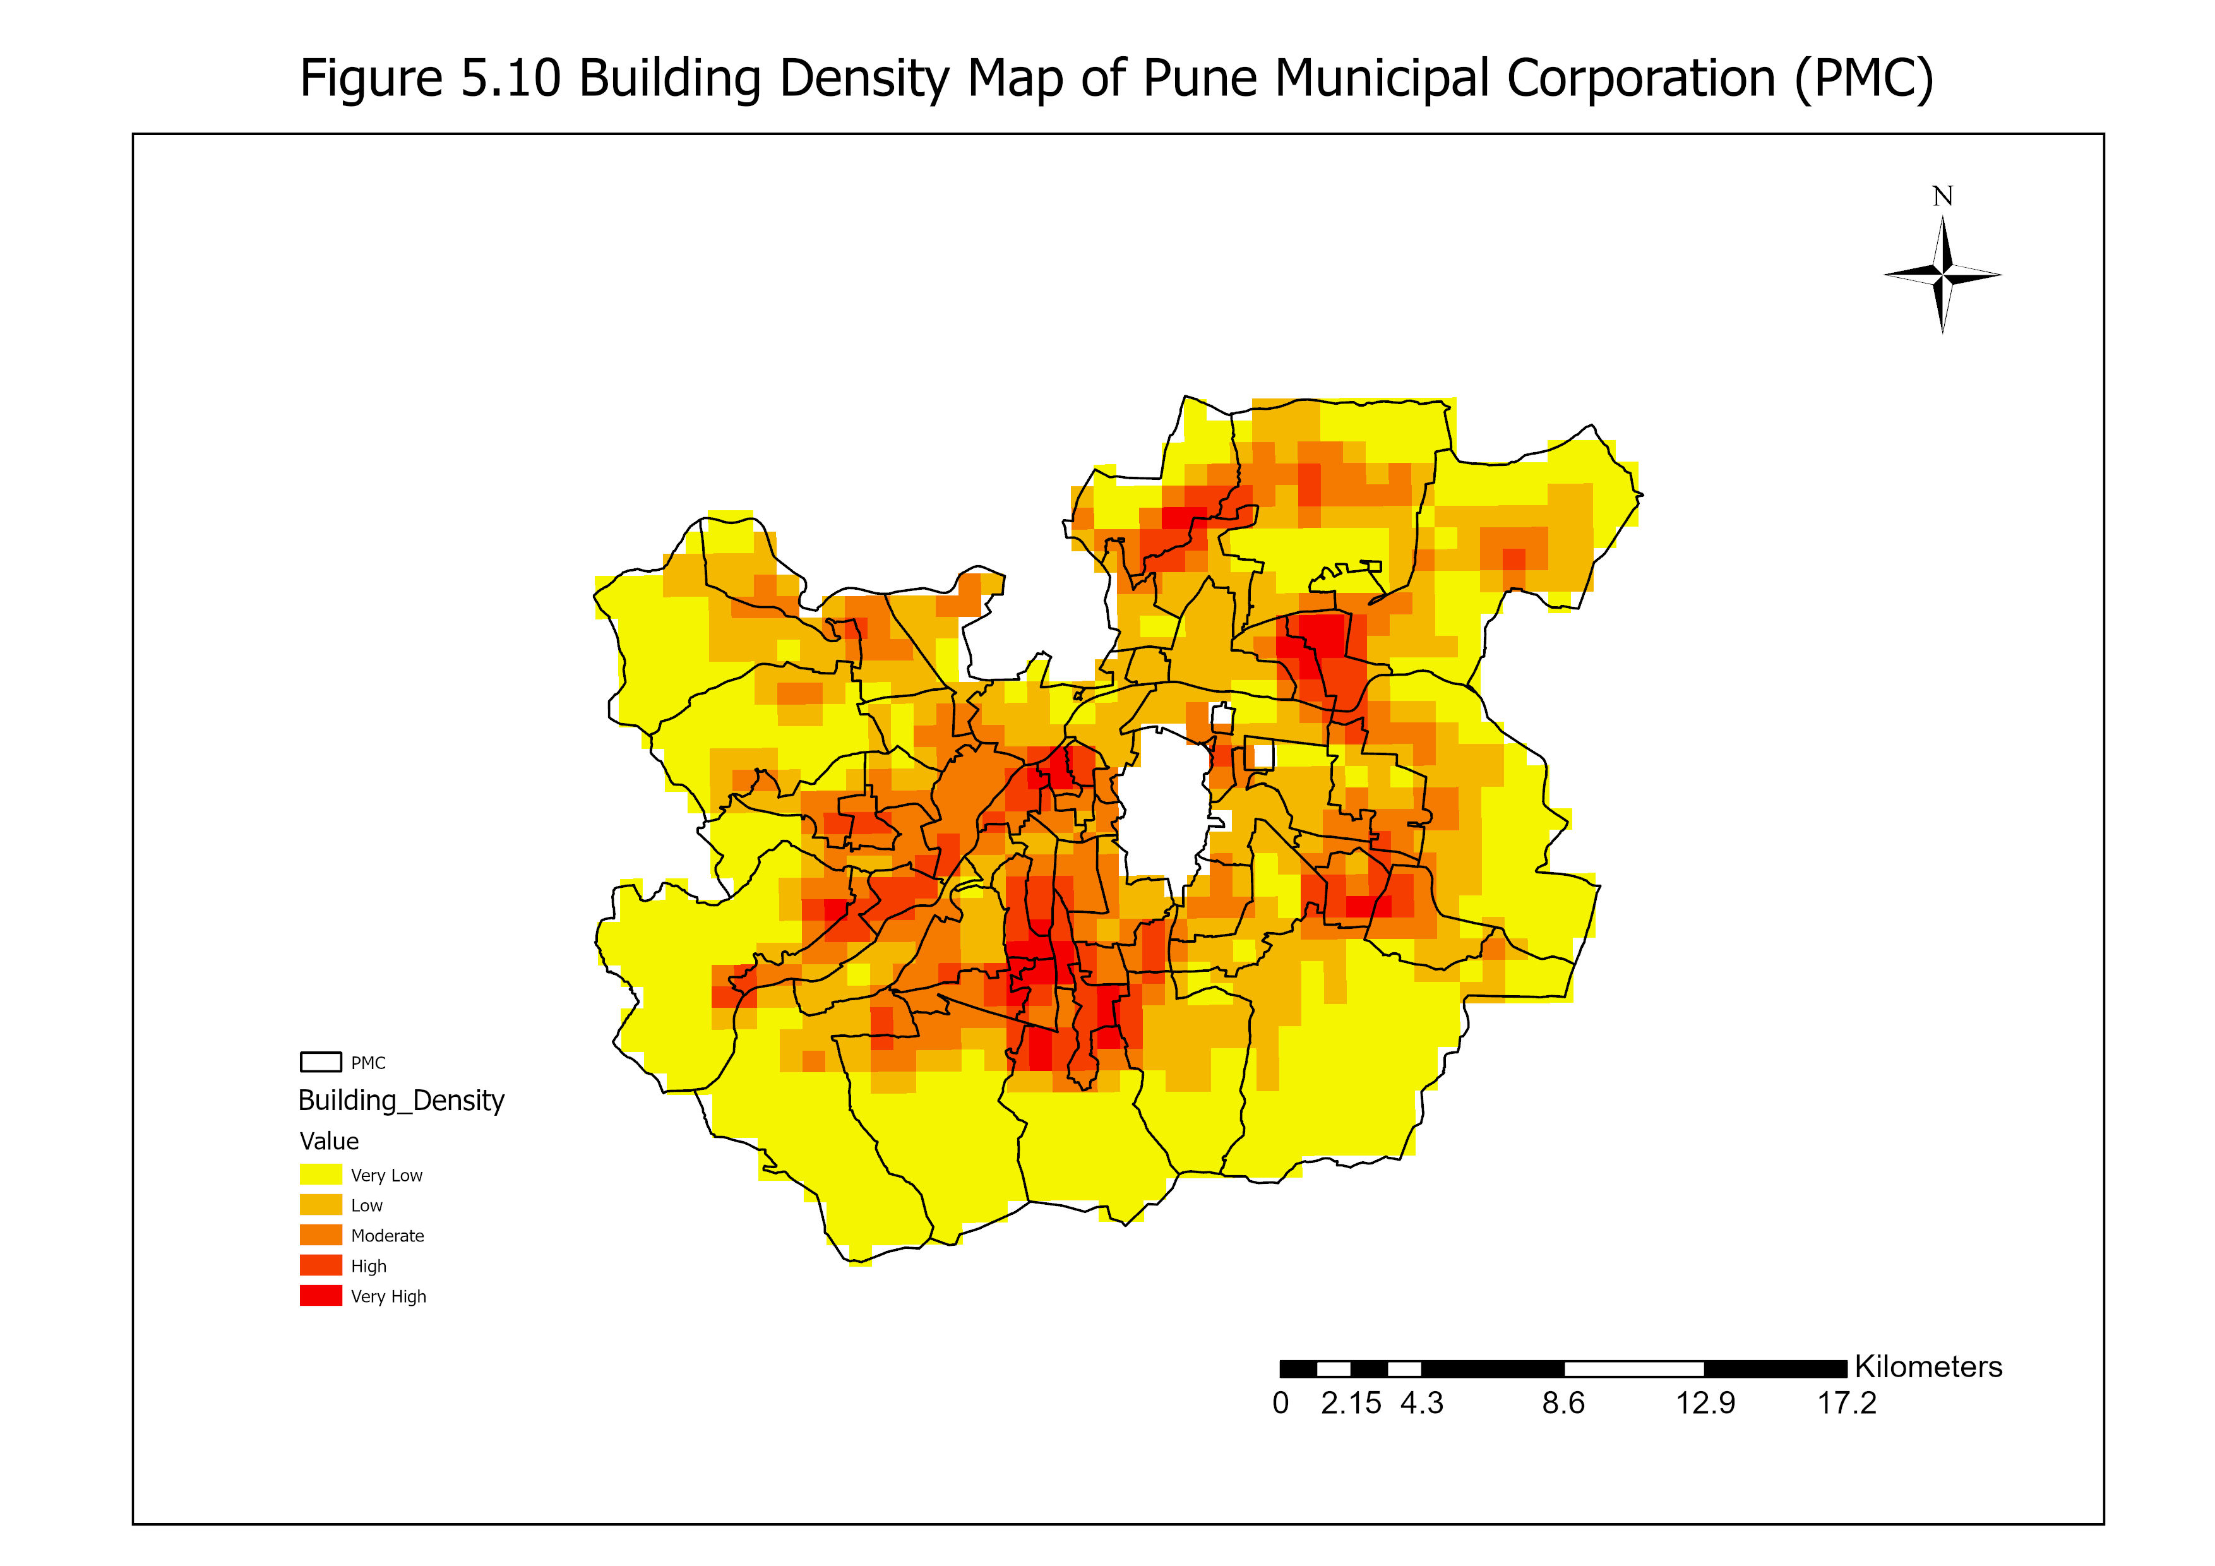
7. FLOOD SUSCEPTIBILITY INDEX (FSI) & STRUCTURAL DENSITY
Synthesized Flood Susceptibility vs. Anthropogenic Structural Building Density:
• High/Very High Susceptibility (Red/Purple) concentrates heavily in riparian wards along Mula-Mutha confluence. • Overlaying structural building density (Right) reveals severe urban exposure in historic high-density civic cores.
GEONARRATIVE AI | M.SC. THESIS DEFENSE | SYMBIOSIS INSTITUTE OF GEOINFORMATICS (SIG), PUNE
Notes:
By executing our AHP overlay algebra, we generate Figure 5.11—the definitive Flood Susceptibility Map of Pune Municipal Corporation. The spatial distribution demonstrates that high and very high susceptibility zones—shown in purple and red—cluster aggressively along river corridors and historic dense core wards. When superimposed against our building density map in Figure 5.10, we clearly visualize how extreme anthropogenic structural density exacerbates hydrological vulnerability.

Slide 9
8. SCIENTIFIC INTEGRITY: INUNDATION DEPTH DEFINITION & SCOPE
CRITICAL METHODOLOGICAL TERMINOLOGY & GUARDRAILS
• Distinction from Empirical Hydrodynamics:
The computational representations in GeoNarrative AI do NOT constitute direct numerical solutions to fluid Navier-Stokes or 2D Saint-Venant hydraulic shallow water physical equations (e.g., SWMM hydraulic modeling).
• Scenario-Derived Relative Inundation Depth Estimates:
All simulated flood depths represent 'scenario-derived relative inundation depth estimates' derived from topographically evaluated susceptibility indices, localized DEM depressions, river proximity decay coefficients, and precipitation scaling.
• Operational Decision-Support Purpose:
This topological modeling architecture is explicitly designed for instantaneous, real-time spatial prioritization and early warning disaster coordination without the extreme computational CPU rendering latency associated with physical hydrodynamic simulations.
GEONARRATIVE AI | M.SC. THESIS DEFENSE | SYMBIOSIS INSTITUTE OF GEOINFORMATICS (SIG), PUNE
Notes:
At this juncture, it is critical to state the scientific boundaries of our simulation framework with unconditional precision. The flood depth approximations generated within GeoNarrative AI represent scenario-derived relative inundation depth estimates. Rather than solving fluid mechanical Navier-Stokes or shallow water differential equations, our model derives relative inundation intensities from topological DEM depressions, susceptibility indices, and precipitation scaling. This provides municipal emergency commanders with instant, computationally efficient spatial prioritization without the extreme CPU rendering latency of traditional fluid modeling.

Slide 10
9. MULTI-SCENARIO INFRASTRUCTURE EXPOSURE SUMMARY MATRIX
Quantified Empirical Exposure across Normal, Moderate, Heavy, & Extreme Storms:
Scenario | Rainfall Rate | Relative Inundation | Inundated Area (sq km) | Impacted Buildings | Severed Road Length
Normal | 0 mm/hr | Baseline | 0.00 sq km (0.0%) | 0 (0.0%) | 0.00 km (0.0%)
Moderate | 30 mm/hr | ≤ 1.0 m (Ponding) | ~25.40 sq km (5.01%) | ~3,600 (2.00%) | ~370.00 km (4.97%)
Heavy | 65 mm/hr | 1.0 – 2.0 m (Waterlogging) | ~68.10 sq km (13.43%) | ~14,400 (7.99%) | ~930.00 km (12.49%)
Extreme | 120 mm/hr | > 2.0 m (Critical Flood) | 133.97 sq km (26.43%) | 40,723 (22.59%) | 1,877.47 km (25.21%)
GEONARRATIVE AI | M.SC. THESIS DEFENSE | SYMBIOSIS INSTITUTE OF GEOINFORMATICS (SIG), PUNE
Notes:
This comprehensive data matrix represents the central quantitative results of my dissertation. Across our four meteorological scenarios, we observe a dramatic scaling of infrastructure exposure. Under the Extreme Cloudburst Scenario—representing rainfall rates reaching 120 millimeters per hour—the model reveals that 133.97 square kilometers of urban area (over 26% of Pune) is inundated. In this critical regime, exactly 40,723 structural buildings (22.59% of the structural inventory) and 1,877.47 kilometers of municipal transport road networks (25.21% of total arterial roads) experience severe hazard exposure.

Slide 11
10. ENTERPRISE SOFTWARE ARCHITECTURE: 3D DIGITAL TWIN
Full-Stack Geospatial Intelligence & WebGL Engine:
• Backend Analytical Pipeline (FastAPI & PostGIS):
Asynchronous Python FastAPI microservices managing spatial intersecting queries over PostGIS municipal databases, streaming precomputed 45-frame raster animations at 60 FPS.
• Frontend 3D Digital Twin (CesiumJS WebGL):
High-fidelity terrain visualization blending realistic 3D building structural tiles with persistent, dynamic permanent river streamlines.
• Dynamic Infrastructure Hazard Color-Ramps:
Real-time visual geometry shader injection shifting structural building styling dynamically from baseline Safe Cyan to Critical Hazard Red based on localized flood progression.
GEONARRATIVE AI | M.SC. THESIS DEFENSE | SYMBIOSIS INSTITUTE OF GEOINFORMATICS (SIG), PUNE
Notes:
To operationalize these spatial findings, we engineered a state-of-the-art enterprise WebGL software architecture. Our backend combines Python FastAPI microservices with a PostGIS spatial database engine to execute high-performance spatial intersecting queries in real time. Our frontend leverages CesiumJS 3D WebGL rendering, incorporating pre-compiled animation frames to visualize flood propagation smoothly across the terrain while dynamically shifting structural building colors from safe cyan to critical red as simulated water exposure intensifies.

Slide 12
11. EXPLAINABLE GEOAI CONVERSATIONAL ASSISTANT & REPORT AGENT
LLM-Driven Natural Language Decision Support:
• Natural Language Spatial Querying:
Translates non-technical questions (e.g., 'Which ward has the most buildings at risk in heavy storms?') directly into PostGIS analytical queries and presents readable responses.
• Automated Situation Report Agent:
Instantly compiles active simulated parameters into structured, downloadable emergency situation reports and executive ward-level evacuation briefs.
• Bridging Academic GIS and Emergency Operations:
Removes technical barriers, enabling municipal disaster response commanders to operate advanced geospatial risk models without coding or GIS software expertise.
GEONARRATIVE AI | M.SC. THESIS DEFENSE | SYMBIOSIS INSTITUTE OF GEOINFORMATICS (SIG), PUNE
Notes:
A defining novelty of GeoNarrative AI is the integration of an explainable Large Language Model conversational assistant. In a real-world municipal control room, disaster management coordinators rarely have GIS programming expertise. Our GeoAI assistant enables coordinators to simply type questions such as 'What is the structural impact on Shivajinagar during an extreme cloudburst?' to instantly retrieve verified empirical figures and generate formal, automated executive situation reports in seconds.

Slide 13
12. TECHNICAL LIMITATIONS & FUTURE RESEARCH PERSPECTIVES
Academic Transparency & Path Forward:
• DEM Spatial Resolution Constraints:
Current topography modeling is bounded by open 30-meter DEM resolution, which inevitably abstracts micro-urban terrain structures like local curbs, culverts, and individual flood defense retaining walls.
• Calibration & Validation Infrastructure:
Due to an absence of dense real-time municipal IoT river stream gauges, model calibration relies on historical news documentation and municipal flood reporting records.
• Future Scope 1: High-Resolution Drone LiDAR:
Upgrading topographic baseline rasters to sub-meter drone-derived LiDAR surface models for micro-hydrological precision.
• Future Scope 2: Real-Time IoT Sensor Ingestion & 2D Hydrodynamics:
Integrating real-time telemetry river gauge data streams and embedding fully coupled 2D hydrodynamic simulation engines.
GEONARRATIVE AI | M.SC. THESIS DEFENSE | SYMBIOSIS INSTITUTE OF GEOINFORMATICS (SIG), PUNE
Notes:
In maintaining academic rigor and scientific integrity, it is essential to highlight our research boundaries. Presently, spatial precision is governed by our 30-meter Digital Elevation Model resolution, which naturally abstracts macro-topographical features while missing sub-meter drainage structures like curbs or stormwater culverts. Looking forward, our architecture is built modularly to ingest 1-meter drone-derived LiDAR datasets and live IoT water level telemetry sensors, which will eventually allow real-time coupling with complex finite-element hydrodynamic physics equations.

Slide 14
13. CONCLUSION & CORE ACADEMIC CONTRIBUTIONS
Synthesis of Dissertation Contributions:
✓ Successfully unified traditional Multi-Criteria Decision Analysis (AHP) with modern interactive 3D WebGL Digital Twin technology.
✓ Delivered verified empirical impact exposure calculations across 180,307 buildings and 7,445.90 km of road transport networks in Pune.
✓ Established an innovative, explainable GeoAI operational blueprint designed explicitly for Smart City governance and resilient urban disaster coordination.
THANK YOU FOR YOUR ATTENTION. OPEN FOR EVALUATION & DEFENSE Q&A.
GEONARRATIVE AI | M.SC. THESIS DEFENSE | SYMBIOSIS INSTITUTE OF GEOINFORMATICS (SIG), PUNE
Notes:
In conclusion, GeoNarrative AI successfully demonstrates that standard GIS hazard evaluation can be transformed from static archival maps into an intelligent, interactive, and actionable Smart City decision support instrument. By combining a validated five-factor AHP hazard model with empirical exposure quantification across more than 180,000 structures in Pune, this dissertation provides a reproducible and robust framework for urban flood resilience. I sincerely thank the committee for your time and attention, and I now welcome any questions or suggestions.

