Slide 1
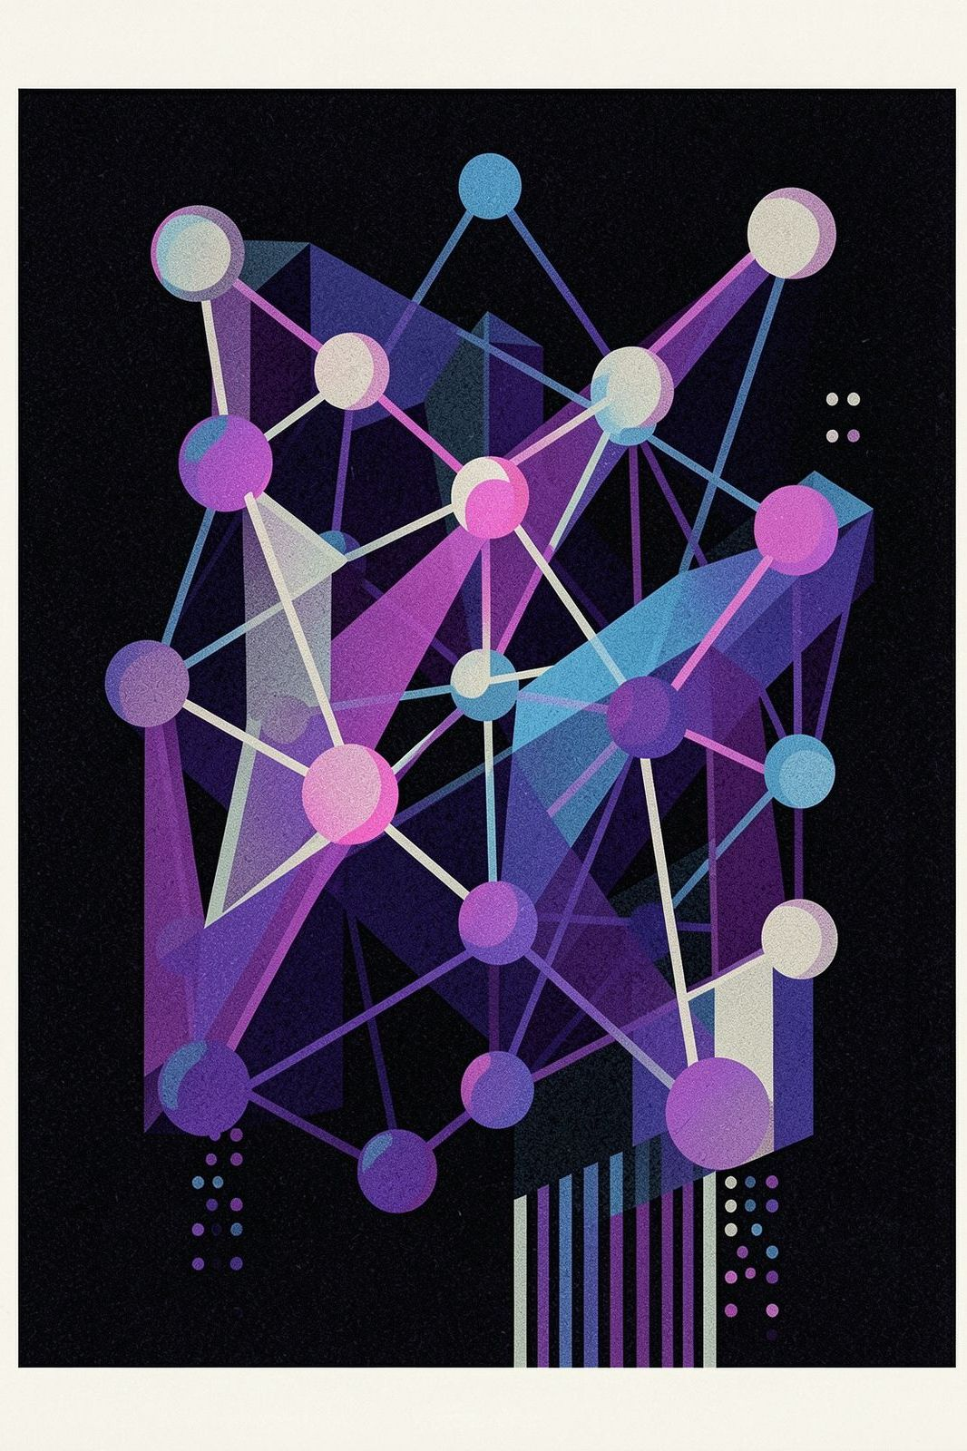
CEDAR: The Dispute That
Evolves
AGENTIC AI-POWERED INVESTIGATION PLATFORM
A stateful AI dispute platform built for operations teams who know that disputes don’t end on Day 1.

Slide 2

The Problem: Disputes Don’t
Stand Still
Evidence Arrives Late
New proof surfaces days or weeks after the initial claim is filed — long after your system has already locked in a decision.
Systems Freeze at Day 1
Your current dispute platform captures a snapshot and stops. It has no way to update conclusions as facts evolve.
Wrong Decisions Stay Wrong
New proof contradicts old conclusions — but you have no way to know which decisions are now incorrect or how many are affected.

Slide 3
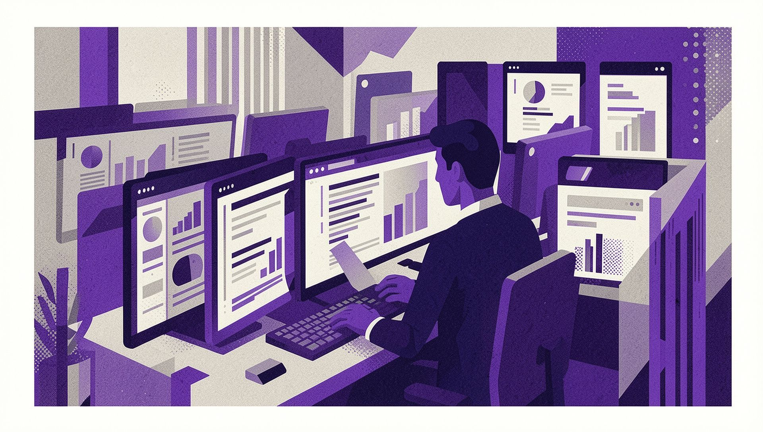
Why Banks Struggle Today
THE THREE FAILURE MODES
Evidence Scattered
Customer, merchant, bank, courier, and authentication data live in entirely separate systems. No one sees the full picture.
Decisions Made Blind
Analysts manually stitch fragments together — missing connections that a connected system would catch instantly.
No Single Truth
When facts change, there is no way to trace impact across prior decisions. Errors compound silently.

Slide 4
The CEDAR Difference: A Living Dispute State
Unlike static systems that freeze decisions, CEDAR maintains a continuously evolving view of every dispute.
One Unified View
Automatic Impact Tracing
Reassess, Don’t Restart
All evidence, hypotheses, and decisions in a single, continuously updated state — not scattered across systems.
When new evidence arrives, CEDAR immediately traces which prior conclusions are affected — without manual effort.
Update affected conclusions from exactly where the new evidence enters. No need to rebuild the case from scratch.

Slide 5
How CEDAR Works: The Operating Loop
Ingest Evidence
Attach Context
Assess Impact
AI Reasoning
Every new piece of evidence travels the full loop — automatically, consistently, and with complete lineage at every step.

Slide 6
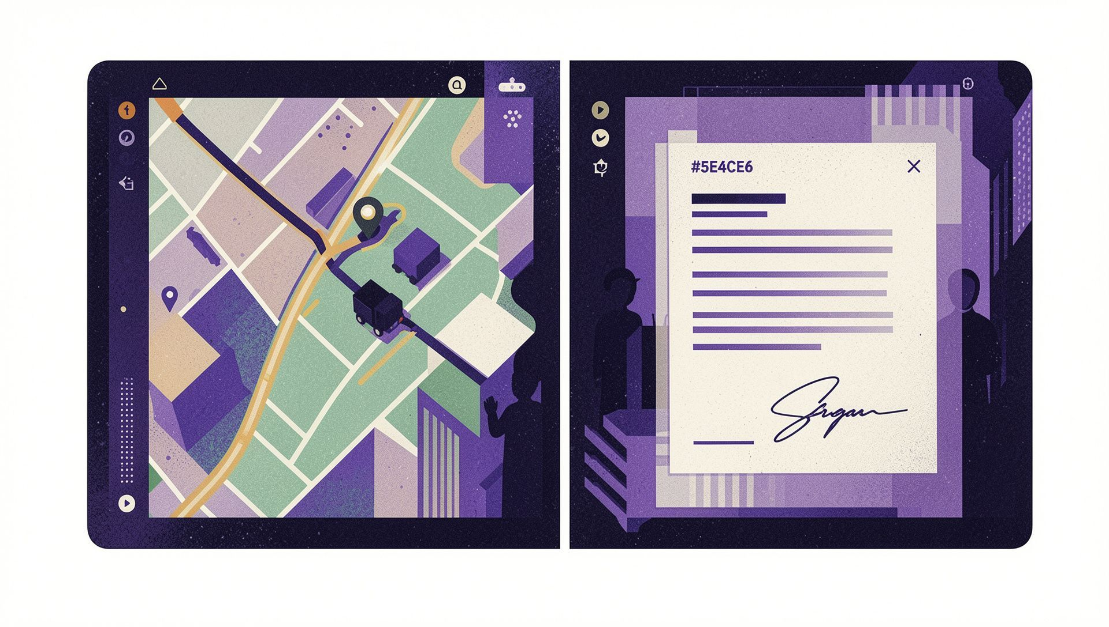
Real Example: Late Evidence Changes Everything
1
Day 1 — Claim Filed
Customer claims non-delivery. CEDAR sets initial hypothesis: 82% likely delivered. Decision logged with full reasoning.
2
Day 5 — New Evidence Arrives
GPS data, delivery signature scan, and photo confirmation are ingested. CEDAR automatically re-evaluates.
3
Day 5 — Hypothesis Shifts
Confidence flips to 62% non-delivery. CEDAR surfaces what changed, why it changed, and what action to take next.

Slide 7

Enterprise-Grade by Design
Stateful AI
Context persists across long-running investigations. CEDAR remembers everything — so your analysts don’t have to.
Human in the Loop
AI recommends the next action. Your team makes the final call. Authority and accountability stay where they belong.
Complete Lineage
Every decision is traced, auditable, and explainable. Regulators and reviewers can follow every step with confidence.
Safe Execution
Policy, authority levels, and idempotent actions are built into every step — so no action is taken twice by accident.

Slide 8
The CEDAR Promise
A single, living source of truth for disputes — where every new event can be understood, traced, challenged, and safely incorporated into your decision.
What You Get
One unified dispute state — always current
Automatic re-evaluation when facts change
Full audit trail for every decision
Human control at every critical step
A foundation that scales beyond card disputes
Start with card disputes. Apply the same decision fabric to every transaction decision across your enterprise. CEDAR is not a point solution — it is the operating model for how disputes should work.

Slide 9

Ready to Evolve Your
Disputes?
See for yourself how CEDAR handles the cases your current system can’t.
01
02
Live Reconstruction
Understand the Impact
See CEDAR reconstruct a real dispute — with late evidence, shifting hypotheses, and full lineage — in minutes.
Learn how stateful AI reduces manual analyst work, improves decision accuracy, and closes audit gaps.
03
Plan the Scale
Explore how to expand from card disputes to enterprise-wide transaction decisions using the same platform.

