Slide 1
Customer
Nexus CEDAR: The Dispute That
Evolves
Evidence
Merchant
Trusted
case view
AGENTIC AI-POWERED INVESTIGATION PLATFORM
Prevent • Resolve • Recover
Evidence-backed AI, human-owned decisions, lower losses and better experiences for every participant.
Network
Bank
"Today, disputes are processed before the truth is reconstructed. Nexus CEDAR changes that."

Slide 2

The Problem: Disputes Evolve, Decisions Shouldn't Freeze
Real Problem: The challenge is not collecting dispute data — it’s reconstructing the truth before a decision is locked in
Scattered Evidence
Frozen Decision
Late Evidence
Manual Reconstruction
Wrong Outcomes
No Impact Tracing
Evidence Arrives Late
New proof surfaces days or weeks after the initial claim is filed — long after your system has already locked in a decision.
Reactive operations
Teams reconstruct the story manually after a dispute is already costly.
No One Knows What Broke
New evidences contradicts old conclusions — but you have no way to know which decisions are now incorrect or how many are affected.
Nexus CEDAR · Persona Journey Across the Dispute Lifecycle · TCS National AI Hackathon 2026

Slide 3

Why Banks Struggle Today
Evidence Scattered
Decisions Made Blind
No Single Truth
Evidence Scattered
Customer, merchant, bank, courier, and authentication data live in entirely separate systems. No one sees the full picture.
Decisions Made Blind
Analysts manually stitch fragments together — missing dots that a connected system would catch instantly.
No Single Truth
When facts change, there is no way to trace impact across prior decisions. Errors compound silently.
Nexus CEDAR · Persona Journey Across the Dispute Lifecycle · TCS National AI Hackathon 2026

Slide 4
Nexus CEDAR | How a Dispute Evolves
A living investigation state that continuously connects evidence, reasoning, controls and decisions.
01 COLLECT
02 CONNECT
03 INVESTIGATE
04 CONTROL
05 ACT
EVIDENCE FROM
Customer · Issuer · Merchant · Acquirer · Documents · External systems/Correspondence
01
COLLECT
02
CONNECT
03
INVESTIGATE
04
CONTROL
05
ACT
Bring evidence together
Build one case picture
Understand what it means
Validate the decision
Execute with confidence
Capture evidence with source, time and history.
Link transactions, evidence, facts and relationships.
AI finds contradictions, tests explanations and clarifies what is missing.
Rules, authority and human review govern the recommendation.
Approved actions run with traceability, safeguards and recovery.
THE Nexus CEDAR DIFFERENCE
NEW EVIDENCE → IMPACT → REASSESS → DECISION V2
Nexus CEDAR identifies which conclusions are affected — preserving the original decision while making the change visible.
AI reasons · Policy controls · Human judges · Software executes
Nexus CEDAR · Persona Journey Across the Dispute Lifecycle · TCS National AI Hackathon 2026

Slide 5
How Nexus CEDAR Works: The Operating Loop
Seven capabilities, one loop — every new fact re-tests the story, re-scores the evidence and re-opens only what it should.
Multi-Agent Collaboration
Competing Narrative Engine
Dynamic Re-Evaluation of Conclusions
Next Best Evidence Recommendation
Audit Replay Capability
Evidence Provenance Graph
Evidence Trust Scoring
Nexus CEDAR · Persona Journey Across the Dispute Lifecycle · TCS National AI Hackathon 2026

Slide 6
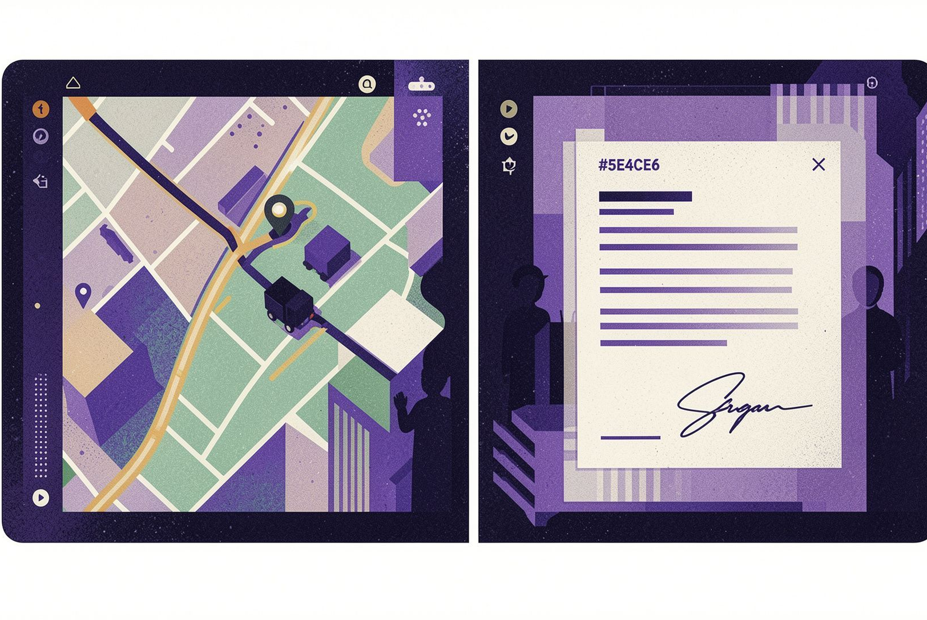
Real Example: Late Evidence Changes Everything
1
Day 1 — Claim Filed
Customer claims non-delivery. Nexus CEDAR sets initial hypothesis: 82% likely delivered. Decision logged with full reasoning.
2
Day 5 — New Evidence Arrives
GPS data, delivery signature scan, and photo confirmation are ingested. Nexus CEDAR automatically re-evaluates.
3
Day 5 — Hypothesis Shifts
Confidence flips to 62% non-delivery. Nexus CEDAR surfaces what changed, why it changed, and what action to take next.
Nexus CEDAR · Persona Journey Across the Dispute Lifecycle · TCS National AI Hackathon 2026

Slide 7
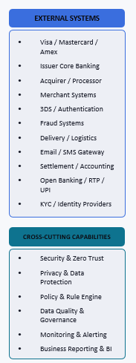
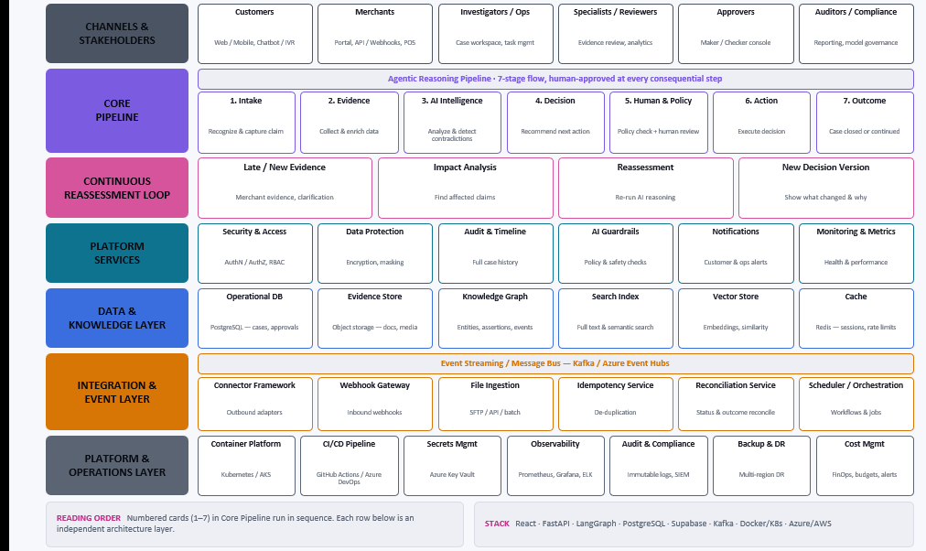
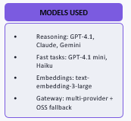
Solution Architecture: The Nexus CEDAR Platform
END-TO-END VIEW: Claim Intake → Evidence → AI Intelligence → Decision → Human & Policy Review → Action → Outcome
CORE PRINCIPLE — AI recommends. Policy authorizes. Human is accountable. Software executes. Every change is visible.
CORE PRINCIPLE — AI recommends. Policy authorizes. Human is accountable. Software executes. Every change is visible.

Slide 8

Enterprise-Grade by Design
Stateful AI
Context persists across long-running investigations. Nexus CEDAR remembers everything — so your analysts don’t have to.
Human in the Loop
AI recommends the next action. Your team makes the final call. Authority and accountability stay where they belong.
Complete Lineage
Every decision is traced, auditable, and explainable. Regulators and reviewers can follow every step with confidence.
Safe Execution
Policy, authority levels, and idempotent actions are built into every step — so no action is taken twice by accident.
Nexus CEDAR · Persona Journey Across the Dispute Lifecycle · TCS National AI Hackathon 2026

Slide 9

Ready to Turn Disputes into 360° intelligence?
See for yourself how Nexus CEDAR handles the cases your current system can’t.
01
02
Live Reconstruction
Understand the Impact
See Nexus CEDAR reconstruct a real dispute — with late evidence, shifting hypotheses, and full lineage — in minutes.
Learn how stateful AI reduces manual analyst work, improves decision accuracy, and closes audit gaps.
03
Plan the Scale
Explore how to expand from card disputes to enterprise-wide transaction decisions using the same platform.
Nexus CEDAR · Persona Journey Across the Dispute Lifecycle · TCS National AI Hackathon 2026

Slide 10
Where Disputes End Up: Before and After the Agent
Current state
With the agent
Early deflection compounds: fewer disputes filed means far fewer representments, pre-arbitrations and arbitrations downstream.
STAGE
CASES PER MONTH
CHANGE
Dispute intents
100,000 100.0%
Baseline
Raised with the bank
100,000 100.0%
Raised as a dispute
91,280 91.3%
-28.6%
Not deflected at intake
65,200 65.2%
Filed into the network
54,248 54.2%
-40.2%
Sent to the card network
32,428 32.4%
Representment
21,155 21.2%
-61.7%
Merchant pushes back
8,107 8.1%
Pre-arbitration
6,770 6.8%
-71.3%
Escalated further
1,946 1.9%
Arbitration
2,051 2.1%
-72.2%
Decided by the network
570 0.6%
Volume reaching each stage out of 100,000 monthly dispute intents

Slide 11
Thank You
Disputes don't end on Day 1 —
and neither should the intelligence behind them.
Nexus CEDAR remembers the case, so no one has to rebuild the truth twice.
Let's make every dispute decision explainable, auditable and alive.
Nexus CEDAR · Persona Journey Across the Dispute Lifecycle · TCS National AI Hackathon 2026

