Slide 1


Chat APPLICATION
“WE SIMPLIFY YOUR NEEDS”

Slide 2

KOLHAPUR INSTITUTE OF TECHNOLOGY COLLEGE OF ENGINEERING, KOLHAPUR
PROJECT ON : CHAT APPLICATION
Guided By,
Mr. Samadhan Palkar, Asst. Professor
Presented By
C02 Prasad Sutar
C09 Ashwith Bhatt
C10 Siddharth Powar
C12 Harnish Savsani

Slide 3

INTRODUCTION
Our project is an example of chat application which is basically based on public chatting
It is made of two applications
New trend
Digital platforms
Communicate, Share, View, and Learn
Collaborative and Conversational

Slide 4

Literature Review
Internet communication is getting more and more popular among the public.
Human-to-human communication
Brave Correspondence

Slide 5

Module
System consists of following modules :
Server Module
Client Module
Join Module

Slide 6

Technology
Languages :
HTML, CSS, JavaScript
Tools :
Visual Studio Code, NodeJS, ExpressJS

Slide 7


-:- Server -:-
System consists of two major parts:
Chat Server
Chat App(Client Part)
Chat Web Socket Server Library
Chat Web Socket Client Library
Chat Device Storage
-:- Client -:-

Slide 8
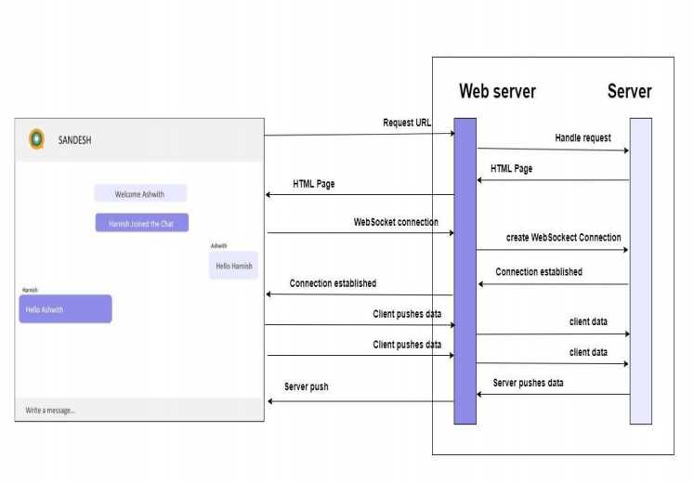
BACKEND FLOW DIAGRAM

Slide 9



How It Works ?
User 1
User 3
Server
User 2
User 4

Slide 10

Features
Personal Privacy
Instant Chat
Secure Rooms
Display Active User
Emoji Support
All Language Support

Slide 11

References
Socket programming by Michael J. Donahoo
https://socket.io/docs/v3/index.html
https://nodejs.org/en/docs/
https://expressjs.com/

Slide 12
THANK YOU

