Slide 1
Game Monitor
Liu Zongrui

Slide 2
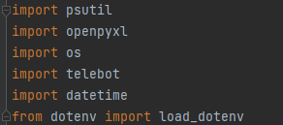
Packages
psutil
openpyxl
os
telebot
datetime
BOT_TOKEN

Slide 3
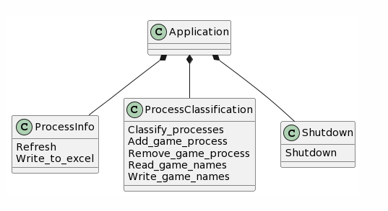
Class
ProcessInfo
Refresh
Write_to_excel
ProcessClassification
Classify_processes
Add_game_process
Remove_game_process
Read_game_names
Write_game_names
Shutdown

Slide 4
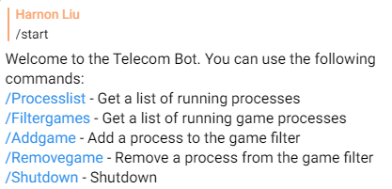
Bot
Start, help
Processlist
Filtergames
Addgame
Removegame
Shutdown

Slide 5
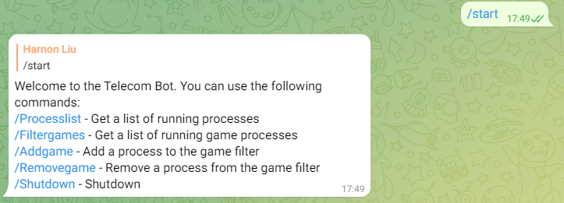
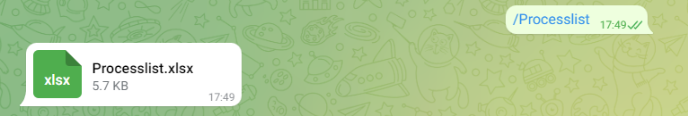
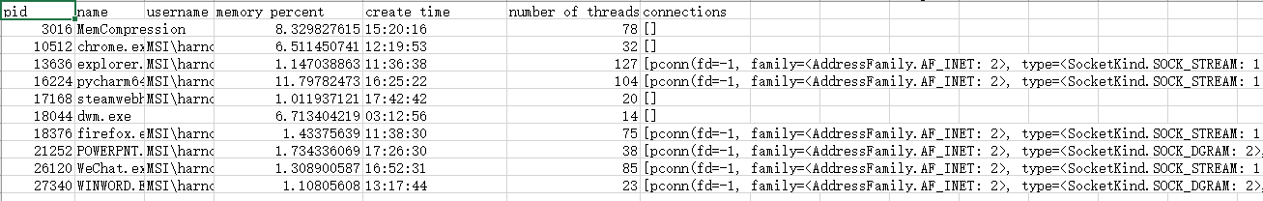
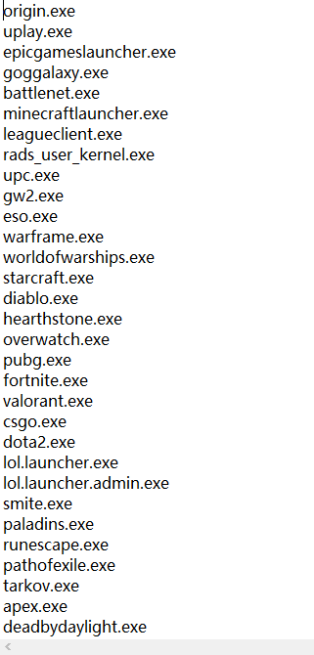
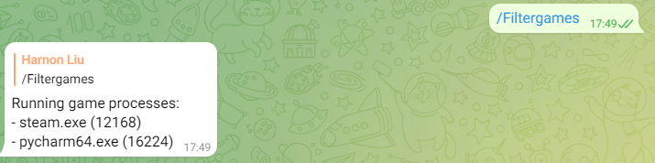
Demo

Slide 6
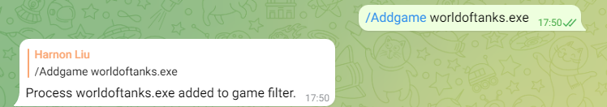
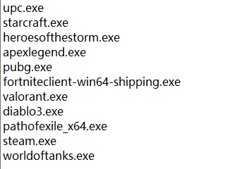
Demo

Slide 7
THE END
THANKS

