Slide 1
Database Application
Harold Suquillo

Slide 2
Application Overview
This application allows users to modify and view entities in a database.
Application Features
- Multi-User Support
- Ability to modify and view entries
- detection of Integrity constraint violations

Slide 3
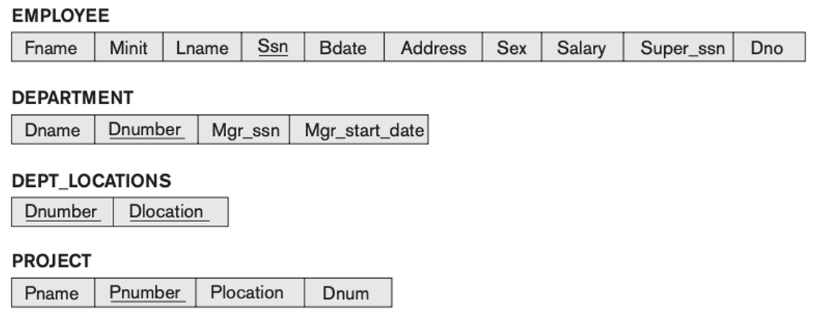

Relational Database Schema

Slide 4
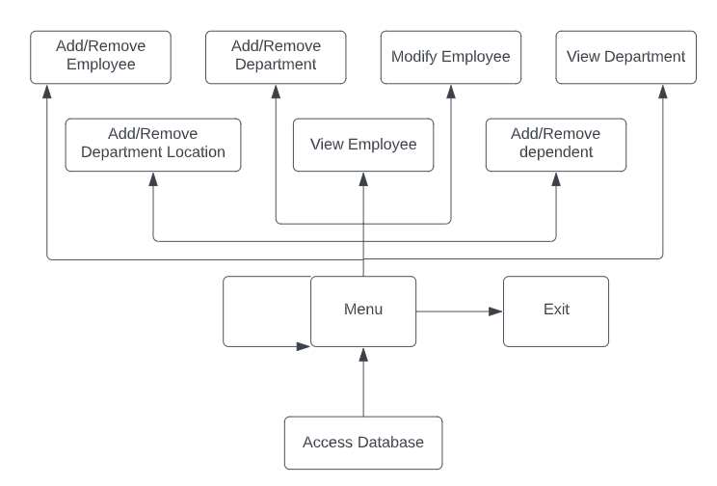
Architecture Diagram

Slide 5
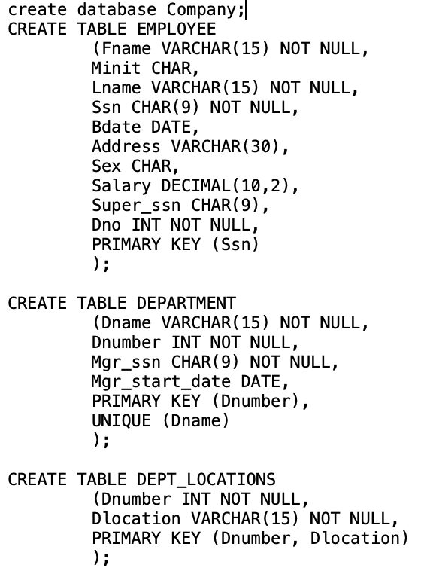
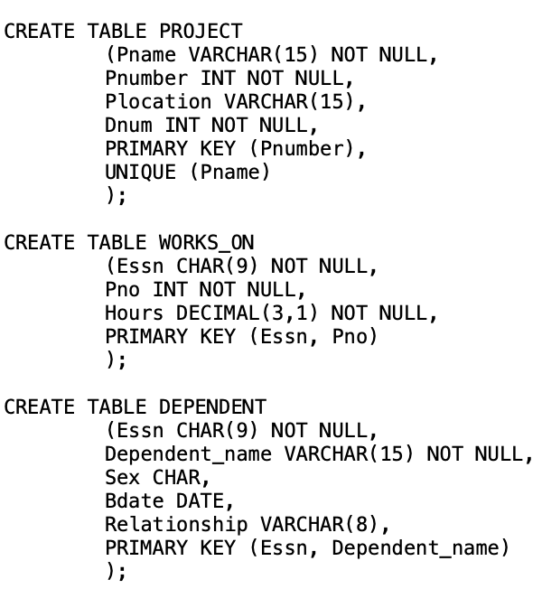
Creating the Database

Slide 6
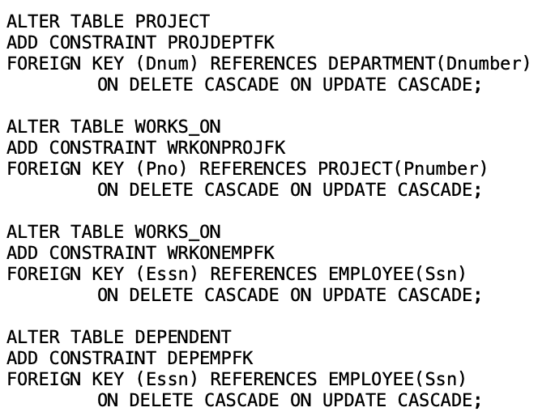
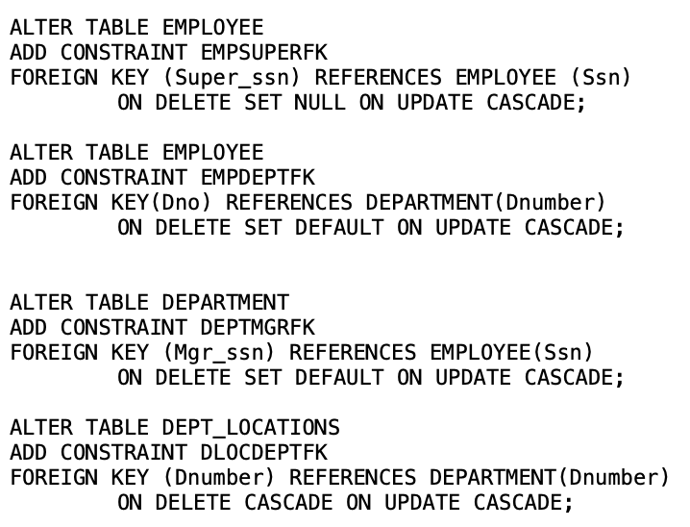
Adding Constraints

Slide 7

Demo

Slide 8
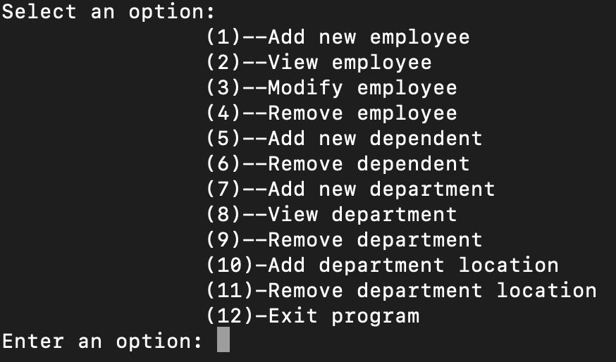
Menu

Slide 9
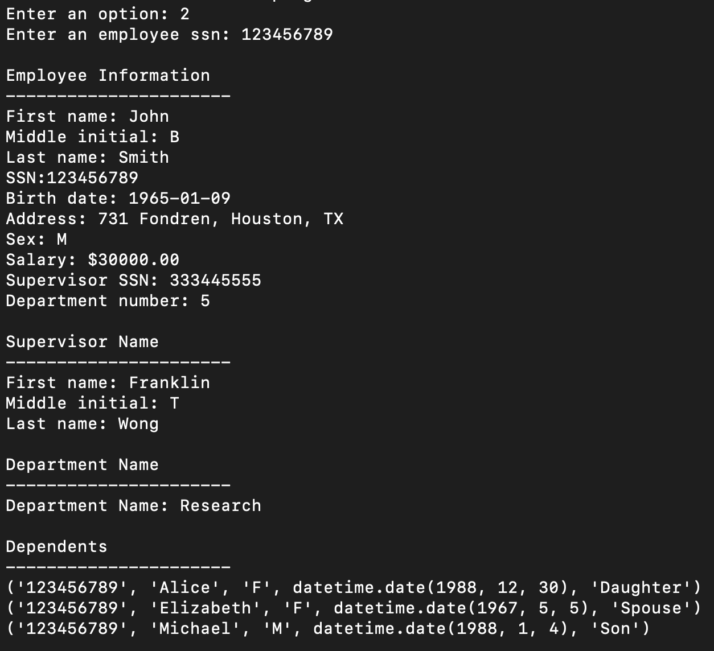




View Employee info

Slide 10
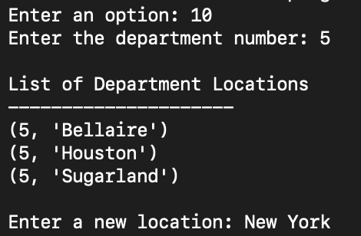


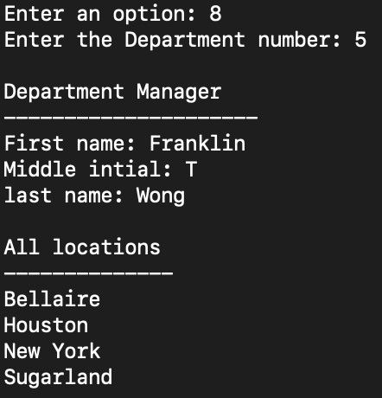

Add A new Department Location

