Slide 1
CS6975 SEMANTIC WEB TECHNIQUES PROJECT “Testing, inverting and round tripping RON Normalizer for RuleML 1.0 in XSLT 2.0”
Supervisor: Dr. Harold Boley
Advisor: Dr. Tara Athan
Team: Simranjit Singh
Pratik Shah
Bijiteshwar R Aayush

Slide 2
Agenda
Introduction
Testing of RON
RuleML official Compactifier
1: Canonical ordering
2: Skipping of stripes
3: Pretty Printing
Demo

Slide 3
Objectives of our project
In our first objective the task is to test the existing normalizer against some defined test cases.
Our second objective is to develop a tool called as ROC: RuleML official Compactifier.
The third step is to perform round tripping. The inverse form obtained from the second step will be composed for round tripping which will lead to improvement of both the suites obtained from 1 and 2 part.

Slide 4
RuleML official normalizer
RuleML is a markup language for sharing rules in XML.
In the normalization of a RuleML document we want to transform stripe-skipped serializations back into ones that are fully striped.
It should be made sure that the sublements are in proper canonical order.
The last point to take care in normalization is to make all attributes that have default values explicit.
Finally, the pretty-print formatting is done to enhance the readability of the code.

Slide 5
Multiple Phases within a Single Stylesheet
Within a single stylesheet, a pipeline is expressed as a series of variables:
<xsl:variable name="phase-1-output">
<xsl:apply-templates select="/" mode="phase-1"/>
</xsl:variable>
<xsl:variable name="phase-2-output">
<xsl:apply-templates select="$phase-1-output" mode="phase-2"/>
</xsl:variable>
In our code we will use three variables and modes for ROC

Slide 6
Testing of RON
Test Case 1(this is just a truncated part from original test case)
<Entails>
<Rulebase>
<Atom> <Rel>buys</Rel>
<Ind>Jill</Ind>
<Ind>produce</Ind>
</Atom>
</Rulebase>
</Entails>
</RuleML>

Slide 7
Testing of RON
Result 1:
<Entails> <if> <Rulebase> <formula> <Atom> <op><Rel>buys</Rel></op> <arg index="1"><Ind>Jill</Ind></arg> <arg index="2"><Ind>produce</Ind></arg> </Atom> </formula> </Rulebase> </if> </Entails> </RuleML>

Slide 8
Need for Compactifier
The normalizer discussed in the first part will insert all the missing stripes and make the document a fully striped one with exact canonical ordering.
Now the question arises if the elements are in proper ordering and all the stripes are added then xml will understand the left to right ordering of elements then why to add stripes.
To answer the above question we need a Compactifier which will invert the normalizer and make our xml file compact.
The fully stripped version of the normalizer will be converted into fully skipped version by Compactifier.

Slide 9
RuleML official Compactifier
The ROC will first check the canonical ordering of edges.
After the canonical check is performed it will remove all the stripes from the element to convert it into a fully skipped form.
The above step will help in obtaining our objective to make the XML element fully compact as is explicit from the name. We will be implementing our tool in the XSLT 2.0.
Due to its functioning we have named our tool as ROC: RuleML official Compactifier.

Slide 10
Canonical Ordering

Slide 11
Canonical Order
RuleML Schema used to infer canonical ordering.
Re-Ordering the sub-elements as necessary to achieve canonical ordering.
E.g.:
Implies mainly contains an <if> tag and a <then> tag.
Therefore the canonical ordering for the sub-elements of Implies is: oid, if, then, followed by all other sub-elements in the order that they appear.

Slide 12
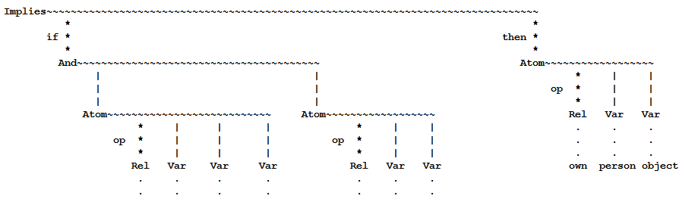
RuleML Schema of <Implies>
Source: own-xsd.ruleml

Slide 13
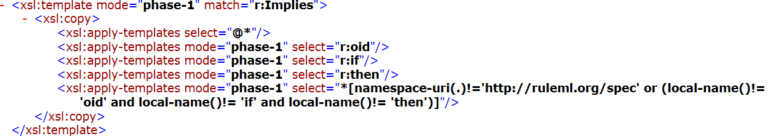
Case: <Implies>

Slide 14
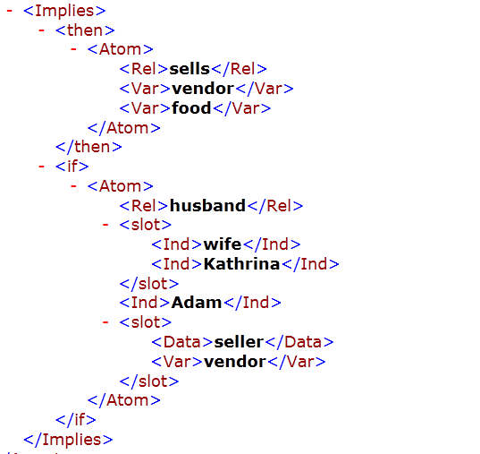
Unordered Form

Slide 15
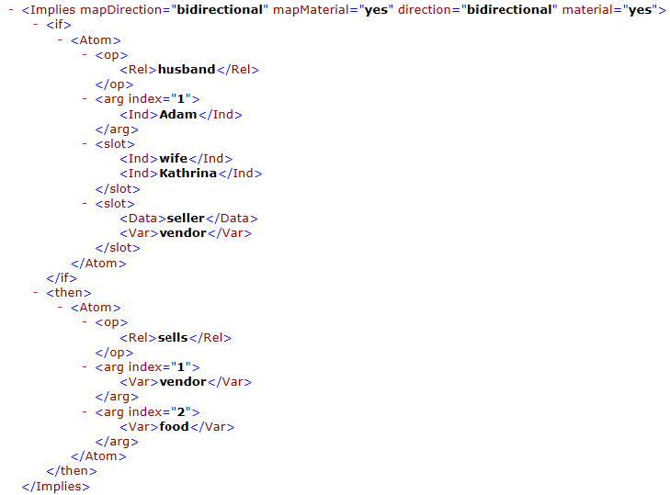
Canonically Ordered Form

Slide 16
Stripe Skipping

Slide 17
Removal of Stripes [Edges]
Edge is also referred to as role tag or method tag.
A test case consists of Nodes, Edges and Elements.
The serialization of the test case can be in different forms, e.g. Node-edge-… -Node-edge-Node etc.
This general structure is called to be as Striped form.
ROC omits the all the stripes so that user can have a fully Stripe Skipped form.

Slide 18
Removal of Stripes
After the previous step is complete, ROC has a canonically ordered test case as an input for further processing.
Stripe Skipping phase removes all the edges.
As the traversal goes on, every time an edge is encountered, ROC skips the edge and call for the copy template .
As soon as the copy template is called, it copies every content of the node as defined in the RuleML schema except for an edge.

Slide 19
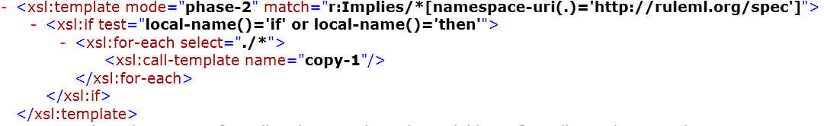
<Implies>
<Implies>
Removes all <if>,<then> edges
Copies all the other elements and sub-elements of the node.

Slide 20
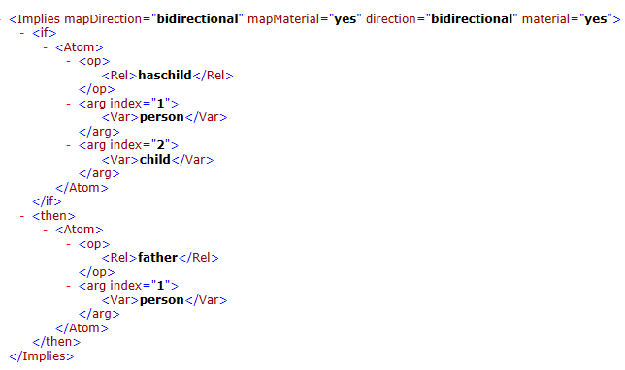
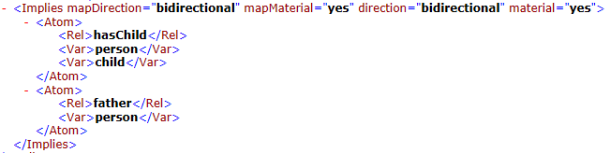
Test Case Results
Normalized Compactified

Slide 21
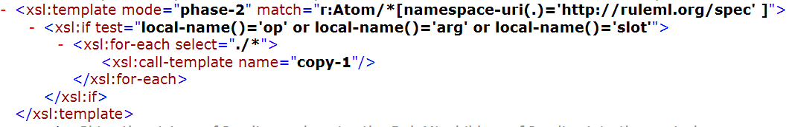
<Atom>
<Atom>
Removes all <op>, <arg>, <slot> edges .
Copies all the other elements and sub-elements of the node.

Slide 22
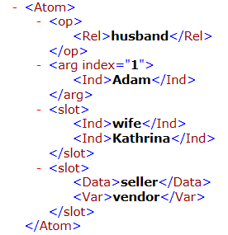
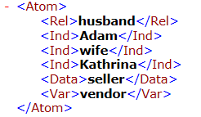
Test Case Results
Normalized Compactified

Slide 23
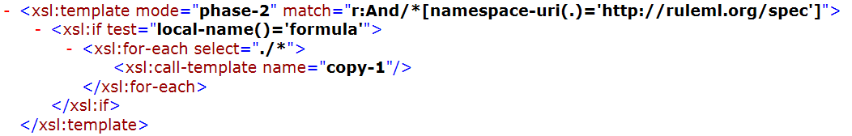
<And>
<And>
Removes all <formula> edges from <And>.
Copies all the other elements and sub-elements of the node.

Slide 24
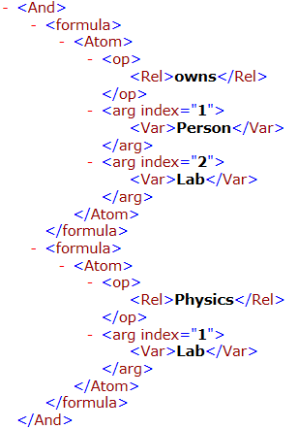
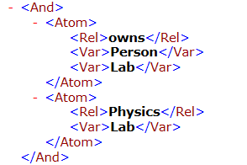
Test Case Results
Normalized Compactified

Slide 25
Modes
Use the feature of “mode” from XSLT 2.0
Format the same Data differently in different places
XSLT<xsl:apply-templates>Element
<xsl:apply-templates select=“XPath expression" mode="name"> <!-- Content:(xsl:sort|xsl:with-param)* --> </xsl:apply-templates>

Slide 26

Pretty Print
Output RuleML nicely
Comments
For some tags we don’t want a new line

Slide 27

Pretty Print - Working
Variables and Parameters

Slide 28
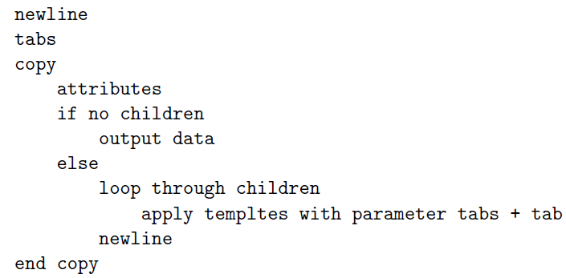
Pretty Print – Outline

Slide 29
Round - Tripping
Round-tripping: consistently refining a high-level model of a software system into a lower-level model (forward engineering) and abstracting a low-level model into a higher-level one (reverse engineering).
Input
RON
Output
ROC
Output
Input

Slide 30
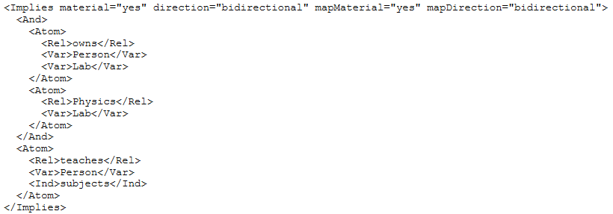
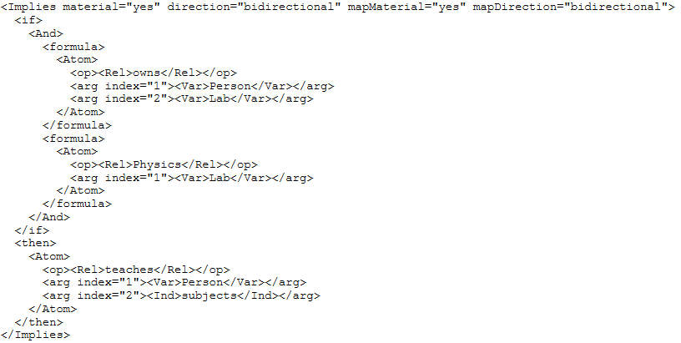
Round - Tripping
ROC output
RON output

Slide 31
Round - Tripping
RON output
ROC output

Slide 32
References
XSLT 2.0
http://www.xfront.com/rescuing-xslt.html
http://www.cafeconleche.org/books/bible3/chapters/ch15.html
http://www.w3.org/2005/08/online_xslt
RuleML
http://ruleml.org/
RuleML 1.0 Normalization
http://ruleml.org/1.0/xslt/normalizer/100_normalizer.xslt
Oxygen Editor
http://www.oxygenxml.com/download.html
RON
http://v37s3b4h7dn47s37hg1br4h7rs7n3du7s8nu.unbf.ca/~lbidlak1/

