Slide 1
Multi-Level Monte Carlo Methods of Option Pricing
Harold R. Kingsberg
Minh Tran
Peter C. Will

Slide 2
What are Options?
A contract that gives one party the right – but not obligation – to trigger an event of some sort
Commonly, the right to exchange currency for some asset at some predetermined price at some point in the future
Call: the right to purchase an asset at a predetermined price
Put: the right to sell an asset at a predetermined price

Slide 3

The Future
Options have expiration dates
The expiration date is the latest one can exercise an option
It may also be the only time to do so

Slide 4
Fair Pricing
Many tradeable assets have some sort of value on their own
Gold
Oil
Stock
Pork Bellies
What about options?

Slide 5

How to Price an Option
Ignore the details of the underlying asset
Assume the underlying asset is currently fairly priced

Slide 6


Complicating Factors
Different means of measuring volatility
Correlation of motion
Multiple underlying assets

Slide 7
Naive Monte Carlo
Euler-Maruyama
Keep checking confidence interval size

Slide 8
New Strategy
High granularity of Euler-Maruyama path means lower error, greater time to run.
Predictor-corrector strategy
Use the cheap stuff to get into the right ballpark
Use the expensive stuff to refine the estimate
Naive MC with number of steps per path as 1 is as cheap as you can get

Slide 9

Layering
Using finer-grained naïve MC by itself is inefficient
Better off using the difference between a fine-grained run and a coarse-grained run
Each coarse-grained run uses the same random numbers as the fine-grained run, just summing them

Slide 10
The Basic Algorithm
Create initial samples of paths
Create more paths until you're at the “ideal number” of paths per layer
Check your error
Strategy 1: See how large the penultimate layer is in comparison to the highest layer
Strategy 2: Figure out the decay rate of the means of the layers, the growth rate of the costs, and extrapolate
If error's too high, add another layer

Slide 11
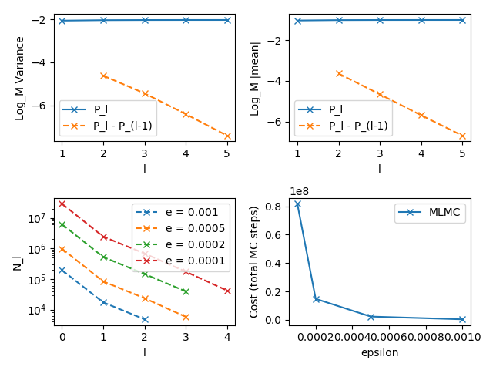
Does this work?

Slide 12
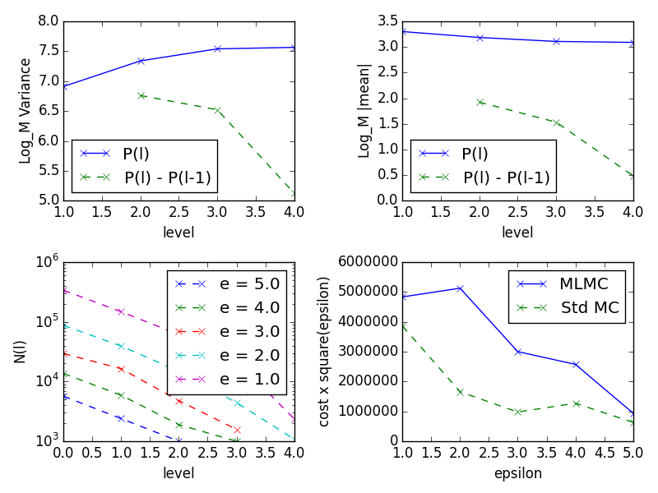
Is This Faster?
Not unequivocally
Doesn't work great with big error
Lipschitz conditions should be met
Plug 'n' chug is not a good strategy

Slide 13
Next Steps
Add functionality for non-European payouts
More sensibly, port to lower-level language

