Slide 1

Digital Twin Project – Server Performance
Course: Digital Twins (WS 2025/26)
Montanuniversität Leoben
Students:
Harold Stiven Vargas H.
Wilson Santiago Bonilla G.

Slide 2

Index
Problem & Motivation
Physical System & DT Objective
Data Sources & Inputs
Data Processing & EDA
Modeling Approach
Digital Twin Architecture
Results & Visualization
Digital Twin Integration
Lessons Learned
Limitations & Improvements
Conclusion

Slide 3

Problem & Motivation
Modern servers operate under varying workloads.
Traditional monitoring tools provide metrics but lack system understanding.
This project develops a Digital Twin to mirror and analyze server behavior using internal telemetry.

Slide 4

Physical System & DT Objective
Physical system: A computing node (PC/server).
Objective: Create a diagnostic Digital Twin to observe, analyze, and understand system performance dynamics.
Focus is diagnostic and analytical, not control.

Slide 5

Data Sources & Inputs
System telemetry collected using psutil:
• CPU utilization
• Memory usage
• Disk I/O
• Network activity
• Process count
Time-series data sampled every second.

Slide 6
Data Processing & EDA
Data cleaning:
• Handling missing values
• Time alignment
• Resampling to minute-level
EDA revealed:
• Load-driven spikes
• Disk saturation patterns
• Correlated CPU–disk events

Slide 7
Modeling Approach
State-based analytical model.
System states:
• Idle
• Moderate load
• High load
Transitions observed empirically from telemetry patterns.
Chosen for interpretability and DT integration.

Slide 8
Digital Twin Architecture
Physical system → Sensors → Data preprocessing → State model → Indicators
Feedback loop enables comparison between real system and twin.
Architecture supports monitoring and diagnosis.

Slide 9


Results & Visualization
Microsoft Power BI
Power BI dashboard visualizes:
• Resource utilization over time
• Peak events
• System state evolution
Used for monitoring and diagnostic insight.

Slide 10
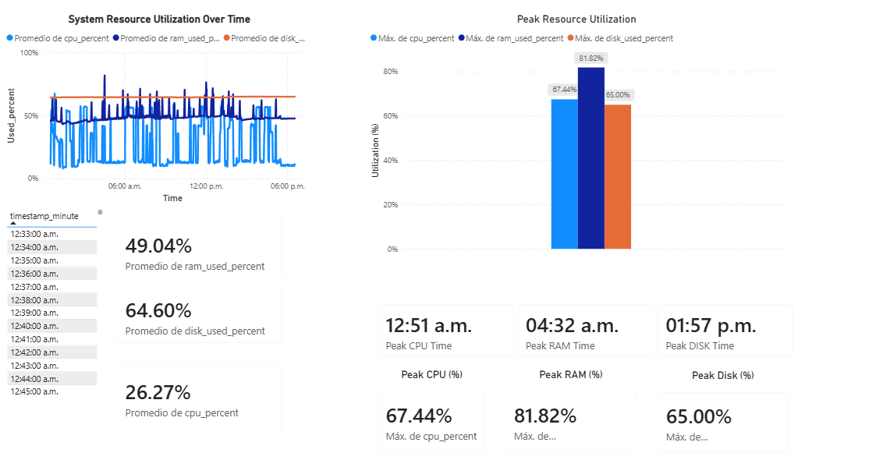

Slide 11
Digital Twin Integration
Inputs:
• Real-time telemetry
• Historical datasets
Outputs:
• System state
• Performance indicators
• Diagnostic insights
Twin updated continuously.

Slide 12
Lessons Learned
What worked:
• Controlled workload experiments
• Time-series analysis
• Dashboard-based monitoring
What did not:
• No real-time control or forecasting implemented.

Slide 13
Limitations & Improvements
Limitations:
• Diagnostic-only DT
• No predictive or prescriptive control
Next steps:
• Forecasting
• Anomaly detection
• Alerting mechanisms

Slide 14

Thanks
Conclusion
The project demonstrates a valid Digital Twin implementation.
It integrates data, models, and visualization to represent a real system.
Forms a foundation for advanced DT capabilities.

