Slide 1

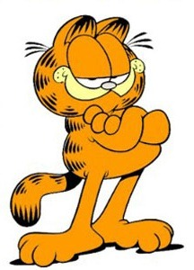

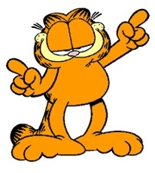
ePetCare Cloud 企畫案
Intel Edison Pet Care Cloud
楊氏雲朵工作室 & Phoenix Technologies Harold Yang (楊宗翰)
Dell --- Michael Chen (陳吉盈)
gandi.net --- Thomas Kuiper (唐古柏)
Tiger ---柯大

Slide 2
Agenda
一、 Intel IoT RoadShow 參賽團隊
二、摘要
三、產品服務介紹
四、設計與發展計畫
五、市場研究與分析
六、結論與願景的期許
七、參考資訊

Slide 3
Intel IoT RoadShow 參賽團隊
Harold Yang
  BT smart, BLE programming , Wi-Fi transfer
  Pet belt collar
  Kitchen
Michael Chen
  Toy Room
Tiger
  Pet Room
Thomas
  Could web system, Data analysis

Slide 4
摘要
使用Intel Edison 開發寵物項圈和互動物品,展示3種使用情境
  Kitchen
    廚房設置可錄製主人聲音(或超音婆發射器)裝置,當寵物項圈接近便發出警告防止寵物闖入廚房,並可記錄寵物闖入的次數向主人發出通知
  Toy Room
    各式互動寵物玩具,可記錄寵物與玩具互動數據
  Pet Room
    寵物飲食和居家環境監控記錄
  Use Intel Edison develop a Pet belt collar and interactive item, demo 3 kinds of user scenario
  Kitchen
    Kitchen setup a device with master sound recording (or ultra-sound transmitter) , it will warns when pet collars approaching Kitchen to prevent pet into the kitchen, and can record the number of pets intend into the Kitchen to notice the master or owner.
  Toy Room
    All kinds of interactive pet toys, pet toys can record Interactive Data
  Pet Room
    Pets diet and home environment monitoring records

Slide 5
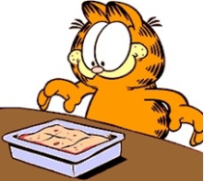


產品服務的介紹 -Harold
  寵物項圈: 使用Intel Edison 藍芽用其他支援藍芽(BT smart or BLE)物件互動,然後收機互動資料透過Intel Edison Wi-Fi 將資料送到雲端系統。
  Pet belt collar: Use Intel Edison BT to interact with item with BT smart or BLE, then collected interactive data to Cloud web system with Intel Edison Wi-Fi .
  廚房警告器: 為了防止
      廚房設置可錄製主人聲音(或超音婆發射器)裝置,當寵物項圈接近便發出警告防止寵物闖入廚房,並可記錄寵物闖入的次數向主人發出通知
  Kitchen: To prevent your pet keep eating like Garfield, Kitchen setup a device with master sound recording (or ultra-sound transmitter) , it will warns when pet collars approaching Kitchen to prevent pet into the kitchen, and can record the number of pets intend into the Kitchen to notice the master or owner.

Slide 6
產品服務的介紹 - Michael
  寵物玩具
  Toy Room

Slide 7
產品服務的介紹 - Tiger
  寵物飲食
  Pet Room

Slide 8
產品服務的介紹 - Thomas
  雲端介面
  Cloud web system

Slide 9
設計與發展計畫-Harold
寵物項圈:
Pet belt collar:

Slide 10
設計與發展計畫- Michael
  寵物玩具
  Toy Room

Slide 11
設計與發展計畫- Tiger

Slide 12
設計與發展計畫- Thomas
  雲端介面
  Cloud web system

Slide 13
市場研究與分析
TBD

Slide 14
結論與願景的期許
TBD

Slide 15
參考資訊
https://software.intel.com/en-us/iot/home
https://software.intel.com/en-us/iot/library/edison-getting-started
https://software.intel.com/en-us/articles/intel-edison-cloud-and-middleware-api-guide

Slide 16
Backup Slide

Slide 17
行銷計畫
TBD

Slide 18
營運計畫
TBD

Slide 19
管理團隊
TBD

Slide 20
財務規劃
TBD

Slide 21
公司報酬計畫
TBD

