Slide 1
Python Programming

Slide 2
What is python
Python is a general-purpose programming language and is widely used among the developers’ community.
Python was mainly developed for emphasis on code readability, and it’s syntax allows programmer to express concepts in fewer lines of code.
It is dynamically typed language with its interpreted nature.
So it makes an ideal language for scripting and rapid application development in many areas on most platforms.
Example:
Print(‘hello world!’)

Slide 3
Key features
Python has many reasons for being popular and in demand. A few of the reasons are mentioned below.
Emphasis on code readability, shorter codes, ease of writing.
Programmers can express logical concepts in fewer lines of code in comparison to languages such as C++ or Java.
Python supports multiple programming paradigms, like object-oriented, imperative and functional programming or procedural.
It provides extensive support libraries(Django for web development, Pandas for data analytics et cetera).
Dynamically typed language(Data type is based on value assigned)
Philosophy is “Simplicity is the best”.

Slide 4
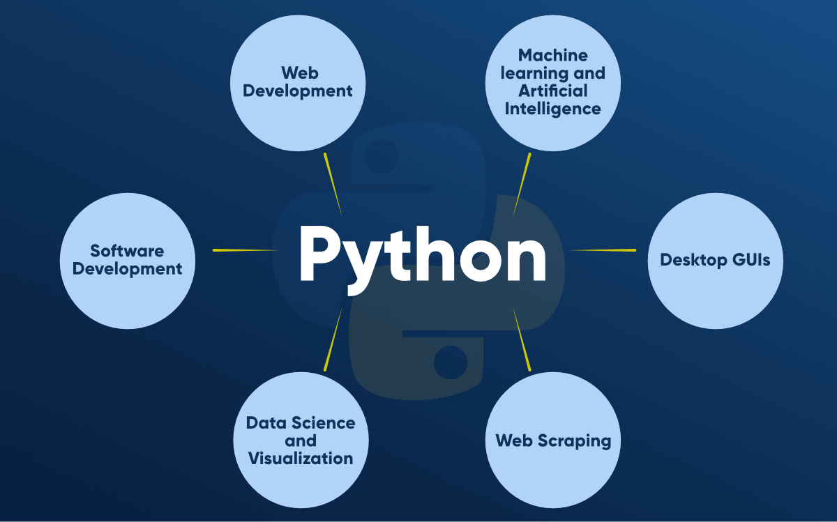
Additional areas

Slide 5
Reasons to learn python
Data Science and Machine Learning
Extensive Libraries & Frameworks
Open Source
Can work with other programming languages
Improving productivity
Jobs & Careers

Slide 6
Make familiar to…
Hello World syntax.
Using interactive Interpreter prompt
Using a script file

Slide 7
Variables
Variable is a name that is used to refer to memory location. Python variable is also known as an identifier and used to hold value.
In Python, we don't need to specify the type of variable because Python is a infer language and smart enough to get variable type.
Variable names can be a group of both the letters and digits, but they have to begin with a letter or an underscore.
It is recommended to use lowercase letters for the variable name. Rahul and rahul both are two different variables.

Slide 8
Object references
It is necessary to understand how the Python interpreter works when we declare a variable. The process of treating variables is somewhat different from many other programming languages.
Python is the highly object-oriented programming language; that's why every data item belongs to a specific type of class. Consider the following example.
print(“john”)
In the above print statement, we have created a string object. You can check the type using the python built-in type() function.
In Python, variables are a symbolic name that is a reference or pointer to an object. The variables are used to denote objects by that name.

Slide 9
Naming rules
The multi-word keywords can be created by the following method.
Camel Case – each word or abbreviation in the middle of begins with a capital letter. There is no intervention of whitespace. For example - nameOfStudent, valueOfVaraible, etc.
Pascal Case – It is the same as the Camel Case, but here the first word is also capital. For example - NameOfStudent, etc.
Snake Case – Words are separated by the underscore. For example - name_of_student, etc.

Slide 10
Data types
Variables can hold values, and every value has a data-type.
Python is dynamically typed language; hence we do not need to define the type of the variable while declaring it.
The interpreter implicitly binds the value with its type.
A = 5
The variable ‘A’ holds integer value five which is an integer; so python interpreter will automatically interpret ‘A’ as an integer type.

Slide 11
Standard Data types
A variable can hold different types of values. For example, a person's name must be stored as a string whereas its id must be stored as an integer.
Python provides various standard data types that define the storage method on each of them. The data types defined in Python are given below.
Numbers
Sequence Type
Boolean
Set
Dictionary

Slide 12
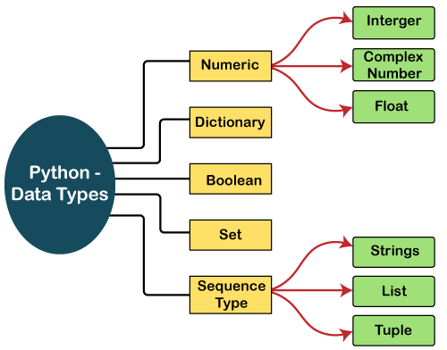

Slide 13
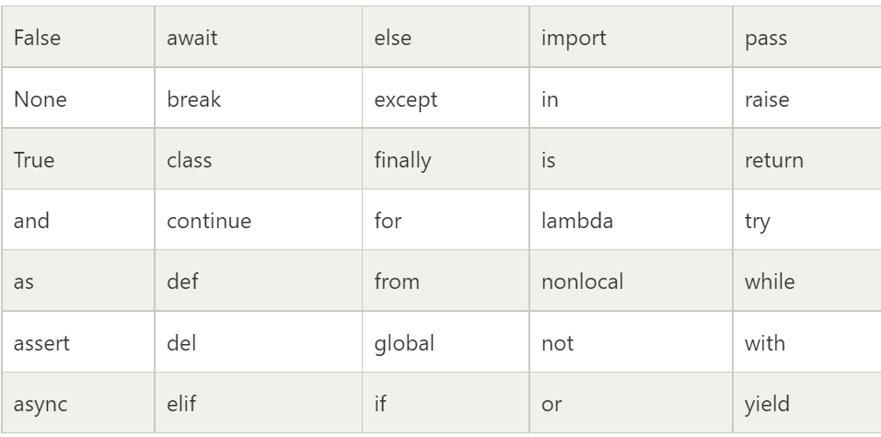
Keywords

Slide 14
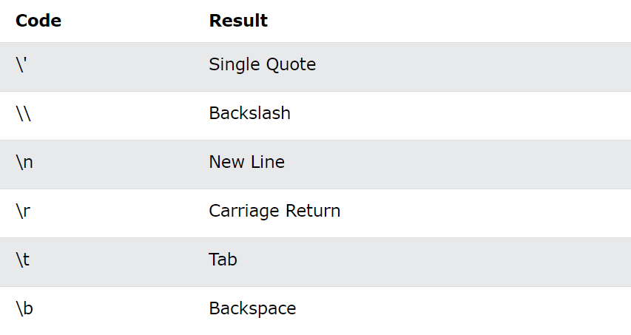
Escape characters

Slide 15
operators
Arithmetic operators
Arithmetic operators are used to perform arithmetic operations between two operands.
Comparison operators
Comparison operators are used to comparing the value of the two operands and returns Boolean true or false accordingly.
Assignment operator
The assignment operators are used to assign the value of the right expression to the left operand.
Logical operator
The logical operators are used primarily in the expression evaluation to make a decision.
Membership operator
Python membership operators are used to check the membership of value inside a Python data structure.
Identify operator
The identity operators are used to decide whether an element certain class or type.

Slide 16
operators
Membership Operator | Description
in | It is evaluated to be true if the first operand is found in the second operand (list, tuple, or dictionary).
not in | It is evaluated to be true if the first operand is not found in the second operand (list, tuple, or dictionary).
Identity Operator | Description
is | It is evaluated to be true if the reference present at both sides point to the same object.
is not | It is evaluated to be true if the reference present at both sides do not point to the same object.

Slide 17
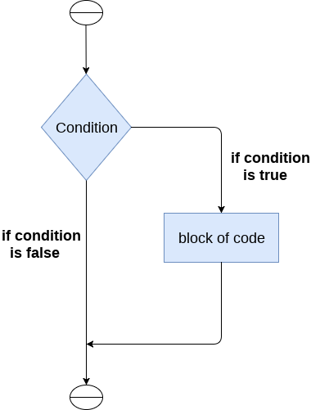
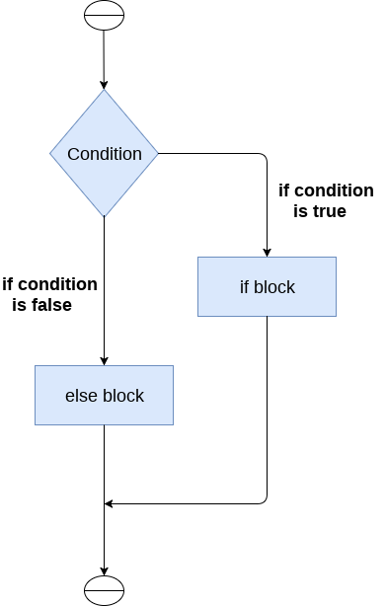
IF else Statement

Slide 18
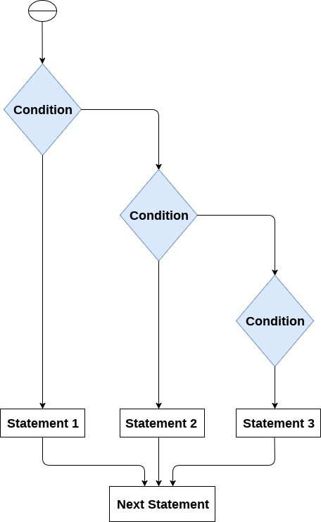
If… elif… else statement

Slide 19
List
A list in Python is used to store the sequence of various types of data. Lists are mutable type its mean we can modify its element after it created.
A list can be defined as a collection of values or items of different types. The items in the list are separated with the comma (,) and enclosed with the square brackets [].
L1 = ["John", 102, "USA"]
L2 = [1, 2, 3, 4, 5, 6]

Slide 20
Characteristics of Lists
The list has the following characteristics:
The lists are ordered.
The element of the list can access by index.
The lists are the mutable type.
A list can store the number of various elements.
a = [1,2,"Peter",4.50,"Ricky",5,6]

Slide 21
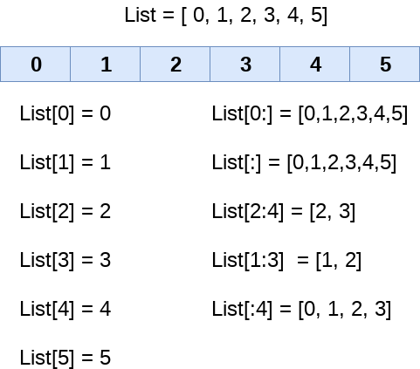
List indexing and splitting
The indexing is processed in the same way as it happens with the strings. The elements of the list can be accessed by using the slice operator [].
The index starts from 0 and goes to length - 1. The first element of the list is stored at the 0th index, the second element of the list is stored at the 1st index, and so on.
To get the sub list, following is the syntax:
The start denotes the starting index position of the list.
The stop denotes the last index position of the list.
The step is used to skip the n^{th} element within a start:stop

Slide 22
Tuples
A collection of ordered and immutable objects is known as a tuple.
Tuples and lists are similar as they both are sequences.
Though, tuples and lists are different because we cannot modify tuples, although we can modify lists after creating them, and also because we use parentheses to create tuples while we use square brackets to create lists.
tuple_1 = ("Python", "tuples", "immutable", "object")
tuple_2 = (23, 42, 12, 53, 64)

Slide 23
Advantages of Tuple over List
We generally employ lists for homogeneous data types and tuples for heterogeneous data types.
Tuple iteration is quicker than list iteration because tuples are immutable. There is such a modest performance improvement.
Tuples with immutable components can function as the key for a Python dictionary object. This feature is not feasible with lists.
Collecting data in a tuple will ensure that it stays write-protected if it never changes.

Slide 24
dictionary
Dictionary is used to store the data in a key-value pair format.
The dictionary is the data type in Python, which can simulate the real-life data arrangement where some specific value exists for some particular key.
It is the mutable data-structure. The dictionary is defined into element Keys and values.
Keys must be a single element.
Value can be any type such as list, tuple, integer, etc.
We can say that a dictionary is the collection of key-value pairs where the value can be any Python object.
In contrast, the keys are the immutable Python object, i.e., Numbers, string, or tuple.

Slide 25
Dictionary syntax
The dictionary can be created by using multiple key-value pairs enclosed with the curly brackets {}, and each key is separated from its value by the colon (:).
The syntax to define the dictionary is given below.
Dict = {"Name": "Tom", "Age": 22}
In the above dictionary Dict, The keys Name and Age are the string that is an immutable object.

