Slide 1
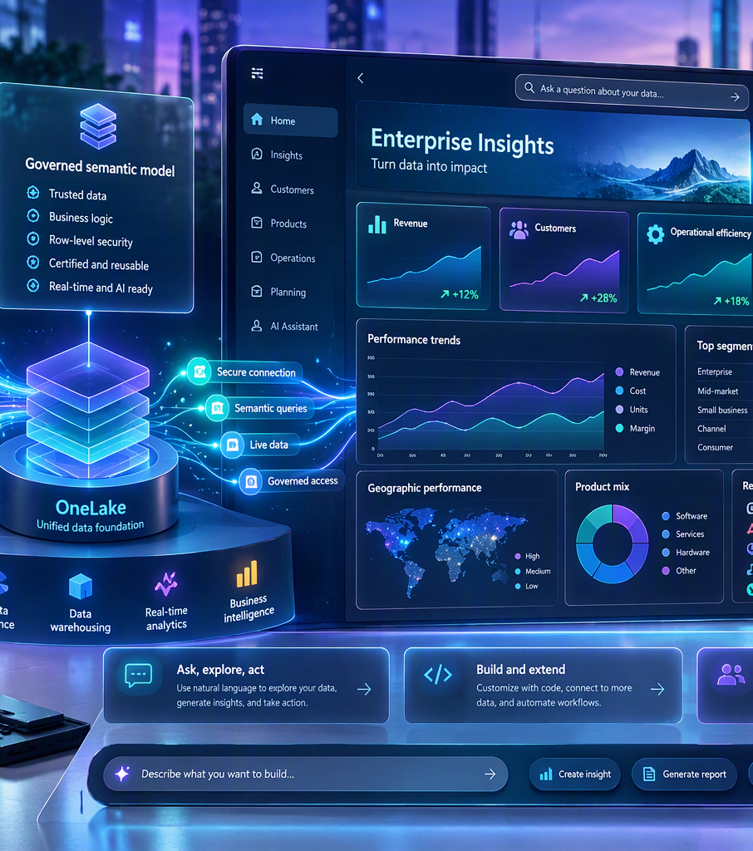
Fabric Apps (Rayfin)
on a Semantic Model
Partner hands-on lab • Build a Partner Opportunity Command Center
L300 WORKSHOP
GITHUB READY
Includes presentation, synthetic data, lab guide, Copilot prompts, and pricing guidance
Notes:
Open with the business outcome: move from a governed semantic model to an interactive analytical application that partners can adapt and demonstrate.
[Sources]
Visual on this slide was generated with Microsoft Copilot.
[/Sources]

Slide 2
Workshop outcomes
A practical path from data to a governed app experience
MODEL
CONNECT
BUILD
VALIDATE
PUBLISH
Create a reusable semantic model with measures and relationships
Add delegated, typed access through the semantic-model connector
Use the data app template and Copilot prompts to create interactions
Reconcile KPIs, permissions, accessibility, and query behavior
Deploy as a Fabric item and monitor capacity consumption
Notes:
Set expectations: most workshop time is hands-on. The deliverable is an app that uses the semantic model as the calculation and governance layer.

Slide 3
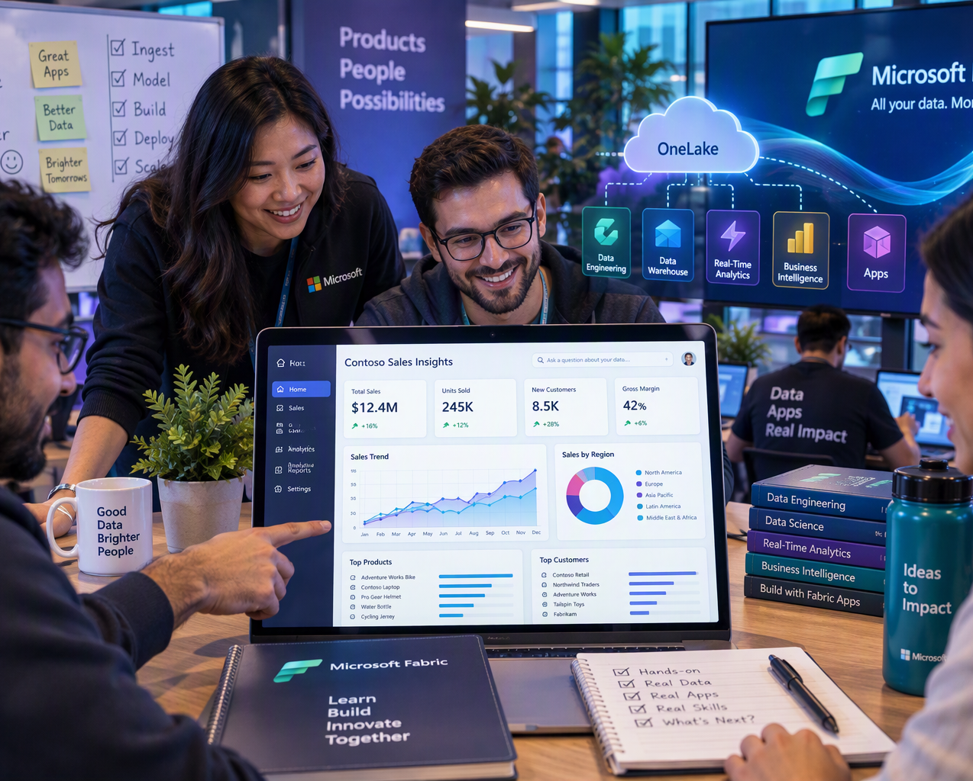
Why a Fabric App on a semantic model?
Use the semantic layer for trusted logic and the app layer for tailored interaction
Reuse trusted business logic
Measures, relationships, formatting, and security remain centralized in the semantic model.
Go beyond a report canvas
Create workflows, custom navigation, guided exploration, and task-oriented experiences.
Keep identity delegated
The app connects under the signed-in user and respects access to the underlying model.
Notes:
Position Fabric Apps as complementary to Power BI reports, not a report replacement. Use the app when the user journey requires guided interaction or workflow presentation.
[Sources]
Visual on this slide was generated with Microsoft Copilot.
https://learn.microsoft.com/en-us/fabric/apps/data-apps-template
[/Sources]

Slide 4
Reference architecture
The app experience is separate from the governed analytical contract
Excel / CSV
Lakehouse or
Warehouse
Semantic model
Fabric App
(Rayfin)
Partner users
Business logic + security
Interaction + workflow
Notes:
Emphasize the split of responsibilities. Put measures in the semantic model. Use the application layer for navigation, interaction, and task flow.

Slide 5
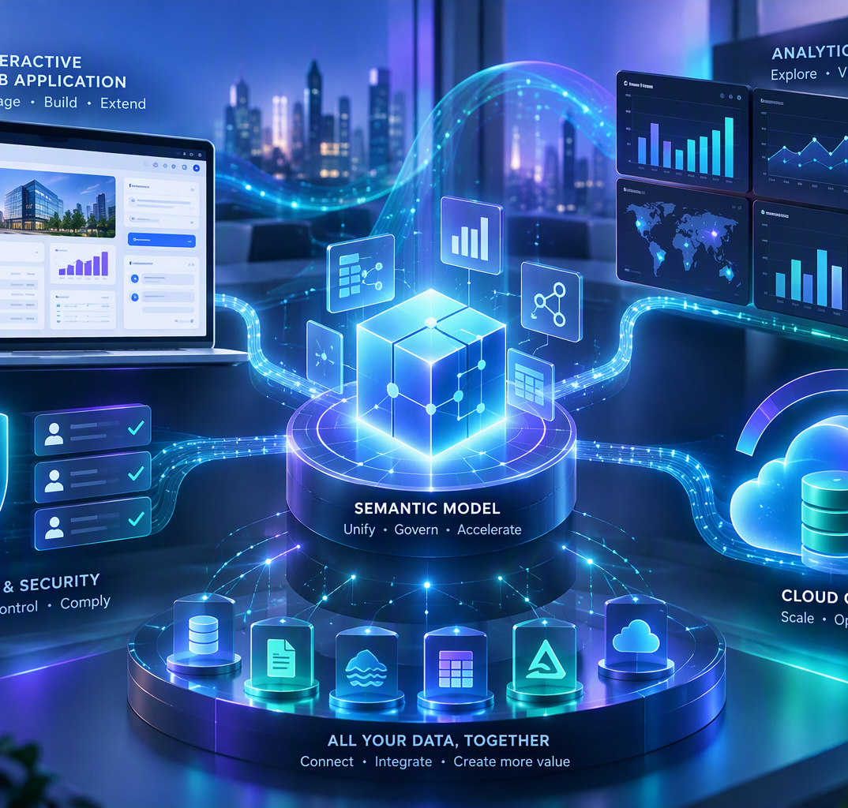
Lab scenario and sample data
Partner Opportunity Command Center
240 synthetic opportunities
Star-schema friendly
Five regions, five partners, four solution areas, five stages, and delivery health.
FactOpportunities with Region, Partner, and Solution dimensions.
Business metrics
App interactions
Total ACR, Won ACR, opportunity count, win rate, and average ACR.
Filters, ranking, stage funnel, detail grid, and selected-opportunity panel.
Training data only • Safe to publish in a public demo repository
Notes:
Explain that the data is intentionally synthetic. Partners can swap in their own semantic model later while retaining the app patterns.
[Sources]
Visual on this slide was generated with Microsoft Copilot.
[/Sources]

Slide 6
Hands-on flow
Five build stages with explicit validation gates
1
2
3
4
5
Prepare
Baseline
Scaffold
Build
Validate + publish
Load the workbook and create relationships + measures
Build a simple report and capture expected KPI totals
Create the data app template and add the connector
Generate overview, filters, visuals, and detail experience
Reconcile results, test access, deploy, and monitor
Notes:
Do not skip the baseline step. A visually correct app can still be analytically wrong.

Slide 7
Create the semantic model
Recommended relationships and measures
Relationships
Measures
• FactOpportunities[RegionID] → DimRegion[RegionID]
Total ACR = SUM(ACR_USD)
• FactOpportunities[PartnerID] → DimPartner[PartnerID]
Opportunity Count = DISTINCTCOUNT(OpportunityID)
Won ACR = CALCULATE([Total ACR], Stage = "Won")
• FactOpportunities[SolutionID] → DimSolution[SolutionID]
Win Rate = DIVIDE([Won Opportunities], [Opportunity Count])
Average ACR = DIVIDE([Total ACR], [Opportunity Count])
Design rule: the semantic model owns calculations; the app owns interaction.
Notes:
The workbook already contains dimension keys. Participants can use a default semantic model or build an explicit model if the environment allows it.

Slide 8
Scaffold and connect
Use the supported data app template and semantic-model connector
npm create @microsoft/rayfin@latest -- "partner-opportunity-command-center" \
--template dataapp --workspace "{WORKSPACE_NAME}"
cd partner-opportunity-command-center
npx rayfin connector search --workspace-id "{WORKSPACE_ID}" \
--type fabric-semanticmodel --json
npx rayfin connector add --type fabric-semanticmodel \
--workspace-id "{WORKSPACE_ID}" --item-id "{MODEL_ITEM_ID}" \
--name opportunityModel --operations executeQuery
Prerequisites
Node.js 20+, Fabric access, workspace role, Fabric Apps enabled, Execute Queries setting, Build + Read permission.
Connector outcome
Configuration, generated schema, and delegated executeQuery access.
Security posture
Do not commit workspace IDs, tenant values, tokens, or local environment files.
Notes:
Run the exact connector package install command printed by the CLI. Environment-specific values remain placeholders in the public repository.
[Sources]
https://learn.microsoft.com/en-us/fabric/apps/data-apps-template
[/Sources]

Slide 9
Copilot build sequence
Prompt for facts first, then layout, then interaction
1. Inventory
Inspect connector schema; write data-connections.md; do not invent fields.
2. App shell
Create Overview, Partners, Opportunities, and Data Quality navigation.
3. KPI layer
Render semantic-model measures and filter contracts.
4. Analytical views
Add stage funnel, regional comparison, partner ranking, solution mix.
5. Detail flow
Add searchable grid and selected-opportunity side panel.
6. Validation
Compare every result with the semantic-model baseline and expose failures.
Notes:
The prompt pack in the repository follows this sequence. The key control is to make the connector schema and validation files the source of truth.

Slide 10
Validation gates before publishing
A demo is only credible when numbers, access, and failure states are proven
Analytical
Filter
Access
Every KPI reconciles to the Power BI or semantic-model baseline.
Single and combined filters return expected values.
Test an authorized user and a user without underlying model access.
UX
Repository
Capacity
Keyboard, contrast, responsive layout, loading, empty, and error states.
No secrets, IDs, local settings, or customer data committed.
Review item and operation usage in the Capacity Metrics app.
Notes:
Use these as go/no-go gates. If a measure cannot be reconciled, do not mask the discrepancy with client-side calculations.

Slide 11
Pricing approach
Price the Fabric capacity and observed usage, not the app as a fixed unit
What is billed
How to estimate
Commercial guidance
Fabric Apps run on Fabric capacity. Child-service operations consume CUs. Microsoft documents consumption across SQL Database, GraphQL API, User Data Functions, and OneLake operations.
Run a controlled lab, capture item-level activity in the Fabric Capacity Metrics app, and translate the selected SKU and region through the Azure pricing calculator.
Do not quote a fixed per-app amount. Cost varies by agreement, region, capacity, storage, and usage. Reservations may save about 41% versus pay-as-you-go.
Recommended partner message: “Start on assigned capacity, measure the app, then size and optimize.”
Notes:
The lab intentionally avoids a hardcoded price because Azure commercial pricing varies. Show partners the measurement method and official calculator instead.
[Sources]
https://learn.microsoft.com/en-us/fabric/apps/pricing
https://azure.microsoft.com/en-us/pricing/details/microsoft-fabric/
[/Sources]

Slide 12
GitHub-ready repository structure
Everything needed to teach, build, validate, and extend
fabric-apps-semantic-model-hol/
├── README.md
├── LICENSE
├── .gitignore
├── Fabric-Apps-Semantic-Model-HOL.pptx
├── sample-data/
│ ├── partner-opportunity-sample.xlsx
│ └── fact-opportunities.csv
├── docs/
│ ├── LAB_GUIDE.md
│ ├── PRICING.md
│ └── visual-*.png
└── prompts/
└── copilot-prompts.md
Publish safely
Keep the data synthetic and remove environment-specific IDs and secrets.
Partner customization
Replace the sample semantic model while retaining the interaction, validation, and cost patterns.
Suggested demo close
Show the same trusted measures in Power BI and the app, then demonstrate the app-specific guided workflow.
Notes:
The repository is deliberately documentation-first. Partners can clone it, use the included data, and later replace the model without redesigning the workshop.

