Slide 1

Helpdesk Session 3
Object Types

Slide 2
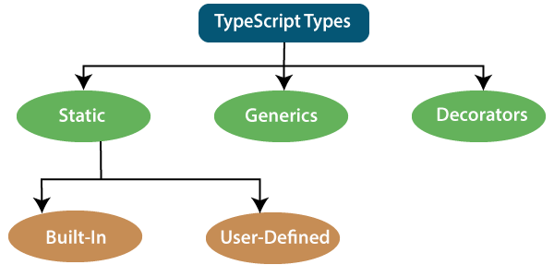

Slide 3
