Slide 1




ETNA AZOULAY HAROUN
SYMFONY
`CROWDIN`
Here your text

Slide 2

ETNA SYMFONY
Table Of `Contents`
}
}
01
}
02
}
SYMFONY
DEMO
Presentation and characteristics .
I will show my project.
}
03
}
My assessments

Slide 3

<Company> <Lesson>
{01}
`PHP ?`
PHP (Hypertext Preprocessor) is a widely-used open-source back end language It was created by Rasmus Lerdorf in 1994.
Bad reputation ? why ?
PHP actually

Slide 4

<Company> <Lesson>
Welcome To <SYMFONY>

Slide 5


ETNA SYMFONY
{ }
`Why SYMFONY`
Advantage
{
}
Default

Slide 6
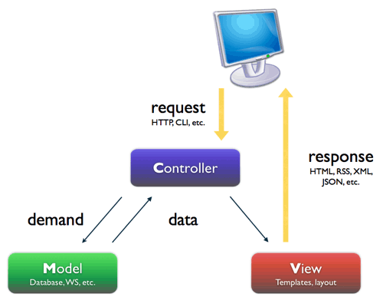
ETNA SYMFONY
‘MVC’ {

Slide 7

ETNA SYMFONY
Features of ‘SYMFONY’ {
Doctrine
Entity
Controller
Description: Represents the application's data objects, typically mapped to tables in a database via Doctrine ORM. Relations: Mapped to tables in the database, used in services and controllers.
Description: Handle HTTP requests and return HTTP responses. They contain the basic logic to direct user requests to the right services or actions. Relationships: Call services, use entities, return views (templates).

Slide 8
ETNA SYMFONY
Features of ‘SYMFONY’ {
Repository
Voters
Twig
Repositories are classe responsible for encapsulation acces logic
Voters are component of the security system used to make authorization decisions
Twig is the templating used in symfony

Slide 9

ETNA SYMFONY
CRUD`/
The Unit of Work is used to manage the state of the different objects hydrated by the Entity Manager.
Using the find function, it finds and hydrates an object from information found in the database;
Using the persist function, it adds the manipulated object to the Unit of Work;
Using the flush function, all objects "marked" to be added, updated and deleted will lead to the execution of a transaction with the database.

Slide 10
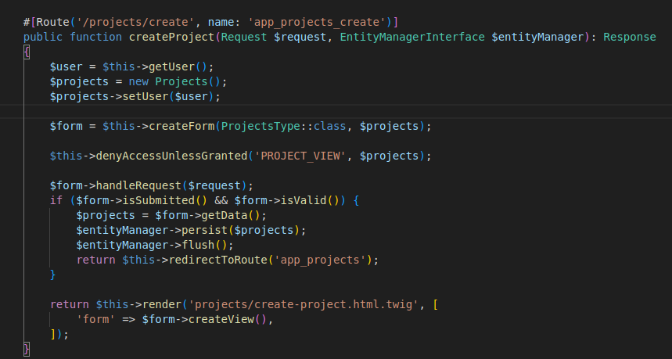
ETNA SYMFONY
Let’s go read the`code}

Slide 11
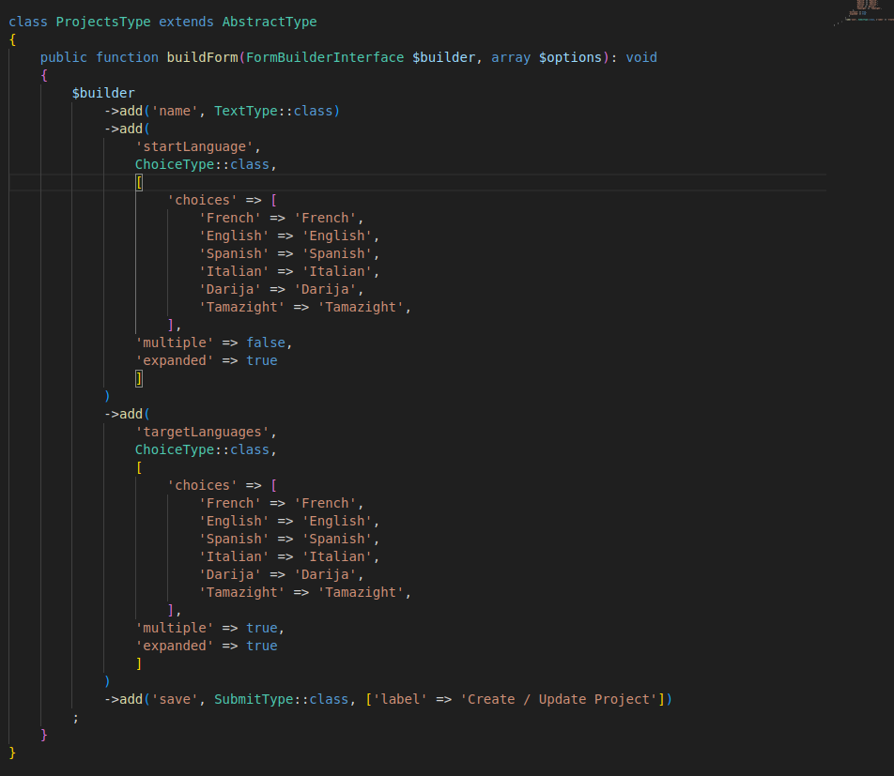
ETNA SYMFONY

Slide 12
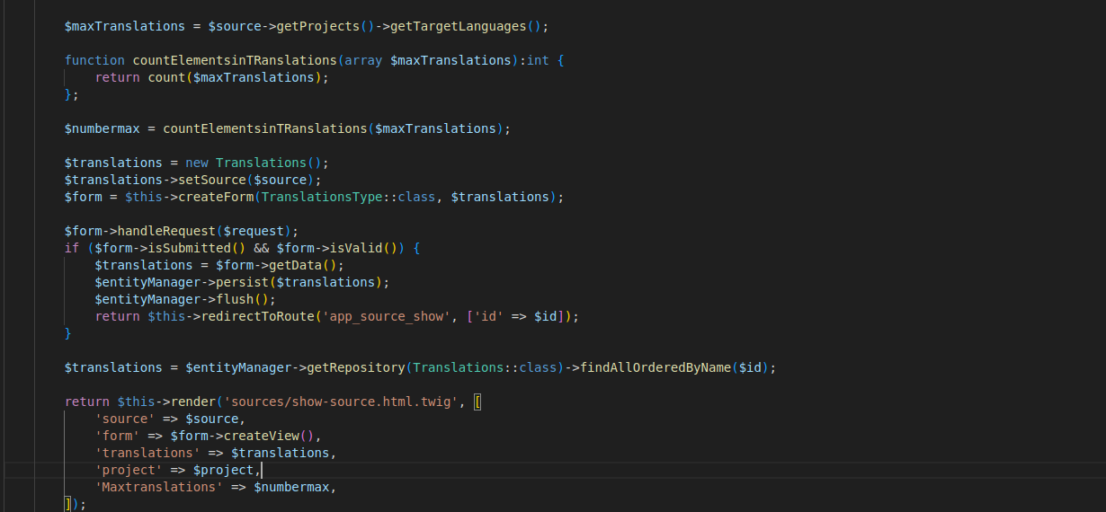
ETNA SYMFONY

Slide 13
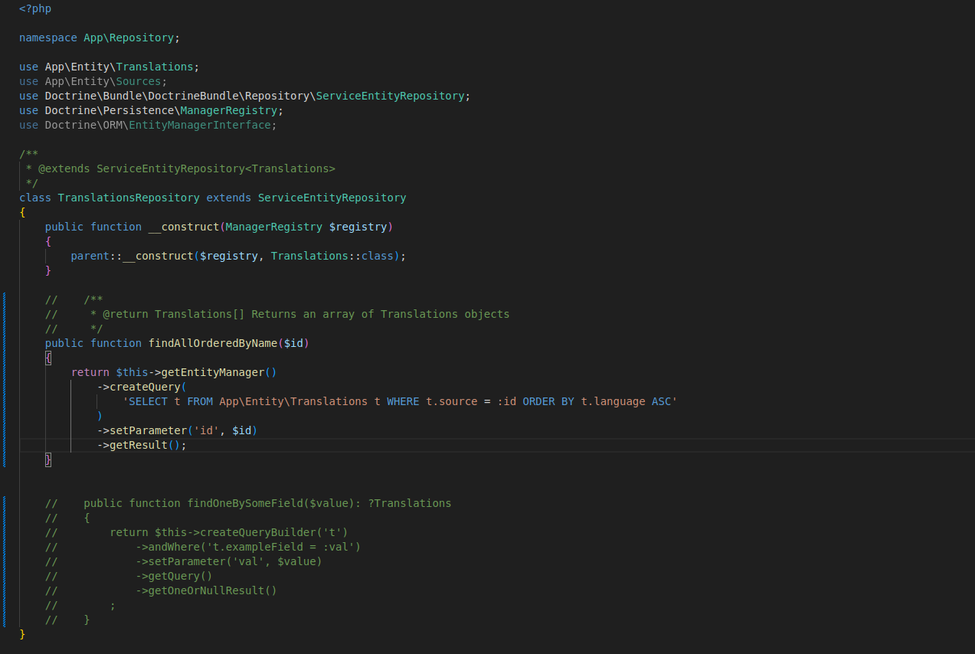
ETNA SYMFONY

Slide 14
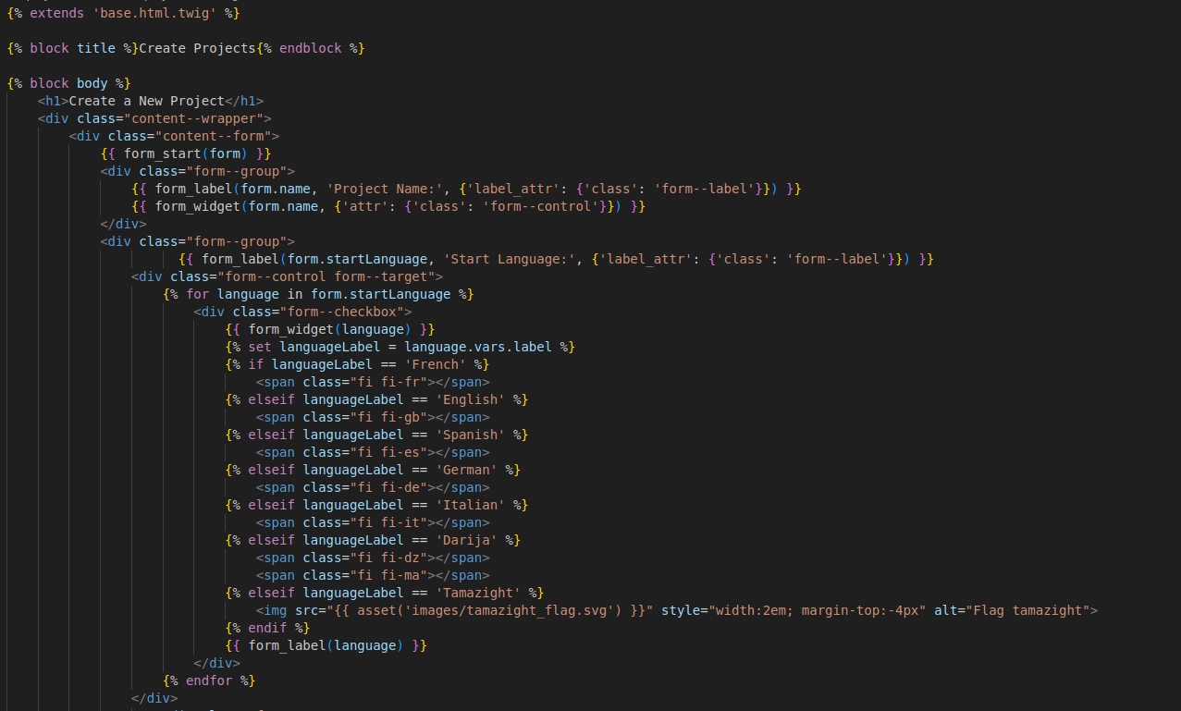
ETNA SYMFONY

Slide 15

DEMO

Slide 16

ETNA SYMFONY
Tips :
Use the make cmd
dd / dump

Slide 17

ETNA SYMFONY
Instructions!}`
Assessments intermediary :
- Db done
- Authentification done
- Crud
PHP 8.1+
Symfony 7+
MySQL/MariaDB/postgreSQL
You must use :
Doctrine (ORM)
Voters & access control
Form
Not a lot business logic in the controller

Slide 18












DOCUMENTATIONS
This is your only ressources for the project. You don't need more.
Symfony 7 : Documentation
https://symfony.com/doc/7.0/index.html
Twig : Documentation
https://twig.symfony.com/doc/
Php : Documentation
https://www.php.net/docs.php

Slide 19
Thanks for you attention !
Any Questions ?
If you have any questions or problems contact me on google tchat !

