Slide 1
How to Construct Deep Recurrent Neural Networks
Authors: R. Pascanu, C. Gulcehre, K. Cho, Y. Bengio
Presentation: Haroun Habeeb
Paper: https://arxiv.org/abs/1312.6026

Slide 2
This presentation
Motivation
Formal RNN paradigm
Deep RNN designs
Experiments
Note on training
Takeaways

Slide 3
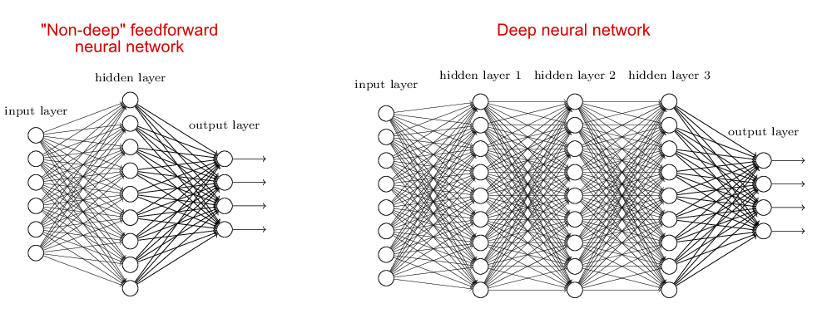
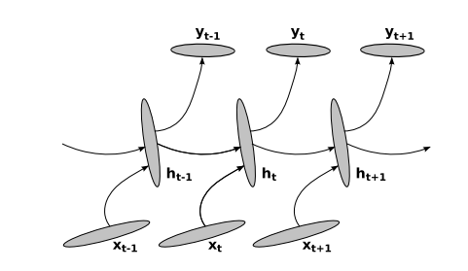
Motivation: Better RNNs?
Depth makes feedforward neural networks more expressive
What about RNNS? How do you make them deep? Does depth help?

Slide 4
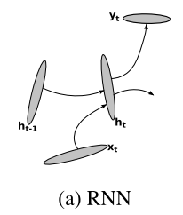
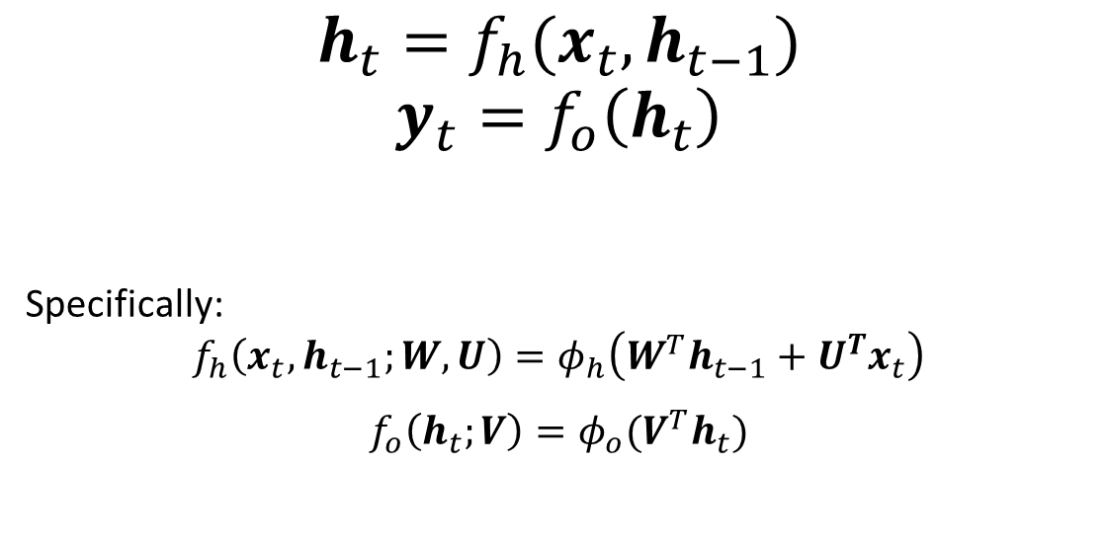
Conventional RNNs
$$h_{t}=f_{h}(x_{t}, h_{t−1})$$
$$y_{t}=f_{o}\left(h_{t}\right)$$
Specifically:
$$f_{h}\left(x_{t},h_{t−1};W,U\right)=φ_{h}\left(W^{T}h_{t−1}+U^{T}x_{t}\right)$$
$f_{o}\left(h_{t};V\right)=φ_{o}(V^{T}h_{t})$
How general is this?
How easy is it to represent an LSTM/GRU in this form?
What about bias terms?
How would you make an LSTM deep?

Slide 5
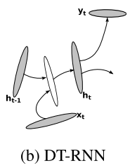
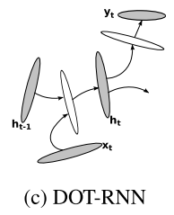
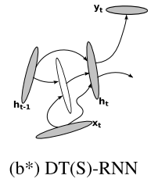
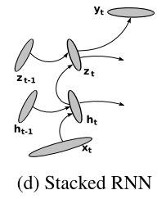
THE DEEPENING

Slide 6
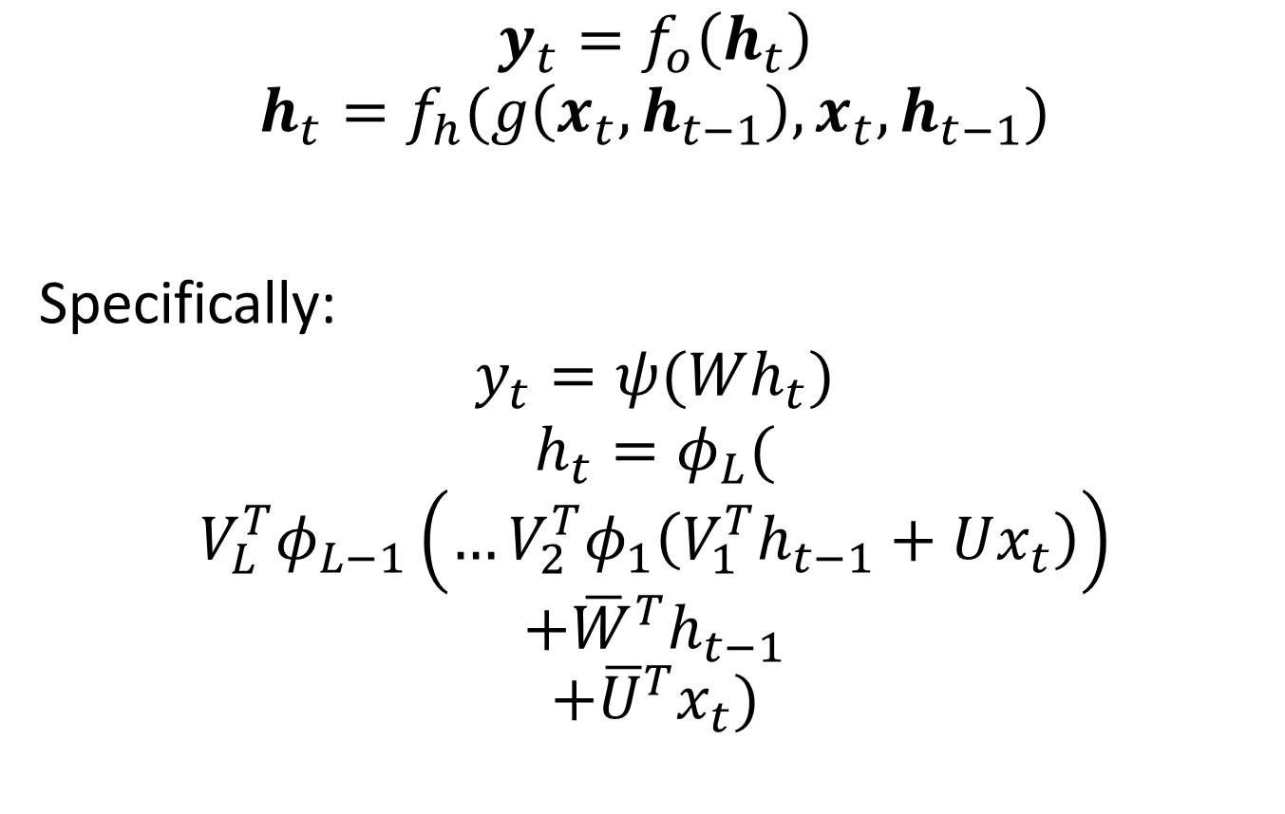
DT(S)-RNN
$$y_{t}=f_{o}\left(h_{t}\right)$$
$$h_{t}=f_{h}(g\left(x_{t}, h_{t−1}\right),x_{t}, h_{t−1})$$
Specifically:
$$y_{t}=ψ(Wh_{t})$$
$$h_{t}=φ_{L}($$
$$V_{L}^{T}φ_{L−1}\left(…{V_{2}^{T}φ}_{1}\left(V_{1}^{T}h_{t−1}+Ux_{t}\right)\right)$$
$$+{\overline{W}}^{T}h_{t−1}$$
$$+{\overline{U}}^{T}x_{t})$$

Slide 7
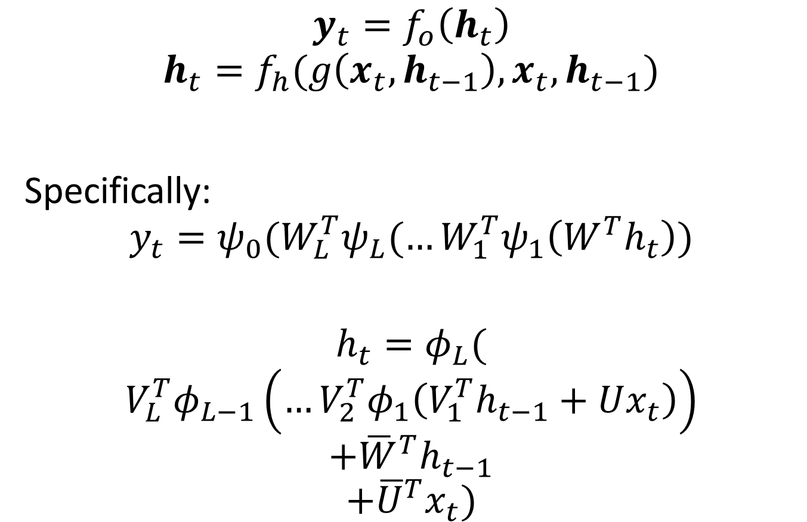
DOT(S)-RNN
$$y_{t}=f_{o}\left(h_{t}\right)$$
$$h_{t}=f_{h}(g\left(x_{t}, h_{t−1}\right),x_{t}, h_{t−1})$$
Specifically:
$$y_{t}=ψ_{0}(W_{L}^{T}ψ_{L}(…W_{1}^{T}ψ_{1}\left(W^{T}h_{t}\right))$$
$$h_{t}=φ_{L}($$
$$V_{L}^{T}φ_{L−1}\left(…{V_{2}^{T}φ}_{1}\left(V_{1}^{T}h_{t−1}+Ux_{t}\right)\right)$$
$$+{\overline{W}}^{T}h_{t−1}$$
$$+{\overline{U}}^{T}x_{t})$$

Slide 8
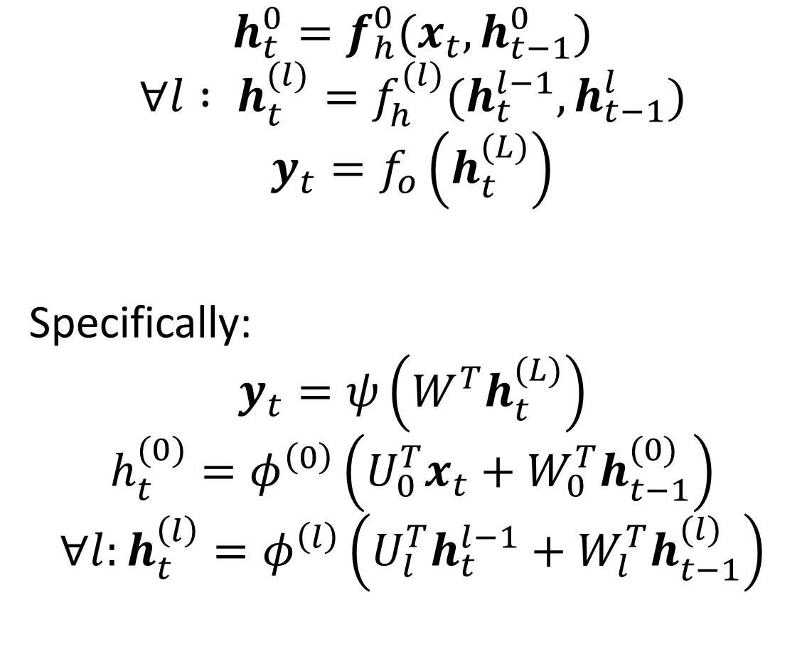
sRNN
$$h_{t}^{0}=f_{h}^{0}(x_{t},h_{t−1}^{0})$$
$$∀l : h_{t}^{(l)}=f_{h}^{(l)}(h_{t}^{l−1}, h_{t−1}^{l})$$
$$y_{t}=f_{o}\left(h_{t}^{(L)}\right)$$
Specifically:
$$y_{t}=ψ\left(W^{T}h_{t}^{(L)}\right)$$
$$h_{t}^{(0)}=φ^{\left(0\right)}\left(U_{0}^{T}x_{t}+W_{0}^{T}h_{t−1}^{(0)}\right)$$
$$∀l:h_{t}^{\left(l\right)}=φ^{\left(l\right)}\left(U_{l}^{T}h_{t}^{l−1}+W_{l}^{T}h_{t−1}^{(l)}\right)$$

Slide 9
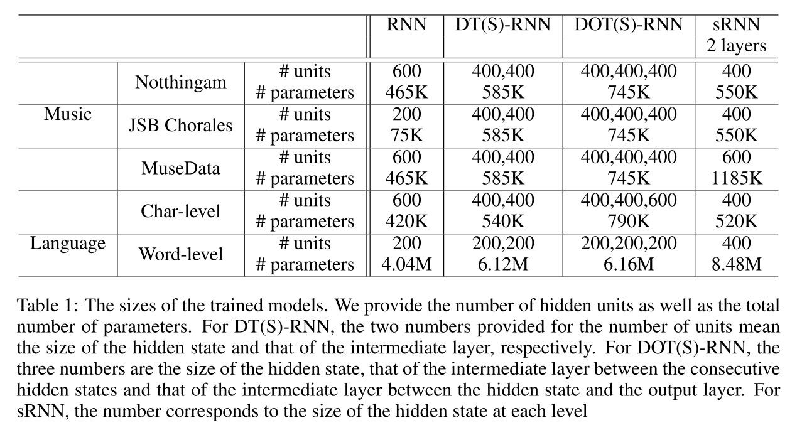
Experiment 0: Parameter count
Food for thought:
Not clear which one has most number of parameters – sRNN or DOT(S)-RNN.

Slide 10
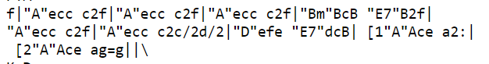
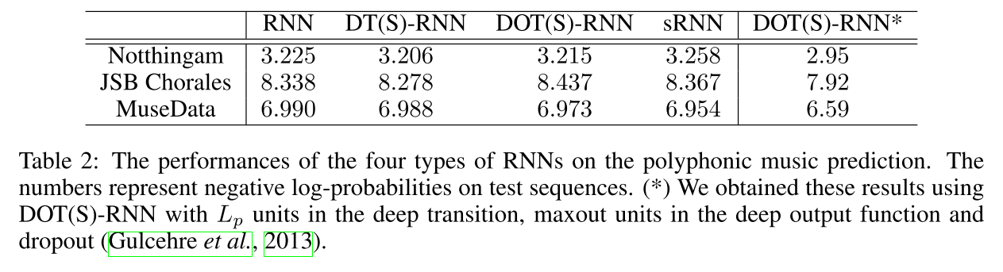
Experiment 1: Polyphonic Music Prediction
Task:
Next note(s)
Sequence of musical notes
Food for thought:
Sure, depth helps, but * helps a lot more in this case. What about RNN* and other models with *?

Slide 11
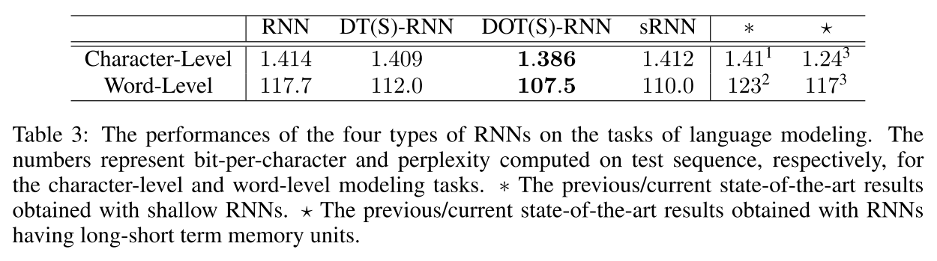
Experiment 2: Language Modelling
Task
(LM on PTB)
Next character/word
:
Sequence of characters/words
Food for thought:
Deepening LSTMs? Stack them or DOT(S) them?

Slide 12
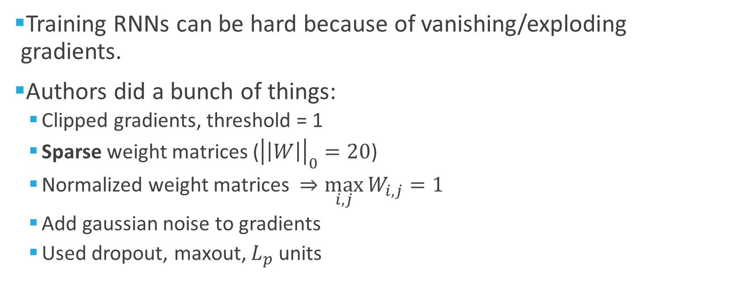
Note on training
Training RNNs can be hard because of vanishing/exploding gradients.
Authors did a bunch of things:
Clipped gradients, threshold = 1
Sparse weight matrices (${\left|\left|W\right|\right|}_{0}=20$)
Normalized weight matrices $⇒\max_{i,j}{W_{i,j}}=1$
Add gaussian noise to gradients
Used dropout, maxout, $L_{p}$ units

Slide 13
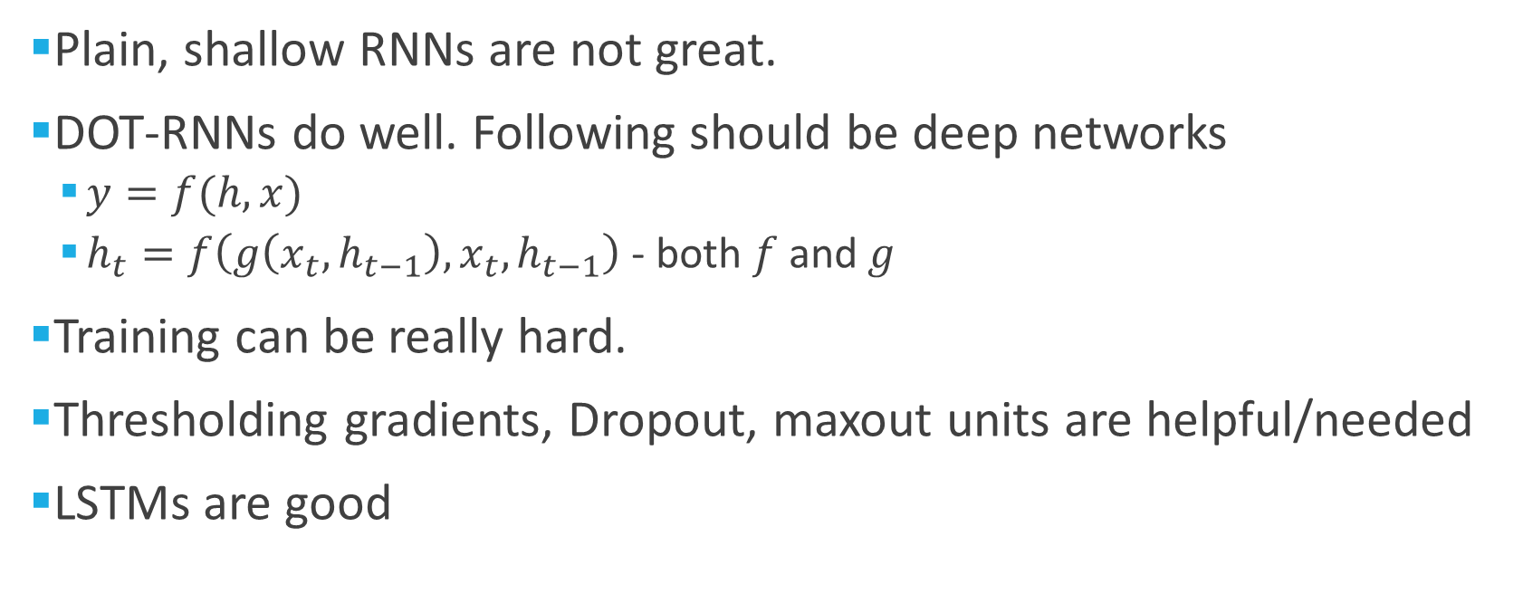
Takeaways
Plain, shallow RNNs are not great.
DOT-RNNs do well. Following should be deep networks
$y=f(h, x)$
$h_{t}=f\left(g\left(x_{t},h_{t−1}\right),x_{t},h_{t−1}\right)$ - both $f$ and $g$
Training can be really hard.
Thresholding gradients, Dropout, maxout units are helpful/needed
LSTMs are good
Questions?

