Slide 1



African Centre of Excellence for Genomics of Infectious Diseases (ACEGID): Bioinformatics core facility
Dr. Javan Okendo
ORCID: 0000-0001-8218-5448
09th May, 2023
@javan_okendo

Slide 2



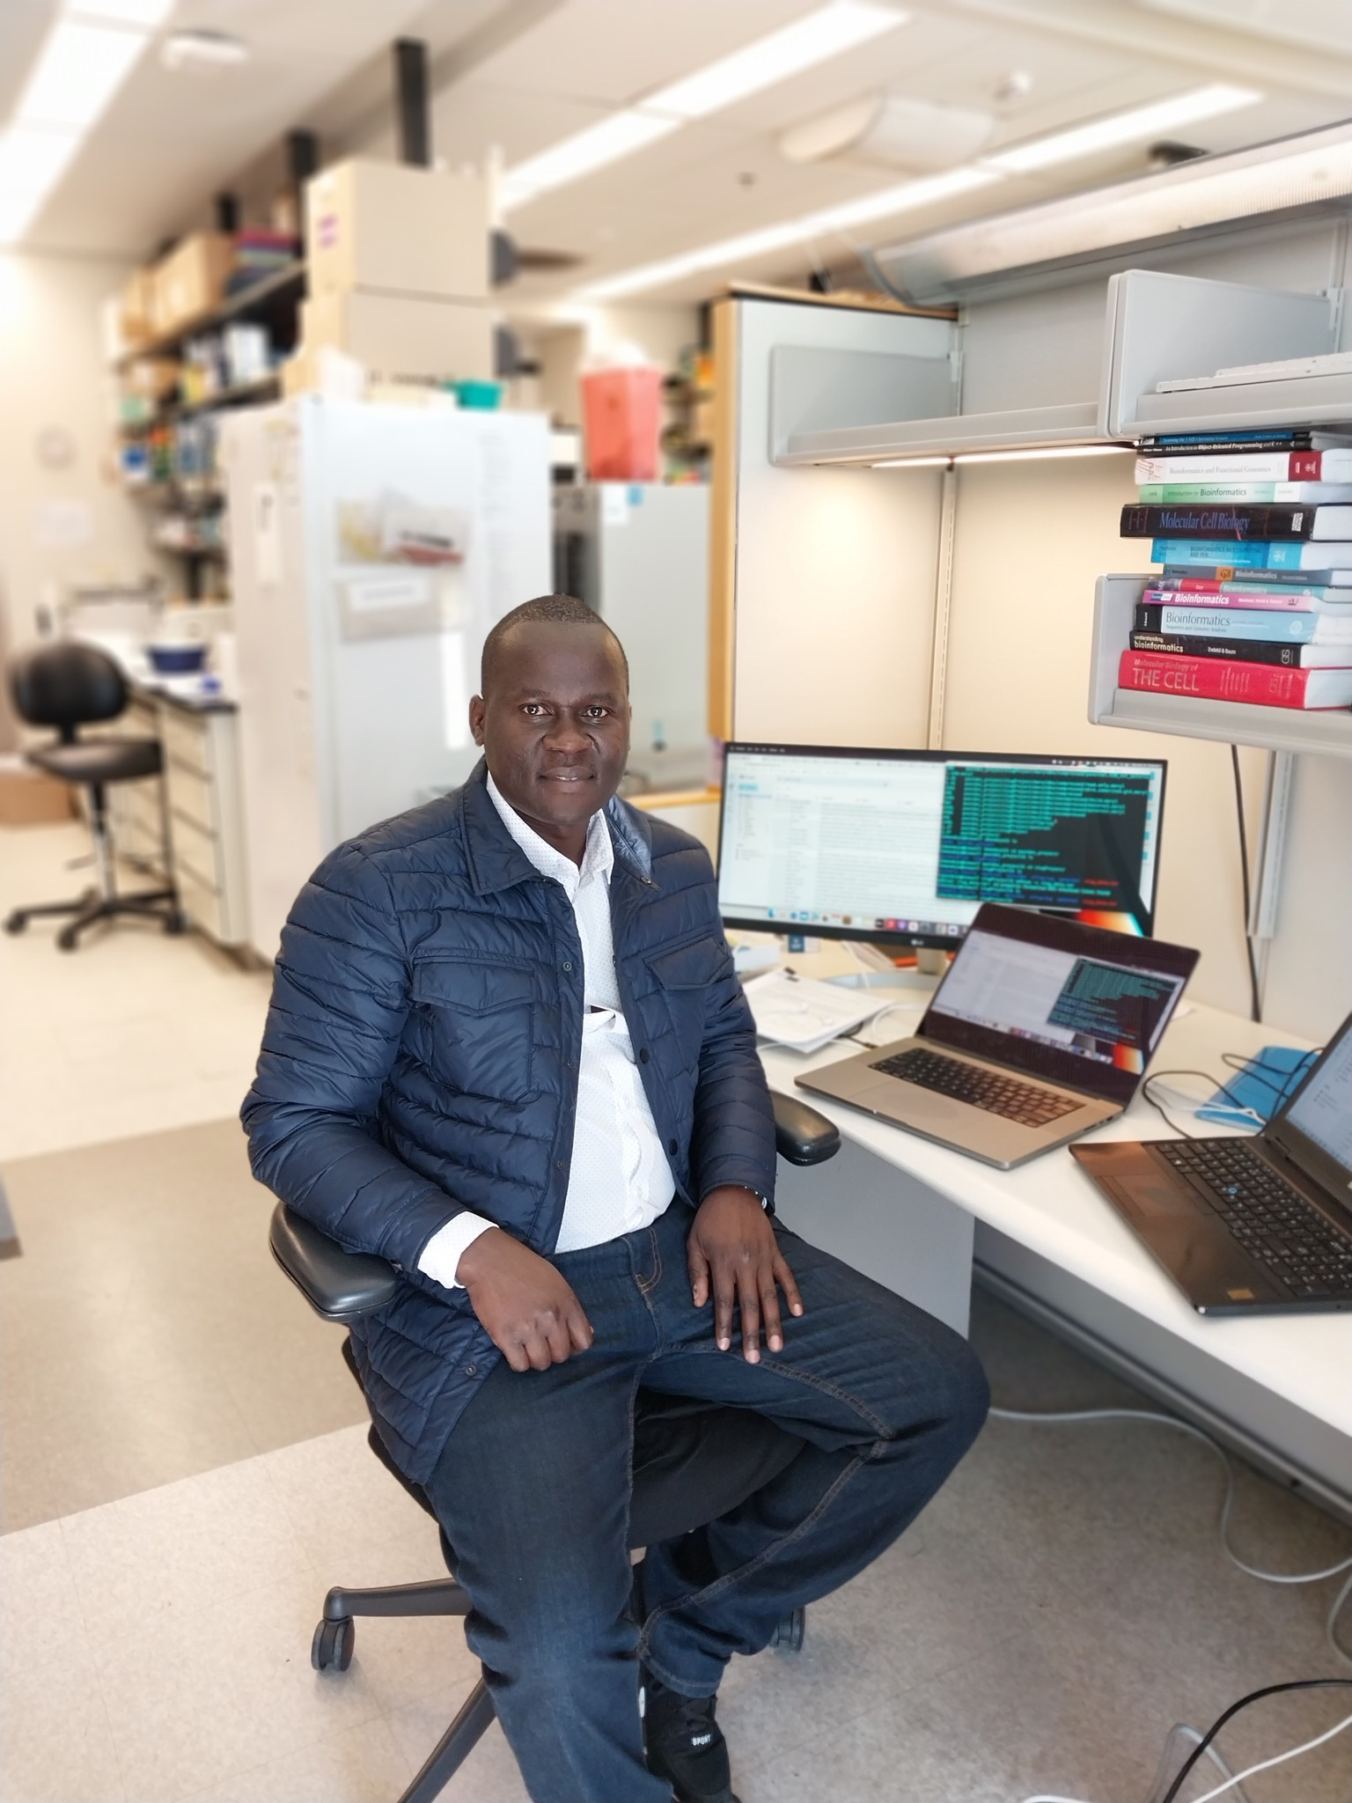


About me: Dr. Javan Okendo
Postdoctoral visiting fellow
NHGRI, NIH, Bethesda USA
PhD (Chemical & systems Biology)
M.Sc. Bioinformatics
BSc (Molecular biology)
Introduction
Education
Employment
Why work at ACEGID?
Train next generation of African scientists
Contribute to the understanding of circulating health threats
Give back to Africa
Novartis, Pharma, Basel, Switzerland
DIPLOMICs, South Africa
Research Assistant, Strathmore University

Slide 3
Bioinformatic analysis
Raw sequences
(FASTQ)
List of Differentially
Expressed Genes

Slide 4
Becoming too complicated day by day
Automation in analysis increasingly common
Duplication Rates
Stranded Vs Unstranded
Alignment Stats
Biases
featureCounts
Raw sequences
(FASTQ)
List of Differentially
Expressed Genes
Sample Mix Ups
Read Error Rates
Read Counts
BAM

Slide 5
Bioinformatics in a typical NGS project
Experimental Design and Planning
Library Preparation
Sample Tracking
Sequencing
Quantitation
Comparison
NGS Pipeline automation increasingly common
Many advantages, but errors, bias and bug need to be checked for
Statistics
Functional Analysis
Results

Slide 6
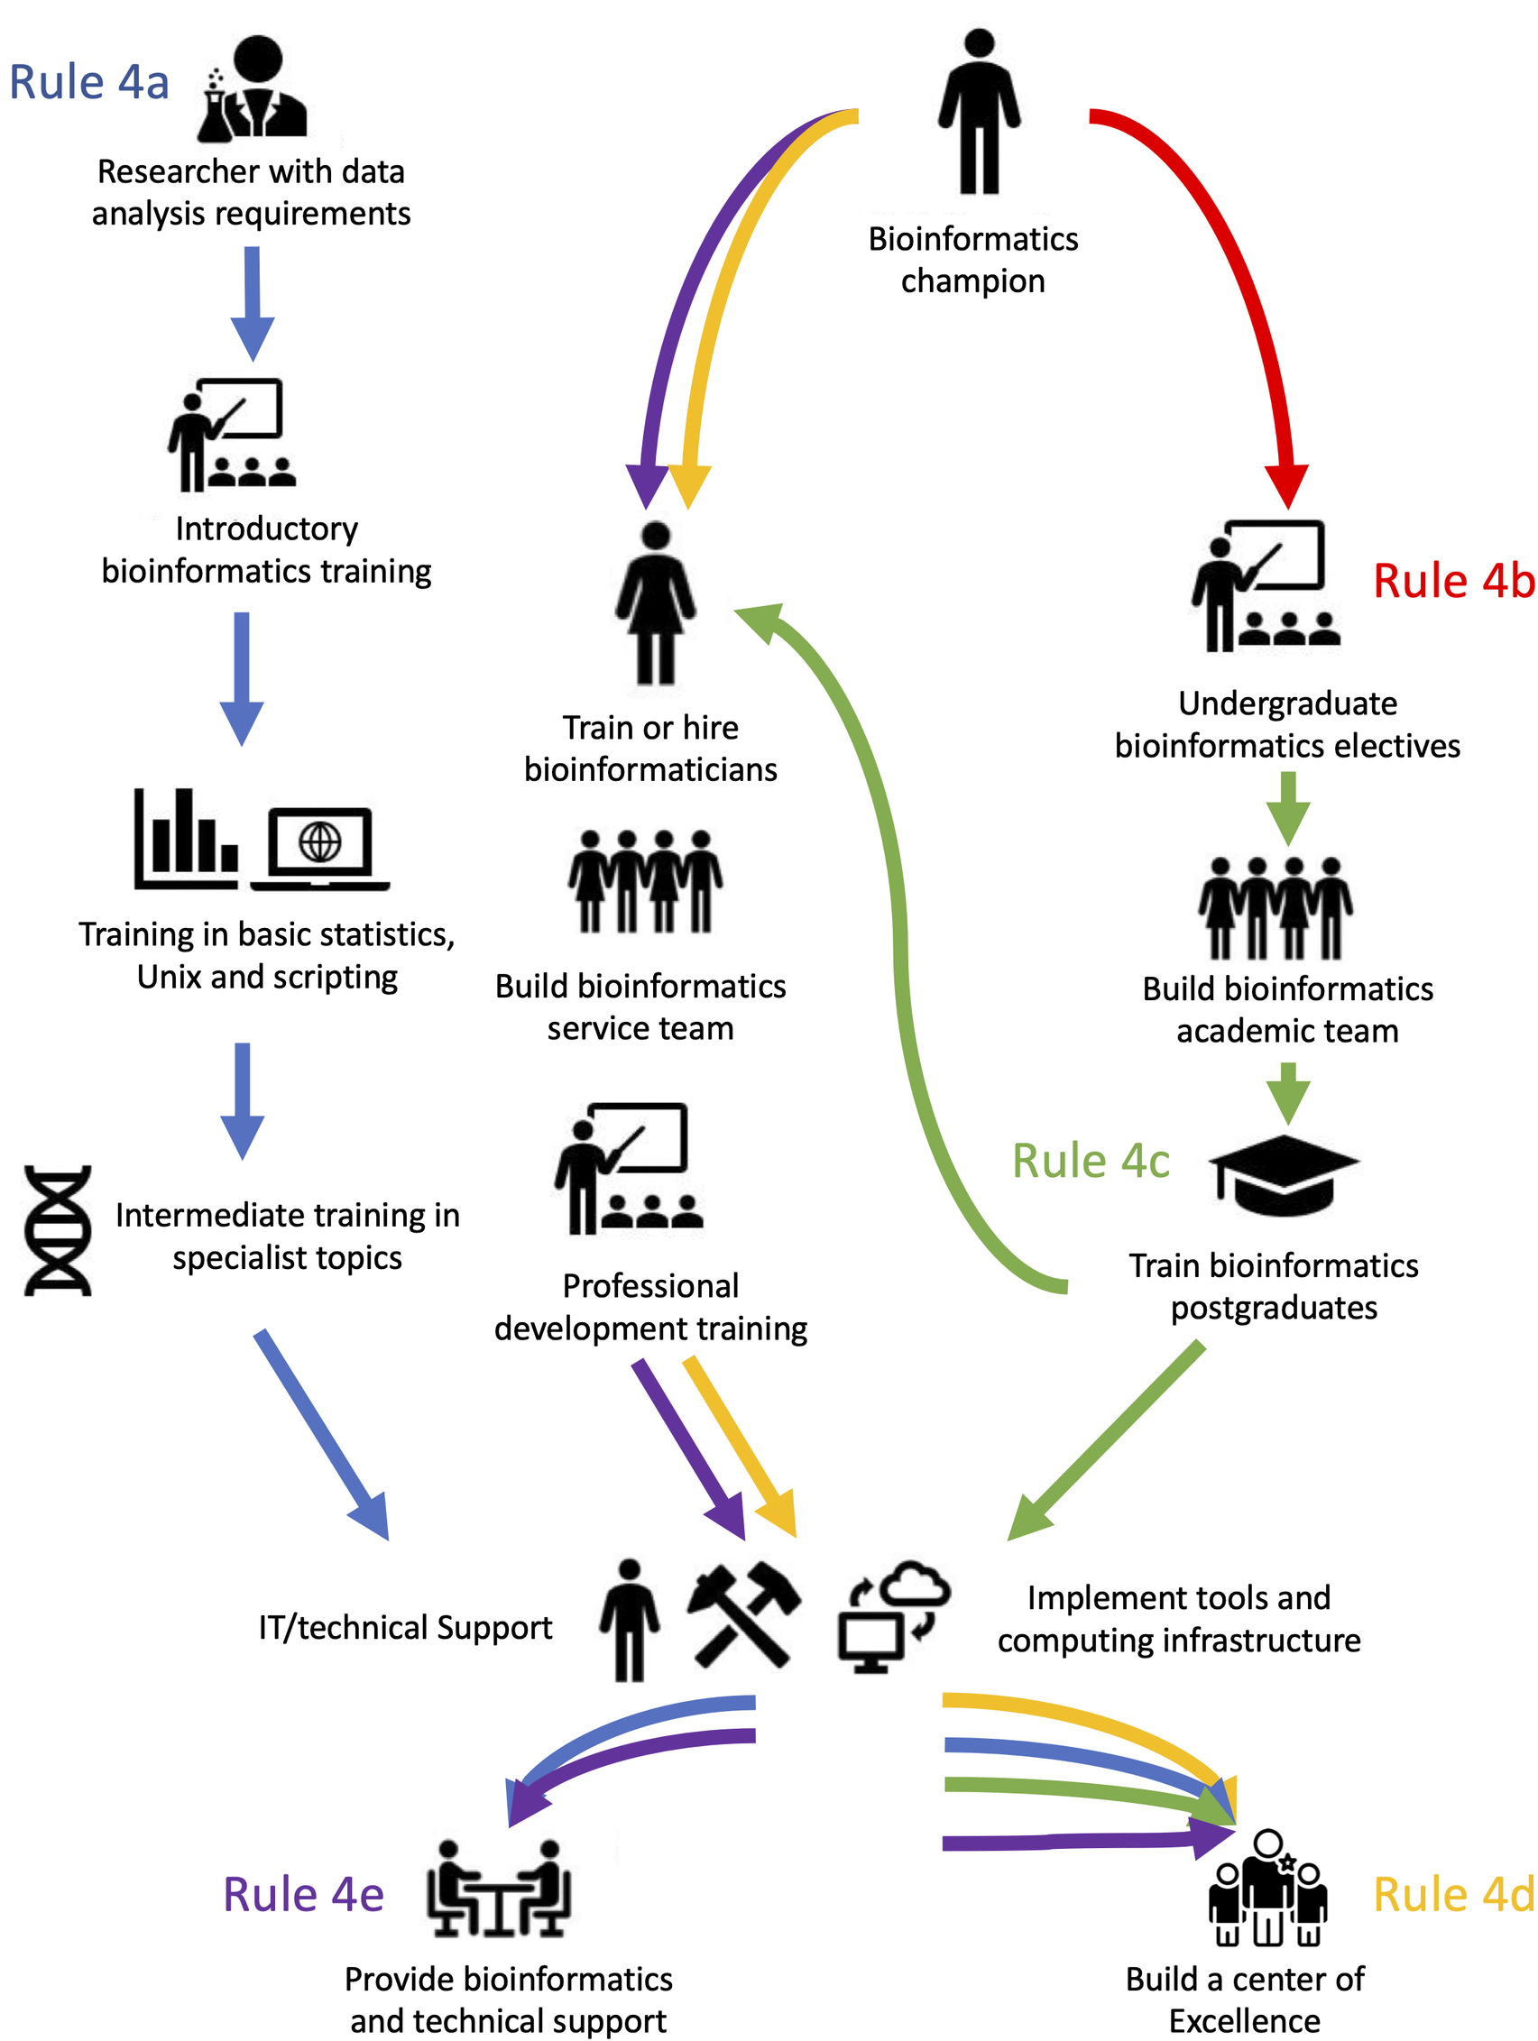
Bioinformatic team focus area at ACEGID

Slide 7
Role of bioinformatic team
Project planning & management: Develop project plans, timelines & budget
Team management: Oversees training, tasks assignment & responsibilities.
Data analysis & interpretation: Identify pattern, trends and insights from the data.
Research design & implementation: Project design, execution and documentation e.g use GitHub repos
Collaboration and communication: Research relevance and impactful
Quality control and assurance: Ensures data analysis & research output is of good quality and also meets ethical standards.

Slide 8


Open door policy

Slide 9
Immediate Plan(s)
Collect lab demographics
Consult team
Design our first training
Organize and deliver our first training

Slide 10
Thank you!

