Slide 1
ACEGID Lab Demographics outlook
Bioinformatics core team

Slide 2
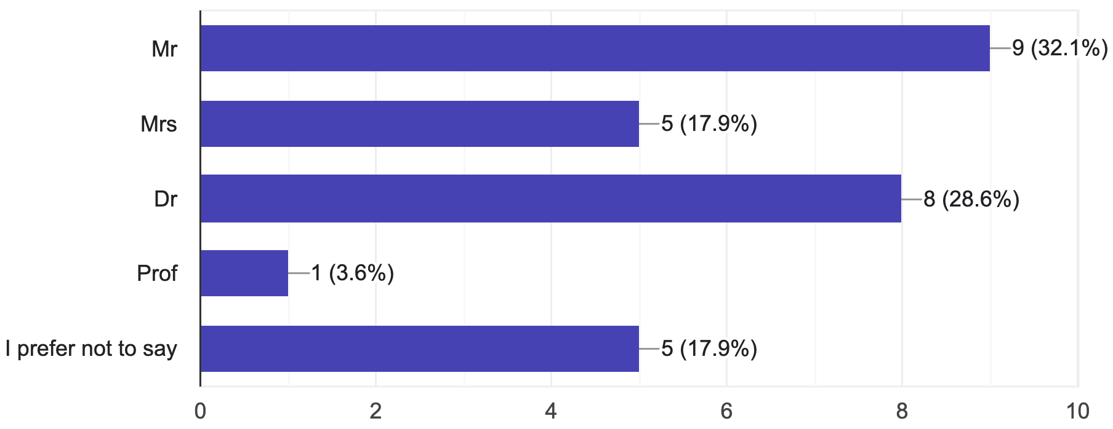
Title of the lab members

Slide 3
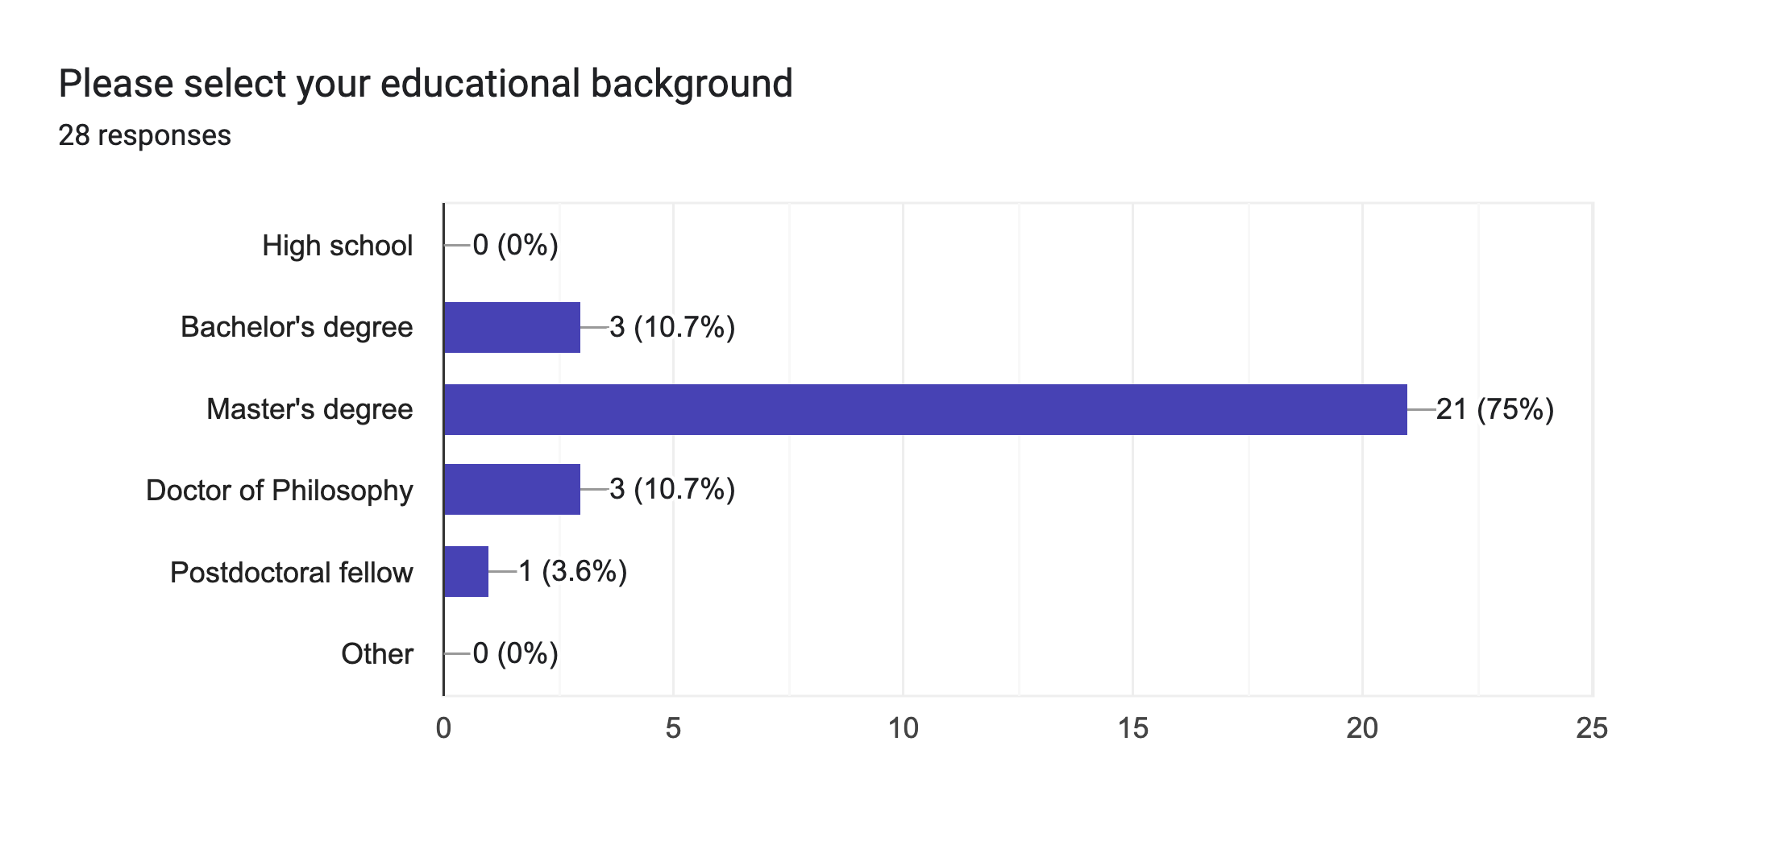
Majority in the lab are MSc graduates/students

Slide 4
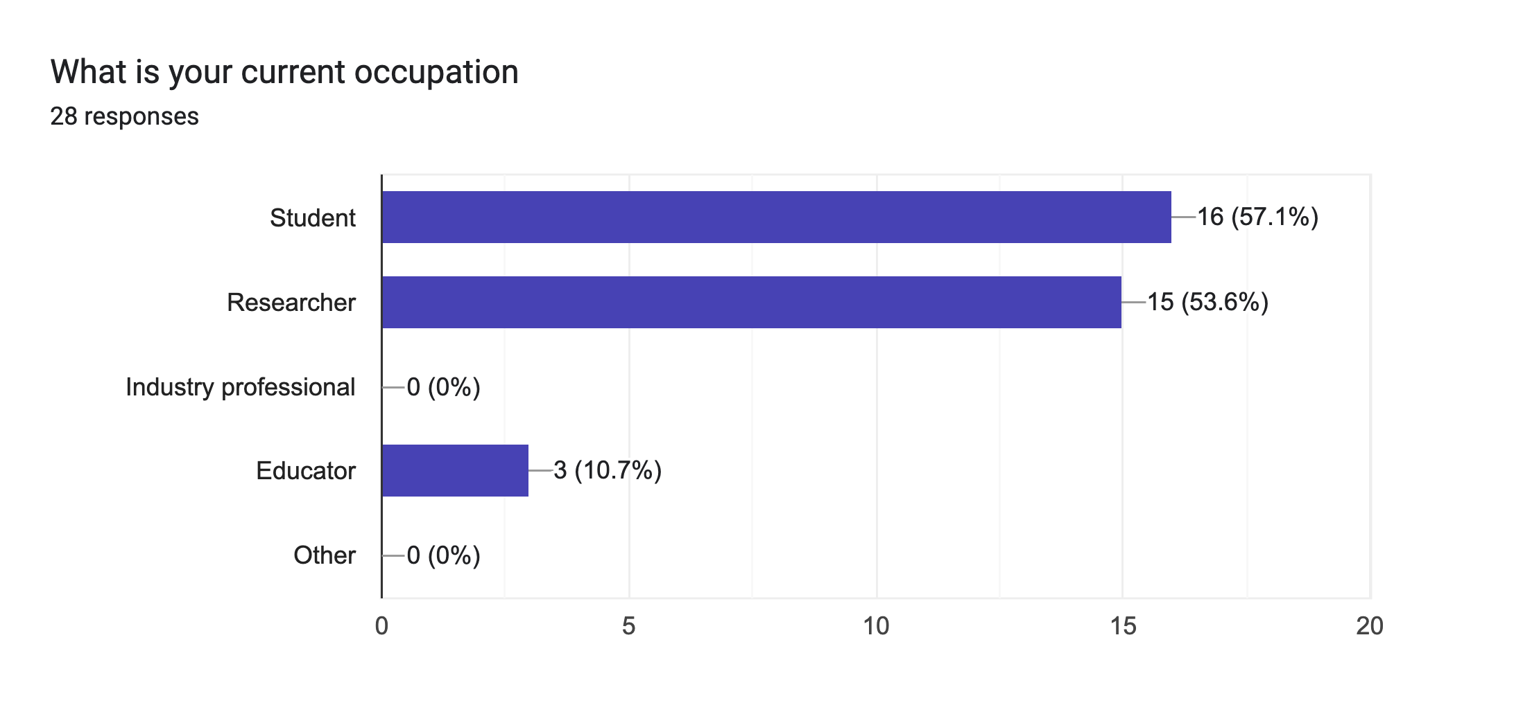
The lab is made up of majority students and researchers

Slide 5
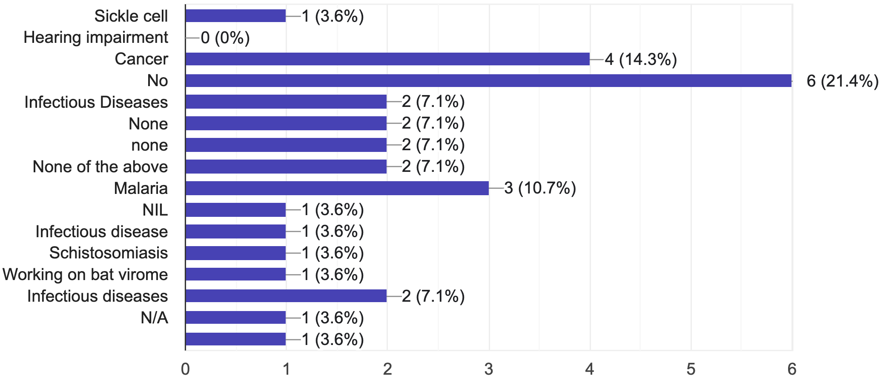
Most of the responders are not working on non-communicable diseases

Slide 6
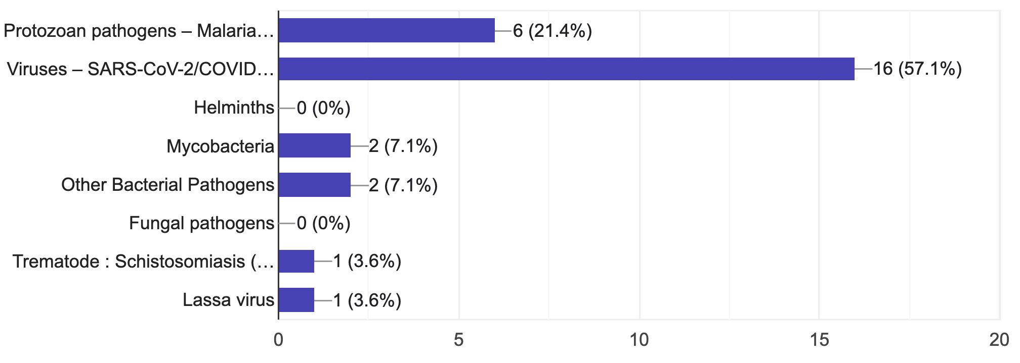
Viruses are the most studied pathogens in the lab

Slide 7
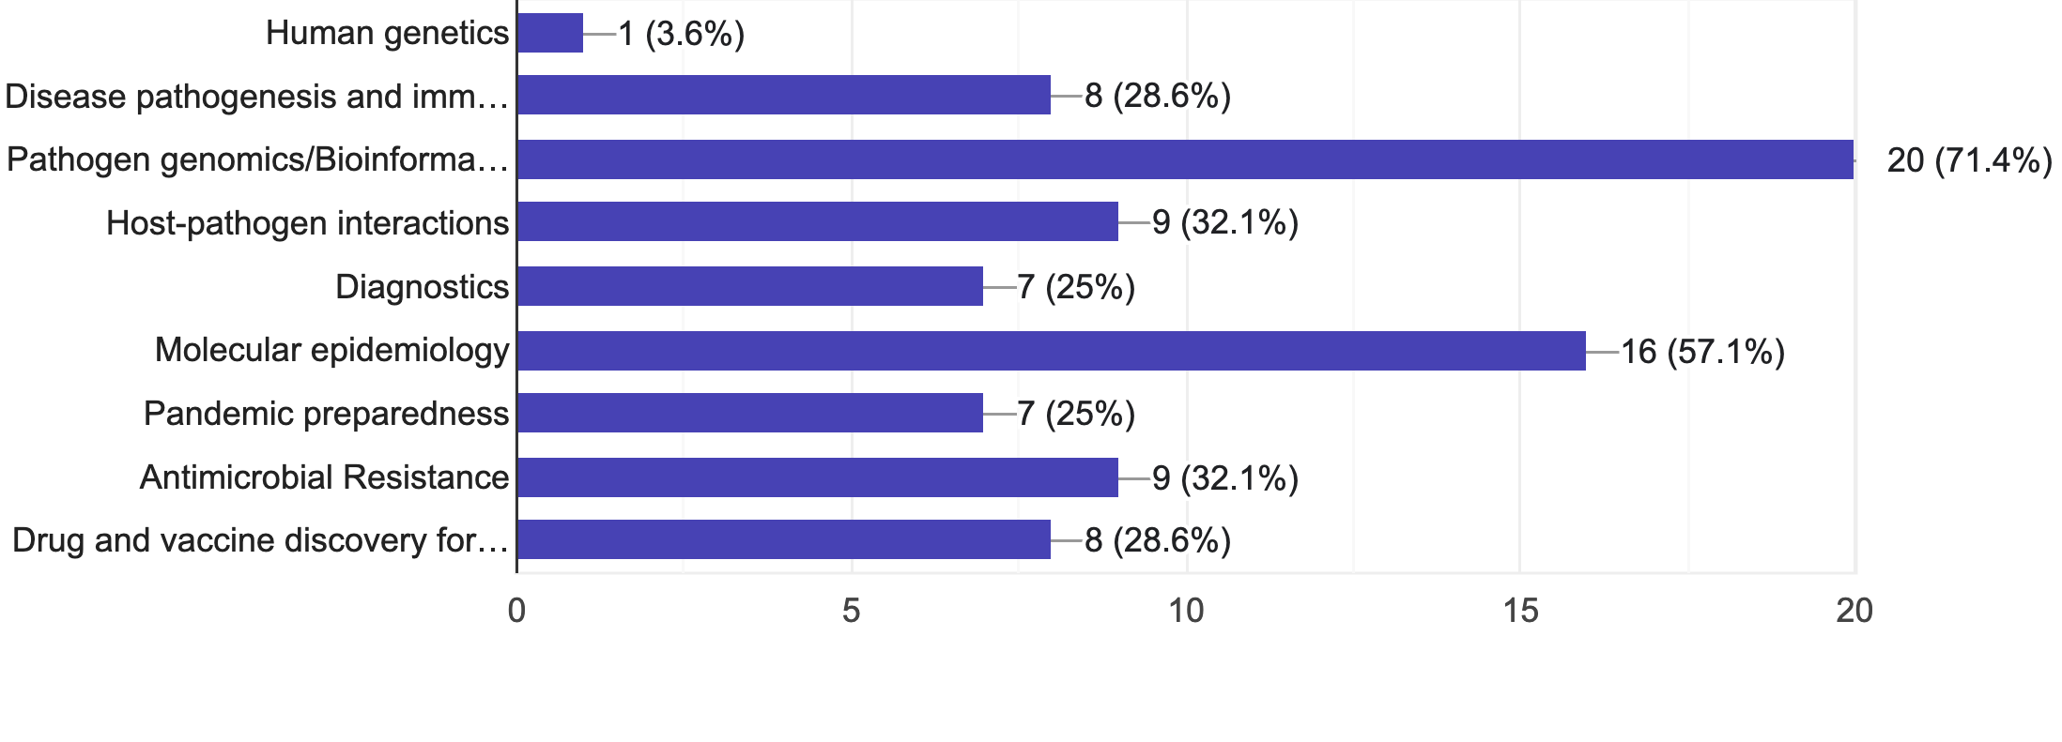
There is a high diversity in research theme

Slide 8
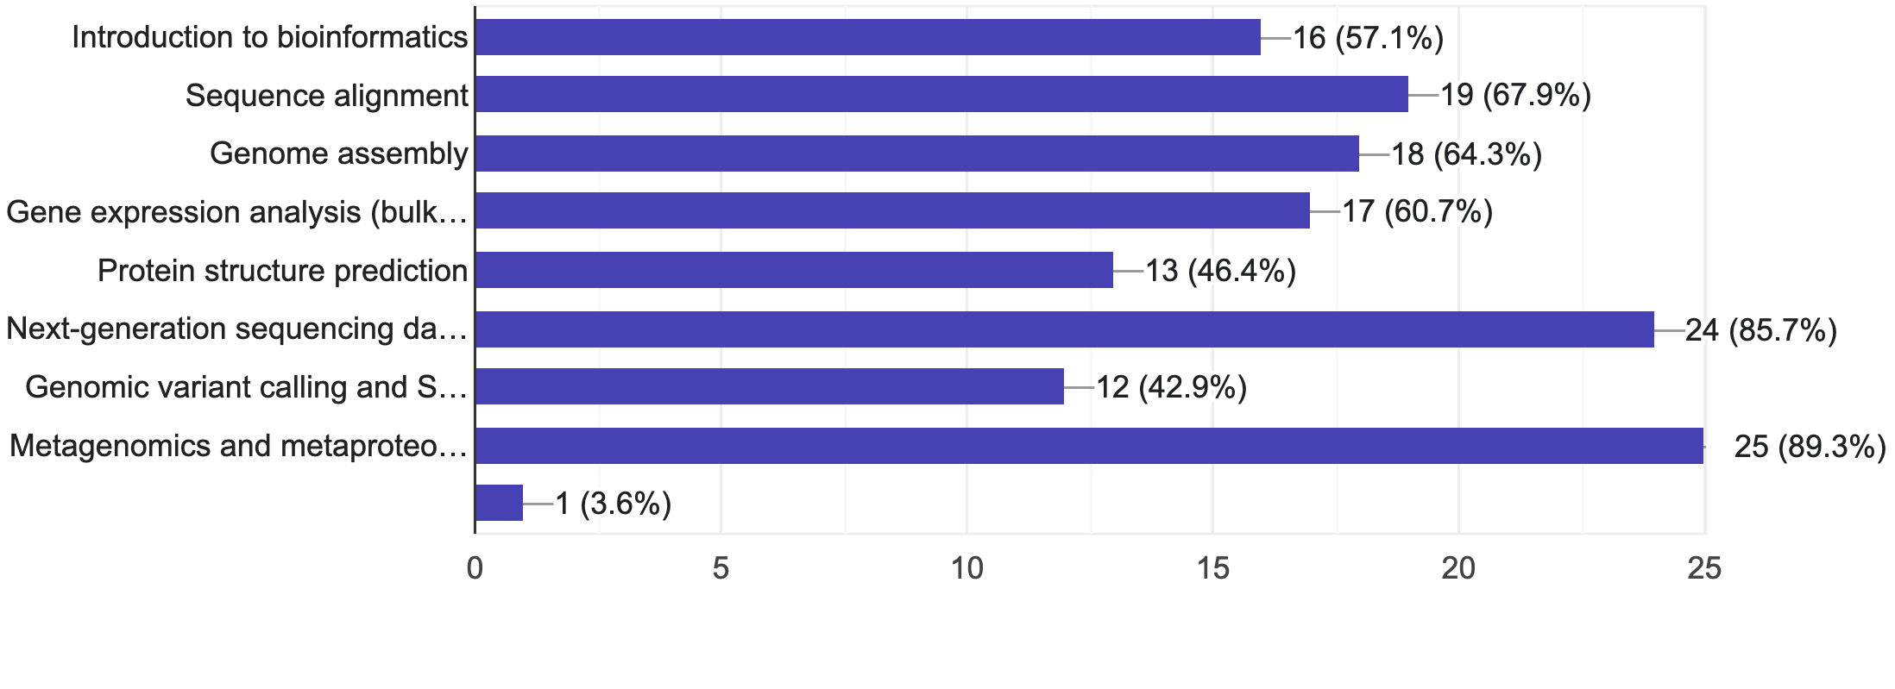
Lab members desire to learn a broad bioinformatics skills

Slide 9
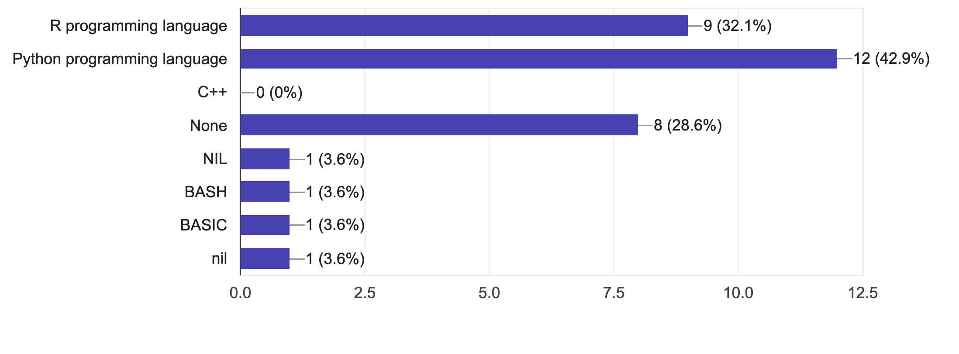
Python and R are the most preferred

Slide 10
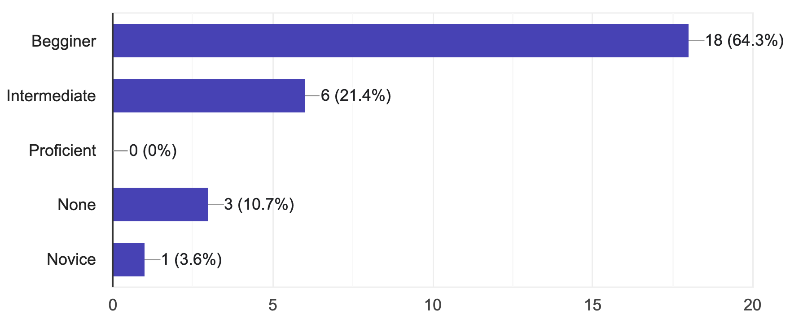
64% of the respondents are beginners in R and python programming languages

Slide 11
Conclusion
The training design should begin from the introductory level to bioinformatics

