Slide 1


Introduction to Linux and PBS server
Javan Ochieng Okendo (javanokendo@gmail.com) Chemical and systems biology division
University of Cape Town

Slide 2


Learning Objectives
①Understand the Unix file structure
②Understand full vs relative paths: when and how to use them
③Learn how to create directories and navigate through the file structure
④Learn Learn how to create a basic bash script
5 Learn how to transfer files from PC to the server

Slide 3
Learning Outcomes
① Be able to create a bash script
②Be able to run the jobs in the HPC environments
③Be able to create text files and view their content
④Be able to use simple shortcuts

Slide 4
What is Linux?
UNIX is an Operating System (OS) initially developed in the 1960.
There are many diﬀerent versions of UNIX, that share common similarities.
The most popular varieties of UNIX are Solaris, Linux and MacOS.
UNIX systems have a graphical user interface (GUI) making them easier to use.

Slide 5
Linux vs Unix
Linux is a “clone” of the original Unix but doesn’t contain its code
Linux is free and open source, the original Unix is not (but some of its derivatives are)
All command lines work the same on both

Slide 6



Why Linux?
Linux is free and the most popular distributions are Ubuntu, Fedora/Red Hat, Mandriva, etc.
Low cost and very stable system
Most secure OS
Best multi-user and multi tasking OS
The world’s fastest super computers run Linux
Fast developing OS (many developers)
Very popular as servers OS

Slide 7
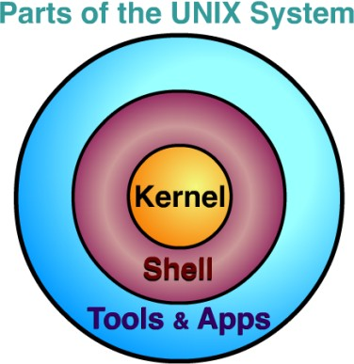












The core operating system
Accessible via the Terminal
Programs and softwares
Adapted from: www.usna.edu

Slide 8
The Terminal
A terminal refers to a wrapper program which runs a shell
There are many diﬀerent Unix shells, the most popular shell for interactive use include Bash: the default on most Linux installations

Slide 9










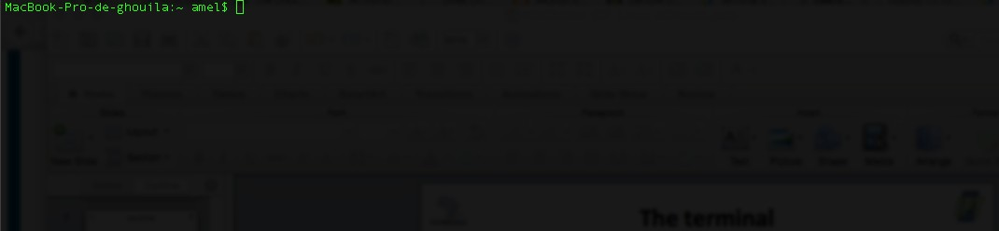
The Terminal
User name
Even though it is a command line interface, the mouse is still handy (scroll, copy, paste, etc.)
Shell prompt
Machine name

Slide 10
File-system under UNIX

Slide 11

































Linux ﬁles structure
Root directory of the entire file system
Users home directories
home
dev
bin etc
Essential user commands binaries
Configuration files
Device
files
Crick
Watson
Sanger
Desktop
Documents
IBT2017
Wastson ﬁles
Genomics
Linux
Session 1
Session 2

Slide 12































home
Watson
Desktop
Documents
IBT2017
Genomics
Linux
Directories ﬁles
fileX
Session 1
Session 2
file1
file2
Ordinary files
14

Slide 13
Home directory and working directory
When you first log in on a UNIX system, the working directory is your home directory.
While working you will be associated to one directory called the working directory or the current directory
An abbreviation of the working directory is displayed as part of the prompt on your terminal
The command pwd gives the absolute path of the working directory

Slide 14
What is a path or a pathname?
A path locates a given file in the system hierarchy
An absolute path in the file system hierarchy for a given file or folder describes the parents all the way up to the root
A relative path describes the path to the file starting from the current working directory

Slide 15
(your home directory)
~ refers to the home directory in a given file system
The tilde ~ character can be used to specify paths starting at your home directory

Slide 16























Absoulte path?
/
home
Watson
The full path to file1 is:
/home/Watson/IBT2017/Linux/Session1/ﬁle1
Desktop
Documents
IBT2017
Genomics
Linux
Session 1
Session 2
file1 file2

Slide 17






Absoulte path?
/
/
home
/home
Watson
/home/Watson
Desktop
Documents
IBT2017
/home/Watson/IBT2017
Genomics
Linux
/home/Watson/IBT2017/Linux
/home/Watson/IBT2017/Linux/Session1
Session 1
Session 2
/home/Watson/IBT2017/Linux/Session1/file1
file2
file1

Slide 18
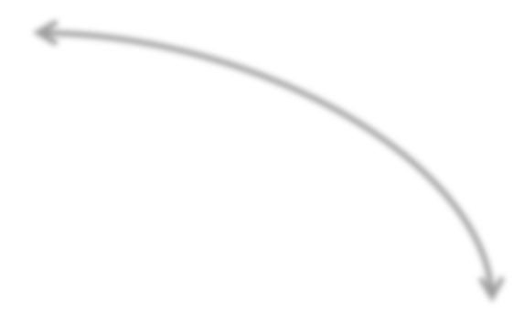














Refer to the parent and current directories
Every directory has two special sub- directories:
IBT2017
Genomics
Linux
. ..
. (dot): the current directory
.. (dot-dot): the parent directory
Session 1
Session 2

Slide 19





Relative path?
/
home
Current working directory
Watson
.
Desktop
Documents
IBT2017
refers to the current directory
Genomics
./Linux
Linux
./Linux/Session1
Session 1
Session 2
file2 ./Linux/Session1/file1
file1

Slide 20
First test of the terminal
Open the Terminal on your system
The shell prompt will appear
Ok, let’s try some typing !

Slide 21

II. Getting Started: Basic command
When you sign in you will be located in your home directory.
To see where this directory is located in the file system, use the pwd command:
echimusa@login2 ~]$ pwd
/home/echimusa
For example:
Now you should be in the home directory. To see what is inside of this directory, use the ls command (ls stands for list):
[echimusa@login2 ~]$ ls
get-pip.py hapfuse MarViN1 soft supportmix vcftools
To change to a different directory, use the cd command (cd means change directory):
[echimusa@login2 ~]$ cd /mnt/lustre/users/echimusa/
You can supply certain alias terms to the cd command. One of these is the ̃ character, which represents your home directory (/home/echimusa/). Another is .., which represents the directory above the current directory.

Slide 22

II. Getting Started: Basic command
What does it do?
List files in the current directory
Usage
$ ls # list all files in current directory
$ ls *.txt # list all text files
Option s | What does it do?
-l | List file details
-h | Human-readable file sizes (e.g. 3.3MB vs. 3354123)
 | Lots of build in sorting options (size, type, last update, etc.)
22

Slide 23
II. Getting Started: Basic command
You can supply certain alias terms to the cd command. One of these is the character, which represents your home directory (/home/echimusa/). Another is .., which represents the directory above the current directory. Let try this
$ cd
$ cd ..
To see which user you are signed in as, use the whoami command:
[okendoj@login2 ~]$ whoami
To see who else is signed in to the same system, use the who command:
[okendoj@login2 ~]$ who
embele pts/0 2017-05-04 11:10 (10.128.23.174)
abarde pts/1 2017-05-06 20:30 (146.141.41.149)
zfakhar pts/3 2017-05-06 18:41 (2.146.1.71
To see current data:
[okendoj@login2 ~]$ date
Sat May 6 22:24:28 SAST 2017

Slide 24
II. Getting Started: Basic command
To create your own directories use the mkdir (make directory) command:
[echimusa@login2 ~]$ mkdir proteins [echimusa@login2 ~]$ cd proteins/ [echimusa@login2 proteins]$ ls [echimusa@login2 proteins]$
[echimusa@login2 proteins]$ pwd
/home/echimusa/proteins
To create new file, let use touch and nano see who else is signed in to the same system, use the who command:
[echimusa@login2 proteins]$ touch my_sequence.sh [echimusa@login2 proteins]$ ls -l my_sequence.sh
-rw-rw-r-- 1 echimusa echimusa 0 May 6 22:49 my_sequence.sh

Slide 25
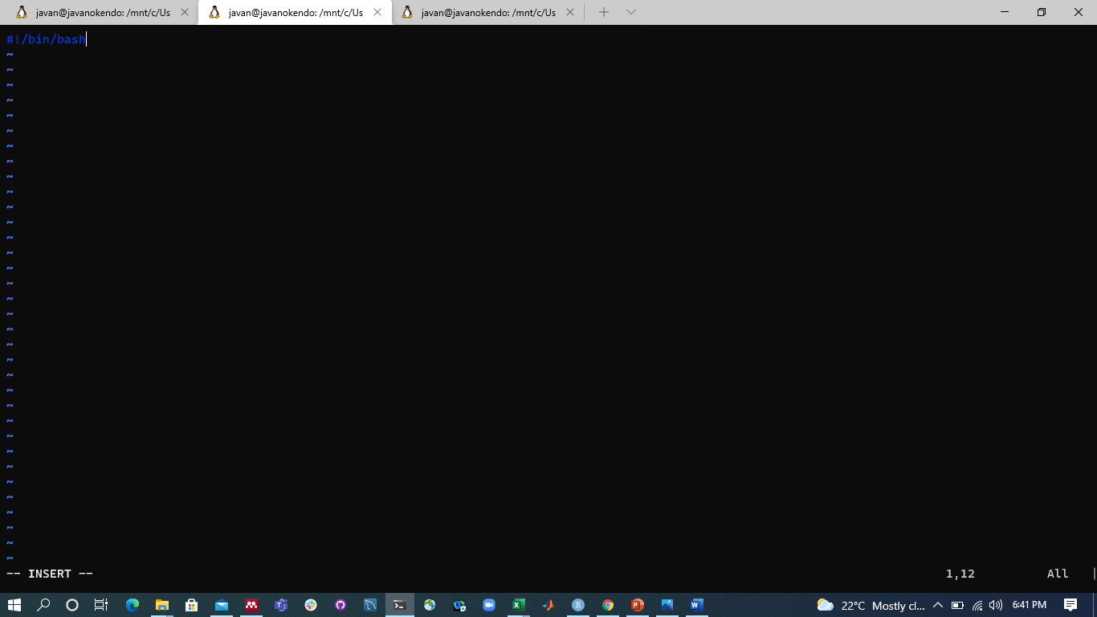

II. Getting Started: Basic commandc
okendoj@logins$ vim filename

Slide 26
II. Getting Started: Utility less
What does it do?
View a file or data stream with navigation options
Usage
$ less my_file
$ cat *.txt | less # ‘less’ is often used at the end of a chain
Option s | What does it do?
-S | Don’t wrap long lines
←↑→↓ | Arrow keys to navigate in file (PageUp, PageDown, Home, End work too)
/ | [in program] Search for text, use n and N to see next/previous matches
17/05/
08
26

Slide 27
II. Getting Started: Utility cat/zcat
What does it do?
Dumps files on disk to STDOUT (for feeding into another program)
Usage
$ cat my_file # lines of file scroll over screen Any other command $ zcat my_file.gz | program
$ cat my_file | program # lines of file enter program as STDIN
$ cat *.txt | program # concatenate all text files as STDIN
Cmd *char Cmd chr|*
Operate or apply on all files/folders with extension “char”. Operate or apply on all files/folders with prefix “char”.
Any piece of string mainly from file or folder name
Cmd *chr* Operate or apply on all files/folder containing the string “char”.
Should be any Linux command (cmd)

Slide 28
II. Getting Started: Utility top/kill
Opening an application or run a job locally on background: & at the end of the command line
Example:
$ firefox &
To see all running processes in your machine
A screen showing all running applications
$ top
To kill or stop a running process
$ kill PID
will be displayed.
Each with an id (PID), and the user names. Ctrt + c to terminate the screen.
PID can be used to force the stop
Running process id

Slide 29
II. Getting Started: Modules on PBS
modules manipulates your environment, to provide access to the supported software.
For a list of available modules:
[echimusa@login2 ~]$ module avail
To see currently loaded modules:
[echimusa@login2 proteins]$ module list
To remove all modules:
[echimusa@login2 proteins]$ module list
To load a modules:
[echimusa@login2 proteins]$ module load name_module

Slide 30
II. Getting Started: Job script parameters
my_sequence.sh
#!/bin/bash #PBS -N Xchr #PBS -q smp
#PBS -P CBBI0818
#PBS -l select=1:ncpus=24 #PBS -l walltime=48:00:00 #PBS -M echimusa@gmail.com
module load chpc/BIOMODULES module load chpc/python/2.7.11
qstat: View queued jobs. (eg. qstat -u user_name), or to see what are on each queue (qstat -Q).
qsub :Submit a job to the scheduler.
qdel :Delete one of your jobs from queue (qdel ID_of_your_job).

Slide 31
III. Transferring files
From both Mac and Ubuntu, we use the terminal to transfer the data from local to remote computer or from a remote to local machine. We commonly use scp, rsync, wget (curl)
Synthax:
a)
rsync options source destination
-au: update files that are newer in the
original directory
b)
scp options source destination
-r: if copying folder
From the ftp or internet source such as
http://www.whatever.com/filename.txt
wget options source -o path destination
c)
-nc => --no-clobber
-N => Turn on time-stamping
Is optional if copying in to current folder
-r => Turn on recursive retrieving

Slide 32
III. Transferring files: Examples
Example 1:
Launch the Terminal program.
Switch to your home directory on the Mac or Ubuntu using the command cd ̃ .
Create a text file containing your home directory listing using ls -l > myprotein.txt
(you will learn more about the meaning of > later).
Now use the scp command on your Mac/Ubuntu to transfer the file you created to your CHPC account. This command requires two values: the file you want to transfer and the destination. Be sure to replace “user” with your user name, and replace hostname with the real hostname or IP address of the CHCP system you want to connect to:
$ scp myfiles.txt user@hostname:~
You should be prompted for your user account password. Remember, in the above example you are running the scp ( can try also rsync) command on your Mac/Ubuntu desktop, not from your CHPC account.

Slide 33
III. Transferring files: Examples
Example 1:
Now, delete the myprotein.txt file on your Mac, and see if you can use scp to retrieve the file from your Linux account:
In the terminal on your Mac, switch to your home directory using cd ̃ .
Delete the myprotein.txt file using rm myprotein.txt.
Use the scp command to copy myprotein.txt from your Linux account back to your Mac. Remember to replace “hostname” and “user” with the appropriate values when you enter the command:
$ scp user@hostname: ̃/myprotein.txt ./
Current directory (.)

Slide 34
III. Transferring files: Assignment I
To test your ability to transfer files to your CHPC account, download the following file to your Mac/Ubuntu/Window local system form http://web.cbio.uct.ac.za/~emile/AGe/sample_sequences.zip
Once the file has been downloaded to your local machine, use the file transfer methods outlined above to transfer the file to your at the folder protein
(in scratch, /mnt/lustre/users/username).
Once the data is at CHPC, unzip it, it will be a folder and in side contain zip files, thus unzip them too.
Be sure to perform this exercise, as the sample_sequences.zip file will be used later on.

Slide 35
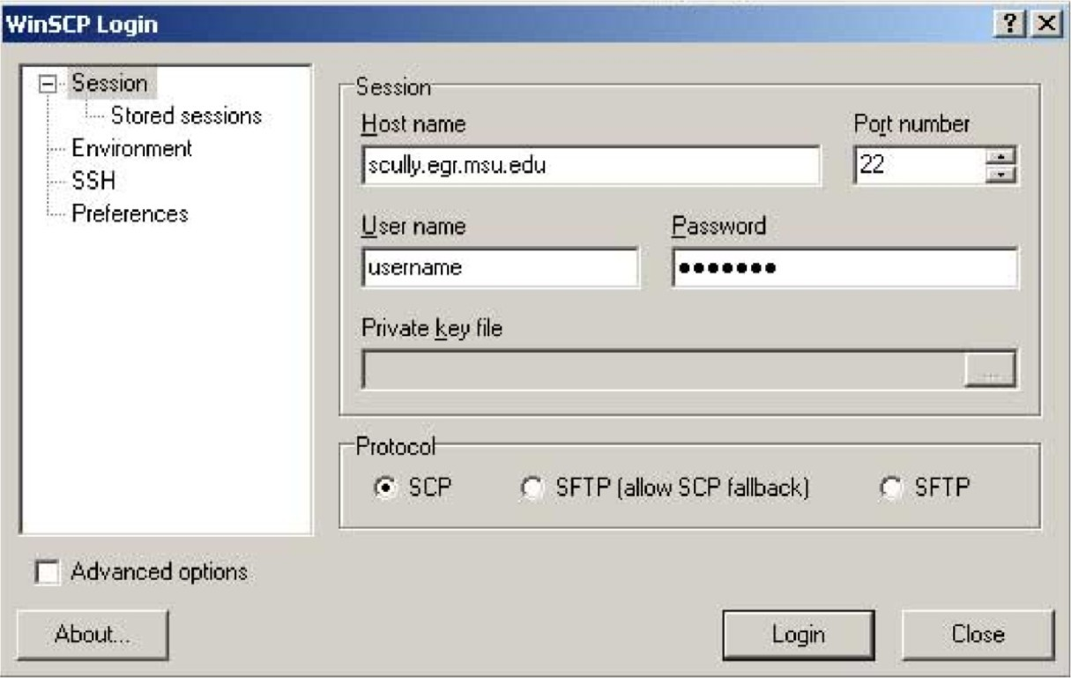
III. Transferring files
Transferring data from Windows: we can use winscp software:
To use WinSCP, launch the program and enter the
appropriate information into the Host name, User name, and Password text areas.
Click Login to connect to the remote system. Once you are connected you should
be able to transfer files and directories between systems
using the simple graphical interface by dragging file to .

Slide 36
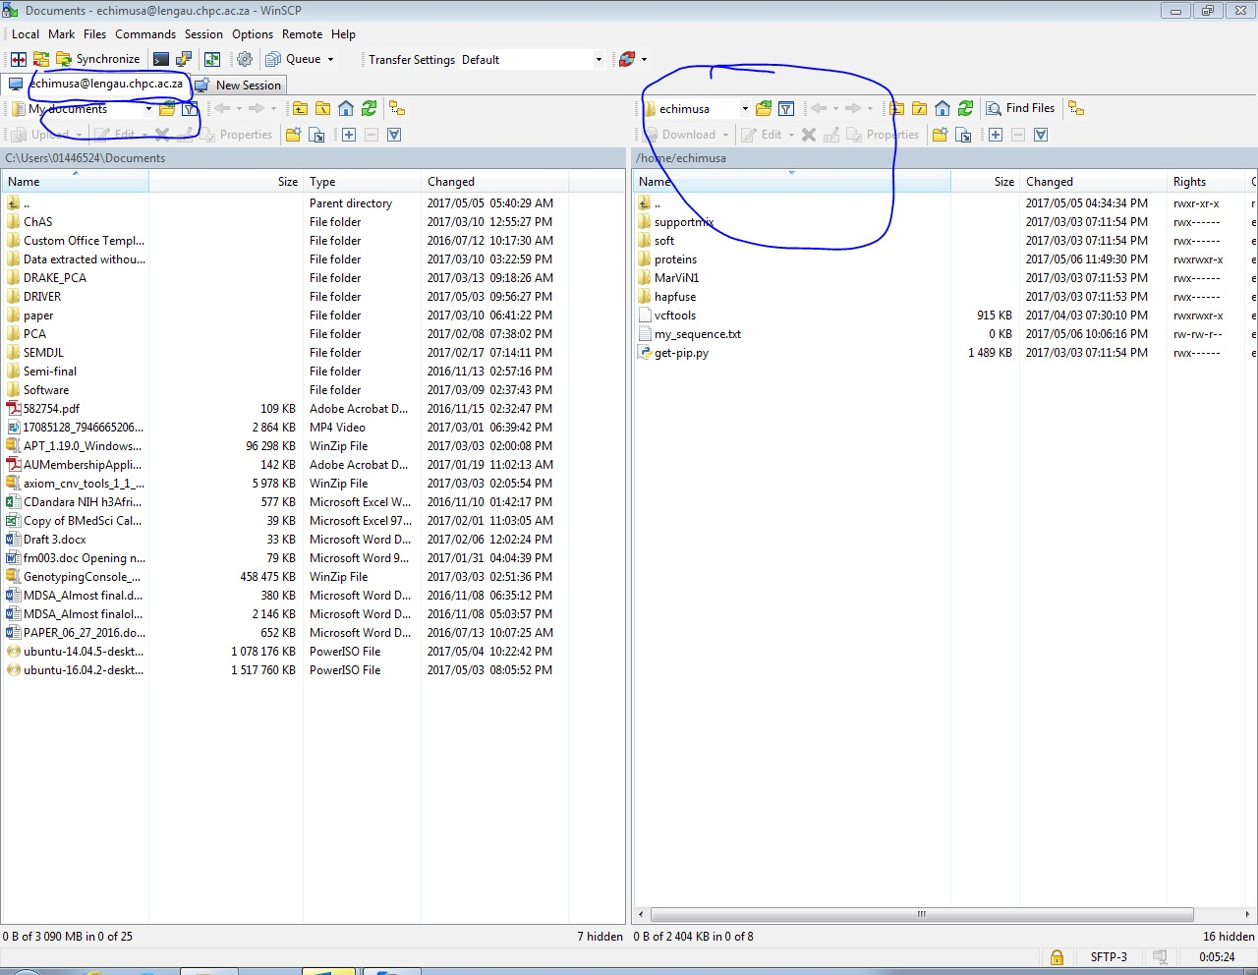
III. Transferring files
Transferring data from Windows: we can use winscp software:
Explore folder
Explore folder
Local machine
Once you
are connected you should be able to transfer files and directories between systems by dragging files folder in between.
or

Slide 37
III. Transferring files: Large data
Transferring large genomic data may takes weeks:
Screen is a full-screen software program that can be used to multiplexes a physical console between several processes (typically interactive shells). It offers a user to open several separate terminal instances inside a one single terminal window manager.
[echimusa@login2 ~]$ screen option There is no screen to be resumed.
-r : to resume existing screen.
-S :name_screen: create new screen
Once in an open screen, press ctrl+shift+A+D you can detach and back to the terminal without stop the process or even logout without stop the process.
screen -r allow you to screen list of screens, screen -r id_screen allows you to go to the screen.
Screen is useful when copying large data from web or other to PBS server such CHPC.

Slide 38
III. Transferring files: Example
Transferring large genomic data may takes weeks:
From your CHPC account tape the follows
[echimusa@login2 ~]$ screen -S jobs1
Once in the screen is open,
[echimusa@login2 ~]$ top
Now, press at the same time ctrl+shift+A+D
[echimusa@login2 ~]$ screen -r
Should be able to see your screen, the number before your screen name is the id. You can use that id to go back to you screen by,
[echimusa@login2 ~]$ screen -r xxxx

Slide 39
III. Transferring files: UCT research data
UCT research data is a long term storage server. You cannot perform any data analysis from there. You will need to move the to the productive server such CHPC or UCT/HPCT.
How from your Ubuntu local machine to mount UCT research data, so that you can transfer them?
Here is how you can mount a driver in Linux,
1. Create empty folder at your local machine:,
chimusa@chimusa:~$ mkdir
LAPTOP/
2. Mount the researchdata.uct.ac.za to LAPTOP/:
chimusa@chimusa:~$ sudo mount -t cifs -o user=01446524 //researchdata.uct.ac.za/HumanGenetics
LAPTOP/
Your UCT ID
Human genetics folder at research data
Need to be super user of your local machine
Your local folder
UCT Hostname rersearch data

Slide 40
III. Transferring files: Working with tar
and zip file
Let get zip file from NCBI database,
>$ wget ftp://ftp.ncbi.nlm.nih.gov/genomes/H_sapiens/GFF/alt_CHM1_1.1_top_level.gff3.gz
To extract this
>$ gunzip alt_CHM1_1.1_top_level.gff3.gz
Now let zip this with tar (to have zip format with .tar or .tar.zip
>$ tar -cvf alt_CHM1_1.1_top_level.gff3
>$ tar -cvzf alt_CHM1_1.1_top_level.gff3.tar.zip alt_CHM1_1.1_top_level.gff3
To extract a tar file use the tar command, this time with the -x (extract) option:
>$ tar -xvf alt_CHM1_1.1_top_level.gff3.tar
>$ tar -xvzf alt_CHM1_1.1_top_level.gff3.tar.zip
Note to compress a folder using tar/zip/gzip you need a recursive -r parameter :
>$ zip -r my_folder.zip my_folder

Slide 41

III. Transferring files: file permissions,
using chmod
>$ chmod go-r somefile
>$ ls -l
The go-r portion of the above chmod command means “from the group (g) and other (o) permission sets take away the read permission (r).” To allow everyone to read the file somefile you could modify the permissions using the following:
>$ chmod a+r somefile
The a in the above command means “all users”. To refer to different types of users separately, use u (user who owns the file), g (group that owns the file), and o (other users).
r (read permission) indicates that the file can be read.
w (write permission) indicates that the file can be modified.
x (execute permission) indicates that the file can be executed as a program.

Slide 42
IV. Streamlining data manipulation
Utilities: man
What does it do?
Displays a “manual” page for another tool, detailing expected input data and optional flags
Usage
$ man less
Option s | What does it do?
Q | [within program] Exits the current man page

Slide 43
IV. Streamlining data manipulation
Utilities: rm
What does it do?
Deletes (removes) a file PERMANENTLY
Usage
$ rm my_file
Option s | What does it do?
-r | Force-remove a directory (will fail by default)
-i | Confirm each deletion event

Slide 44
IV. Streamlining data manipulation
Utilities: cp
What does it do?
Copy a file
Usage
$ cp my_file my_copy
Option s | What does it do?
-i | Warn before overwriting a file
-r | Copy recursively (needed for copying directories)

Slide 45
IV. Streamlining data manipulation Utilities: mv
What does it do?
Move a file to a new location (or rename a file)
Usage
$ mv my_file MY_FILE # rename my_file as MY_FILE
$ my /my_dir/my_file . # move file “here” (.)
Option s | What does it do?
-i | Warn before overwriting a file

Slide 46
Path syntax
$ is used to indicate the start of a command (your prompt may look different)
$ command
/ is the root of the file system (C:\ on Windows, typically; note the backslash)
$ ls /
A subdirectory of the root directory
$ ls /my_dir/
. refers to the current directory
$ wc -l ./my_file.txt
$ cp /my_dir/my_file.txt . # copy file “here”
.. refers to the parent directory
$ mv ../my_file.txt .

Slide 47
IV. Streamlining data manipulation
Utilities: grep
What does it do?
Isolate lines of a data stream (file or STDIN) that match a pattern
Usage : egrep (or grep) [command line options] <pattern> [path]
$ grep pattern my_file
$ cat *.txt | grep pattern
Options | What does it do?
-P | Richer pattern options (regular expressions); more on these in a later lecture
-v | Isolate lines that DO NOT match the pattern (invert the match)
-i | Case-insensitive match
-f | Specify a file of patterns to match (slow if there are lots of options)

Slide 48
IV. Streamlining data manipulation Utilities: grep
. (dot) : a single character.
? : the preceding character matches 0 or 1 times only.
* : the preceding character matches 0 or more times.
+ : the preceding character matches 1 or more times.
{n} : the preceding character matches exactly n times.
{n,m} : the preceding character matches at least n times and not more than m times. [agd] : the character is one of those included within the square brackets.
[^agd] : the character is not one of those included within the square brackets.
[c-f] : the dash within the square brackets operates as a range. In this case it means either the letters c, d, e or f.
() : allows us to group several characters to behave as one.
| (pipe symbol) : the logical OR operation.
^ : matches the beginning of the line.
$ : matches the end of the line.

Slide 49
IV. Streamlining data manipulation Utilities: grep (or egrep) some Examples
Using the mysamples.txt @ : http://web.cbio.uct.ac.za/~emile/AGe/mysampledata.txt
Identify any line with two or more vowels in a row.
>$ grep '[aeiou]{2,}' mysampledata.txt
Print out any line with a 2 on it which is not the end of the line.
>$ egrep '2.+' mysampledata.txt
Print out lines match "Lerato" and line number as well
>$ grep -n "Lerato" mysampledata.txt
Print out lines of whic number 2 as the last character on the line.
>$ egrep '2017$' mysampledata.txt
1.Print out line which contains either 'Raj' or 'Clinical' or 'Genetics'.
>$ egrep 'Raj|Clinical|Genetics' mysampledata.txt 1.Print out Sunrname begins with A - K.
>$ egrep '^[A-K]' mysampledata.txt

Slide 50
IV. Streamlining data manipulation
Utilities: cut
What does it do?
Isolate tab-delimited columns of a data stream. First column is #1 (not #0 as in Python).
Usage
$ cut -f2 my_file # isolate the 2nd column of the file
$ cut -f2,3 my_file # isolate columns 2 and 3
$ cut -f2-5 my_file # isolate columns 2 THROUGH 5
$ cut -f3- my_file # isolate columns 3 to END (python [2:] slice)
Options | What does it do?
-f | Select columns (fields)
-t‘char’ | Break columns on the specified character instead of tab, e.g. -t‘,’ for .csv file

Slide 51
IV. Streamlining data manipulation
Utilities: cut
Let use the data GIANT_BMI.EUR.gwas.assoc.txt.zip, GIANT_BMI.EUR.gwas.assoc.txt.gzip and a normal tab separation file hmp2012_metadata.tsv. All these files are located at http://web.cbio.uct.ac.za/~emile/AGe/
Download these file at local CHPC account, using wget
$ wget http://web.cbio.uct.ac.za/~emile/AGe/xxxxxxx
To view the first 4 lines of zip file, use zcat (for .gzip) and unzip for (.zip), following pipe (|),
$ zcat GIANT_BMI.EUR.gwas.assoc.txt.gzip | head -n 4
$ unzip GIANT_BMI.EUR.gwas.assoc.txt.zip | head -n 4
$ cat hmp2012_metadata.tsv | head -n 4
You can use grep to search pattern, cut to extract columns of interest and use > to redirect the output to a new file.
Example:
$ zcat GIANT_BMI.EUR.gwas.assoc.txt.gzip | cut -f1,3,4 | gzip -c > emile.txt.gz

Slide 52
IV. Streamlining data manipulation Utilities: sort
What does it do?
Sort the lines of a data stream (alphabetically)
Usage
$ sort my_file
Options | What does it do?
-r | Reverse the sort
-k N | Sort on the value of WHITESPACE-delimited column N
-t‘char’ | Specify the delimiter character (e.g. -t‘\t’ for tab)
-n | Perform a numeric sort (otherwise 10 comes before 2)

Slide 53
IV. Streamlining data manipulation
Utilities: uniq
What does it do?
Isolate the unique ADJACENT lines of a data stream
Usage
$ sort my_file | uniq # w/o sorting, non-adjacent repeats missed
Option s | What does it do?
-c | Count the occurrence of each unique line
53

Slide 54
IV. Streamlining data manipulation
Excise:
From data in hmp2012_metadata.tsv located at http://web.cbio.uct.ac.za/~emile/AGe/
gzip the file.
delete hmp2012_metadata.tsv
How many patients with BODY_SITE = Stool, rewrite these patients sorted by VISIT retain only column SAMPLE_ID, VISIT and BODY_SITE into a new gzipped file.

Slide 55
IV. Streamlining data manipulation Utilities: wc
What does it do?
Counts the lines, words, and characters of a data stream
Usage
$ wc my_file
Option s | What does it do?
-l | Only report line count (faster, and often all you want)
-w | Only report word count
-c | Only report character count
55

Slide 56
IV. Streamlining data manipulation Utilities: head/tail
What does it do?
Stream the first/last (tail/head) lines of a data stream (default 10)
Usage
$ head my_file
$ head -n 100 my_file | tail # Stream lines 91-100
Option s | What does it do?
-n N | Stream N lines instead of default 10
56

Slide 57
IV. Streamlining data manipulation Utilities: column
What does it do?
“Normalize” the widths of column entries (Excelify your data)
Usage
$ column -t my_file
Option s | What does it do?
-s‘char’ | Specify the delimiter character (e.g. -s‘\t’ for tab); default = any whitespace

Slide 58
IV. Streamlining data manipulation
Utilities: sed
What does it do?
Edit a data stream, most often used for find/replace operations
Usage
$ sed “s/find/replace/g” my_file
$ sed “s/apple/banana/g” my_file # replace all instances of “apple” with “banana”
Option s | What does it do?
-i | Edit file “in place” (use with caution)
 | “find” can be a regular expression, and “replace” can use captured elements of the pattern (this will make more sense after our regular expressions lecture).

Slide 59
IV. Streamlining data manipulation
Utilities: awk
What does it do?
Is specifically designed for quickly manipulating space delimited data
Usage
$ awk ‘/<pattern>/’ file #search the file and output line with match pattern
$ awk ‘{<code>}’ file # put a little awk program in the curly braces
Example:
Let download data from NCBI
$ wget ftp://ftp.ncbi.nlm.nih.gov/genomes/H_sapiens/GFF/alt_CHM1_1.1_top_level.gff3.gz
$ zcat alt_CHM1_1.1_top_level.gff3.gz | awk '{if ( ($3=="gene") && ($4 > 10000) && ($4 < 20000) ) print $0}'

Slide 60
IV. Streamlining data manipulation Utilities: awk
$ zcat alt_CHM1_1.1_top_level.gff3.gz | awk '{if ( ($3=="gene") && ($4 > 10000) && ($4 < 20000) ) print $0}'
In the previous code, $3==”gene” asks for the entry in the third field to be “gene.” The next two fragments request for the values in the fourth field (i.e. $4) to be between 10000 & 20000. Thus we have found all the features annotate as genes in a 10000bp region of this genome. Notice that each these three commands were enclosed in a pair of brackets within an outer pair of brackets. This gave a command of the form:
( (Condition1) && (Condition2) && (Condition3) )
After this came the fragment print $0 which asked awk to print the entire line if the 3 conditions are true.
Another example (what does this do?):
$ gzip alt_CHM1_1.1_top_level.gff3.gz
$ awk '{if (($5 - $4 > 1000) && ($3 == "gene")) print $1, $2, $4, $5, \
$9}' alt_CHM1_1.1_top_level.gff3 > myoutput.gff3}
Above we specify which columns to output.

Slide 61
IV. Streamlining data manipulation Utilities: awk
More a example with GIANT_BMI.EUR.gwas.assoc.txt dataset
Choose rows where column MAF > 0.05 :
>$ awk '$4>0.05' GIANT_BMI.EUR.gwas.assoc.txt > output.cSNP.txt
Extract column SNP,MAF,PVALUE:
>$ awk '{print $1,$4,$7}' GIANT_BMI.EUR.gwas.assoc.txt > output.PV.txt
or
>$ awk 'BEGIN{OFS="\t"}{print $2,$4,$5}' GIANT_BMI.EUR.gwas.assoc.txt
Show rows between 20th and 80th:
>$ awk 'NR>=20&&NR<=80' GIANT_BMI.EUR.gwas.assoc.txt> output.sub.txt
calculate the average of PVALUE:
>$ awk '{x+=$7}END{print x/NR}' input.avP.txt

Slide 62
IV. Streamlining data manipulation Utilities: awk
More a example with GIANT_BMI.EUR.gwas.assoc.txt dataset
5.Calculate the sum of column 5 and 6 and put it at the end of a row or replace the first column:
>$ awk '{print $0,$5+$6}' GIANT_BMI.EUR.gwas.assoc.txt
>$ awk '{$1=$5+$6;print}' GIANT_BMI.EUR.gwas.assoc.txt
How to join two files based on a common column, support is the column 1:
>$ awk 'BEGIN{while((getline<"file1.txt")>0)l[$1]=$0}$1 in l{print $0"\t"l[$1]}' file2.txt > output.txt
More tutorials are onlines

Slide 63
V. Shell Scripting
V.1: Variables:
The shell uses variable and the simple assignment of value to a variable is by = eg.
exe_plink=”/mnt/lustre/users/echimusa/myprotein/plink” To use a variable
$exe_plink or ${exee_plink}
If statement Type 1:
if condition is true then
do this
if Type 2:
if condition is true
then
do this
else
do that
if
V.2 If statement:

Slide 64
V. Shell Scripting
V.2 If statement:
exe_plink=”/mnt/lustre/users/echimusa/myprotein/plink” path=”/mnt/lustre/users/echimusa/myprotein/”
if [ ! -d "${exe_plink}" ];then mkdir ${path}MAF chmod +rw ${path}MAF
else
${exe_plin} --help
fi
V.3 Iteration in Shell
#simple for loop
for i in 1 2 3 do
echo "==>$i" done
or
For chr in {1..22} do
echo “this chromose ${chr} done
while loop – syntax
while [ condition ] do
code block;
done

Slide 65
V. Shell Scripting
V.3 Iteration in Shell
Let download GWAS data GWAStutorial.bed, GWAStutorial.fam and GWAStutorial.bim at http://web.cbio.uct.ac.za/~emile/Age/.
The download data is for the whole genome. We split is into chromosemes, convert into VCF and after submit the job at CHPC.
Create a text file call emile_vcf.sh
We have to a) put the shell header and as we wish to qsub to node, we then load PBS headers at the top of the created file
#!/bin/bash
#PBS -N test #PBS -q smp
#PBS -P CBBI0818
#PBS -l select=1:ncpus=24 #PBS -l walltime=48:00:00
Now let load potential module needed module add chpc/BIOMODULES module add chpc/gnu/parallel-20160422

Slide 66
V. Shell Scripting
V.3 Iteration in Shell
Let download GWAS data GWAStutorial.bed, GWAStutorial.fam and GWAStutorial.bim at http://web.cbio.uct.ac.za/~emile/Age/.
The download data is for the whole genome. Let split it into chromosemes, convert into VCF by running the task on CHPC cluster.
4. Let declare or setup some variable to specify working directory, where to find software and where to read Inputs and write the output
exe_plink=”/mnt/lustre/users/echimusa/myprotein/plink” path=”/mnt/lustre/users/echimusa/myprotein/” out=”/mnt/lustre/users/echimusa/myprotein/” inputbed=”/mnt/lustre/users/echimusa/myprotein/GWAStutorial”
CHR=22
if [ -f "${exe_plink}" ];then
echo “Plink software exists”
fi
if [ -f “{inputbed}.bed”];then mkdir ${out}
chmod +rw ${out}
fi

Slide 67
V. Shell Scripting
V.3 Iteration in Shell
Let execute plink
${exe_plink} –bfile ${inputbed} –chr ${CHR} –recode vcf –out ${out}GWAS.${CHR}
${exe_plink} –bfile ${inputbed} –chr ${CHR} –freq –out ${out}GWAS.${CHR}
Let discuss the rest of the code in both shell scripts, qsub_emile_vcf.sh and emile_vcf.sh

Slide 68
?

