Slide 1



Introduction to Linux and Unix and the command line
Javan Okendo
Chemical and Systems Biology
University of Cape Town

Slide 2

Learning Objectives
①Understand the Unix file structure
②Understand full vs relative paths: when and how to use them
③Learn how to create directories and navigate through the file structure
④Learn some useful shortcuts

Slide 3
Learning Outcomes
① Be able to create a file structure
②Be able to navigate through the file structure
③Be able to create text files and view their content
④Be able to use simple shortcuts

Slide 4

Part 1
Introduction to Linux and UNIX

Slide 5
What is Linux?
UNIX is an Operating System (OS) initially developed in the 1960.
There are many diﬀerent versions of UNIX, that share common similarities.
The most popular varieties of UNIX are Solaris, Linux and MacOS.
UNIX systems have a graphical user interface (GUI) making them easier to use.

Slide 6
Linux vs Unix
Linux is a “clone” of the original Unix but doesn’t contain its code
Linux is free and open source, the original Unix is not (but some of its derivatives are)
All command lines work the same on both

Slide 7


Why Linux?
Linux is free and the most popular distributions are Ubuntu, Fedora/Red Hat, Mandriva, etc.
Low cost and very stable system
Most secure OS
Best multi-user and multi tasking OS
The world’s fastest super computers run Linux
Fast developing OS (many developers)
Very popular as servers OS

Slide 8
Linux distributions
Diﬀerent Linux distributions are available http://distrowatch.com/
Ubuntu distribution is easy and convenient to use for beginners
A simple guide to install Ubuntu in your machine: http://www.ubuntu.com/download/desktop/ install-ubuntu-desktop

Slide 9
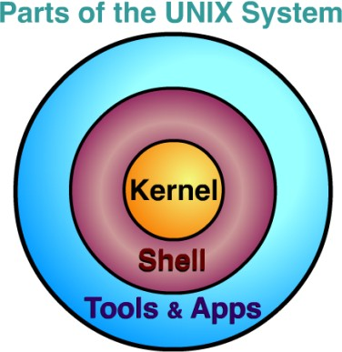












The core operating system
Accessible via the Terminal
Programs and softwares
Adapted from: www.usna.edu

Slide 10
The Terminal
A terminal refers to a wrapper program which runs a shell
There are many diﬀerent Unix shells, the most popular shell for interactive use include Bash: the default on most Linux installations

Slide 11










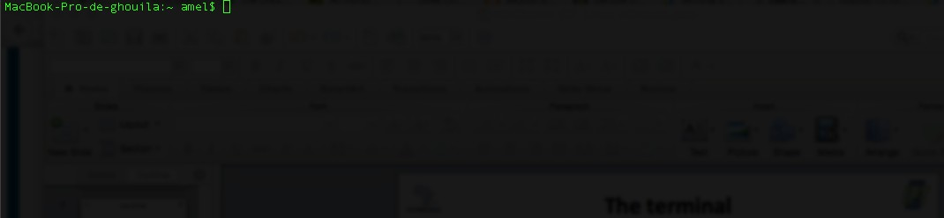
The Terminal
User name
Even though it is a command line interface, the mouse is still handy (scroll, copy, paste, etc.)
Shell prompt
Machine name

Slide 12
Part 2
File-system under UNIX

Slide 13

































Linux ﬁles structure
Root directory of the entire file system
Users home directories
home
dev
bin etc
Essential user commands binaries
Configuration files
Device
files
Crick
Watson
Sanger
Desktop
Documents
IBT2017
Wastson ﬁles
Genomics
Linux
Session 1
Session 2

Slide 14































home
Watson
Desktop
Documents
IBT2017
Genomics
Linux
Directories ﬁles
fileX
Session 1
Session 2
file1
file2
Ordinary files
14

Slide 15
Home directory and working directory
When you first log in on a UNIX system, the working directory is your home directory.
While working you will be associated to one directory called the working directory or the current directory
An abbreviation of the working directory is displayed as part of the prompt on your terminal
The command pwd gives the absolute path of the working directory

Slide 16
What is a path or a pathname?
A path locates a given file in the system hierarchy
An absolute path in the file system hierarchy for a given file or folder describes the parents all the way up to the root
A relative path describes the path to the file starting from the current working directory

Slide 17
~ (your home directory)
~ refers to the home directory in a given file system
The tilde ~ character can be used to specify paths starting at your home directory

Slide 18























Absoulte path?
/
home
Watson
The full path to file1 is:
/home/Watson/IBT2017/Linux/Session1/ﬁle1
Desktop
Documents
IBT2017
Genomics
Linux
Session 1
Session 2
file1 file2

Slide 19






Absoulte path?
/
/
home
/home
Watson
/home/Watson
Desktop
Documents
IBT2017
/home/Watson/IBT2017
Genomics
Linux
/home/Watson/IBT2017/Linux
/home/Watson/IBT2017/Linux/Session1
Session 1
Session 2
/home/Watson/IBT2017/Linux/Session1/file1
file2
file1

Slide 20
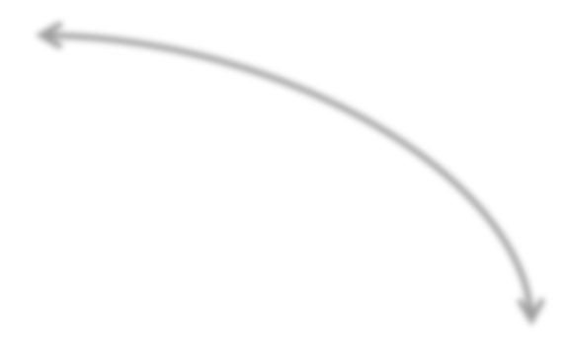














Refer to the parent and current directories
Every directory has two special sub- directories:
IBT2017
Genomics
Linux
. ..
. (dot): the current directory
.. (dot-dot): the parent directory
Session 1
Session 2

Slide 21





Relative path?
/
home
Current working directory
Watson
.
Desktop
Documents
IBT2017
refers to the current directory
Genomics
./Linux
Linux
./Linux/Session1
Session 1
Session 2
file2 ./Linux/Session1/file1
file1

Slide 22
First test of the terminal
Open the Terminal on your system
The shell prompt will appear
Ok, let’s try some typing !

Slide 23
Part 3
Creating directories and navigating through the ﬁle structure

Slide 24

Commands for manipulating directories
mkdir | Make directory: creates a new directory
rmdir | Removes a directory
pwd | Displays the absolute path of the current working directory
cd | Change directory: allows moving from one directory to another
ls | Lists a directory content

Slide 25
pwd command
pwd: print working directory
Displays the absolute path of your current location in the file system
Try pwd on your terminal
You should see: /home/YourUsername

Slide 26
ls command
ls lists the content of the current directory by default
Command structure ls [OPTION] [dirname]
Some useful options:
-l: shows sizes, modified date and time, file or folder name and owner of file and permissions
- a: List all files including hidden file starting with ‘.’
-lh: shows sizes in easier readable format
-R: recursively lists sub-directories
-lS: sorting by file sizes

Slide 27
Create a directory
mkdir: makes a directory
Command structure: mkdir dirname [path]
mkdir dirname: would create a directory with the specified dirname
The new created directory will be created in your current working directory
If you want to create it elsewhere, you have to specify the path: mkdir dirname path

Slide 28
Commands basic structure
command [–options] [arguments] Example:
ls –lh /home/Watson/IBT2016 pwd
mkdir Test1

Slide 29
What you should know about ﬁle names in Linux
No real distinction between the names of ordinary files and the names of directory files.
No two files in the same directory can have the same name.
Files in diﬀerent directories can have the same name.
Linux is case-sensitive: Sanger, sanger and SANGER are diﬀerent and would represent three
distinct files.
In most cases, file (.txt, .exe, etc.)
extensions are optional

Slide 30
Move in the ﬁles system
cd: change the working directory
Command structure: cd <path>
The path name of the directory you want to move to should be specified
You can specify either the absolute path or the relative path

Slide 31













Move in the ﬁles system: example
/
Move to Watson directory
1. cd /home/Watson 2. cd ../..
3. cd .. + cd ..
home
Watson
Move to Genomics directory
IBT2017
Current working directory
cd /home/Watson/IBT2017/Genomics
cd ../Genomics
cd .. + cd Genomics
Genomics
Linux

Slide 32
Remove a directory
rmdir: removes a directory
Command structure: rmdir dirname [path]
It would remove the dirname directory
The directory should be in your current working directory
If you want to remove it from elsewhere, you have to specify the path: rmdir dirname path to the directory
rmdir works if there is no contents in the directory

Slide 33
Remove a directory
rmdir works if there is no contents in the directory
If the directory contains files or sub- directories, an error message will appear: “Directory not empty”
There is an option to remove -r, which stands for recursive, that will recursively remove a directory and its contents

Slide 34
How to get help for a command from the terminal?
man commandname displays

Slide 35
Part 4
Some useful shortcuts and Links

Slide 36
Useful Links
cd: cd followed by nothing will change the working directory to your home directory
cd ~user_name: moves to the specified user home directory

Slide 37
Linux, some useful CLI key combinations
Ctrl+A: move the cursor to the beginning of the command line
Ctrl+C: end a running program and return to the prompt
Ctrl+D: logout from the current shell session: equivalent to exit
Tab: autocomplete a file name
Tab Tab: displays command completion possiblities
Ctrl+L: clear the terminal

Slide 38
Thanks

