Slide 1
Introduction to genome assembly
Javan Okendo, PhD

Slide 2
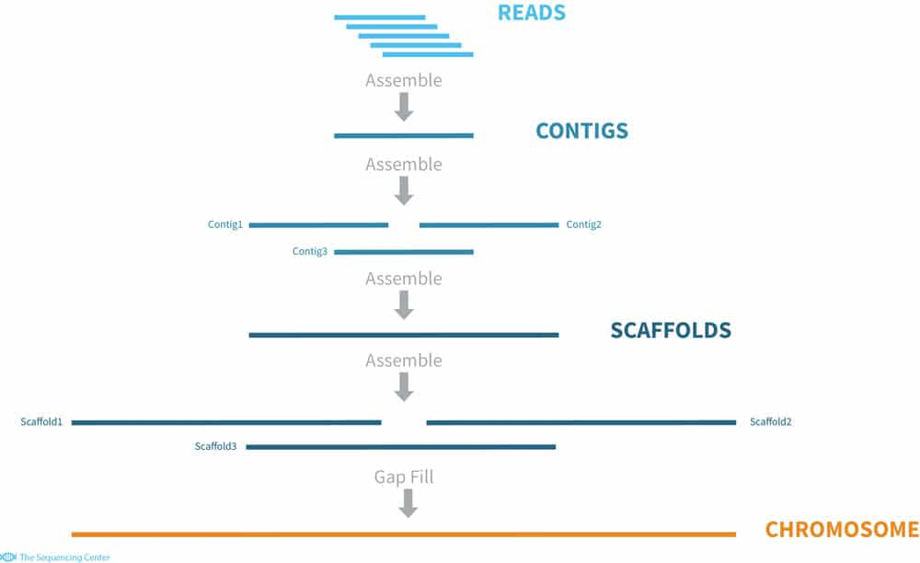

What is genome assembly?
It is the process of reconstructing the complete genome of an organism from its raw DNA sequencing data.

Slide 3
Strategies used in genome assembly
De Novo Assembly: the genome is reconstructed from scratch without the use of a reference genome
Reference-Guided Assembly: involves using a closely related reference genome as a scaffold to guide the assembly process
Hybrid Assembly: Hybrid assembly combines data from different sequencing technologies, typically short-read and long-read sequencing.

Slide 4
Terminologies
Genome: The complete set of an organism's genetic material, including all of its genes and non-coding sequences
Reads: Short DNA sequences generated through DNA sequencing techniques
Contig: Contigs are intermediate sequences in the assembly process and represent portions of the genome
Scaffold: A scaffold is a collection of ordered and oriented contigs that represent a portion of the genome
N50: A statistical measure used to assess the quality of an assembly
Assembly graph: A graphical representation of how reads overlap and can be assembled into contigs
Coverage: The average number of times a base in the genome is represented by reads
K-mer: A k-mer is a sequence of k nucleotides
Haplotype: Different versions of a specific genomic region on homologous chromosomes

Slide 5
De novo genome assembly
The process of reconstructing the original DNA sequence from the fragment reads alone.
Instinctively like a jigsaw puzzle
Find reads which "fit together" (overlap)
Could be missing pieces (sequencing bias)
Some pieces will be dirty (sequencing errors)

Slide 6
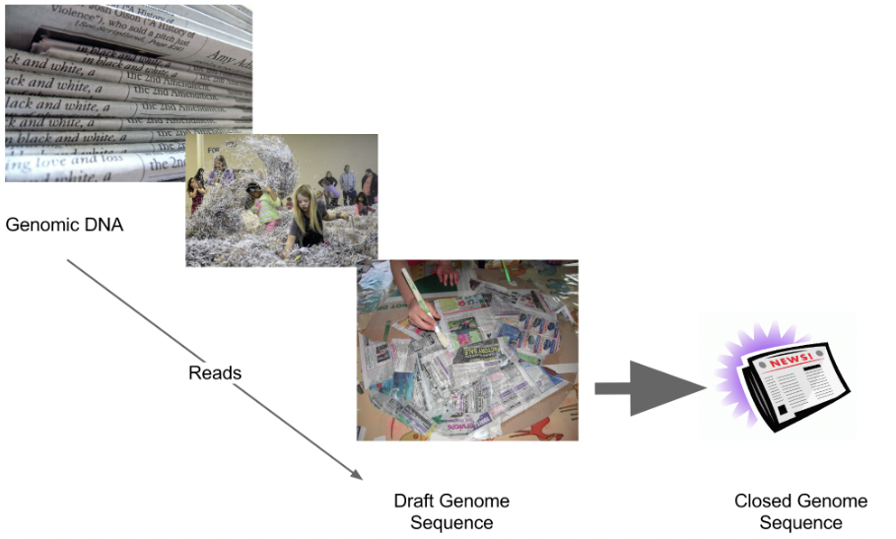
Graphical view of De novo assembly

Slide 7
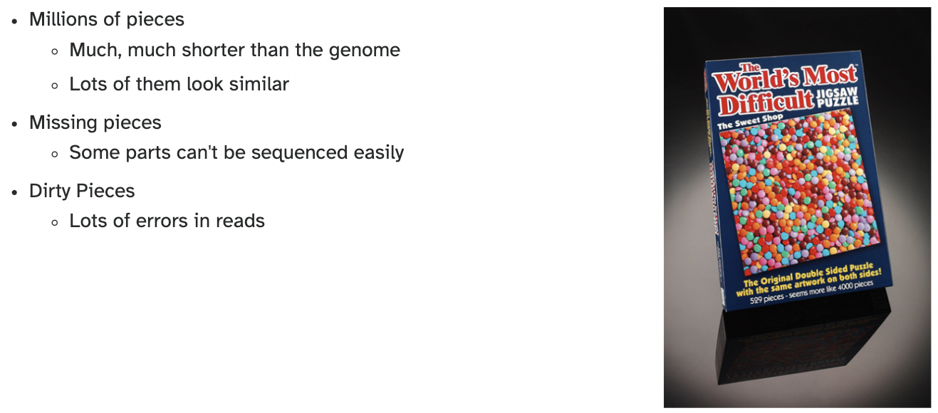
Why is it so hard?

Slide 8
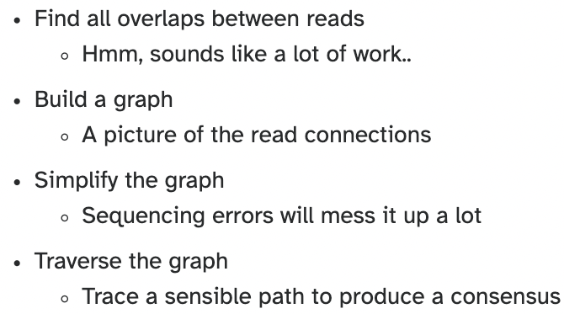
Assembly recipe

Slide 9
Can you identify which of these is a graph?
A.
B.
C.
D.

Slide 10
Can you identify which of these is a graph? B
Edge
Vertex (node)
In mathematics, a graph is a term that refers to a collection of vertices connected by edges.

Slide 11
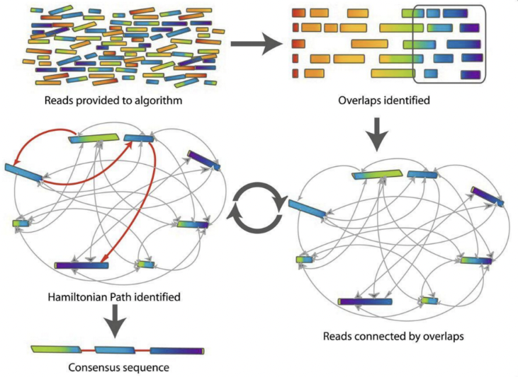
Genome assembly graphs

Slide 12
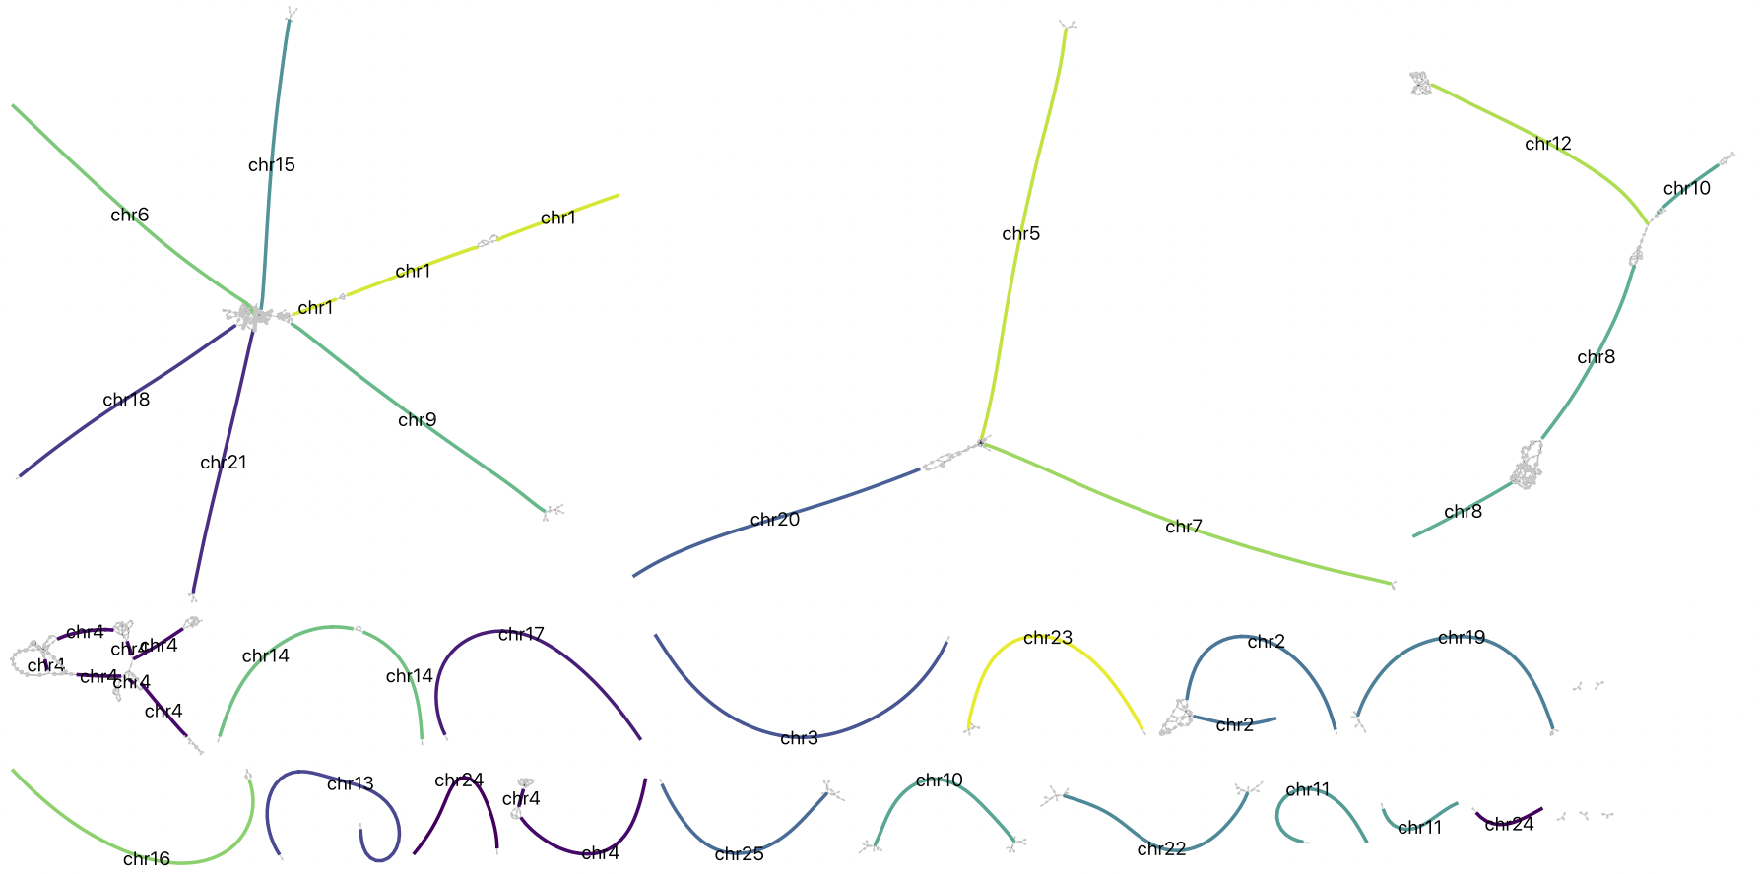
A more realistic graph

Slide 13
What ruins the graph?
Read errors
Introduces false edges and nodes
Non haploid organisms
Heterozygosity causes lots of detours
Repeats
If they are longer than the read length
Causes nodes to be shared, locality confusion.

Slide 14

What is a DNA repeat?
A segment of DNA which occurs more than once in the genome sequence
Very common
Transposons (self replicating genes)
Satellites (repetitive adjacent patterns)
Gene duplications (paralogs)

Slide 15
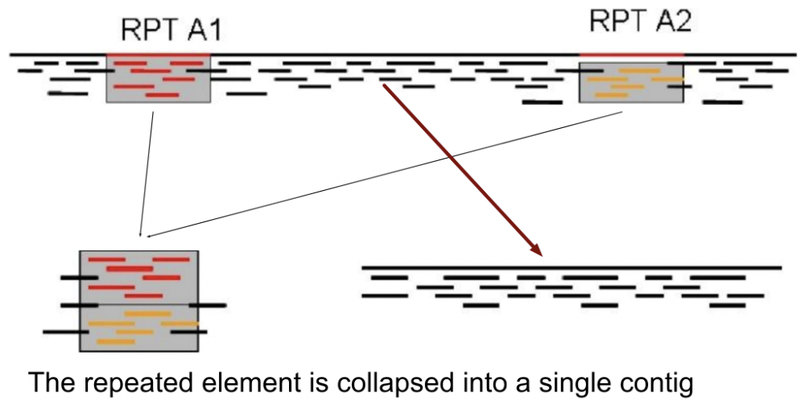
Effect of repeats on assembly

Slide 16
The “law” of repeats
It is impossible to resolve repeats of length S unless you have reads longer than S

Slide 17
Thanks!

