Slide 1
INTRODUCTION TO LINUX
BY
Javan Okendo, PhD
Bioinformatician ACEGID/NIH

Slide 2
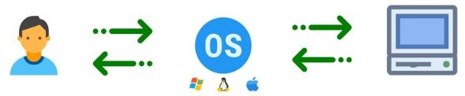
Introduction to LINUX
What is an operating system
An operating system (OS) is the program that manages the computer hardware and other software applications. The application programs make use of the operating system by making requests for services through a defined application program interface

Slide 3
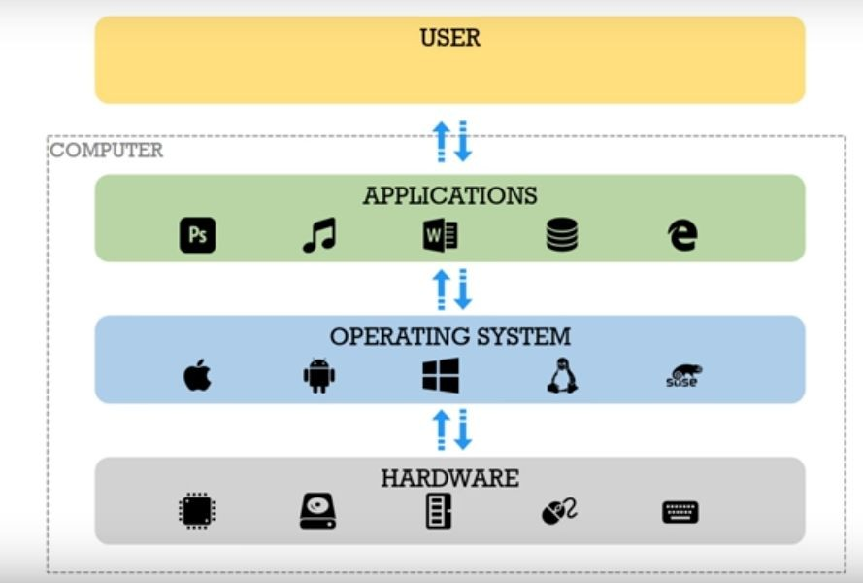

Slide 4
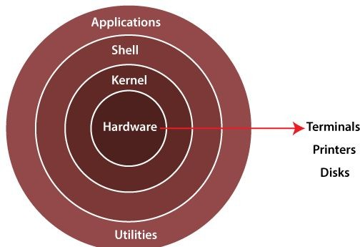
What is unix
Unix is multi-tasking, multi-user operating system but is not free to use and is not open source. It was developed in 1969 by Ken Thompson team at AT&T Bell Labs. It is widely used on servers, workstations
What is Linux
●

Slide 5
Why use linux
Stability
Ease of Maintenance
High security
Types of linux
Categorized according to distributions
Debian
Red Hat Enterprise Linux (RHEL)
Community ENTerprise Operating System (Centos)
SUSE enterprise Linux

Slide 6
Files and processes
Everything in UNIX is either a file or a process. A process is an executing program identified by a unique PID (process identifier). A file is a collection of data. They are created by users using text editors, running compilers etc.
Examples of files:
a document (report, essay etc.)
a directory, containing information about its contents, which may be a mixture of other directories (subdirectories) and ordinary files.

Slide 7
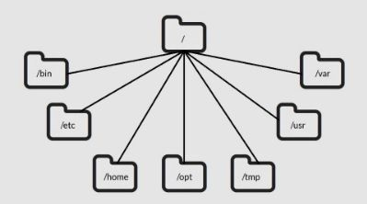
Directory structure

Slide 8
How do I open a terminal

Slide 9
What is a command
A command is an instruction given by a user telling a computer to do something, such a run a single program or a group of linked programs. Commands are generally issued by typing them in at the command line (i.e., the all-text display mode) and then pressing the ENTER key, which passes them to the shell.
Syntax
<command> <options> <arguments>

Slide 10
How do I know my location
pwd
What is a path
Human readable representation of a file or folder’s location on a computer system
Listing files and directories
ls
Creating files and directories
touch
Text editors (vim, emacs, nano, pico, etc)
mkdir
Removing files and directories
rm
rmdir

Slide 11
Copying and moving files
cp
mv
I have created a file/directory but I can’t see its contents. How do I proceed
You can edit your file using a text editor of choice
You can display contents on the screen
Move into the directory and ………………………..
The file is too huge but I would like to see whether a particular text exists
grep
sed
awk

Slide 12
Redirection
>
>>
|
Wildcards
A wildcard is a character that can be used as a substitute for any of a class of characters in a search, thereby greatly increasing the flexibility and efficiency of searches
*
[]
?

Slide 13
File permissions
All files have permissions. They determine who can access specified files and what they can do with those files
In linux, these permissions are organised according to ownership. Ownership is who owns the file.
A file can be owned by the user, group or other user.
A user is the owner of the file
A group can contain multiple users
Other is any other user who has access to a file.
User, group, and other are denoted as u, g, and o respectively

Slide 14
All the three owners (user owner, group, others) in the Linux system have three types of permissions defined. Nine characters denotes the three types of permissions.
Read (r) : The read permission allows you to open and read the content of a file.
Write (w) : The write permission allows you to edit, remove or rename a file.
Execute (x): In Unix type system, you can't run or execute a program unless execute permission is set

Slide 15
How do I change permissions
chmod <ownership>(+/-)<permissionName> <fileName>
Octal permissions
Octal permissions can also be set for the groups.
For example, to set r octal will be 4, to set w octal will be 2, to set x octal will be 1
Default permissions
File = 666
Directory = 777 Umask

Slide 16
Compression
Gzip
Tar
Bzip
How can I work with compressed files
Zcat
Zless

Slide 17
Working between the local and remote
What is a server
In computing, a server is a piece of computer hardware or software (computer program) that provides functionality for other programs or devices, called "clients"
Why do I need a server
How do I log onto the server
What should I do from the server
I have files on my local machine but would like to access them from the server. How do I transfer these files between the server and my local machine

