Slide 1
Generation of amplicon sequencing libraries
Laboratory Module

Slide 2
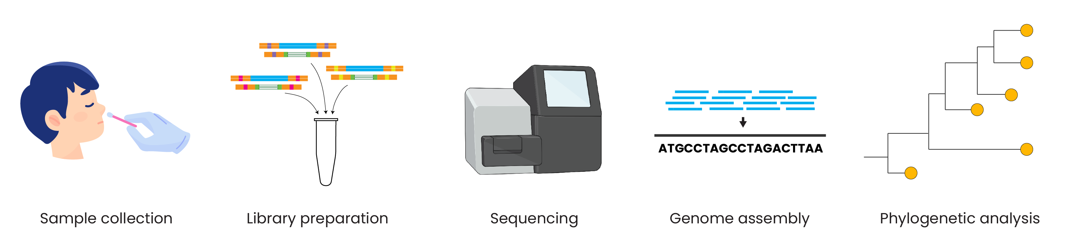
Genomic epidemiology workflow
BioRender.com
Pixel True https://www.pixeltrue.com/about, CC BY-SA 4.0, via Wikimedia Commons

Slide 3
Outline
Principles of amplicon-based sequencing
Using synthetic controls to detect contamination
Review of LibAmp amplicon sequencing protocol

Slide 4
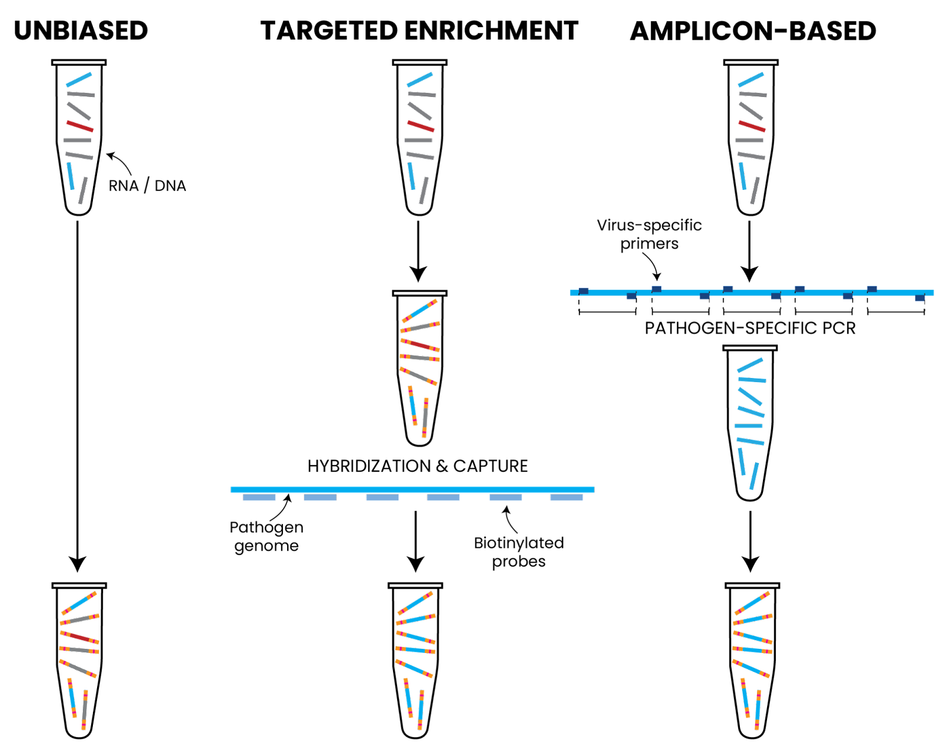
Sensitivity, speed
Unbiased, accuracy

Slide 5
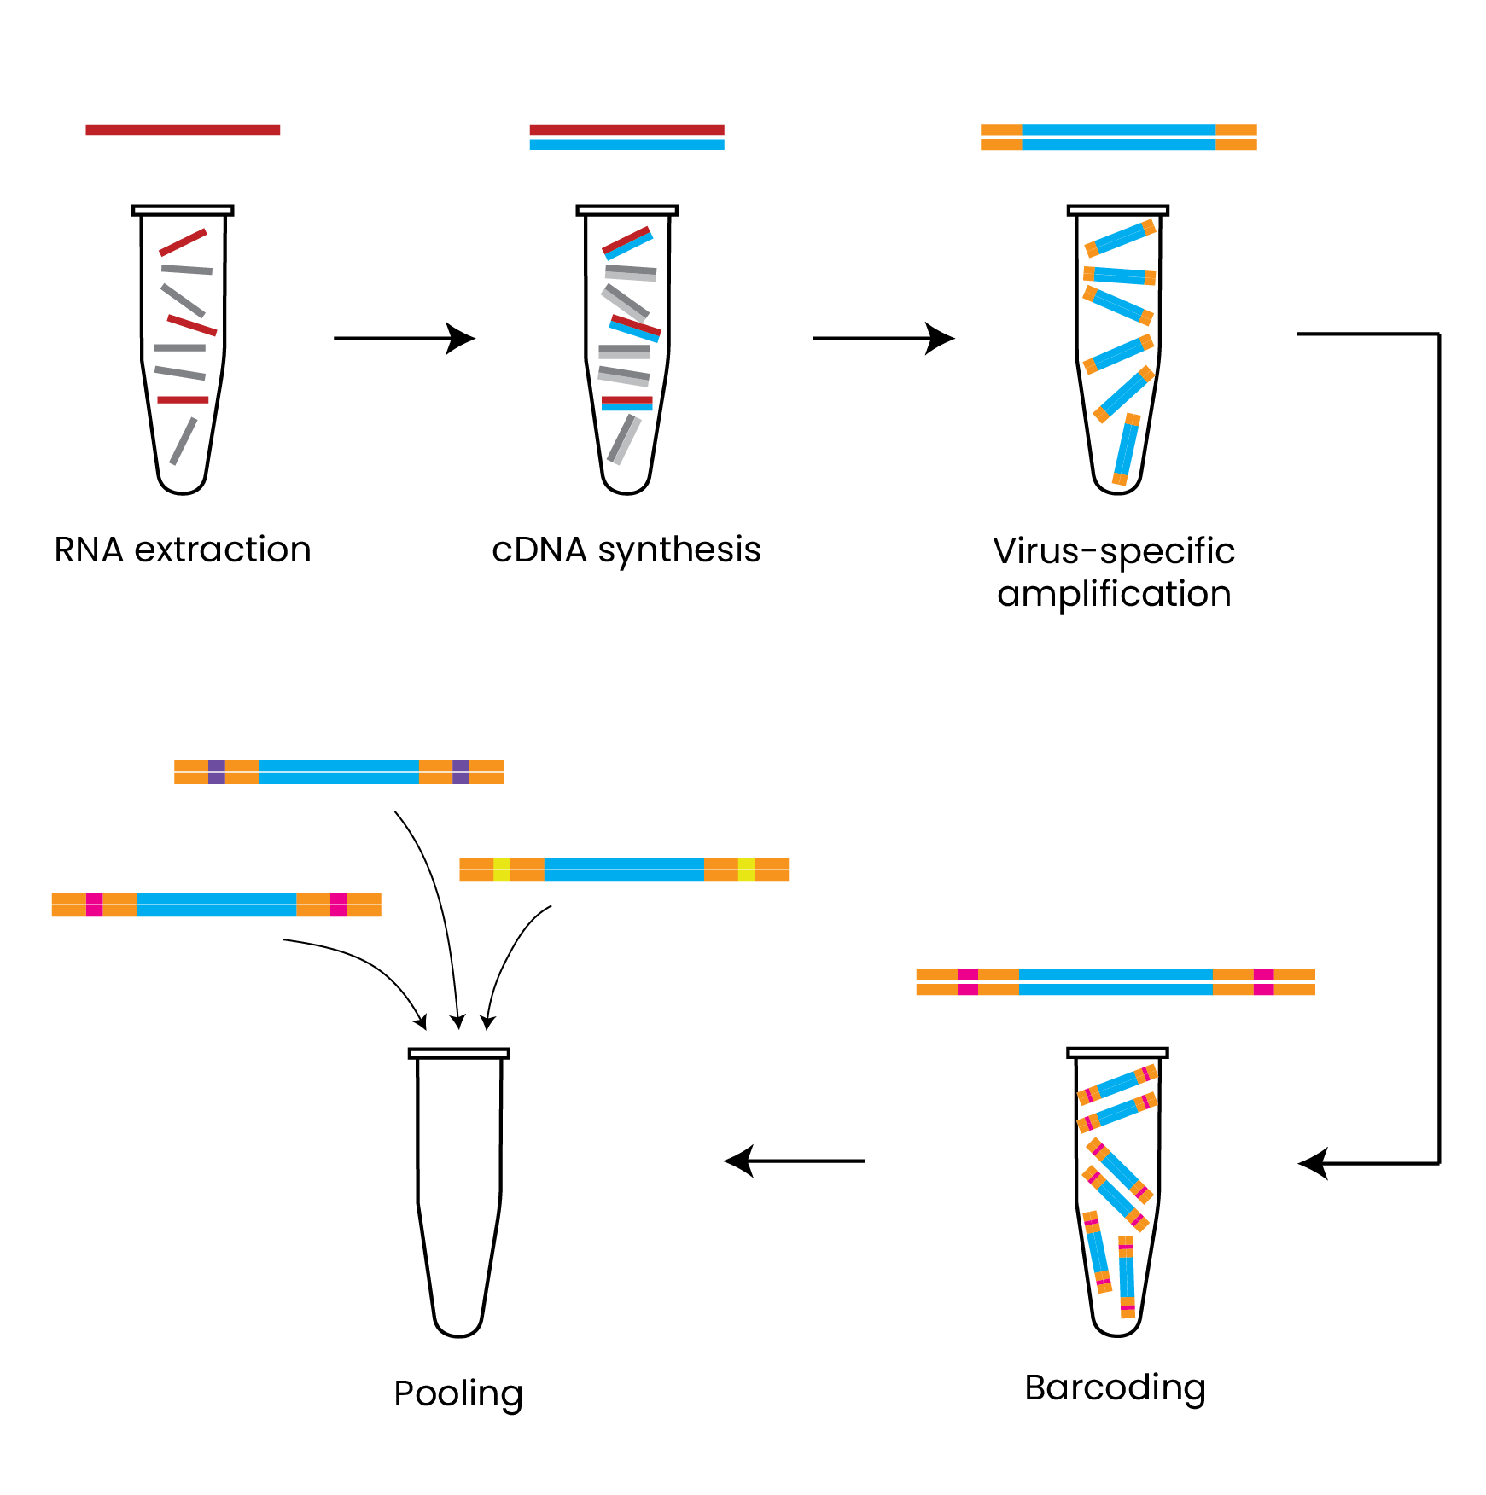
Overview of amplicon-based sequencing
Notes:
Take off yellow/orange ends here?

Slide 6
Overview of amplicon-based sequencing
1. For RNA viruses, first extract RNA from your sample
2. RNA needs to be converted to cDNA before preparing the sample for sequencing
Skip this step for DNA samples

Slide 7
Overview of amplicon-based sequencing
3. PCR amplification with pathogen specific primers
Use an existing primer set or design custom primers (for SARS-CoV-2, ARTIC and Midnight are common primer sets)

Slide 8
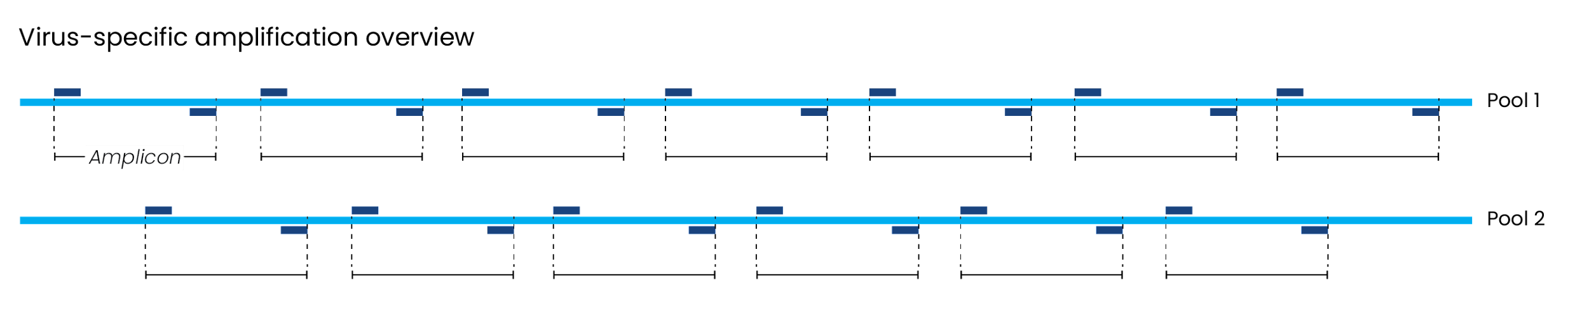
Details on multiplex PCR amplification
A set of many primer pairs (“multiplex”) can be used to amplify the entire genome
These primers are usually tiled in an overlapping way to ensure complete coverage

Slide 9
Details on multiplex PCR amplification
A set of many primer pairs (“multiplex”) can be used to amplify the entire genome
These primers are usually tiled in an overlapping way to ensure complete coverage
Splitting primers into two pools avoids mixing overlapping primers
The length of each amplicon varies between protocols

Slide 10
Overview of amplicon-based sequencing
4. Construct sequencing libraries
Add sequencing platform-specific adapters and sample-specific barcodes using one of several methods

Slide 11
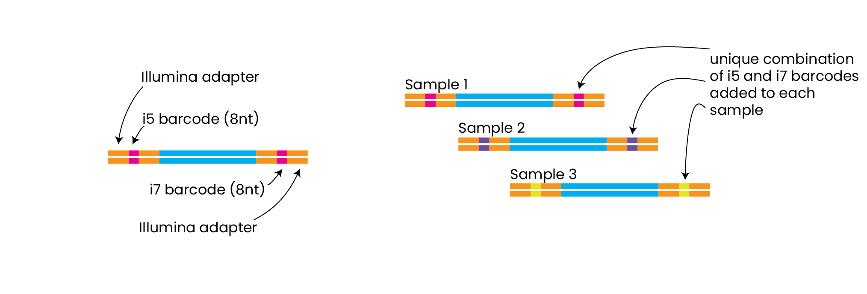
Adding barcodes and adapters to amplicons
Two items need to be added to DNA fragments before sequencing:
Adapters

Slide 12
Adding barcodes and adapters to amplicons
Two items need to be added to DNA fragments before sequencing:
Adapters
and barcodes

Slide 13
Adding barcodes and adapters to amplicons
Two items need to be added to DNA fragments before sequencing:
Adapters
and barcodes

Slide 14
Overview of amplicon-based sequencing
5. Pooling together multiple samples
Combine libraries after adding a unique barcode sequence to each

Slide 15
Pooling multiple samples at equimolar ratios
Quantify sequencing libraries
Pool the same amount of DNA per sample to ensure all samples get the same number of sequencing reads
Only pool samples with different barcodes
The number of samples to pool depends on the sequencing platform and the desired number of reads per sample

Slide 16
Pooling multiple samples at equimolar ratios
Quantify sequencing libraries
Pool the same amount of DNA per sample to ensure all samples get the same number of sequencing reads
Only pool samples with different barcodes
The number of samples to pool depends on the sequencing platform and the desired number of reads per sample
Goal of ~1 million reads per sample:
MiSeq V2 kit generates ~15 million read pairs, so pool 24 samples and 1 NTC

Slide 17
Outline
Principles of amplicon-based sequencing
Using synthetic controls to detect contamination
Review of LibAmp amplicon sequencing protocol

Slide 18
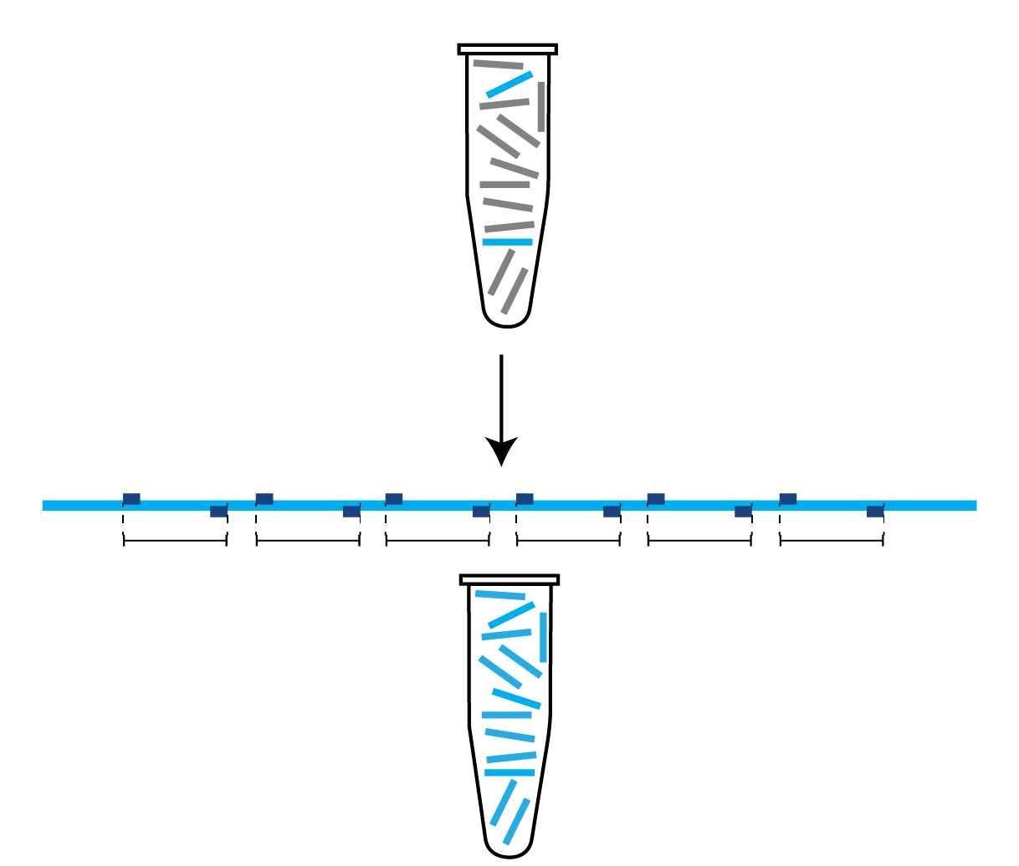
Contamination is a risk for amplicon approaches
Pathogen-specific PCR generates billions of copies of pathogen amplicons!
Good laboratory practices can reduce the risk of contamination, but it still happens
It is important to have methods to detect contamination when it occurs

Slide 19
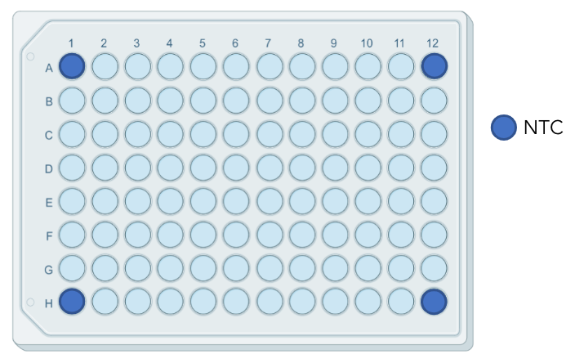
Controls are a necessary part of sequencing
Negative controls (e.g., water) should always be used
BioRender.com

Slide 20
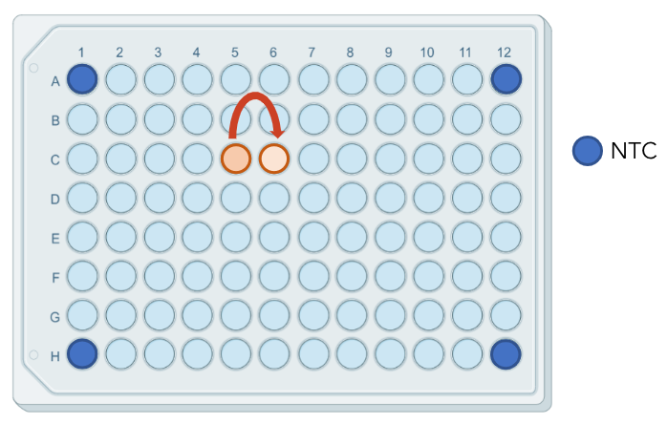
Controls are a necessary part of sequencing
Negative controls (e.g., water) should always be used
Negative controls can miss spillovers and other sporadic contamination events
Synthetic spike-ins can help to track contamination at a per-sample level
BioRender.com

Slide 21
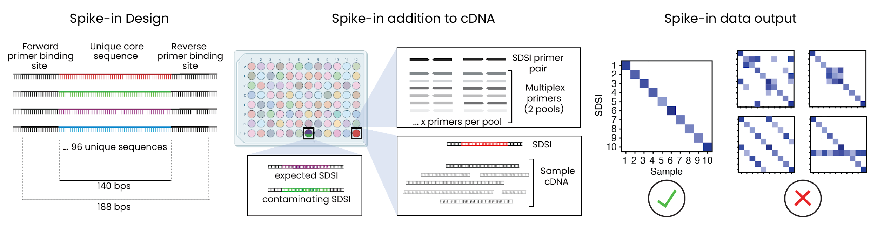
Spike-ins can help track potential contamination
Lagerborg, Normandin, Bauer et al., 2021

Slide 22
Spike-ins can help track potential contamination
Historically spike-ins have not worked with amplicon-based sequencing because the unique spike-in sequence is lost during pathogen-specific amplification
Issue solved by adding a special spike-in-specific primer pair to each primer pool
Lagerborg, Normandin, Bauer et al., 2021

Slide 23
Spike-ins can help track potential contamination
Addition of DNA spike-ins

Slide 24
Spike-ins can help track potential contamination
Lagerborg, Normandin, Bauer et al., 2021

Slide 25
Outline
Principles of amplicon-based sequencing
Using synthetic controls to detect contamination
Review of LibAmp amplicon sequencing protocol

Slide 26
Pathogen amplification using tailed primers
We can add part of the Illumina adapter sequence to our pathogen-specific primers, an approach often called “tailed PCR”
Faster and more cost-effective alternative to adding platform-specific primers in a separate step (e.g., Illumina Nextera)

Slide 27
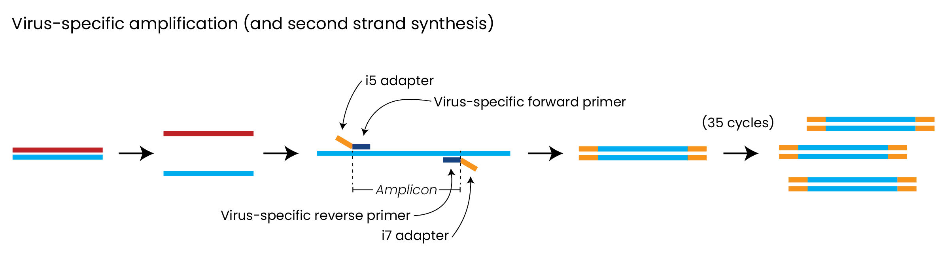
Pathogen amplification using tailed primers
We can add part of the Illumina adapter sequence to our pathogen-specific primers, an approach often called “tailed PCR”
Faster and more cost-effective alternative to adding platform-specific primers in a separate step (e.g., Illumina Nextera)

Slide 28
Pathogen amplification using tailed primers
We can add part of the Illumina adapter sequence to our pathogen-specific primers, an approach often called “tailed PCR”
Faster and more cost-effective alternative to adding platform-specific primers in a separate step (e.g., Illumina Nextera)

Slide 29
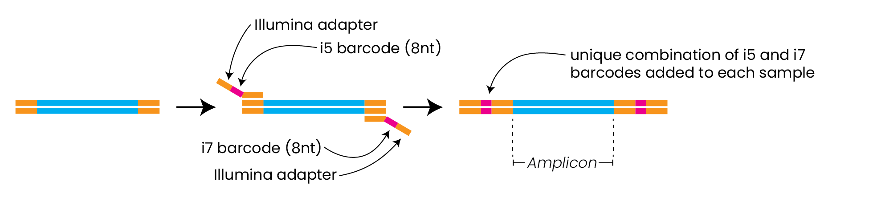
Generating barcoded libraries from tailed amplicons
Using another set of primers, we can attach the remainder of the adapter and the sample-specific barcode through PCR
Add a different set of primers (indexes) to each sample to ensure each one gets a unique barcode

Slide 30
Generating barcoded libraries from tailed amplicons
Using another set of primers, we can attach the remainder of the adapter and the sample-specific barcode through PCR
Add a different set of primers (indexes) to each sample to ensure each one gets a unique barcode

Slide 31
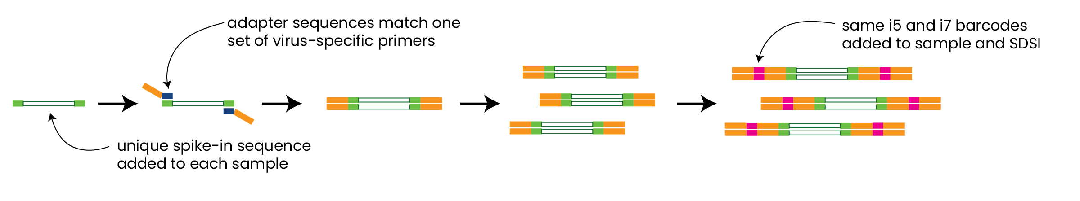
Using spike-ins in the LibAmp protocol
Spike-in specific primers also have Illumina adapters added
Barcodes added to well containing both sample and spike-ins

Slide 32
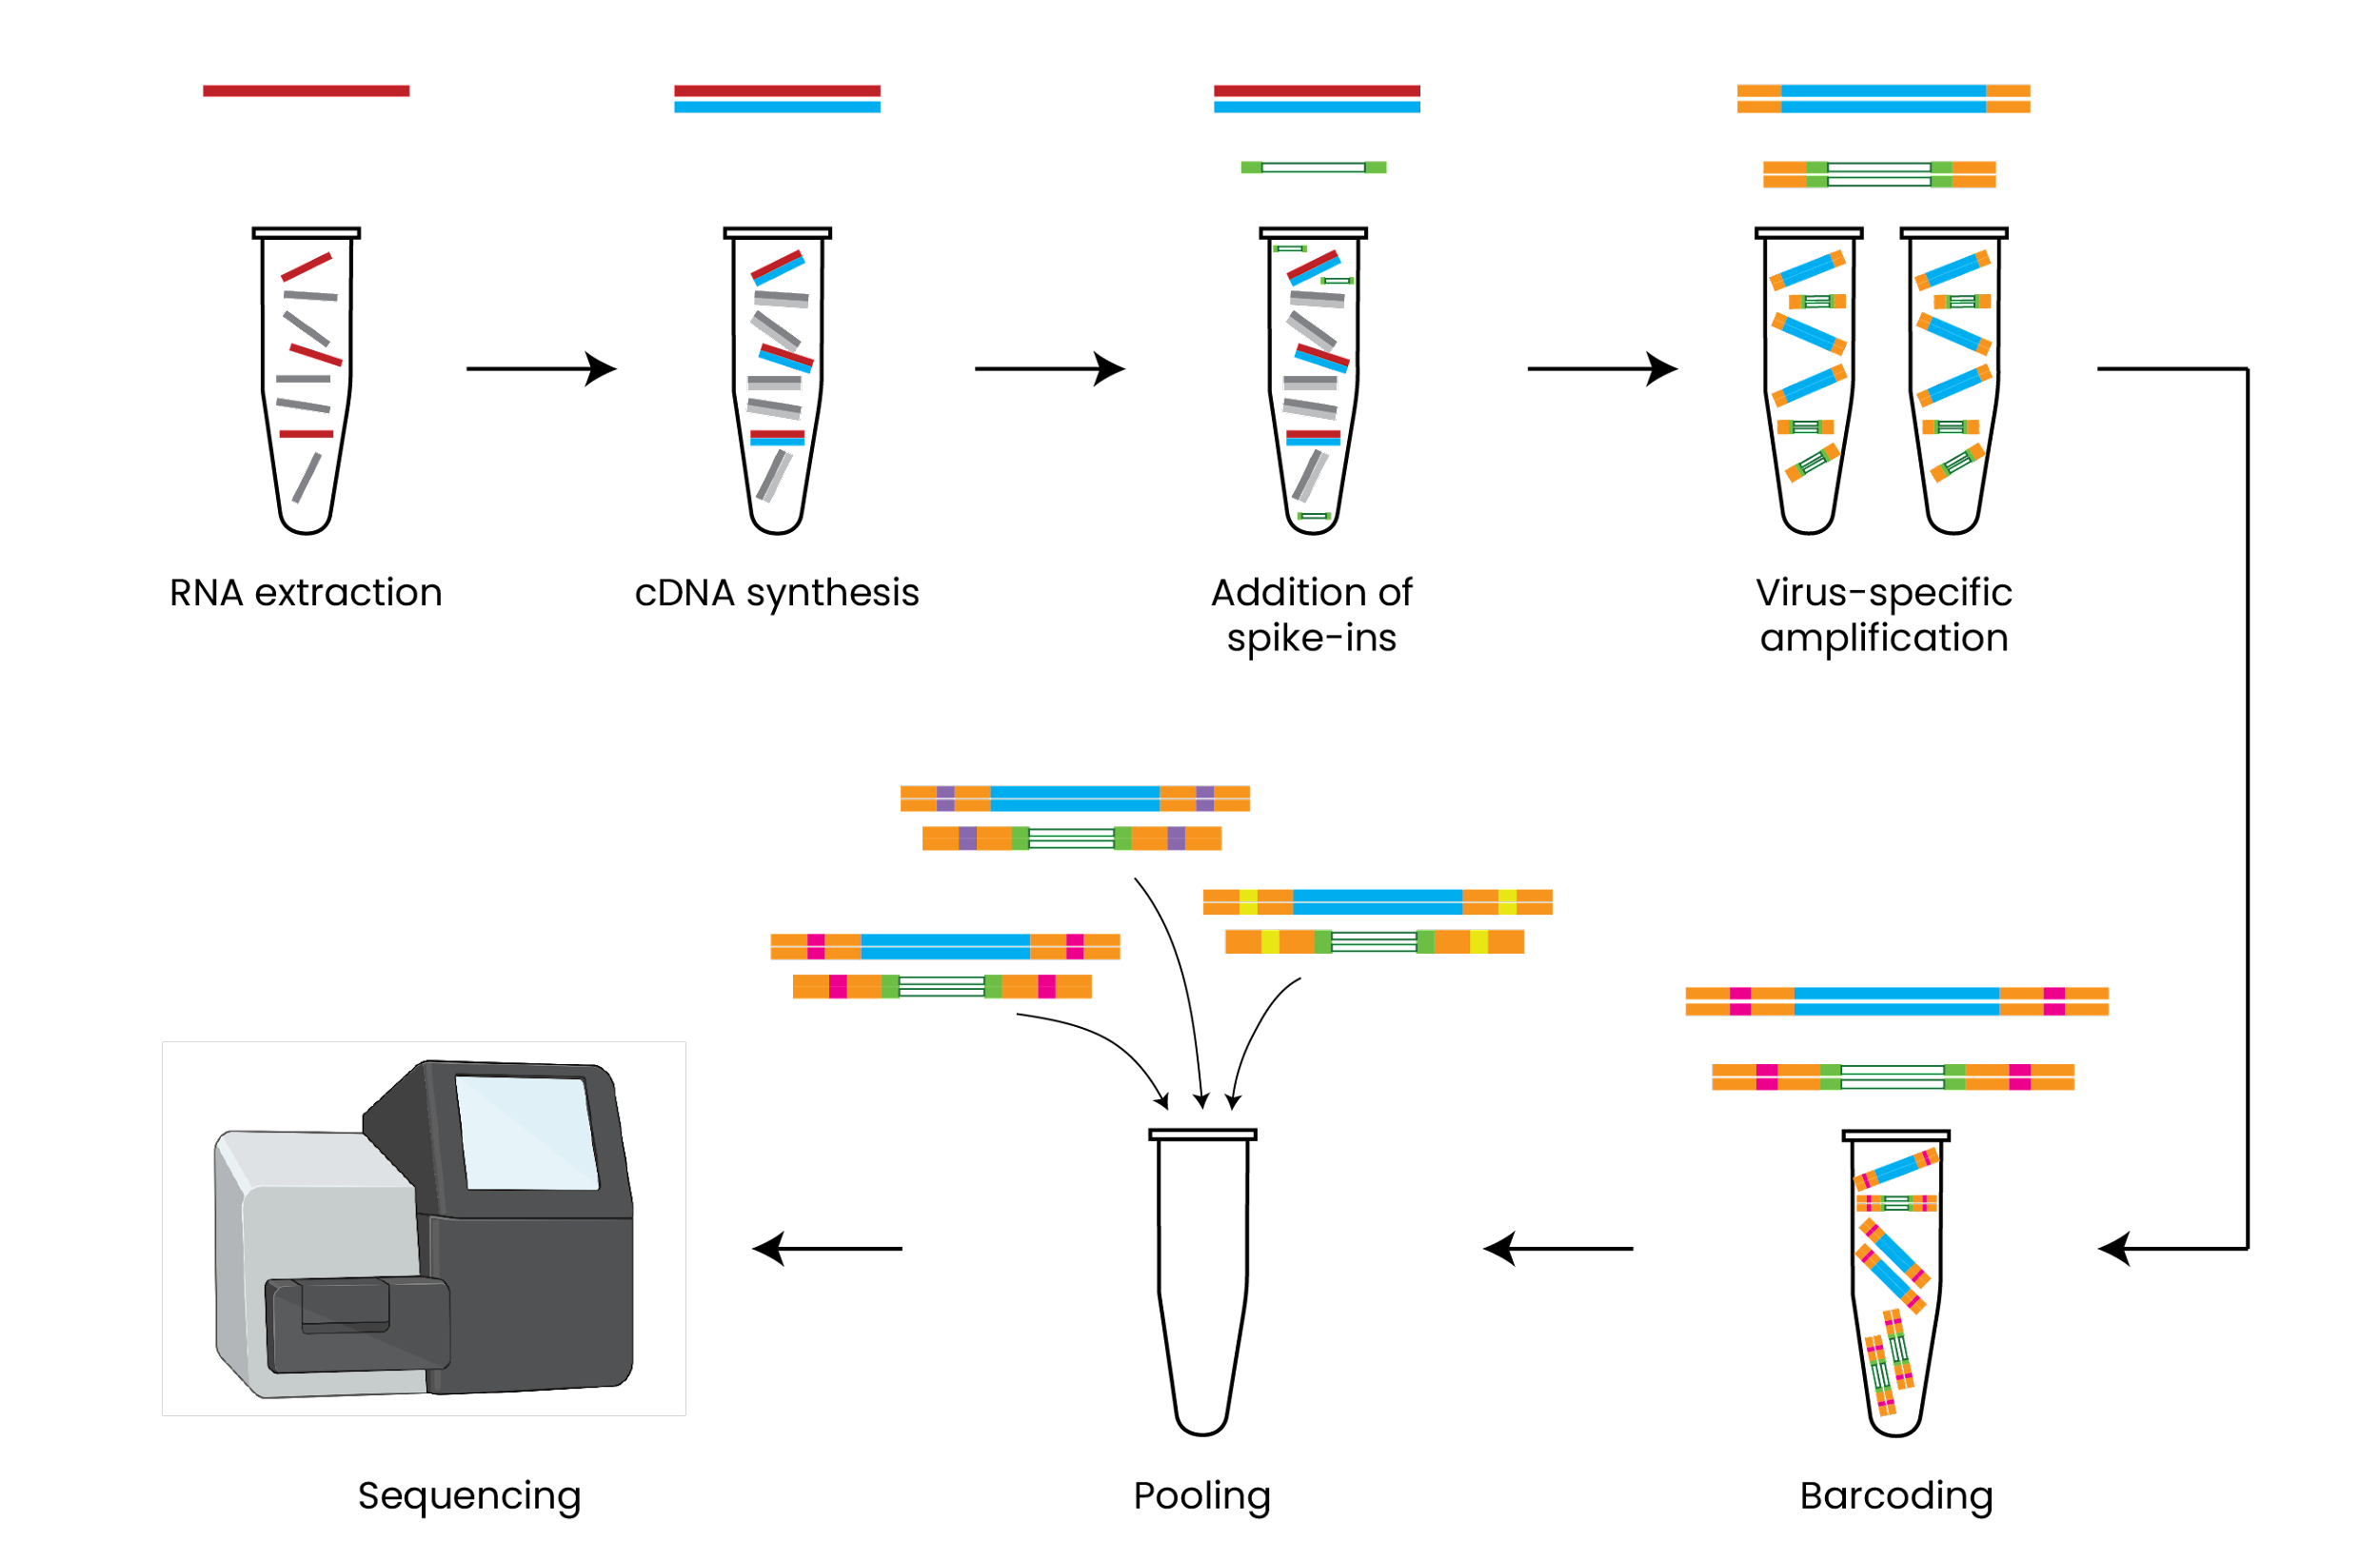
Overview of amplicon-based sequencing
BioRender.com

Slide 33
Summary
Amplicon-based sequencing uses multiplex primers to generate short amplicons across the genome
Contamination is a major risk in amplicon-based approaches but can be detected with good controls, including synthetic spike-ins
Tailed PCR methods are a quick cost-effective method for amplicon-based sequencing

